Slide 1



Technology &
Career Centre
Dubai · TCD
Teacher Introduction
Emirates National Schools , Dubai Al Khawaneej 2
April 2026
Explore Your Creativity · Build Your Future

Slide 2



What IS TCD? — The Big Picture
The DOING Engine
2 Workshops, 10 Skills
Your Subject Lives Here
TCD is the applied-learning heart of ENS Dubai. NOT extra-curricular — it IS the curriculum, made visible and tangible for every student.
Two multi-skill workshops cover 10+ different activities — robotics, cool tools, 3D printing, jewellery, candle-making, coding and more.
Every TCD project is linked to Science, Maths, English, Arts, Social Studies, ICT,.. You bring the theory. TCD turns it into evidence.

Slide 3
TCD (Dubai) vs TCC (MBZ & Al Ain) — What's Different?
TCC — MBZ & Al Ain
TCD — Dubai (US!)
19+ specialist workshops
Advanced fabrication labs
Mechanical, wood, construction, electrical, cooking, automotive, information techhnology, fashion, health, media, smart building, etc
High school pathway specialisation
Students select ONE pathway to deep-dive
2 multi-skill workshops
10+ different skills in ONE flexible space
Grades 4–8 broad foundations
Every student experiences ALL skill areas
Builds curiosity → leads to TCC pathways later
TCD = The entry point that builds curiosity & skills → leading to TCC pathway specialisation in higher grades

Slide 4

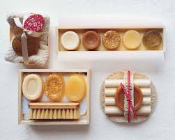

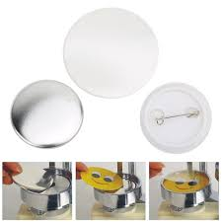


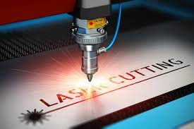

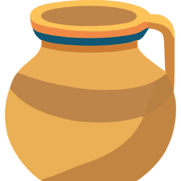
10 Skills in 2 Workshops
Students rotate through these skills across Grades 4–8
1
2
3
4
5
Candle
Making
Soap
Making
Logo Design
& Branding
Badge
Making
Coding &
Robotics
6
7
8
9
10
3D Design &
Printing
Laser
Cutting
Cool Tools
(Woodwork)
Pottery
Making
Jewellery
Design

Slide 5



What TCD Needs From YOU:
Our Partnership
Teach the theory first
Share key vocabulary
Introduce the topic in your classroom BEFORE the TCD session. Students who arrive with background knowledge go deeper and further.
Let the TCD instructor know what terminology students know. Aligned vocabulary = stronger evidence of academic transfer.
Use portfolio evidence
Visit if you can
TCD portfolios show academic understanding. Reference them in your lessons - they are valid cross-curricular evidence.
Observing your students in the workshop gives insight you cannot get in a classroom. It also signals to students that this work matters.

Slide 6





How YOUR Subject Lives Inside Every TCD Project
Forces, energy, circuits, plant biology → Bridge testing, solar models, hydroponics data, robotics systems
Measurement, scale, geometry, data, budgeting → CAD dimensions, 3D print sizing, enterprise pricing
SCIENCE
MATHS
Design briefs, technical vocab, presentations → Project reports, product pitches, portfolio reflections
UAE sustainability, innovation, community → Smart city models, food security solutions, cultural designs
ENGLISH / ELA
SOCIAL STUDIES
Form, colour, aesthetics, branding → Candle/soap design, logo creation, ceramics, jewellery making
Algorithms, digital citizenship, CAD, coding → Robotics, 3D design workflow, digital media campaigns
VISUAL ARTS
ICT / TECH

Slide 7
Sample Projects— Robotics, Smart City & Sustainable Design
Robotics Coding Challenge
3D Design for a Real User
Code robots (Photon, Edison, VinciBot) to complete missions. Design algorithms, troubleshoot logic, map routes
Technical sketch → TinkerCAD/simple CAD → 3D printed object. Students measure, constrain and iterate
🔗 ICT: algorithms, input/output | Maths: coordinates, angles | ELA: technical explanation
🔗 Maths: geometry, scale, dimensions | Science: materials | Arts: form & function
Smart City Automation Model
Sensor-controlled micro-system (smart crossing, streetlight, garden). Code, test, explain social impact
🔗 Science: circuits, energy | Social Studies: UAE smart cities | ELA: technical report

Slide 8
Sample Project — Grade 4: Classroom Helper Challenge
What Students Do (1.5 hrs)
Your Subject Is Already In Here
📋 Interview classmates — find a real classroom need
✏️ Write a simple design brief (objective + constraints)
💡 Sketch 2 ideas, choose the best one
🔨 Build first prototype: foam, card, Whybricks, 3D print
🧪 Test it — get peer feedback
✅ Improve it & present to the class
SCIENCE
Properties of materials + simple forces (push/pull, friction)
MATHS
Measurement: length, area, comparison, shape
ELA
Asking questions, design brief writing, oral explanation
SOCIAL STUDIES
Classroom & community responsibility, user needs
Tools: Whybricks · Safe craft tools · 3Doodler pens · Rulers · iPads

Slide 9

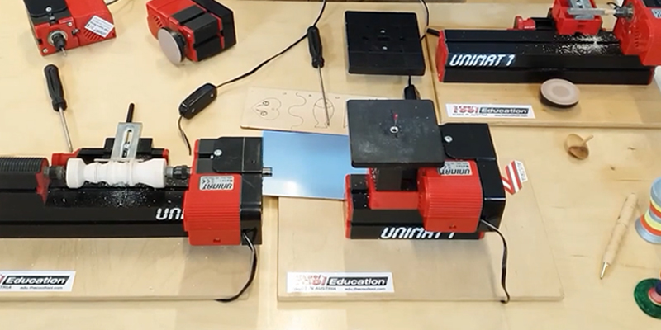
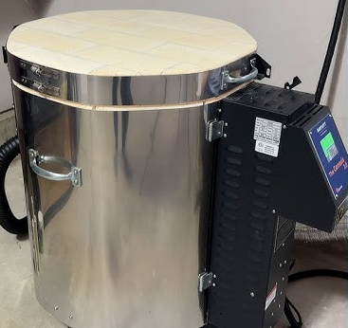
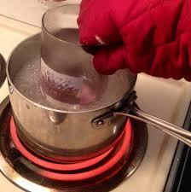
Safety is a Curriculum Outcome;
Not Just a Rule
A student who makes a great product but cannot explain risk controls has NOT met the TCD standard.
Level 1
Guided Maker
Grades 4–5
Scissors, rulers, 3D pens, Whybricks, Photon kits, iPads
Level 2
Developing Technician
Grades 5–7
Hand tools, robotics kits, CAD/3D print, textiles, hydroponics
Level 3
Supervised Fabricator
Grades 8
Cordless drills, clamps, vices, 3D printers, Unimat demo, wax & textiles
RESTRICTED
Instructor Controlled
Staff only
Kiln, hot wax systems, soldering, advanced machine setups, high-heat processes

Slide 10

Discover Your Talents
… and Develop Your Skills
TCD is embedded curriculum
Every 1.5-hr session links to your subject
Students build portfolios of real evidence
Safety is taught as a curriculum outcome
Broad skills now → TCC pathways later
Questions? Let's build this together!
Emirates National Schools · TCD Dubai · Al Khawaneej 2

