Slide 1



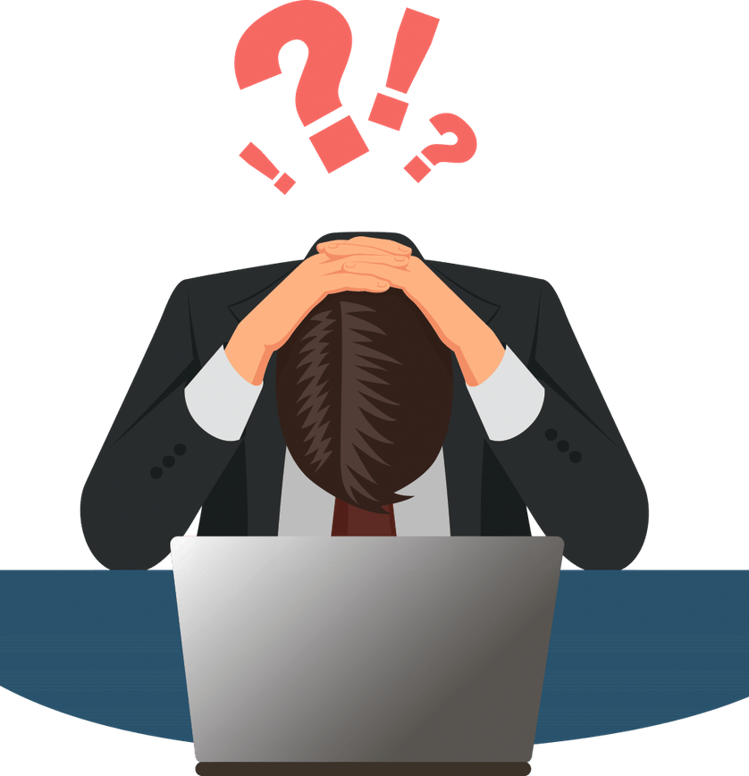
ARE BURNOUTS PREDICTABLE ?
SOCIOECONOMICAL CHARACTERISTICS
multivariate logistic regression
PROBABILITY OF A BURNOUT
WORKING ROUTINE

Slide 2



HOW TO RECOMMEND THE NEXT MOVIE TO WATCH ?
PREFERENCES OF PEOPLE WITH MY SAME INTERESTS
MY PREFERENCES
Collaborative filtering
NEXT MOVIE TO WATCH

Slide 3

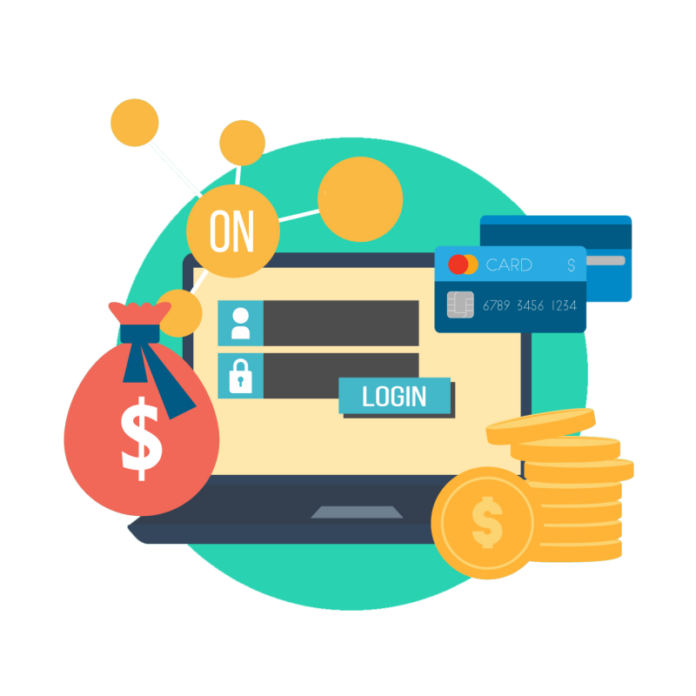

WHICH CUSTOMER WILL BUY ANOTHER AUDIOBOOK?
PURCHASED AUDIO BOOK CHARACTERISTICS
PROBABILITY OF A NEW PURCHASE
CUSTOMER’S APP USAGE
deep neural network

Slide 4



WHAT IS PEOPLE OPINION ABOUT … THAT?
LATEST TWEETS
TEXT PROCESSING
Sentiment analysis
PUBBLIC OPINION

Slide 5



IS IT POSSIBLE TO CLASSIFY SPAM BASED ON THE EMAIL TEXT ?
LENGTH OF MESSAGE
TERM FREQUENCY
Logistic Regression
SPAM / NOT-SPAM

Slide 6



TIME SERIES ANALYSIS - TIME SERIES MODELLING
TRENDS
SEASONALITY
AUTOREGRESSIVE MODELS
NON-LINEAR MODEL

Slide 7


HTML AND WEB SCRAPING
HTML
WEB SCRAPING

