Slide 1

SAMUSE
SKILL ACQUISITION THROUGH A MULTI-SENSING APPROACH
Embodiment indicators of music skill acquisition
Laura Serra Marin, PhD Student
Prof. Dr. Luc Nijs, Supervisor
This project is funded by the Institute for Advanced Studies (IAS)
Notes:
Hello everyone,
I’m Laura Serra, PhD student of Dr. Luc Nijs, and I’m part of the SAMUSE project and of the organisation of this symposium.
We organised this event, mainly because we wanted to create community between researchers that are doing similar work to the SAMUSE project, to learn about what others are doing, but also receive feedback about what we do.

Slide 2
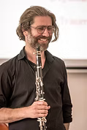





PRINCIPAL INVESTIGATORS
SAMUSE
TEAM
LUC NIJS
ASSOCIATE PROFESSOR
IN EARLY CHILDHOOD MUSIC EDUCATION
DEPARTMENT OF EDUCATION AND SOCIAL WORK
​​
INES CHIHI​​
​ASSISTANT PROFESSOR
IN ELECTRICAL MEASUREMENT AND SENSOR TECHNOLOGY
DEPARTMENT OF ENGINEERING
​
LUIS LEIVA
​ASSISTANT PROFESSOR
IN COMPUTER SCIENCE​
DEPARTMENT OF COMPUTER SCIENCE
PHD STUDENT &
POST-DOC COLLABORATORS
LAURA SERRA MARIN​
PHD STUDENT
DEPARTMENT OF EDUCATION AND SOCIAL WORK
HAJER GAMMOUDI​
PHD STUDENT
​DEPARTMENT OF ENGINEERING
SARAVANAKUMAR DURAISAMY
POSTDOCTORAL RESEARCHER
DEPARTMENT OF COMPUTER SCIENCE​
Notes:
The SAMUSE team, is formed of musicians, engineers and computer scientists.
As principal investigators we have Professors Luc Nijs, Ines Chihi and Luis Leiva, and as PhD student and post-docs, we have Hajer, Dr. Saravanakumar and me.
The starting point of this project, stems from the fact that

Slide 3
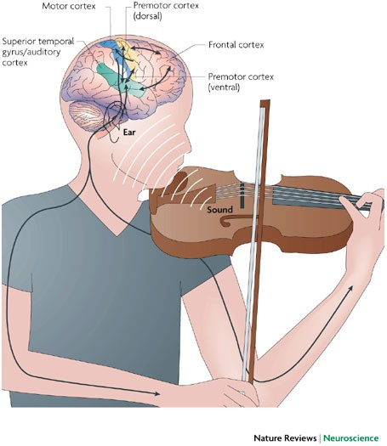
Learning to play a musical instrument
has an impact on the structure and function of our brain and body (Brown et al., 2015)
Image from Zatorre et al. (2007)
Notes:
It’s well established within the literature, that learning to perform a music instrument, has an impact on the structure and function our brain and body (Brown et al., 2015).

Slide 4
Learning to play a musical instrument
has an impact on the structure and function of our brain and body (Brown et al., 2015)
At the structural level
Musicians exhibit:
  increases in gray matter in auditory, motor and prefrontal regions (Jauset, 2024)
  enhanced white-matter connectivity in the corpus callosum (Altenmüller et al., 2019)
Image from Zatorre et al. (2007)
Notes:
At the structural level, musicians exhibit regional increases in gray matter in auditory, motor, and prefrontal regions, which means that those areas become denser and support enhanced processing.
They also show enhanced white-matter connectivity in pathways such as the corpus callosum, which means that different parts of the brain communicate more efficiently, specially those involved in sound processing and movement coordination.

Slide 5
Learning to play a musical instrument
has an impact on the structure and function of our brain and body (Brown et al., 2015)
At the functional level
  Auditory regions → better sound processing, pitch discrimination, timbre sensitivity (Maidhof, 2013)
  Motor regions → enhanced movement planning and control (Altenmüller & Furuya, 2016).
  Somatosensory areas → enhanced proprioceptive and tactile sensitivity (Altenmüller et al., 2019)
  Prefrontal cortex → improved executive functions (attention, planning, cognitive flexibility)(Brown et al., 2015).
Image from Zatorre et al. (2007)
Notes:
Functionally, these anatomical changes correlate with enhanced sensorimotor and cognitive functions:
- heightened sensitivity to timing and micro-pitch variations (Maidhof, 2014; Zatorre et al., 2001).
- enhanced ability to plan and execute really fast finger movements, and complex hand postures.
- enhanced tactile and proprioceptive sensitivity (Altenmüller et al., 2019).

Slide 6

Learning to play a musical instrument
has an impact on the structure and function of our brain and body (Brown et al., 2015)
At the structural level
At the functional level
Musicians exhibit:
  increases in gray matter (Jauset, 2024)
  enhanced white-matter connectivity (Altenmüller et al., 2019)
  Auditory regions → better sound processing, pitch discrimination, timbre sensitivity (Maidhof, 2013)
  Motor regions → enhanced movement planning and control (Altenmüller & Furuya, 2016).
  Somatosensory areas → enhanced proprioceptive and tactile sensitivity (Altenmüller et al., 2019)
  Prefrontal cortex → improved executive functions (attention, planning, cognitive flexibility)(Brown et al., 2015).
Image from Zatorre et al. (2007)
A more efficient system
Notes:
Taken together, these adaptations contribute to what is often described as a more efficient system.
And efficiency gains are not limited to neural processes, but also seen in muscular and observable movement patterns, which means that this efficiency is reflected in the fluid, flexible, and expressive performance of expert musicians.

Slide 7



Learning to perform a musical instrument
an embodiment process
musician
instrument
Notes:
In this learning process and to achieve expert performance, it is really important the relationship that the musician develops with the instrument.
Is one of the goals of many, if not every music teacher, that their students achieve such a level of control of the instrument, that it becomes experienced, as if it was an extension of their own body.
In the beginning, the instrument is an external object to be processed, requiring a lot of conscious effort, but as learning occurs, it starts to be processed as if it was part of the body.
From this perspective, expertise in music performance means embodying the instrument, and learning to play an instrument is conceptualised as an embodiment process.

Slide 8
Three Order
Embodiment Framework
Musical skill acquisition as
a gradual incorporation process
through which the instrument becomes integrated into the musician’s bodily, cognitive, and experiential system.
(Nijs, 2017)
Gallagher (2005), Metzinger (2014), Quadt (2018)
musician
instrument
Notes:
At least, this is what this theoretical framework, argues,
the « Three Order Embodiment Framework »,
which suggest that the learning-related structural and functional adaptations we just mentioned, lead to a feeling of
« having incorporated the instrument as part of one’s body » .

Slide 9


Three Order
Embodiment Framework
3rd Order Embodiment
Feelings of ownership and presence; the experience of the instrument becoming experienced as an extension of the self (Nijs, 2017).
2nd Order Embodiment
Enhanced sensorimotor and cognitive functions → internal models (Münte et al., 2002)
1st Order Embodiment
Unconscious neural and muscular adaptations (Massion et al., 2004; Gallagher, 2005).
Notes:
From this perspective, learning to play an instrument has an impact on the body at three levels.

Slide 10
Three Order
Embodiment Framework
1st Order Embodiment
Unconscious neural and muscular adaptations (Massion et al., 2004; Gallagher, 2005).
sensorimotor couplings
Notes:
The first level, refers to the impact on the basic sensorimotor system, these are neuroanatomical and muscular adaptations, such as structural brain changes and posture, that happen outside of conscious awareness.

Slide 11
Three Order
Embodiment Framework
2nd Order Embodiment
Enhanced sensorimotor and cognitive functions (Münte et al., 2002)
internal models
1st Order Embodiment
Unconscious neural and muscular adaptations (Massion et al., 2004; Gallagher, 2005).
sensorimotor couplings
Notes:
The second level, refers to the impact of musical training on cognitive and motor functions.
Specifically, on the development of predictive internal models.
As a musician learns, he or she develops a coupling between the actions afforded by the musical instrument, and the auditory consequences of these actions (Novembre et al., 2014; Maes et al., 2014).
Is these couplings that form the basis of predictive internal models, that allow musicians to anticipate what's going to happen as a result of their movements, so they can adjust themin an anticipatory way.
The result is a more efficient sensorimotor system

Slide 12
Three Order
Embodiment Framework
3rd Order Embodiment
Feelings of ownership and presence; on the experience of the instrument becoming experienced as an extension of the self (Nijs, 2017).
agency
control
ownership
2nd Order Embodiment
Enhanced sensorimotor and cognitive functions (Münte et al., 2002)
internal models
1st Order Embodiment
Unconscious neural and muscular adaptations (Massion et al., 2004; Gallagher, 2005). → put examples
sensorimotor couplings
Notes:
The last level refers to the subjective experience of embodiment, to how these first- and second-levelchanges support feelings of agency, control and ownership over the instrument.

Slide 13
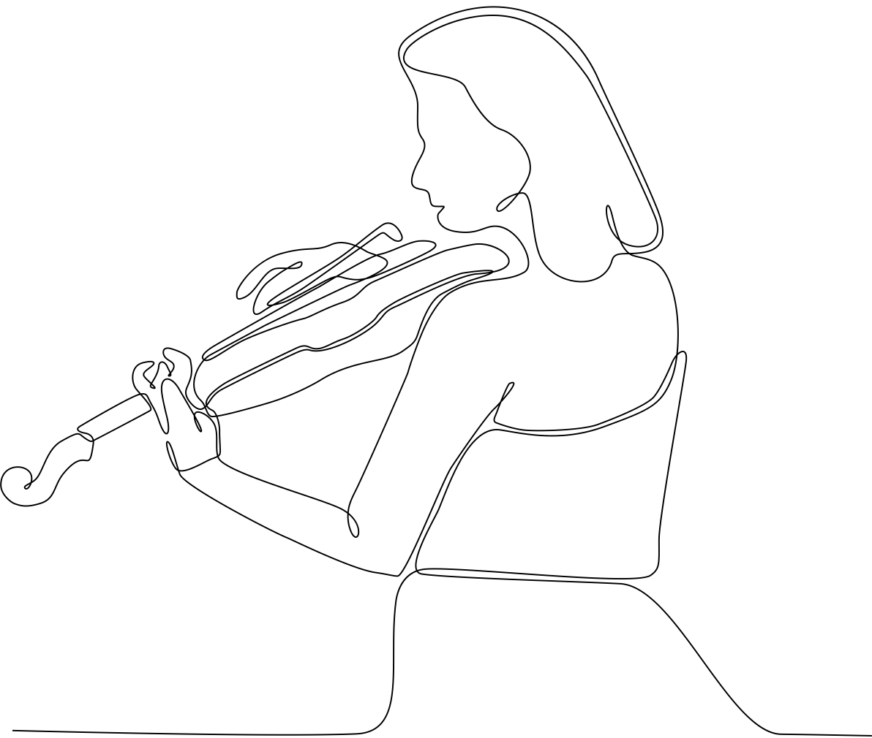

Embodiment indicators
Biomechanical and psychophysiological markers that reflect the impact of learning on the body, which evolve over time in relation to skill level.
Quantifiable through measurement tools: fMRI, EEG, EMG and Motion Capture
Notes:
Given the impact of playing the instrument on the body, we hypothesized that this process would become apparent in a set of indicators, which we called embodiment indicators.
These are quantifiable markers that capture the impact of learning on the body, which can be measured with biomechanical and psychophysiological measurement tools, such as fMRI, EEG, EMG and Motion Capture.

Slide 14
Research Question
Can we identify embodiment indicators that characterise skill level?
Notes:
The question was, can we identify embodiment indicators that characterise skill level?

Slide 15
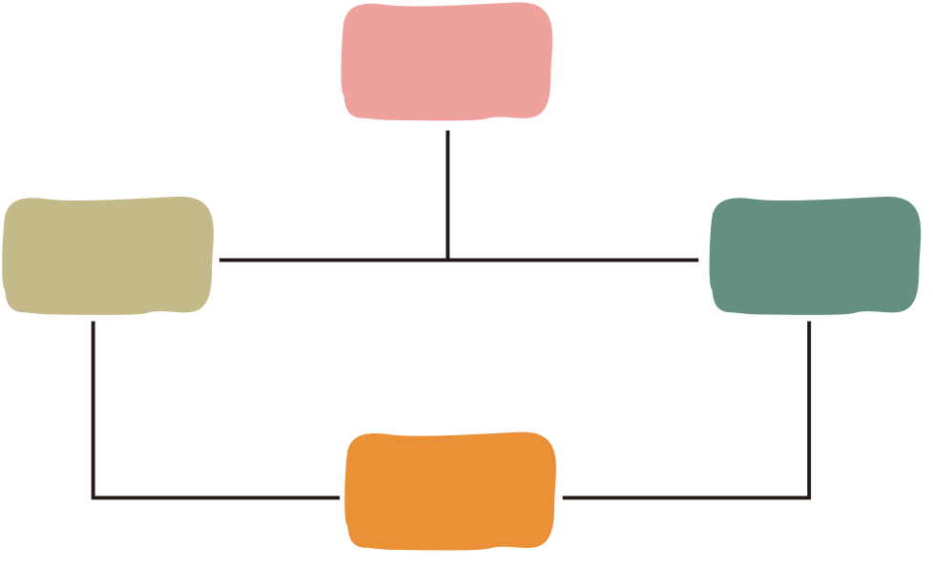

Scoping review
3rd Order Embodiment
on studies that used psychophysiological or biomechanical measurement tools to investigate skill differences in performing musicians.
Neural efficiency
2nd Order
Embodiment
Movement efficiency
1st Order Embodiment
Sensorimotor integration functions
Notes:
To answer this question, we did a scoping review on studies that used psychophysiological and biomechanical measurement tools to quantify skill differences among performing musicians.

Slide 16
Results
37 studies examined music learning and the acquisition of instrumental music skills using psychophysiological and biomechanical methods.
Notes:
We found 37 studies that examined music learning using these methods.
And from these studies, we extracted a series of indicators that differentiated musicians at different levels.

Slide 17
Psychophysiological studies using EEG, EMG, fMRI, and TMS
Category | Indicator | Tool | Measure
Sensori-motor integration | Auditory-motor couplings | DC-EEG | Task-related slow DC potentials in the sensorimotor cortex
Sensori-motor integration | Auditory-motor couplings | fMRI | Activity in the auditory-premotor network: M1, PMd, PMv, preSMA and SMA; in the auditory network: the right AC, STG and the dorsal auditory stream.
Sensori-motor integration | Visuo-motor couplings | fMRI | Activity in the fusiform gyrus, in the visual ventral stream.
Sensori-motor integration | Brain-network synchronization and functional connectivity | fMRI and TMS | Enhanced connectivity between the preSMA and the AC. Enhanced interhemispheric connectivity in the corpus callosum.
Notes:
For instance, the first category of indicators that we found were related to the development of sensorimotor associations, that occurred with training.

Slide 18
Neural network retuning and neural predictors of learning success associated with cello training
Wollman et al. (2018)
Aim
to investigate changes in brain activity patterns and their relation to performance improvements associated with cello learning.
Notes:
To show you an example, one of the included studies, done by Wollman and colleagues, investigated changes in brain activity patterns and their relation to performance improvements in cello playing.

Slide 19

Neural network retuning and neural predictors of learning success associated with cello training
Wollman et al. (2018)
Method
  13 non-musicians learned to play the cello during 1 month.
  Scanned participants with fMRI while playing and listening to simple sequences on the cello (before and after week 1 and 4).
  Evaluated performance with two performance indices: pitch and timing accuracy → both of which improved with learning.
Notes:
They recruited 13 non-musicians and taught them to play the cello, twice a week, for one month.
At the same time, they scanned participants with an fMRI, before and after week 1 and week 4.
They also measured and evaluated performance through pitch and timing accuracy.

Slide 20
Neural network retuning and neural predictors of learning success associated with cello training
Wollman et al. (2018)
Results
  During passive listening to trained sequences, the motor regions showed increased activation in comparison to activity before training and non-trained sequences.
  Playing at week 4 activated similar regions. They found an overlap between listening and playing networks, supporting the idea the listening to trained music automatically activates the motor representations.
Notes:
They found that, after learning, when participants listened to trained sequences, they showed increased activation in motor areas , compared to before learning, and compared to non-trained sequences.
Also they found that playing at week 4 activated similar regions than from listening.
From these, the authors suggest that because of learning, an audito-motor circuit is established, reflecting the development of sensorimotor couplings.

Slide 21
Neural network retuning and neural predictors of learning success associated with cello training
Wollman et al. (2018)
Discussion:
  Internal models refers to the brain’s capacity to automatically trigger sensorimotor processes that resemble those associated with actual playing, just by listening to trained sounds.
  These mechanisms may support the generation of anticipatory images that may facilitate action planning and control.
Notes:
The authors suggest that these sensorimotor couplings form the basis of internal models, and they go on to suggest that these mechanisms may facilitate action planning and control.

Slide 22
Three Order
Embodiment Framework → Embodiment Indicators
2nd Order Embodiment
Enhanced sensorimotor and cognitive functions (Münte et al., 2002)
Internal models:
anticipatory planning
and motor control
1st Order Embodiment
Unconscious neural and muscular adaptations (Massion et al., 2004; Gallagher, 2005). → put examples
Sensorimotor couplings: increased activity in regions of the auditory-to-motor dorsal cortical pathway
Notes:
So then, in the review, we categorize the different skill-related indicators, to the different embodiment levels.
In this case, the sensorimotor couplings would be an adaptation that happens at the first level, outside of conscious awareness
which gives rise to indicators at the second level, that include those that reflect that the musician has developed and refined these internal models, such as indicators of:
- cognitive and motor control
- movement consistency and accuracy
- and movement smoothnes

Slide 23
Psychophysiological studies using EEG, EMG, fMRI, and TMS
Category | Indicator | Tool
Neural efficiency | Motor control | fMRI
Neural efficiency | Motor control | EEG
Neural efficiency | Motor control | EEG
Neural efficiency | Neuromuscular control | fMRI and EMG
Neural efficiency | Neuromuscular control | TMS and EMG
Neural efficiency | Cognitive control | fMRI
Neural efficiency | Cognitive control | EEG
Neural efficiency | Error processing | EEG
Neural efficiency | Auditory processing | fMRI
Muscular efficiency and consistency | Reduced muscle activity and variability | sEMG
Notes:
Other indicators that we found were indicators of neural an muscular efficiency

Slide 24
Movement studies using Motion Capture, and Force Sensors.
Category | Indicator | Tool
Movement control | Movement coordination | MoCap
Movement control | Movement smoothness | MoCap and EMG
Movement control | Movement consistency | MoCap
Movement control | Movement consistency | 2D position sensor, EMG, and cyberglove
Movement control | Movement accuracy | MoCap
Movement control | Movement flexibility | MoCap
Movement efficiency | Use of interaction torques and gravitational forces | 2D position sensor and EMG.
Movement efficiency | Use of interaction torques and gravitational forces | 2D Position Sensor
Movement efficiency | Efficiency and consistency in muscle activation patterns | EMG
Movement efficiency | Economical use of force | F-scan sensor and 2D position sensor
Notes:
From the studies using motion capture, we found indicators of movement control and efficiency.

Slide 25
Three Order
Embodiment Framework → Embodiment Indicators
3rd Order Embodiment
The impact of playing the instrument on feelings of ownership and presence; on the experience of the instrument becoming experienced as an extension of the self (Nijs, 2017).
Internal models:
anticipatory planning
and motor control
Sensorimotor couplings: increased activity in regions of the auditory-to-motor dorsal cortical pathway
Notes:
In this review, given its methodological focus, we didn’t found indicators at the third level.
Which takes me to highlight some of the limitations of the studies included in the review

Slide 26
METHODOLOGICAL LIMITATIONS
Limitations
Sample size
Age range
Skill level definition
Group comparisons
Instruments studied
Tasks
Study design
Notes:
which challenge the identification of reliable and objective indicators at different skill levels,
and highlight that the neuromuscular and motor dynamics underlying skilled musical performance remain insufficiently understood.

Slide 27
METHODOLOGICAL LIMITATIONS
From the Review
Limitations
Small sample: ~20 participants per study.
Sample size
Most studies investigated adults (mean age: 28.5 years).
Age range
Varied criteria for defining expertise:
experts > 15 vs > 7 years of experience
Skill level definition
Most studies compared beginners / non-musicians and experts
Group comparisons
Pianists (52%) drummers (18%), cellists (13%), violinists (10%), guitarists (5%).
Instruments studied
Highly simplified laboratory tasks (e.g., keystrokes, bowing exercises)
Tasks
Cross-sectional or short longitudinal studies
Study design

Slide 28
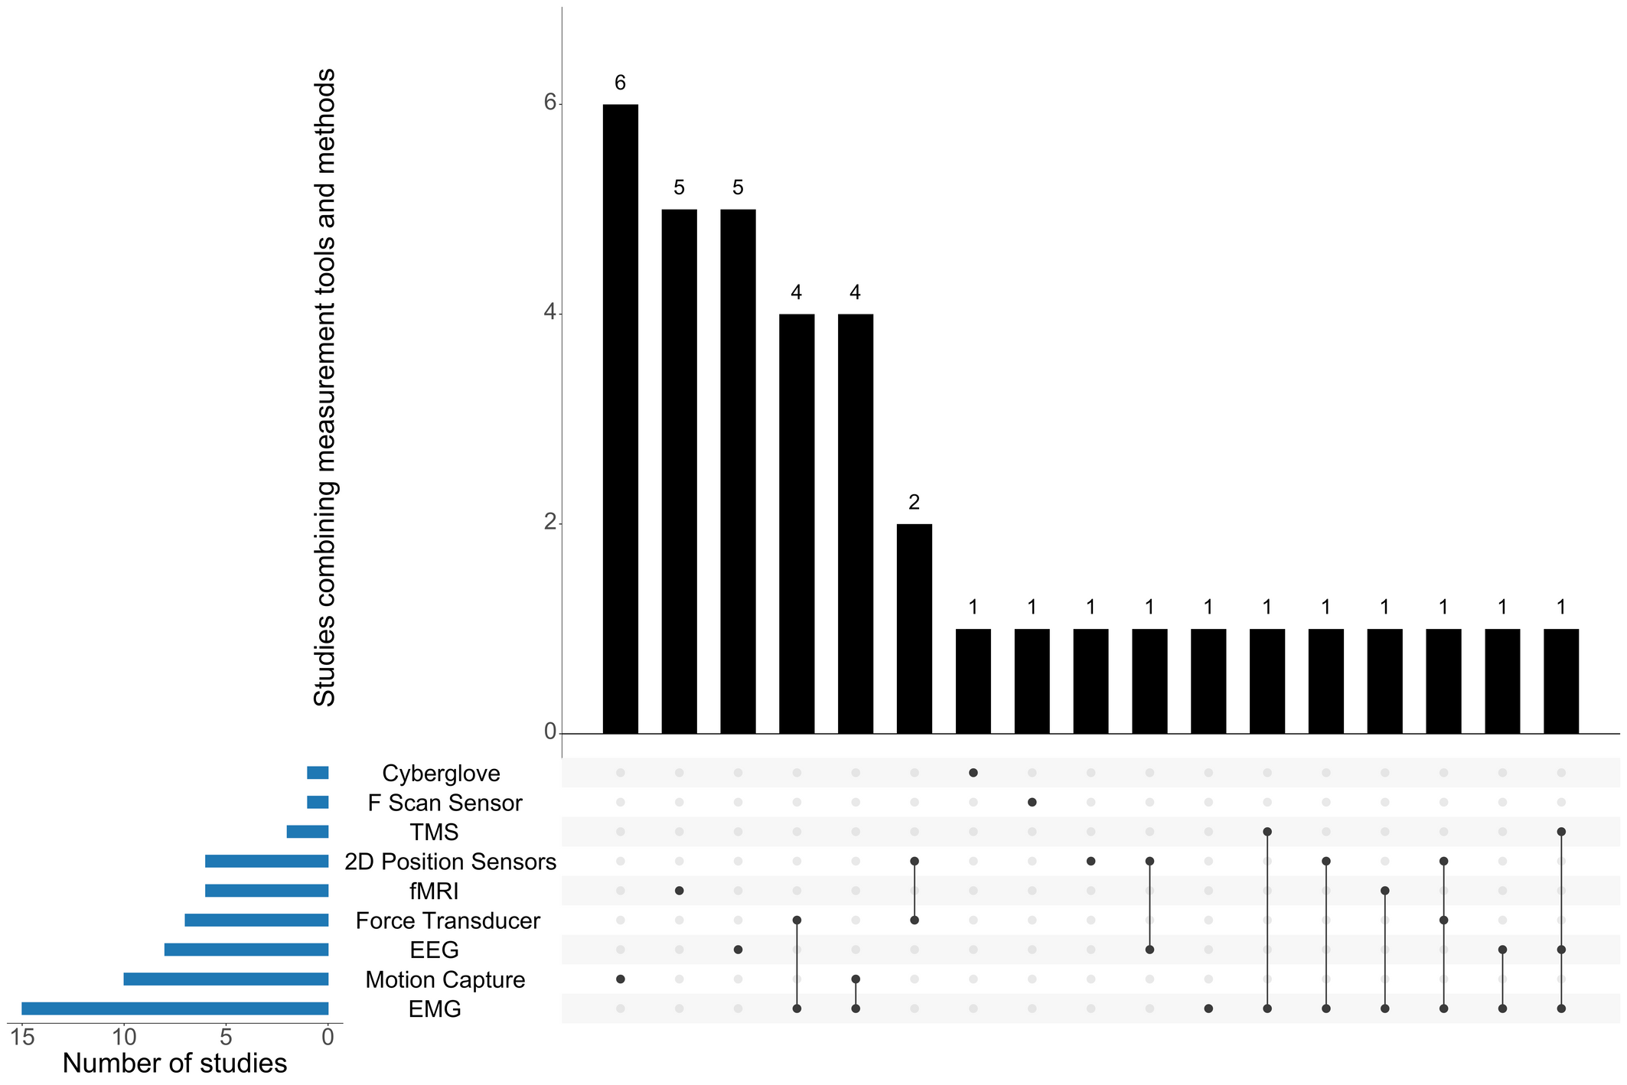
Limitations
Most studies examined only a single class of markers.
Relying on a single measurement technique, Motion Capture (n=6), fMRI (n=5), or EEG (n=5).
Notes:
Most studies examined only a single class of markers at a time, thus overlooking the dynamic interaction between cognitive and motor processes (Kamat et al., 2025).
As most of them relied on a single measurement technique, Motion Capture (n=6), fMRI (n=5), or EEG (n=5).

Slide 29
METHODOLOGICAL LIMITATIONS
From the Review
Limitations
Small sample: ~20 participants per study.
Sample size
Most studies investigated adults (mean age: 28.5 years).
Age range
Varied criteria for defining expertise:
experts > 15 vs > 7 years of experience
Skill level definition
Most studies compared beginners / non-musicians and experts
Group comparisons
Pianists (52%) drummers (18%), cellists (13%), violinists (10%), guitarists (5%).
Instruments studied
Highly simplified laboratory tasks (e.g., keystrokes, bowing exercises)
Tasks
Cross-sectional or short longitudinal studies
Study design
Notes:
So, from all these limitations together, we propose an experimental protocol to advance in the identification of embodiment indicators as a function of skill level.

Slide 30
METHODOLOGICAL LIMITATIONS
From the Review
Limitations
SAMuSE
Small sample: ~20 participants per study.
Sample size
200 participants
Most studies investigated adults (mean age: 28.5 years).
Age range
9 - 65 years old
Varied criteria for defining expertise:
experts > 15 vs > 7 years of experience
Skill level definition
Control for practice time per week, years of experience, conservatoire training
Most studies compared beginners / non-musicians and experts
Group comparisons
From beginner to experts, full skill continuum
Pianists (52%) drummers (18%), cellists (13%), violinists (10%), guitarists (5%).
Instruments studied
Violinists and Clarinetists
Highly simplified laboratory tasks (e.g., keystrokes, bowing exercises)
Tasks
A small section of a music piece from the repertoire
Cross-sectional or short longitudinal studies
Study design
Cross-sectional
Notes:
Describe the SAMUSE protocol.

Slide 31
Research Question(s)
Can we identify embodiment indicators that characterise skill level?
Notes:
Overall, the scoping review allowed us to start to respond to this RQ, and helped us to narrow it down:

Slide 32
Research Question(s)
Does the strength of dorsal auditory–motor pathway engagement and stronger functional connectivity between auditory cortex (AC) and motor/premotor regions (PMC, SMA/preSMA) predict:
H1a — Better task performance
  sound stability
  expert-rated performances
  consistency across trials
  note and timing accuracy
H1b — Higher movement efficiency
Movement indicators (MoCap)
  Movement smoothness (e.g., SPARC index)
  Reduced movement variability / increased consistency
  Joint coordination patterns (instrument- and task-specific)
Muscular indicators (EMG)
  Co-contraction indices
  Lower variability in muscle activation timing (from trial to trial)
  Earlier onset and faster rise and decline time of EMG amplitude
H1c — Higher neural efficiency: lower cognitive demands
Neural indicators (fNIRS)
  Reduced engagement of higher-order cognitive control regions: DLPFC / PFC during task execution
  Auditory (A1)–motor couplings (M1: SMA and PMC (PMd & PMv))
Self-report indicators (Questionnaires)
  Reduced perceived effort
  More stable focus of attention
Notes:
In the SAMUSE study, we look to whether the strength of coupling between auditory and motor areas predict:
- better task performance
- higher movement efficiency measured through several movement and muscular indicators, including smoothness, movement variability
- and higher neural efficiency, measured via fNIRS and self-report indicators of effort and perceived load.
Importantly, we will add some slef-report indicators

Slide 33

MEASUREMENT TOOLS
Follow these 6 essential phases to deliver exceptional products iteratively
Motion Capture
Captury
Eye-tracking
Instructions
Place
EMG
Delsys
fNIRS
Cortiview
Aria Glasses
PsychoPy
Conservatoires
For both
  Right and left upper trapezius
  Sternocleidomastoid (violin side)
  Left anterior deltoid
For violinists
  Left EDC or FDS
  Right deltoid or right biceps (bowing)
For clarinetists
  Left anterior deltoid
  Right EDC or Right brachioradialis or biceps brachii
Full-body markerless system, ≥50 Hz
Cortiview
HbO, HbR changes
Regions: bilateral PFC, PMC, SMA, M1, A1
Optode placement:
10–20 system
Also used for synchronisation of the other measurement tools
Luxembourg
Belgium
France
Is there standardised protocols for data analysis (e.g., pre-processing steps and basic analysis)

Slide 34
EXPERIMENTAL DESIGN
Block 1-4 will be randomised
30-40'
45'
50'
55'
60'
65'
Set up and Calibration
Warm up
Block 1: Play
Block 2: Imagery
Block 3: Listen
Block 4: Move
Perform a scale and a arpeggio at a controlled tempo (matched per skill level).
To check the data is being collected properly and for the participant to get used to the setup
Perform, by memory, a section of a piece they have prepared. Matched per skill level and based on the curriculum.
Repetitions (x3):
+ (20")
Play (30")
Rest (20")
Imagine the same piece as vividly as possible (eyes closed)
Repetitions (x3):
+ (20")
Play (45")
Rest (20")
Listen to the same piece, without moving (eyes closed)
Repetitions (x3):
+ (20")
Play (45")
Rest (20")
Perform the movements of the piece on the instrument, but without producing any sound.
Repetitions (x3):
+ (20")
Play (45")
Rest (20")
EMG
Motion Capture
fNIRS
Eye-tracking
30-40'
5'
5'
5'
5'
5'
Questionnaires on perceived difficulty, enjoyment, self-efficacy, and attentional focus after each block

Slide 35
Analysis
Can we identify embodiment indicators that caracterize skill level?
Data-driven approach
  Integrate multimodal time-series (MoCap, EMG, fNIRS, eye tracking)
  Automated classification of skill level inspired by D’Amato et al. (2020) that uses machine learning models (e.g., SVM, Random Forest, LSTM/CNN hybrids)
  Identify objective neuromuscular, neural, movement, and attentional markers of expertise
  Resolve inconsistencies in musical expertise literature
Notes:
To respond to the first question, we aim to use a data-driven approach where we will use machine learning models to perform an automated classification of skill level.
The aim will be to identify neuromuscular, neural, and movement markers of expertise.
[forthcoming]

Slide 36
Feedback and Suggestions
Thank you for listening!

Slide 37
References
Altenmüller, E., Wiesendanger, M., & Kesselring, J. (Eds). (2006). Music, Motor Control and the Brain (1st edn). Oxford University PressOxford. https://doi.org/10.1093/acprof:oso/9780199298723.001.0001
Altenmüller, E., Furuya, S., Scholz, D. S., & Ioannou, C. I. (2019). Brain Research in Music Performance. In M. H. Thaut & D. A. Hodges (Eds), The Oxford Handbook of Music and the Brain (pp. 458–486). Oxford University Press. https://doi.org/10.1093/oxfordhb/9780198804123.013.19
Ashkenazi, C., Waddell, G., & Williamon, A. (2025). Antagonistic muscular co-contraction for skilled, healthy piano technique: A scoping review. Frontiers in Psychology, 16, 1386273. https://doi.org/10.3389/fpsyg.2025.1386273
Bernstein, N.A. (1967) The Coordination and Regulation of Movements. Pergamon Press, Oxford.
Brown, R. M., & Penhune, V. B. (2018). Efficacy of auditory versus motor learning for skilled and novice performers. Journal of Cognitive Neuroscience, 30(11), 1657–1682. Scopus. https://doi.org/10.1162/jocn_a_01309
Brown, R. M., Zatorre, R. J., & Penhune, V. B. (2015). Expert music performance: Cognitive, neural, and developmental bases. In Progress in Brain Research (Vol. 217, pp. 57–86). Elsevier. https://doi.org/10.1016/bs.pbr.2014.11.021
Bangert, M., & Altenmüller, E. O. (2003). Mapping perception to action in piano practice: A longitudinal DC-EEG study. BMC Neuroscience, 4(1), 26. https://doi.org/10.1186/1471-2202-4-26
Chen, J. L., Rae, C., & Watkins, K. E. (2012). Learning to play a melody: An fMRI study examining the formation of auditory-motor associations. NeuroImage, 59(2), 1200–1208. https://doi.org/10.1016/j.neuroimage.2011.08.012
Dounskaia, N. (2005). The internal model and the leading joint hypothesis: Implications for control of multi-joint movements. Experimental Brain Research, 166(1), 1–16. https://doi.org/10.1007/s00221-005-2339-1

Slide 38
References
Gallagher, S. (2005). How the Body Shapes the Mind (1st edn). Oxford University PressOxford. https://doi.org/10.1093/0199271941.001.0001
Jauset, J. A. (2024). Neuro-música. Cerebro, ciencia y arte.
Konczak, J., Vander Velden, H., & Jaeger, L. (2009). Learning to play the Violin: Motor control by freezing, not freeing degrees of freedom. Journal of Motor Behavior, 41(3), 243–252. Scopus. https://doi.org/10.3200/JMBR.41.3.243-252
Lotze, M., Scheler, G., Tan, H.-R. M., Braun, C., & Birbaumer, N. (2003). The musician’s brain: Functional imaging of amateurs and professionals during performance and imagery. NeuroImage, 20(3), 1817–1829. https://doi.org/10.1016/j.neuroimage.2003.07.018
Maidhof, C. (2013). Error monitoring in musicians. Frontiers in Human Neuroscience, 7. https://doi.org/10.3389/fnhum.2013.00401
Metzinger, T. (2014). First-order embodiment, second-order embodiment, third-order embodiment. In L. Shapiro (Ed.), The Routledge handbook of embodied cognition (pp. 272–286). Routledge/Taylor & Francis Group.
Massion, J., Alexandrov, A., & Frolov, A. (2004). Why and how are posture and movement coordinated? In Progress in Brain Research (Vol. 143, pp. 13–27). Elsevier. https://doi.org/10.1016/S0079-6123(03)43002-1
Münte, T. F., Altenmüller, E., & Jäncke, L. (2002). The musician’s brain as a model of neuroplasticity. Nature Reviews Neuroscience, 3(6), 473–478. https://doi.org/10.1038/nrn843
Nijs, L. (2017). The Merging of Musician and Musical Instrument. In M. Lesaffre, P.-J. Maes, & M. Leman (Eds), The Routledge Companion to Embodied Music Interaction (1st edn, pp. 49–57). Routledge. https://doi.org/10.4324/9781315621364-6
Quadt, L. (2018). Commentary: First-Order Embodiment, Second-Order Embodiment, Third-Order Embodiment. Frontiers in Psychology, 9, 445. https://doi.org/10.3389/fpsyg.2018.00445

Slide 39
References
Verrel, J., Pologe, S., Manselle, W., Lindenberger, U., & Woollacott, M. (2013a). Coordination of degrees of freedom and stabilization of task variables in a complex motor skill: Expertise-related differences in cello bowing. In EXPERIMENTAL BRAIN RESEARCH (Vol. 224, Issue 3, pp. 323–334). SPRINGER. https://doi.org/10.1007/s00221-012-3314-2
Verrel, J., Pologe, S., Manselle, W., Lindenberger, U., & Woollacott, M. (2013b). Exploiting biomechanical degrees of freedom for fast and accurate changes in movement direction: Coordination underlying quick bow reversals during continuous cello bowing. In FRONTIERS IN HUMAN NEUROSCIENCE (Vol. 7). FRONTIERS MEDIA SA. https://doi.org/10.3389/fnhum.2013.00157
Verrel, J., Woollacott, M., & Lindenberger, U. (2014). Articulated coordination of the right arm underlies control of bow parameters and quick bow reversals in skilled cello bowing. In FRONTIERS IN PSYCHOLOGY (Vol. 5). FRONTIERS MEDIA SA. https://doi.org/10.3389/fpsyg.2014.00885
Wright, D. J., Holmes, P., Di Russo, F., Loporto, M., & Smith, D. (2012a). Reduced Motor Cortex Activity during Movement Preparation following a Period of Motor Skill Practice. PLoS ONE, 7(12), e51886. https://doi.org/10.1371/journal.pone.0051886
Wright, D. J., Holmes, P. S., Di Russo, F., Loporto, M., & Smith, D. (2012b). Differences in cortical activity related to motor planning between experienced guitarists and non-musicians during guitar playing. In HUMAN MOVEMENT SCIENCE (Vol. 31, Issue 3, pp. 567–577). ELSEVIER SCIENCE BV. https://doi.org/10.1016/j.humov.2011.07.001
Yasuhara, M., Uehara, K., Oku, T., Shiotani, S., Nambu, I., & Furuya, S. (2024). Robustness and adaptability of sensorimotor skills in expert piano performance. iScience, 27(8), 110400. https://doi.org/10.1016/j.isci.2024.110400
Zatorre, R. J., Chen, J. L., & Penhune, V. B. (2007). When the brain plays music: Auditory–motor interactions in music perception and production. Nature Reviews Neuroscience, 8(7), 547–558. https://doi.org/10.1038/nrn2152

Slide 40
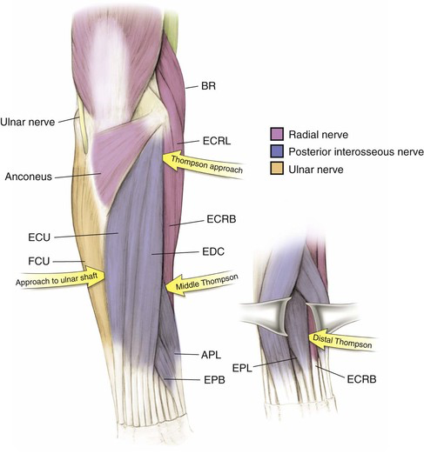
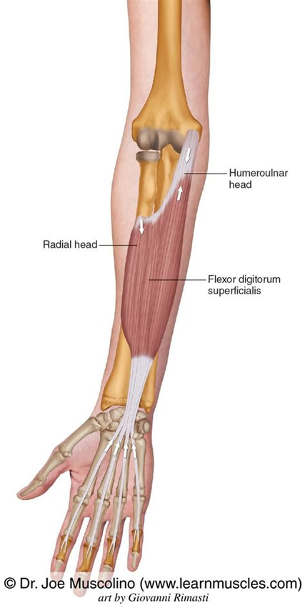
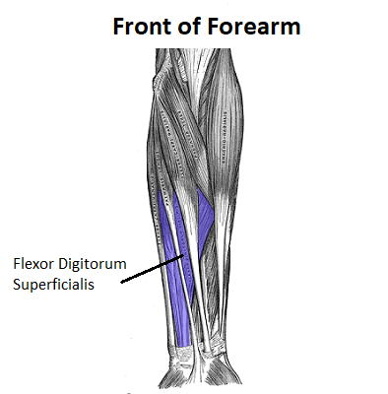
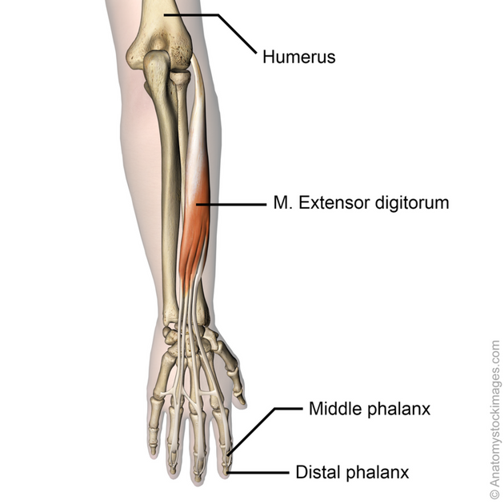
Muscles (EDC and FDS)

Slide 41
Reduced activation in frontal and motor regions (DLPFC, pre-SMA, M1) (Lotze et al., 2003).
Neural
Neural efficiency
Increased activation: parietal, cerebellar, and subcortical areas (Brown and Penhune, 2018)
Muscular efficiency co-contraction with expertise
Decreases and increases, depending on task demands, stability needs, and movement uncertainty.
Limitations
Muscular
Hypothesis-driven approach
Biomechanical
Empirical results vary across instruments and tasks, which seem to indicated that joint coordination is task-specific, rather than a universal progression from proximal to distal control (Konczack et al., 2009; Verrel et al., 2013; 2014).
It can be both an indicator of adaptive and maladaptive control strategy (see Ashkenazi et al., 2025 for a review).
Theory predicts a shift from “freezing” to “releasing” degrees of freedom with practice (Bernstein, 1967; Dounskaia, 2005).
Notes:
Research shows mixed neural dynamics in expertise which highlight that neural efficiency is not reflected in one simple pattern of reduced activity:
- Reduced activation in frontal and motor regions (DLPFC, pre-SMA, M1) → linked to automatizationand lower attentional demands (Lotze et al., 2003).
- Increased activation in parietal, cerebellar, and subcortical areas → suggesting continued need for fine timing, and motor planning (Brown and Penhune, 2018)
Classical models expect less co-contraction with expertise→ efficiency.
Decreases and increases, depending on task demands, stability needs, and movement uncertainty. It can be both an indicator of adaptive and maladaptive control strategy (see Ashkenazi et al., 2025 for a review).

