Slide 1

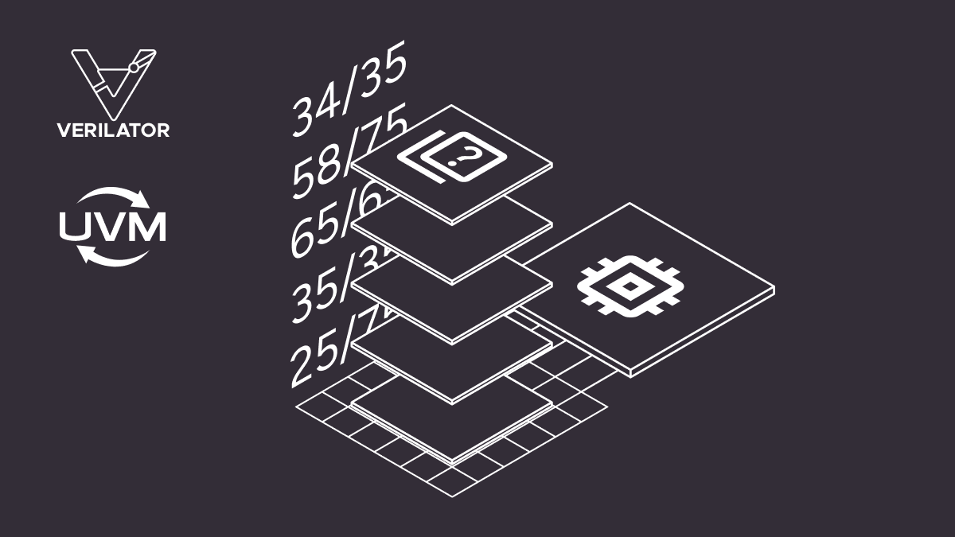
Project: VERIFICATION OF A 5-STAGE PIPELINED RISC-V RV32IM PROCESSOR USING UVM
Review and Analysis of Technical Papers
Members:
Huỳnh Dương Tôn Lực – 21161252
Ngô Quốc An – 21161226
Bùi Ngọc Duy Tân – 21161266
Trương Quốc Tuấn – 22161084

Slide 2
[1] Mallidu, J. and Siddamal, S.V., 2022. A survey on in-order 5-stage pipeline RISC-V processor implementation. In Information and Communication Technology for Competitive Strategies (ICTCS 2021) Intelligent Strategies for ICT (pp. 777-784). Singapore: Springer Nature Singapore
[5] Katke, S. P., & Jain, G. P. (2012). Design and implementation of 5 stages pipelined architecture in 32 bit risc processor. International Journal of Emerging Technology and Advanced Engineering, 2(4), 340-346.
[3] Miyazaki, H., Kanamori, T., Islam, M.A. and Kise, K., 2020. RVCoreP: An optimized RISC-V soft processor of five-stage pipelining. IEICE TRANSACTIONS on Information and Systems, 103(12), pp.2494-2503.
[2] Barbirotta, M., Mastrandrea, A., Menichelli, F., Vigli, F., Blasi, L., Cheikh, A., ... & Olivieri, M. (2020, October). Fault resilience analysis of a RISC-V microprocessor design through a dedicated UVM environment. In 2020 IEEE International Symposium on Defect and Fault Tolerance in VLSI and Nanotechnology Systems (DFT) (pp. 1-6). IEEE.
[6] Barraco, L., 2021. UVM Environment for RISC-V processor (Doctoral dissertation, Politecnico di Torino).

Slide 3
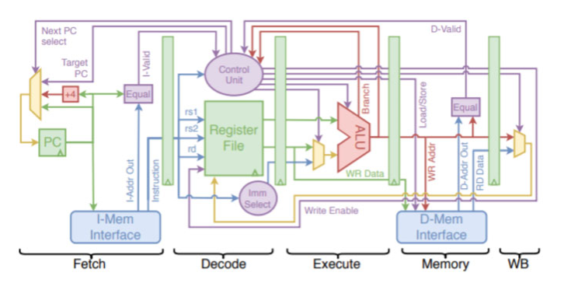
1. Technical problem.
[1] A Survey on In-Order 5-Stage Pipeline RISC-V Processor Implementation
Author: Jayashree Mallidu and Saroja V. Siddamal
Domain: RISC-V microarchitecture design (5-stage pipeline: IF, ID, EX, MEM, WB).
Problem: Pipeline hazards affect performance
Structural hazards (resource conflicts).
Data hazards (data dependency).
Control hazards (control branch, wrong prediction).
Scope of survey: Compare non-pipeline and multipipeline.
Importance: RISC-V processor design is suitable for embedded, FPGA, and ASIC applications with low cost, high efficiency requirements.
Goal: Improved processing speed, throughput, and IPC (Instruction Per Cycle).

Slide 4
2. Technical Solution and Implementation Methodology
Technical Solution:
Non-pipelined design as the basis for comparison with pipeline.
Using branch prediction (BTB, RAS, BHT) to reduce control hazard.
Separate instruction memory and data memory to avoid structural hazard conflicts.
Implementation Methodology:
Tested on FPGA and ASIC (UMC 65nm, 130nm) for practical evaluation.
Use 5-stage and 6-stage pipeline architectures (IF, ID, EX, MEM, WB, and extended stages such as RR, IS).
Use data forwarding, resource duplication, and interlocks to handle data hazards and structural hazards.

Slide 5
3. Results and Evaluation
Results:
Both 5-stage and 6-stage pipelines help increase IPC, improving throughput compared to non-pipelines.
Data forwarding + duplication reduces stalls, eliminates structural hazards.
Branch prediction helps reduce control hazards, increase processing efficiency.
Evaluation:
Advantages: Easy to customize, open-source, low cost, easy to apply to SoC/embedded.
Disadvantages: It is necessary to integrate multiple techniques simultaneously (forwarding, branch prediction, superscalar) to achieve optimal performance.
Prospects: The RISC-V pipeline is a potential research and application direction, both serving academics and meeting industrial requirements.

Slide 6
1. Technical Problem
[5] Design and Implementation of 5 Stages Pipelined Architecture in 32 Bit RISC Processor
Author: Sharda P. Katke, G.P. Jain
Background:
- Increasing demand for higher processing speed and improved performance in microprocessors.
- Need to reduce power consumption and minimize chip area while maintaining efficiency.
Problem:
- Single-cycle RISC executes each instruction in one long clock cycle → low throughput.
- Complex design makes expansion and verification difficult.
Objective:
- Develop a 5‑stage pipelined 32‑bit RISC processor (IF, ID, EX, MEM, WB).
- Reduce cycles per instruction, increase throughput, ensure scalability.

Slide 7
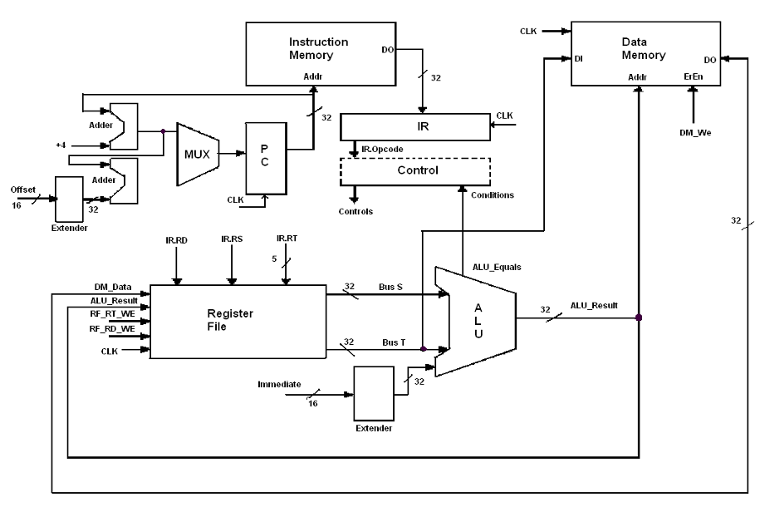
2. Technical Solution and Implementation Methodology
Technical Solution:
- Implement a 5-stage pipelined architecture:
1. Instruction Fetch (IF)
2. Instruction Decode (ID)
3. Execute (EX)
4. Memory Access (MEM)
5. Write Back (WB)
- Integrate hazard detection and forwarding units to resolve data hazards.
- Use VHDL for hardware description and FPGA for prototyping.
SYSTEM ARCHITECTURE WITH PIPELINE
Implementation Methodology:
- Model each functional block in VHDL.
- Simulate using ModelSim to verify logic correctness.
- Synthesize using Xilinx Webpack for FPGA deployment.
- Test with a representative instruction set to evaluate performance.

Slide 8
3. Results and Evaluation
Results:
Simulation confirms correct functional behavior of the pipelined processor.
Achieved higher throughput compared to single-cycle implementation.
Reduced average execution time per instruction.
Evaluation:
Advantages: Higher processing speed, modular and scalable design, suitable for embedded applications.
Limitations: No overflow handling; limited instruction set.
Future Work: Expand instruction set and add more pipeline stages to further enhance performance.

Slide 9
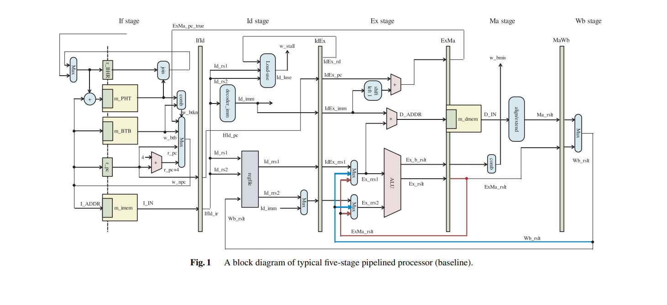
[3] RVCoreP: An optimized RISC-V soft processor of five-stage pipelining
Author: Wang J, Tan N, Zhou Y, Li T, Xia J
Technical problems:
3 critical path:
IF stage: PC → BTB/PHT → choosing next PC.
EX stage: ALU + 2 forwarding path.
MA stage: Load data → align/extend → MaWb.
→ This is the point that causes significant delay, which in turn reduces the operating frequency of a soft RV32I pipeline processor.

Slide 10
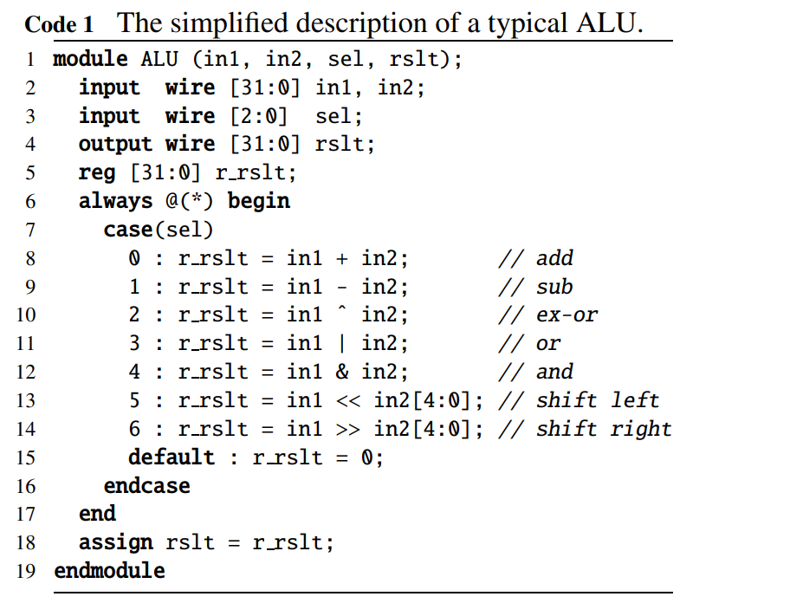
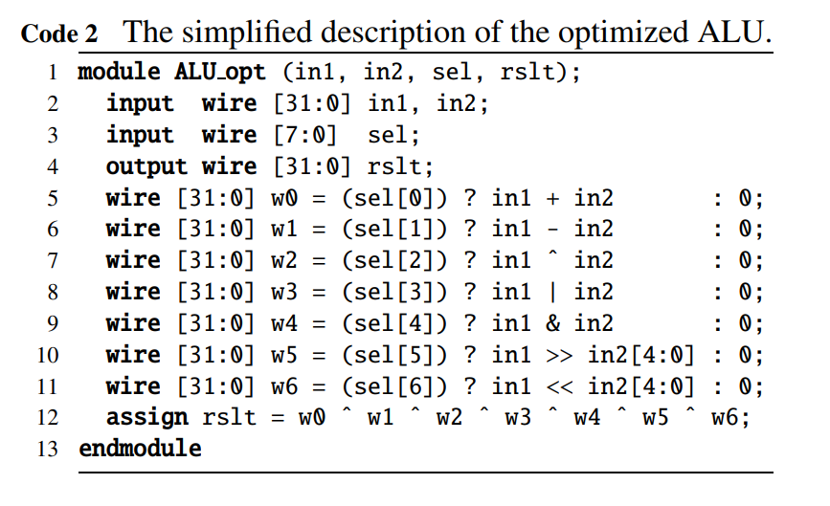
ALU Optimization:
ALU Optimization:the circuit speed is improved by using exclusive OR instead of multiplexer to select the operation result for the ALU optimization on FPGA. Therefore, in this design of RVCoreP, exclusive OR is used to select the 32-bit executed result of ALU.

Slide 11
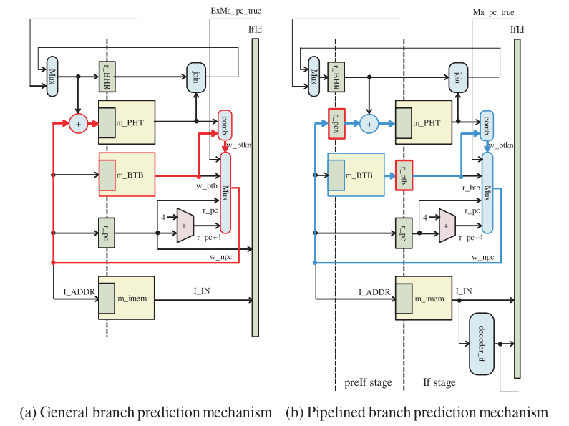
Instruction Fetch Unit Optimization

Slide 12
Alignment and Sign-Extension Optimization
In the MA stage, the align/extend unit must align the loaded data (8, 16, or 32 bits) and perform either sign-extension or zero-extension, which originally relies on large multiplexers and causes delay.
RVCoreP optimizes this unit by applying one-hot encoding combined with XOR-reduction, similar to the ALU optimization, thereby reducing the critical path delay and improving the processor’s operating frequency.

Slide 13
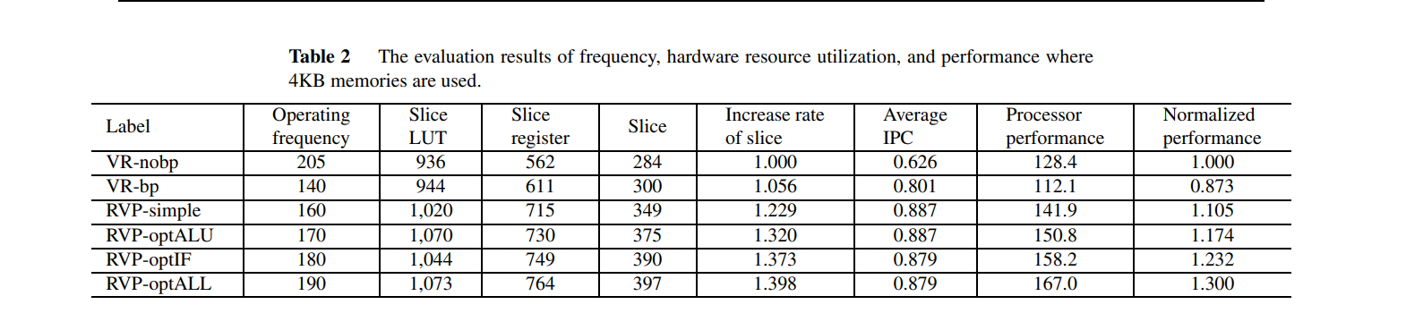
Result:

Slide 14
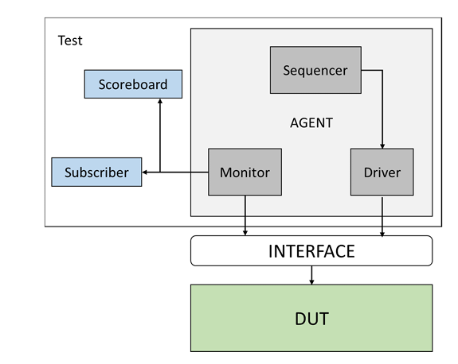
[2] Fault resilience analysis of a RISC-V microprocessor design through a dedicated UVM environment
Author: Barbirotta M, Mastrandrea A, Menichelli F, Vigli F, Blasi L
Technical Problem & Scope of Survey
Problem / Context:
Fault resilience under hardware errors
High relevance in safety-critical domains
Need for scalable and application-oriented trustworthiness evaluation
Scope / Objective:
Klessydra T03 RISC-V
Survey methods combining UVM verification + error injection
Focus on simulation and hardware-assisted verification (emulation/FPGA)
Assess robustness via fault injection across CNN layers and inputs

Slide 15
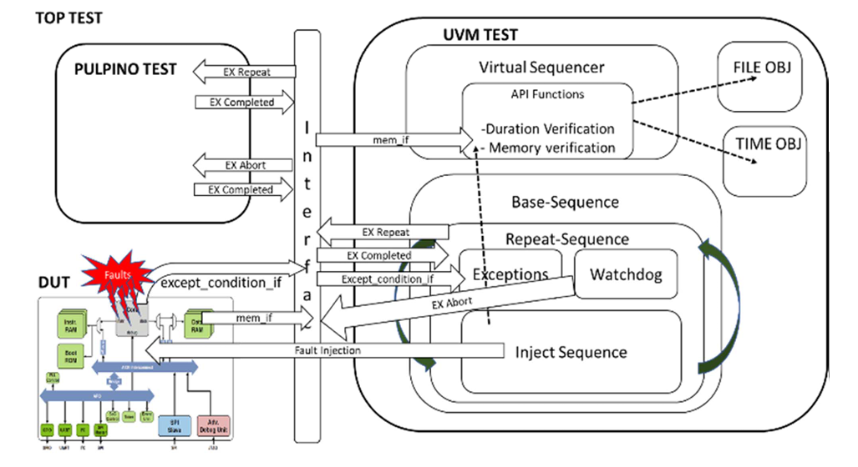
Methods / Approaches Compared
Error injection types:
Single-bit register corruption
Time-frame based injection
Application-driven injection
Verification flows:
Klessydra T03 as the DUT
UVM-based testbench architecture
Simulation only (RTL + UVM)
Overall UVM environment architecture
Fault handling:
Deterministic single-bit corruption
Application-oriented injection
Automated checking

Slide 16
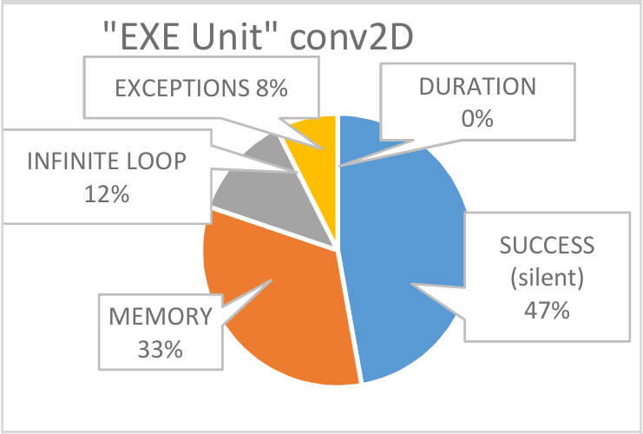
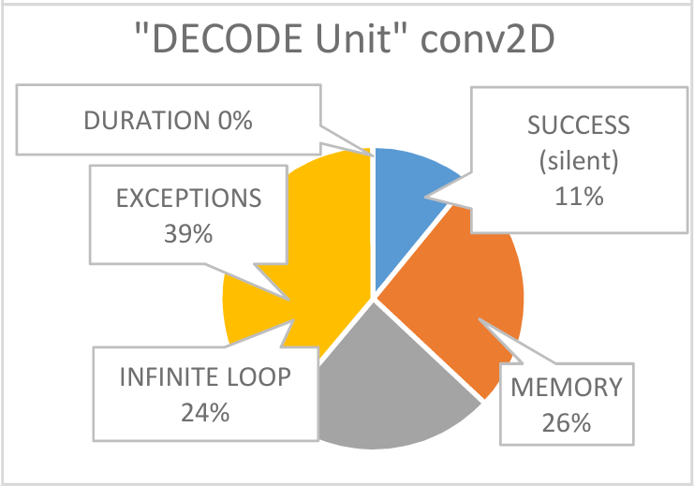
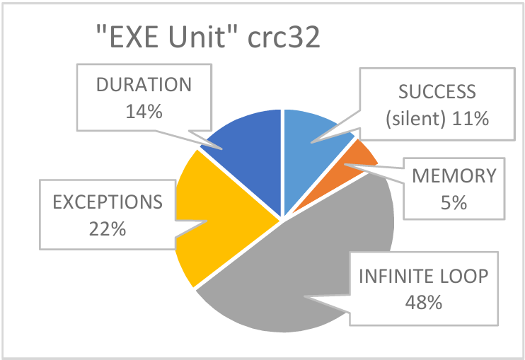
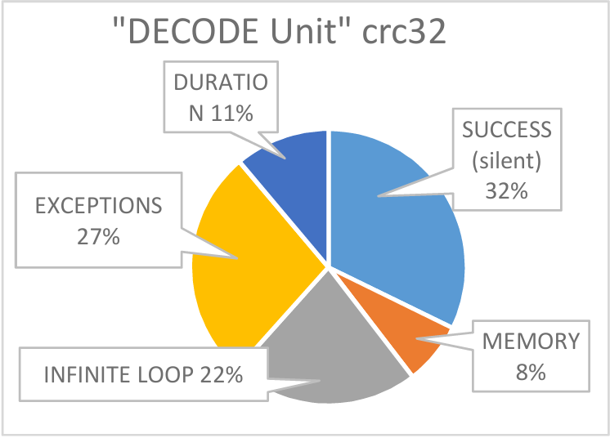
Findings & Insights
Results:
Varying CNN resilience:
  Single-value errors often masked by ReLU or pooling
  Multiple‐value errors propagate, impact accuracy (LeNet-5)
Emulation uncovers more faults than simulation
Minimal overhead; faster runtime vs. software-only methods
Evaluations & Insights:
UVM + error injection = scalable & portable verification framework
Flexible for different CNNs, covers corner cases
The method enhances visibility, early detection, and pre-silicon reliability
Outcomes of fault injection aggregated for hardware units

Slide 17

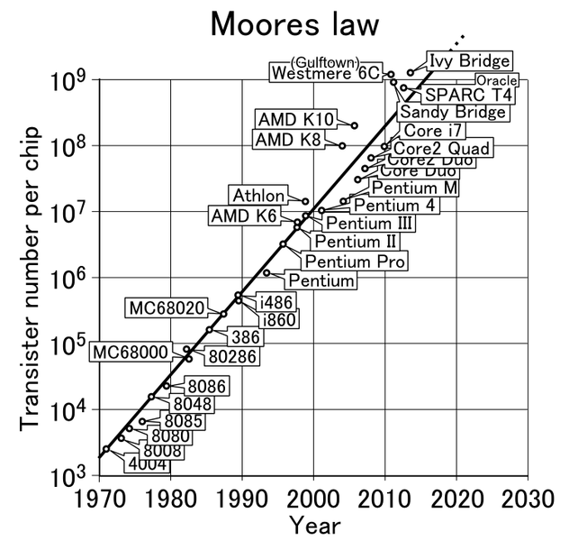
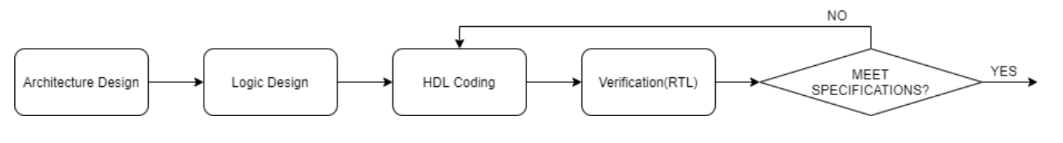
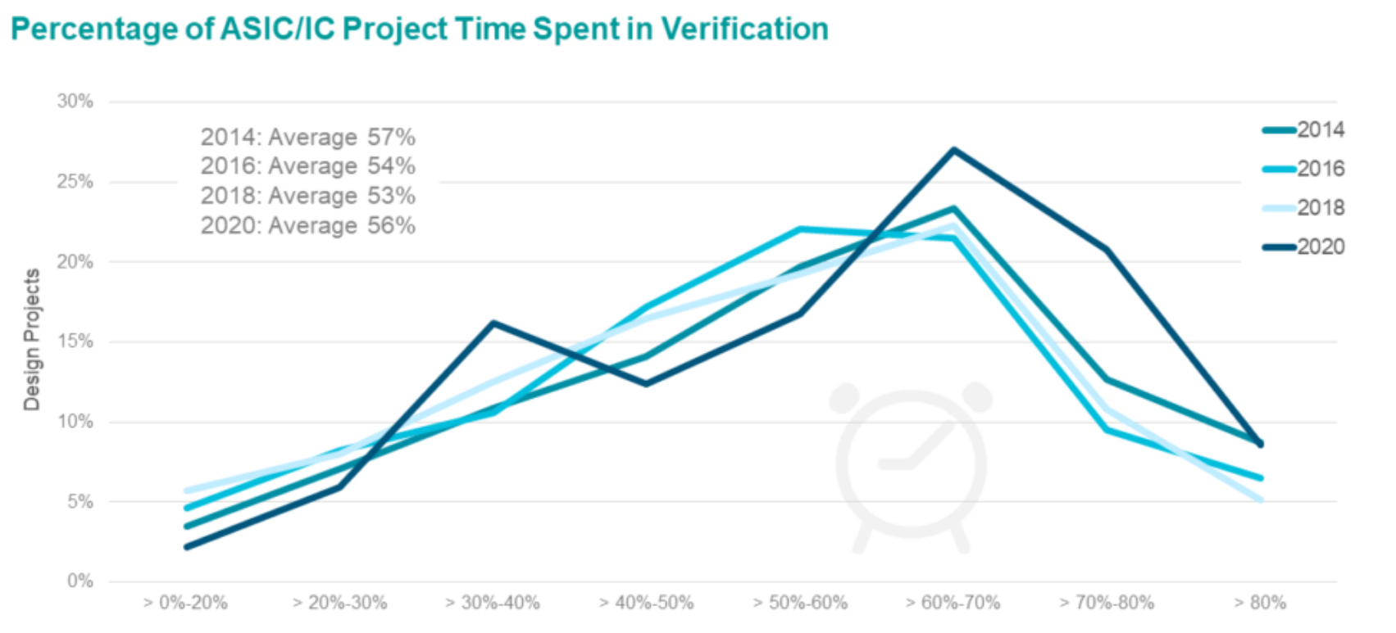
[6] UVM environment for RISC-V processors
By: Leonardo Barraco
VLSI Design Flow
Technical Problem
Problem:
+ Functional verification bottleneck
+ RISC-V processor complexity
+ Time-consuming (≈70% design effort)
+ Risk of undetected hardware bugs
Solution:
+ UVM-based verification environment
+ Automated testbench
+ Randomized test generation
+ Coverage-driven methodology

Slide 18
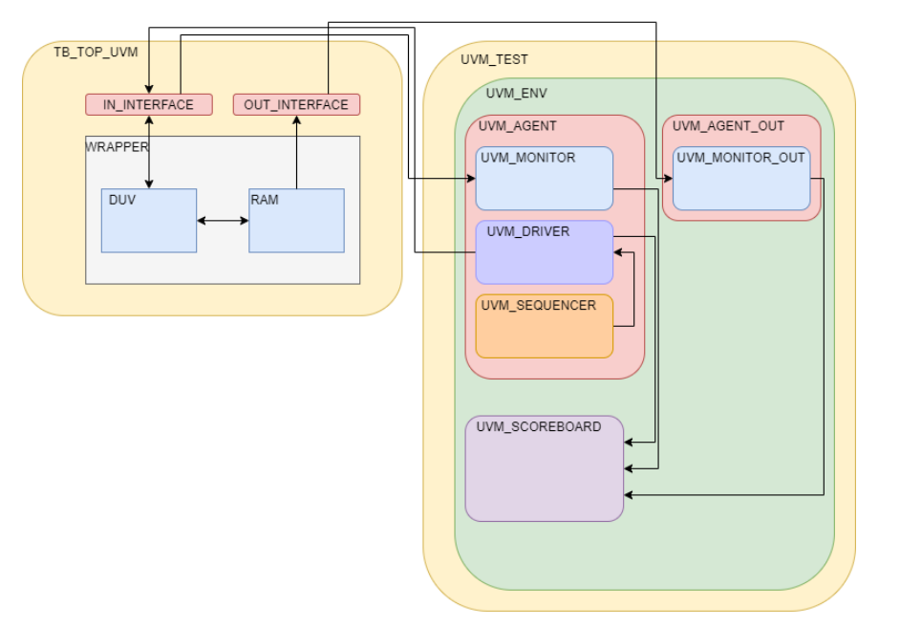
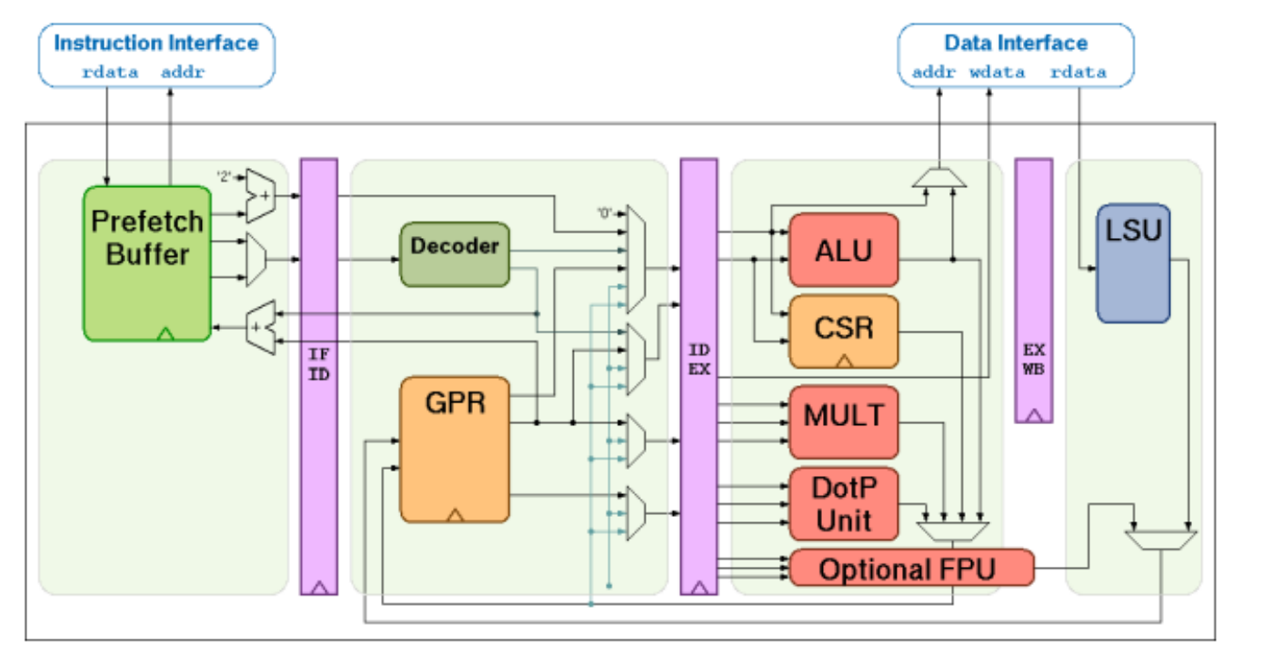
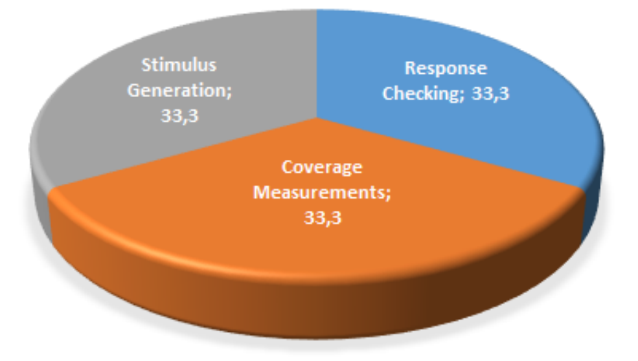
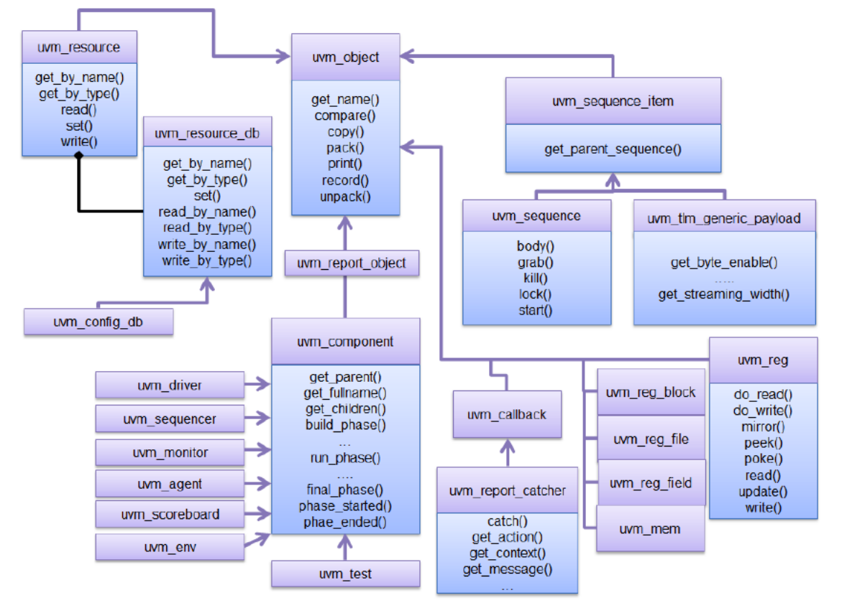
Technical Solution and Implementation Methodology
UVM Framework Structure
Functional Verification Aspects
RISC-V RV32IMFCXpulp core
+ Stimuli: randomized instruction sequences
+ Python script for test generation
+ Valid / invalid ISA operations
+ Functional coverage, code coverage
+ Corner cases: interrupts, asynchronous reset, hardware faults
+ Self-checking testbench
UVM Classes Diagram

Slide 19
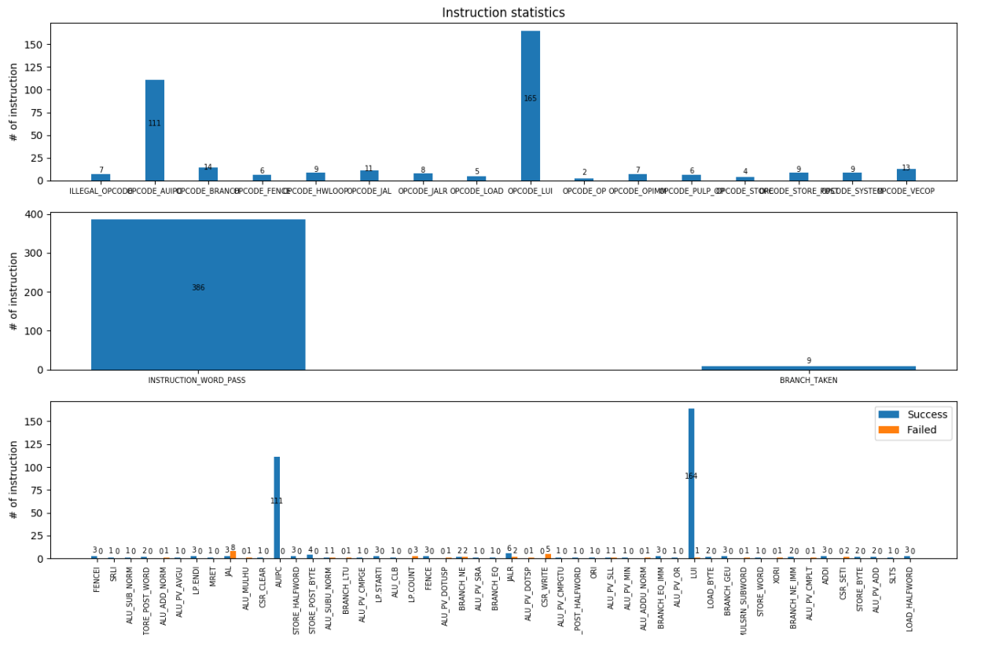
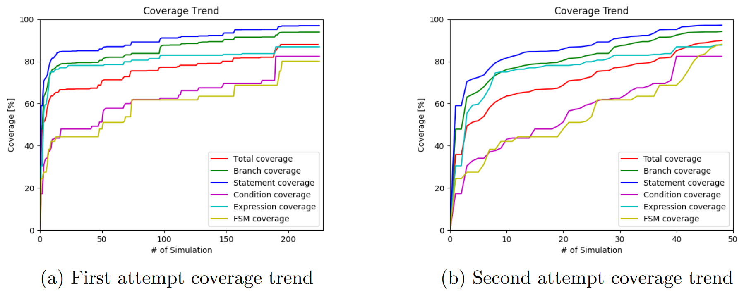
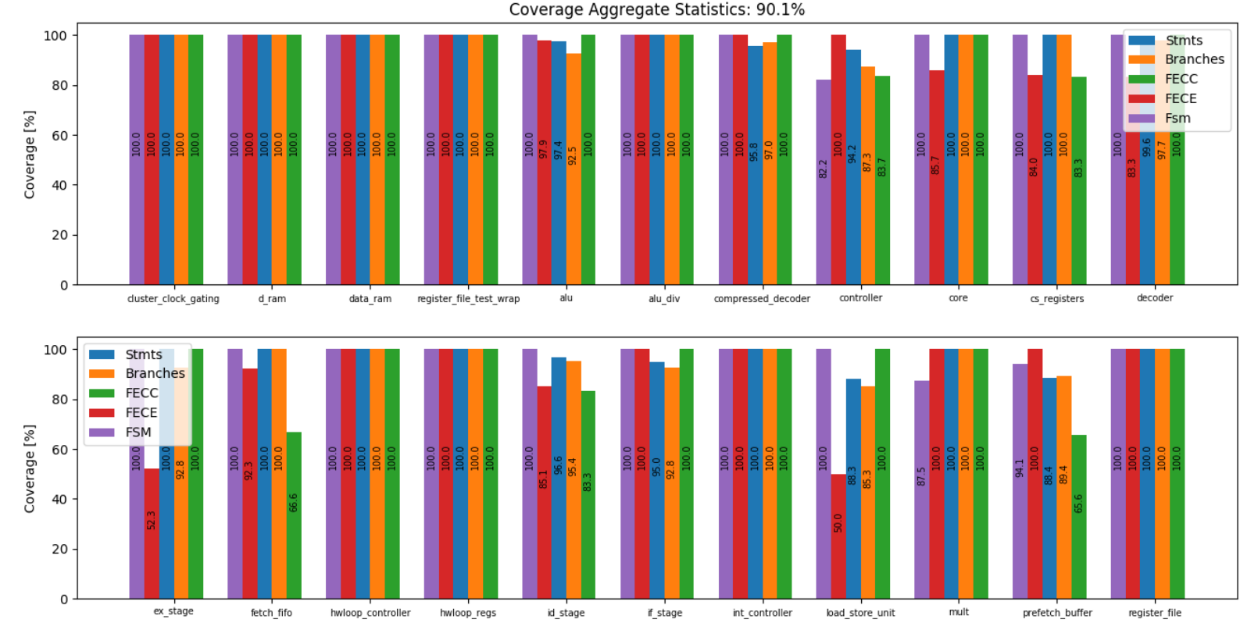
Results and Evaluation
Coverage Trend frame
Plot of simulation summary
+ UVM: flexible, reusable, standardized
+ Randomized stimuli: comprehensive exploration
+ Coverage-driven: measurable verification progress
+ Reliable pre-silicon validation → reduced risk before tape-out
Coverage Report

Slide 20
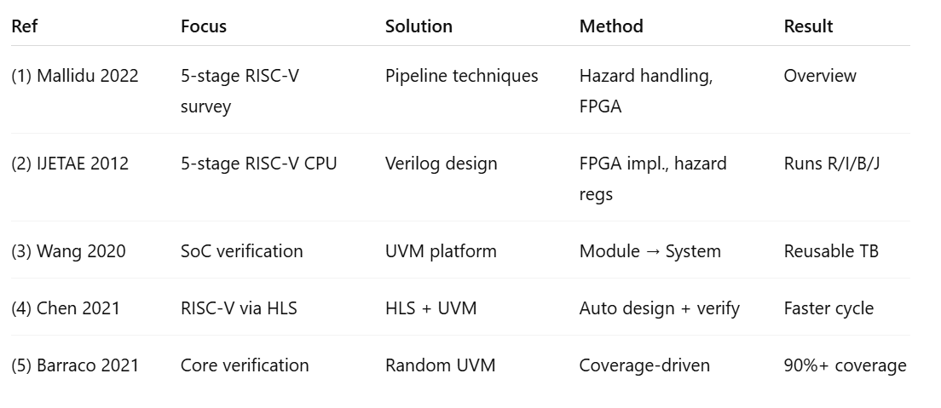
Table Summary of 5 Articles

Slide 21
Relationships & Insights
Common Points
RISC-V ISA → foundation for all works
5-stage pipeline as baseline design
UVM → main verification methodology
Coverage & automation are key metrics
Differences
Survey (1) vs. FPGA implementation (2)
SoC-level (3) vs. Core-level (5)
HLS-based design (4) vs. RTL-based flows
Theory (1) vs. Practical case studies (2–5)
Overall Insights
Survey complements implementations → theory + practice
UVM proves flexible: pipeline CPU, SoC, HLS, fault tolerance
Trend: automation (HLS) + robust UVM verification → scalable, reliable RISC-V SoCs

