Slide 1
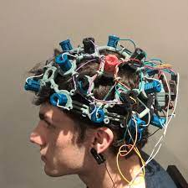

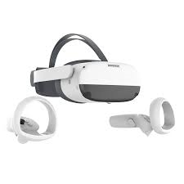


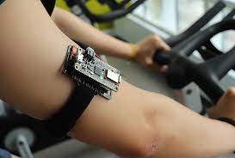

LSLMarker
Websocket:
Gamescore
Evaluation caregiver
Name of player
LSLMarker
WiFi
BLe

