Slide 1
Big data analysis
Project
Secondary Mushroom Dataset
Marco Lorenzo Damiani Ferretti, Luca De Dominicis, Alessandro Pasi

Slide 2
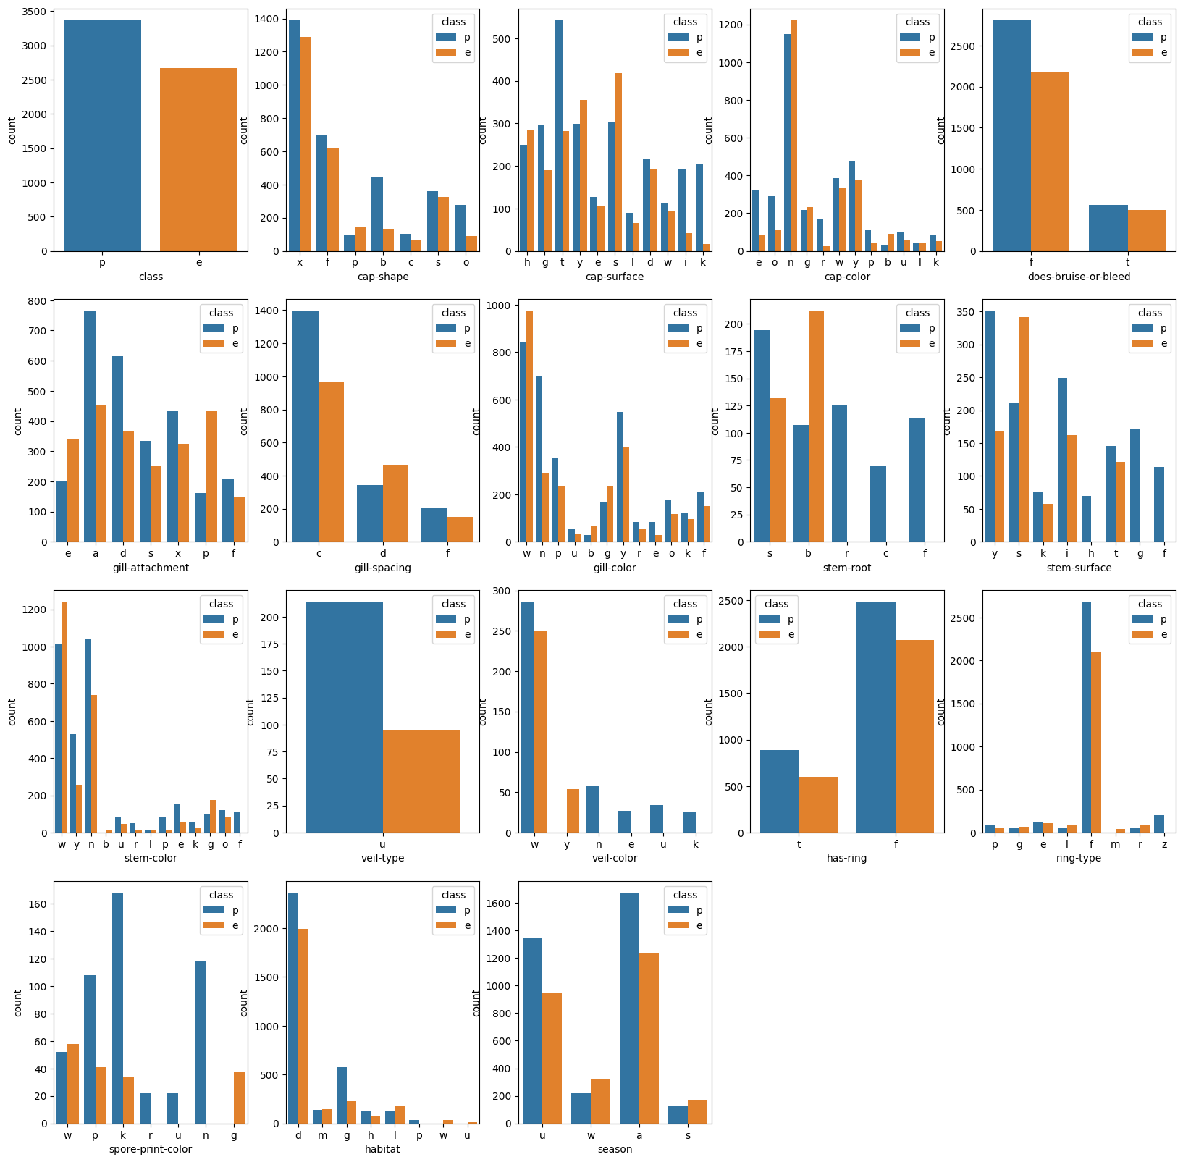
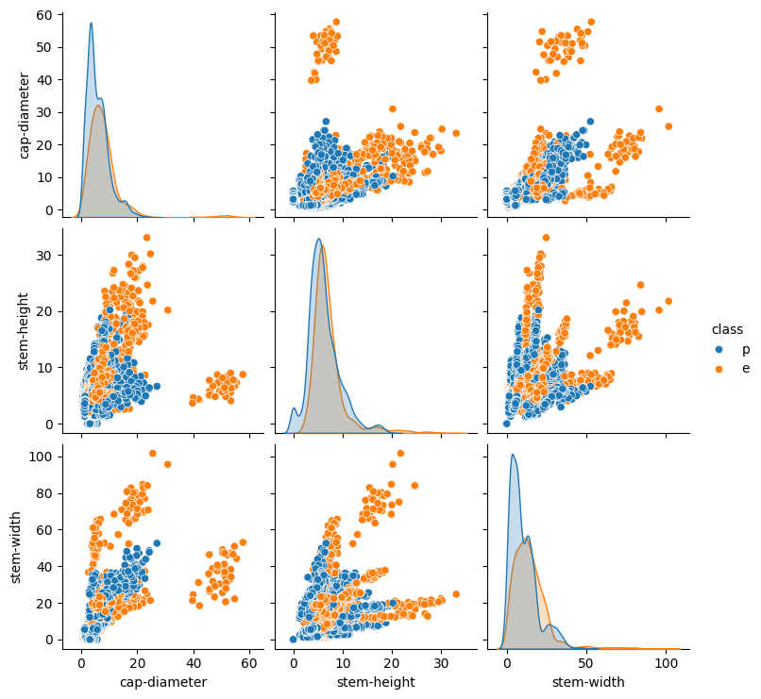
Dataset Secondary Mushroom Dataset
It includes 61069 hypothetical mushrooms.
The caps are based on 173 species.
Each mushroom is identified as definitely edible or poisonous, with almost equal distribution.
It is caracterized by 20 features, divided in numerical and categorical types.
Marco Lorenzo Damiani Ferretti, Luca De Dominicis, Alessandro Pasi

Slide 3
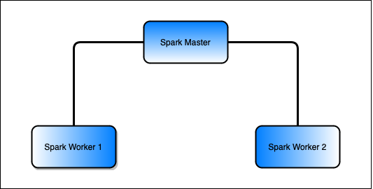


Docker and Spark Setup of the virtual environment
The Spark cluster is built upon docker.
The cluster is created using docker compose.
Each container runs a custom Linux image.
Ths Spark session is created through a Jupyter notebook.
Marco Lorenzo Damiani Ferretti, Luca De Dominicis, Alessandro Pasi

Slide 4
Data pre-processing Enhance the quality of the data
Removal of row duplicates.
Check and removal of NaN values:
Drop of columns with the number of NaN greater than 50% of the total number of rows
Replacement of the remaining NaN with the most frequent value of each column
Use of the R-Formula to transform the dataset, with all the columns considered as features.
Split the transformed dataset into train and test sets.
Marco Lorenzo Damiani Ferretti, Luca De Dominicis, Alessandro Pasi

Slide 5
Metrics and Cross-Validation Evaluation of performances and robustness of the models
Definition of custom function for the evaluation:
Accuracy
F1
F2
AUC ROC
AUC ROC used as the main metric for the evaluation of the performances
Plot of the ROC curves
MLLib Cross Validator used to evaluate the models robustness:
10-fold cross validation is used to produce 10 training and test sets pairs
Parameter Grid used for the optimal tuning
Marco Lorenzo Damiani Ferretti, Luca De Dominicis, Alessandro Pasi

Slide 6
Models Different approaches to find the best
Gaussian Naive Bayes:
Uses the principle of Naive Bayesian probability to make predictions.
Combines prior knowledge with observed evidences. It assumes indipendeces between the features.
Tuned on the smoothing parameter to handle the problem of zero probability.
Best value for it = 1.0
Logistic Regression:
Makes use of logistic functions to predict the probability of a binary outcome.
Tuned on two parameters:
regParam, controls the regularization to prevent overfitting
elasticNetParam, combines L1 and L2 regularizations, balancing between the two.
Best values: regParam = 0, elasticNetParam = 0
Marco Lorenzo Damiani Ferretti, Luca De Dominicis, Alessandro Pasi

Slide 7
Models Different approaches to find the best
PCA – Logistic Regression:
Principal Component Analysis used for dimensionality reduction:
Transforms a set of correlated features in a set of linearly uncorrelated variables called principal components
Components are ordered by the amount of variance they capture from the original dataset, allowing a minimal loss of information
Logistic Regression on the new data to obtain a comparison.
Random Forest:
Is an ensemble ML algorithm that combines multiple decision trees to make more accurate and stable predictions:
Uses bagging and feature randomness when building each individual tree to create an uncorrelated forest of trees whose prediction is more accurate of any individual tree
We used 100 trees with the the best values after tuning for:
Max Depth. Best value = 10
Max Bins. Best value = 40
Marco Lorenzo Damiani Ferretti, Luca De Dominicis, Alessandro Pasi

Slide 8
Models Different approaches to find the best
Decision Tree:
ML algorithm that models decisions and their consequences as a tree-like structure.
Splits data into branches at decision nodes based on feature values.
The leaf nodes represents outcomes or class labels.
Best values: Max Depth = 10, Max Bins = 10
Gradient-Boosted Tree:
GBT is an ensemble ML technique that builds a series of decision trees sequentially:
Each tree tries to correct the errors of its predecessor
Utilizes the Gradient Descent algorithm to minimize the loss function, improving prediction accuracy within each iteration.
Tuned on the same hyper-parameters of the Decision-Tree:
Best values: Max Depth = 10, Max Bins = 20
Marco Lorenzo Damiani Ferretti, Luca De Dominicis, Alessandro Pasi

Slide 9
Models Different approaches to find the best
One-vs-Rest – Gaussian Naive Bayes:
OvR, is a strategy for multi-class classification:
It involves training a single classifier per class
The samples of that class as positive samples and all other ones as negatives
This approach decomposes a multi-class classification problem into multiple binary classification problems, one for each class.
This method is used as a control of effectiveness of the other classifier.
Tested with Gaussian Naive Bayes to have results to compare:
Best value: Smoothing = 1.0
Marco Lorenzo Damiani Ferretti, Luca De Dominicis, Alessandro Pasi

Slide 10
Results Evaluation of the models
Classifier | Accuracy | F1 | F2 | AUC ROC
Gaussian Naive Bayes | 0.625114 | 0.693344 | 0.829687 | 0.691134
Logistic Regression | 0.77535 | 0.752913 | 0.763761 | 0.849208
PCA-Logistic Regression | 0.557984 | 0.122288 | 0.0838972 | 0.63108
Random Forest | 0.968132 | 0.96384 | 0.959675 | 0.997044
Decision Tree | 0.90423 | 0.899939 | 0.940902 | 0.878202
Gradient-Boosted Tree | 0.998179 | 0.997949 | 0.997949 | 0.999964
OvR - GNB | 0.625114 | 0.693344 | 0.829687 | 0.691129
The models based on trees performed well above the others:
They are particularly effective in modeling non-linear relationships between features and labels
They tend to be less sensitive to outliers compared to other methods
Marco Lorenzo Damiani Ferretti, Luca De Dominicis, Alessandro Pasi

Slide 11
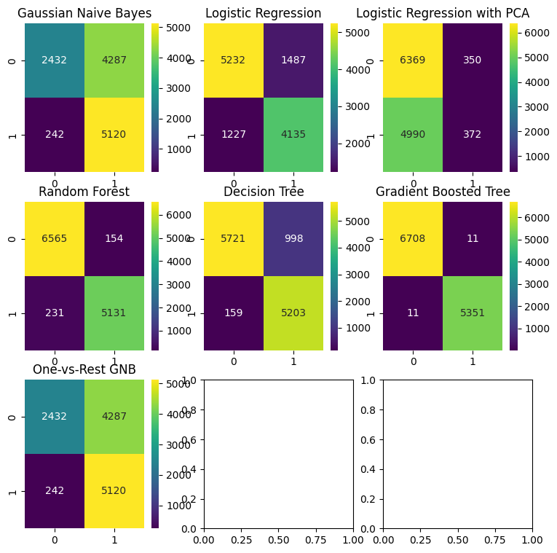
Results Evaluation of the models
Gaussian Naive Bayes:
Good at predicting the positive class, but with many false positives.
Logistic Regression:
Strong at predicting both classes, but with many false positives and negatives.
Logistic Regression-PCA:
Good at predicting the negative class but with a lot of false negatives.
Random Forest:
Strong on both classes.
Decision Tree:
Good at predicting both classes with many false positives.
Gradient-Boosted Tree:
The best, with almost perfect accuracy.
Marco Lorenzo Damiani Ferretti, Luca De Dominicis, Alessandro Pasi

Slide 12
Project Work
Secondary Mushroom Dataset
Extension
Marco Lorenzo Damiani Ferretti, Luca De Dominicis, Alessandro Pasi

Slide 13
Models Different approaches to find the best
Multi Layer Perceptron:
Feed-Forward artificial neural network which maps sets of input data onto a set of appropriate outputs.
It consists of multiple layers of nodes in a directed graph, with each layer fully connected to the next one.
Tuned on the block size hyper parameter:
By dividing the dataset into blocks, the algorithm can leverage Spark’s distributed computing capabilities more effectively
Best value: 256.
Linear Support Vector Machine:
SVM works by finding the hyperplane that best separates two classes in the feature space with maximum margin:
It ensures the greatest distance between the hyperplane and the nearest data points of each class
Tuned on the Max Iterations parameter:
Best values: 100
Marco Lorenzo Damiani Ferretti, Luca De Dominicis, Alessandro Pasi

Slide 14
Models Different approaches to find the best
Factorization Machine:
Supervised learning algorithm that efficiently captures interactions between features in high-dimensional datasets:
Generalize matrix factorization and linear regression
Models not only linear relationships but also interactions between pairs of features using factorized parameters
Tuned on the best number of Max Iterations.
Best value = 100.
Marco Lorenzo Damiani Ferretti, Luca De Dominicis, Alessandro Pasi

Slide 15
Results Evaluation of the models
Classifier | Accuracy | F1 | F2 | AUC ROC
Multi-Layer Perceptron | 0.785614 | 0.793527 | 0.869193 | 0.829603
Linear SVM | 0.781641 | 0.762428 | 0.778411 | 0.838111
Factorization Machines | 0.961841 | 0.956872 | 0.954995 | 0.993065
Factorization Machines are the best performing model:
They are designed to model interactions between any two features efficiently
Especially useful in binary classification where the relationship between features is not just linear
Their versatility allows to capture both simple and complex patterns in the data
Marco Lorenzo Damiani Ferretti, Luca De Dominicis, Alessandro Pasi

Slide 16
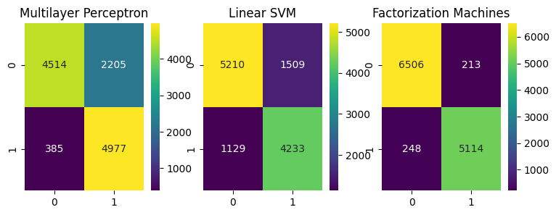
Results Evaluation of the models
Multilayer Perceptron:
Decent prediction of both classes, but a lot of false positives.
Linear SVM:
Good at predicting both classes with some false positives and negatives.
Factorization Machines:
Strong on both classes with few false positives and negatives.
Marco Lorenzo Damiani Ferretti, Luca De Dominicis, Alessandro Pasi

Slide 17
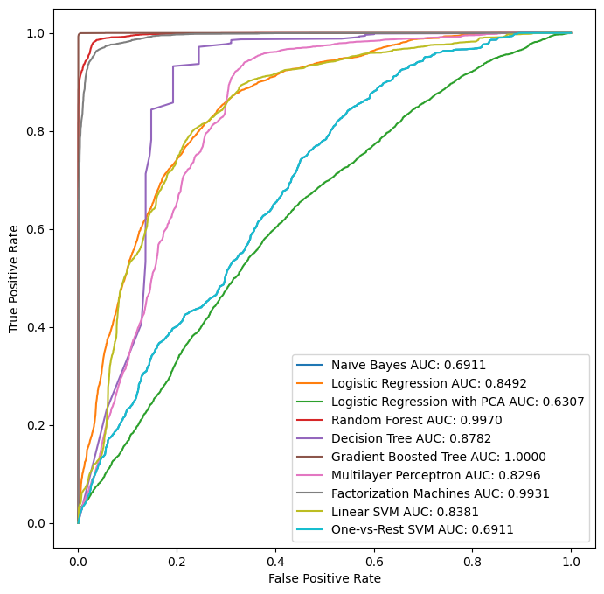
ROC CURVES Plot of all the ROC curves
The plot is coherent with the results obtained:
Tree-based models performs very well
Gradient Boosted Tree has a basically perfect result
The OvR confirms the performance of the Gaussian Naive Bayes.
Using PCA does not result in any advantage.
Marco Lorenzo Damiani Ferretti, Luca De Dominicis, Alessandro Pasi

Slide 18
The END
Thanks for the attention!
Marco Lorenzo Damiani Ferretti, Luca De Dominicis, Alessandro Pasi

