Slide 1

SOFTWARE ENGINEERING 2 PROJECT PRESENTATION
LUCA GRELLA 905655
DANIELE LUNGHI 905083

Slide 2
GOALS
trackme - luca Grella & daniele lunghi - 2019 ©
Application Specific goals
Data4Help:
G4. Allow Third Part User to access the data of Normal User, upon acceptance
G5. Allow TPU to access anonymous data of a group of at least one thousand people
AutomatedSOS:
G6. Notify ill if health values are below threshold for more than 5 seconds
Common goals
G1. Normal User’s account correct handling
G2. Third Part User’s account correct handling
G3. Users data registration

Slide 3
world SHARED machine
trackme - luca Grella & daniele lunghi - 2019 ©
The world and the machine: an example
User wants to access data of a group of people
User requests anonymized data of a group of individuals
Data are shown to the user
Query execution

Slide 4
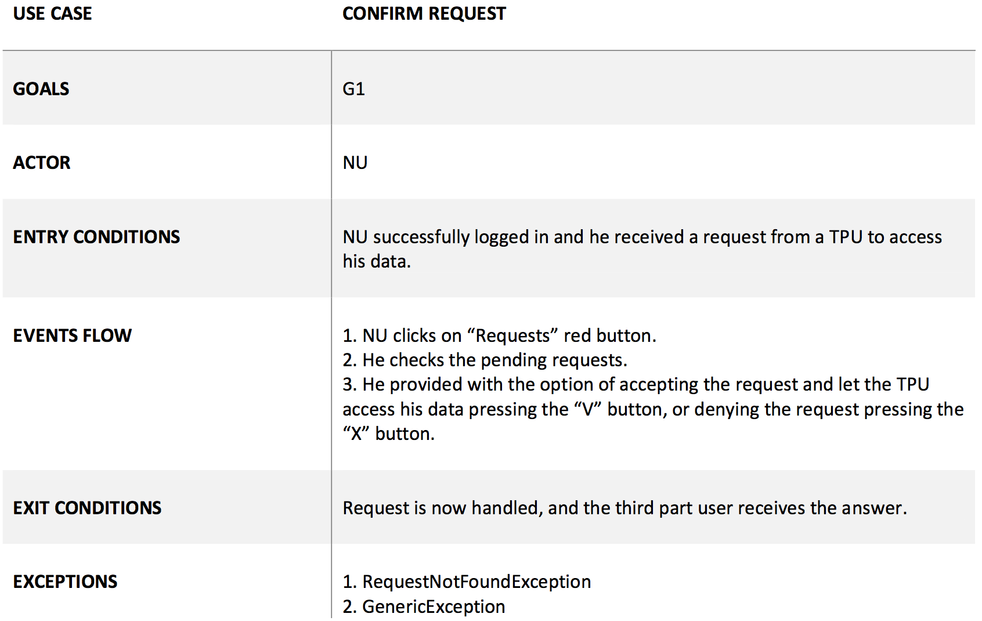
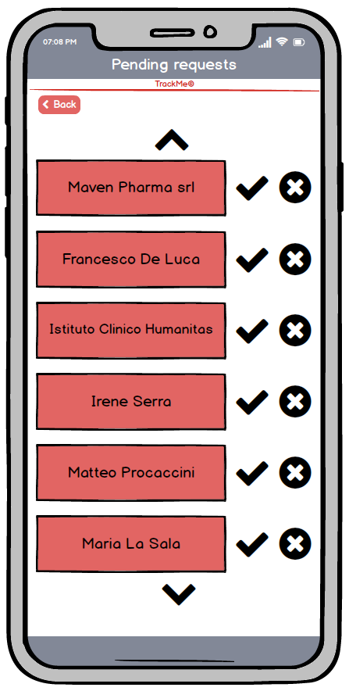
a meaningful use case
trackme - luca Grella & daniele lunghi - 2019 ©

Slide 5
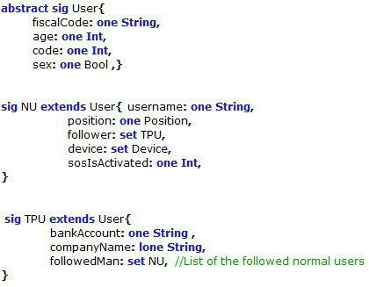

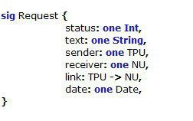
Alloy world
trackme - luca Grella & daniele lunghi - 2019 ©
Signatures
We model the main classes which are part of our system. In particular we create two types of user who are connect by means of request.
We gave a particular focus on the relationship among a normal user and his devices.

Slide 6


Alloy world
trackme - luca Grella & daniele lunghi - 2019 ©
Facts
To be a follower, a third part user must belong to the followers list of the individual user.
The device ownership relationship is symmetric.

Slide 7
dd through sos
trackme - luca Grella & daniele lunghi - 2019 ©
logic and introduction
System is complex, AutomatedSOS is simple
The main elements of the system are involved in the process: highly representative!
But how does it work?

Slide 8
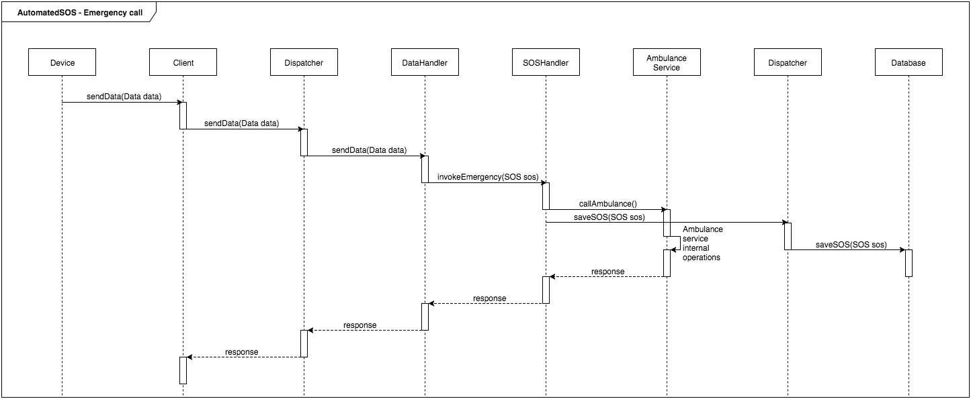
dd through sos
trackme - luca Grella & daniele lunghi - 2019 ©
runtime view

Slide 9
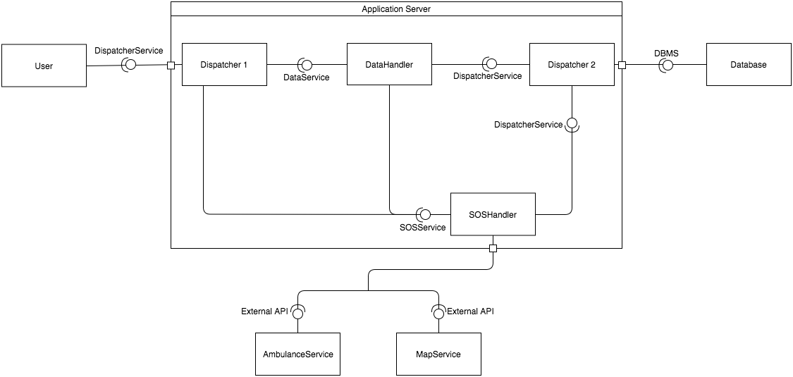
dd through sos
trackme - luca Grella & daniele lunghi - 2019 ©
components and deployment 1

Slide 10
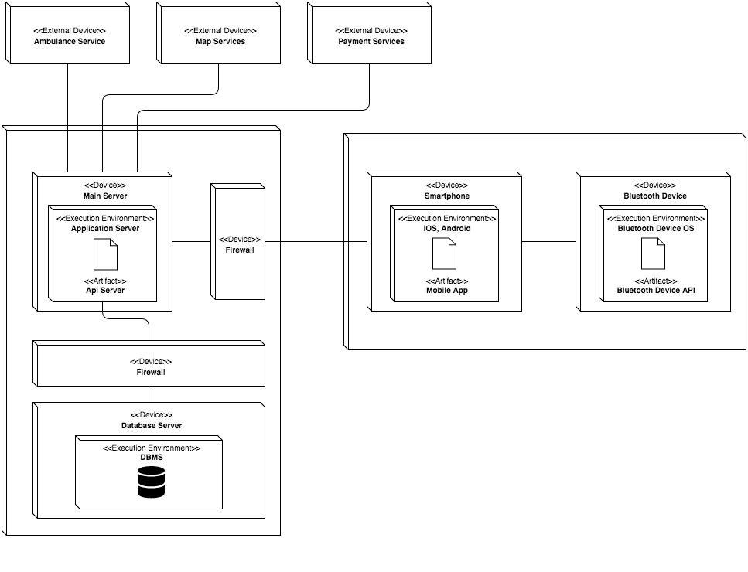
dd through sos
trackme - luca Grella & daniele lunghi - 2019 ©
components and deployment 2

Slide 11
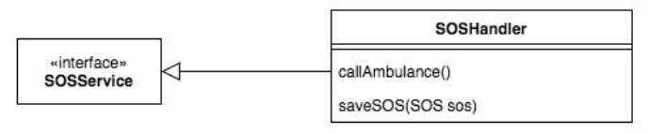
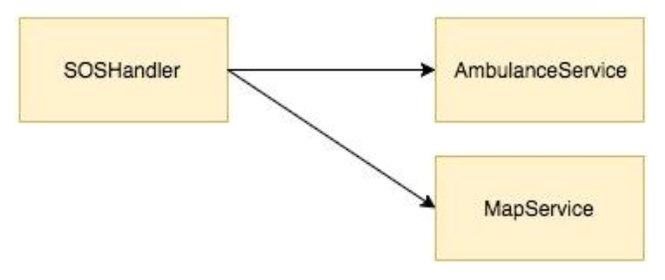
dd through sos
trackme - luca Grella & daniele lunghi - 2019 ©
interfaces and integration
Interfaces
All the components implement one interface
Integration
SOSHandler interacts with some external components, by means of the necessary APIs
Integration must be tested in parallel with the implementation of the single components

Slide 12
design decisions and Patterns
trackme - luca Grella & daniele lunghi - 2019 ©
COTS solution for the Data Base
MVC
Client-Server
Observer
Façade

Slide 13
trackme - luca Grella & daniele lunghi - 2019 ©
thanks for your attention!
Luca Grella and Daniele Lunghi

