Slide 1

Team Project 1 : RDF
Master’s in Computer Engineering
Database 2
Marco alecci , Luca martinelli, elia ziroldo
Academic year 2021/2022

Slide 2
Data
Country
Date
Position
Track
Track URI
Artist
Spotify's Daily Top 200 charts
35 countries + global chart
Over 3 years (2017-2020)
1.53 GB of data
features in the dataset

Slide 3
Dataset Reduction
We reduced the initial dataset combining two different strategies:
selecting only the first x positions of the charts
sampling charts every k days
1.53 GB
109 MB
x = 100 positions, k = 7 days

Slide 4
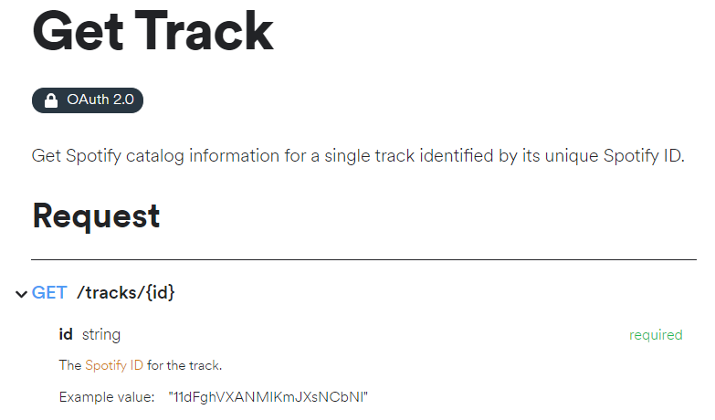
Spotify Web API
To enrich the dataset with more interesting information we decided to use the Spotify Web API
Using the API, we added :
Albums
Genres
Available Markets
More data about Tracks
More data about Artists
An example about how to retrieve data about a specific track

Slide 5
WikiData and MusicBrainz APIs
To add personal information about the artists, we decided to rely on WikiData and MusicBrainz:
1
2
3
4
5
6
We search for the artist on MusicBrainz
We take the first result and check if a WikiData link is present
Using the WikiData link, we retrieve the artist personal data (different approach if single artist or a group)
If the link is not present, we perform a query on WikiData and we perform the same actions of point 3
If the link is not present and the query was unsuccessful or incomplete, we search for data on MusicBrainz
Finally, we remove duplicates, and we obtain a dataset with: Name, Surname, BirthDate, DeathDate, Nationality, ArtistName

Slide 6
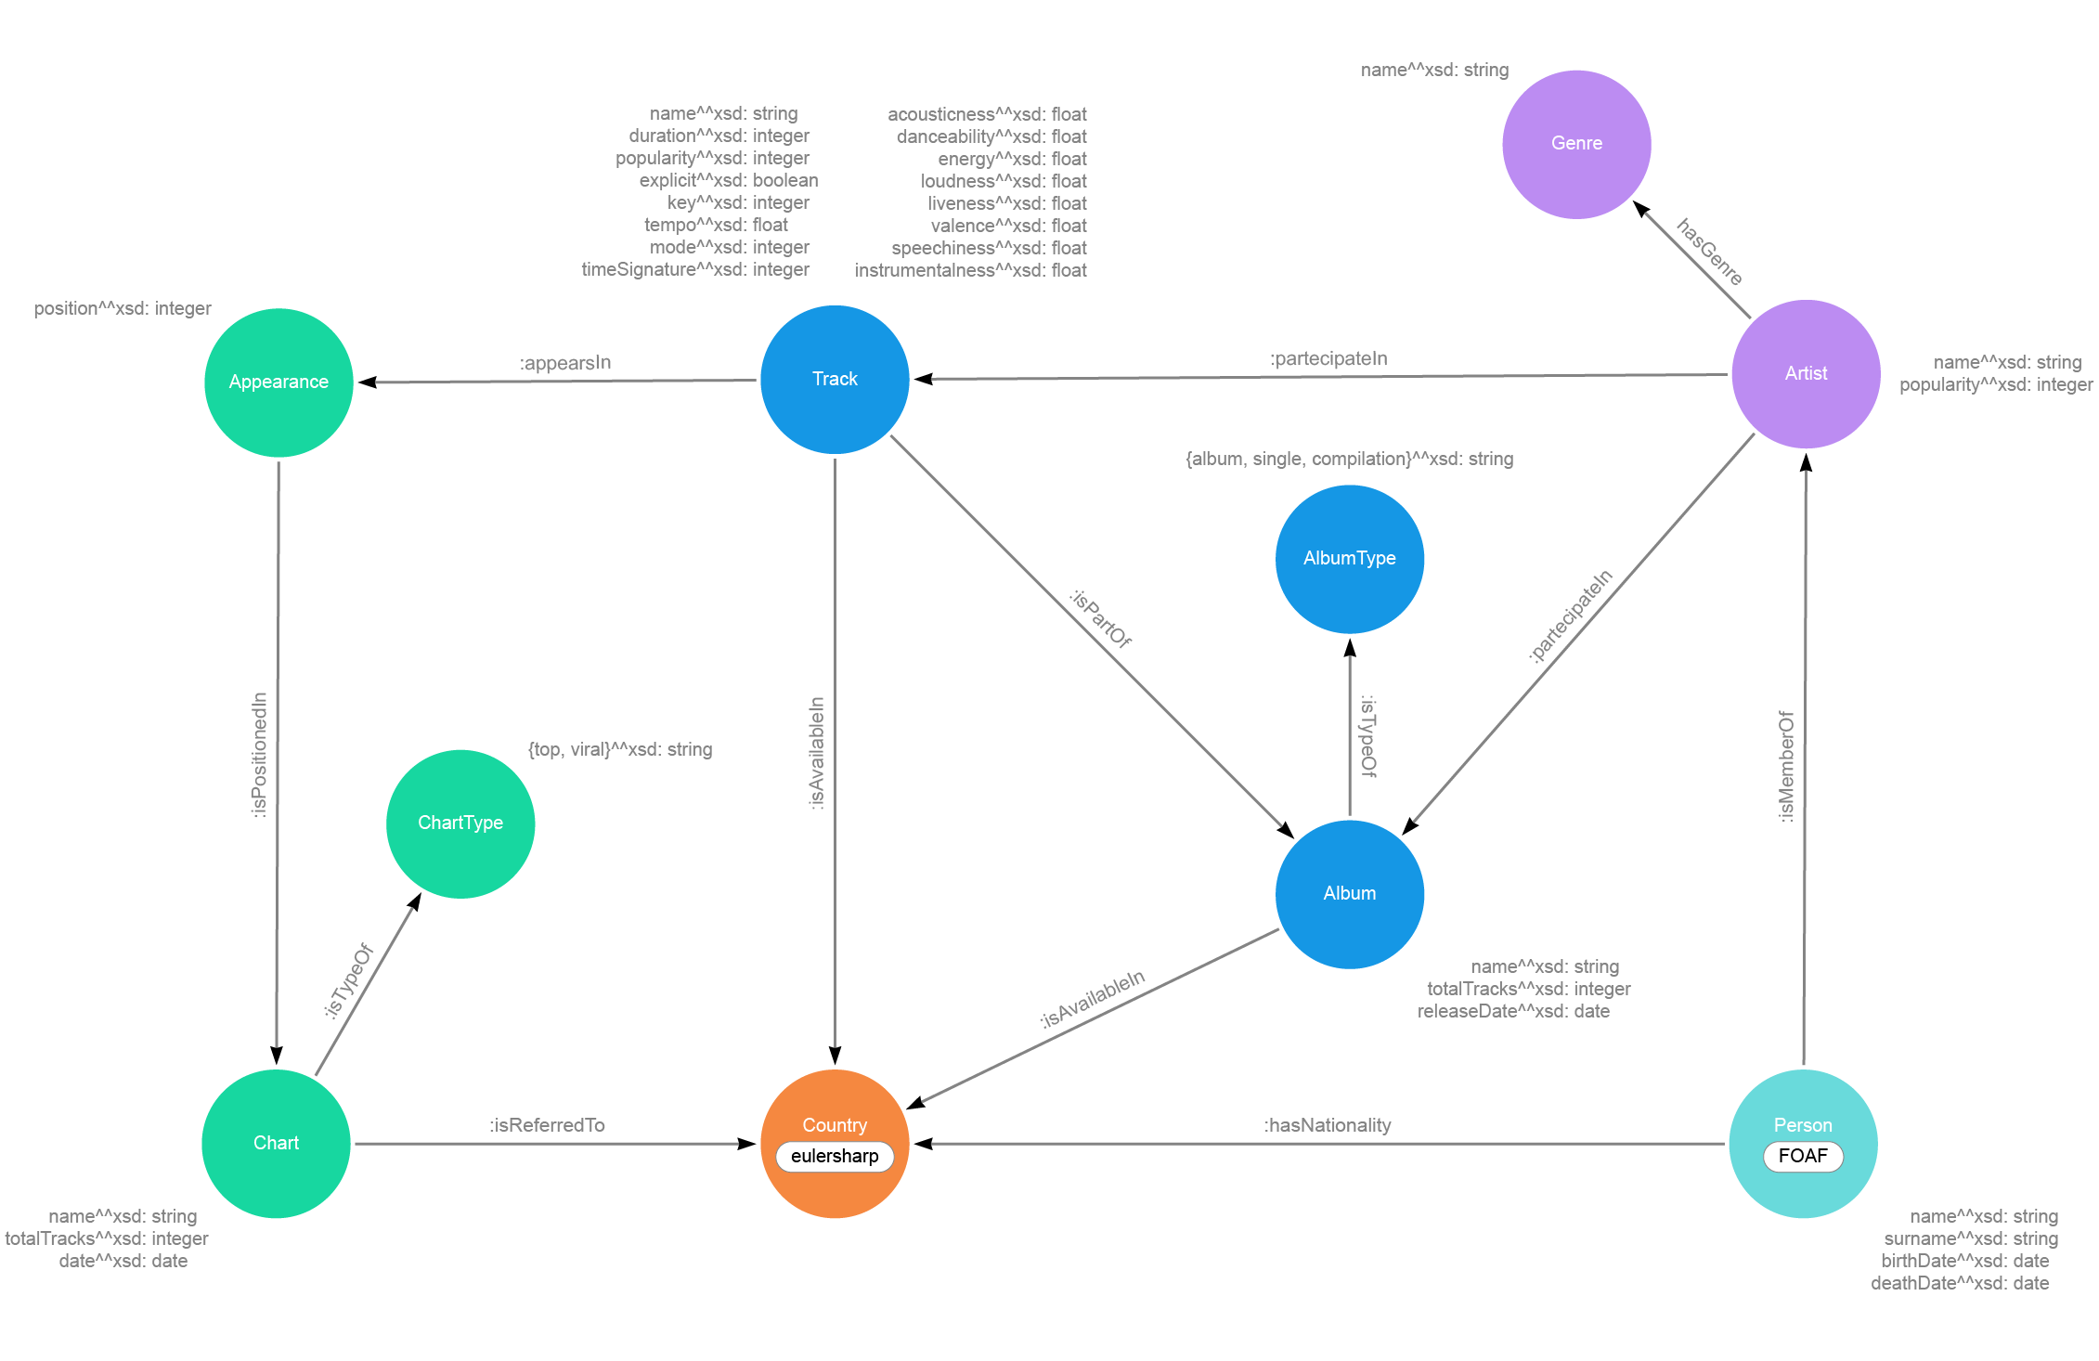
Model

Slide 7
Serialization
Load the CSV file and iterate through it
Retrieve the unique ID used by Spotify or create a unique ID by ourself
Add the node to the graph using the unique ID
Add all the data properties
Add all the object properties
Serialize the data and save them into a TTL file
Output: turtle format (TTL)
Relying on RDFLib library
Easy linking thanks to Spotify unique ID

Slide 8
Queries

Slide 9
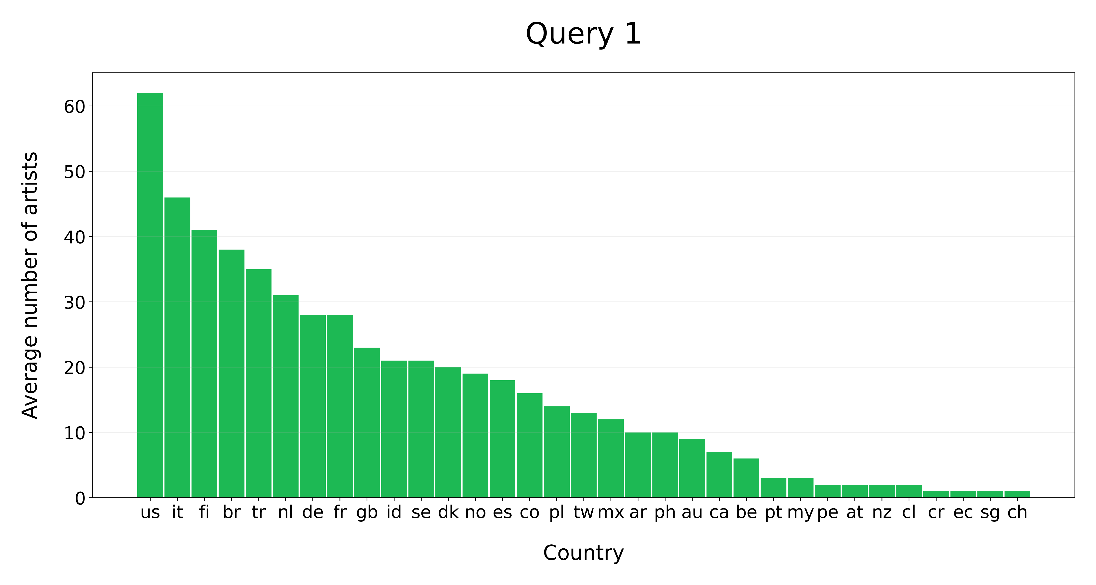
Query 1
On average how many artist of a specific nationality are in the top 100 of the same country?

Slide 10
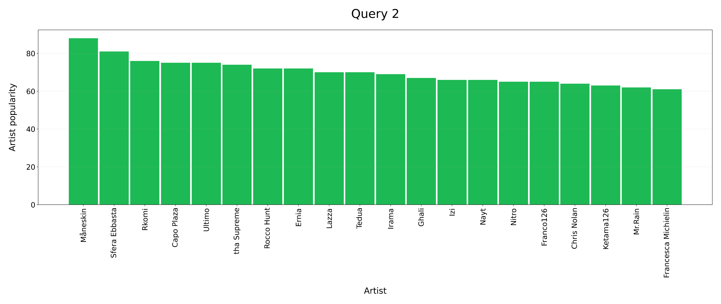
Query 2
Show the 20 most popular under-30 Italian artist who published at least a track in 2018

Slide 11
Query 3
Show the 20 most popular under-30 Italian artist who published at least a track in 2018

