Slide 1



Team Project 1 : RDF
Master’s in Computer Engineering
Database 2
Marco alecci , Luca martinelli, elia ziroldo
Academic year 2021/2022

Slide 2
Data
Country
Date
Position
Track
Track URI
Artist
Available on Kaggle
Spotify's Daily Top 200 charts
35 countries + global chart
Over 3 years (2017-2020)
1.53 GB of data
features in the dataset

Slide 3
Dataset Reduction
We reduced the initial dataset combining two different strategies:
selecting only the first x positions of the charts
sampling charts every k days
1.53 GB
109 MB
x = 100 positions, k = 7 days

Slide 4
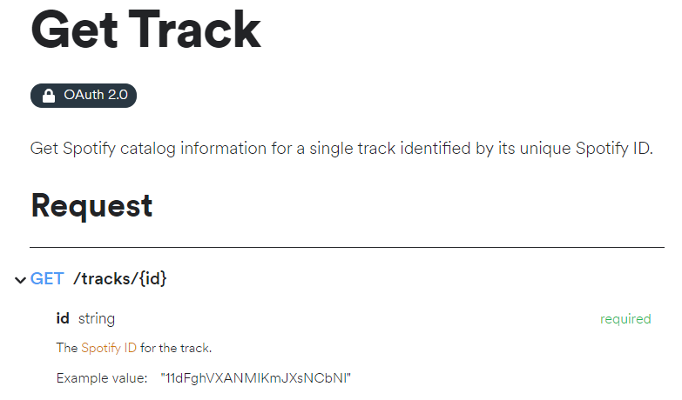
Spotify Web API
To enrich the dataset with more interesting information we decided to use the Spotify Web API
Using the API, we added :
Albums
Genres
Available Markets
More data about Tracks
More data about Artists
An example about how to retrieve data about a specific track

Slide 5
WikiData and MusicBrainz APIs
To add personal information about the artists, we decided to rely on WikiData and MusicBrainz:
1
2
3
4
5
6
We search for the artist on MusicBrainz
We take the first result and check if a WikiData link is present
Using the WikiData link, we retrieve the artist personal data (different approach if single artist or a group)
If the link is not present, we perform a query on WikiData and we perform the same actions of point 3
If the link is not present and the query was unsuccessful or incomplete, we search for data on MusicBrainz
Finally, we remove duplicates, and we obtain a dataset with: Name, Surname, BirthDate, DeathDate, Nationality, ArtistName

Slide 6
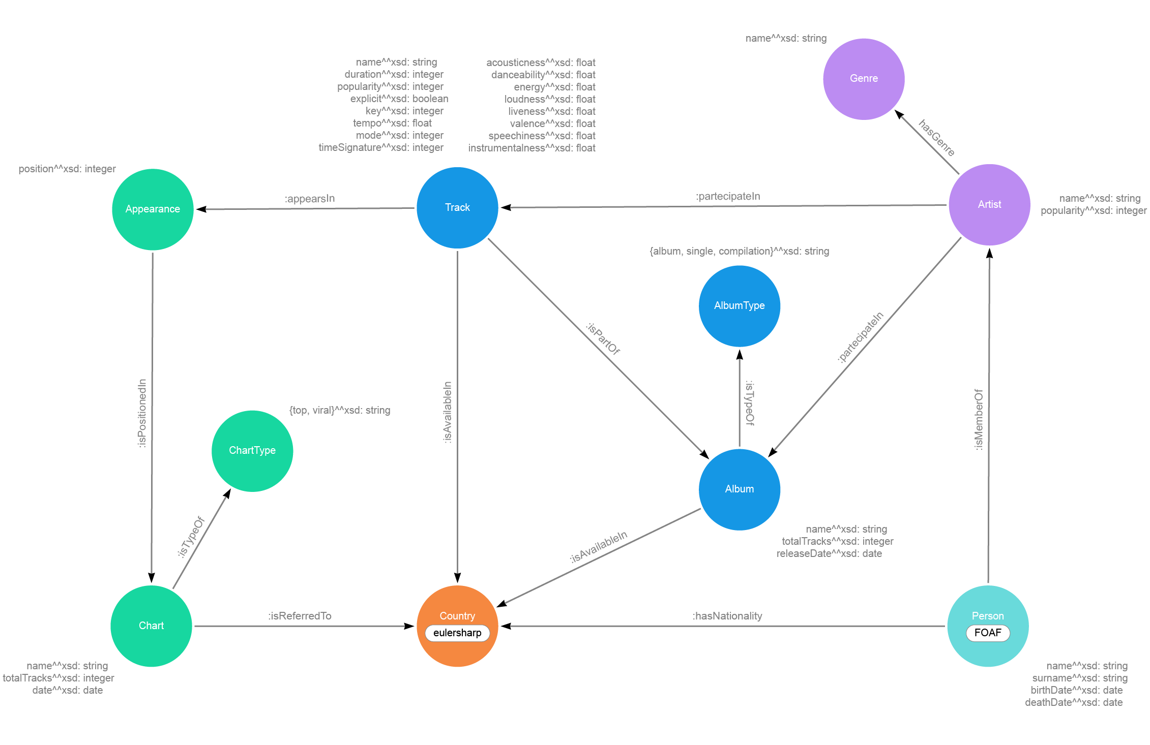
Model

Slide 7
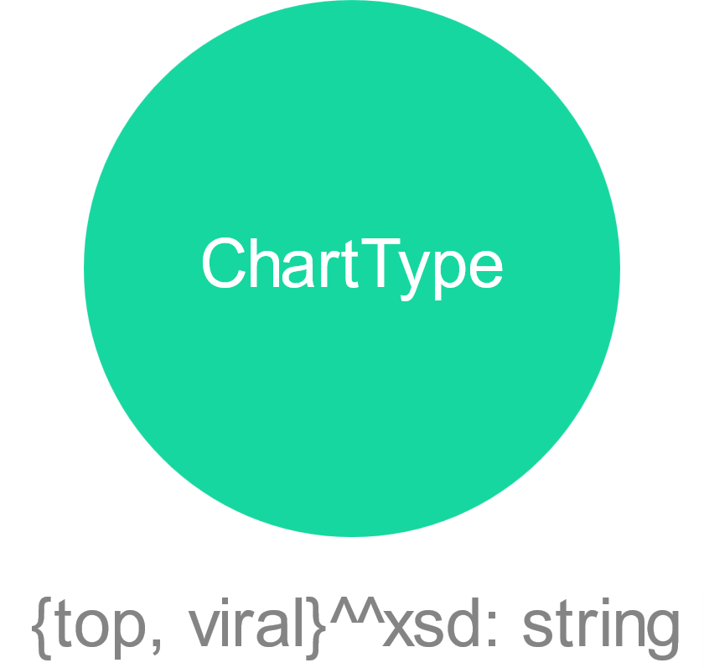
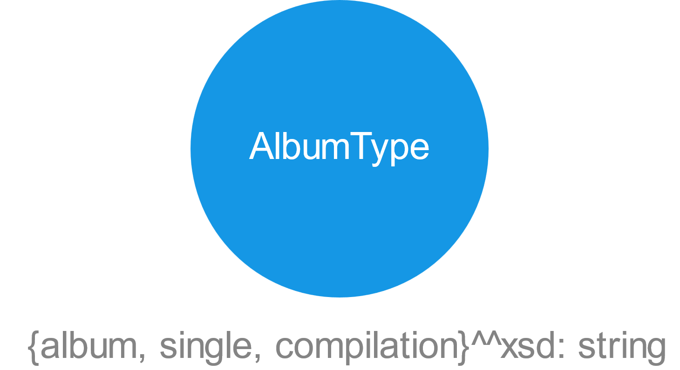
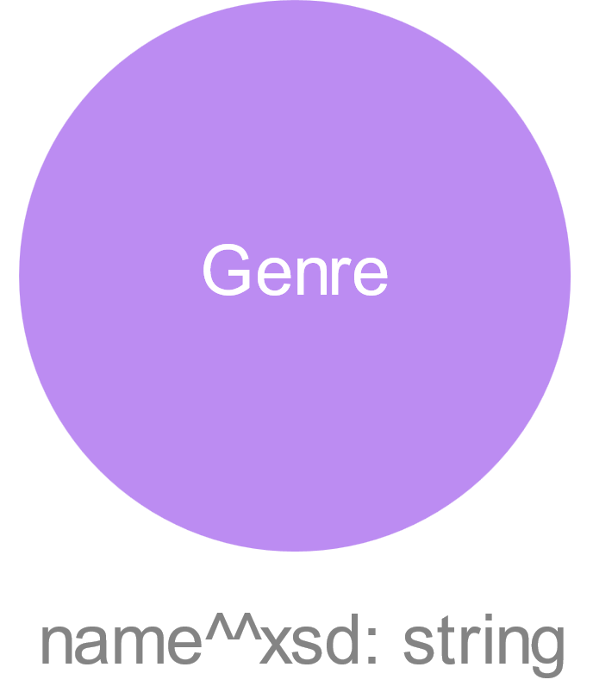
Model : Focus 1
NOT AN ENUMERATION
ENUMERATION
ENUMERATION

Slide 8
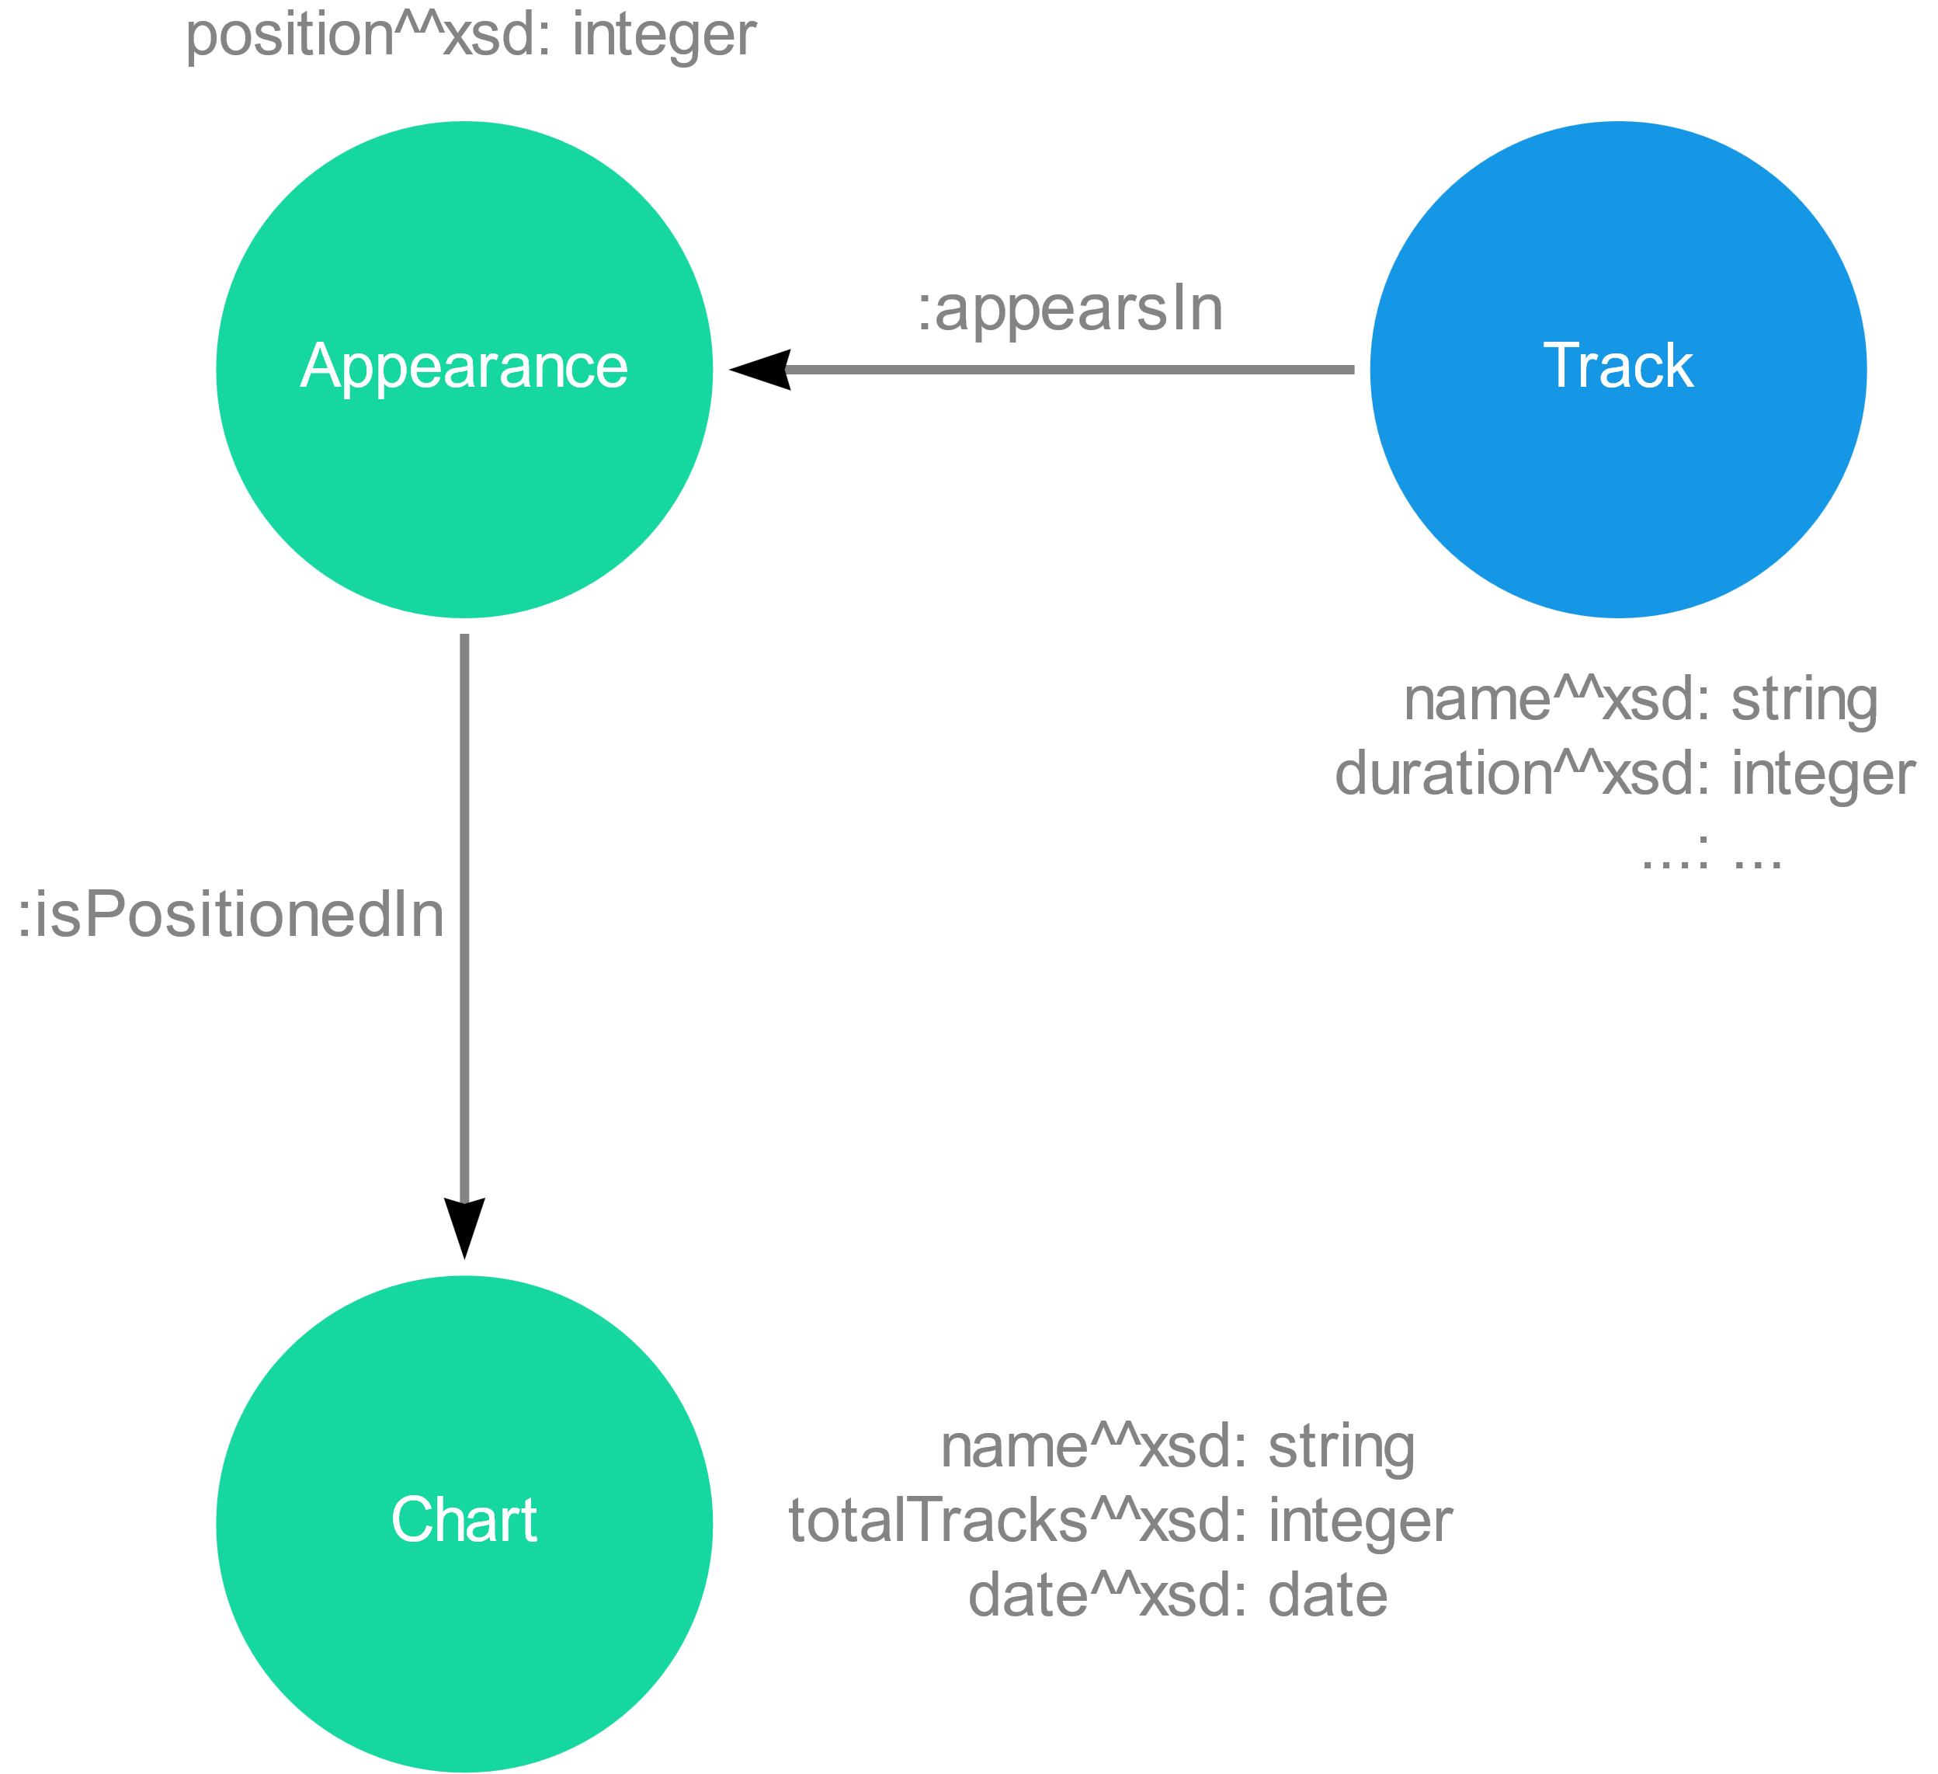
Model : Focus 2
dummy node to represent the positioning of a track in a specific Chart
Contains all the information related to a specific chart

Slide 9
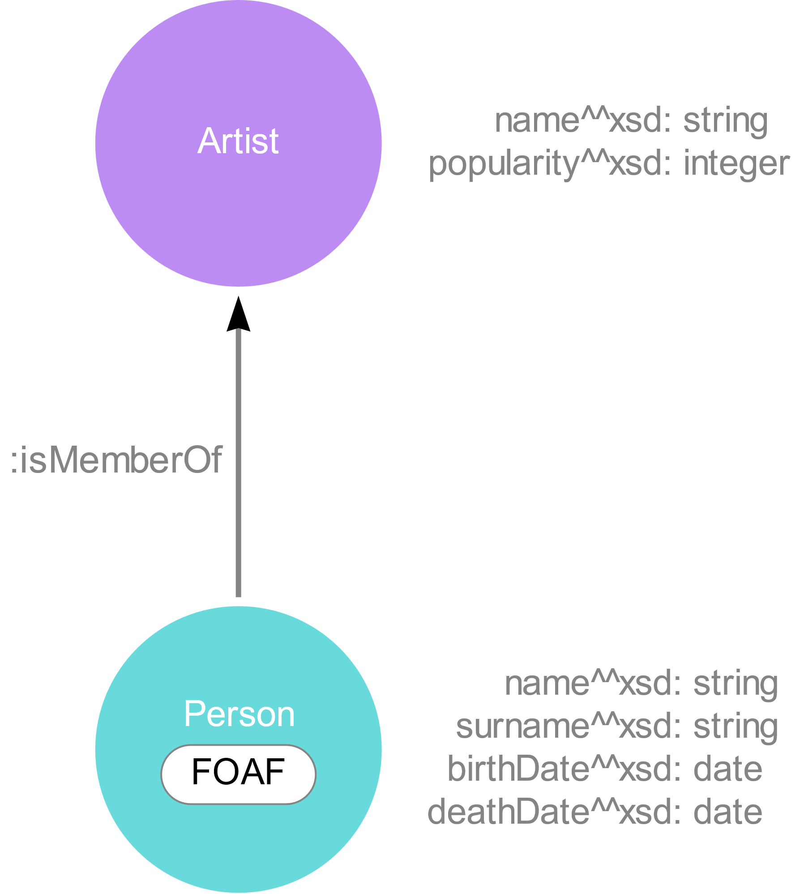
Model : Focus 3
The Artist node is used to represent both:
Group
Single artist
Example:
Sting and The Police are both represented as artists
Gordon Sumner (Sting’s real name) is both linked to Sting and The Police

Slide 10
Serialization
Load the CSV file and iterate through it
Retrieve the unique ID used by Spotify or create a unique ID by ourself
Add the node to the graph using the unique ID
Add all the data properties
Add all the object properties
Serialize the data and save them into a TTL file
Output: turtle format (TTL)
Relying on RDFLib library
Easy linking thanks to Spotify unique ID

Slide 11
Queries

Slide 12
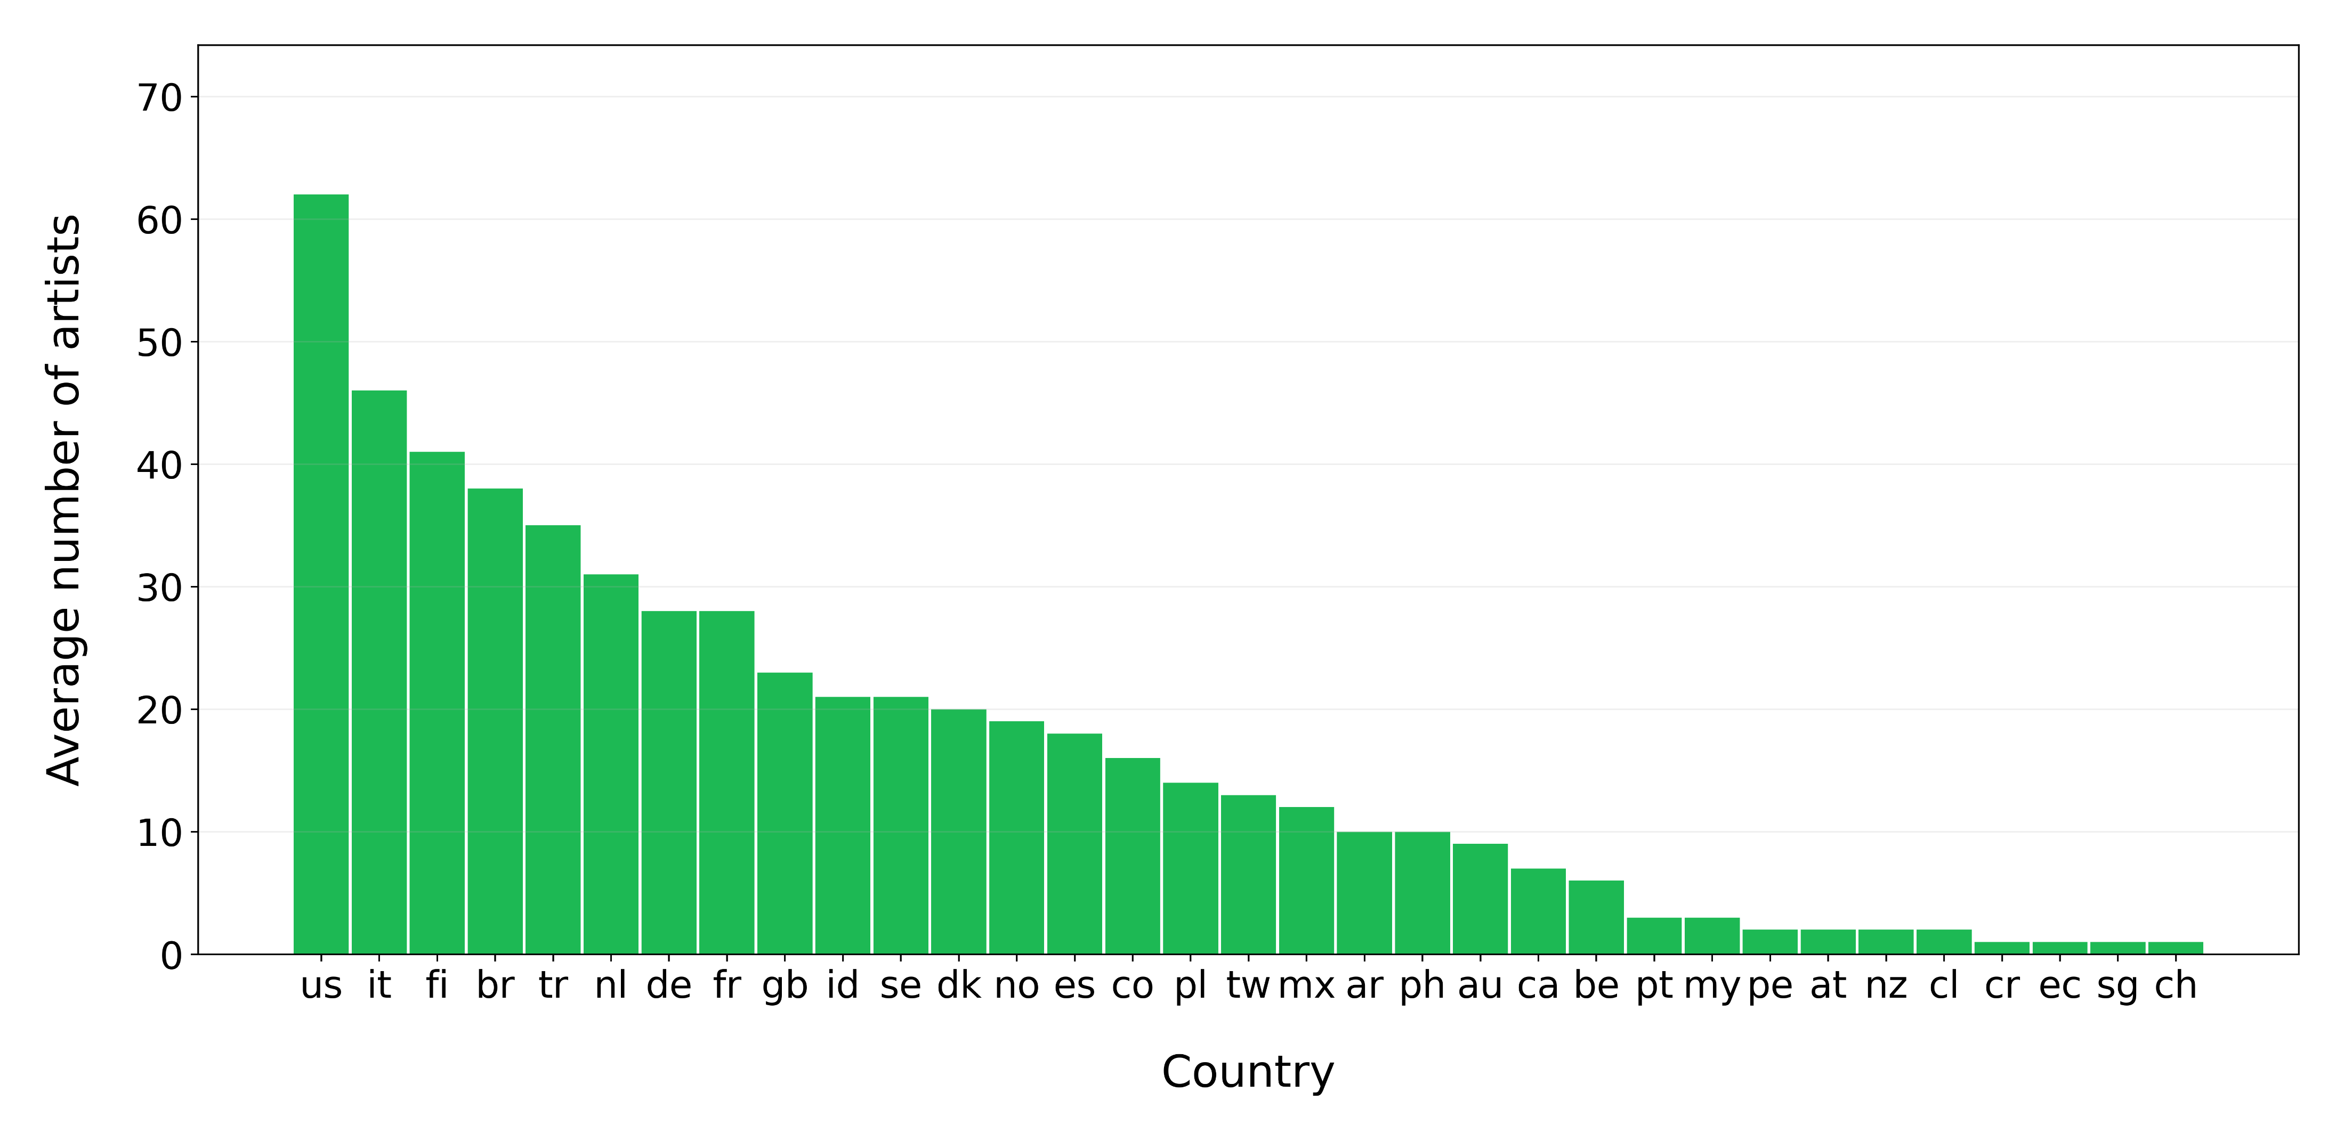
Query 1
On average how many artist of a specific nationality are in the top 100 of the same country?

Slide 13
Query 2
How many times tracks made by an artist born after 2000 were present in top 100 Italy in 2020?
Track Name | Artist Name | Artist Real Name | BirthDate | numAppereances
blun7 a swishland | tha Supreme | Davide Mattei | 2001-03-17 | 44
Cin Cin | Yanomi | Andrea De Filippi | 2000-08-22 | 38
Roses - Imanbek Remix | Imanbek | Imanbek | 2000-10-21 | 37
Dance Monkey | Tones And I | Toni Watson | 2000-08-13 | 32
fuck 3x | tha Supreme | Davide Mattei | 2001-03-17 | 30
Nena (feat. Geolier & Andry The Hitmaker) | Geolier | Geolier | 2000-03-23 | 28
SUPREME - L'ego (feat. tha Supreme & Sfera Ebb...) | tha Supreme | Davide Mattei | 2001-03-17 | 28
TesTa TrA Le NuVoLE, pT. 2 – prod. Yanomi | Yanomi | Andrea De Filippi | 2000-08-22 | 24
death bed (coffee for your head) | beabadoobee | Beatrice Kristi Laus | 2000-06-03 | 24
M' Manc (con Geolier & Sfera Ebbasta) | Geolier | Geolier | 2000-03-23 | 21

Slide 14
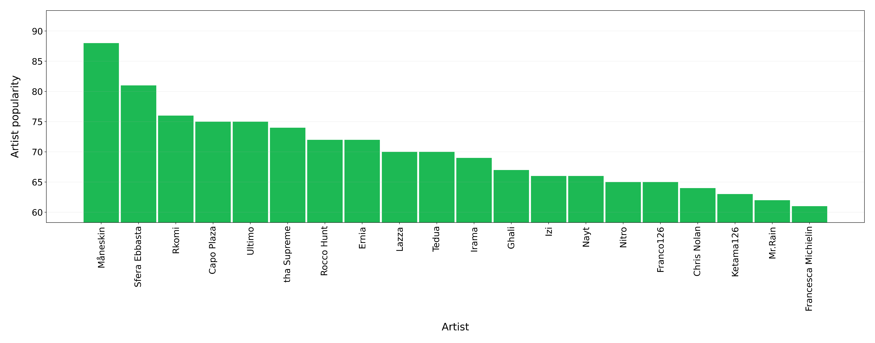
Query 3
Show the 20 most popular under-30 Italian artist who published at least a track in 2018

Slide 15
Query 4
In 2019 there was more distinct singles in top 100 Argentina rather than in top 100 Italy?

Slide 16
Query 4
In 2019 there was more distinct singles in top 100 Argentina rather than in top 100 Italy?
YES

Slide 17
Query 4
In 2019 there was more distinct singles in top 100 Argentina rather than in top 100 Italy?
YES
Argentina : 302 singles
Italy : 272 singles

Slide 18
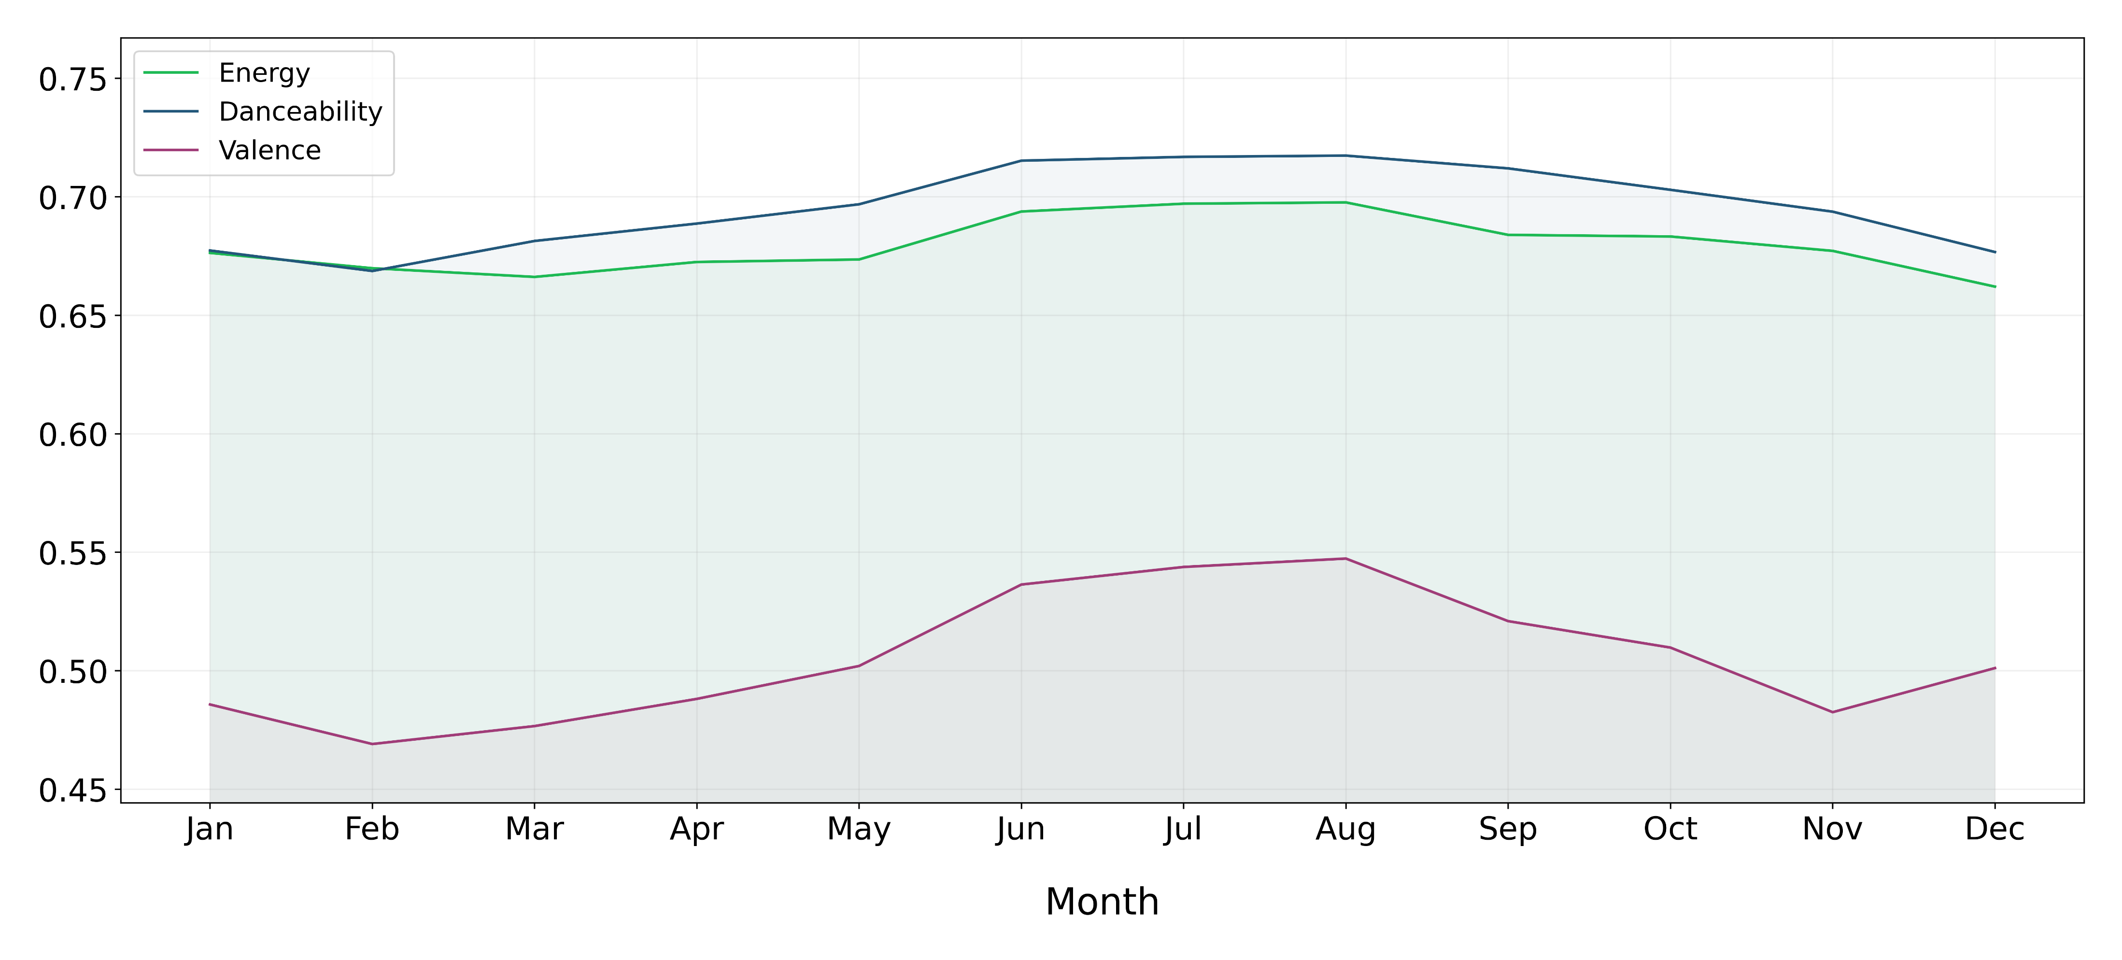
Query 5
Show average of different features of tracks through the months of the year in Italy

Slide 19
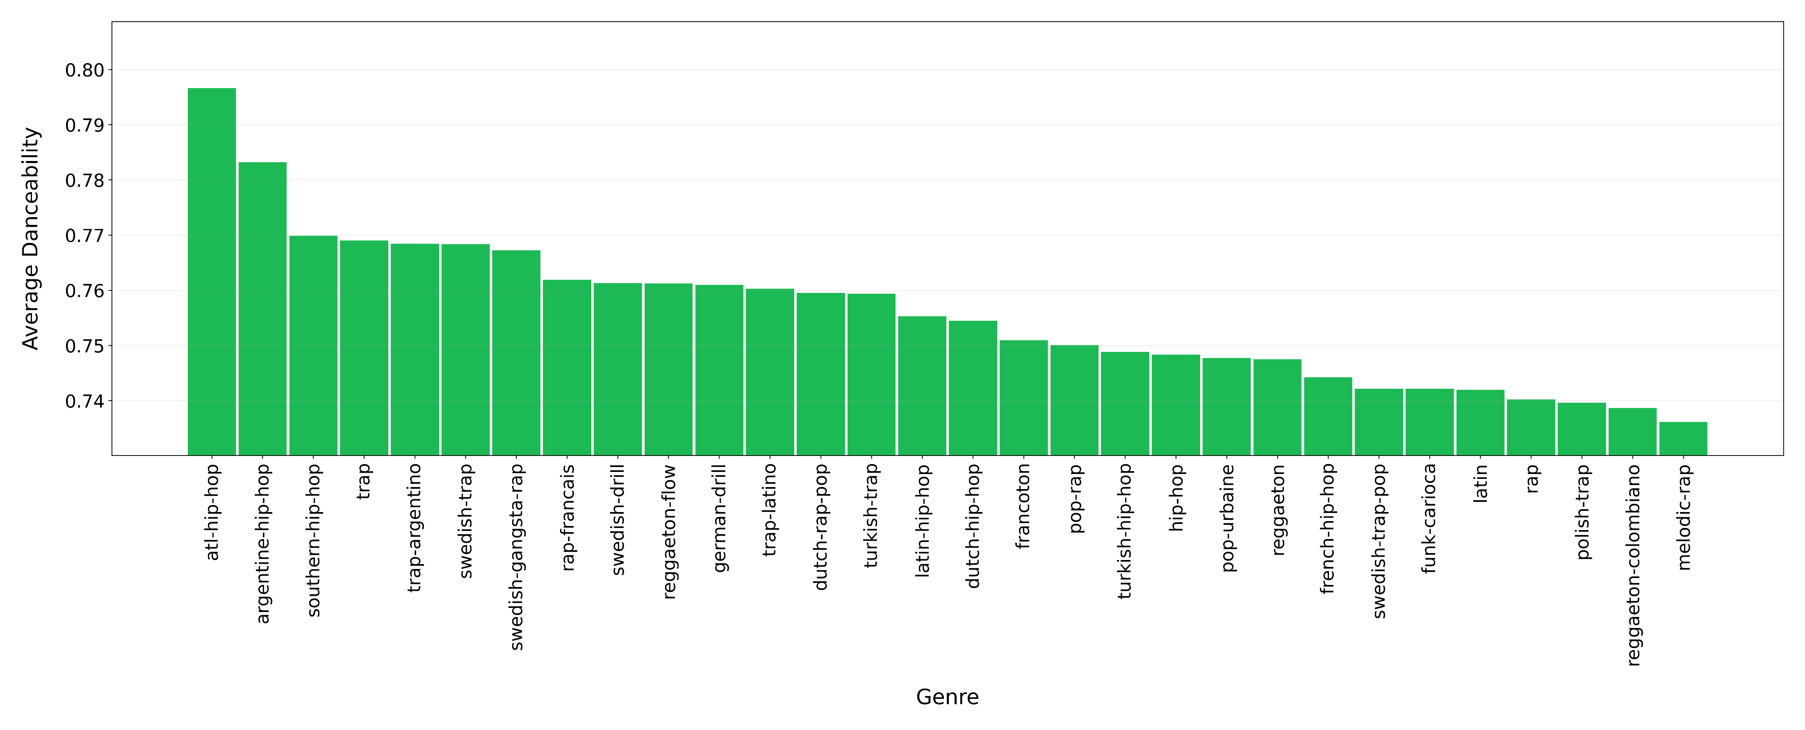
Query 6
Show the 30 genres with most danceable songs relative to songs released in 2019

Slide 20
Query 7
How many albums (at least 2) contains the same track?
Track Name | Albums | albumCount
Boogieman (feat. Salmo) (Ghali, Salmo) | DNA, Boogieman (feat. Salmo) | 6
Believer (Imagine Dragons) | Evolve, Believer | 6
Thunder (Imagine Dragons) | Evolve, Thunder | 6
Feelings (Lauv) | ~how i'm feeling~, Feelings | 6
i'm so tired... (Troye Sivan, Lauv) | ~how i'm feeling~, i'm so tired... | 6
Verloren (Tabitha) | Beste Zangers Seizoen 2020 (Tabitha) | 5
Good Times (Ghali) | DNA | 5
Whatever It Takes (Imagine Dragons) | Evolve, Whatever It Takes | 5
Sunflower - Spider-Man: Into the Spider-Verse ... | Hollywood's Bleeding, Sunflower (Spider-Man: I... | 5
My Only Wish (This Year) | Pop & Wave - Christmas Edition, Five Songs Of ... | 5

Slide 21




Query 7
How many albums (at least 2) contains the same track?

Slide 22
Query 7
How many albums (at least 2) contains the same track?

Slide 23
Query 8
How many songs of artists from Japan or South Korea reaches Top 20 in US, Canada or Mexico?
US : 7 tracks
Canada : 9 track
Mexico : 0 tracks

Slide 24
Query 8
How many songs of artists from Japan or South Korea reaches Top 20 in US, Canada or Mexico?
US : 7 tracks
Canada : 9 track
Mexico : 0 tracks
Track Name | Artist
Run | Jojo
Happy Xmas (War Is Over) - Remastered 2010 | Yoko Ono, The Plastic Ono Band
Dynamite | BTS
Boy With Luv (feat. Halsey) | BTS
Sour Candy (with BLACKPINK) | BLACKPINK
Ice Cream (with Selena Gomez) | BLACKPINK
How You Like That | BLACKPINK
Old Town Road (feat. RM of BTS) - Seoul Town Remix | BTS, RM
Lovesick Girls | BLACKPINK

Slide 25
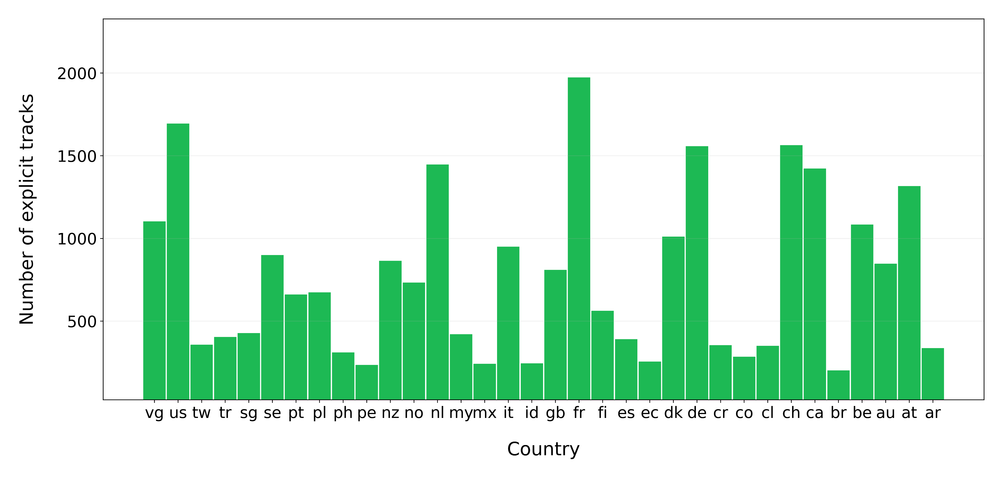
Query 9
Show how many explicit tracks appears in the top 100 for each country

Slide 26
Query 10
Show the 30 albums with the highest number of tracks present in Top 30 at the same time, showing also how many tracks are contained in the album
 | Chart | Date | Album Name | numTracks | totalTracks
1 | TOP 100 USA | 2018-07-01 | Scorpion | 23 | 25
2 | TOP 100 Canada | 2018-07-01 | Scorpion | 22 | 25
3 | TOP 100 Canada | 2017-03-19 | More Life | 21 | 22
4 | TOP 100 USA | 2017-03-19 | More Life | 21 | 22
5 | TOP 100 Italy | 2019-11-17 | 23 6451 | 20 | 20

Slide 27
References
Kaggle Spotify Dataset : https://www.kaggle.com/pepepython/spotify-huge-database-daily-charts-over-3-years?select=Database+to+calculate+popularity.csv
Spotify Web API : https://developer.spotify.com/documentation/web-api/
WikiData : https://www.wikidata.org/wiki/Wikidata:Main_Page
MusicBrainz : https://musicbrainz.org/

Slide 28
Thank you for the attention

