Slide 1



Team Project 2 : Property Graphs
Master’s in Computer Engineering
Database 2
Marco alecci , Luca martinelli, elia ziroldo
Academic year 2021/2022

Slide 2
Data: Recap
Spotify’s Monthly Top 100 charts
35 countries from 2017-2020
Initial data enriched with:
Genre
Albums
Track
Charts
Artist
People

Slide 3
Data: Additions

Slide 4
Model

Slide 5
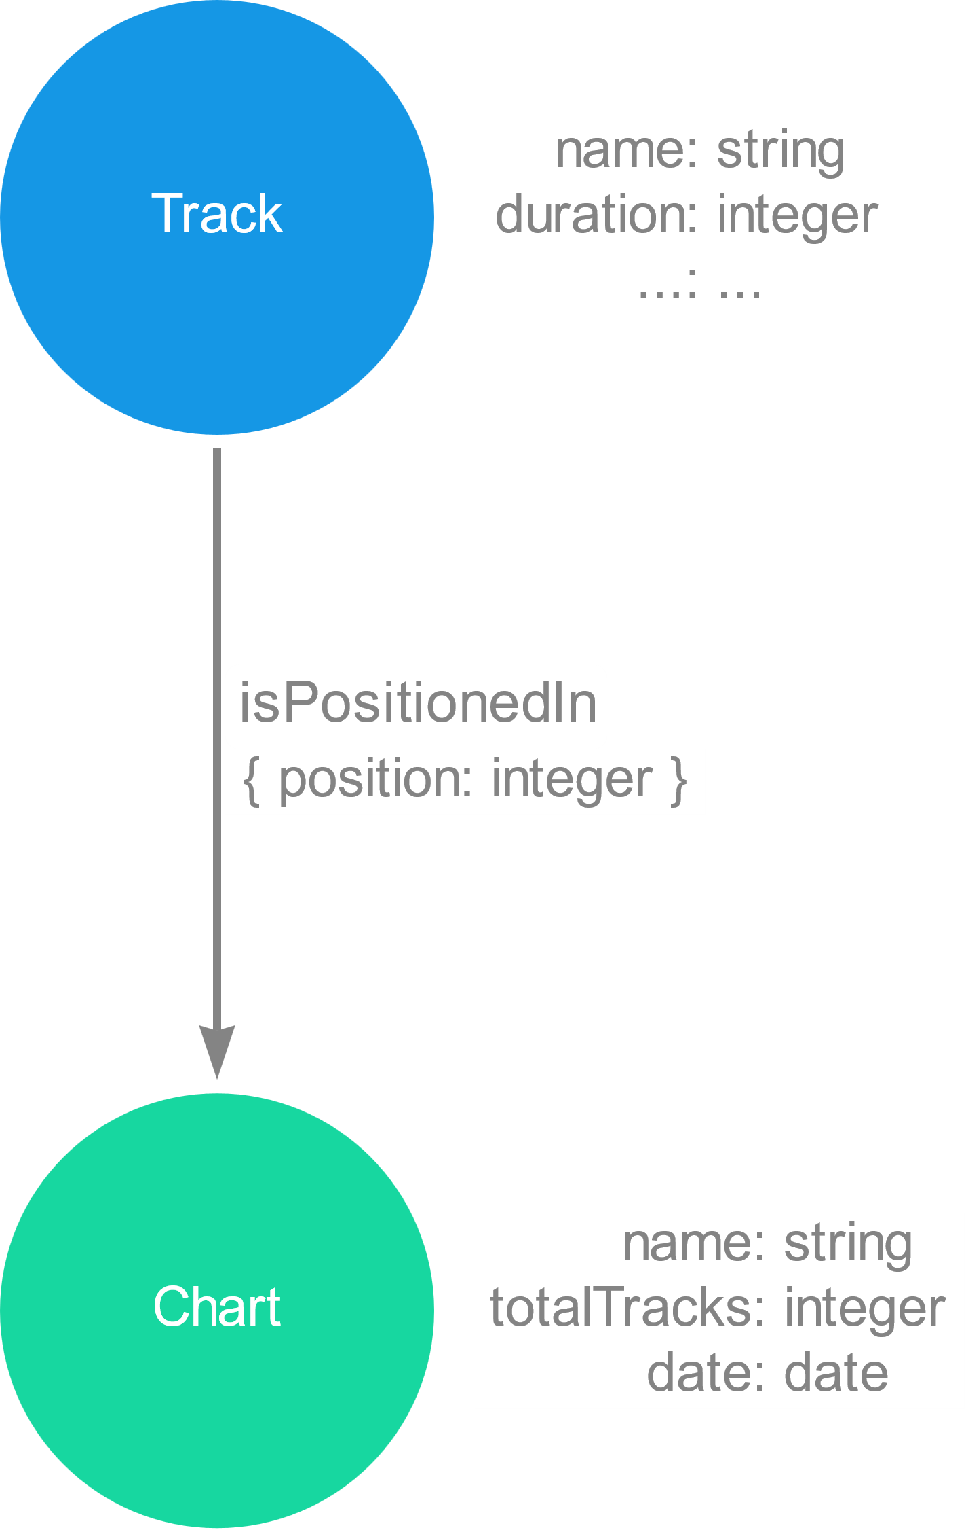
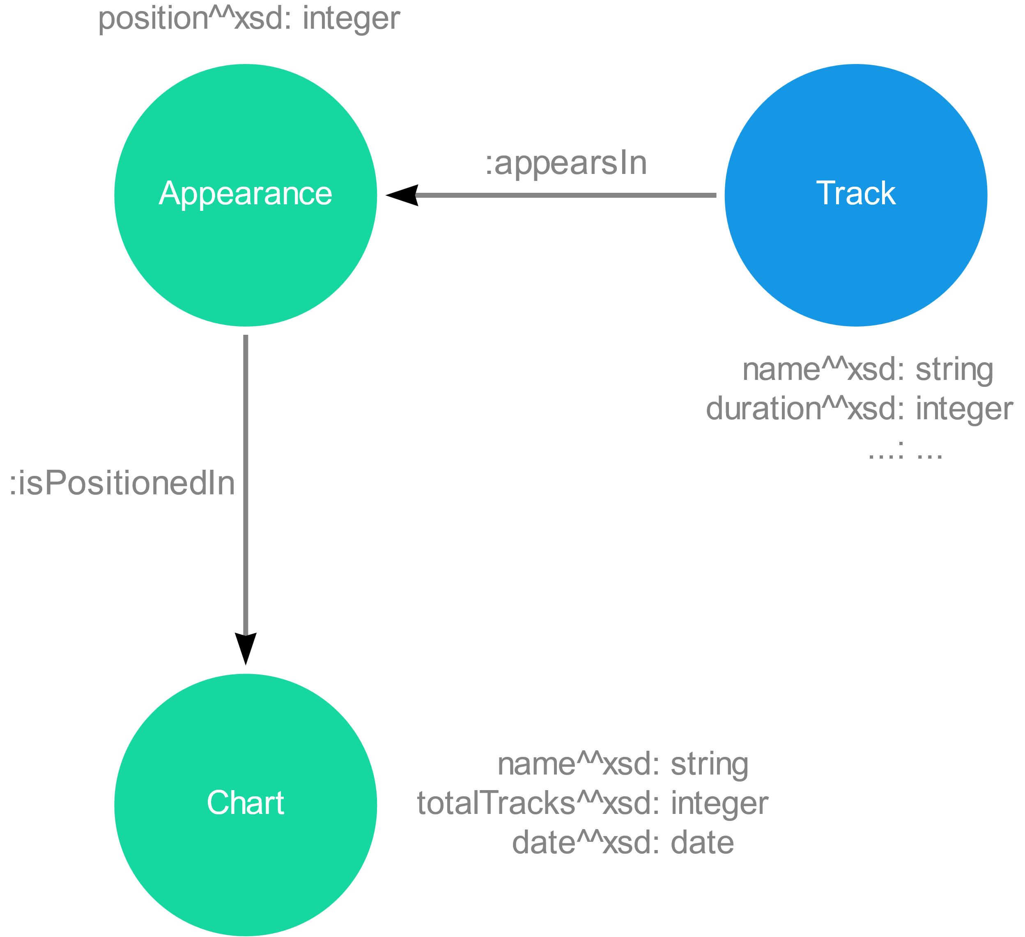
Model : Focus
RDF: dummy node for the position of a track
PG: position as property of the relation

Slide 6
Model : Focus
Focus sulle cose nuove

Slide 7
Ingestion Phase
MERGE
CREATE
CREATE + UNIQUE CONSTRAINTS
LOAD_CSV with customized CSV files

Slide 8
Ingestion Phase
Method | Genres | Countries | Artists | Albums | Tracks | Charts | People
MERGE
CREATE
CREATE + UNIQUE CONSTRAINTS
LOAD_CSV

Slide 9
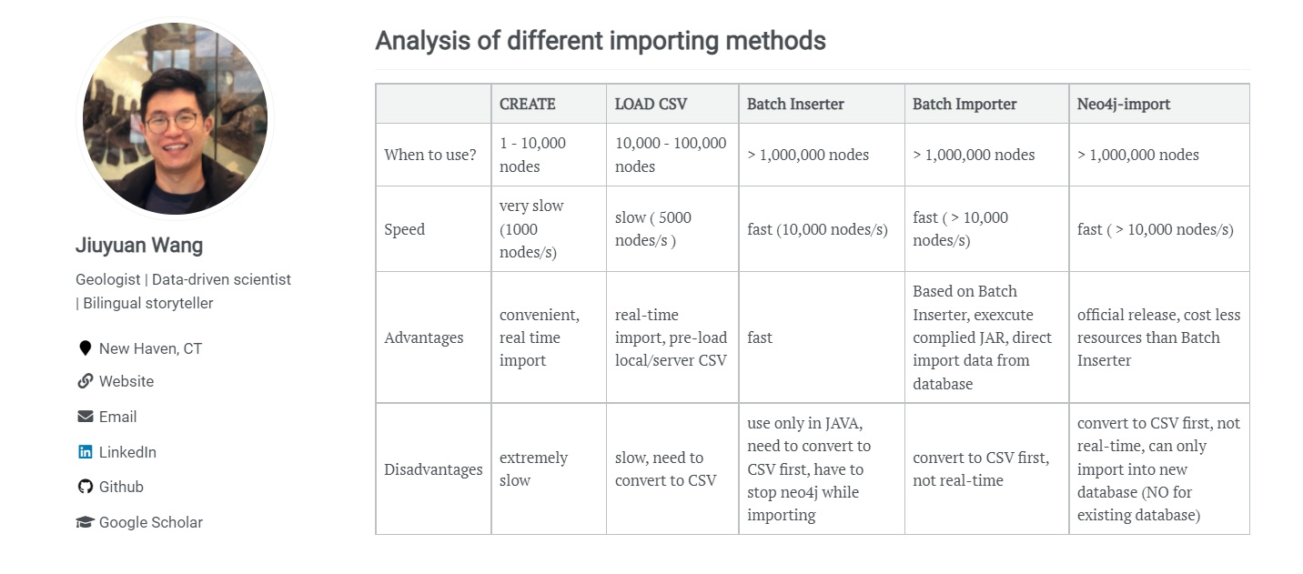
Ingestion Phase
Ref: https://julianwangnwu.github.io/posts/2019/06/import-neo4j/

Slide 10
Queries

Slide 11
Queries
Example Queries
Show how it is possible to use the new added information
Italian Tracks and Italian Artists
Study Italian tracks and artists present in the TOP 100 Italy
Italian Music Abroad
Discover if Italian tracks are listened also outside Italy
such as record label and instruments

Slide 12
Queries Part 1

Slide 13
Queries Part 2

Slide 14
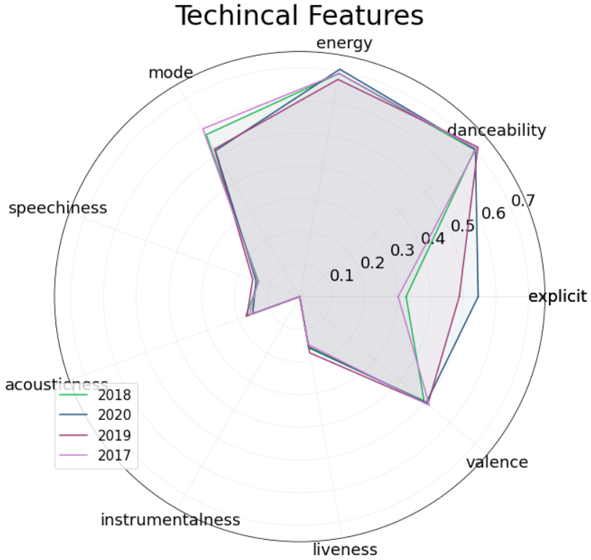
Show technical features of Italian Tracks through the years 2017-2020

Slide 15
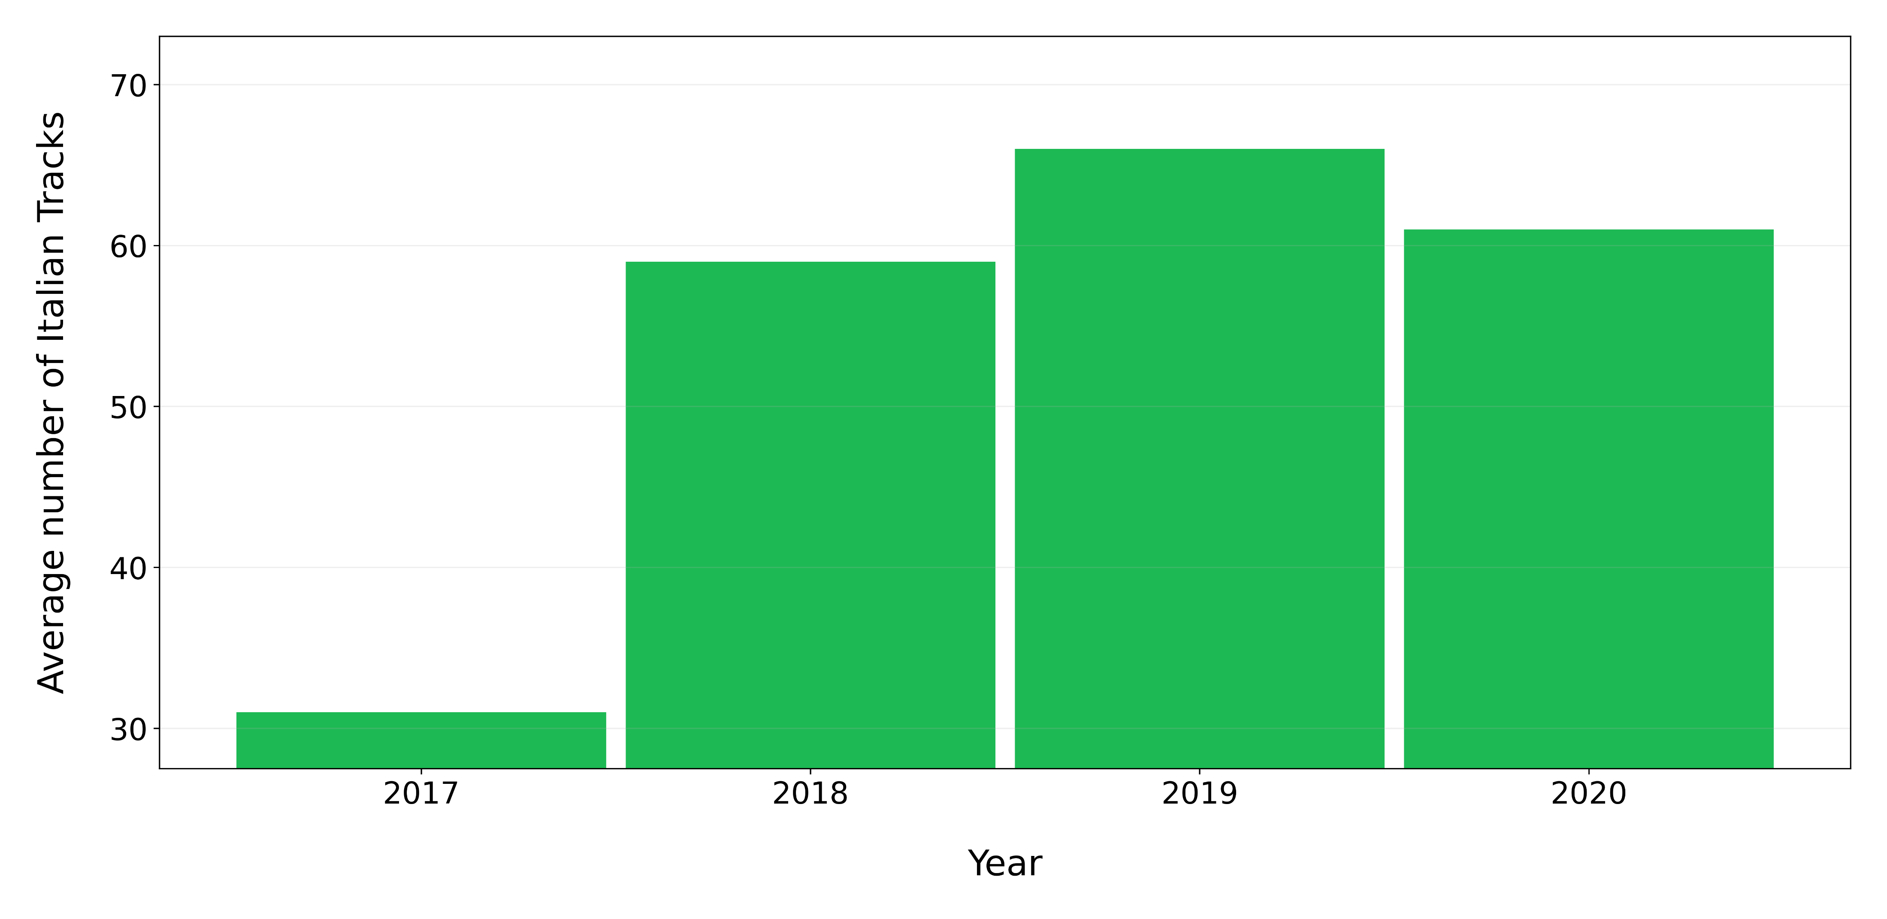
On average how many Italian tracks are present in Top 100 Italy for each year?

Slide 16
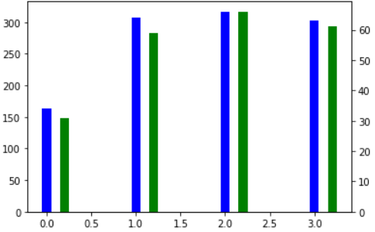
How many Italian tracks were released every year from 2017 to 2020 ?

Slide 17
How many different Italian artist entered in Top 100 Italy for each Year ?

Slide 18
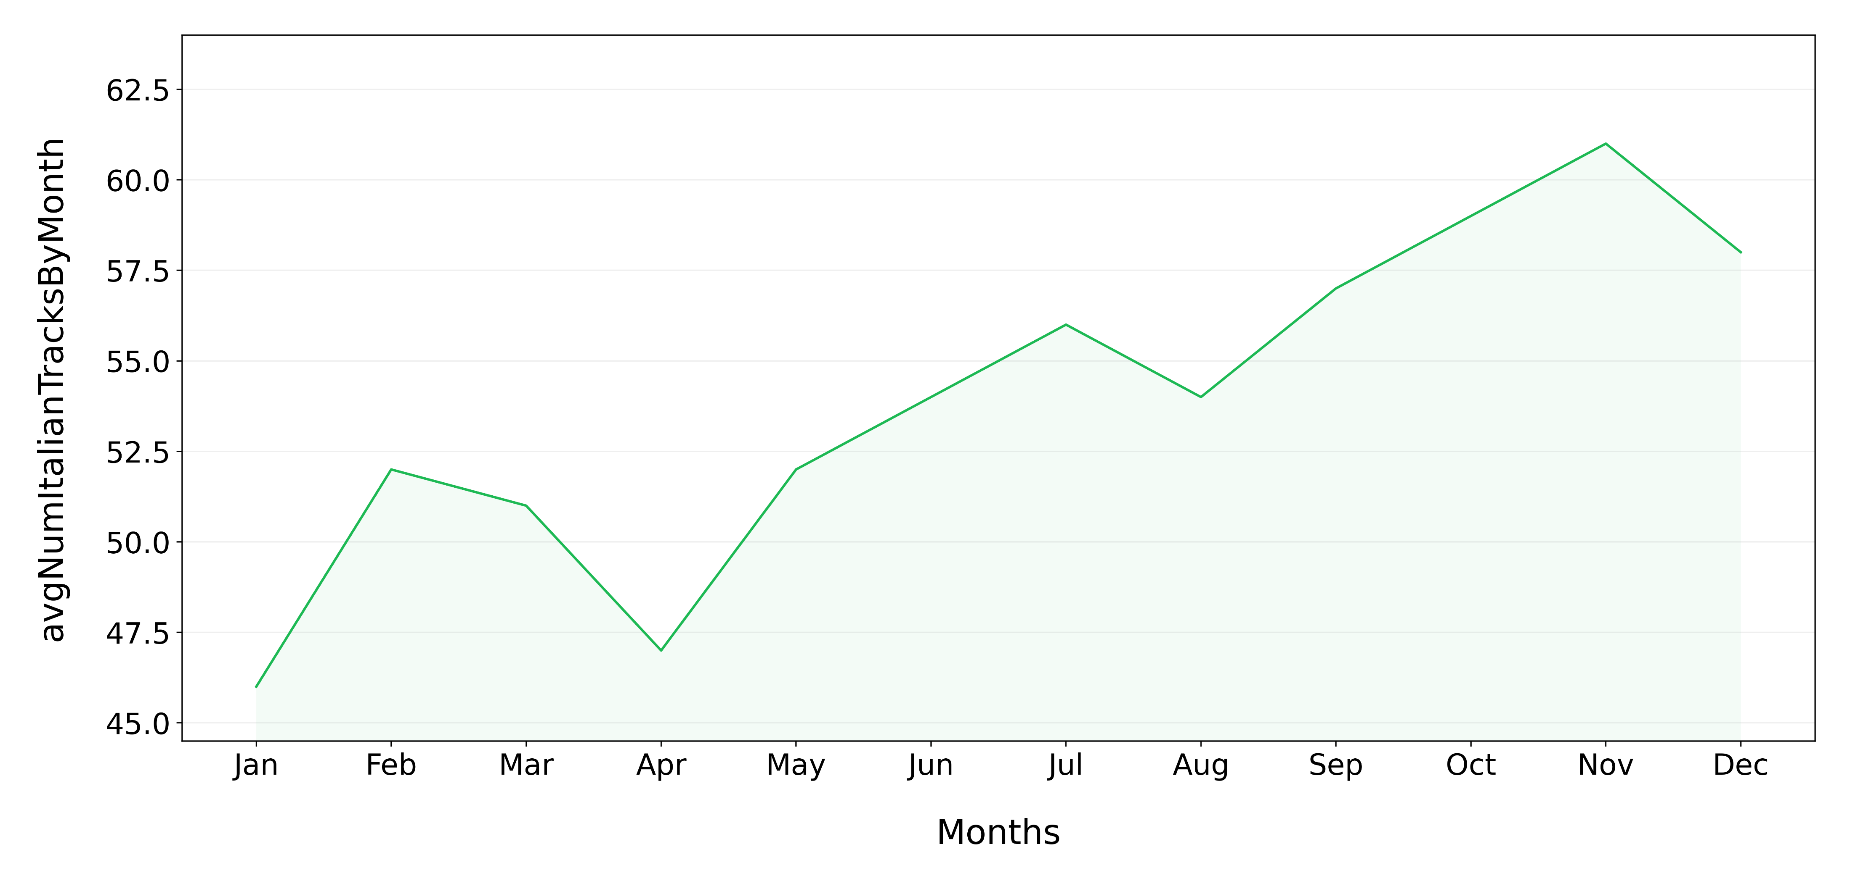
On average how many Italian tracks are present in Top 100 Italy through the different months of the year ?

Slide 19
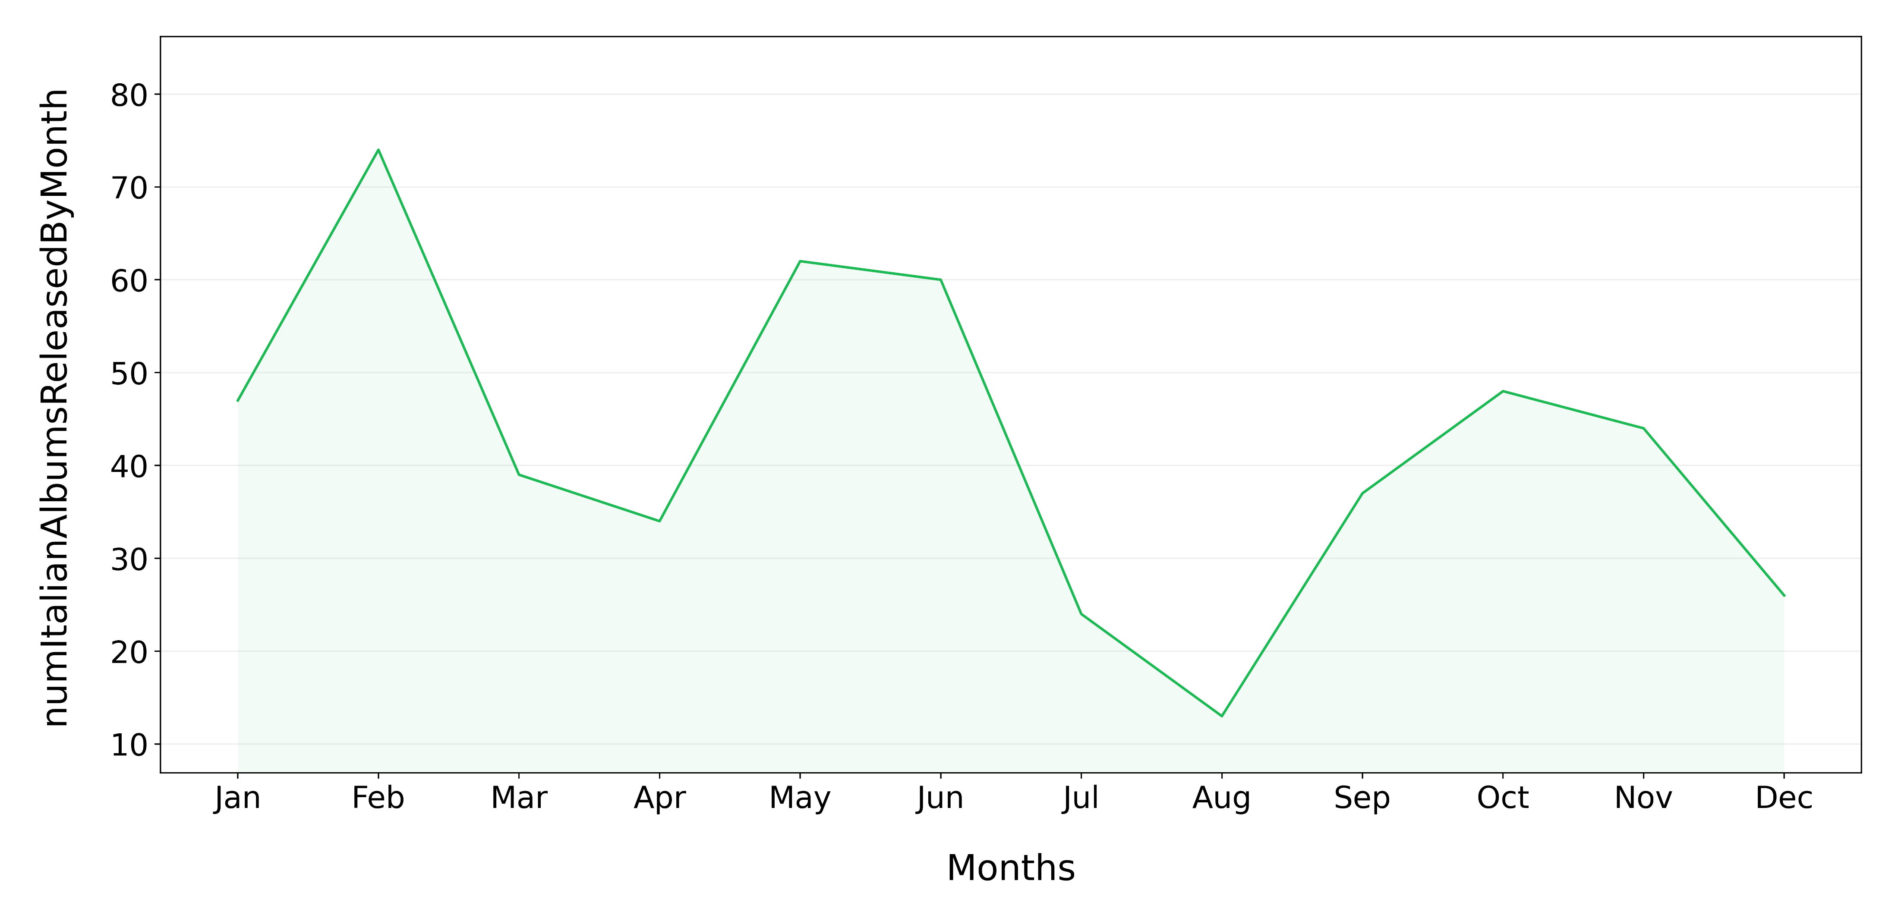
How many albums from Italian artists are released through the different months of the year ?

Slide 20




Show the Italian artist with the highest number of tracks present in Top 100 Italy for each year.
2017
Guè, 20 Tracks
2018
Gemitaiz, 28 Tracks
2019
Madman, 30 Tracks
2020
Tha Supreme, 35 Tracks

Slide 21
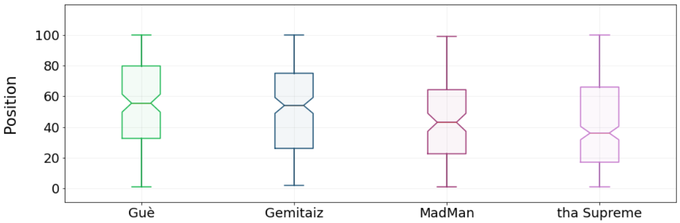
Show the distribution of the positions in the TOP 100 Italy reached by the just retrieved artist

Slide 22


Show the top 3 Italian artists with the highest number of tracks present in Top 100 Italy at the same time.
Tha Supreme
17th Nov 2019
24 tracks
Marracash
17th Nov 2019
19 tracks
Ultimo
7th April 2019
18 tracks

Slide 23



Check if these artists released an album on the same month (or previous one) of the chart in which they have the highest number of tracks.
Tha Supreme
17th Nov 2019
24 tracks
Marracash
17th Nov 2019
19 tracks
Ultimo
7th April 2019
18 tracks
“23 6451”
15th Nov 2019
“Persona”
31th Oct 2019
“Colpa delle Favole”
5th April 2019

Slide 24
Queries Part 3

Slide 25
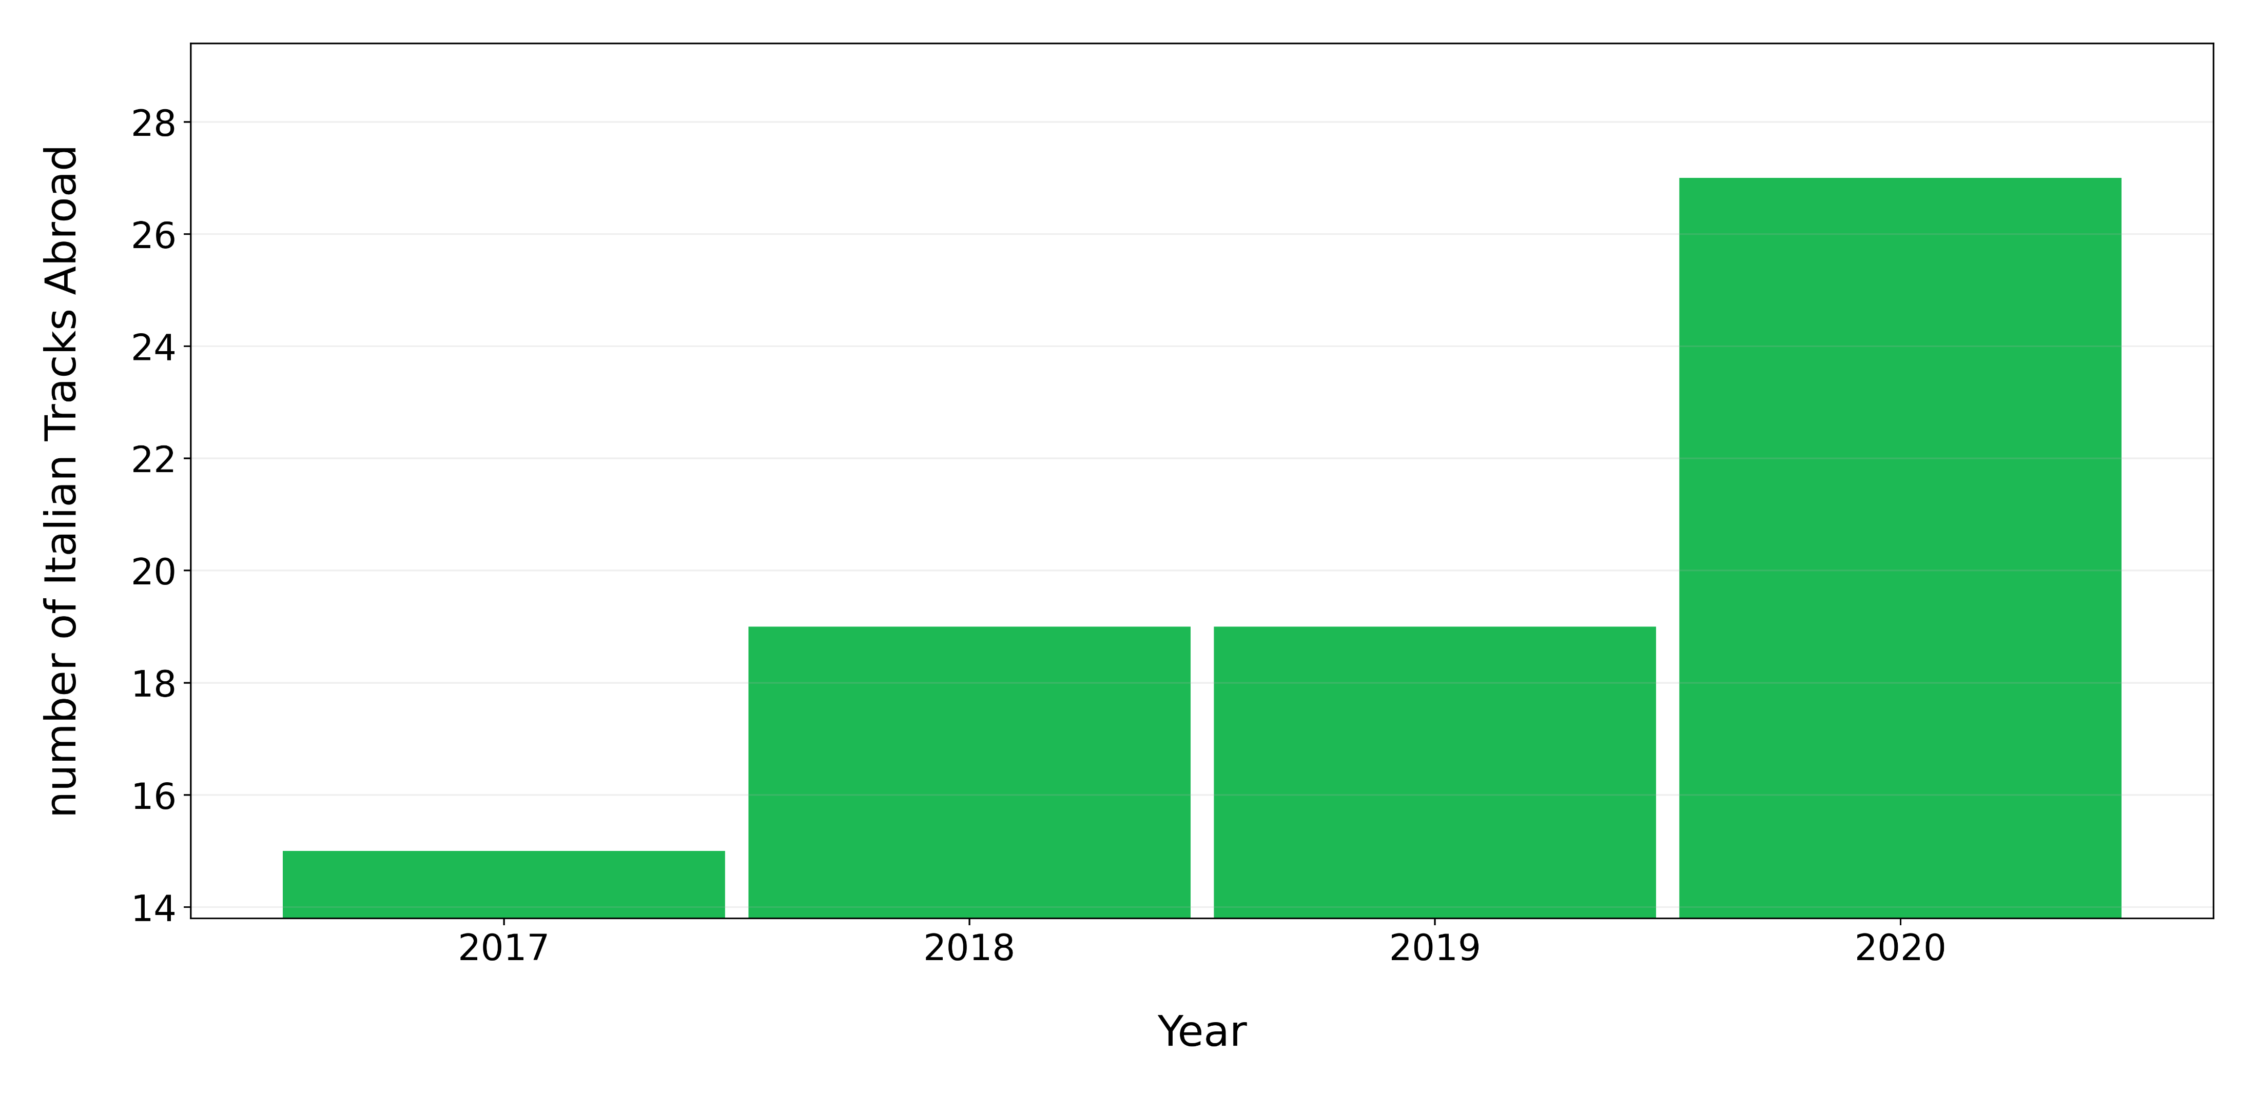
How many Italian tracks are present in a Top 100 of a country different from Italy for each year ?

Slide 26
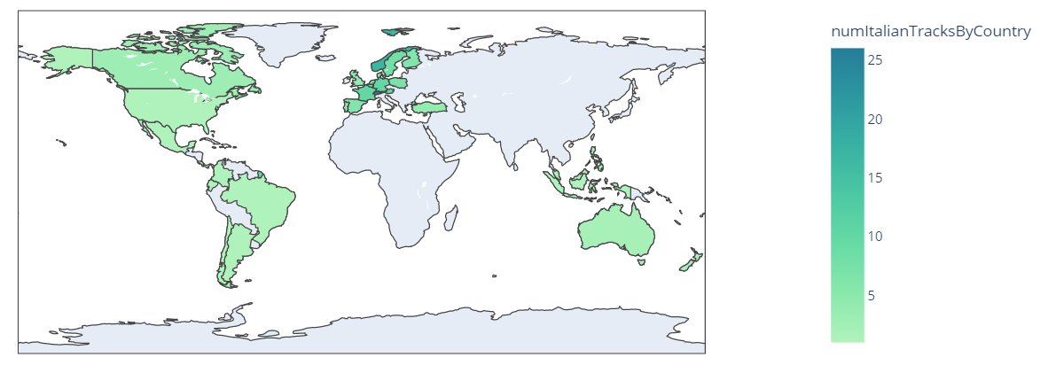
Show the countries that listen the most to Italian tracks

Slide 27
How to determine the most widespread Italian artists ?
1st Approach:
Count, for each artist, how many different countries he/she has reached excluding Italy.
2nd Approach:
Count, for each artist, how many of his tracks have entered in a TOP 100 of a country different from Italy

Slide 28
1st Approach
Gigi Dag

Slide 29
2° Approach
Sfera

Slide 30
References
Kaggle Spotify Dataset : https://www.kaggle.com/pepepython/spotify-huge-database-daily-charts-over-3-years?select=Database+to+calculate+popularity.csv
Spotify Web API : https://developer.spotify.com/documentation/web-api/
WikiData : https://www.wikidata.org/wiki/Wikidata:Main_Page
MusicBrainz : https://musicbrainz.org/

Slide 31
Thank you for the attention

