Slide 1



Team Project 2 : Property Graphs
Master’s in Computer Engineering
Database 2
Marco alecci , Luca martinelli, elia ziroldo
Academic year 2021/2022

Slide 2
Data: Recap
Spotify’s Monthly Top 100 charts
35 countries from 2017-2020
Initial data enriched with:
Genre
Albums
Track
Charts
Artist
People

Slide 3
Data: Additions

Slide 4
Model

Slide 5
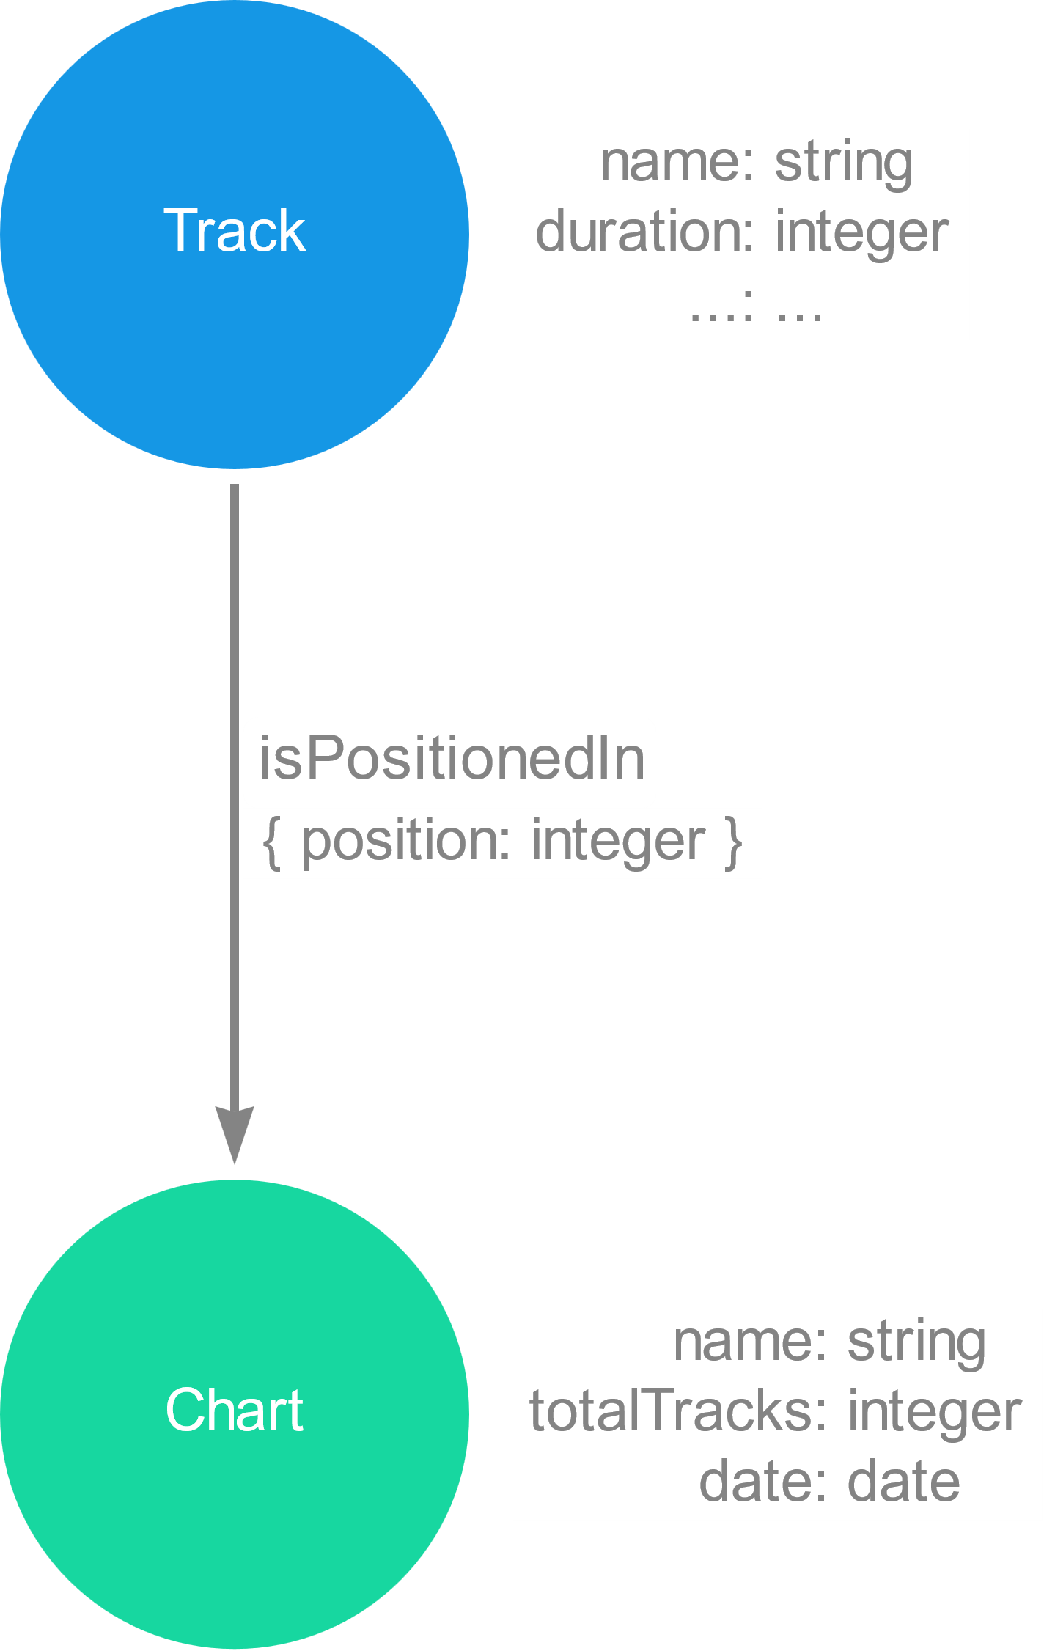
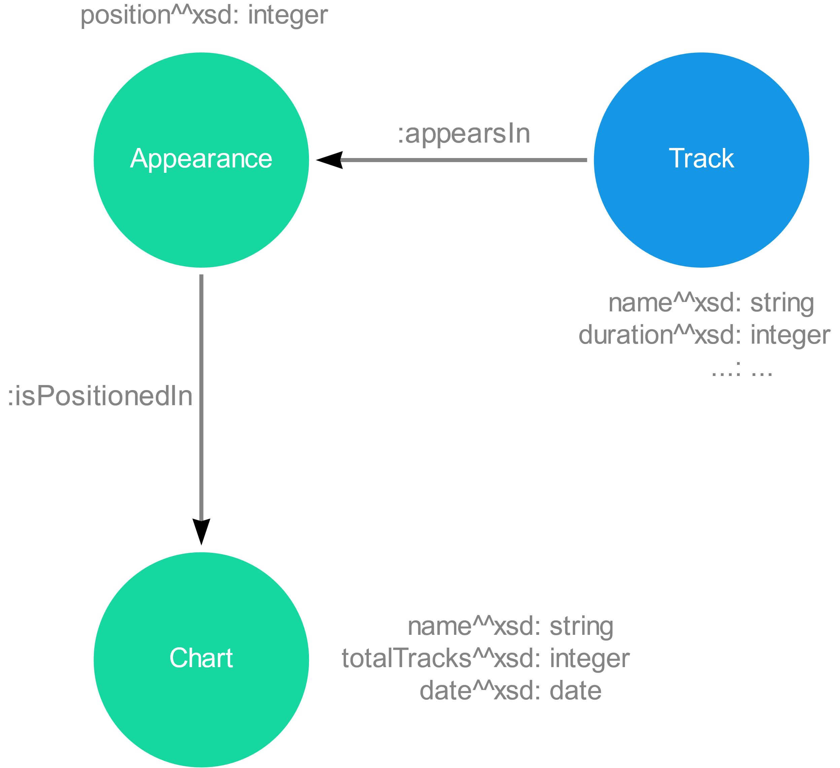
Model : Focus
RDF: dummy node for the position of a track
PG: position as property of the relation

Slide 6
Model : Focus
Focus sulle cose nuove

Slide 7
Ingestion Phase
MERGE
CREATE
CREATE + UNIQUE CONSTRAINTS
LOAD_CSV with customized CSV files

Slide 8
Ingestion Phase
Method | Genres | Countries | Artists | Albums | Tracks | Charts | People
MERGE
CREATE
CREATE + UNIQUE CONSTRAINTS
LOAD_CSV

Slide 9
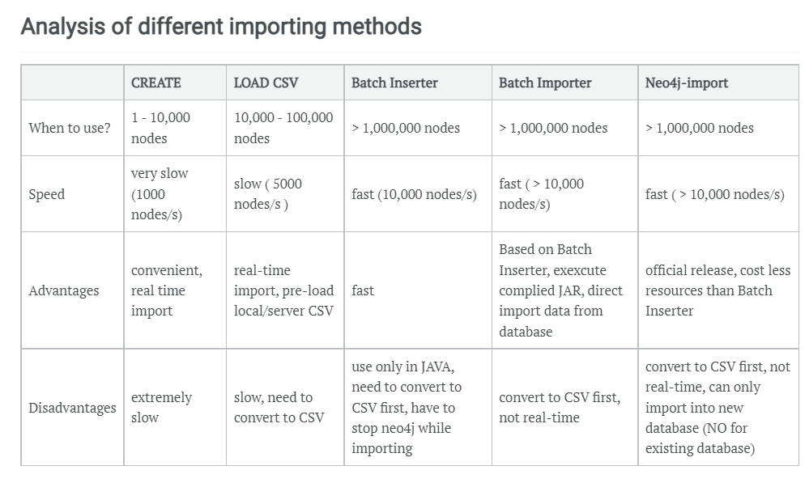
Ingestion Phase
Ref: https://julianwangnwu.github.io/posts/2019/06/import-neo4j/

Slide 10
Queries

Slide 11
Query 1
On average how many artist of a specific nationality are in the top 100 of the same country?

Slide 12
References
Kaggle Spotify Dataset : https://www.kaggle.com/pepepython/spotify-huge-database-daily-charts-over-3-years?select=Database+to+calculate+popularity.csv
Spotify Web API : https://developer.spotify.com/documentation/web-api/
WikiData : https://www.wikidata.org/wiki/Wikidata:Main_Page
MusicBrainz : https://musicbrainz.org/

Slide 13
Thank you for the attention

