Slide 1



Team Project 2 : Property Graphs
Master’s in Computer Engineering
Database 2
Marco alecci , Luca martinelli, elia ziroldo
Academic year 2021/2022

Slide 2
Data: Recap
Spotify’s Monthly Top 100 charts
35 countries from 2017-2020
Initial data enriched with:
Genre
Albums
Track
Charts
Artist
People

Slide 3
Data: Additions

Slide 4
Model

Slide 5
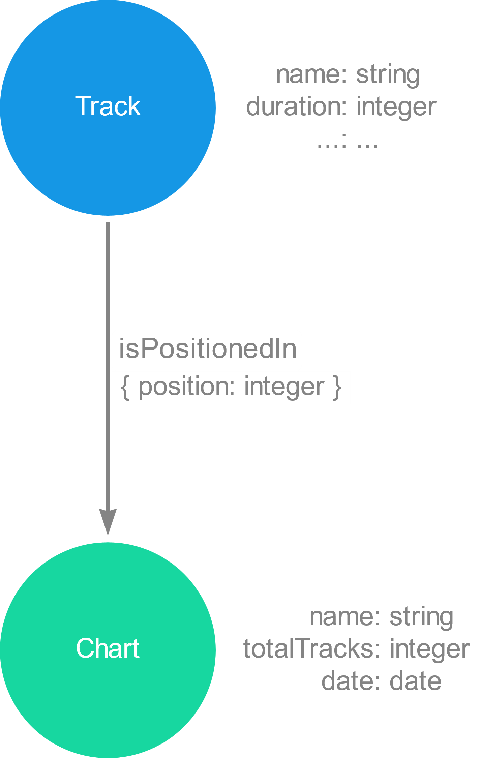
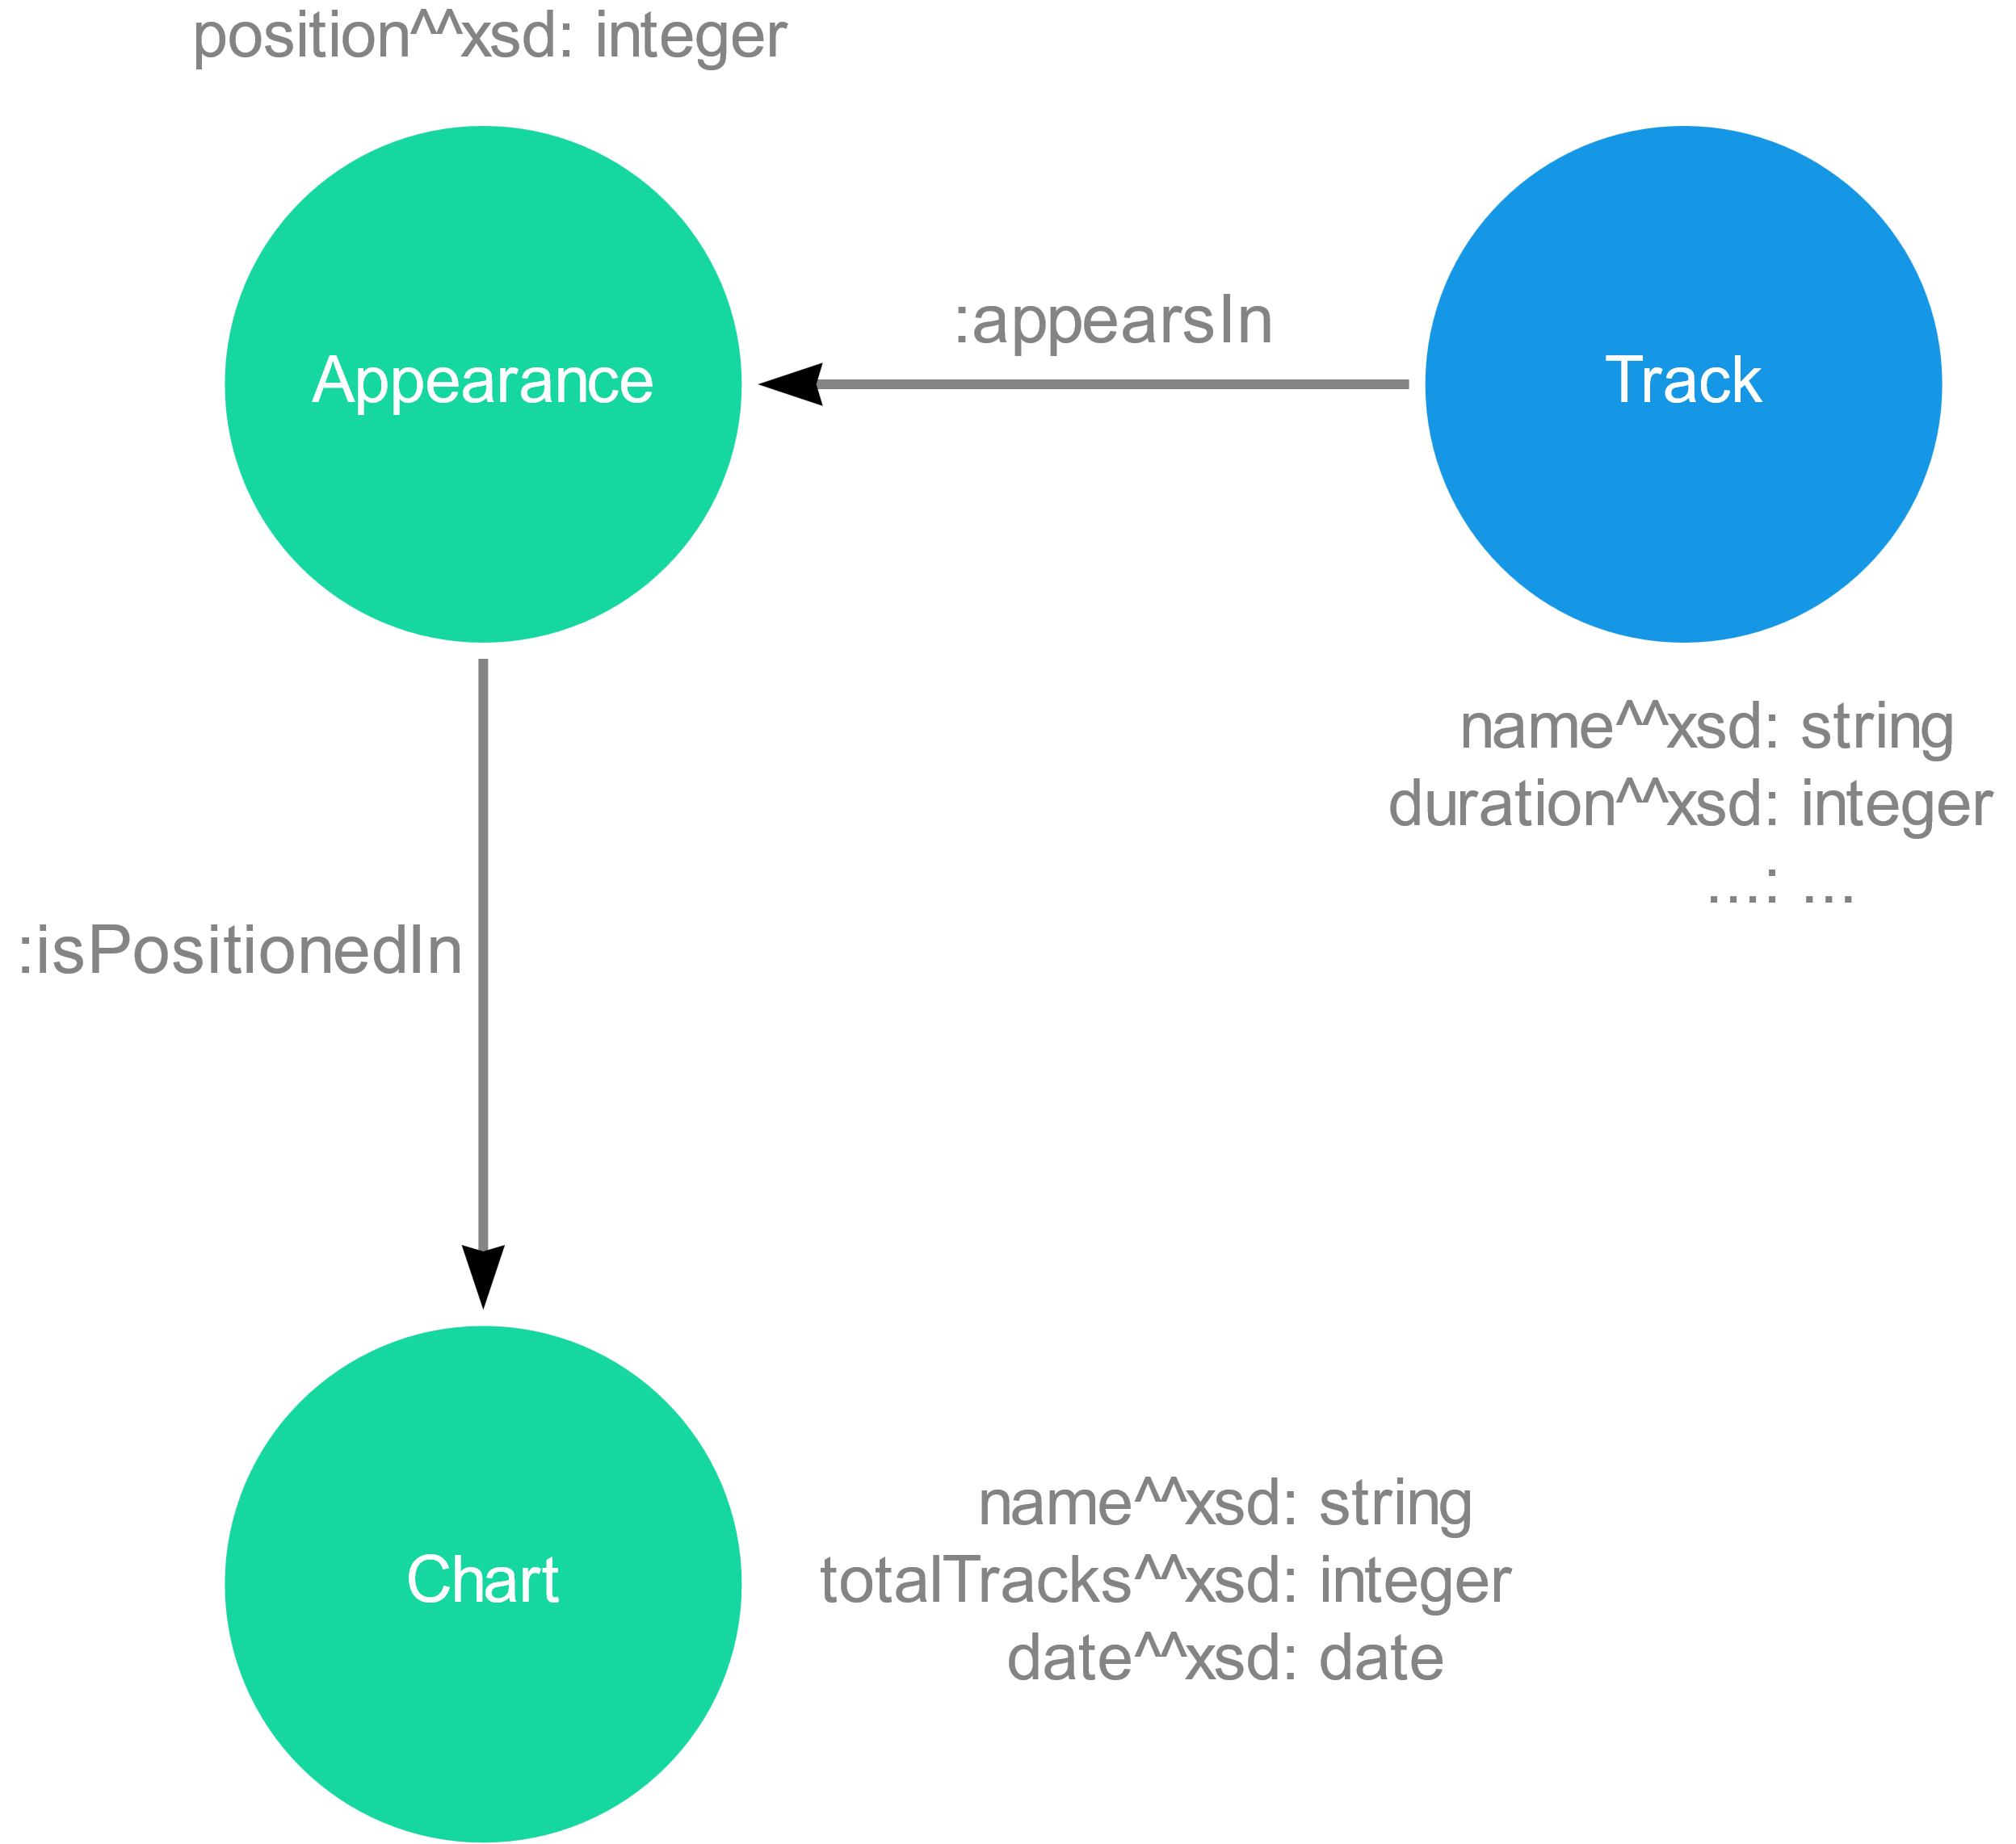
Model : Focus
RDF: dummy node for the position of a track
PG: position as property of the relation

Slide 6
Model : Focus
Focus sulle cose nuove

Slide 7
Ingestion Phase
MERGE
CREATE
CREATE + UNIQUE CONSTRAINTS
LOAD_CSV with customized CSV files

Slide 8
Ingestion Phase
Method | Genres | Countries | Artists | Albums | Tracks | Charts | People
MERGE
CREATE
CREATE + UNIQUE CONSTRAINTS
LOAD_CSV

Slide 9
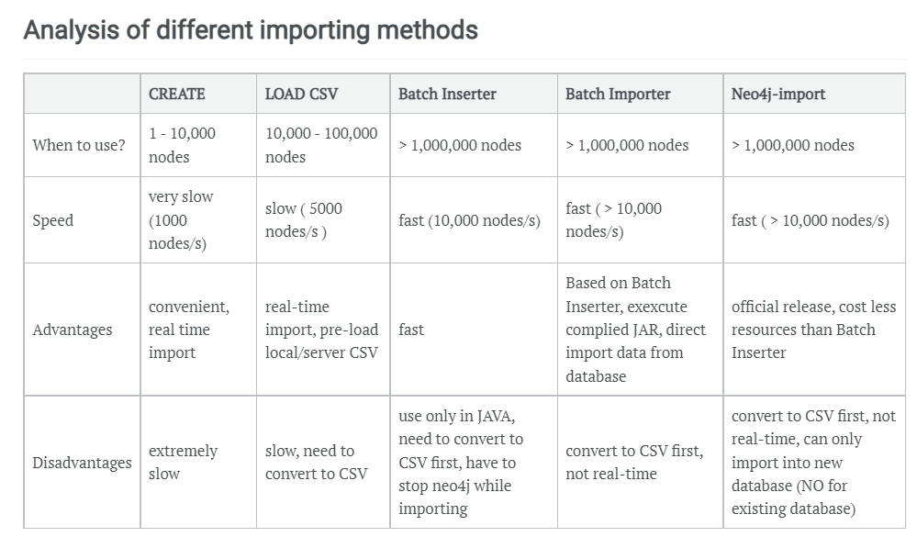
Ingestion Phase
Ref: https://julianwangnwu.github.io/posts/2019/06/import-neo4j/

Slide 10
Queries

Slide 11
Queries
Example Queries
Show how it is possible to use the new added information
Italian Tracks and Italian Artists
Study Italian tracks and artists present in the TOP 100 Italy
Italian Music Abroad
Discover if Italian tracks are listened also outside Italy
such as record label and instruments

Slide 12
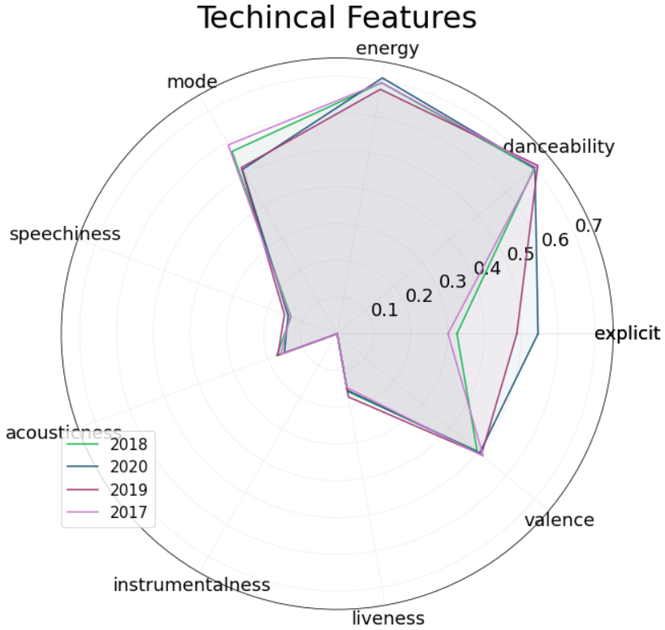
Show technical features of Italian Tracks through the years 2017-2020

Slide 13
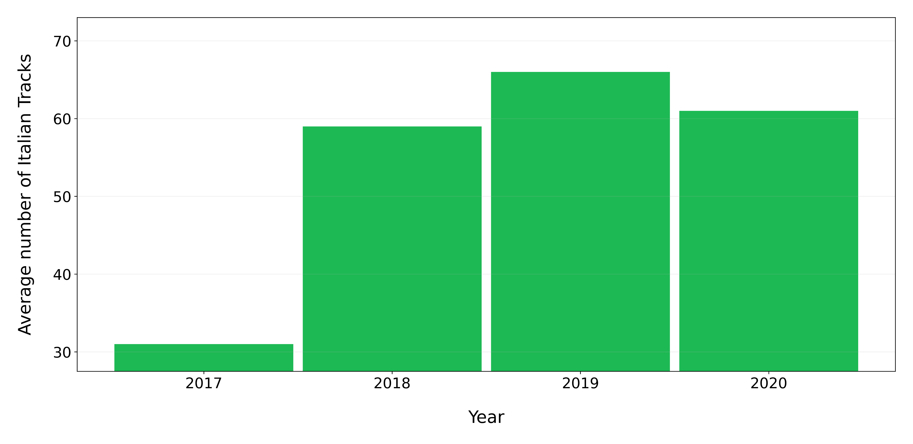
On average how many Italian tracks are present in Top 100 Italy for each year?

Slide 14
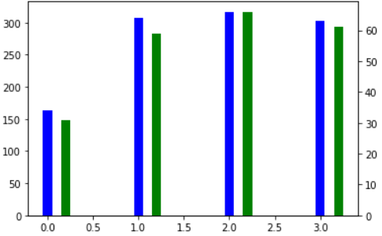
How many Italian tracks were released every year from 2017 to 2020 ?

Slide 15
How many different Italian artist entered in Top 100 Italy for each Year ?

Slide 16
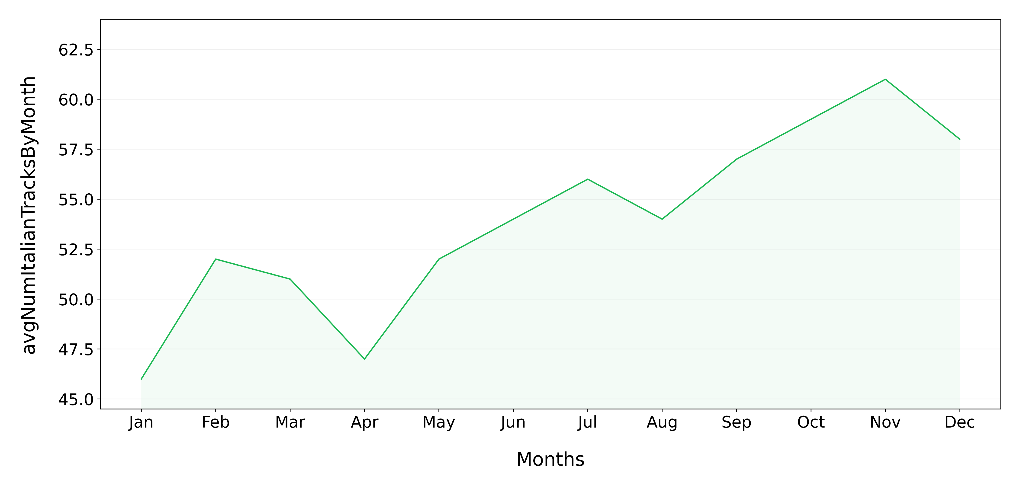
On average how many Italian tracks are present in Top 100 Italy through the different months of the year ?

Slide 17
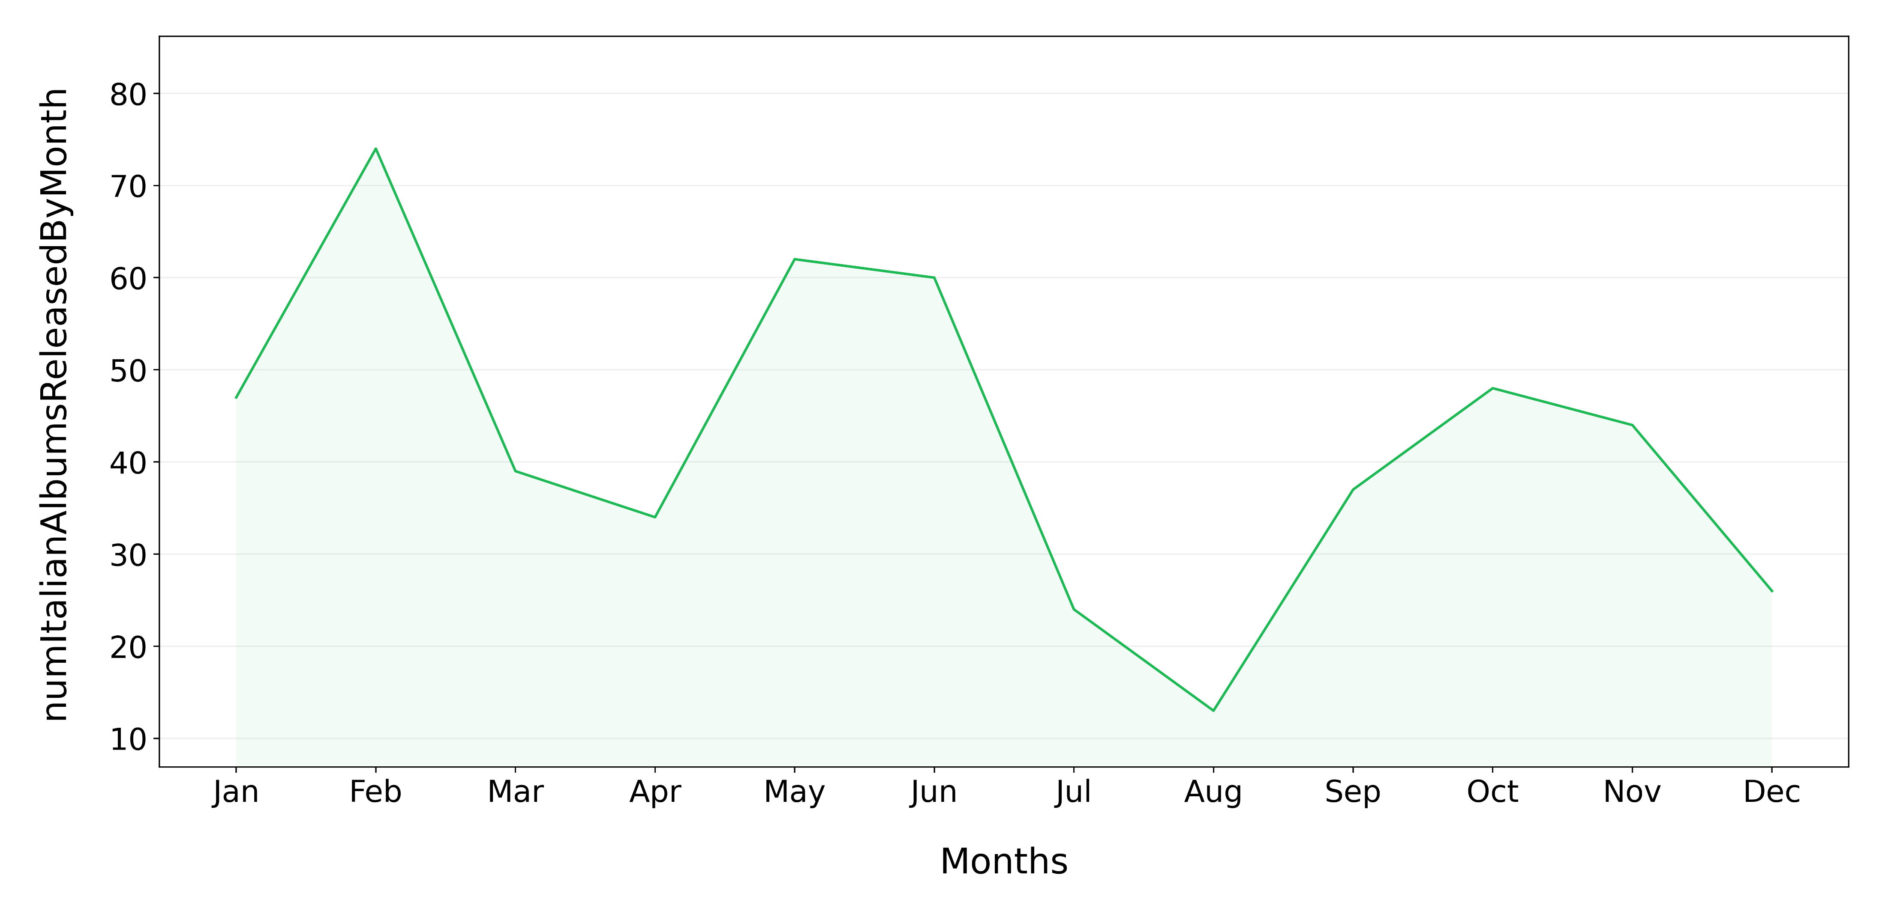
How many albums from Italian artists are released through the different months of the year ?

Slide 18
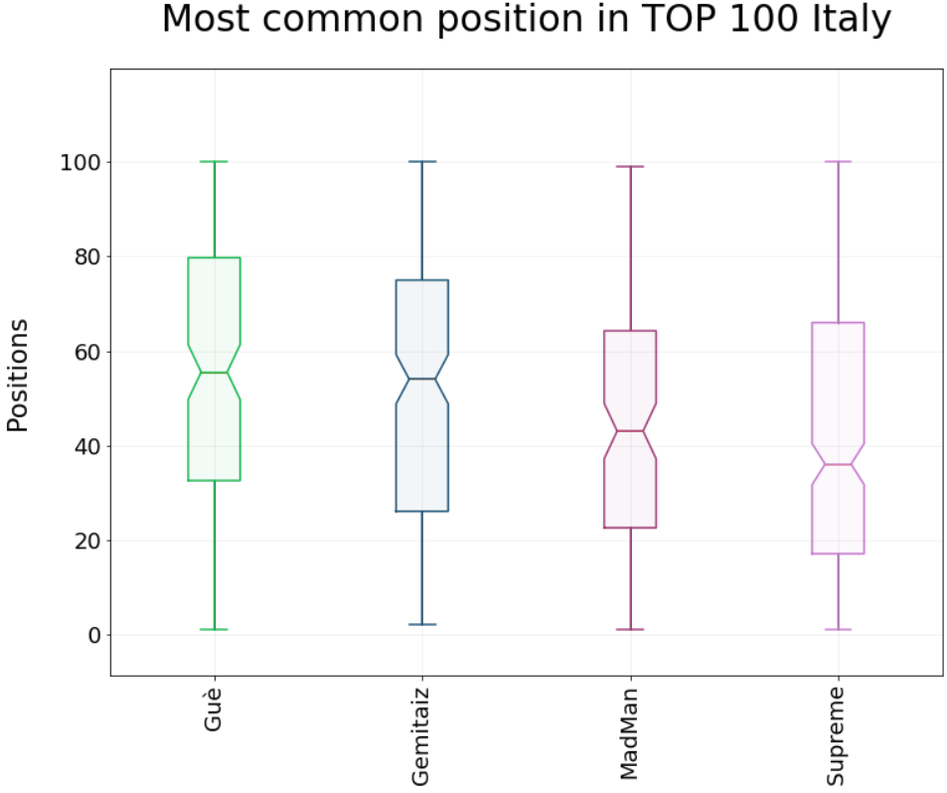
Who is the Italian artist with the highest number of tracks present in Top 100 Italy for each year?
Show the most common position in the TOP 100 Italy obtained by the just retrieved artist.
2017
Guè
2018
Gemitaiz
2019
MadMan
2020
Tha Supreme
20 Tracks
28 Tracks
30 Tracks
35 Tracks

Slide 19




Show the top 3 Italian artists with the highest number of tracks present in Top 100 Italy at the same time.
Tha Supreme
17th November 2019
24 tracks
Tha Supreme
17th November 2019
24 tracks
Tha Supreme
17th November 2019
24 tracks
Name: 23 6451
relaseDate: 2019-11-15
Name: 23 6451
relaseDate: 2019-11-15
Name: 23 6451
relaseDate: 2019-11-15

Slide 20
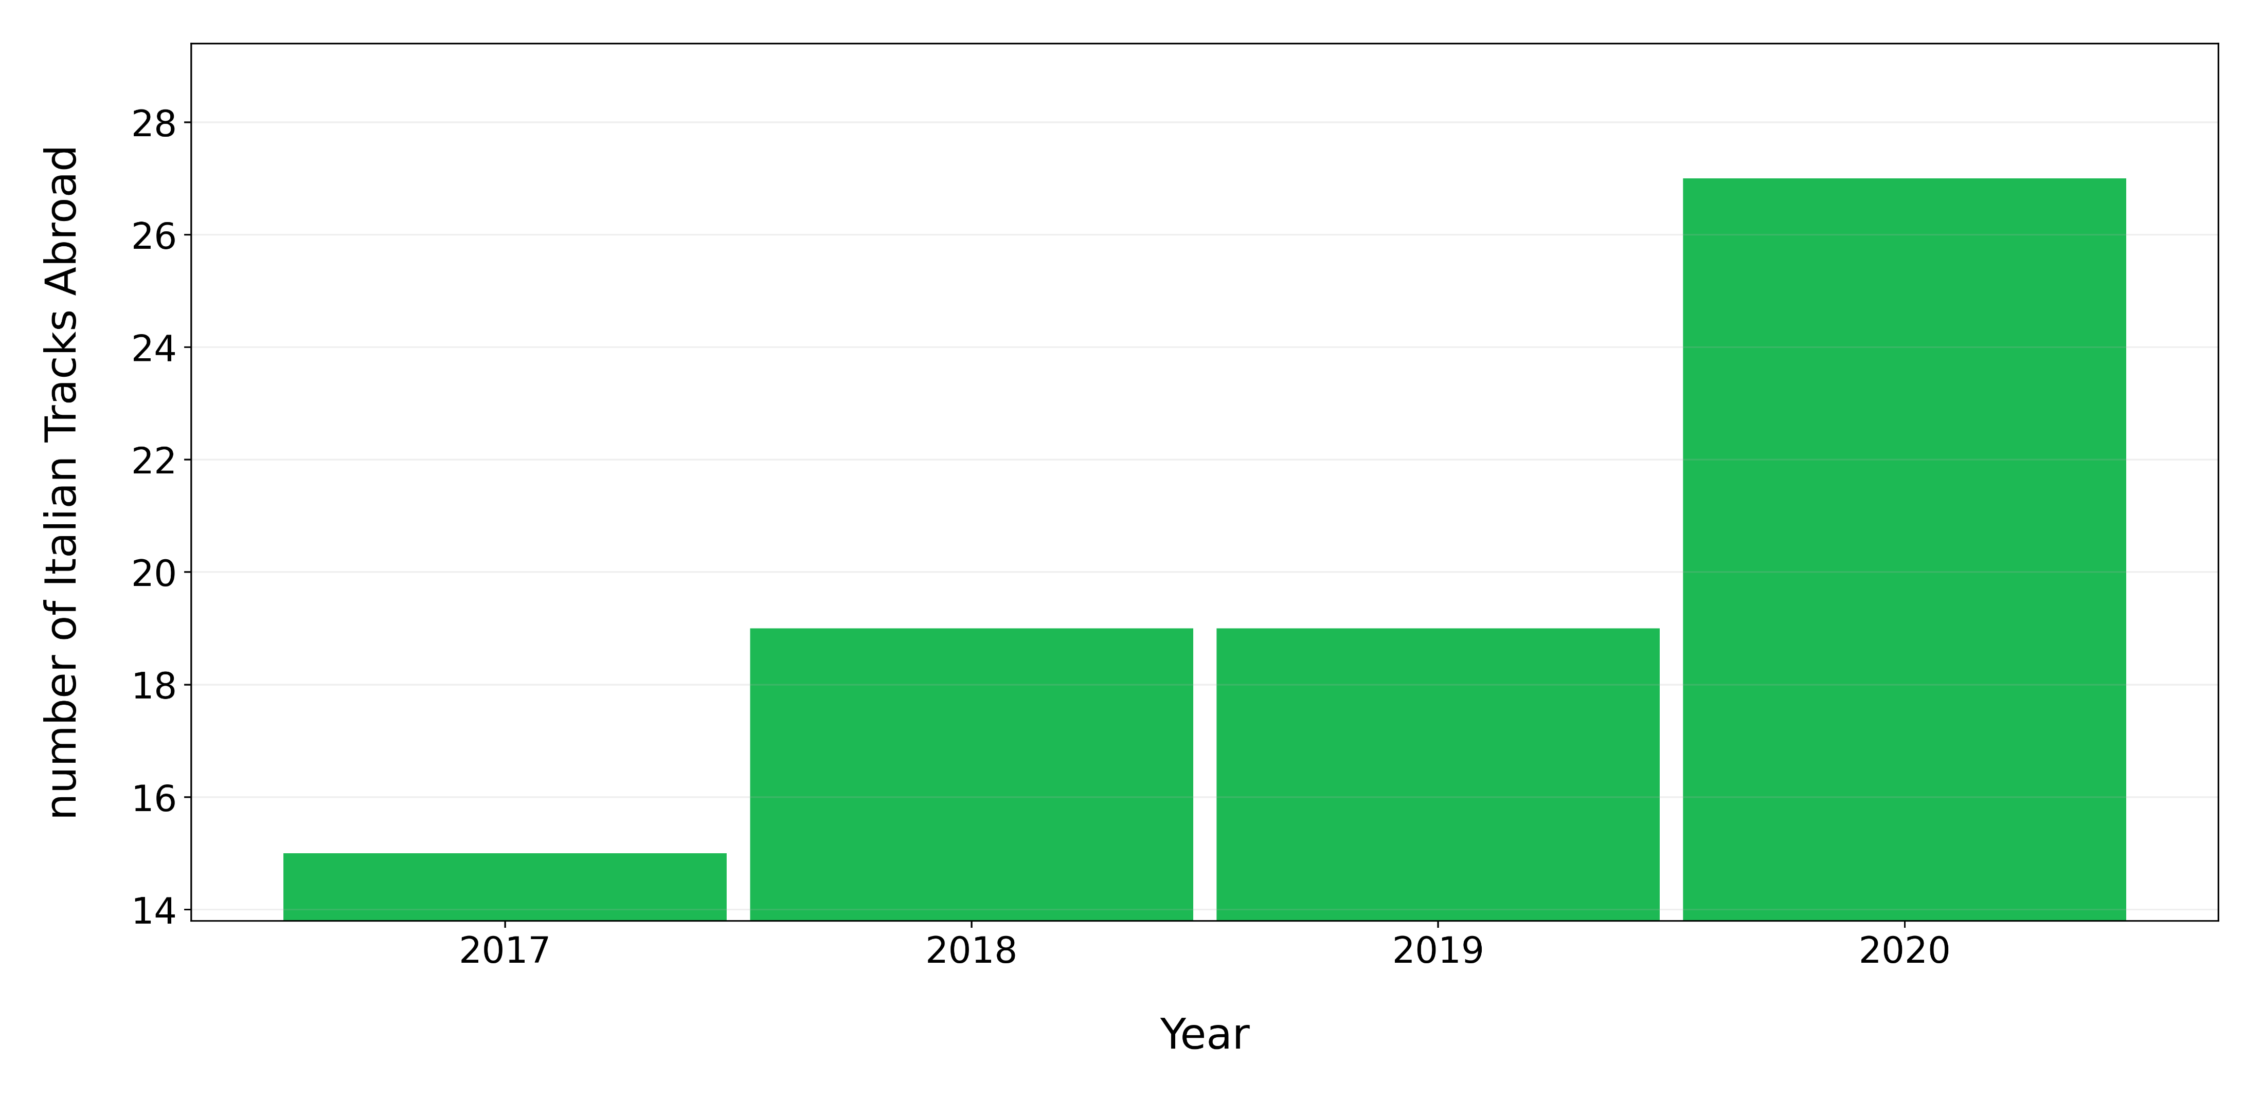
Q11: How many tracks from Italian artist are present in a Top 100 of a different country for each year

Slide 21
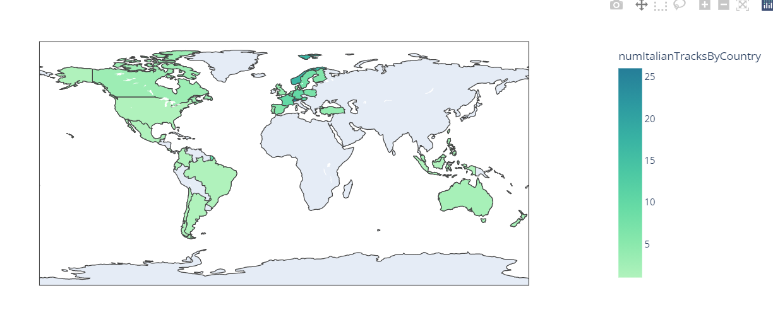
Show the countries that listen the most to Italian tracks

Slide 22
How to determine the most widespread Italian artists ?
Count how many different countries each artist has reached excluding Italy
Count how many distinct tracks have entered in a TOP 100 outside Italy

Slide 23
1st Approach
Gigi Dag

Slide 24
2° Approach
Sfera

Slide 25
References
Kaggle Spotify Dataset : https://www.kaggle.com/pepepython/spotify-huge-database-daily-charts-over-3-years?select=Database+to+calculate+popularity.csv
Spotify Web API : https://developer.spotify.com/documentation/web-api/
WikiData : https://www.wikidata.org/wiki/Wikidata:Main_Page
MusicBrainz : https://musicbrainz.org/

Slide 26
Thank you for the attention

