Slide 1



Team Project 2 : Property Graphs
Master’s in Computer Engineering
Database 2
Marco alecci , Luca martinelli, elia ziroldo
Academic year 2021/2022

Slide 2



Data Recap
Spotify’s Monthly Top 100 charts
35 countries from 2017-2020
Data enriched using WikiData and MusicBrainz APIs

Slide 3



Additional Data
Record Labels which have contracts with artists
Instruments played by artists
Gender of the artists

Slide 4
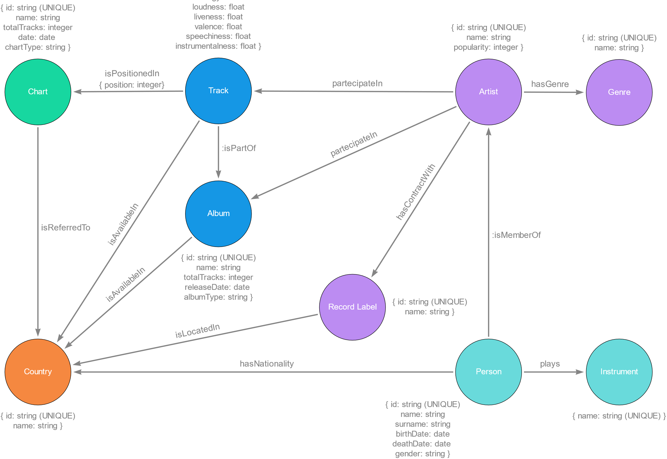
Model

Slide 5
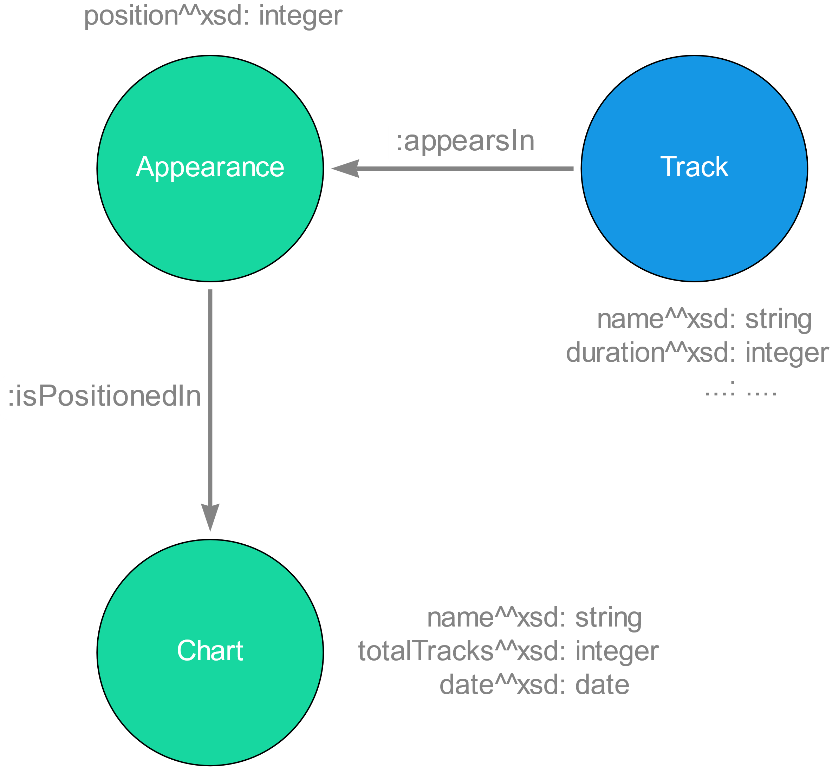
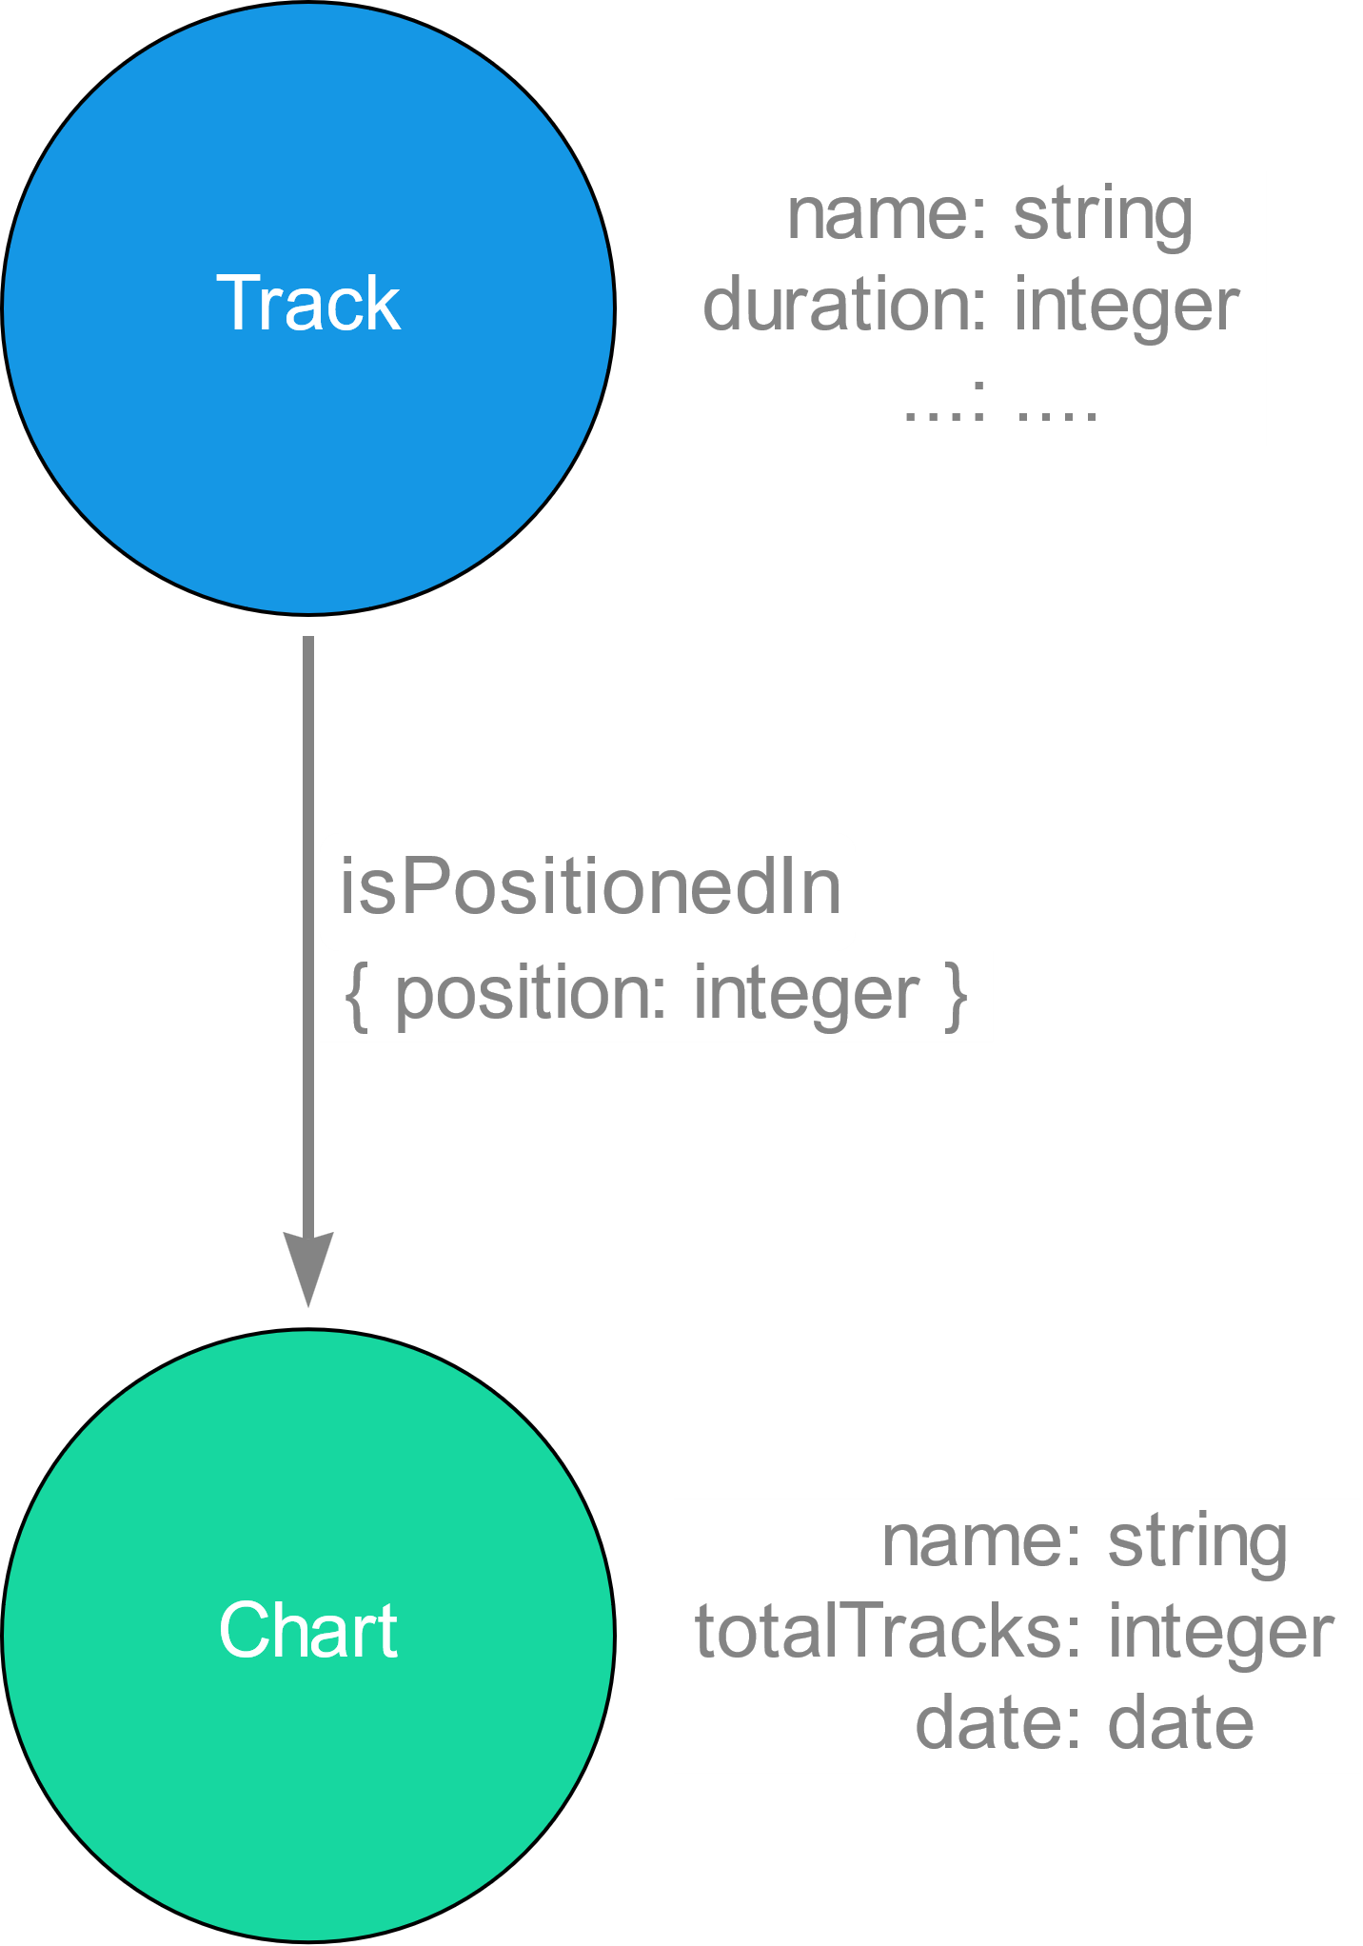
Model : Focus 1
RDF
Property Graphs

Slide 6
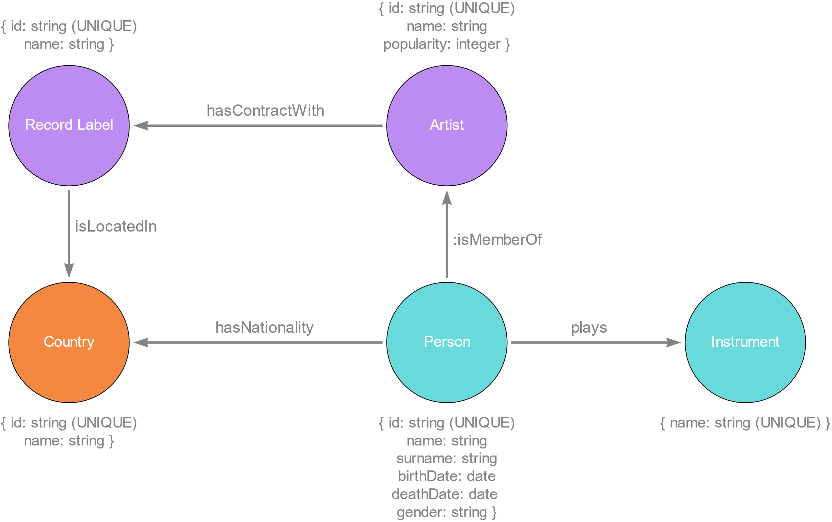
Model : Focus 2

Slide 7
Ingestion Phase

Slide 8
Ingestion Phase
MERGE
Check if already exists
CREATE
Not uniqueness check
CREATE +
UNIQUE CONSTRAINTS
Indexes created for the IDs
LOAD_CSV
with customized CSV files
Less control, but faster

Slide 9
Ingestion Phase
Tested with Intel-i5-5200U CPU @ 2.20GHz, 2195 Mhz and 8GB of RAM
Method | Genres | Countries | Artists | Albums | Tracks | Charts | People
MERGE | 16s | 7s | 3m 21s | 650m | 24H+ | / | /
CREATE | 16s | 6s | 3m 01s | 516m | 24H+ | / | /
CREATE + UNIQUE CONSTRAINTS | 15s | 4s | 2m 39s | 183m | 317m | 77m | 2m 41s
LOAD_CSV

Slide 10
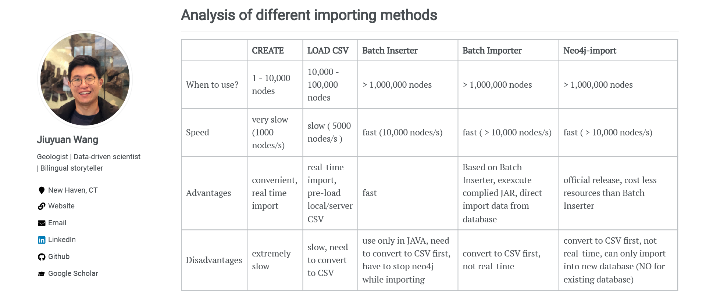
Ingestion Phase
Ref: https://julianwangnwu.github.io/posts/2019/06/import-neo4j/

Slide 11
Queries

Slide 12



Queries
Example Queries:
Show how it is possible to use the new added information such as record label and instruments
Italian Tracks and Italian Artists:
Study Italian tracks and artists present in the TOP 100 Italy
Italian Music Abroad:
Discover if Italian tracks are listened also outside Italy

Slide 13
Queries Part 1

Slide 14
Show …

Slide 15



Show the most common played instrument in rock groups.
Guitar
159 artists
Voice
127 artists
Drum Kit
67 artists

Slide 16
Queries Part 2

Slide 17
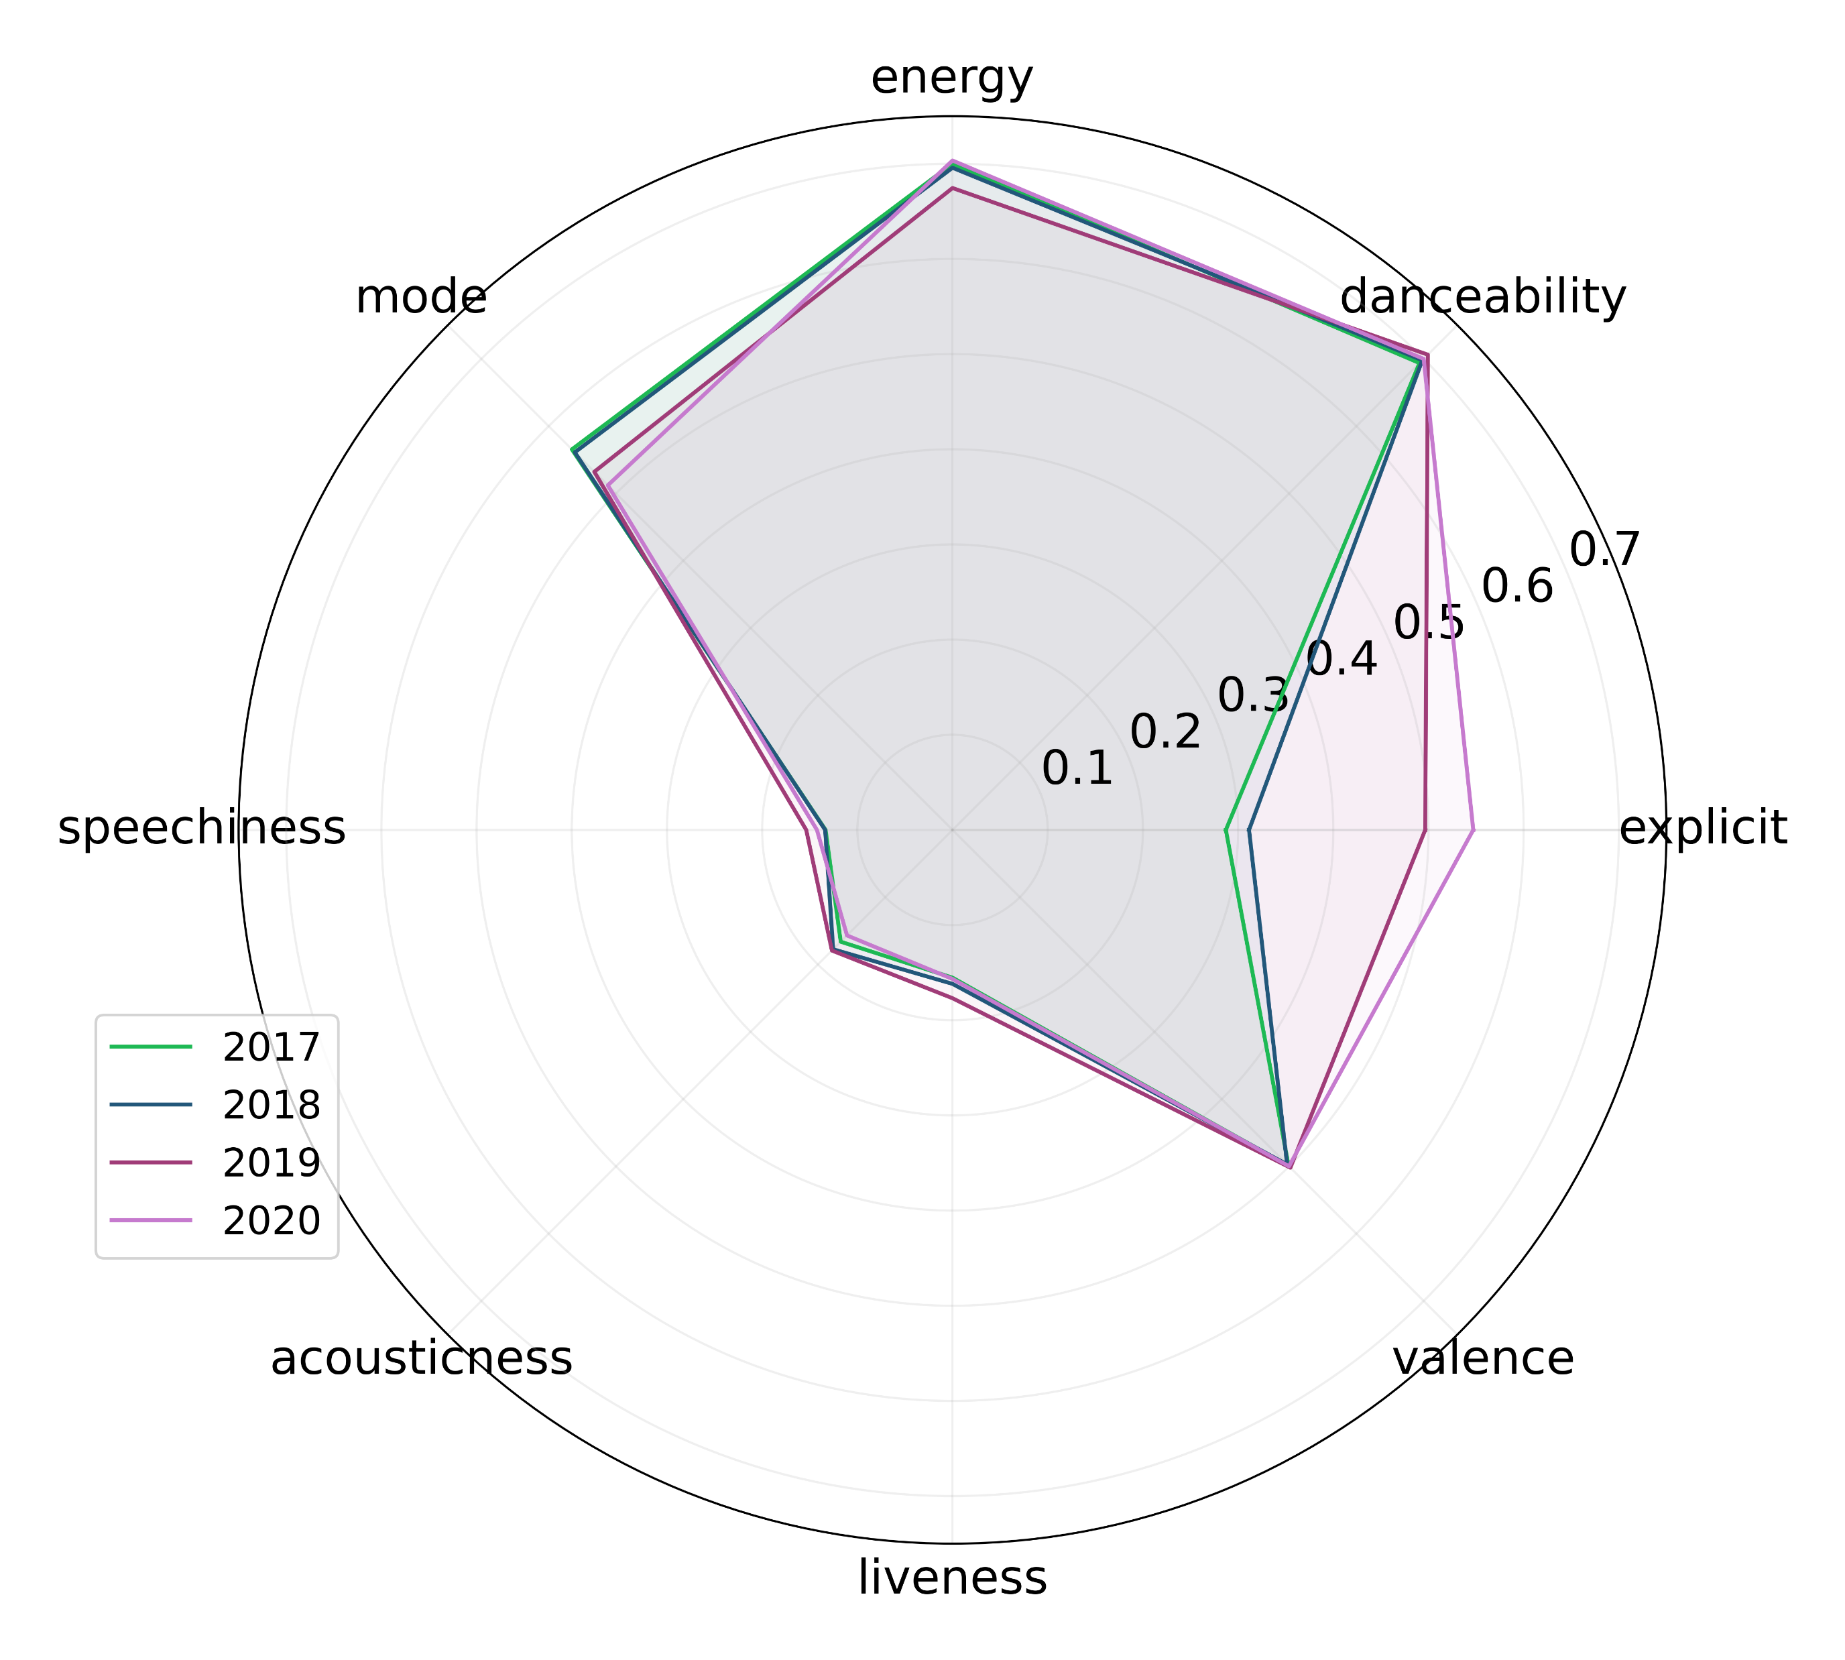
Show technical features of Italian Tracks through the years 2017-2020

Slide 18
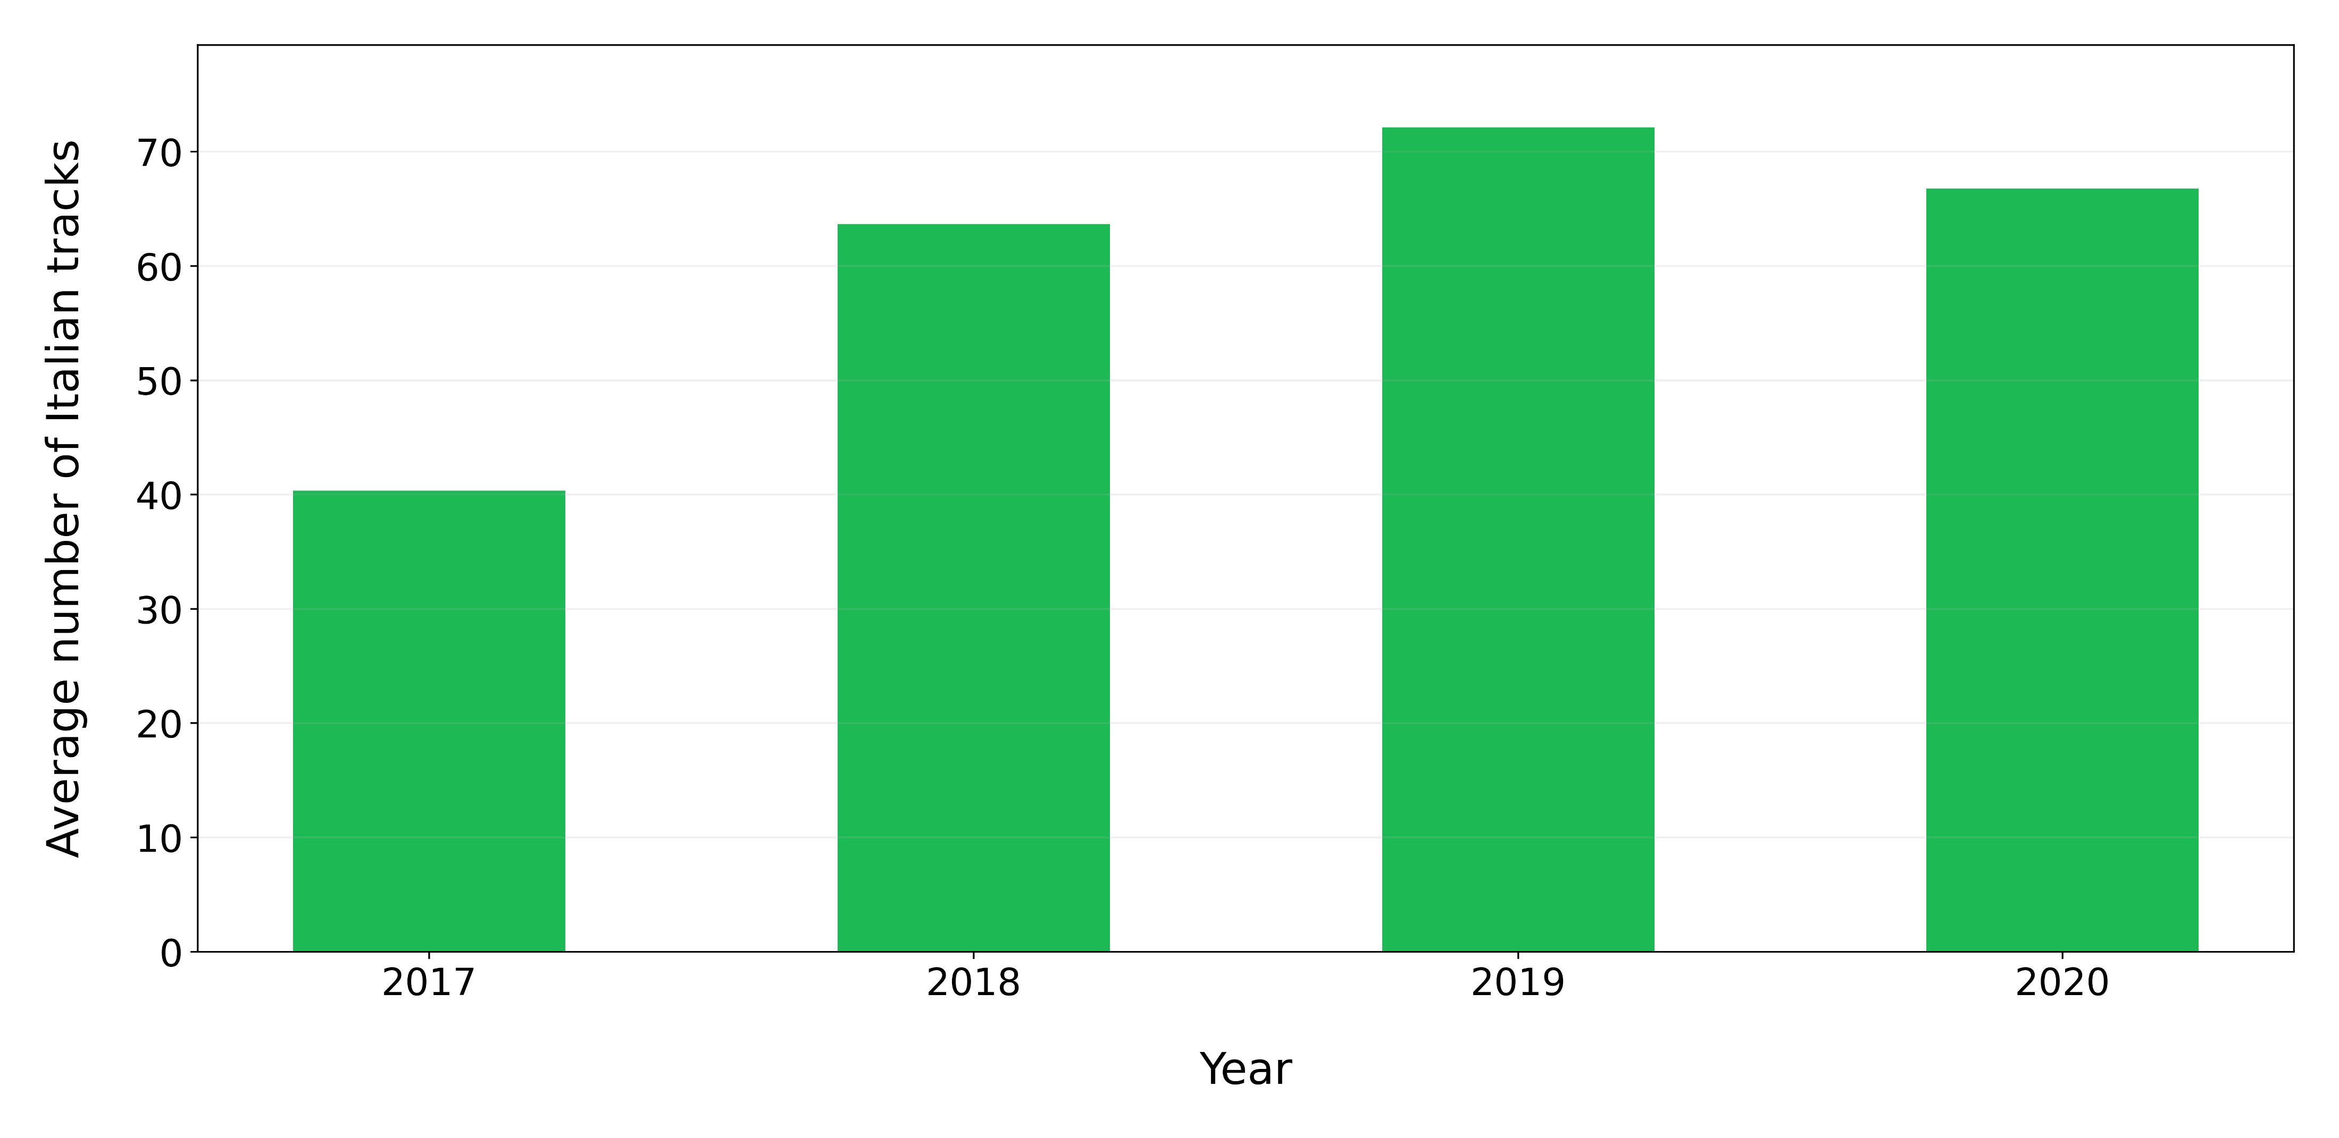
On average how many Italian tracks are present in Top 100 Italy for each year?

Slide 19
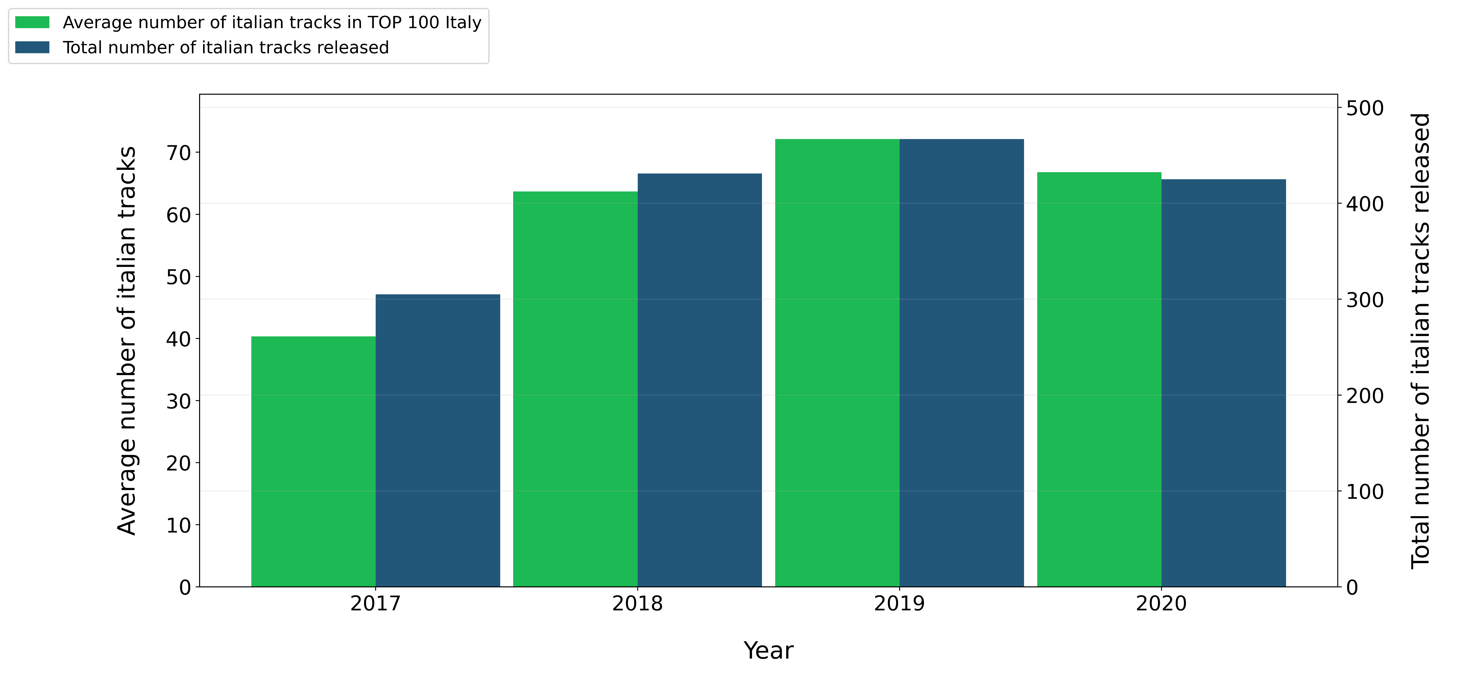
How many Italian tracks were released every year from 2017 to 2020 ?

Slide 20
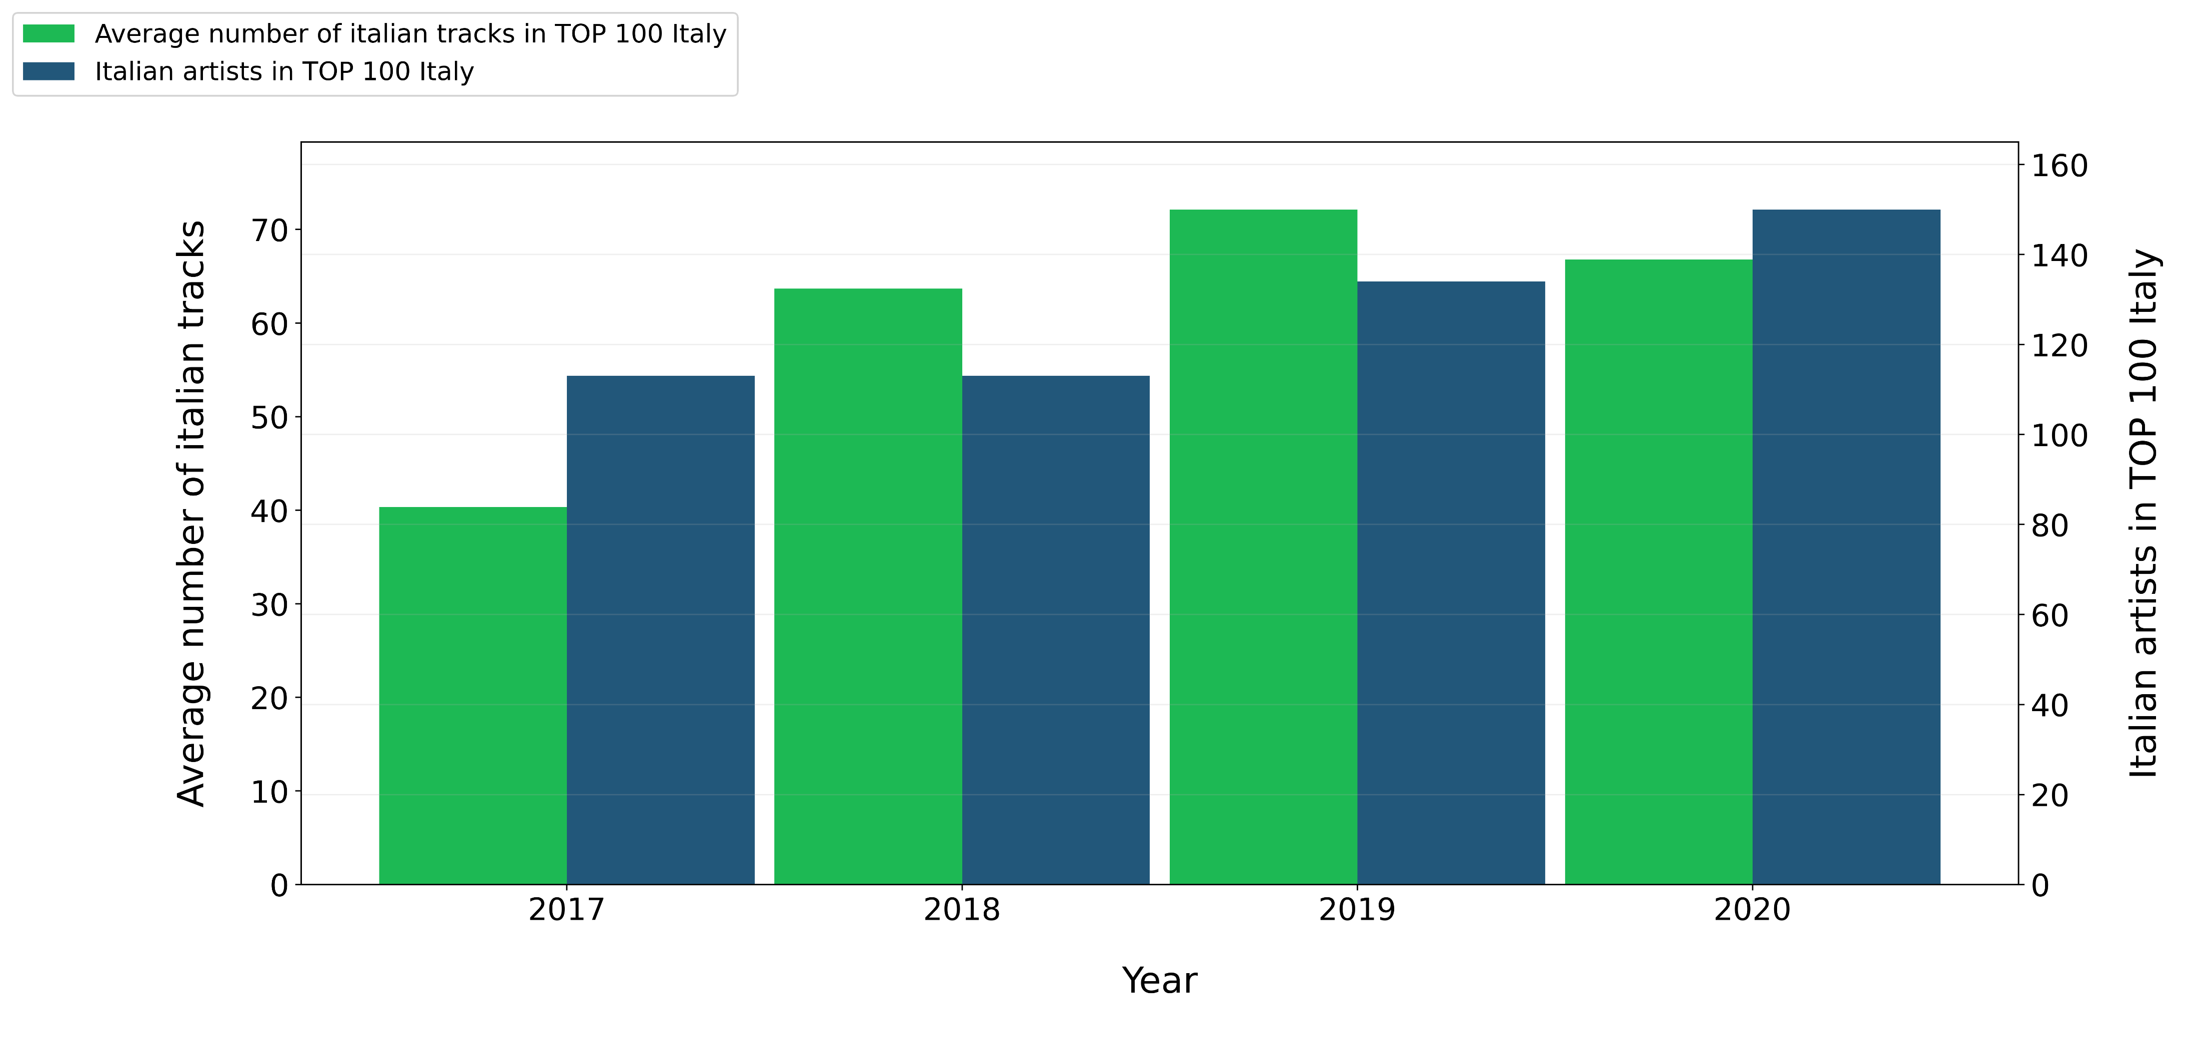
How many different Italian artist entered in Top 100 Italy for each Year ?

Slide 21
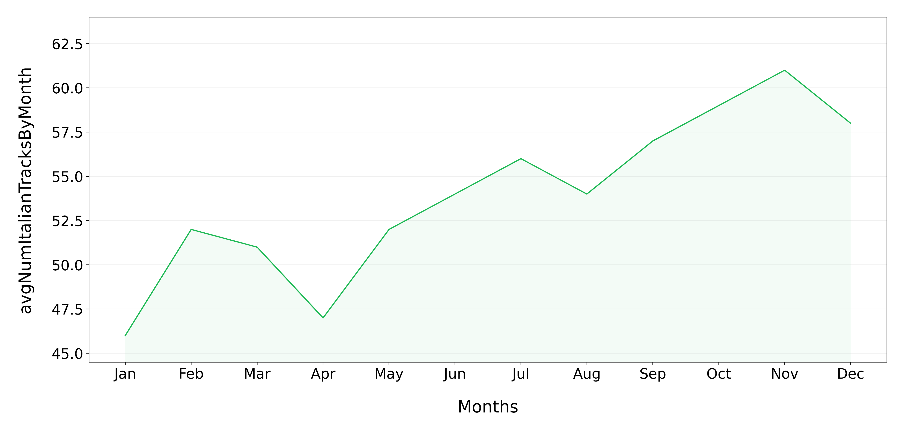
On average how many Italian tracks are present in Top 100 Italy through the different months of the year ?

Slide 22
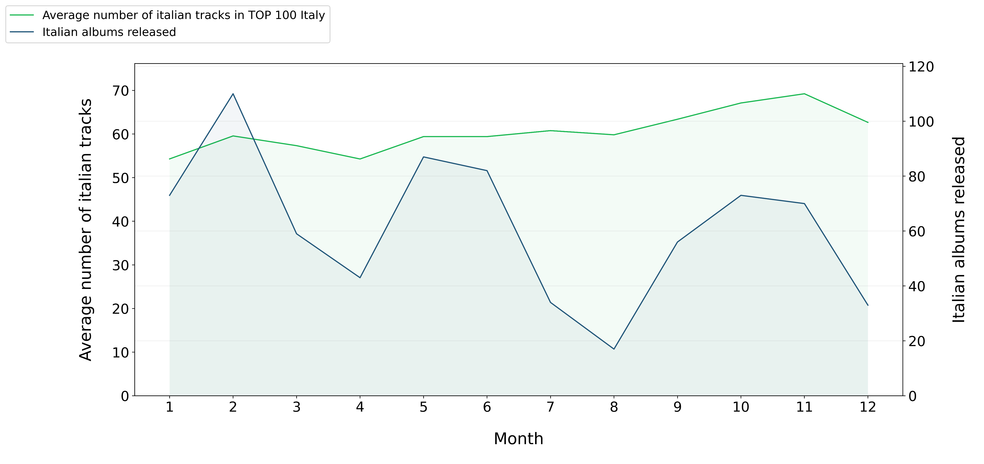
How many albums from Italian artists are released through the different months of the year ?

Slide 23
How many albums from Italian artists are released through the different months of the year ?

Slide 24




Show the Italian artist with the highest number of tracks present in Top 100 Italy for each year.
2017
Guè, 30 Tracks
2018
Gemitaiz, 31 Tracks
2019
Lazza, 35 Tracks
2020
Tha Supreme, 40 Tracks

Slide 25
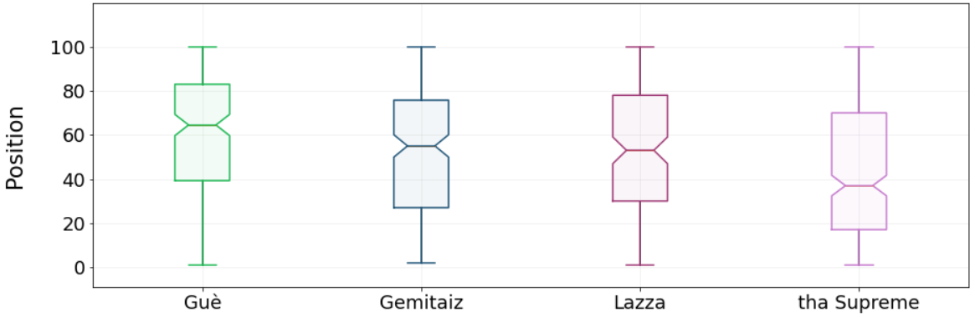
Show the distribution of the positions in the TOP 100 Italy reached by the just retrieved artists

Slide 26





Show the top 3 Italian artists with the highest number of tracks present in Top 100 Italy at the same time.
Tha Supreme
17th Nov 2019
24 tracks
Tedua
14th June 2020
21 tracks
Marracash
17th Nov 2019
19 tracks

Slide 27



Check if these artists released an album on the same month (or previous one) of the chart in which they have the highest number of tracks.
Tha Supreme
17th Nov 2019
24 tracks
Tedua
14th June 2020
21 tracks
Marracash
17th Nov 2019
19 tracks
“23 6451”
15th Nov 2019
“Vita Vera Mixtape”
5th June 2020
“Persona”
31th Oct 2019

Slide 28
Queries Part 3

Slide 29
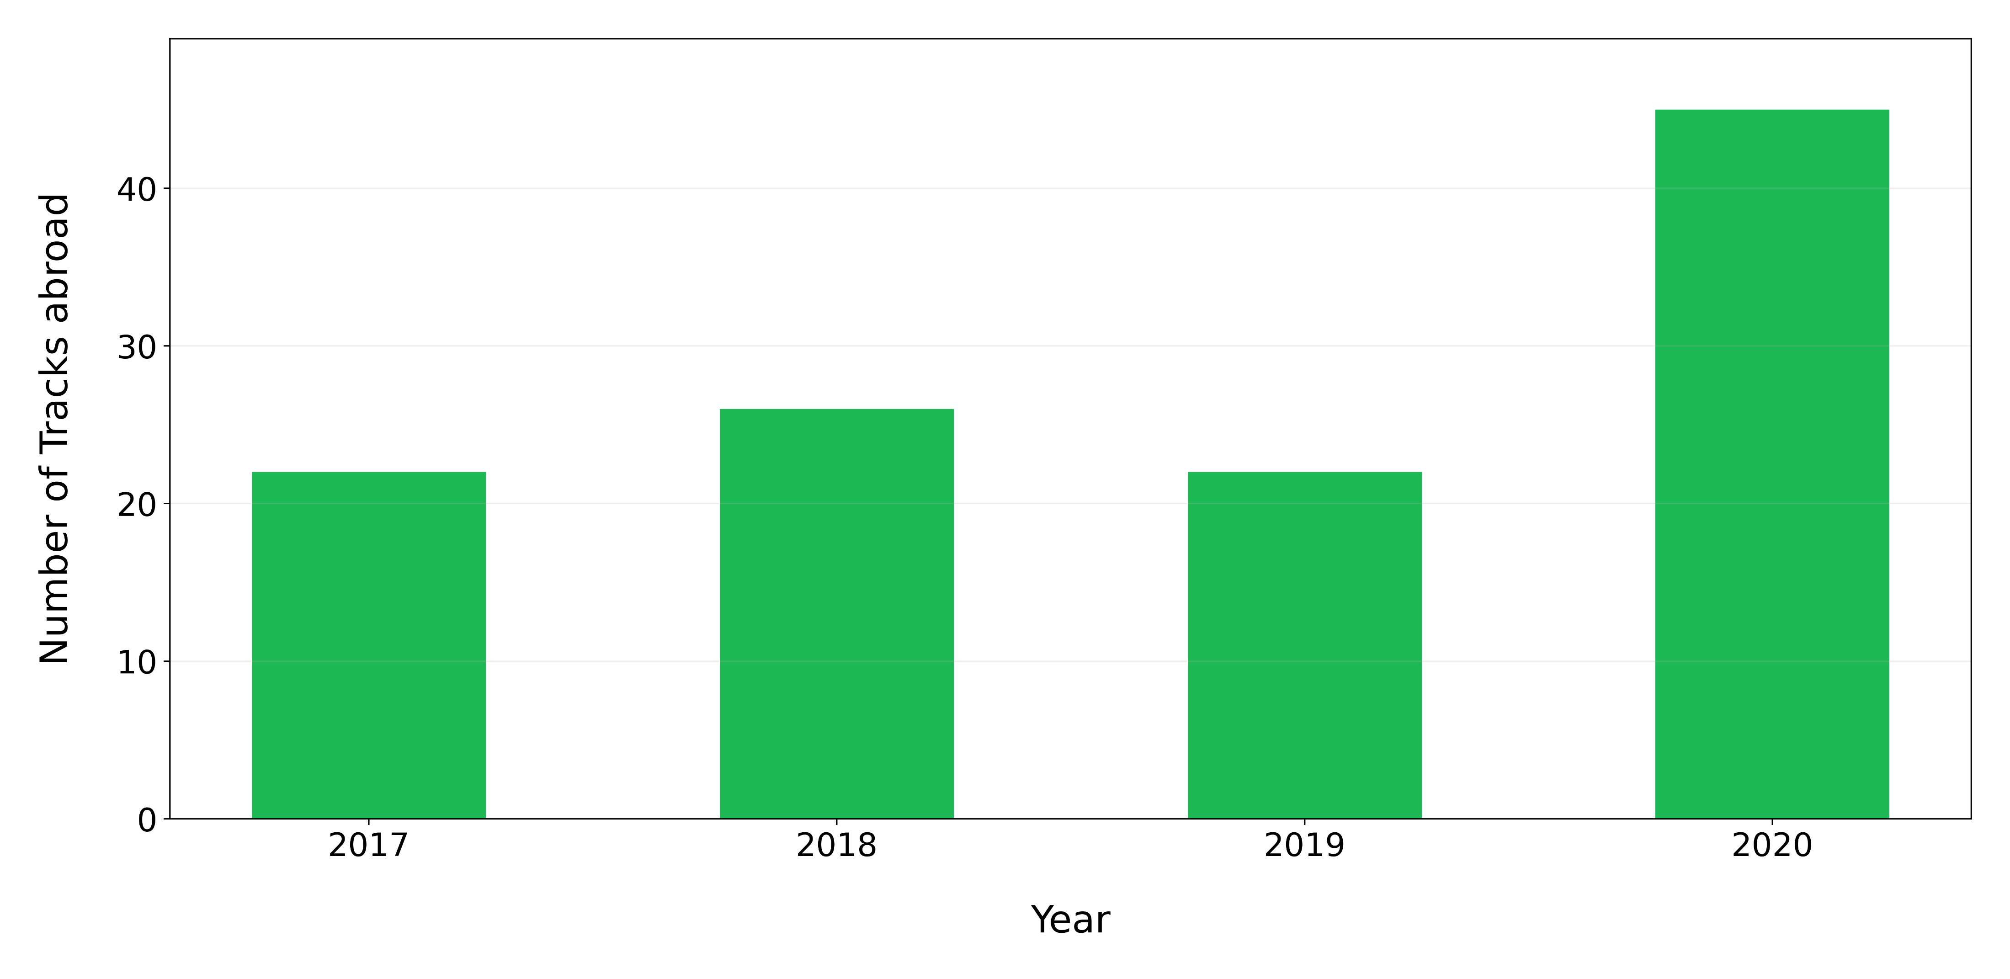
How many Italian tracks are present in a Top 100 of a country different from Italy for each year ?

Slide 30
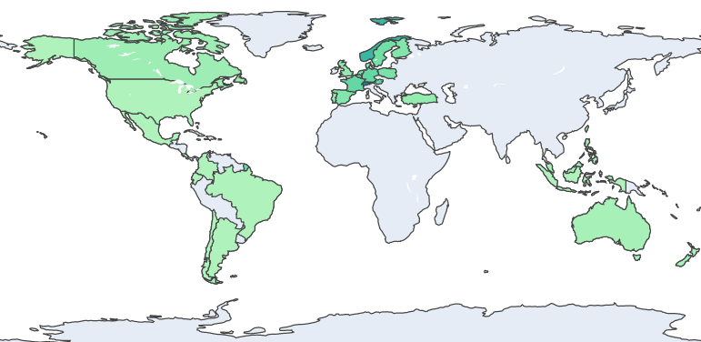
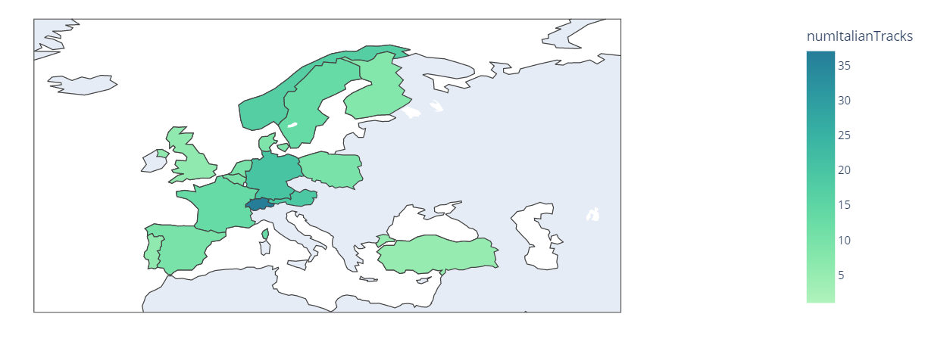
Show the countries that listen the most to Italian tracks

Slide 31
Show the countries that listen the most to Italian tracks

Slide 32
How to determine the most widespread Italian artist ?
1st Approach:
Count, for each artist, how many different countries he/she has reached excluding Italy.
2nd Approach:
Count, for each artist, how many of his tracks have entered in a TOP 100 of a country different from Italy

Slide 33


How to determine the most widespread Italian artist ?
1st Approach:
Gigi D’Agostino
30 different countries excluding Italy
2nd Approach:
Sfera Ebbasta
12 tracks in a TOP 100 of a country different from Italy

Slide 34
References
Kaggle Spotify Dataset : https://www.kaggle.com/pepepython/spotify-huge-database-daily-charts-over-3-years?select=Database+to+calculate+popularity.csv
Spotify Web API : https://developer.spotify.com/documentation/web-api/
WikiData : https://www.wikidata.org/wiki/Wikidata:Main_Page
MusicBrainz : https://musicbrainz.org/
Neo4j Ingestion Analysis: https://julianwangnwu.github.io/posts/2019/06/import-neo4j/

Slide 35
Thank you for the attention

