Slide 1



Team Project 2 : Property Graphs
Master’s in Computer Engineering
Database 2
Marco alecci , Luca martinelli, elia ziroldo
Academic year 2021/2022

Slide 2
Data: Recap
Spotify’s Monthly Top 100 charts
35 countries from 2017-2020
Initial data enriched with:
Genre
Albums
Track
Charts
Artist
People

Slide 3
Data: Additions

Slide 4
Model

Slide 5
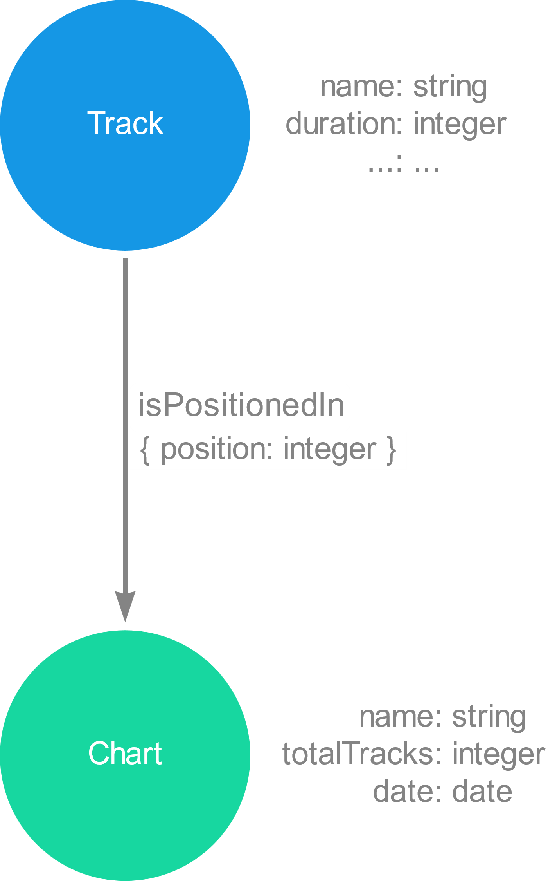
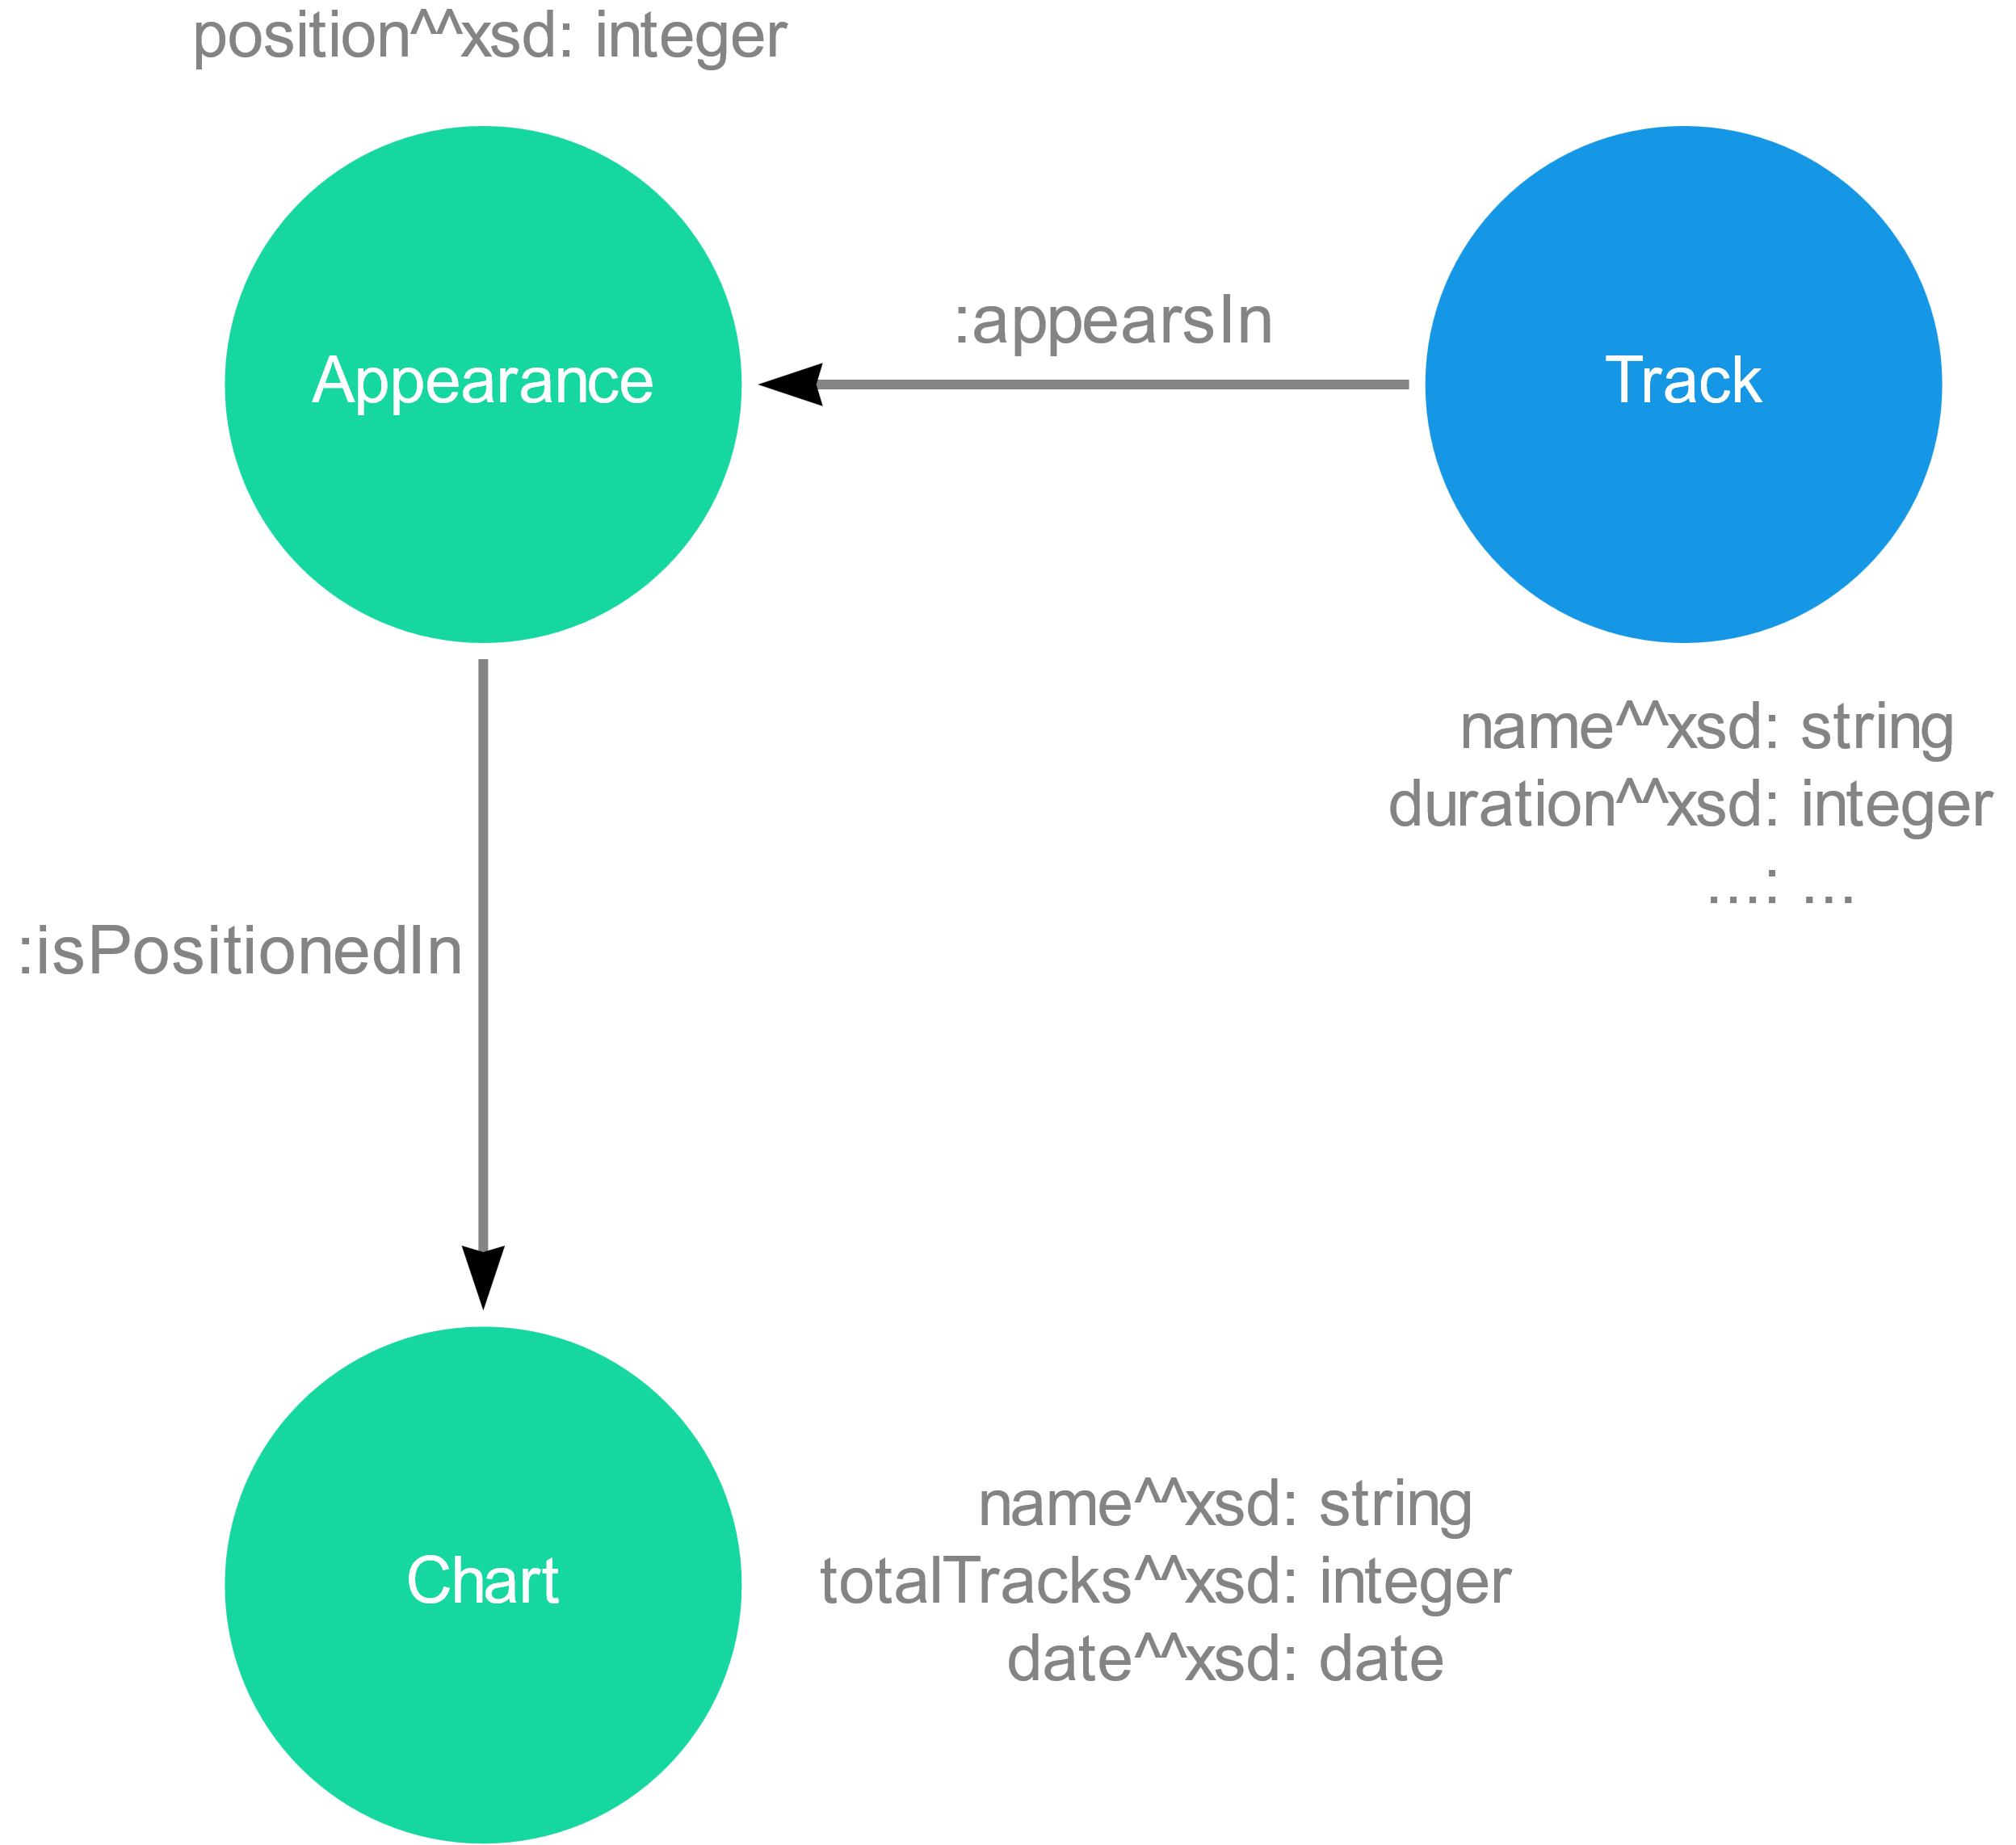
Model : Focus
RDF: dummy node for the position of a track
PG: position as property of the relation

Slide 6
Model : Focus
Focus sulle cose nuove

Slide 7
Ingestion Phase
MERGE
CREATE
CREATE + UNIQUE CONSTRAINTS
LOAD_CSV with customized CSV files

Slide 8
Ingestion Phase
Method | Genres | Countries | Artists | Albums | Tracks | Charts | People
MERGE
CREATE
CREATE + UNIQUE CONSTRAINTS
LOAD_CSV

Slide 9
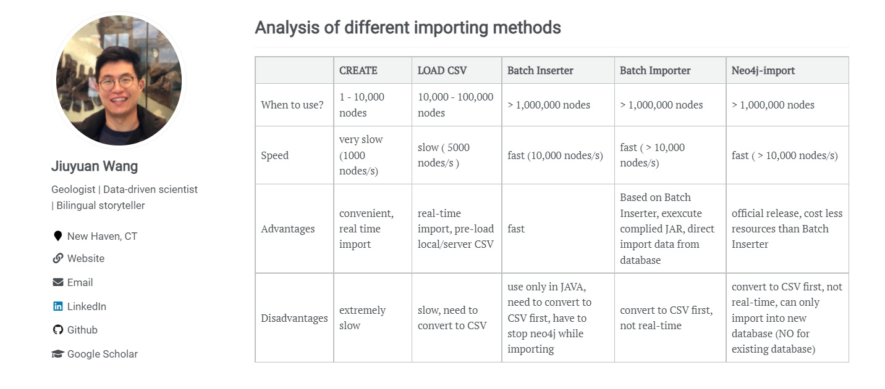
Ingestion Phase
Ref: https://julianwangnwu.github.io/posts/2019/06/import-neo4j/

Slide 10
Queries

Slide 11
Queries
Example Queries
Show how it is possible to use the new added information
Italian Tracks and Italian Artists
Study Italian tracks and artists present in the TOP 100 Italy
Italian Music Abroad
Discover if Italian tracks are listened also outside Italy
such as record label and instruments

Slide 12
Queries Part 1

Slide 13
Show …

Slide 14



Show the most common played instrument in rock groups.
Guitar
159 artists
Voice
127 artists
Drum Kit
67 artists

Slide 15
Queries Part 2

Slide 16
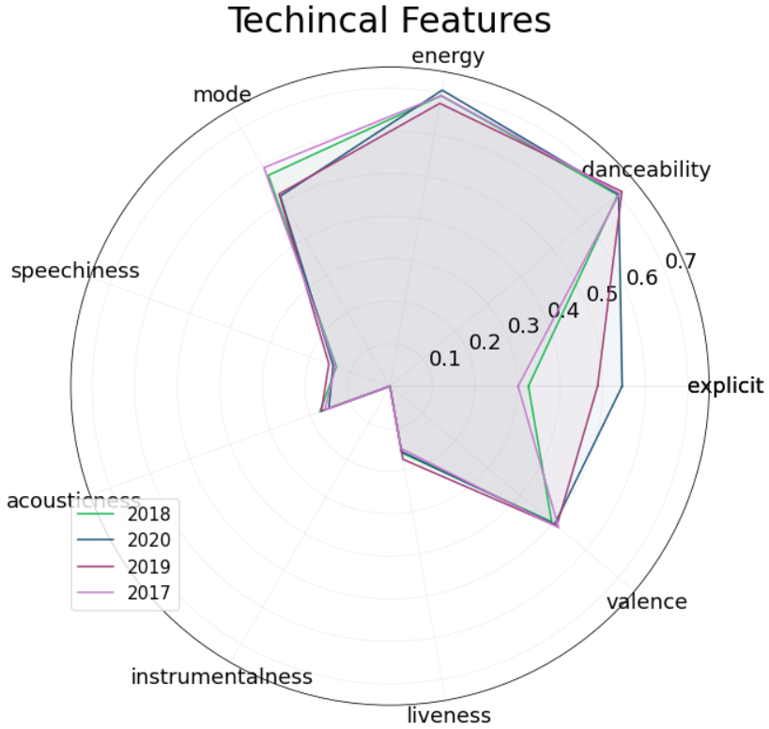
Show technical features of Italian Tracks through the years 2017-2020

Slide 17
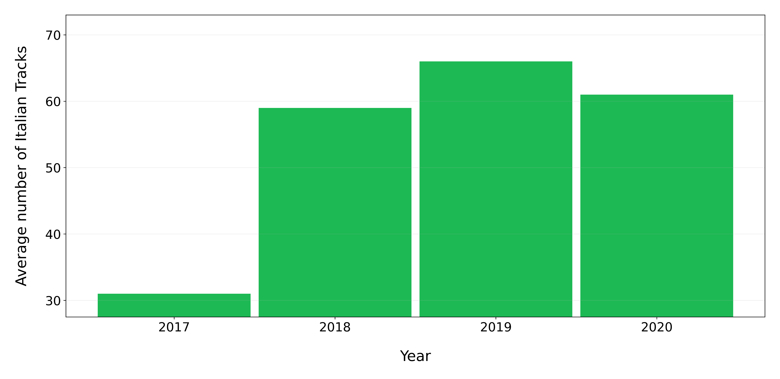
On average how many Italian tracks are present in Top 100 Italy for each year?

Slide 18
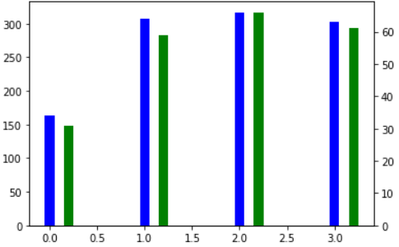
How many Italian tracks were released every year from 2017 to 2020 ?

Slide 19
How many different Italian artist entered in Top 100 Italy for each Year ?

Slide 20
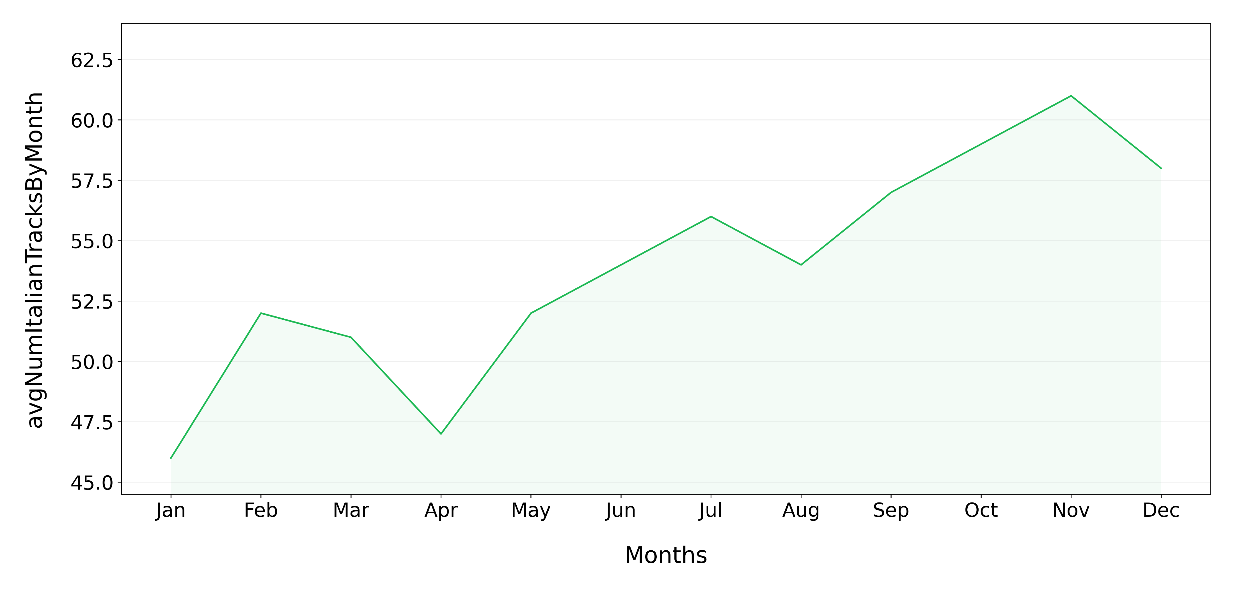
On average how many Italian tracks are present in Top 100 Italy through the different months of the year ?

Slide 21
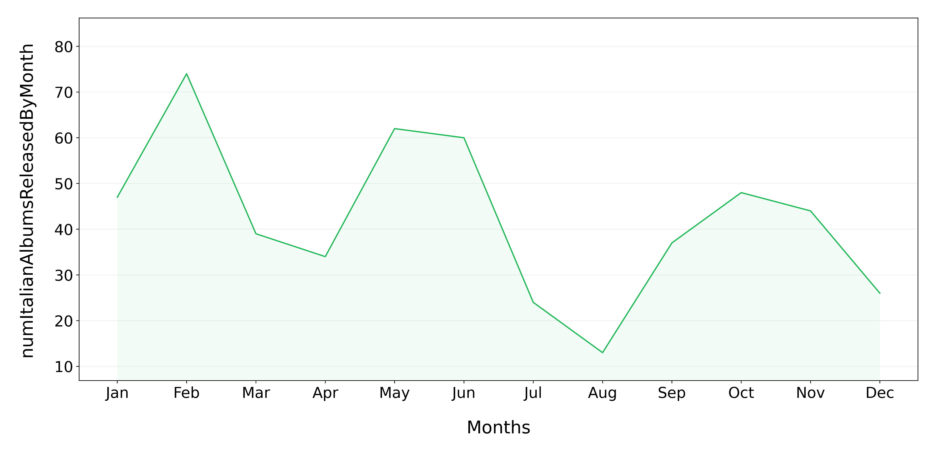
How many albums from Italian artists are released through the different months of the year ?

Slide 22




Show the Italian artist with the highest number of tracks present in Top 100 Italy for each year.
2017
Guè, 30 Tracks
2018
Gemitaiz, 31 Tracks
2019
Lazza, 35 Tracks
2020
Tha Supreme, 40 Tracks

Slide 23
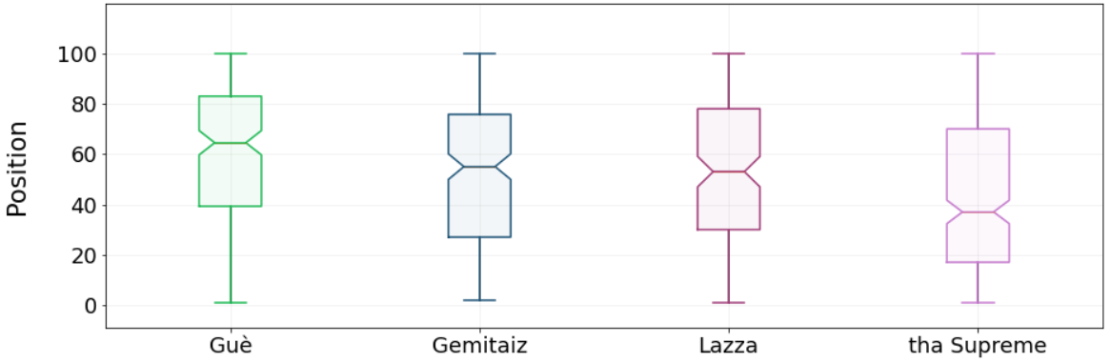
Show the distribution of the positions in the TOP 100 Italy reached by the just retrieved artist

Slide 24





Show the top 3 Italian artists with the highest number of tracks present in Top 100 Italy at the same time.
Tha Supreme
17th Nov 2019
24 tracks
Tedua
14th June 2020
21 tracks
Marracash
17th Nov 2019
19 tracks

Slide 25



Check if these artists released an album on the same month (or previous one) of the chart in which they have the highest number of tracks.
Tha Supreme
17th Nov 2019
24 tracks
Tedua
14th June 2020
21 tracks
Marracash
17th Nov 2019
19 tracks
“23 6451”
15th Nov 2019
“Vita Vera Mixtape”
5th June 2020
“Persona”
31th Oct 2019

Slide 26
Queries Part 3

Slide 27
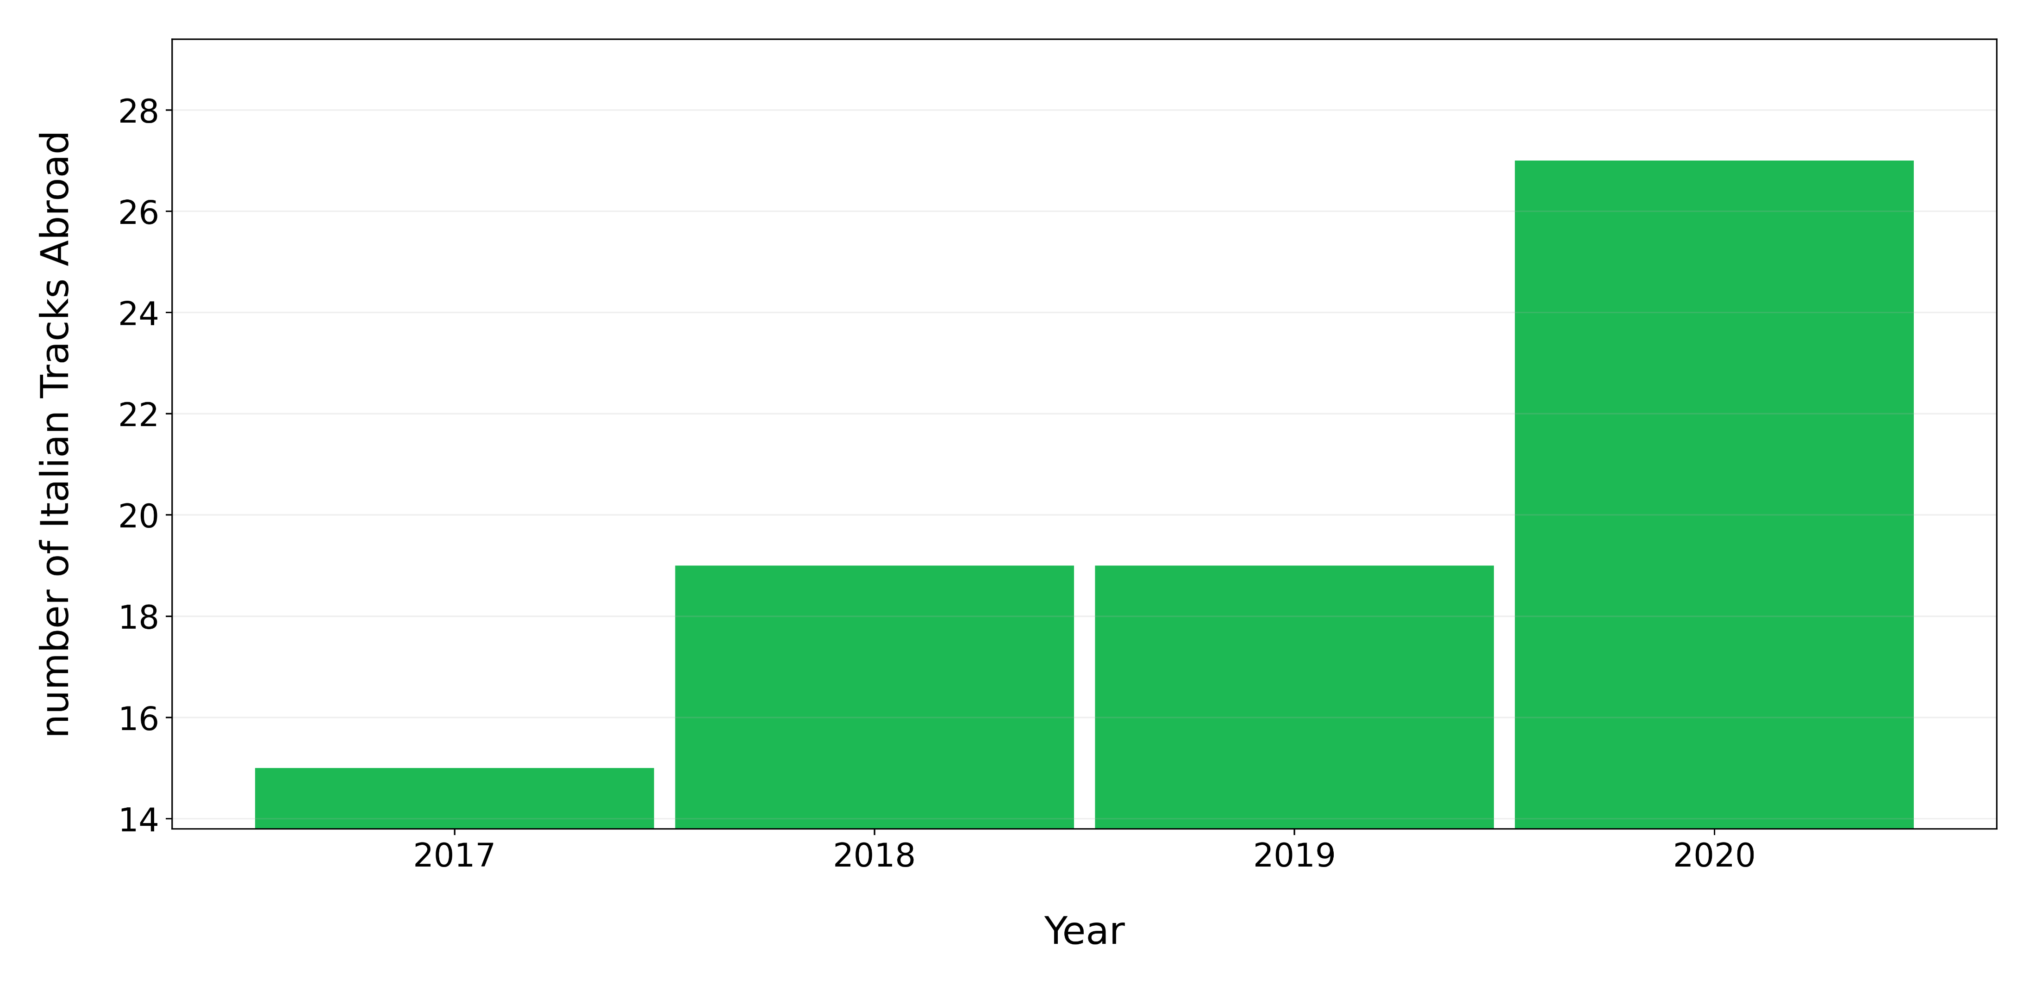
How many Italian tracks are present in a Top 100 of a country different from Italy for each year ?

Slide 28
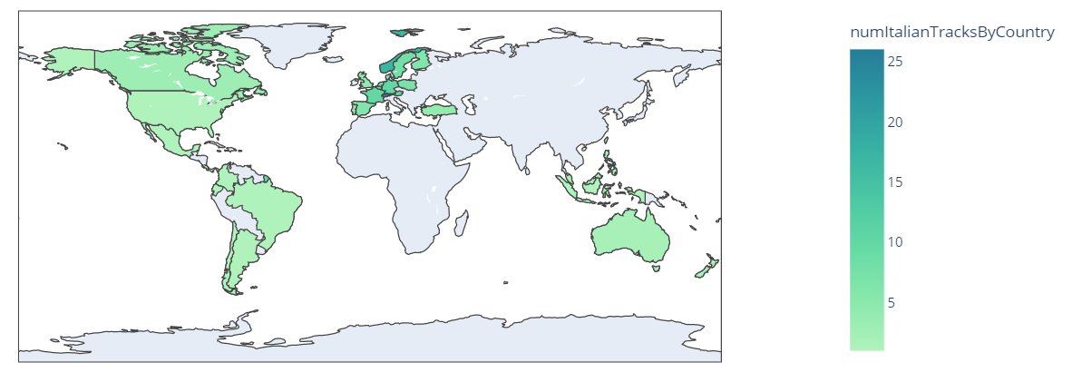
Show the countries that listen the most to Italian tracks

Slide 29
How to determine the most widespread Italian artists ?
1st Approach:
Count, for each artist, how many different countries he/she has reached excluding Italy.
2nd Approach:
Count, for each artist, how many of his tracks have entered in a TOP 100 of a country different from Italy

Slide 30


How to determine the most widespread Italian artists ?
1st Approach:
Gigi D’Agostino
30 different countries excluding Italy
2nd Approach:
Sfera Ebbasta
12 tracks in a TOP 100 of a country different from Italy

Slide 31
References
Kaggle Spotify Dataset : https://www.kaggle.com/pepepython/spotify-huge-database-daily-charts-over-3-years?select=Database+to+calculate+popularity.csv
Spotify Web API : https://developer.spotify.com/documentation/web-api/
WikiData : https://www.wikidata.org/wiki/Wikidata:Main_Page
MusicBrainz : https://musicbrainz.org/

Slide 32
Thank you for the attention

