Slide 1
Amazon Reviews ingestion - Takeaway.com interview technical challenge -
Mr. Luca Mircea
Delivered on 13 May 2024

Slide 2
Premise
Part of the selection process for an Analytics Engineer
Show technical skills + data management abilities + thinking/conceptualization
Task: design data warehouse tables + ETLs to populate them
Design data model (i.e. the logic of the data)
Implement it as code
Resolution: GitHub repository with Dockerized code
www.github.com/luca-mircea/amazon-reviews-ingestion

Slide 3
Battle plan
In practice, there is always back-and-forth between steps & reiteration. Nonetheless, the plan (in theory) is:
Have a look at the data to understand what it represents and how it’s structured
Design the data model, i.e. the logic according to which the data will be stored in the final result
Implement the code that structures the data according to the model

Slide 4
Step 1: Preliminary analysis
Data clean to begin with:
Very few NULLs, missing in logical places
No duplicates
Mostly one per row, no messy identification process
Some lack of uniformity, e.g. sometimes missing data is NULL, other times ‘{ }’ (in the same column)
Main challenges:
Nested lists and dictionaries
How to manage many-to-X relationships

Slide 5
Step 2: Data model – logic & considerations
The raw data consists of reviews of Amazon items + item metadata
The main logical entities underpinning the model are products and reviews
Other relevant entities that can be distilled: reviewers, date info, related_items, item_categories, rankings
Based on the challenge requirements & present data I opted for a hybrid model, a combination of Kimball and Data Vault 2.0
Kimball because I’m following the facts & dimensions logic + normalization
Data vault 2.0 because of hub tables (tables with only the PK column that identifies an entity) + good way to manage edge cases and many-to-many relationships by adding many satellite tables:
Use cases needing the product images will rarely need the sales rank or the related items, and v-versa
Items belong to multiple categories <- easier to manage through tables different from the “main” one

Slide 6
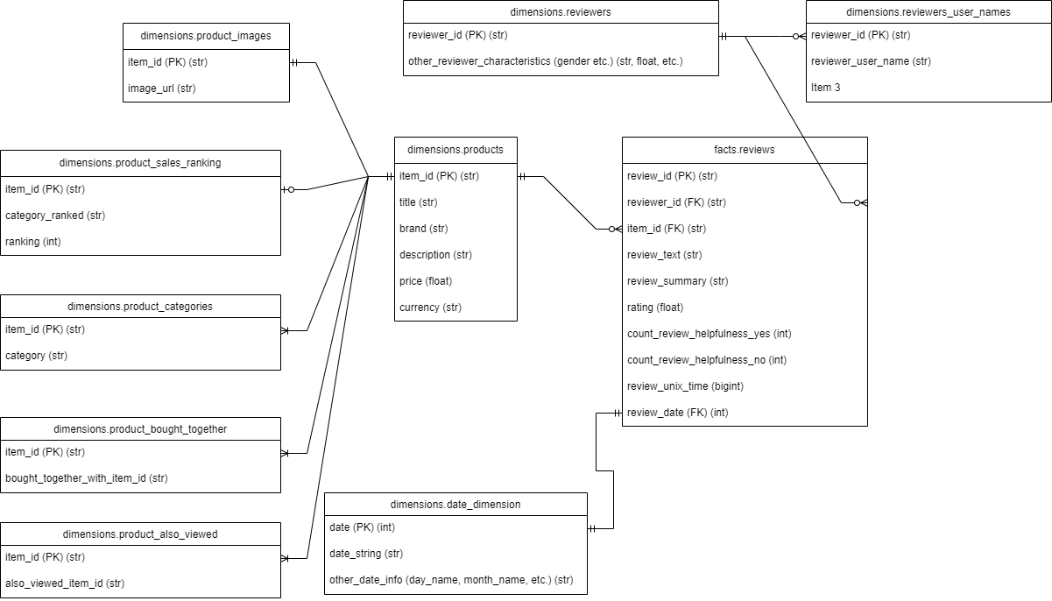
Step 2 (cont.): Data model – final result

Slide 7
Step 3: Code implementation
The requirements match the regular Extract-Transform-Load (ETL) pattern
Code structured in each of these steps
High degree of reusability:
Functions for validating data and handling nulls are abstracted and therefore data-agnostic, which is why they can be copied into similar projects
Using configurations stored in .yml files that are easy to adjust
APIInteractor class is neat for future API ingestion projects
Code implemented to read & write data to/from multiple locations
Main method delivered: to and from AWS S3 as a mock database + API endpoint
Code implemented with entry points & parameters
Can be run in Airflow to take advantage of {{ data_interval_start }} and _end macros
Can run every hour/day/15 min for incremental processing

Slide 8
Step 3 (cont.): Trade-offs present in code
There are always trade-offs involved when writing code:
Most salient: readability vs. performance. When working with others, it’s extra nice to write readable code, with the efficiency losses being minor. Hence list comprehension instead of .map; for-loop only as a last resort
Testing required: list comprehension and map have different speeds depending on the data size => should prototype & experiment (no time now)
With data this large, we should discuss EMR/Spark
NULL handling:
When done right, leaving empty data saves database costs
There needs to be alignment + uniformity in the company, otherwise NULLs can create errors + confusion
I preferred here to err on the side of caution and replace NULLs with clearly-wrong values that become obvious to analysts & scientists faster

Slide 9
Step 3 (cont.): data processing & validation
The steps to pre-process the data were as follows:
Reviews:
Created unique review_id out of item_id + reviewer_id
Parsed strangely formatted date string from ‘MM D, YYYY’ to a neat int in the format ‘YYYYMMDD’ (with zero-padding)
Parsed list of helpfulness votes into independent columns
Metadata:
Removed unnamed index column
Flatten nested lists/dictionaries for sales_rank, categories, related items
The validations were:
Checking for uniqueness of PKs in key tables + dropping rows where the PK is null (because useless data; there were no such instances)
Under normal circumstances I’d try to understand where the NULLs are coming from and see if I can fix them
Checking if the UNIX date matches the string date
Checking if all the rankings show up in the categories (they don’t) <- this would affect the data model

Slide 10
Step 3 (cont.): data processing steps in ETL
Uniform steps were applied to the data (step 0. is loading it in):
Process the columns that need adjusting in the raw data
Split the data into slices that will turn into the final tables
Rename columns
Do further processing if required, e.g. flatten nested lists or dictionaries
Handle NULLs (drop, fill with “Unknown” or -1, or raise errors)
Explicitly convert the results to specific data types
Upload each dataset to its corresponding table

Slide 11
Step 3 (cont.): if I had infinite time…
Further steps I’d take:
Add unit tests, especially for the final function before the upload
Create nicer mock DWH + API with date parameters used to slice the data into efficient-to-process chunks
Query the resulting data with AWS Athena or similar to check if the result matches the specification
(Maybe) analyze the data to see the reviews, out of curiosity

Slide 12
Step 3 (cont.): if I had infinite time…
Further steps I’d take:
Add unit tests, especially for the final function before the upload
Create nicer mock DWH + API with date parameters used to slice the data into efficient-to-process chunks
Query the resulting data with AWS Athena or similar to check if the result matches the specification
(Maybe) analyze the data to see the reviews, out of curiosity

Slide 13
Running instructions
The instructions are explained in detail in an additional document, but the gist is:
Clone the GitHub repo
Download the credentials file from the secret-sharing link, paste them into a .txt file called .env, move this to src/credentials
Build the docker image: docker build –t takeaway-challenge .
Run the desired task: docker run takeaway-challenge python entrypoint.py --task_name process_raw_reviews_data_without_timestamps (can replace reviews_data with metadata for the other dataset)
Check success with docker run takeaway-challenge python entrypoint.py --task_name check_successful_completion

Slide 14
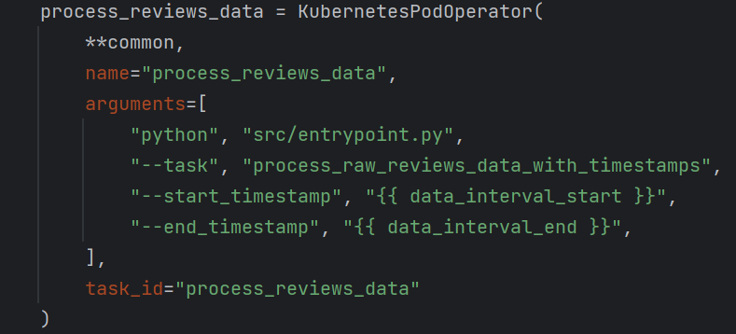
Scheduling on AirFlow
I coded the functions & Docker to make it possible to pass arguments into the entry point. This can help with running the data on Airflow, which has really nice functionalities for implementing data processing.
The command would be docker run takeaway-challenge python entrypoint.py --task_name process_raw_reviews_data_with_timestamps -- start_timestamp ‘2024-05-07 00:00:00’ --end_timestamp ‘2024-05-07 01:00:00’
The command on Airflow would replace the start_timestamp with {{ data_interval_start }} and end_ with {{ data_interval_end }}

Slide 15
Conclusion
The data ingestion pipeline has been built:
I dove into the data to understand it and get a grasp of what’s in there
I created a data model based on what I thought made sense
I wrote code for the ETLs that would feed the DWH tables, optimizing for readability while staying aware of efficiency losses, and Dockerizing it for ease of use/testing and to demonstrate Airflow usage
Please hire me!

