Slide 1
Zero-Shot Learning
Learning from no data

Slide 2
Overview
Introduction to N-Shot Learning
Zero-Shot Learning definition
Types of Zero-Shot Learning
Challenges
Methodologies
Evaluation
Hands on

Slide 3
Overview
Introduction to N-Shot Learning
Motivation
Transfer Learning
Few-Shot Learning
One-Shot Learning
Zero-Shot Learning definition
Types of Zero-Shot Learning
Challenges
Methodologies
Evaluation
Hands on

Slide 4
Motivation - Why N-Shot Learning
Deep learning based models achieved human level performance on complex image classification datasets like ImageNet which includes a thousand diverse object classes.
Problems:
These models rely on supervised training paradigm and their performance heavily depends on the availability of labeled training data.
The classes that the models can recognize are limited to those they were trained on.
These models are less useful in realistic scenarios where there might not be enough labeled images for all classes during training.
Since it is practically not possible to train on images of all possible objects, we want our model to recognize images from classes with few (Few-Shot Learning) or no (Zero-Shot Learning) samples available in the training phase.
Two main approaches:
Transfer Learning, Domain Adaptation…
N-Shot Learning

Slide 5
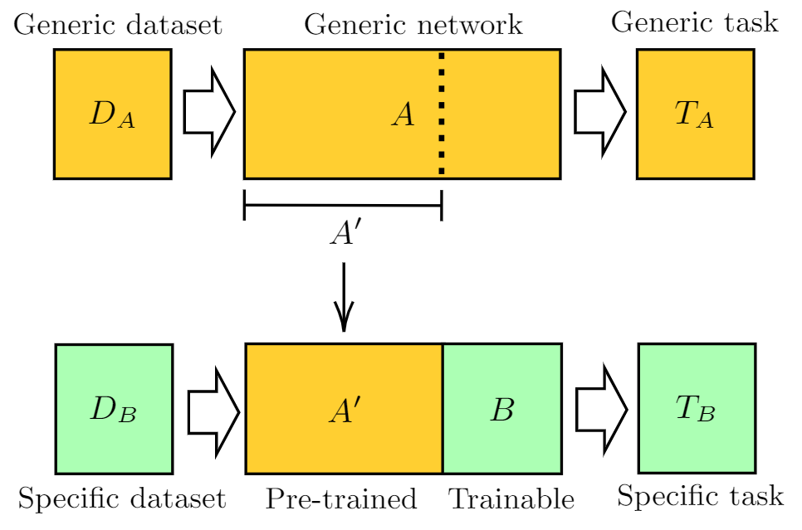
Transfer Learning
Storing knowledge gained while solving one problem and applying it to a different but related problem.

Slide 6
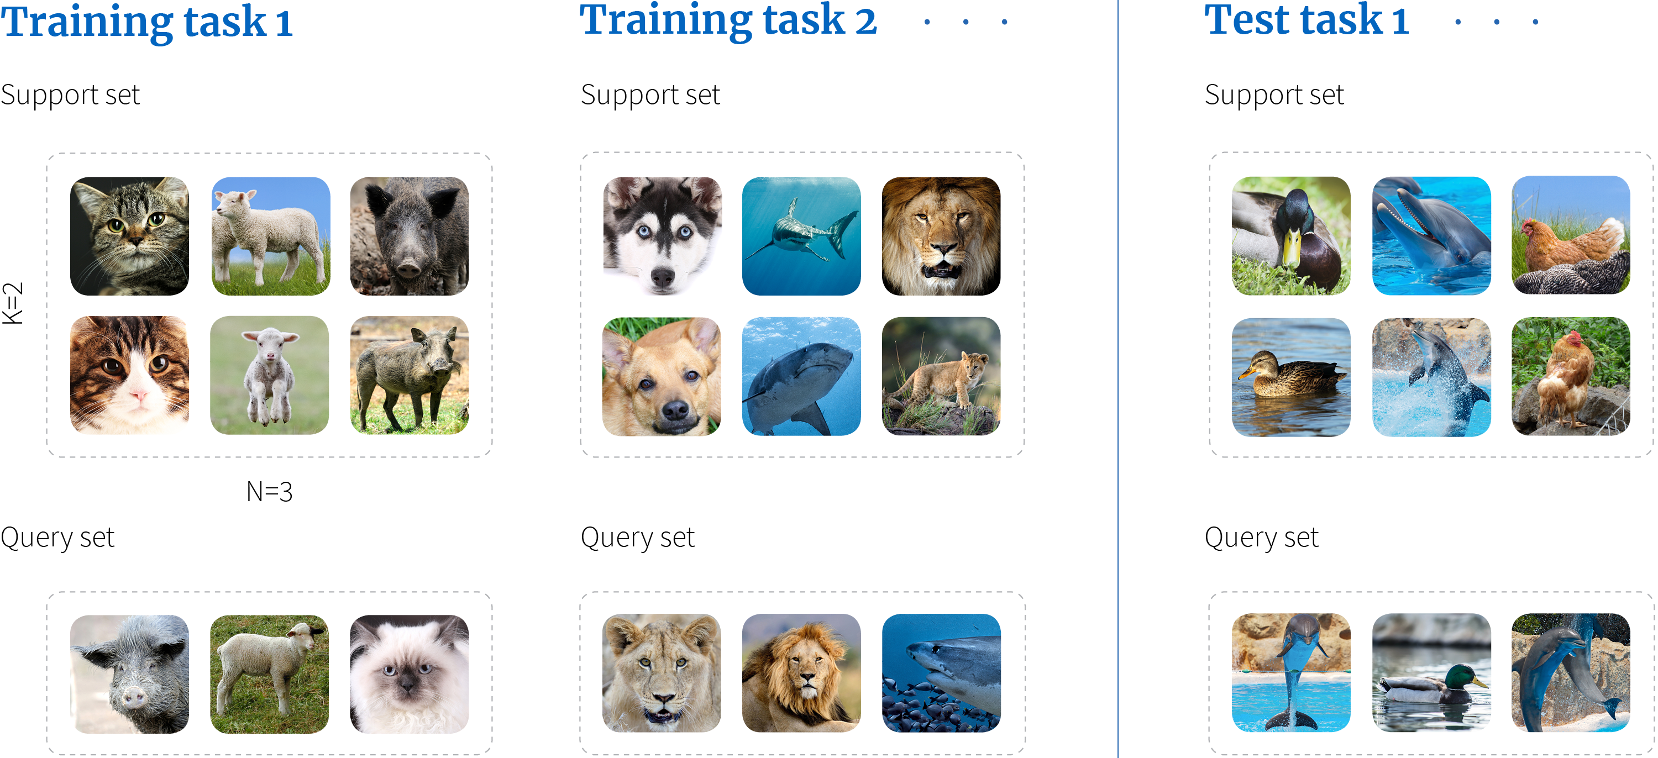
Few-Shot Learning
Humans can recognize new object classes from very few instances.
The goal of few-shot learning is to classify new data having seen only a few training examples.

Slide 7
One-Shot Learning
One-Shot Learning is the set of methods to train models that recognize classes from one sample.
Classic example is face recognition: only one sample is given for each person, the neural network needs to recognize whether a new face correspond to a given person.
A common solution to the 1-SL problem is the use of Siamese Networks with a triplet loss or contrastive loss. These networks learn to minimize the difference between two samples as a distance. For example, the person with the lowest distance from the face to be recognized is the predicted one.

Slide 8
Overview
Introduction to N-Shot Learning
Zero-Shot Learning definition
Definition
Notation
Types of Zero-Shot Learning
Challenges
Methodologies
Evaluation
Hands on

Slide 9
Definition - What is Zero-Shot Learning
Humans are capable of recognizing novel objects that they have never seen in the past given some information/description about them.
Example:
You have seen a horse but never seen a zebra.
I tell you that a zebra looks like a horse but it has black and white stripes.
You will probably immediately recognize a zebra when you see it.
Zero-shot classification refers to the problem setting where we want to recognize objects from classes that our model has not seen during training.

Slide 10
Notation
Seen classes – S
Classes for which we have labeled images during training.
S consists of several images (each image is denoted by x), the associated labels (denoted by y), and the auxiliary information (denoted by h_y).
Unseen classes – U
Classes for which labeled images are not present during the training phase.
Auxiliary information – A
Descriptions/semantic attributes/word embeddings for both seen and unseen classes.
This information acts as a bridge between seen and unseen classes.
Each class (seen or unseen) can be identified by its attribute vector h_y (signature).

Slide 11
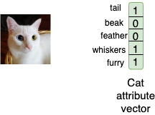
Semantic Encoding
A semantic encoding is a mapping between the attribute space and the classes.
This mapping is defined by the human operator.
Example:
The image is x.
The class label y is “cat”.
The auxiliary information h_y is stored as a one hot encoded vector consisting of 5 elements — tail, beak, feather, whiskers, furry.
Each element of the vector is an attribute, its value is 1 if the attributes describe that class, and 0 elsewhere.

Slide 12
Overview
Introduction to N-Shot Learning
Zero-Shot Learning definition
Types of Zero-Shot Learning
Based on training data (Inductive ZSL, Transductive ZSL)
Based on test data (Conventional ZSL, Generalized ZSL)
Challenges
Methodologies
Evaluation
Hands on

Slide 13
Types of ZSL – Based on training data
Inductive ZSL
We have access to labeled image data from seen classes during the training phase.
We have access to semantic descriptions/attributes of both seen and unseen classes during the training phase.
The main goal is to transfer knowledge from semantic space to visual image space so that the model can recognize objects from unseen classes at test time.
Transductive ZSL
In addition to labeled image data from seen classes, we also have access to unlabeled images from unseen classes during the training phase.
We have access to semantic descriptions/attributes of both seen and unseen classes during the training phase.
This setting is useful in practical scenarios where we have access to a large pool of images but annotating/labelling each image is either not possible or labour intensive.
Compared to the inductive setting, the transductive setting is a bit easier as the model has some knowledge about the distribution of visual features of unseen classes.

Slide 14
Types of ZSL – Based on test data
Conventional ZSL
The images to be recognized at test time belong only to unseen classes.
This setting is practically less useful as, in realistic scenarios, the assumption that the images at test time will come only from unseen classes is difficult to guarantee.
Generalized ZSL
The images to be recognized at test time may belong to seen or unseen classes.
This setting is practically more useful/realistic and much more challenging than the conventional setting.
The model has been trained only on seen class images and therefore its predictions are biased towards seen classes: many unseen class images can be wrongly classified into seen classes at test time.

Slide 15
Overview
Introduction to N-Shot Learning
Zero-Shot Learning definition
Types of Zero-Shot Learning
Challenges
Domain shift
Bias
Cross-domain transfer
Semantic loss
Hubness
Methodologies
Evaluation
Hands on

Slide 16
Challenges in ZSL – Domain shift
Training and testing data come from two different distributions.
Our deep network learns the function using only seen classes during training.
It might not work for/generalize well to out of distribution unseen classes at test time.

Slide 17
Challenges in ZSL – Bias
The model is inherently biased towards predicting the seen classes as the correct class at test time.
This problem becomes crucial especially in the case of generalized ZSL where the test image can belong to both seen or unseen classes.

Slide 18
Challenges in ZSL – Cross-domain transfer
Image features are learned from seen classes and transferred to unseen classes.
Example:
Our model has seen a brown bear during training but not a polar bear.
At test time, to recognize a polar bear, our model needs to transfer the ‘white fur’ attribute of a polar bear into visual space and merge it with the brown bear visual features to recognize a polar bear image correctly.

Slide 19
Challenges in ZSL – Semantic loss
While learning a classifier on seen classes during training, the model might ignore attributes/features that do not help it to differentiate between seen classes.
However, those ignored features could be helpful to differentiate between unseen classes at test time.
We experience a “semantic loss” during the training process.
Example:
We have 2 classes at train time: male and female.
Our model will learn to look for features like “facial appearance”, “body structure”, etc. to differentiate between male and female classes.
The attribute “two legged” does not help it to differentiate between the classes and therefore it may not regard that attribute as important.
But at test time if one of the novel unseen classes is dog, the information about the number of legs is very useful in distinguishing it from seen classes.
However, our model has learned to ignore the information about the number of legs since it was not useful at train time.

Slide 20
Challenges in ZSL – Hubness
The problem of hubness arises when a high dimensional (visual) vector is projected into a low dimensional (semantic) space.
Such a projection reduces variance and results in mapped points being clustered as a hub.
This leads to the formation of hubs of projected points in the semantic space.
The points in these hubs tend to cluster near semantic attribute vectors with higher frequency.

Slide 21
Overview
Introduction to N-Shot Learning
Zero-Shot Learning definition
Types of Zero-Shot Learning
Challenges
Methodologies
Embedding-based
GAN-based
Evaluation
Hands on

Slide 22
ZSL Methodologies – Embedding-based
Embedding-based methods map the image features and semantic attributes into a common embedding space using a projection function, which is learned using deep networks.
During training, a deep network learns that projection function using data from seen classes.
During the test phase, the unseen class image features are passed as input to the trained network and we get the corresponding semantic embedding as the output.
To perform classification, we do a nearest neighbour search in the semantic attribute space to find the closest match to the output of the network.

Slide 23
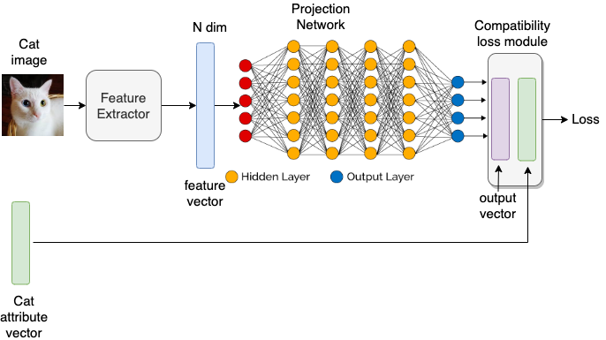
ZSL Methodologies – Embedding-based
The input image is first passed through a feature extractor network to get an N dimensional feature vector for the image.
This feature vector acts as the input to our main projection network which in turn outputs a D dimensional output vector.
The compatibility loss module measures the similarity between the D dim output and ground truth semantic attribute.

Slide 24
ZSL Methodologies – GAN-based
The main drawback with embedding-based methods is that they suffer from the problem of bias and domain shift.
The deep network has only learned to map seen class image features to semantic space during training and might not be able to do the same for novel unseen classes at test time correctly.
It is necessary that out zero-shot classifier is trained on both seen and unseen class images at train time.
Generative methods aim to generate image features for unseen classes using the semantic attributes.
Typically, this is done using a Conditional Generative Adversarial Network (C-GAN) which generates image features conditioned on the semantic attribute of a particular class.

Slide 25
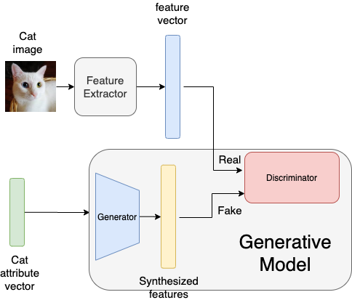
ZSL Methodologies – GAN-based
A feature extractor network outputs produces an N dim feature vector.
An attribute vector is passed as input to the generative model.
The generator generates an N dim output vector conditioned on the attribute vector.
Both vectors are fed to the discriminator.
The generative model is trained such that the synthesized feature vector looks indistinguishable from the original N dim feature vector.

Slide 26
ZSL Methodologies – GAN-based
Once the generative model is trained, we pass the unseen class attributes to the generator to generate unseen class image features.
Both seen class image features (from the dataset) and unseen class image features (generated by generator) are used to train a simple classifier.

Slide 27
Overview
Introduction to N-Shot Learning
Zero-Shot Learning definition
Types of Zero-Shot Learning
Challenges
Methodologies
Evaluation
Hands on

Slide 28


Evaluation Metrics
Average per-class-top-1 accuracy.
This encourages high performance on both sparsely and densely populated classes.
Evaluation of generalized zero-shot setting:
We aim for high accuracy on both seen classes Y^S as well as set of unseen classes Y^U.
The performance metric is defined as the harmonic mean of performance on seen classes and unseen classes.

Slide 29
Overview
Introduction to N-Shot Learning
Zero-Shot Learning definition
Types of Zero-Shot Learning
Challenges
Methodologies
Evaluation
Hands on

