Slide 1
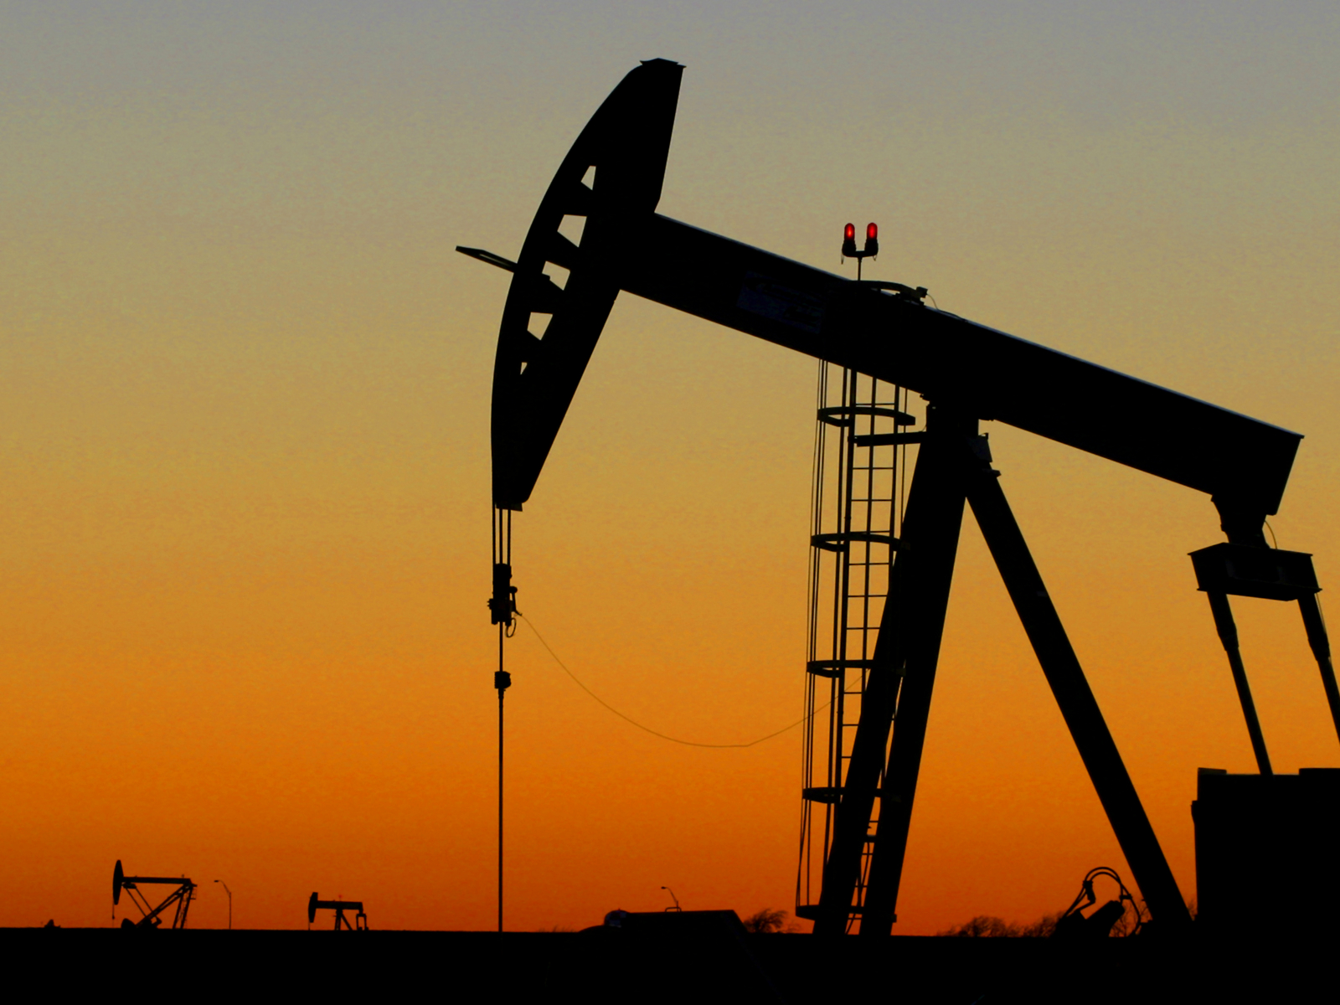
INVESTIGATING LINKAGES BETWEEN US OIL PRODUCTION AND RESULTING MARKET AND CONSUMER PRICES
By Luca Reichelt for his Project in Python 2 by Christian Westheide, University of Vienna
http://admin.acceleratingscience.com/metals/wp-content/uploads/sites/4/2015/02/istock_000000393530_medium.jpg

Slide 2
TOPIC AND POSSIBLE QUESTIONS
Topic
US biggest producer with 11,118,870 bbl/day^{[2]}
however not self-reliant (consumption>production), but majority is domestic^{[3]}
66% for transportation (gasoline(44%) and distillates))^{[5]}
recently prices spiked (allegedly) due to Covid-19 and the invasion of Ukraine (inflation + decrease in supply) and are expected to continue to rise
Questions
Are there any linkages between consumer prices and...
...?
...?
...?
...?
...?
Main question: Do US consumer prices properly reflect the production output of the US oil industry?

Slide 3
Methods I plan to apply
additional parameters of consumption to production and oil reserves
zi
to
to
for
for
for

Slide 4
DATA
Data sources I will use include:
for world oil prices
for US production output
for US oil reserves
for US oil import
for US gasoline prices
for to adjust prices to inflation rates
And maybe some more for a time-frame of approximately a hundred years ending today

Slide 5
SOURCES
[1] various pages from https://www.eia.gov/dnav/pet/
[2] https://en.wikipedia.org/wiki/List_of_countries_by_oil_production
[3] https://www.worldometers.info/oil/us-oil/
[4] https://www.officialdata.org/us/inflation/1800?amount=1
[5] https://www.eia.gov/energyexplained/oil-and-petroleum-products/use-of-oil.php
[2]
[2]
Title-image: http://admin.acceleratingscience.com/metals/wp-content/uploads/sites/4/2015/02/istock_000000393530_medium.jpg

Slide 6
Thank you!

