Slide 1
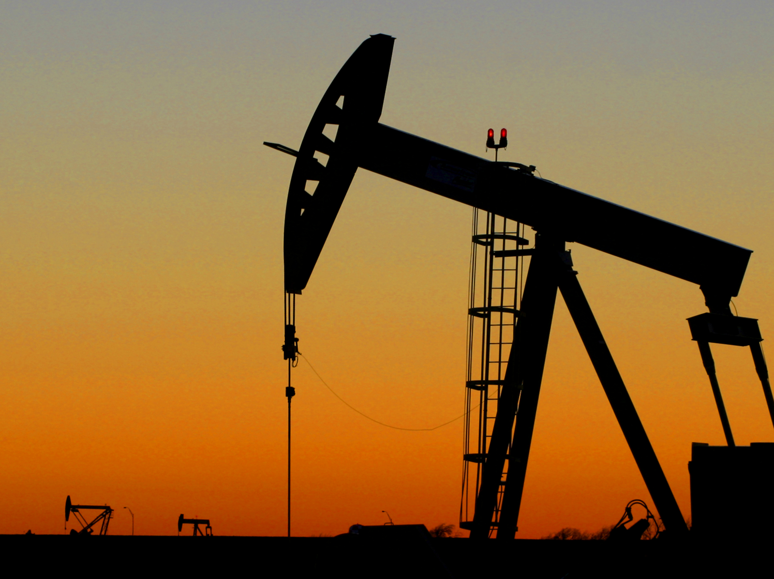
INVESTIGATING LINKAGES BETWEEN US OIL PRODUCTION AND CONSUMER PRICES
by Luca Reichelt for his project in Python 2
teached by Christian Westheide, University of Vienna
http://admin.acceleratingscience.com/metals/wp-content/uploads/sites/4/2015/02/istock_000000393530_medium.jpg

Slide 2
TOPIC AND POSSIBLE QUESTIONS
Topic
US biggest producer with 11,118,870 bbl/day^{[2]}
however not self-reliant (consumption>production), but majority is domestic^{[3]}
66% for transportation (gasoline(44%) and distillates))^{[5]}
recently prices spiked due to Covid-19 and the invasion of Ukraine (inflation + decrease in supply) and are expected to continue to rise
Questions
Are there any linkages between consumer prices and...
... domestic production?
... global crude oil prices?
... domestic consumption?
... petrol industry stock performance?
... Inflation levels?
... all together or neither?
Main : 1. Do US consumer prices properly reflect the production output of the US oil industry?
2. If not production, what other metrics influence consumer prices the most and can ML predict consumer prices with (some of) these parameters?

Slide 3
Methods
create additional ratio parameters
stratified k-fold cross-validation for data split
check which parameters are best to predict changes in consumer prices (Random forest) and tune hyperparameters using GridSearchCV
try and build a ML algorithm from these findings and test it for the past two years

Slide 4
DATA
Data sources I will use include:
Yahoo finance for world oil prices(crude futures)
eia.gov/petroleum/ for US production output, reserves, imports/exports, prices, consumption, us crude oil/petrol stock prices
officialdata.org/us/inflation to adjust prices to inflation rates
And maybe some more for a time-frame of approximately a hundred years (starting 1920) ending today and weekly intervalls

Slide 5
SOURCES
[1] various pages from https://www.eia.gov/dnav/pet/
[2] https://en.wikipedia.org/wiki/List_of_countries_by_oil_production
[3] https://www.worldometers.info/oil/us-oil/
[4] https://www.officialdata.org/us/inflation/1800?amount=1
[5] https://www.eia.gov/energyexplained/oil-and-petroleum-products/use-of-oil.php
Title-image: http://admin.acceleratingscience.com/metals/wp-content/uploads/sites/4/2015/02/istock_000000393530_medium.jpg

Slide 6
Thank you!

