Slide 1
Principal Component Analysis (PCA)

Slide 2
What is Principal Component Analysis (PCA)?
Intentions:
Data reduction – reducing the number of varibles required to explain a set of data.
If there are some redundant variables which don’t help to explain much of the variation in data, we don’t want to waste time computing those variables. PCA can help to make computations feasible or efficient.
Interpretations – by seeing which variables explain most of the data and which variables are highly correlated with others.
variables are highly correlated when they explain most of the same variation in the data. By finding these relationships in variables, we can find relationships in the data we might not have expected.
How?
Explain the variance/covariance in the data by creating a set of linear combinations of initial variables.
#Note: After reducing the number of variables to explain the data, we can no longer explain 100% of the variation in data. The objective of PCA is not to explain all the variation, but find a good ratio between a (smaller) number of variables and as much variation explained as possible.

Slide 3
PCA Intuition
Create new basis (coordinate system) by combining initial variables, such that each new ‘axis’ captures the maximum variability in the data in a particular direction.
Depends only on covariance of random variables X₁, X₂, … , X_{p} (or correlation matrix of p).
No additional assumptions, such as multivariate normal distribution, are necessary.

Slide 4
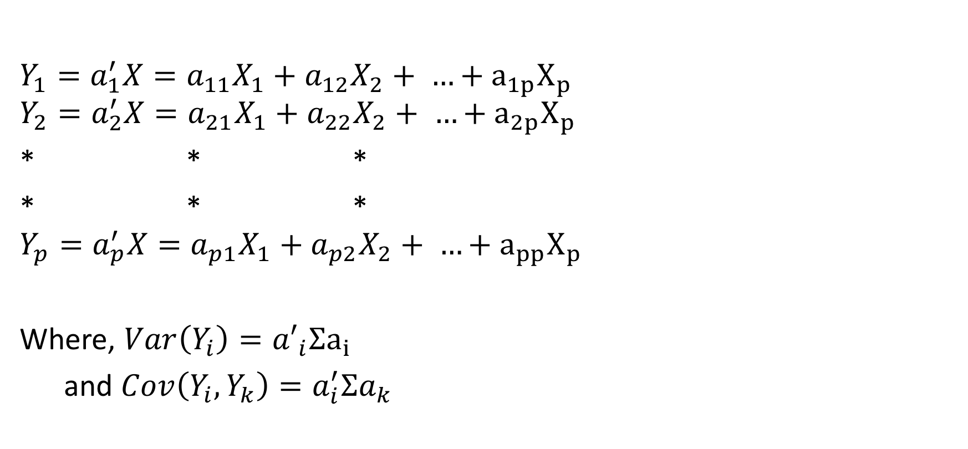
PCA Calculation
$$Y_{1}=a_{1}^{′}X=a_{11}X_{1}+a_{12}X_{2}+ …+a_{1p}X_{p}$$
$$Y_{2}=a_{2}^{′}X=a_{21}X_{1}+a_{22}X_{2}+ …+a_{2p}X_{p}$$
* * *
* * *
$$Y_{p}=a_{p}^{′}X=a_{p1}X_{1}+a_{p2}X_{2}+ …+a_{pp}X_{p}$$
Where, $Var\left(Y_{i}\right)={a′}_{i}Σa_{i}$
and $Cov\left(Y_{i}, Y_{k}\right)=a_{i}^{′}Σa_{k}$
Creating new variables (dimensions) from data. New variables (Yp) should be orthogonal (uncorrelated) accounting for maximum variability

Slide 5
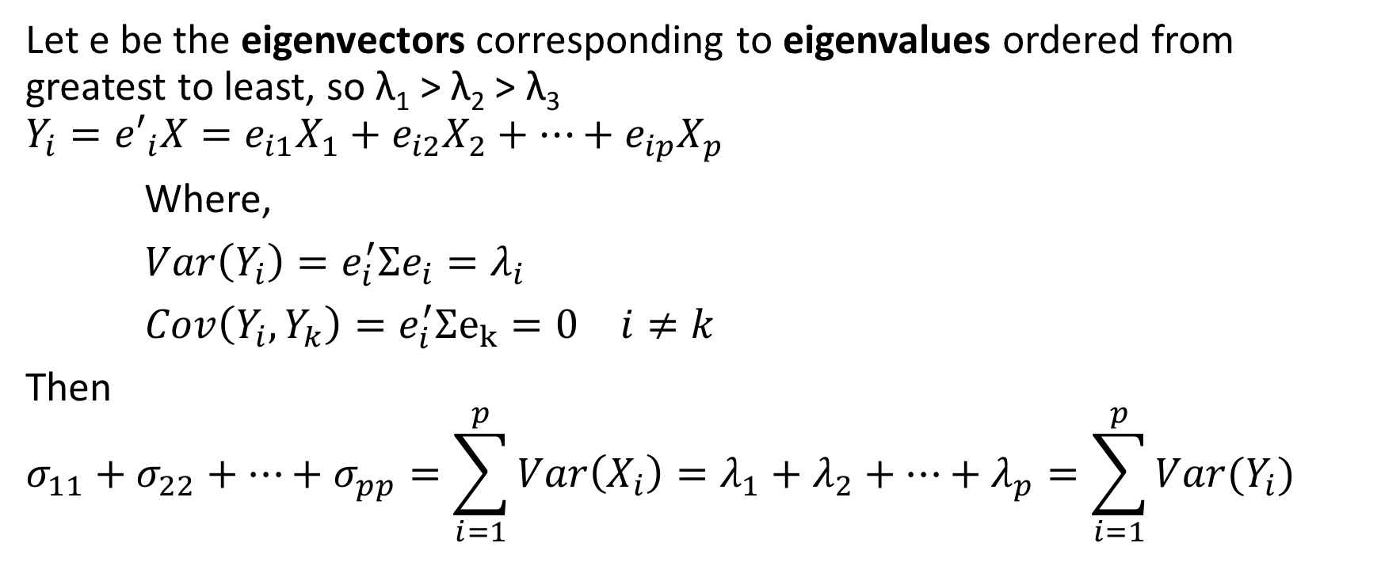
Eigenvalues and Eigenvectors
Let e be the eigenvectors corresponding to eigenvalues ordered from greatest to least, so λ₁ > λ₂ > λ₃
$$Y_{i}={e′}_{i}X=e_{i1}X_{1}+e_{i2}X_{2}+…+e_{ip}X_{p}$$
Where,
$Var\left(Y_{i}\right)=e_{i}^{′}Σe_{i}=λ_{i}$
$Cov\left(Y_{i},Y_{k}\right)=e_{i}^{′}Σe_{k}=0$ $i≠k$
Then
$$σ_{11}+σ_{22}+…+σ_{pp}=\sum_{i=1}^{p}{Var\left(X_{i}\right)}=λ_{1}+λ_{2}+…+λ_{p}=\sum_{i=1}^{p}{Var(Y_{i})}$$

Slide 6
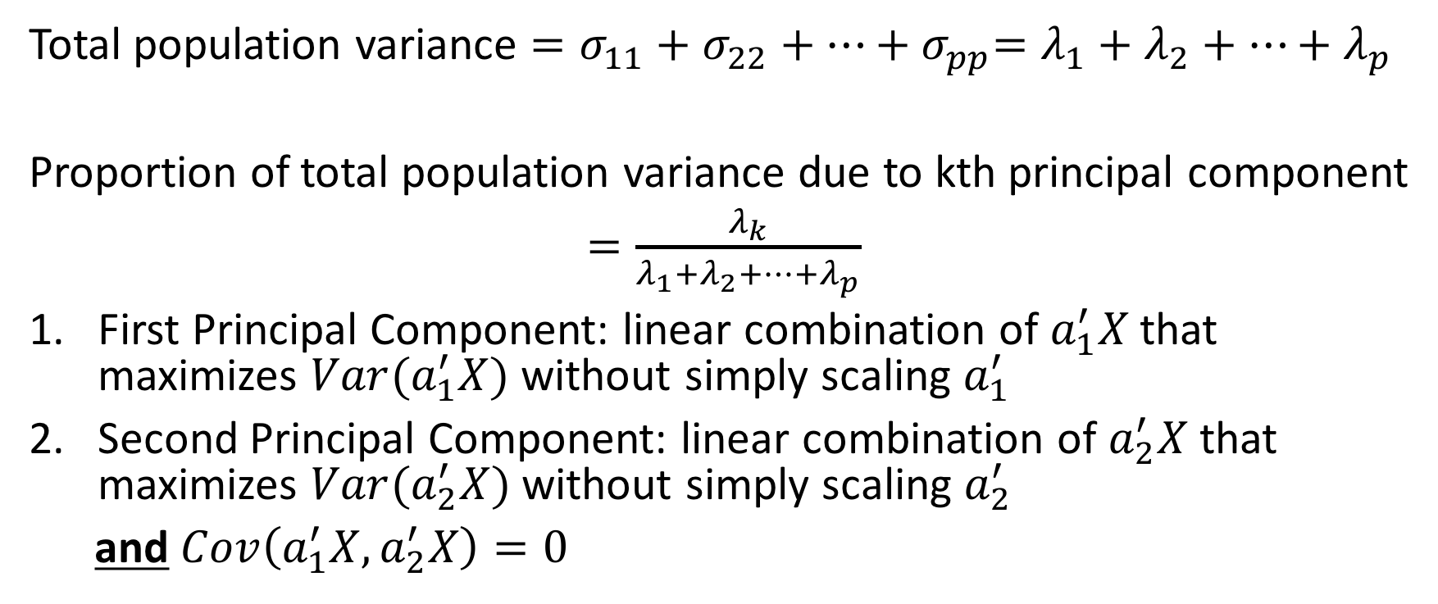
Variance and Principal Components
Total population variance $=σ_{11}+σ_{22}+…{+ σ}_{pp}=λ_{1}+λ_{2}+…+λ_{p}$
Proportion of total population variance due to kth principal component
$=\frac{λ_{k}}{λ_{1}+λ_{2}+…+λ_{p}}$
First Principal Component: linear combination of $a_{1}^{′}X$ that maximizes $Var(a_{1}^{′}X)$ without simply scaling $a_{1}^{′}$
Second Principal Component: linear combination of $a_{2}^{′}X$ that maximizes $Var(a_{2}^{′}X)$ without simply scaling $a_{2}^{′}$
and $Cov\left(a_{1}^{′}X, a_{2}^{′}X\right)=0$

Slide 7
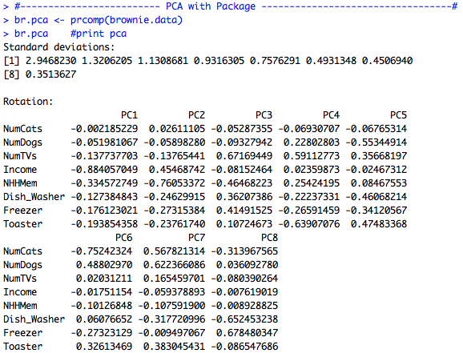
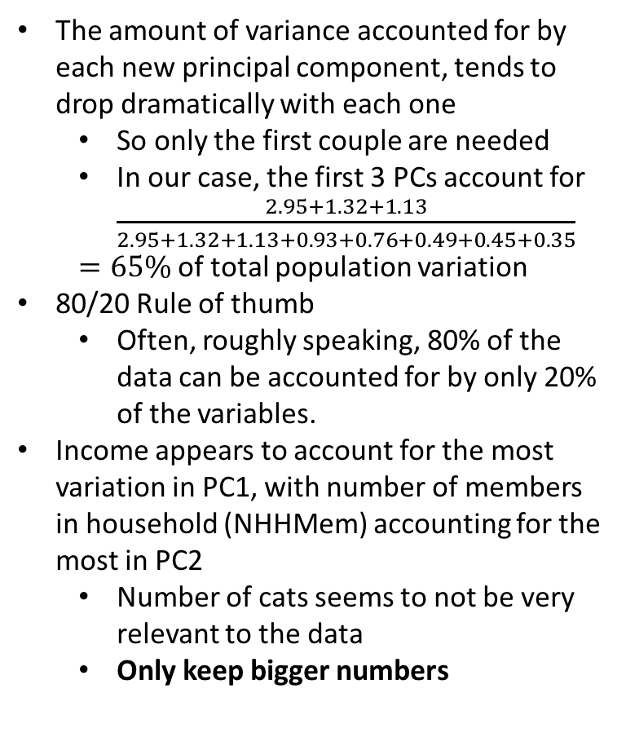
PCA Implementation – brownie data
The amount of variance accounted for by each new principal component, tends to drop dramatically with each one
So only the first couple are needed
In our case, the first 3 PCs account for $\frac{2.95+1.32+1.13}{2.95+1.32+1.13+0.93+0.76+0.49+0.45+0.35}$
$=65\%$of total population variation
80/20 Rule of thumb
Often, roughly speaking, 80% of the data can be accounted for by only 20% of the variables.
Income appears to account for the most variation in PC1, with number of members in household (NHHMem) accounting for the most in PC2
Number of cats seems to not be very relevant to the data
Only keep bigger numbers

Slide 8
PCA Intuition
PCs create new basis vectors to explain the data, but the vectors themselves don’t have much intuitive meaning
For example, we cannot get any interesting insight by just combining components of a vector, because each component is in a different unit.
No “scientific meaning” behind the combination of those 8 variables
Remember, goal is to explain most of the data with as few variables as possible, so we really only need to keep the first 3 or so PCs, depending on how much data we need to account for.
In fact, we don’t even need to keep all the parts of each PC. Can represent each PC with, say, the 4 largest of the 8 components.

