Slide 1
HealthCare System
presentation
Aquilini (S5667729), Ferrari (S4784573), Vella (S4803218)

Slide 2
This is a table
01
02
03
04
of contents.
The Idea
NodeRed
ThingWorx
Code Structure

Slide 3
We will talk about
01
The Idea

Slide 4
Health Care System was built in order to facilitate doctor’s work by monitoring the patients, even remotely, and providing notifications when specific conditions are met. This is aimed at preventing people from the occurrence of dangerous diseases as quick as possible.

Slide 5
What does Health Care System monitor?
1. Temperature (linked to disases like fever or
hypothermia).
2. Blood Oxygen (related to a disease called hypoxia)
3. Heart Rate (affected by either tachycardia or
bradicardia)
4. Blood Pressure (influenced by hypertension)
5. Physical activity (if the patient is either running or
walking).
In addition, for each patient, the system records its anagraphic data since health data must be contextualized to them.

Slide 6
How does Health Care System work?
The system is structured in three parts:
The edge device. Using NodeJS, we simulate a
wearable sensor to get data and transmit them to a MQTT broker.
The middleware. Through NodeRed, we pass the sensor and anagraphic data to ThingWorx and listen on a MQTT topic for alerts to be sent both via SMS and email.
The cloud. All sensor data will be shown through a dashboard with ThingWorx and it will be responsible for reporting anomalous conditions about patients health.

Slide 7
We will talk about
02
NodeRed

Slide 8
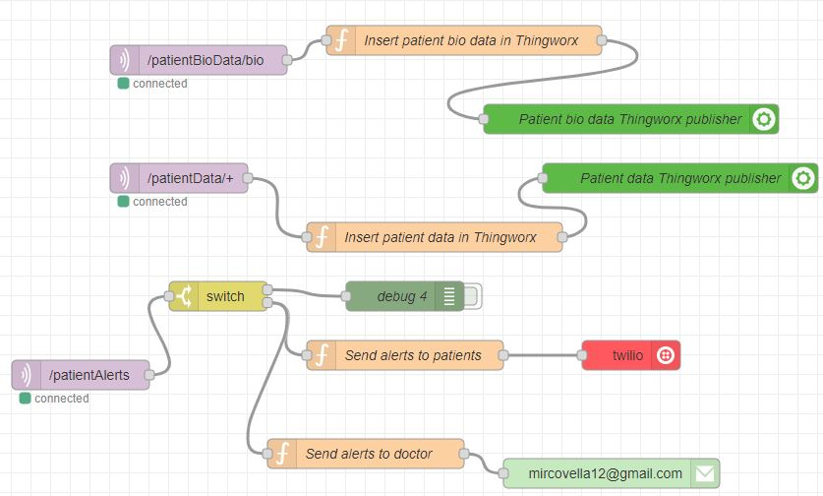

Slide 9
Three topics:
PatientBioData. This topic hosts anagraphic data of
every patient and passes data to a ThingWorx
element responsible for the insertion of a patient
in the system.
PatientData. Every patient has its own topic where its sensor data is recorded and its own ThingWorx thing storing actual values.
PatientAlerts. This topic stores the alerts to be sent about patient’s conditions.

Slide 10
We will talk about
03
Thingworx

Slide 11
Mashup
We implemented the dashboard through a ThingWorx mashup that visualizes sensor data for the selected patient (if it changes, data shown will change accordingly) along with its anagraphic data. Also, widgets are refreshed every 20 seconds.

Slide 12
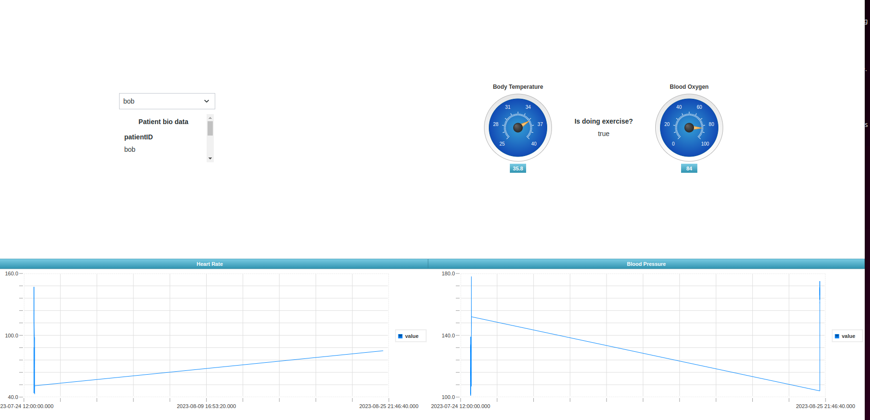

Slide 13
DataTable
In order to contain all patients’ anagraphic data we used a DataTable. Also, we implemented services to get sensor data and historical values for a given patient.
To monitor if a new patient has to be inserted, we use a Thing whose properties record the data related to the last inserted patient so when any of these change, the service to add or update a new patient is triggered.
In addition, when a new patient is inserted, the associated thing and value stream are created automatically through the service.

Slide 14
Thing
Every patient-related thing has some associated alerts (to detect anomalies) and the corresponding subscriptions to take action: so, if it is necessary, we’ll exploit an MQTT publisher thing to write into a topic the data regarding the alert when its own property changes.

Slide 15
We will talk about
04
Code Structure

Slide 16
Code Structure
The sensor’s code and the node-red flow are available the Git repository linked below
https://github.com/luca959/IoTProject
Regarding the ThingWorx stuff, we created our project called HealthCareSystem.
Note: in order to make the node-red flow work, we installed some plugins like node-red-node-email, node-red-node-thingrest and node-red-node-twilio.

Slide 17
Thanks for the attention!

