Slide 1
Bortolotti Simone De Cenzo Davide Marignati Luca
Progetto di Modelli e Architetture Avanzate di DataBase (MAADB)

Slide 2
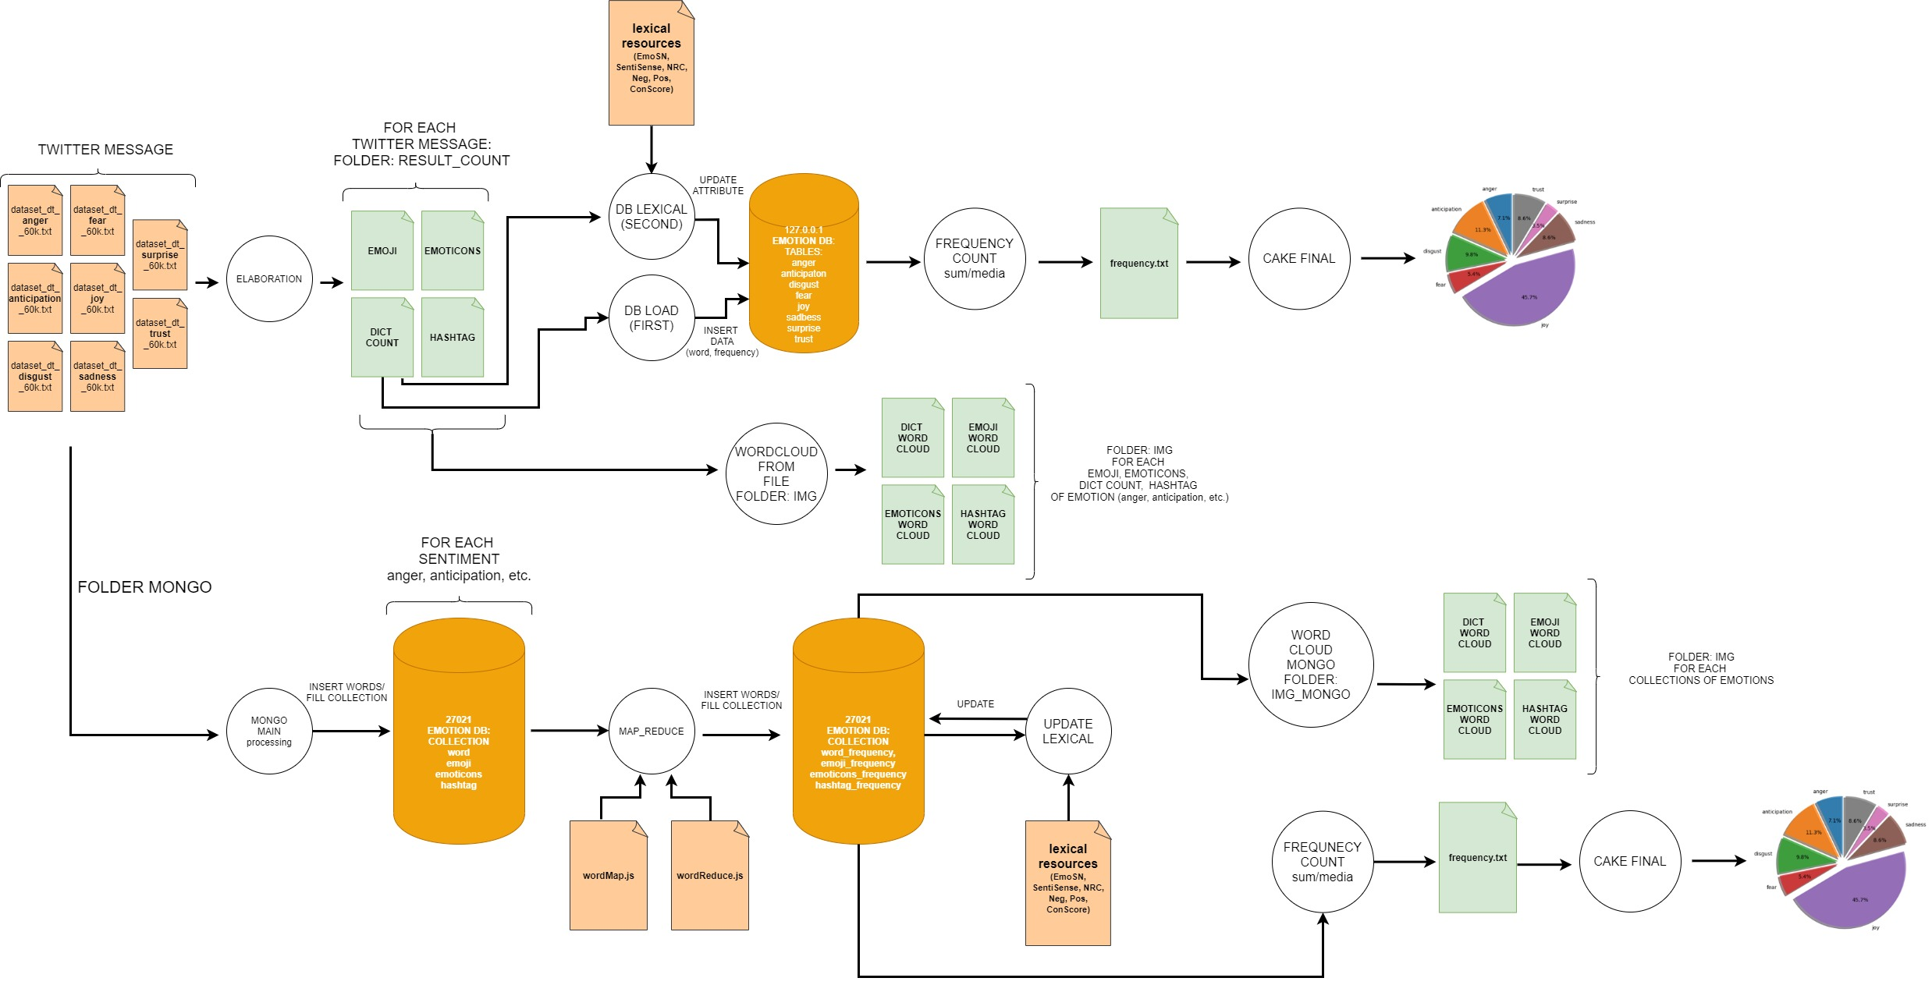

Slide 3
FILE-SYSTEM

Slide 4
File system – main folder
archivi_risorse_lessicali → Es. Anger, Anticipation, etc.
img → wordcloud from file result_count
(4 for each emotion: word + hashtag + emoji + emoticons)
result_count → result file from processing (elaboration.py) → PRE LOAD DB
(4 for each emotion: word + hashtag + emoji + emoticons)
twitter_message → initial dataset
mongo → mongo elaboration
img_mongo → wordcloud from mongo collection
(4 for each emotion: word + hashtag + emoji + emoticons)

Slide 5
File system – main file – MySQL
elaboration.py
INPUT: twitter message
processing twitter message (nltk)
frequency count
save to local array/dictionary (emoji, emotions, hashtag, word)
OUTPUT: save to file (into folder «result_count»)
db_load.py
Read file (from folder «result_count») (for each emotion)
Insert data to db (Mysql)
DB = «emotion»
Table = ["anger", "anticipation", "disgust", "fear", "joy", "sadness", "surprise", "trust"]
db_lexical.py
INPUT: read lexical resources
Update table
["anger", "anticipation", "disgust", "fear", "joy", "sadness", "surprise", "trust"]
boolean values (emo_sn, nrc, sentisense),
conScore (afinn, anew_aro, anew_dom, ...),
Neg/Pos (gi_neg, hl_neg, …, gi_pos, hl_pos, ...)
frequency_count
INPUT: sum from DB (for each emotion)
average calculation (for each emotion)
OUTPUT: save to file «frequency.txt»
wordcloud_from_file
INPUT: read result count
Create wordcloud IMG
OUTPUT: save file to folder «wordcloud» (4 for each emotion: word + hashtag + emoji + emoticons)

Slide 6
File system – main file – Mongo
main.py
INPUT: twitter message
processing twitter message (nltk)
OUTPUT: save to mongo collection (anger_word, anticipation_word, etc.)
map_reduce.py
INPUT: mongo collection (anger_word, anticipation_word, etc.)
map reduce operation (wordMap.js, wordReduceOperation.js)
OUTPUT: save to mongo colletion «frequency»
(anger_frequency, anticipation_frequency)
update_lexical.py
INPUT: read lexical resources
Update mongo collection «frequency»
boolean values (emo_sn, nrc, sentisense),
conScore (afinn, anew_aro, anew_dom, ...),
Neg/Pos (gi_neg, hl_neg, …, gi_pos, hl_pos, ...)

Slide 7
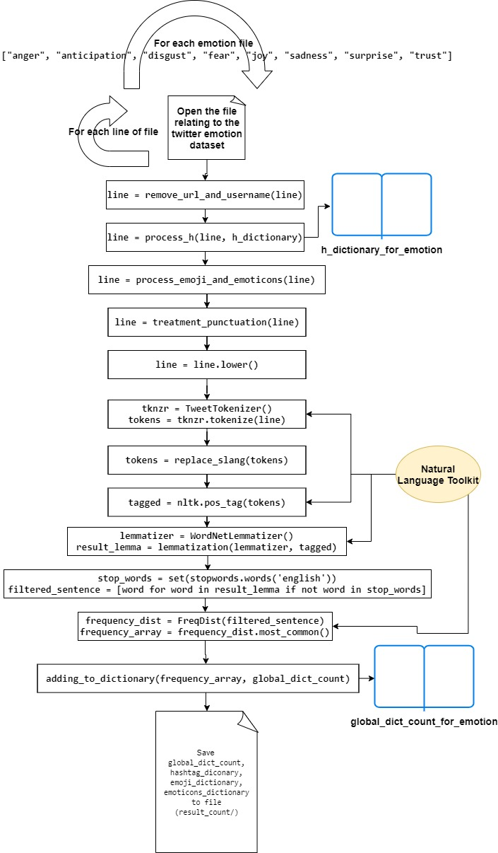
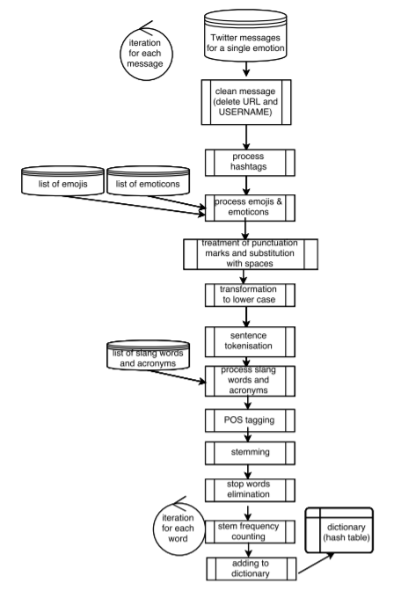
Elaboration.py

Slide 8
Data structure

Slide 9
MySQL

Slide 10
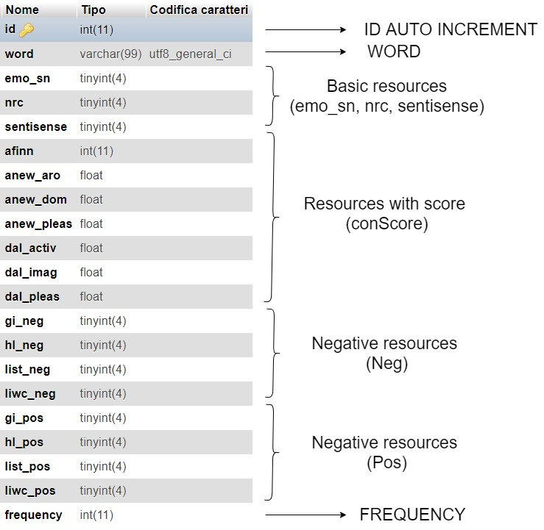
For each emotion: 8 table

Slide 11
Mongo

Slide 12
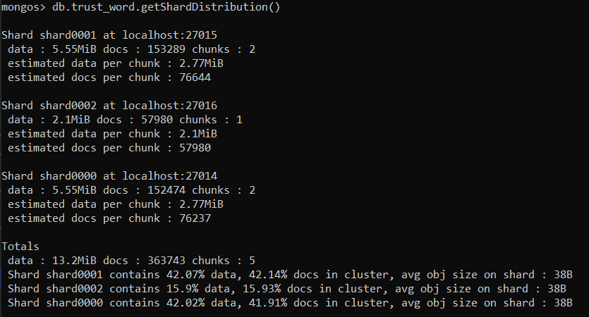
Sharding Data Example Collection: trust_word

Slide 13
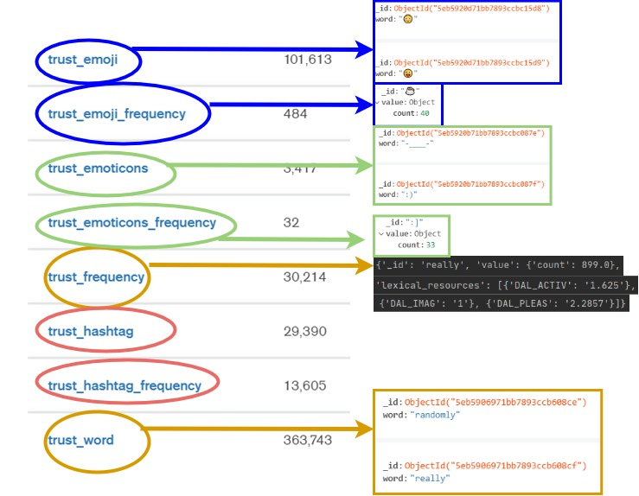
For each emotion: 8 collection

Slide 14
Document example – word: “Love”
{
'_id': 'love’,
'value': {'count': 10677.0},
'lexical_resources’: [
{'GI_POS': 1}, {'HL_POS': 1}, {'LIST_POS': 1}, {'LIWC_POS': 1},
{'AFINN': '3'}, {'ANEW_ARO': '6.44'},{'ANEW_DOM': '7.11’},{'ANEW_PLEAS': '8.72’},
{'DAL_ACTIV': '2.6364’}, {'DAL_IMAG': '1.4'}, {'DAL_PLEAS': '3’}
]
}

Slide 15
Results

Slide 16
Statistics of use of lexical resources (MySQL/Mongo)
anger: 6.03 %
anticipation: 9.56 %
disgust: 8.27 %
fear: 4.55 %
joy: 38.74 %
sadness: 7.27 %
surprise: 2.96 %
trust: 7.30 %
media = 10.58 %

Slide 17
WORDCLOUD

Slide 18


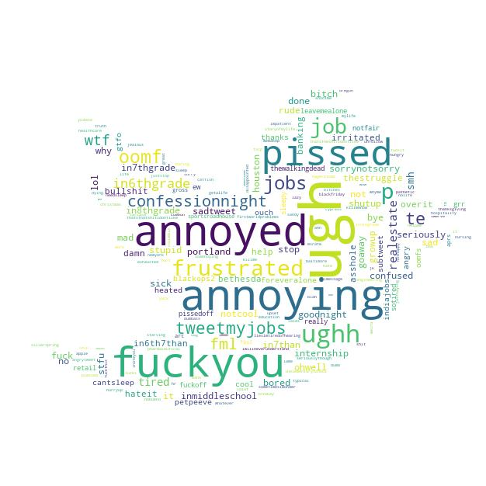
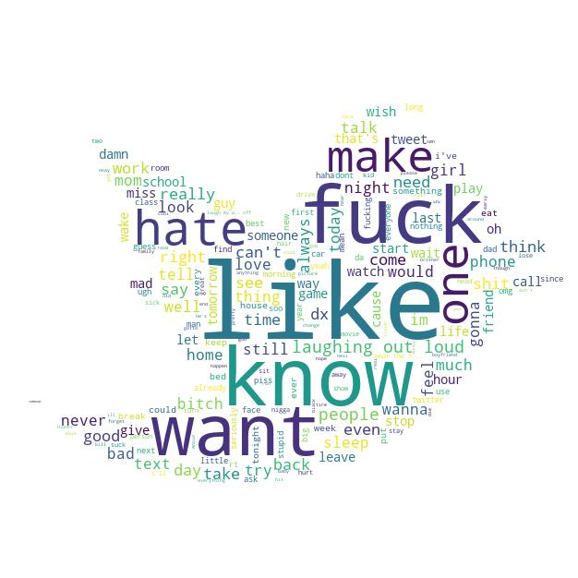
Anger Wordcloud
EMOTICONS
EMOJI
HASHTAG
WORDS

Slide 19

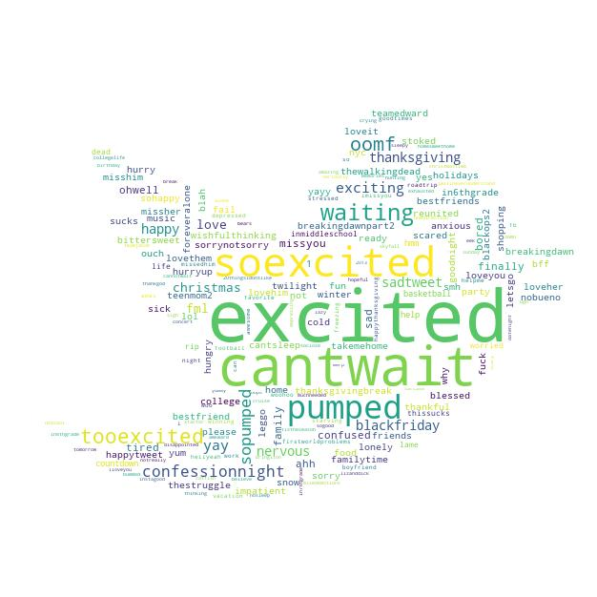

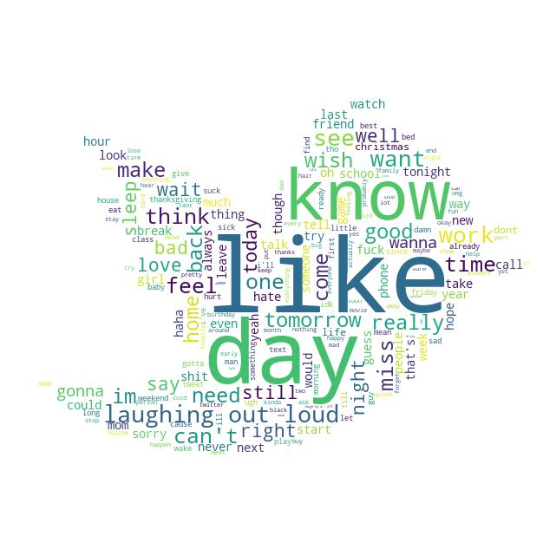
Anticipation Wordcloud
EMOTICONS
EMOJI
HASHTAG
WORDS

Slide 20


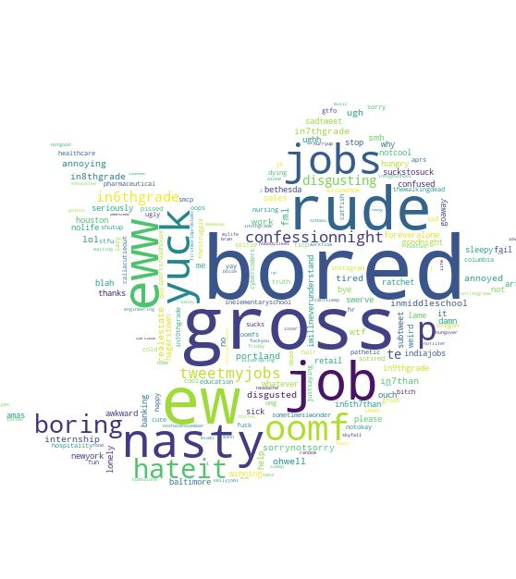
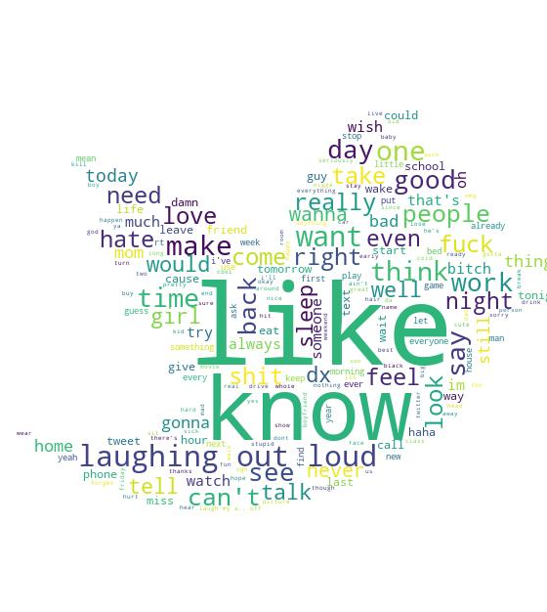
Disgust Wordcloud
EMOTICONS
EMOJI
HASHTAG
WORDS

Slide 21


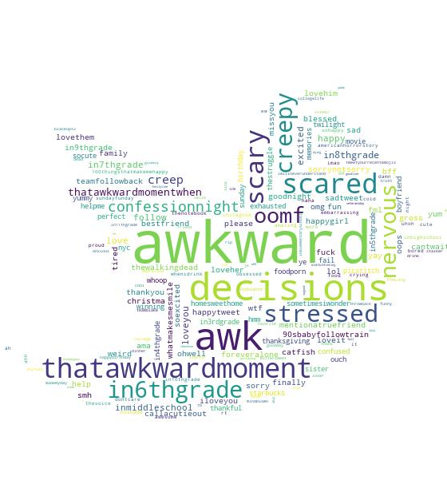
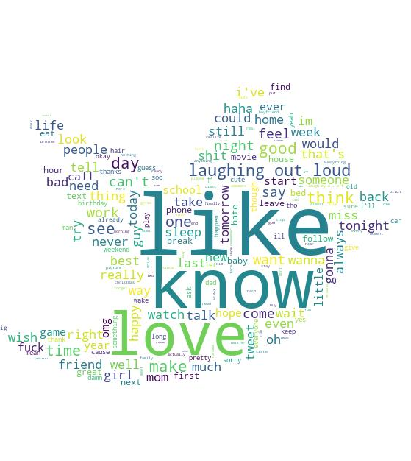
Fear Wordcloud
EMOTICONS
EMOJI
HASHTAG
WORDS

Slide 22


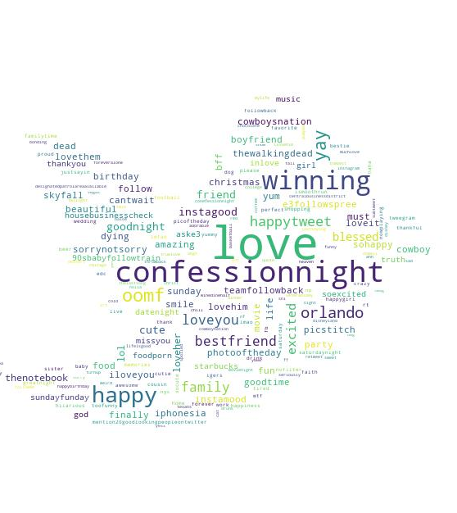
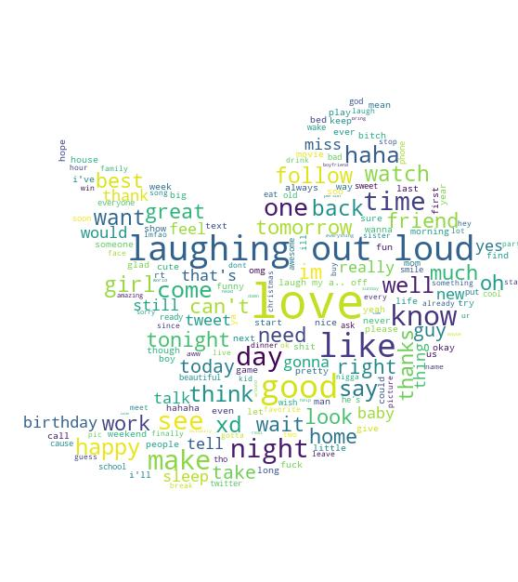
Joy Wordcloud
EMOTICONS
EMOJI
HASHTAG
WORDS

Slide 23


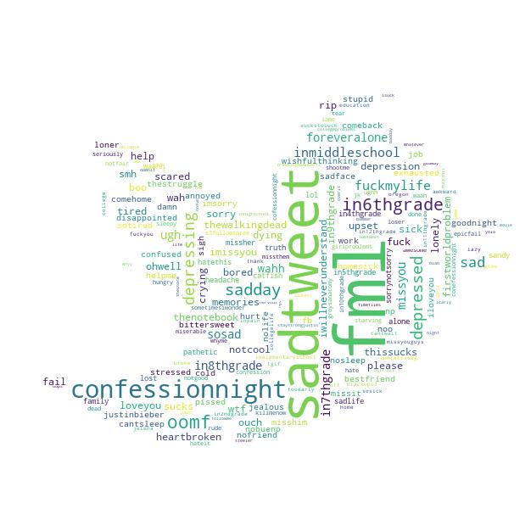
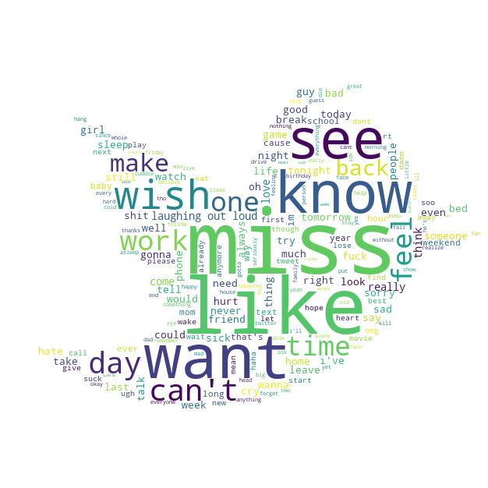
Sadness Wordcloud
EMOTICONS
EMOJI
HASHTAG
WORDS

Slide 24


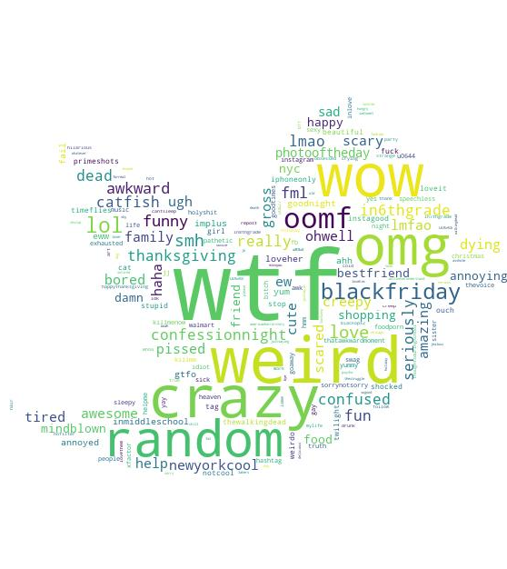
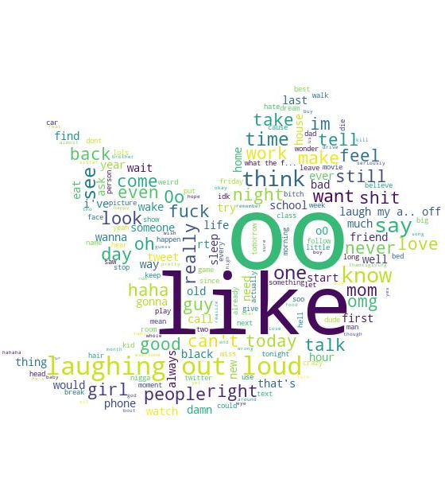
Surprise Wordcloud
EMOTICONS
EMOJI
HASHTAG
WORDS

Slide 25


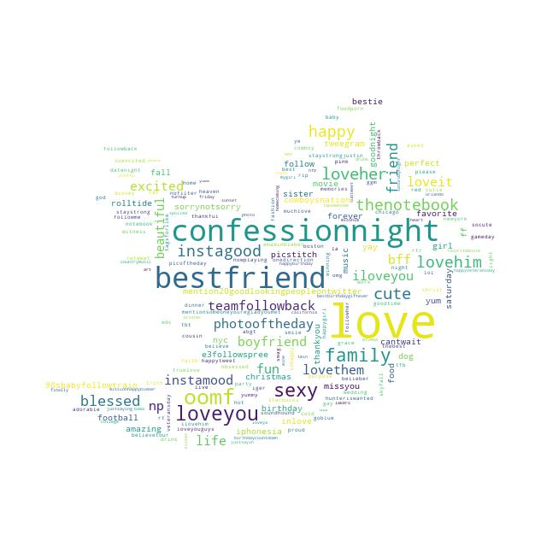
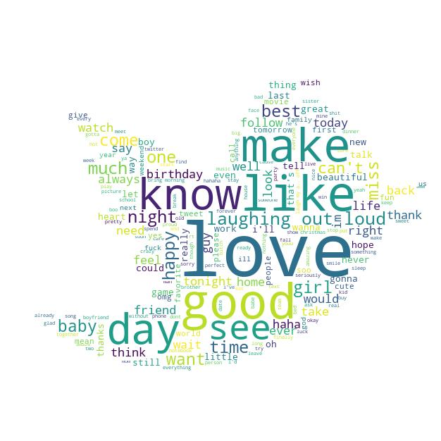
Trust Wordcloud
EMOTICONS
EMOJI
HASHTAG
WORDS

Slide 26
CONCLUSIONI

Slide 27
Mongo vs MySql https://www.simform.com/mongodb-vs-mysql-databases/#section3 https://towardsdatascience.com/keras-challenges-the-avengers-541346acb804
Entrambe le soluzioni di archiviazione funzionerebbero, in realtà dipendono dalle dimensioni dei dati che si prevede di utilizzare e dal modo in cui vengono utilizzate per questo caso d'uso. Se il set di dati supera alcuni terabyte di dati, un approccio MapReduce sarebbe l'ideale, se più piccolo di un database SQL in questo caso potrebbe essere sufficiente.
Un altro aspetto da considerare è il numero di query al secondo che il sistema dovrebbe eseguire, che dovranno essere prese in considerazione nella progettazione.

