Slide 1
Bortolotti Simone De Cenzo Davide Marignati Luca
Progetto di Modelli e Architetture Avanzate di DataBase (MAADB)

Slide 2
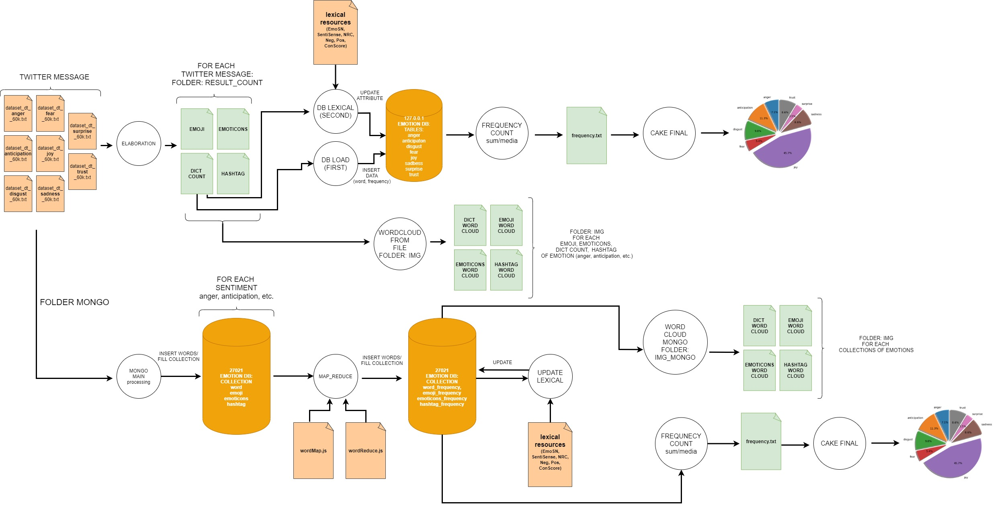

Slide 3
FILE-SYSTEM

Slide 4
Main folder
archivi_risorse_lessicali → Es. Anger, Anticipation, etc.
twitter_message → initial dataset
img → wordcloud from file «result_count»
(4 for each emotion: word + hashtag + emoji + emoticons)
img_mongo → wordcloud from mongo collection
(4 for each emotion: word + hashtag + emoji + emoticons)
result_count → result file from processing (elaboration.py) → PRE-LOAD DB
(4 for each emotion: word + hashtag + emoji + emoticons)
mongo → mongo elaboration

Slide 5
Main file (1) – MySQL
elaboration.py
INPUT: twitter message
processing twitter message (string + nltk operation)
frequency count
save to local array/dictionary (emoji, emotions, hashtag, word)
OUTPUT: save local array/dictionary to file into folder «result_count» (e.g anger_emoji.txt, anger_emoticons.txt, anger_global_dict_count.txt, etc.)
db_load.py
INPUT: read file from folder «result_count» (e.g anger_emoji.txt, anger_emoticons.txt, anger_global_dict_count.txt, etc.)
insert data to db (Mysql)
DB = «emotion»
Table = ["anger", "anticipation", "disgust", "fear", "joy", "sadness", "surprise", "trust"]

Slide 6
Main file (2) – MySQL
db_lexical.py
INPUT: read file from folder «lexical resources»
Update table
["anger", "anticipation", "disgust", "fear", "joy", "sadness", "surprise", "trust"]
boolean values (emo_sn, nrc, sentisense),
conScore (afinn, anew_aro, anew_dom, ...),
Neg/Pos (gi_neg, hl_neg, …, gi_pos, hl_pos, ...)
frequency_count
INPUT: «select sum from DB»
average calculation
OUTPUT: save to file «frequency.txt»
wordcloud_from_file
INPUT: read result count (e.g anger_emoji.txt, anger_emoticons.txt, anger_global_dict_count.txt, etc.)
Create wordcloud IMG
OUTPUT: save file to folder «wordcloud» (4 for each emotion: word + hashtag + emoji + emoticons)

Slide 7
File system – main file – Mongo
main.py
INPUT: twitter message
processing twitter message (nltk)
OUTPUT: save to mongo collection (anger_word, anticipation_word, etc.)
map_reduce.py
INPUT: mongo collection (anger_word, anticipation_word, etc.)
map reduce operation (wordMap.js, wordReduceOperation.js)
OUTPUT: save to mongo colletion «frequency»
(anger_frequency, anticipation_frequency)
update_lexical.py
INPUT: read lexical resources
Update mongo collection «frequency»
boolean values (emo_sn, nrc, sentisense),
conScore (afinn, anew_aro, anew_dom, ...),
Neg/Pos (gi_neg, hl_neg, …, gi_pos, hl_pos, ...)

Slide 8
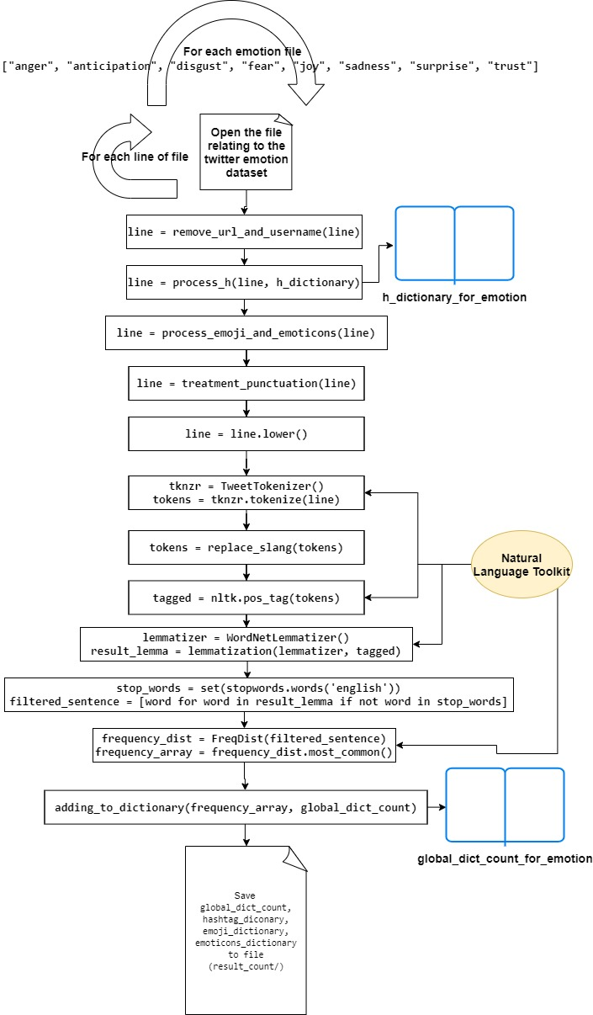
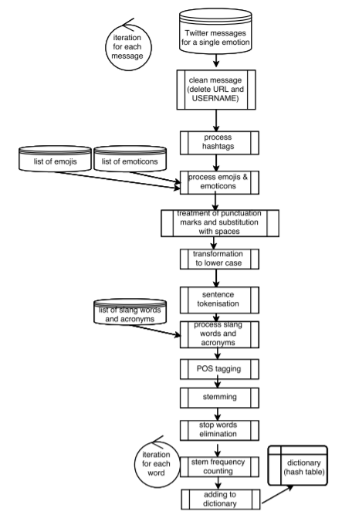
Elaboration.py

Slide 9
Data structure

Slide 10
MySQL

Slide 11
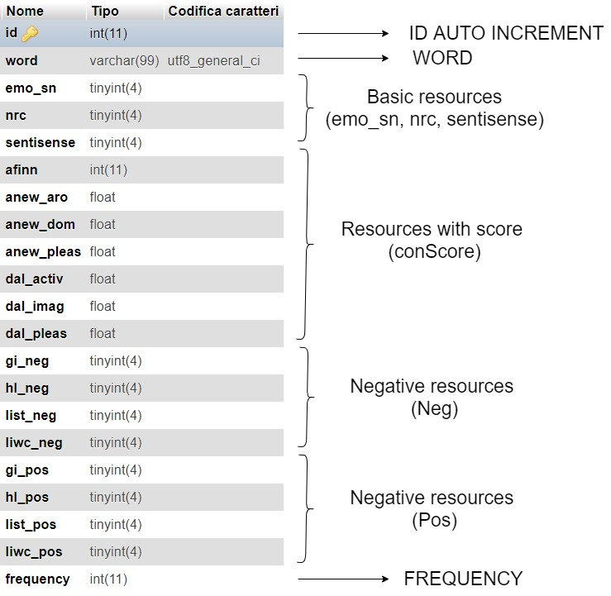
For each emotion: 8 table

Slide 12
Mongo

Slide 13
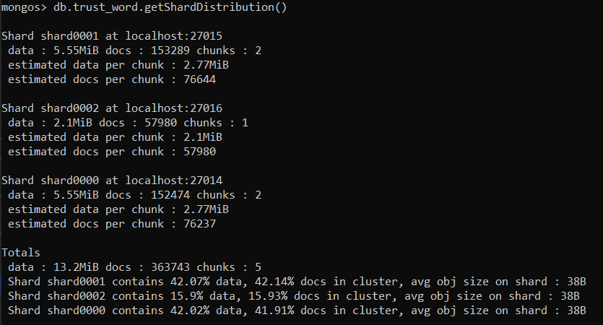
Sharding Data Example Collection: trust_word

Slide 14
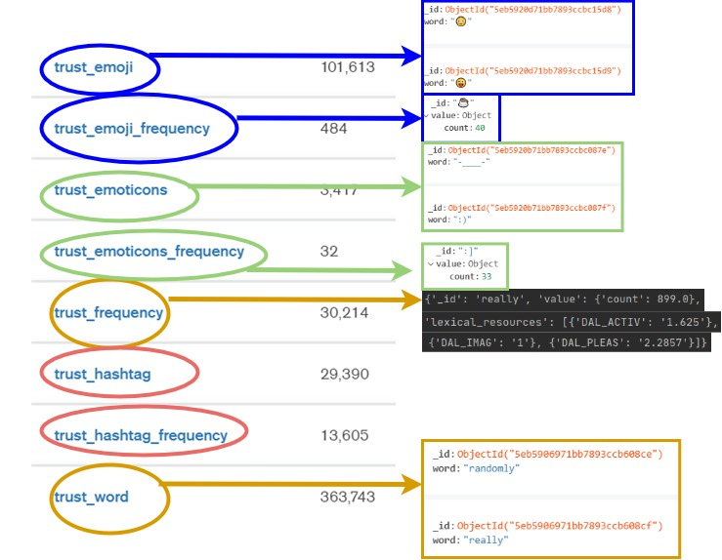
For each emotion: 8 collection

Slide 15
Document example – word: “Love”
{
'_id': 'love’,
'value': {'count': 10677.0},
'lexical_resources’: [
{'GI_POS': 1}, {'HL_POS': 1}, {'LIST_POS': 1}, {'LIWC_POS': 1},
{'AFINN': '3'}, {'ANEW_ARO': '6.44'},{'ANEW_DOM': '7.11’},{'ANEW_PLEAS': '8.72’},
{'DAL_ACTIV': '2.6364’}, {'DAL_IMAG': '1.4'}, {'DAL_PLEAS': '3’}
]
}

Slide 16
Results

Slide 17
Statistics of use of lexical resources (MySQL/Mongo)
anger: 6.03 %
anticipation: 9.56 %
disgust: 8.27 %
fear: 4.55 %
joy: 38.74 %
sadness: 7.27 %
surprise: 2.96 %
trust: 7.30 %
media = 10.58 %

Slide 18
WORDCLOUD

Slide 19


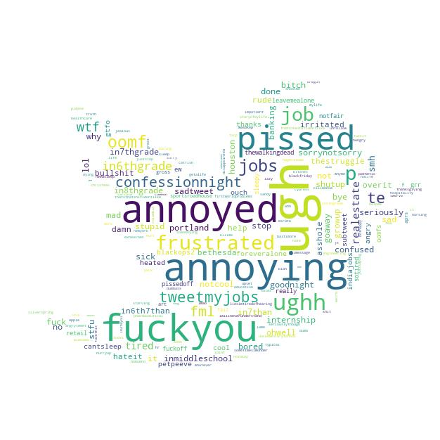
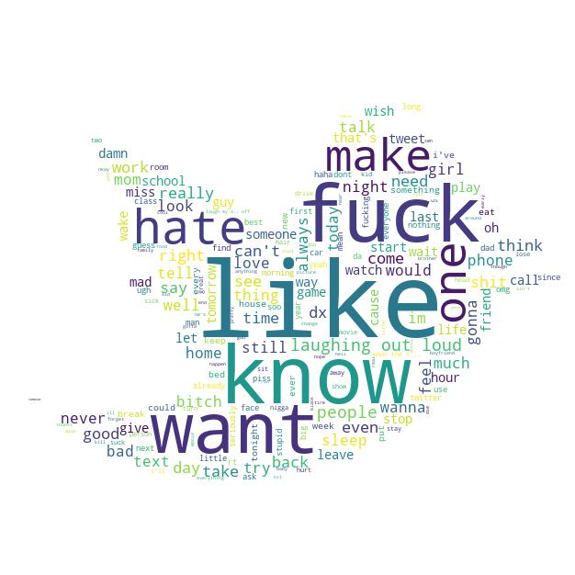
Anger Wordcloud
EMOTICONS
EMOJI
HASHTAG
WORDS

Slide 20

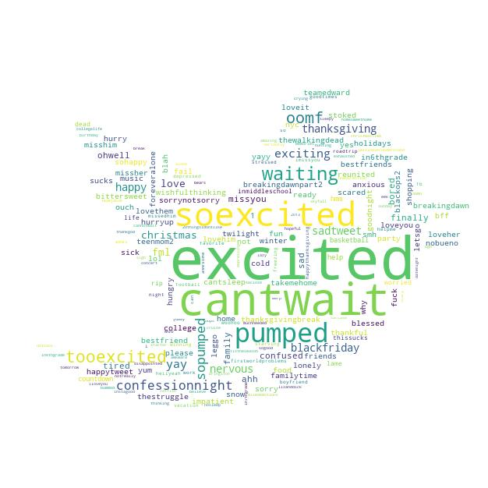

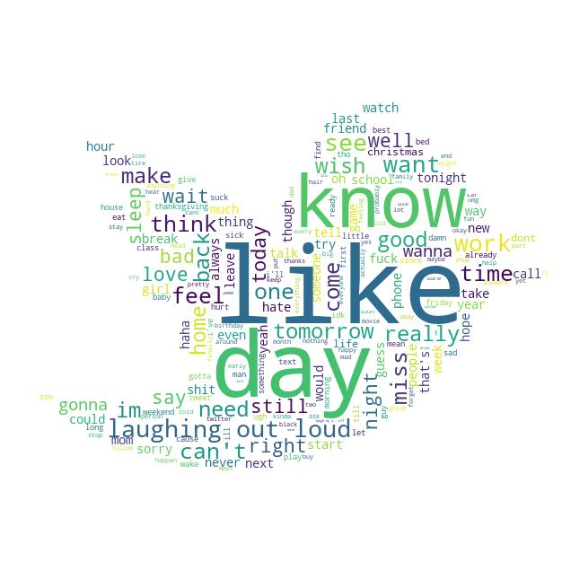
Anticipation Wordcloud
EMOTICONS
EMOJI
HASHTAG
WORDS

Slide 21
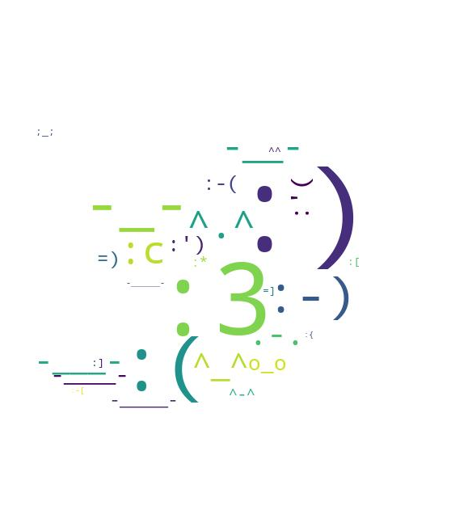

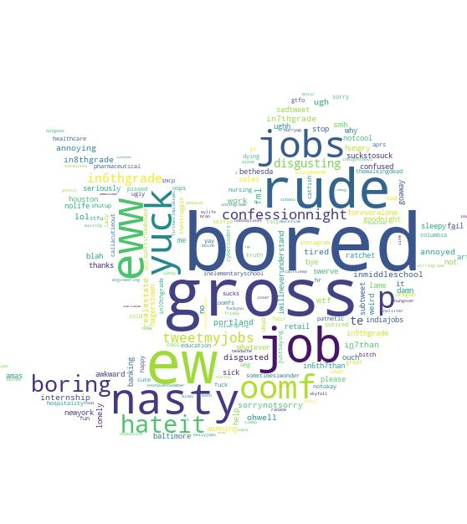

Disgust Wordcloud
EMOTICONS
EMOJI
HASHTAG
WORDS

Slide 22


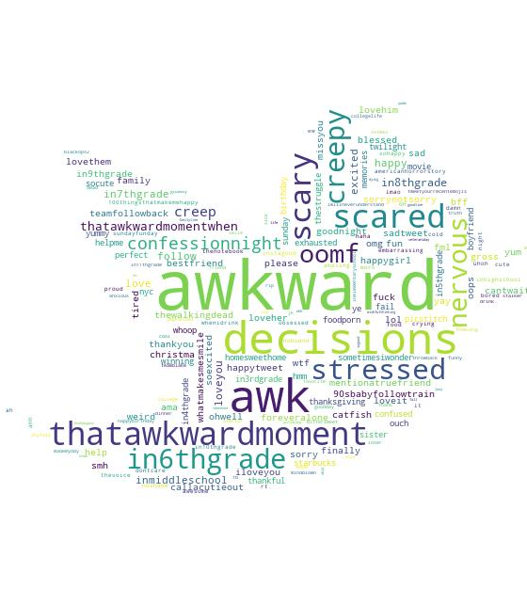
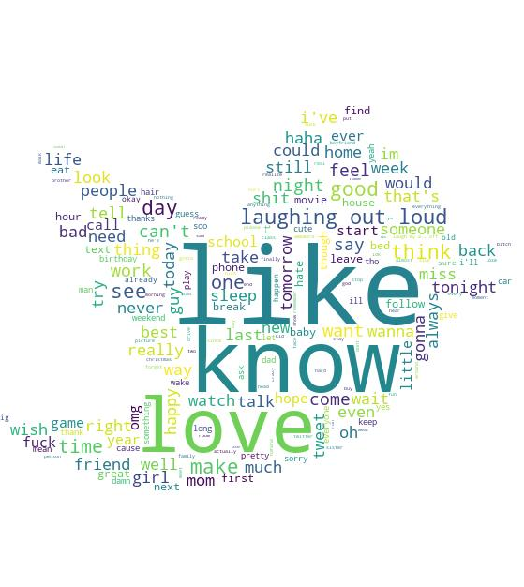
Fear Wordcloud
EMOTICONS
EMOJI
HASHTAG
WORDS

Slide 23


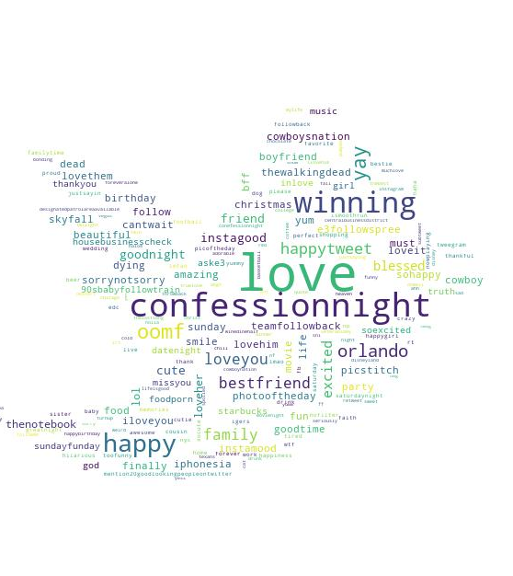
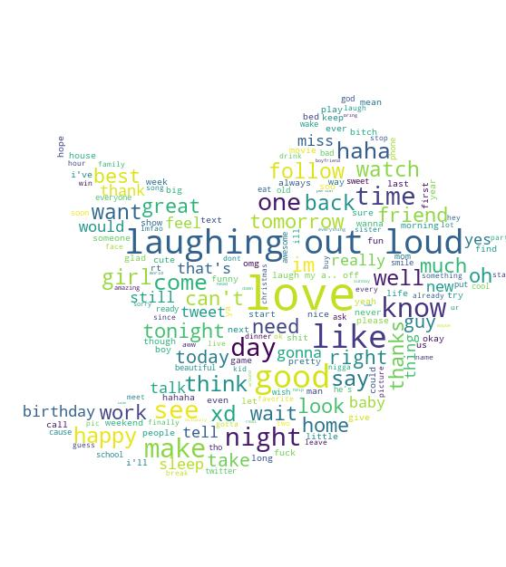
Joy Wordcloud
EMOTICONS
EMOJI
HASHTAG
WORDS

Slide 24


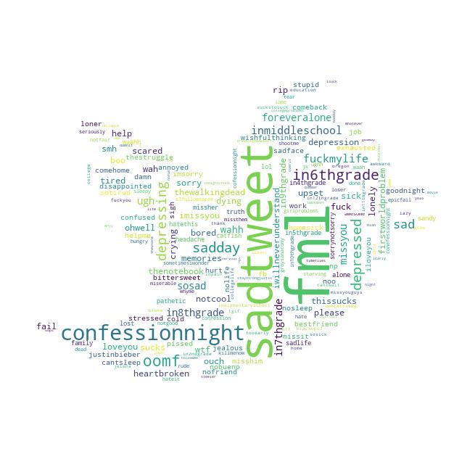

Sadness Wordcloud
EMOTICONS
EMOJI
HASHTAG
WORDS

Slide 25


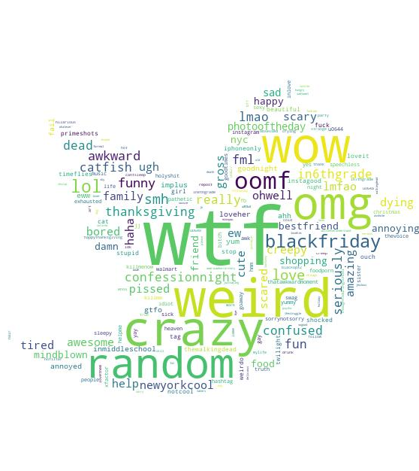
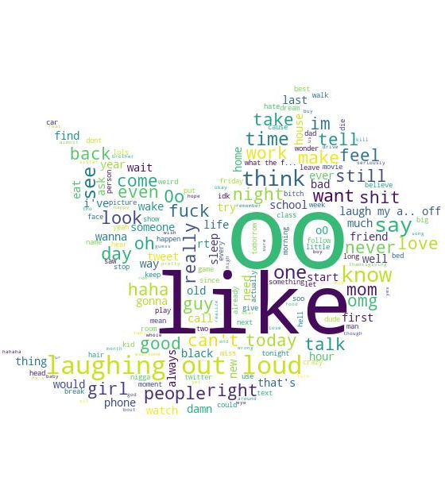
Surprise Wordcloud
EMOTICONS
EMOJI
HASHTAG
WORDS

Slide 26
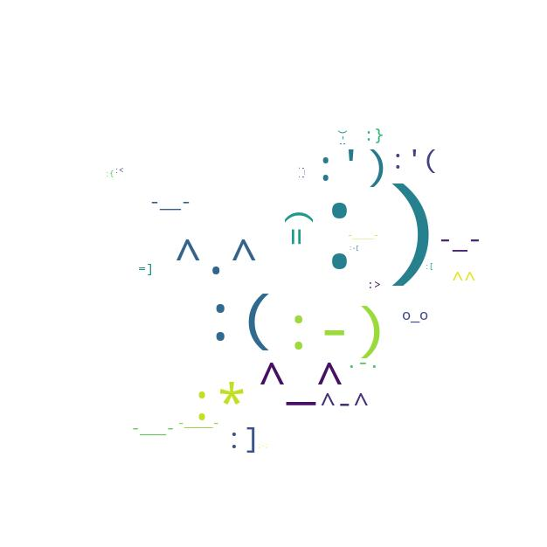

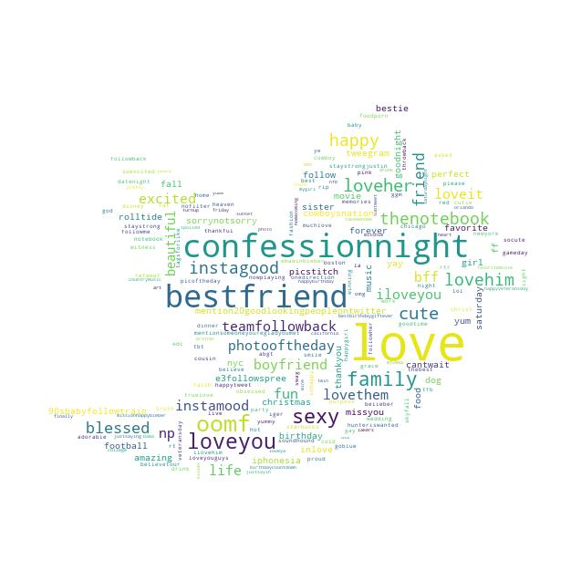
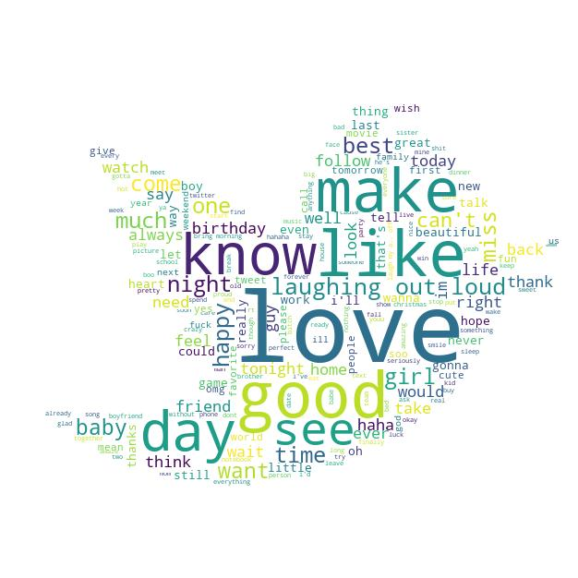
Trust Wordcloud
EMOTICONS
EMOJI
HASHTAG
WORDS

Slide 27
CONCLUSIONI

Slide 28
Mongo vs MySql https://www.simform.com/mongodb-vs-mysql-databases/#section3 https://towardsdatascience.com/keras-challenges-the-avengers-541346acb804
Entrambe le soluzioni di archiviazione funzionerebbero, in realtà dipendono dalle dimensioni dei dati che si prevede di utilizzare e dal modo in cui vengono utilizzate per questo caso d'uso. Se il set di dati supera alcuni terabyte di dati, un approccio MapReduce sarebbe l'ideale, se più piccolo di un database SQL in questo caso potrebbe essere sufficiente.
Un altro aspetto da considerare è il numero di query al secondo che il sistema dovrebbe eseguire, che dovranno essere prese in considerazione nella progettazione.

