Slide 1
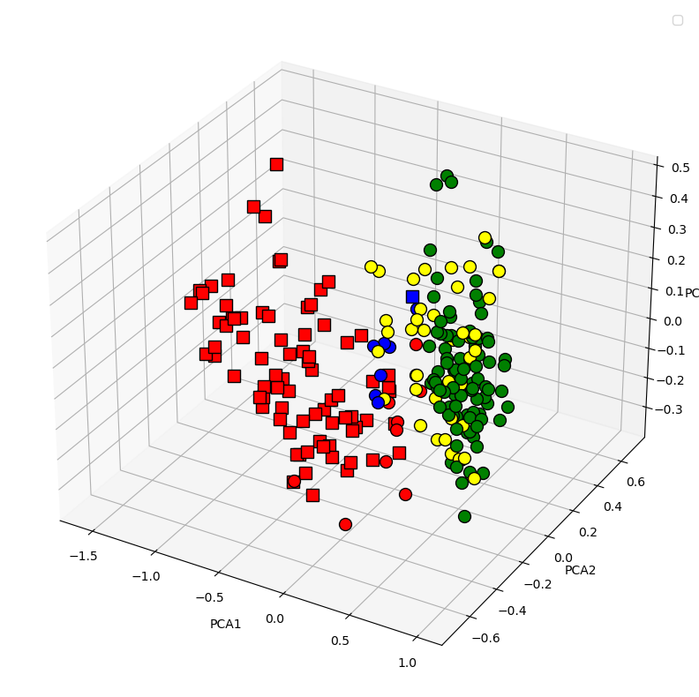
Cluster 1
North
Centre
Cluster 2
Southern regions
Italy

