Slide 1
The M.A.L.L.S.
A Punk Rock Band Website
By Luca Airoldi

Slide 2
Project Idea
A website for a music band
- to present the band
- to share live shows
- to allow interaction

Slide 3
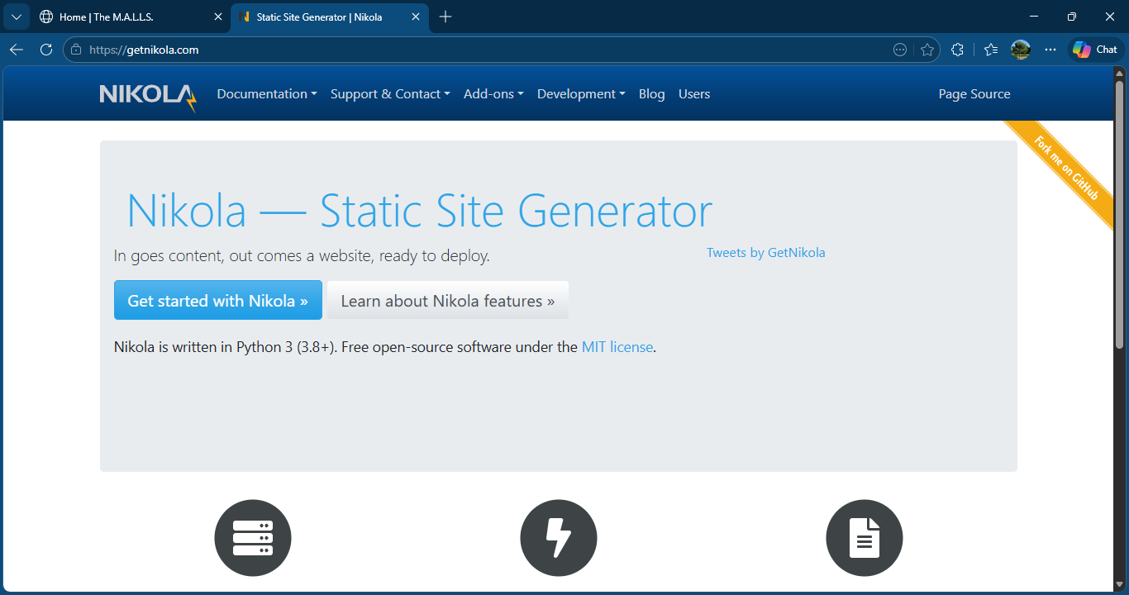
GetNikola
GetNikola has been used to give some structure to the website
Its static but it’s quite simple to understand and build
(to compensate javascript has been used to make the site a bit more dynamic)

Slide 4
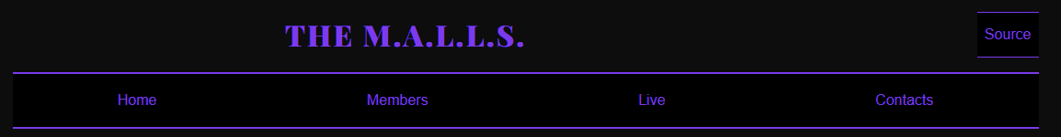
Website Structure
- Home
- Members
- Live
- Contacts

Slide 5
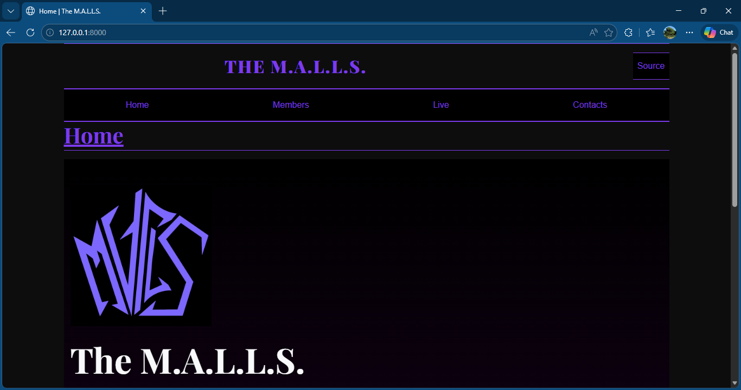
Design
Dark theme
Purple accents
Inspired by punk-rock style

Slide 6
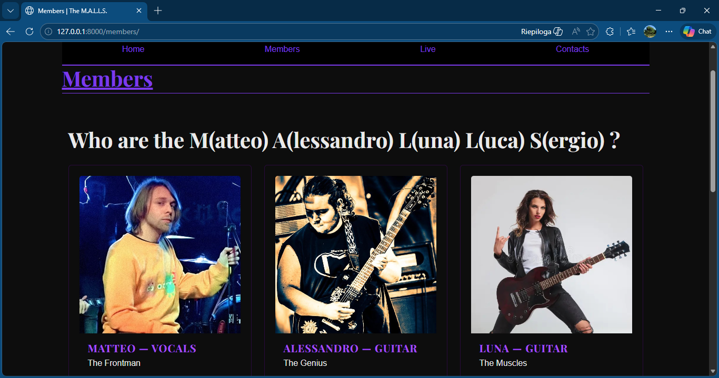
Members Page
Band presentation
- images
- roles
- descriptions

Slide 7
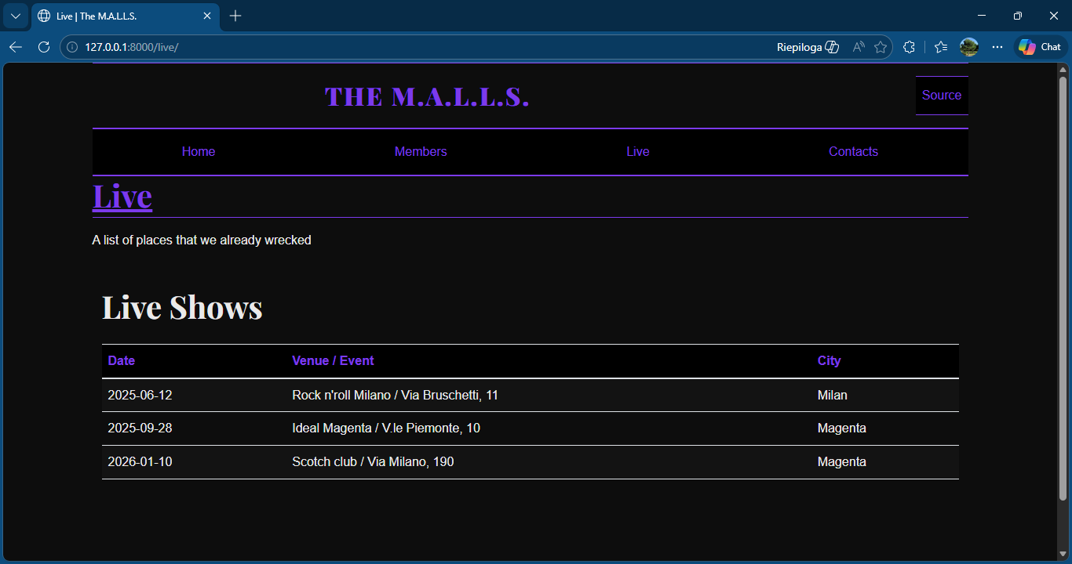
Live Page
Live shows table
- dates
- venues
- cities

Slide 8
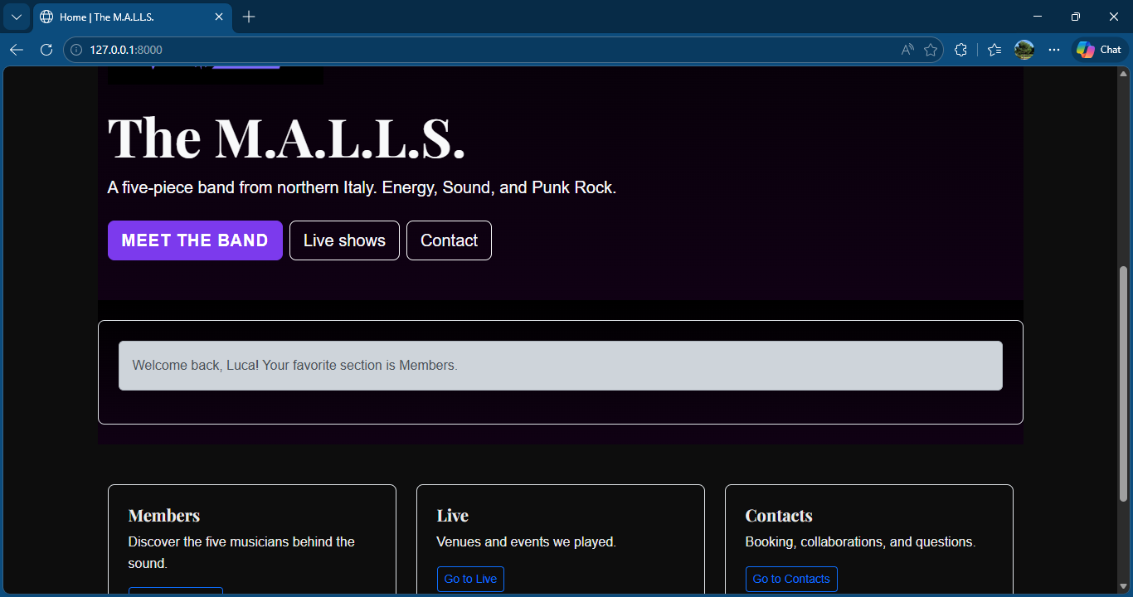
Cookies
Store user preferences
- name
- favorite section

Slide 9
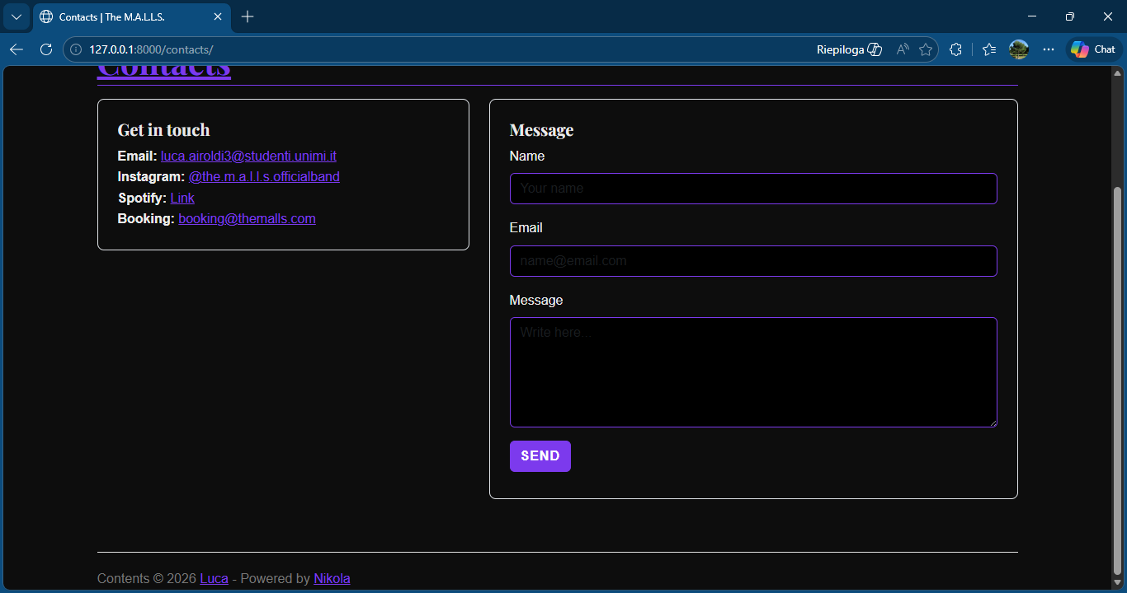
Contact Form
Collects user input
Generates email via mailto

Slide 10
Conclusion
It is a web project designed to help a band in being noticed
Introduces each member
Adds interactivity with the user

