Slide 1

Software Engineering 2 Project
School of Industrial and Information Engineering
Computer Science and Engineering
made by
Luca Alessandrelli 846260
Andrea Caraffa 919970
Andrea Bionda 921082

Slide 2


Some assumptions we made
Data4Help
Partner Application (a),(b),(D.1)
Individuals accept Individual Request one by one
Privacy Policy Conditions (e)

Slide 3

Some assumptions we made
AutomatedSOS
No additional service for third parties (d)
Using historical data to check user’s health status (e)

Slide 4

Some assumptions we made
Track4Run
Organize runs and invite athletes in order to promote them (d)
Enroll to all the present runs (c),(f)
Public runs
Spectate all the present runs (e)

Slide 5
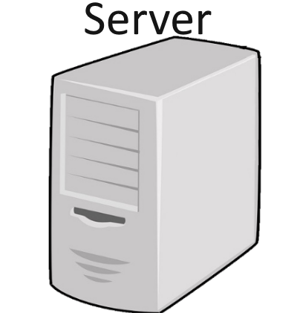
Goal and Requirements
Data4Help
G.2 Provide to third parties, the user’s position
and health status.
R.7 The system should allow third parties to send
information requests.
R.10 The system has to send to the third party all
the raw data collected until the moment of the
request.

Slide 6
Goal and Requirements
AutomatedS0S
G.7 Send an ambulance to user’s location whenever
certain parameters are below the threshold.
R.23 The application has to control health status
with data retrieved in local to immediately
realize whether certain parameters are critical.
R.24/R.26 The application sends an ambulance
request to the nearest hospital whenever
parameters are critical, repeating it until an
answer from the hospital is reached.

Slide 7
Goal and Requirements
Track4Run
G.9 Allow athlete to enroll on a specific run.
R.35 Deny user to enroll to a run if maximum
number of participants is already reached.
G.10 Allow spectators to watch in real time the
position of every athletes in a specific run.
R.38 The application receives and displays the
Position of all the other athletes involved.

Slide 8
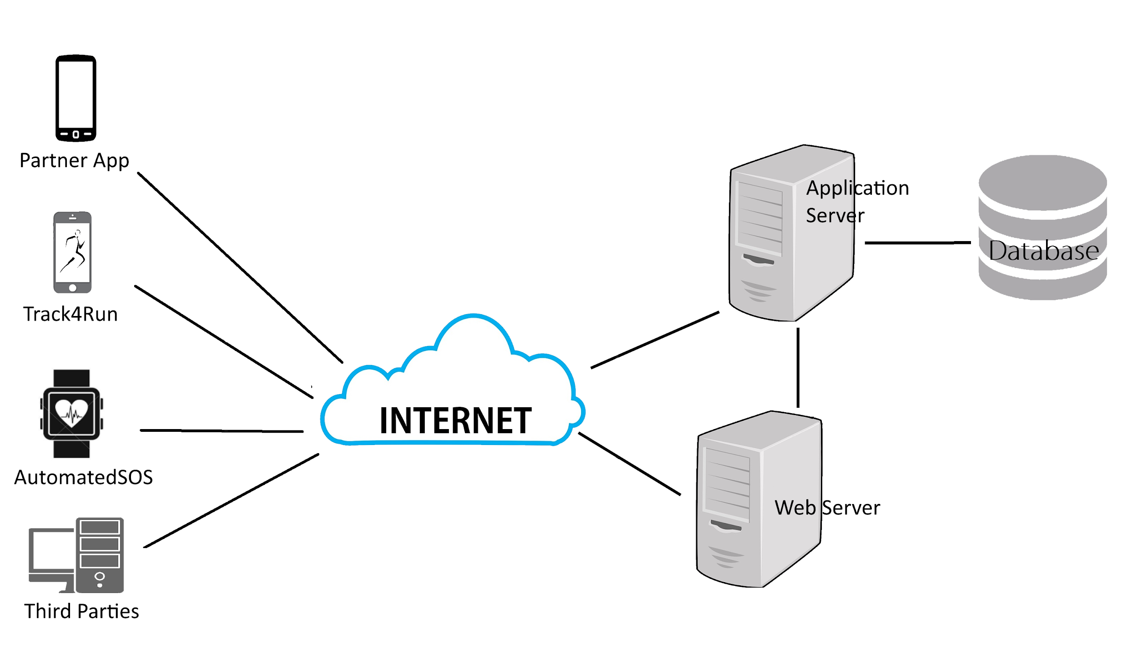
System Architecture and Patterns
HTTP/TCP
JDBC
HTTP/TCP
TCP
RMI
HTTP/TCP
HTTP
HTTP

Slide 9
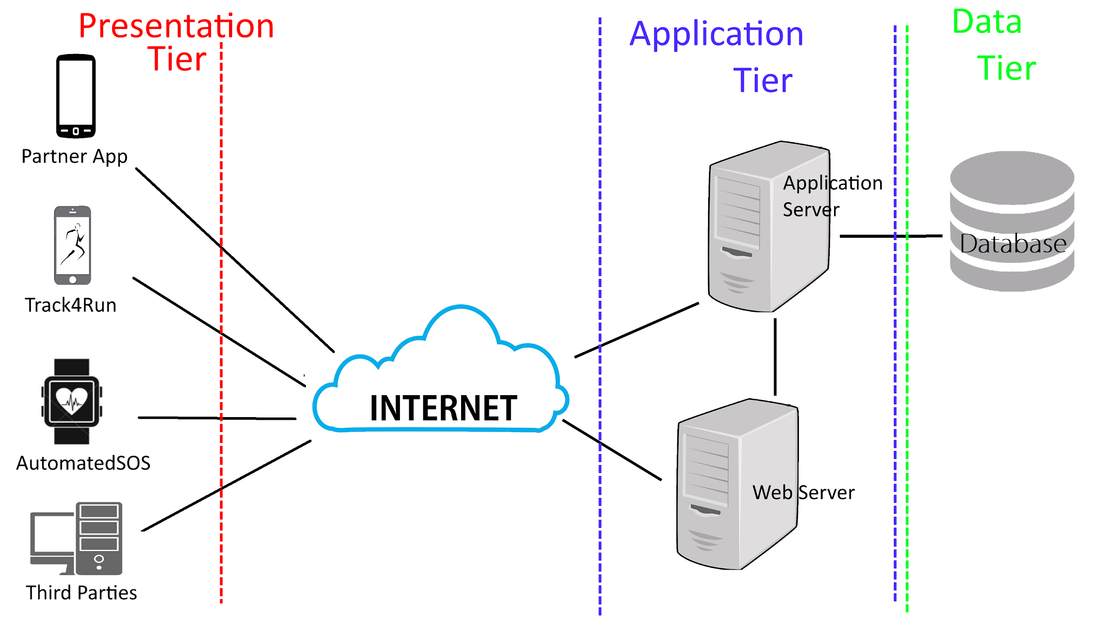
System Architecture and Patterns
HTTP/TCP
JDBC
HTTP/TCP
TCP
RMI
Proxy
HTTP/TCP
HTTP
HTTP
View
Controller
Model

Slide 10
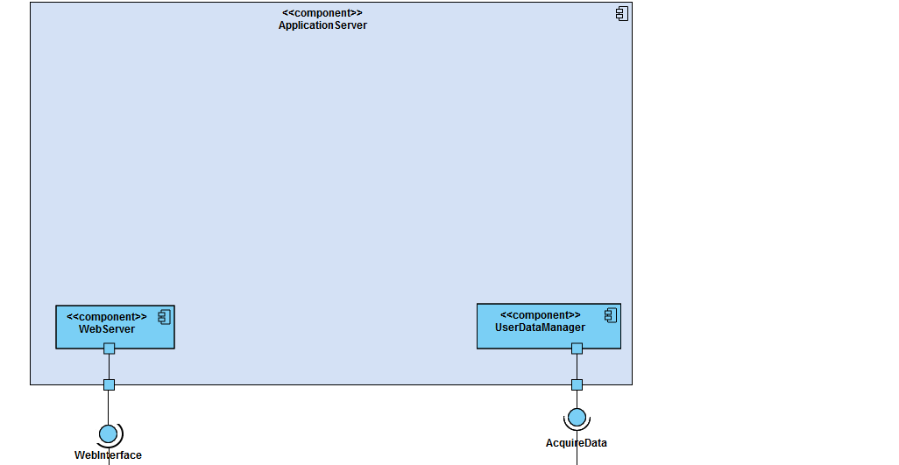
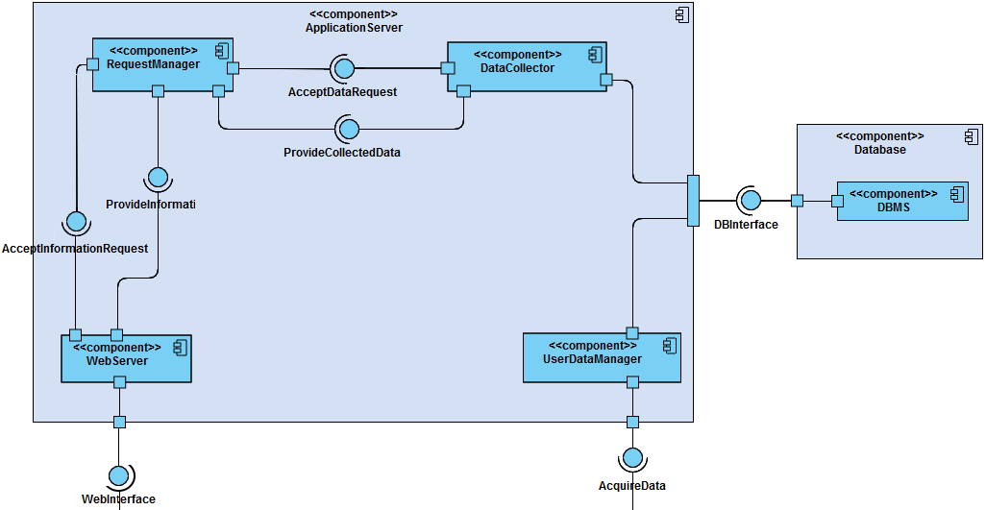
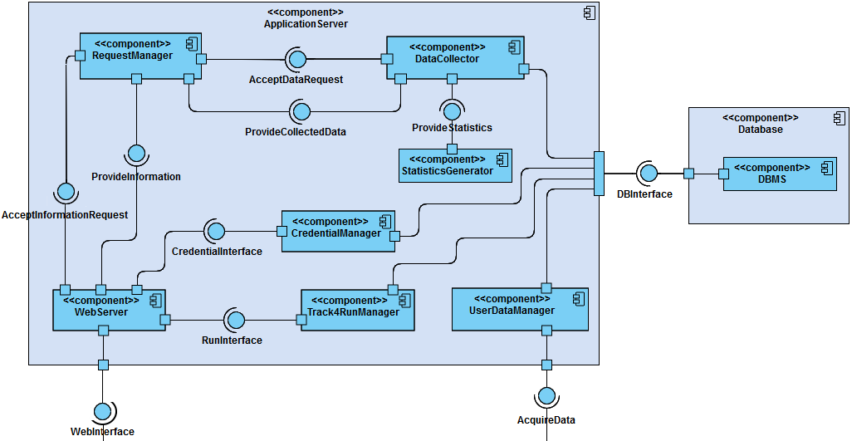
System’s Components
Components interfaced
with third parties and partner applications
Components that handle Information Monitoring Requests
Components that support system operations
Third Party
Partner Application

Slide 11
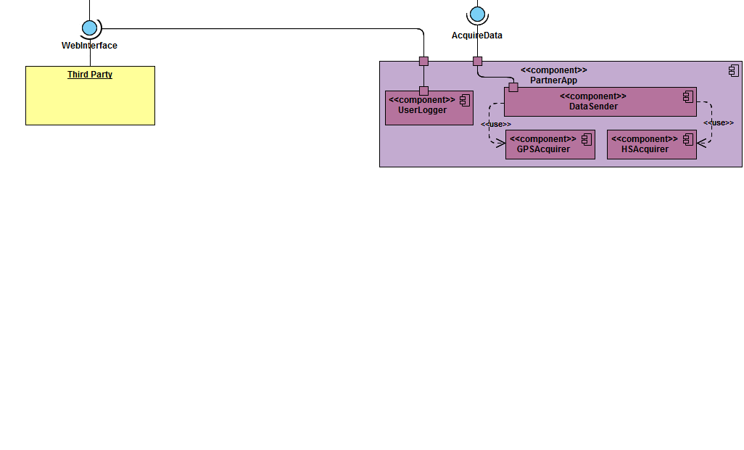
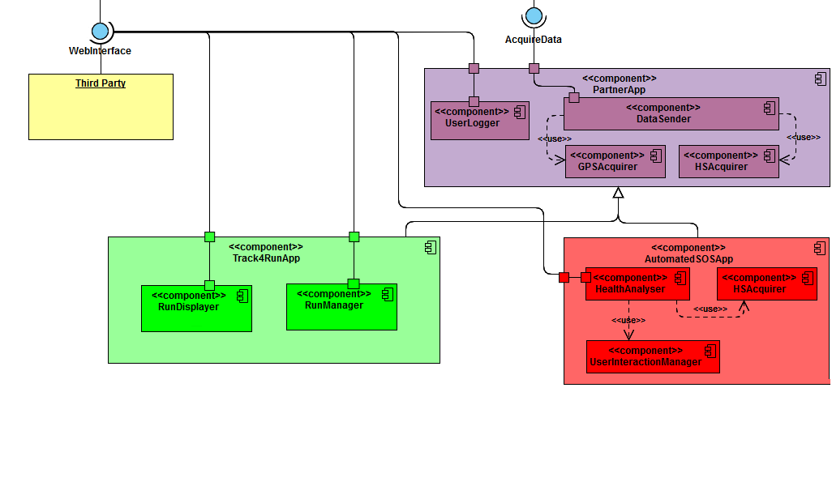
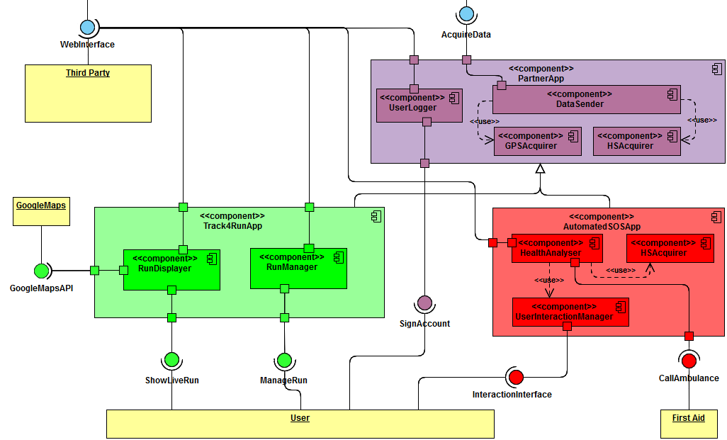
System’s Components
Data4Help components
interfaced with
the ApplicationServer
Components of the specific applications Track4Run and AutomatedSOS
Interaction with the external world

Slide 12
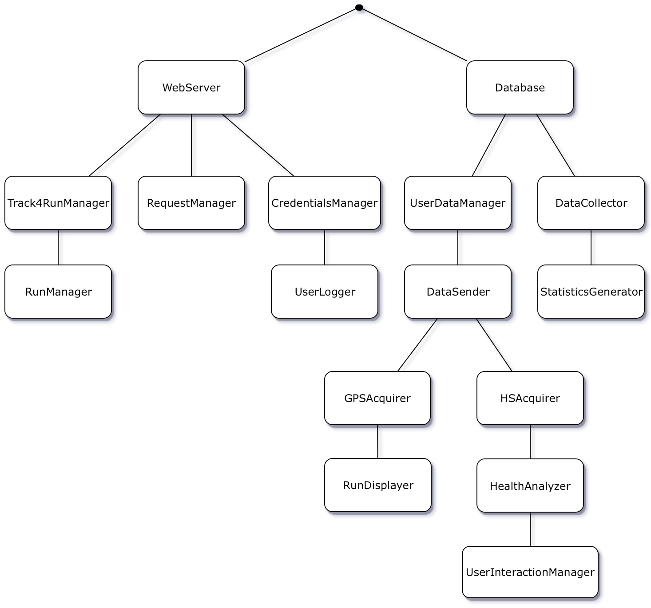
Implementation
Critical components first
Dependency between components
Top-Down approach

Slide 13
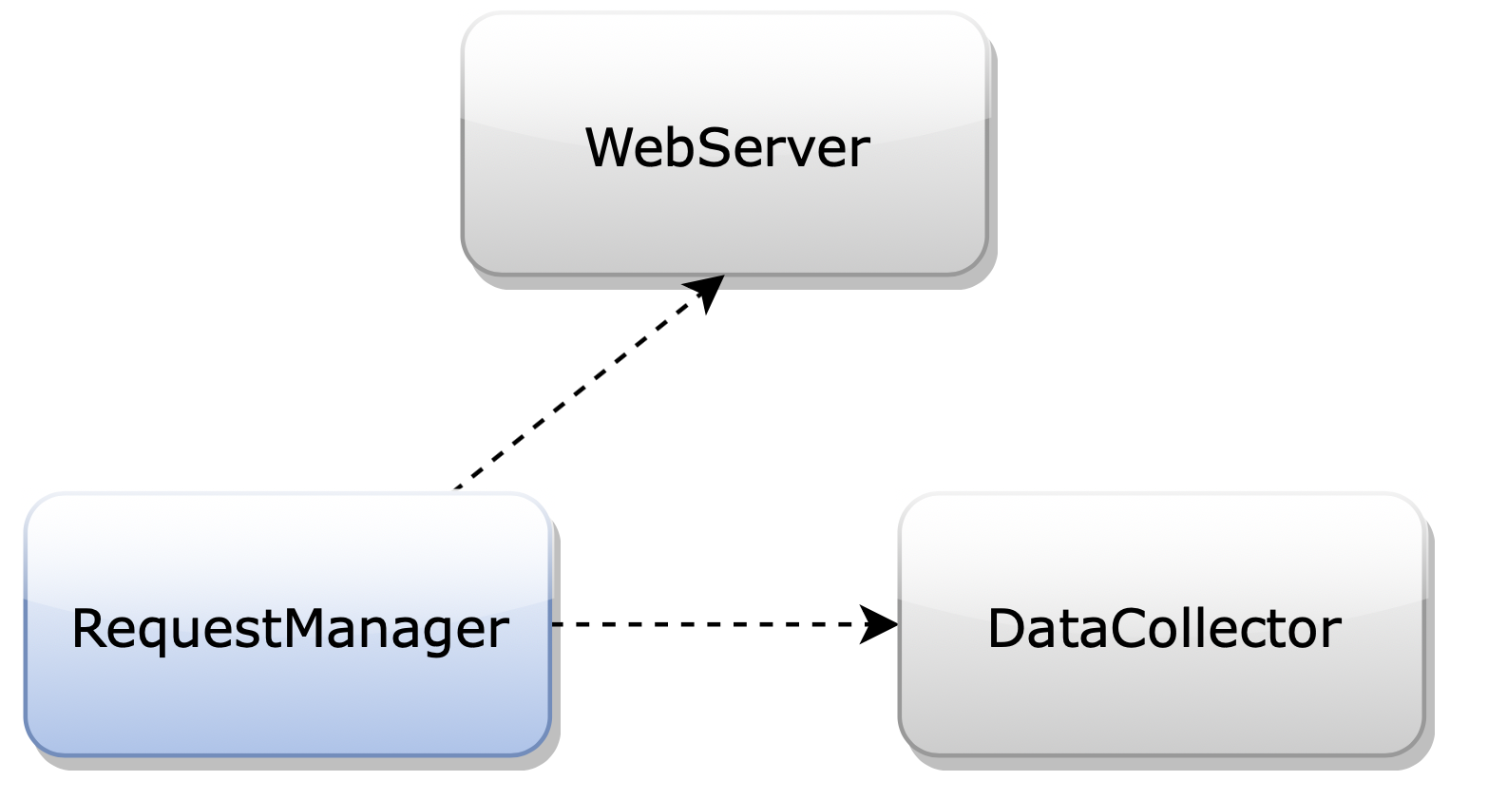
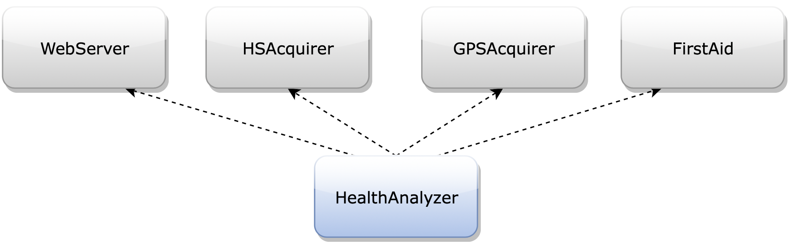
Integration and Test Plan
Unit testing
Top-Down approach
Incremental Integration and Testing approach
Query Optimization
System Testing
Algorithm Optimization
Recovery after failure

Slide 14
Thank you
Reference Documents
Requirements Analysis and Specification Document
Specification Document "Mandatory Project Assignment AY 2018-2019".
Slides "Structure of RASD". Slides "Use of Alloy in RE". Use Case Diagrams created with https://www.lucidchart.com
Mockups created with https://www.fluidui.com
Design Document
Specification Document "Mandatory Project Assignment AY 2018-2019". Slides about "Design". Slides about "Implementation, Integration and Test Plan". Sequence Diagrams created with https://www.nomagic.com/products/magicdraw
Mockups created with https://www.fluidui.com and https://www.simbla.com
Component Diagram created with https://online.visual-paradigm.com
Other Diagrams created with https://www.draw.io

Slide 15
Reference Documents
Requirements Analysis and Specification Document
Specification Document "Mandatory Project Assignment AY 2018-2019".
Slides "Structure of RASD". Slides "Use of Alloy in RE". Use Case Diagrams created with https://www.lucidchart.com
Mockups created with https://www.fluidui.com
Design Document
Specification Document "Mandatory Project Assignment AY 2018-2019". Slides about "Design". Slides about "Implementation, Integration and Test Plan". Sequence Diagrams created with https://www.nomagic.com/products/magicdraw
Mockups created with https://www.fluidui.com and https://www.simbla.com
Component Diagram created with https://online.visual-paradigm.com
Other Diagrams created with https://www.draw.io

