Slide 1
Hands-on Qt Quick and QML
A practical approach to modern application design

Slide 2
Schedule
NoteApp
Design Strategy
Live NoteApp development with Qt Creator
Lessons Learned

Slide 3
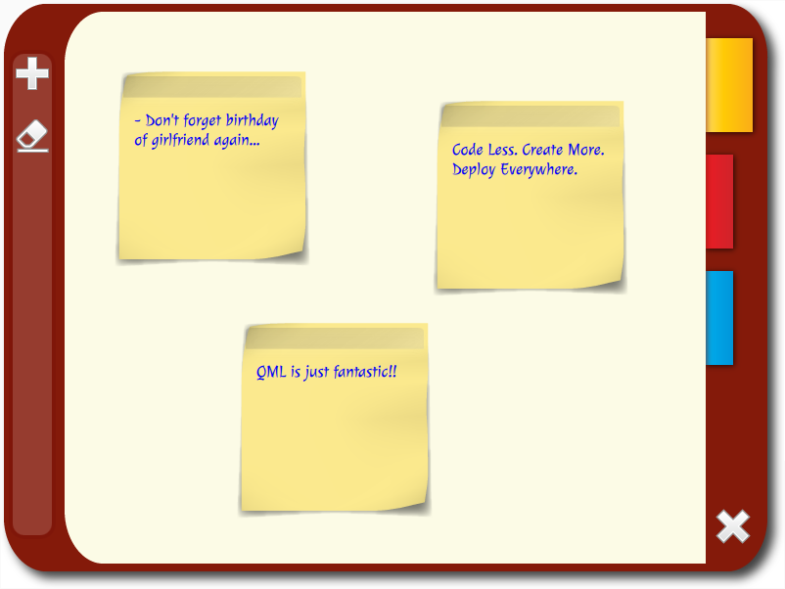
NoteApp Source: Digia, Qt Learning

Slide 4
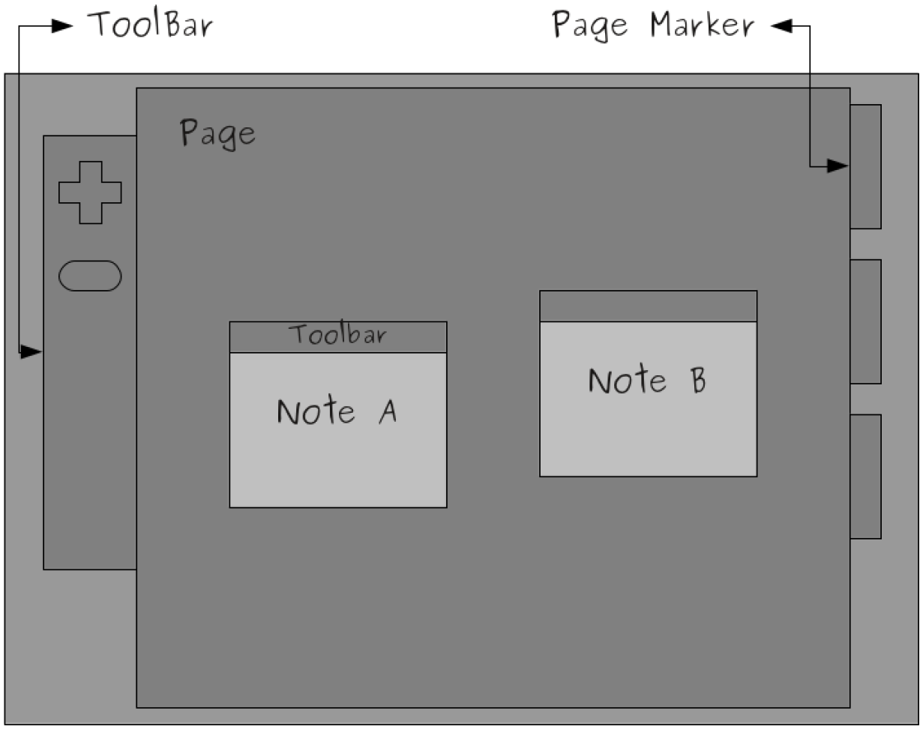
Mockup for NoteApp

Slide 5
Design Strategy
Prototyping and Initial Design
Implementing the UI and Adding Functionality
Managing QML Objects Dynamically
Enhancing the Look and Feel
Deploying the Application

Slide 6

Prototype for NoteApp

Slide 7
Live NoteApp development with Qt Creator

Slide 8
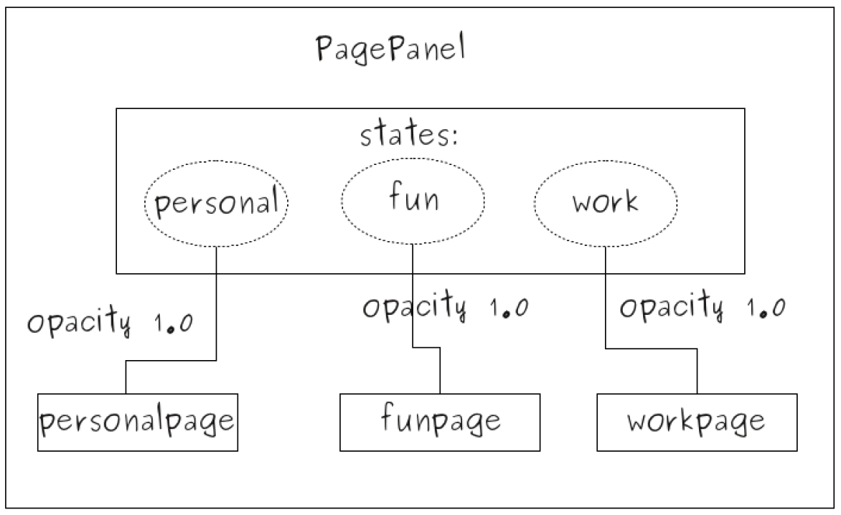
Implementation of PagePanel

Slide 9
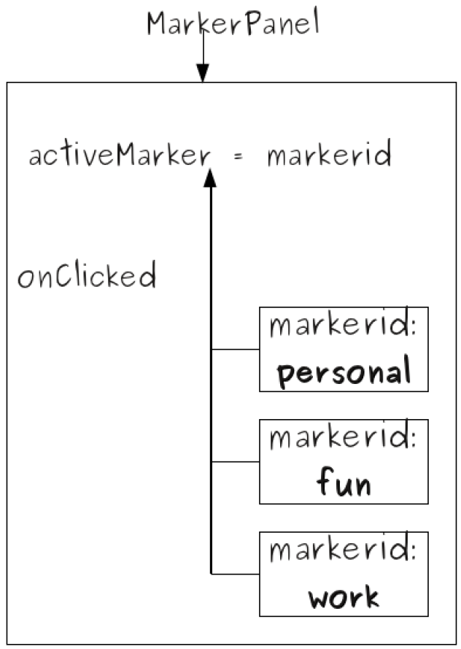
Implementation of MarkerPanel

Slide 10
Lessons Learned
Prototyping
Creation of new QML Components
Use of QML Layout items
Use of States
Use of Images and Backgrounds

Slide 11
Danke!
Luca Bonifacio
info@bbv.ch
www.bbv.ch
https://github.com/lucab0ni/QmlDemoPresentation.git

