Slide 1
Scientific Programming Practical 7
Introduction
Luca Bianco - Academic Year 2017-18
luca.bianco@fmach.it

Slide 2
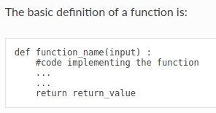
Functions: just a reminder
A function is a block of code that has a name and that performs a task. A function can be thought of as a box that gets an input and returns an output.
1. Reduce code duplication: put in functions parts of code that are needed several times in the whole program so that you don’t need to repeat the same code over and over again;
2. Decompose a complex task: make the code easier to write and understand by splitting the whole program in several easier functions

Slide 3
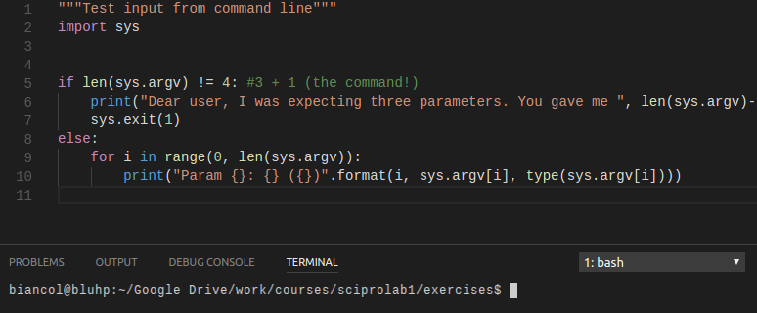
Passing parameters from command line
Python provides the module sys to interact with the interpreter.
sys.argv is a list representing all the arguments passed to the python script from the command line.
Check out: https://docs.python.org/3/

Slide 4
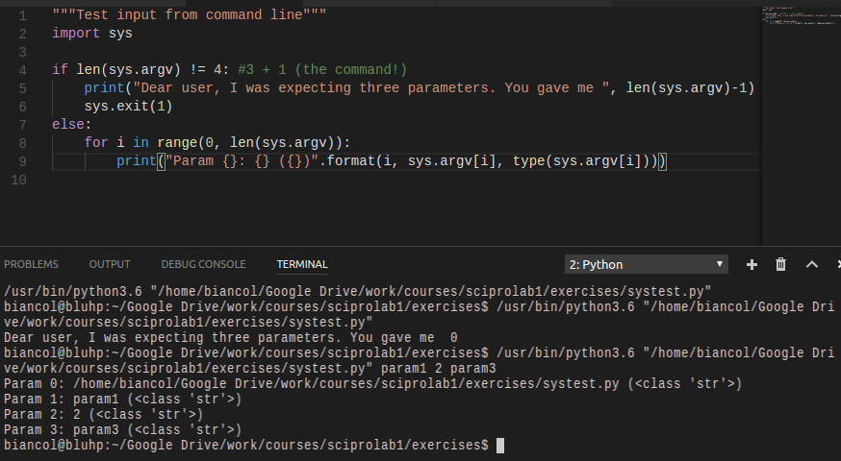
Passing parameters from command line

Slide 5
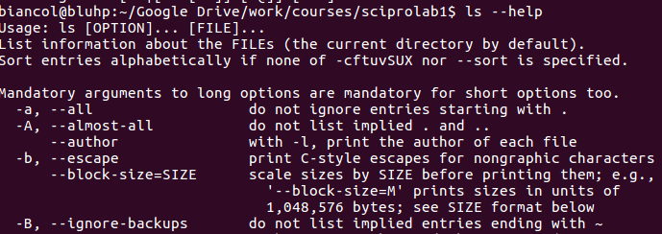

Argparse
Six steps:
1. Import the module
2. Create the parser object
Argparse is a command line parsing module which deals with positional arguments and optional arguments.
3. Add positional arguments
4. Add optional arguments
5. Parse the arguments
6. Retrieve and process the arguments

Slide 6
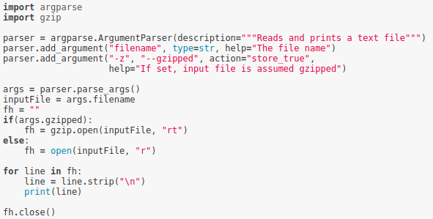
Argparse
Example: Let’s write a program that reads and prints to screen a text file specified by the user. Optionally, the file might be compressed with gzip to save space. The user should be able to read also gzipped files. Hint: use the module gzip which is very similar to the standard file management method

Slide 7
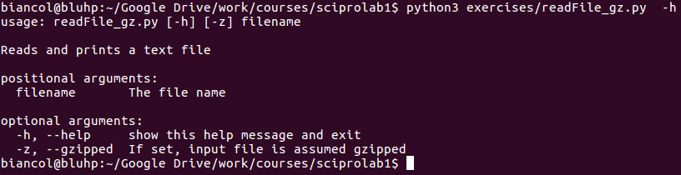
Argparse

Slide 8
Argparse

Slide 9
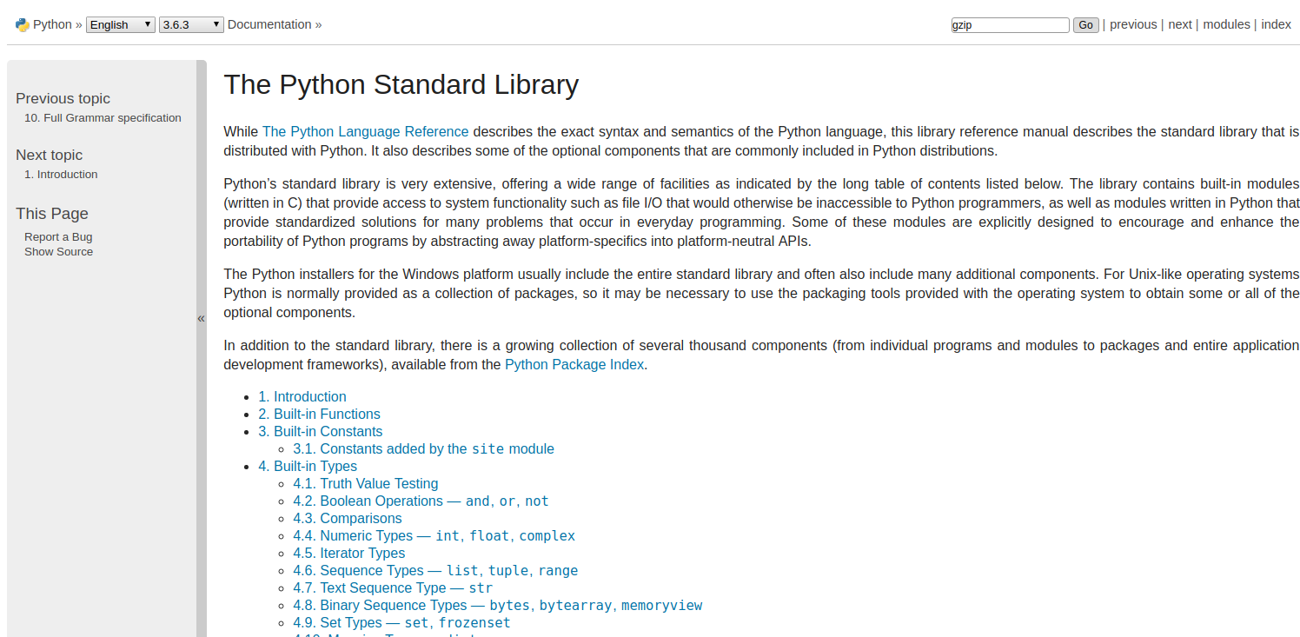
https://docs.python.org/3/library/index.html

Slide 10
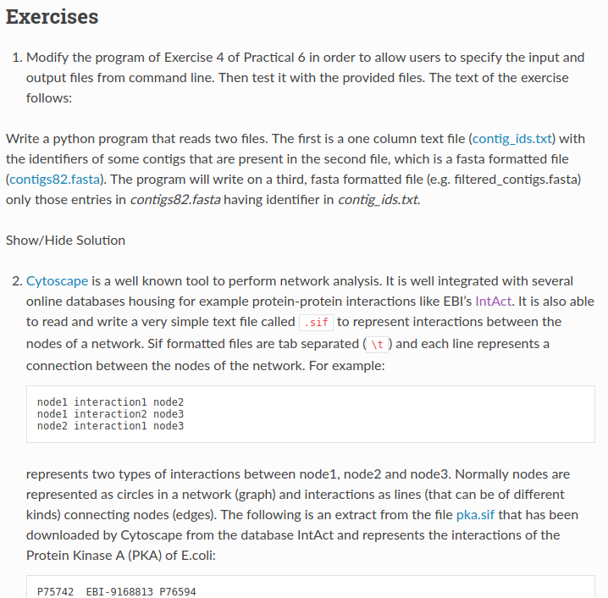
http://sciprolab1.readthedocs.io/en/latest/practical7.html

