Slide 1
What’s new in C# 8.0
Luca Bolognese – lucabol_at_microsoft.com
Demo and ppt at: https://github.com/lucabol/WhatsNewInCSharp8

Slide 2
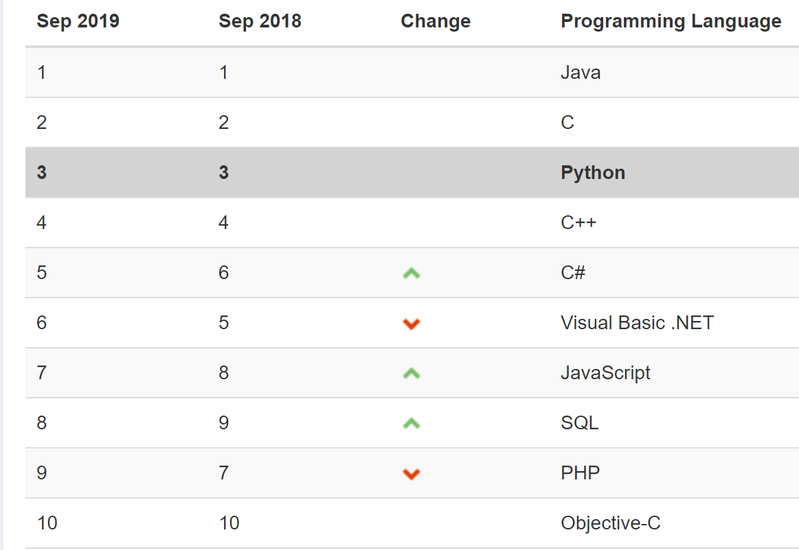
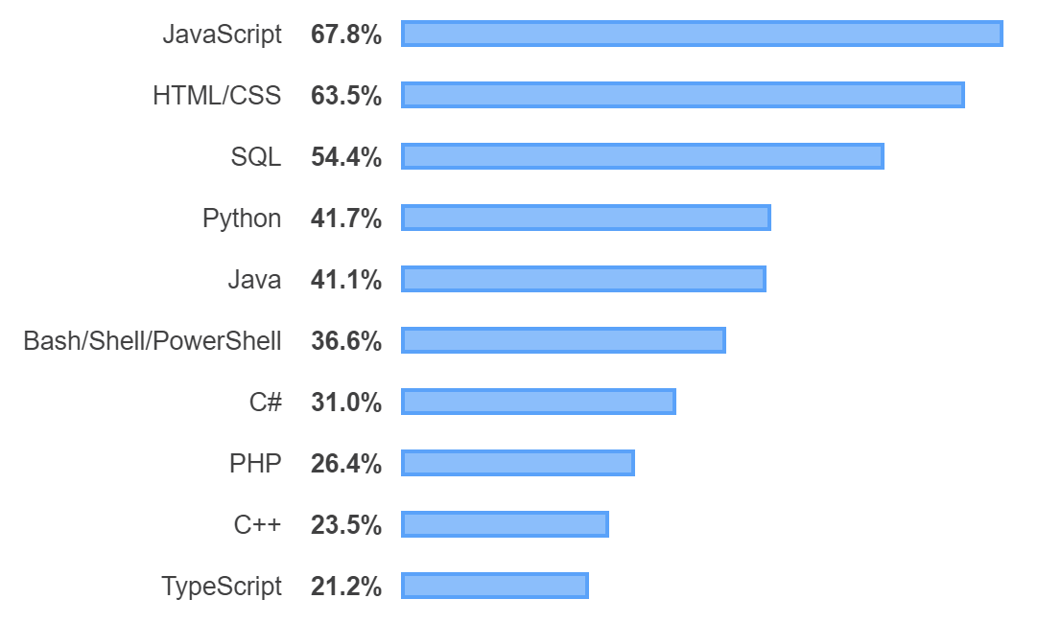
A popular and exciting language (TIOBE, SO Survey)

Slide 3
Innovation
1.0
Hello
2.0 Generics
3.0
LINQ
4.0 Dynamic
5.0 Async
6.0 Concise
7.0 Tuples …
8.0 Nullable
9.0
????

Slide 4
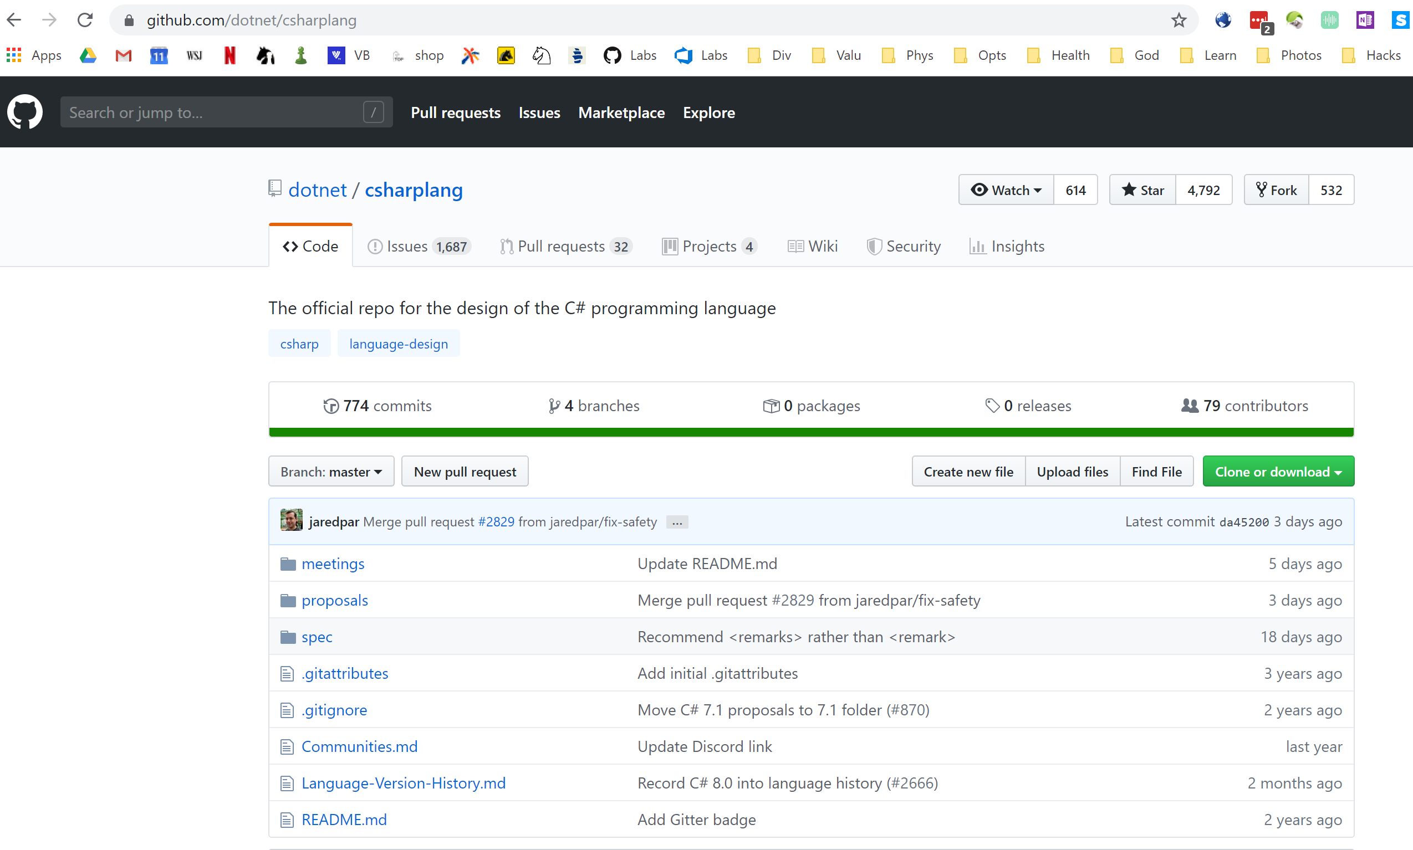
Transparent design process

Slide 5
Demo
New features in C# 8.0

Slide 6
Key takeaways
Switch on Nullable ref types on your projects.
Proactively apply new features.
Contribute https://github.com/dotnet/csharplang.

