Slide 1
Advertising
Data Intelligence Application
Academic Year: 2018/2019
Antoniazzi Matteo 895712 (matteo.antoniazzi@mail.polimi.it)
Bonali Luca 896641 (luca.bonali@mail.polimi.it)
Chittò Pietro 899045 (pietro.chitto@mail.polimi.it)
Lamparelli Andrea 894005 (andrea.lamparelli@mail.polimi.it)
Ravelli Leonardo 894222 (leonardo.ravelli@mail.polimi.it)

Slide 2
Outline
Product Description
Classes Definition
CGPTS
CGPTS vs CGTS
CGPTS Disaggregation

Slide 3
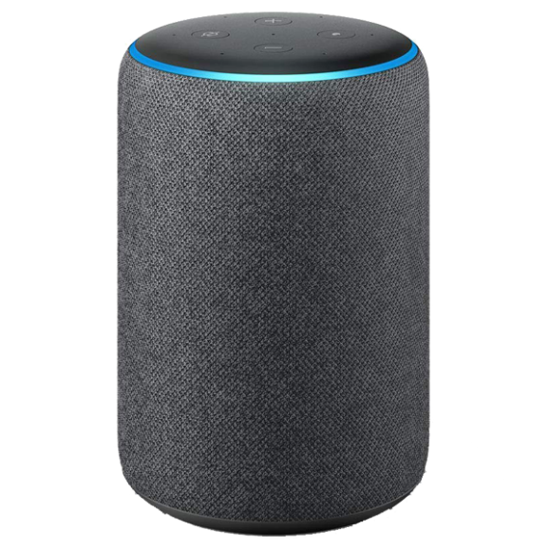
Which product?
Amazon Echo Plus
Voice interaction, music playback, making to-do lists, setting alarms, streaming podcasts, in addition to providing weather, traffic and other real-time information.
Home Automation Hub.
Released in 2018.
Encourages faster and broader development and support from third-parties of its skills market.

Slide 4
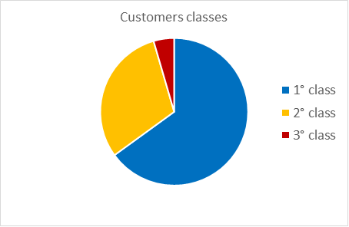
Classes: Features
Three main features:
Age: Young, Adult, Retire
Home Status: Living Alone, Living with Family
Welfare: Normal, Richer
FAMILY 0.40 | Young 0.50 | Workers 0.40 | Retires 0.1
Richer 0.55 | 0,11 | 0,088 | 0,022
Normal 0.45 | 0,09 | 0,072 | 0,018
0,045
0,305
0,65
ALONE 0.60 | Young 0.50 | Workers 0.40 | Retires 0.1
Richer 0.55 | 0,165 | 0,132 | 0,033
Normal 0.45 | 0,135 | 0,108 | 0,027

Slide 5
Classes: Description
Giving the same amount of people that visit our Ads in the three classes, the first class will be the one where we expect the most clicks, than comes the second class, and the third.
1° Class: Young students, young workers or young families with good economic wellness. (Assumption that they will be more interested in our product)
2° Class: Older families or retired couples, less inclined in spending money in a commodity like this product, but still have a good economic situation.
3° Class: People almost not interested in our product, for interests or less economic availability

Slide 6
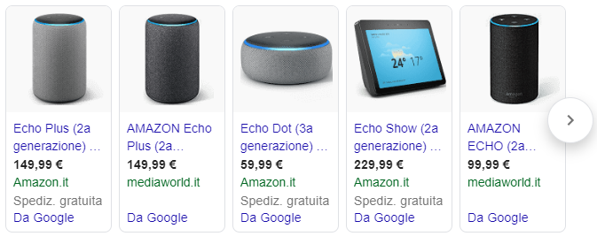

Sub-Campaign definition
We have identified 5 different sub-campaigns:
Search advertising:
Google
Bing
Display Advertising:
YouTube
Social advertising:
Facebook
Instagram

Slide 7
Average daily budgets/clicks curves assumptions
Three levels of maximum clicks limit, due to the auction mechanism:
High = 90 clicks
Medium = 60 clicks
Low = 40 clicks
We have used a composition of sigmoid function (taking just the positive part) to estimate the behaviour of the real world curves.
Once generated all the curves for a sub-campaign, the aggregated one is achieved by weighted average between the three class, according to the probability of belonging to each class.

Slide 8
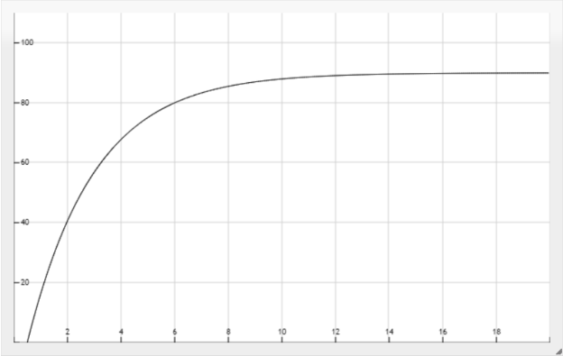
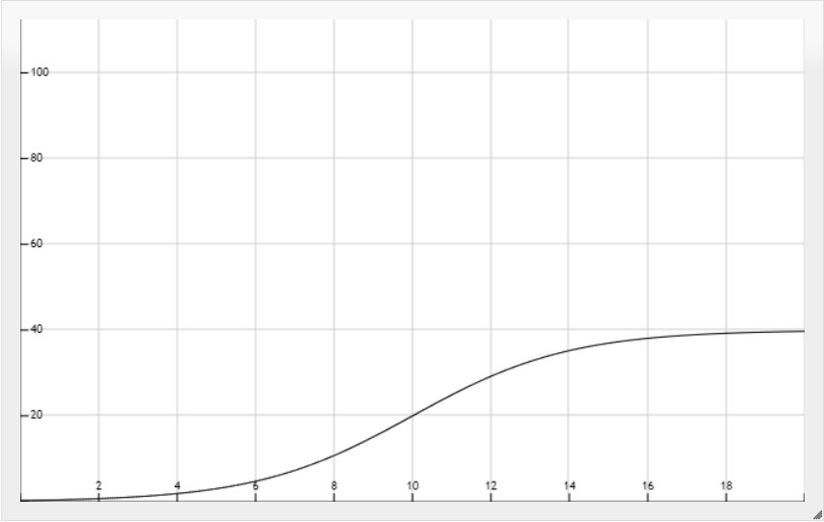
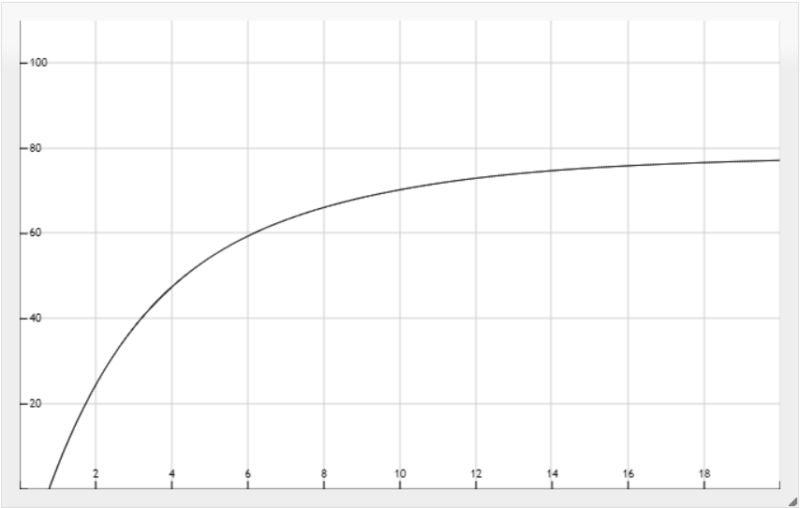
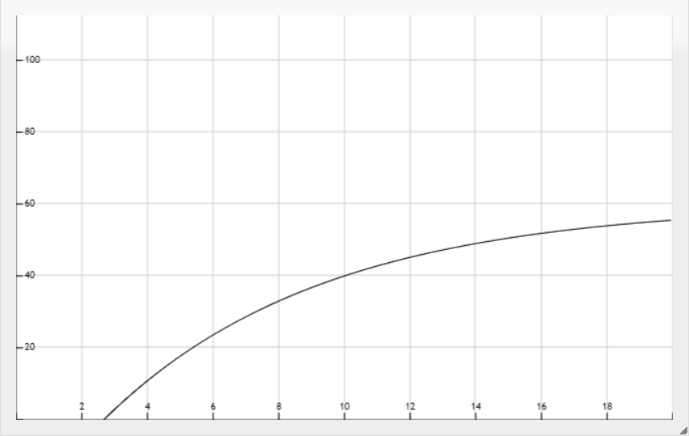
Curves aggregation: Google sub-campaign
These are the three curves for the google sub-campaign:
Google 1° class
Google 2° class
Google aggregated
Google 3° class

Slide 10
CGPTS
Combinatorial Gaussian Process Thompson Sampling

Slide 11
CGPTS vs CGTS

Slide 12
CGPTS Disaggregation

