Slide 1
Advertising
Data Intelligence Application
Academic Year: 2018/2019
Antoniazzi Matteo 895712 (matteo.antoniazzi@mail.polimi.it)
Bonali Luca 896641 (luca.bonali@mail.polimi.it)
Chittò Pietro 899045 (pietro.chitto@mail.polimi.it)
Lamparelli Andrea 894005 (andrea.lamparelli@mail.polimi.it)
Ravelli Leonardo 894222 (leonardo.ravelli@mail.polimi.it)

Slide 2
Outline
Product Description
Classes Definition
Sub-campaign and curves definition
CGPTS
CGPTS Disaggregation

Slide 3

Which product?
Amazon Echo Plus
Voice interaction, music playback, making to-do lists, setting alarms, streaming podcasts, in addition to providing weather, traffic and other real-time information.
Home Automation Hub.
Released in 2018.
Encourages faster and broader development and support from third-parties of its skills market.

Slide 4
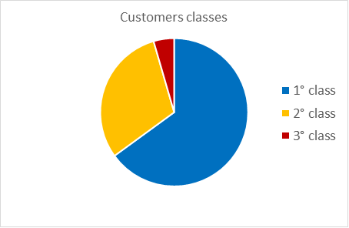
Classes: Features
Three main features:
Age: Young, Adult, Retire
Home Status: Living Alone, Living with Family
Welfare: Normal, Richer
FAMILY 0.40 | Young 0.50 | Workers 0.40 | Retires 0.1
Richer 0.55 | 0,11 | 0,088 | 0,022
Normal 0.45 | 0,09 | 0,072 | 0,018
0,045
0,305
0,65
ALONE 0.60 | Young 0.50 | Workers 0.40 | Retires 0.1
Richer 0.55 | 0,165 | 0,132 | 0,033
Normal 0.45 | 0,135 | 0,108 | 0,027

Slide 5
Classes: Description
Giving the same amount of people that visit our Ads in the three classes, the first class will be the one where we expect the most clicks, than comes the second class, and the third.
1° Class: Young students, young workers or young families with good economic wellness. (Assumption that they will be more interested in our product)
2° Class: Older families or retired couples, less inclined in spending money in a commodity like this product, but still have a good economic situation.
3° Class: People almost not interested in our product, for interests or less economic availability

Slide 6
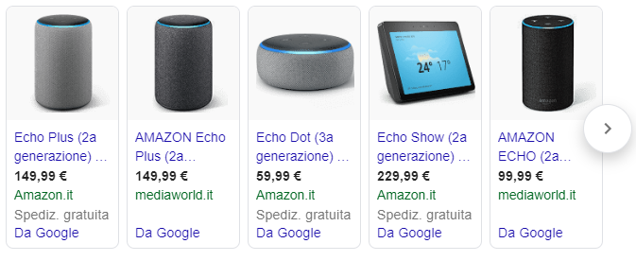

Sub-Campaign definition
We have identified 5 different sub-campaigns:
Search advertising:
Google
Bing
Display Advertising:
YouTube
Social advertising:
Facebook
Instagram

Slide 7
Average daily budgets/clicks curves assumptions
Three levels of maximum clicks limit, due to the auction mechanism:
High = 90 clicks
Medium = 60 clicks
Low = 40 clicks
We have used a composition of sigmoid function (taking just the positive part) to estimate the behaviour of the real world curves.
Once generated all the curves for a sub-campaign, the aggregated one is achieved by weighted average between the three class, according to the probability of belonging to each class.

Slide 8
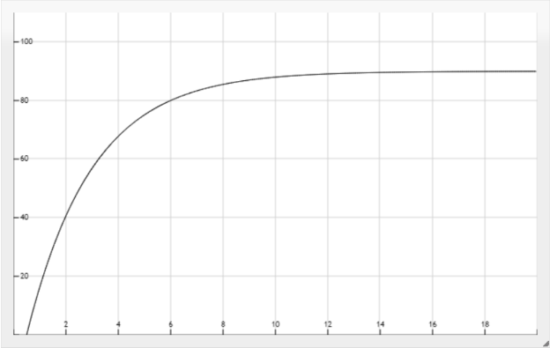
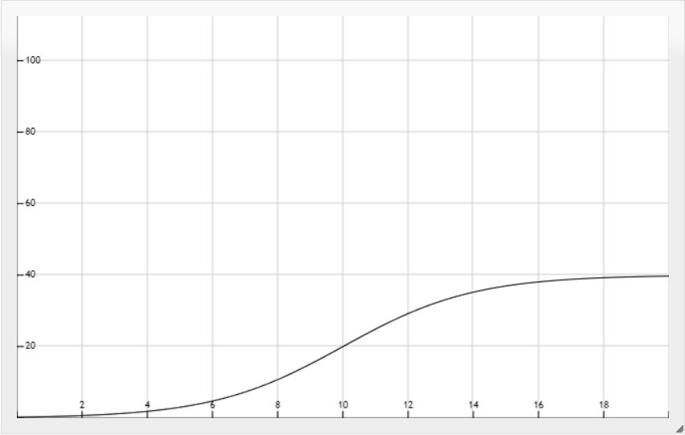
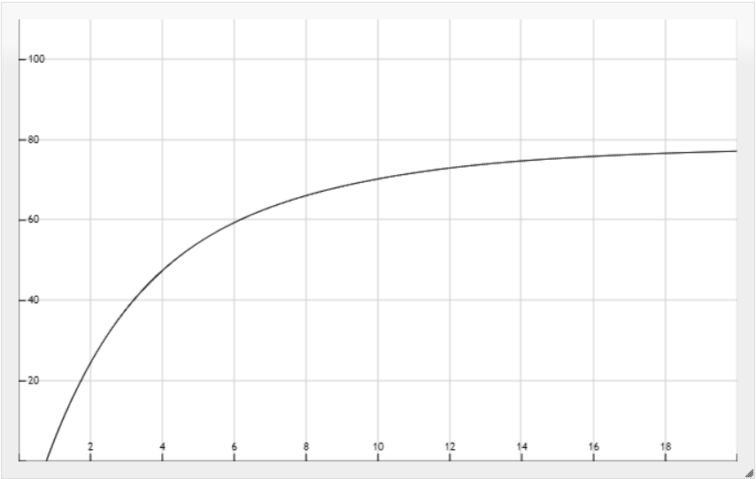
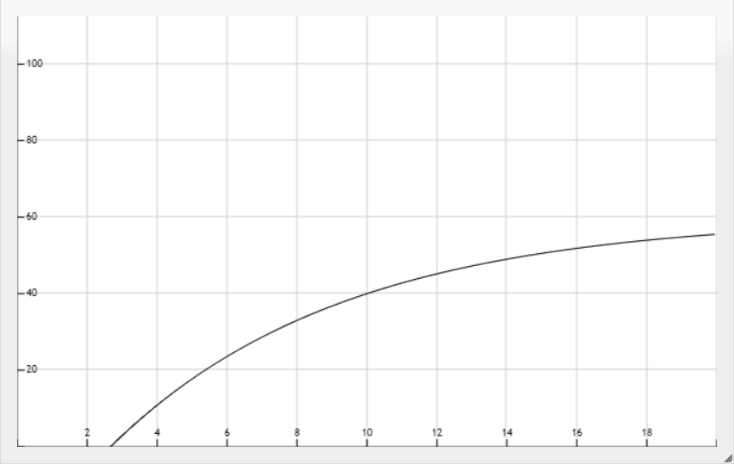
Curves aggregation: Google sub-campaign
These are the three curves for the google sub-campaign:
Google 1° class
Google 2° class
Google aggregated
Google 3° class

Slide 9
CGPTS
Combinatorial Gaussian Process Thompson Sampling

Slide 10
Combinatorial Algorithm
Picks an arm for each learner, accordin to constraints.
Each learner represents a GP-TS algorithm, learning a budget/click curve for that sub-campaign.
The final result gives the partition of budget to assign to each sub-campaign.
Two cases:
Forcing all sub-campaign to have a non-zero budget
Allowing 0-budget sub-campaign

Slide 11
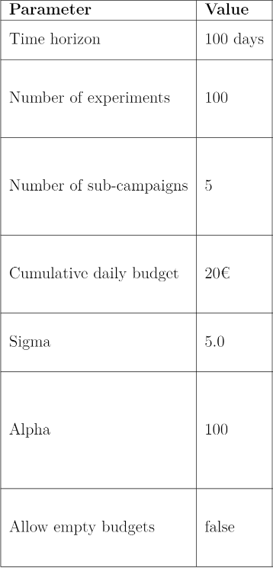
CGPTS settings & result
Best partition found by the algorithm
Google = 4 €
Facebook = 1 €
Instagram = 6 €
Youtube = 1 €
Bing = 7 €
This result was achieved using the settings in the table, and forcing the algorithm to assign at least 1€ per day to each sub-campaign.

Slide 12
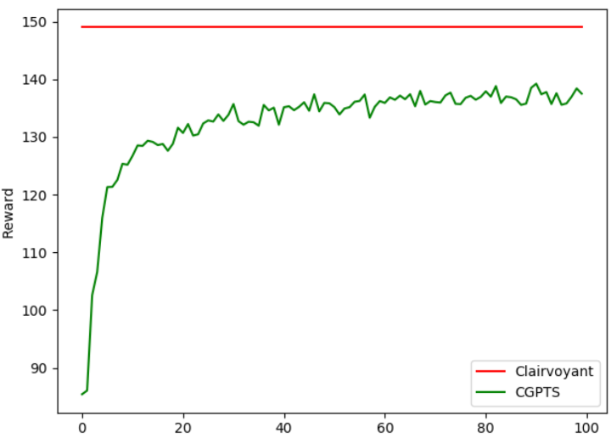
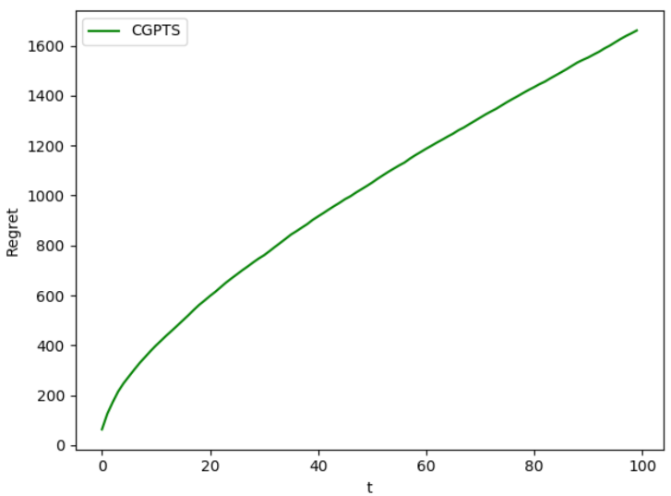
CGPTS : Graphs
Reward graph
Regret graph
Initial transition : ~20/30 days
Maximum Clairvoyant value = 149 clicks
Mean value: ~135 clicks
Regret expressed in terms of lost of clicks
After first period, it increases linearly

Slide 13
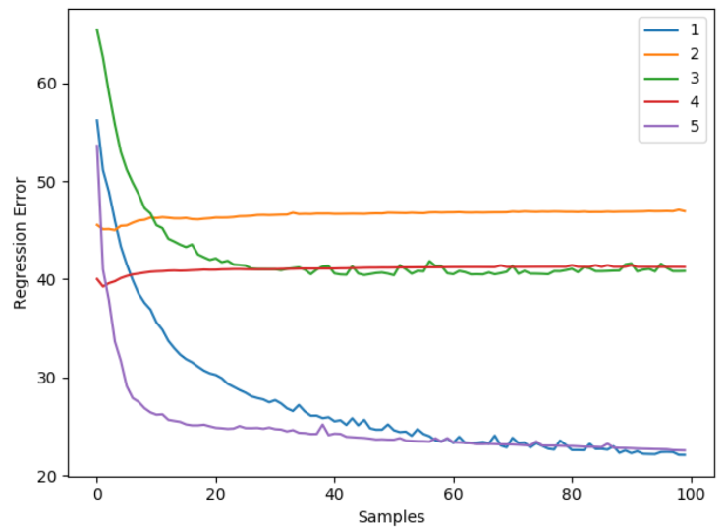
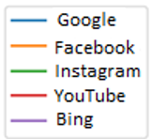
Average regression error of GPs
The regression error is the maximum error among all the possible arms
When the Gp is able to approximate the curves, as the samples increase, it should decrease
Facebook and Youtube sub-campaign are not decreasing, Gp are not approximating correctly the curve.
The algorithm is forced to pull at least 1 € arm on all sub-campaigns.
Analize the case of allowing 0-budget sub-campaign

Slide 14
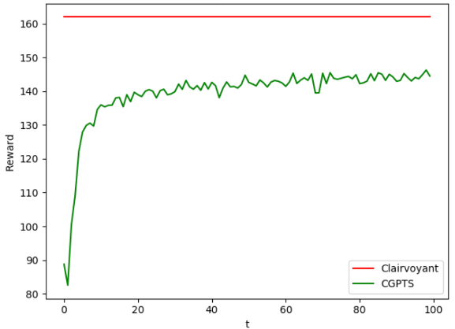
CGP-TS allowing 0-Budget sub-campaign
Same settings as before, result:
Google = 5 €
Facebook = 0 €
Instagram = 7 €
Youtube = 0 €
Bing = 7 €
Maximum Clairvoyant value: 162
Mean value: ~143
The algorithm has an higher reward w.r.t. the first one.
The regret behaves almost the same as before, since the gap from the clairvoyant is almost the same.

Slide 15
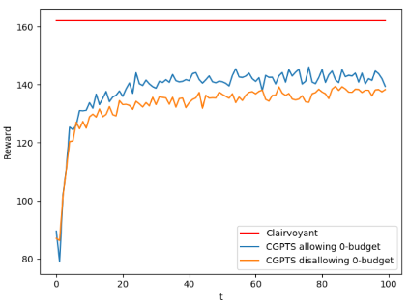
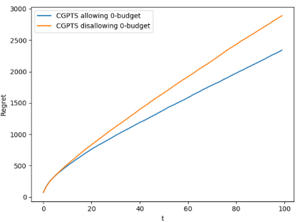
CGP-TS: 0-Budget vs nonZero-Budget
Reward comparison
Regret comparison

Slide 16
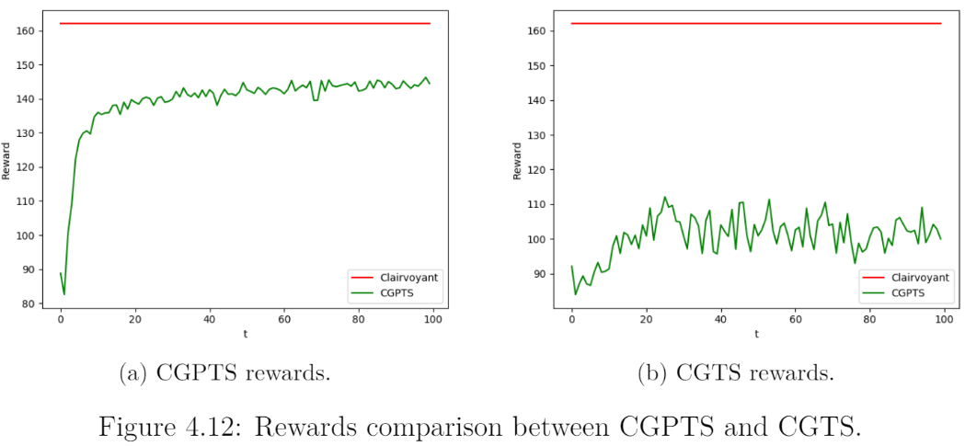
CGPTS vs CGTS
Gaussian Thompson sampling algorithm performs very badly w.r.t. our best solution CGP-TS

Slide 17
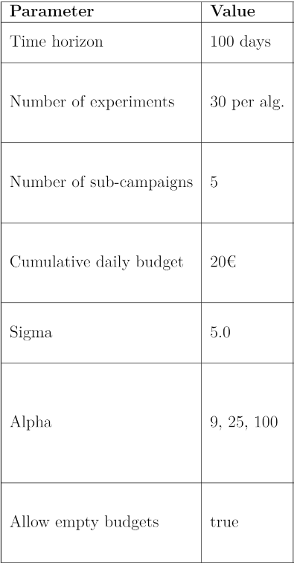
CGP-TS: additional analysis
Observing the performance of the algorithm over different Gaussian Processes parameter settings.
Sigma: standard deviation.
Alpha parameter of GPs: Larger values correspond to increased noise level in the observations.
Alpha values 3,5,10, to be powered by two.
Using the three values of Alpha, [9,25,100], we have obtained the next results.

Slide 18
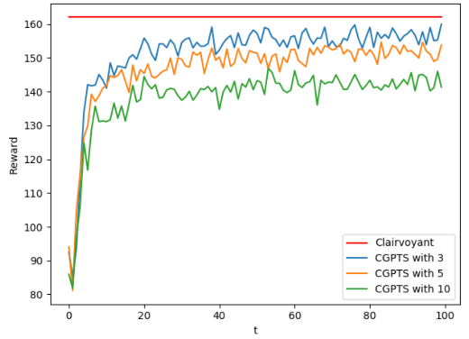
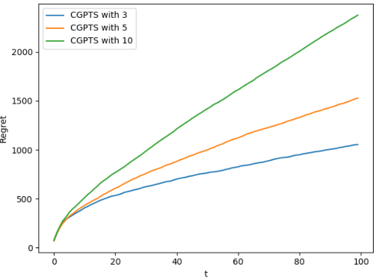
CGP-TS with Alpha: Reward & Regret
Lowering the alpha values leads to best solution, since less presence of noise.
Clairvoyant value remains the same : 162
Mean maximum value (alpha = 3) : ~ 155

Slide 19
CGPTS Disaggregation

Slide 20
CGP-TS disaggregation, context identification
Check whether at some point is better disaggregate the aggregate curves and so create a new sub-campaigns or not.
Context identification: identifying from which class the clicks come from.
Learning in parallel other combinatorial GP-TS, consiering all the possible disaggregation combination:
Example: (class1,class2,class3) or (class1+class2, class3) exc...
First day of the week, check whether disaggregate or not, according to the expected reward of that combination, untill we have a complete disaggregation.

Slide 21
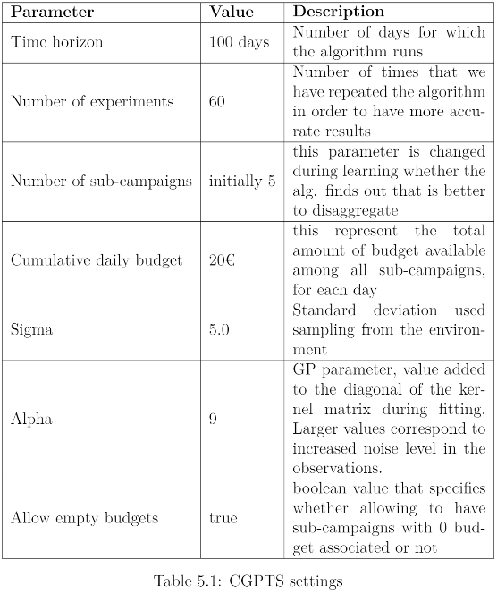
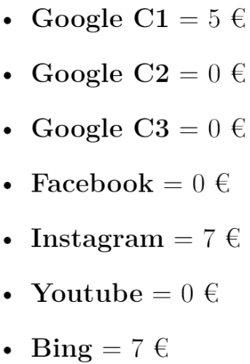
Disaggregated CGP-TS settings e result
Given those settings and for computational reason we have decided to analize only the first sub-campaign, Google.
The algorithm has choosen in average to disaggregate the first time around the 14th and the 21th day, and the second time around the 28th and 42th day.

Slide 22
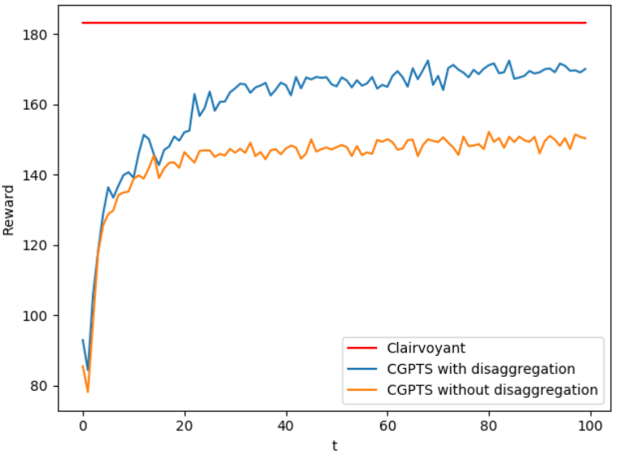
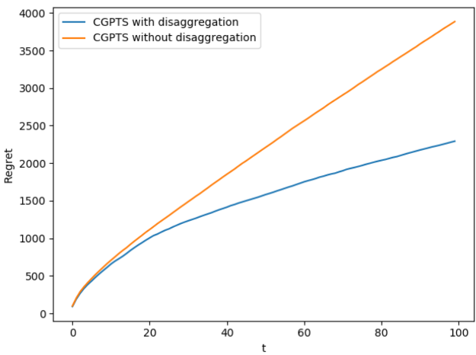
Disaggregated CGP-TS performance graphs
Maximum Clairvoyant algorithm value : 183 clicks
Avg values : ~143 clicks vs ~ 170 clicks
Reward comparison
Regret comparison

