Slide 1
Advertising
Data Intelligence Application
Academic Year: 2018/2019
Antoniazzi Matteo 895712 (matteo.antoniazzi@mail.polimi.it)
Bonali Luca 896641 (luca.bonali@mail.polimi.it)
Chittò Pietro 899045 (pietro.chitto@mail.polimi.it)
Lamparelli Andrea 894005 (andrea.lamparelli@mail.polimi.it)
Ravelli Leonardo 894222 (leonardo.ravelli@mail.polimi.it)

Slide 2
Outline
Product
Classes Definition
CGPTS
CGPTS vs CGTS
CGPTS Disaggregation

Slide 3
Product

Slide 4
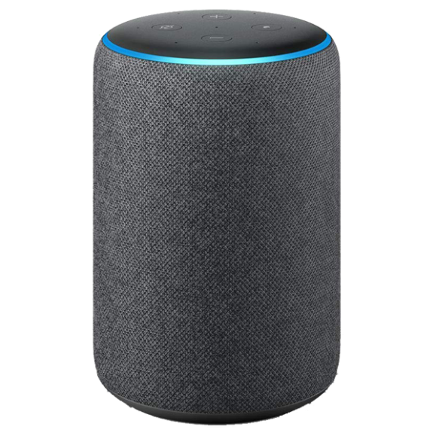
Which product?
Amazon Echo Plus
Smart speaker
Released in 2018

Slide 5
Classes Definition

Slide 6
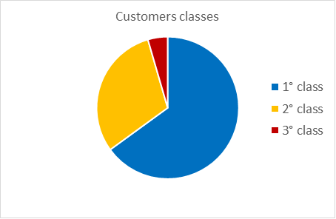
Classes
FAMILY 0.40 | Young 0.50 | Workers 0.40 | Retires 0.1
Richer 0.55 | 0,11 | 0,088 | 0,022
Normal 0.45 | 0,09 | 0,072 | 0,018
ALONE 0.60 | Young 0.50 | Workers 0.40 | Retires 0.1
Richer 0.55 | 0,165 | 0,132 | 0,033
Normal 0.45 | 0,135 | 0,108 | 0,027

Slide 7
CGPTS
Combinatorial Gaussian Process Thompson Sampling

Slide 8
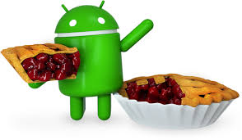

Analysis
Target Sdk Version = 28
Minimum Sdk Version = 23
Supported languages: English, Italian
Approximate devices coverage of 62.6%

Slide 9
GP Regression Error
Target Sdk Version = 28
Minimum Sdk Version = 23
Supported languages: English, Italian
Approximate devices coverage of 62.6%

Slide 10
CGPTS vs CGTS

Slide 11
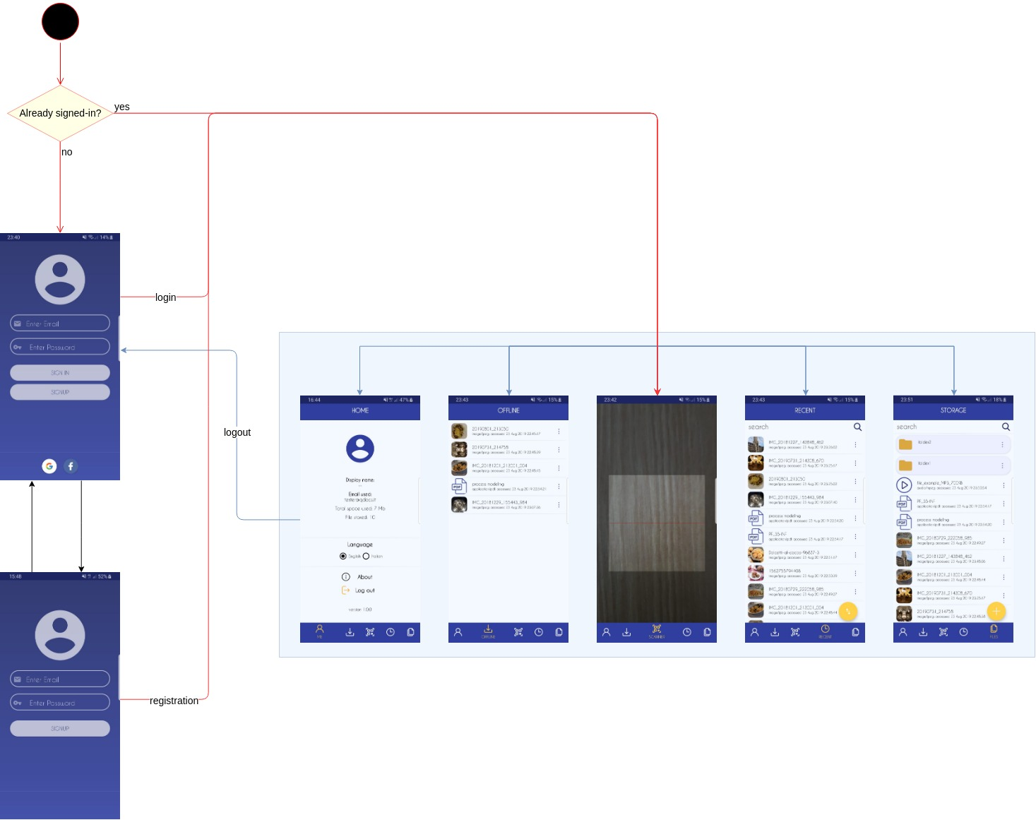
Application Start UI Design
Checks whether a user is already signed-in or not

Slide 12
CGPTS Disaggregation

Slide 13
Unit Test
Local tests: used to test local classes functionalities
Tools: JUnit4 and PoweredMockito
Classes: MyFile, MyDirectory, StorageElement, Utility

