Slide 1
Auction Routing and Target Clustering
Project Developer: Luca Bonali 10/04/2019

Slide 2
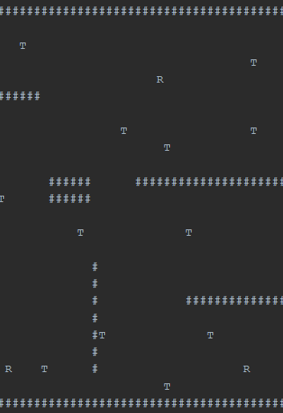
Goals of the project
Implement the bidding rules for MiniSum and MiniMax objective functions, in a sample scenario of a 2d gridmap with obstacles and positioned targets (one minimizing the total path cost, and the other minimizing the maximum path cost)
TWO POSSIBLE CASES:
  Robot already positioned in the map
  Robot can be positioned in the map to cover all targets
    This positioning can be done by Target clustering
Project implemented in python with support of Mesa ABM Framework.

Slide 3
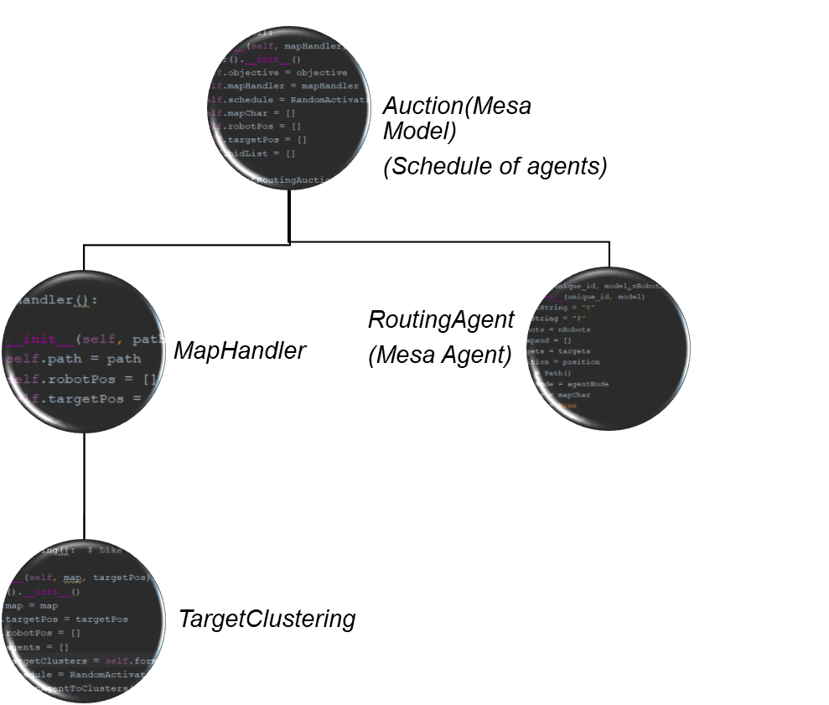
Architecture
Perform steps
and retrieving results
Reading the map
One step of computation is the activation of the agents for one round of the auction
Compute bid
Broadcast bid
Receive bid
Compute winner and inform others
Cluster of targets, and positioning the robots
Step by step the state of the auction is printed untill all targets have been allocated

Slide 4
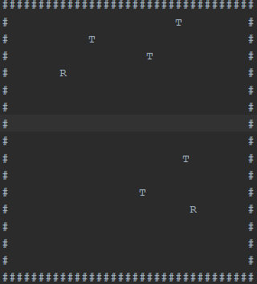
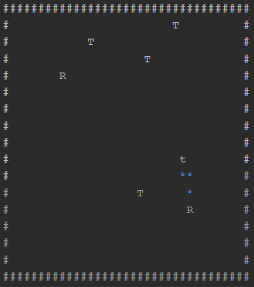
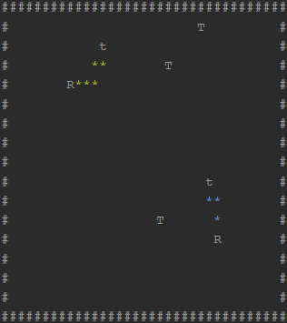
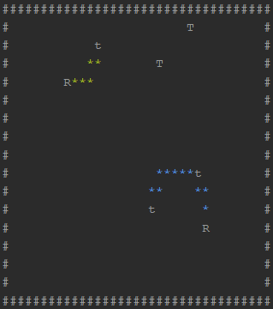
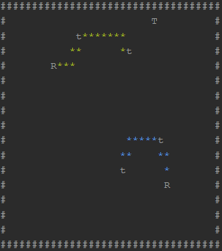
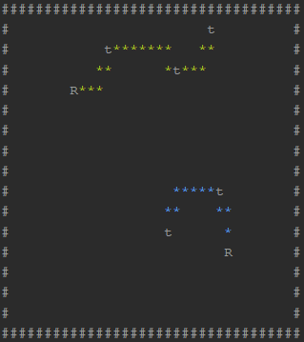
Some ScreenShots: 6 steps

