Slide 1
Auction-Based Multi-Robot Routing
Michail G. Lagoudakis , Evangelos Markakis , David Kempe, Pinar Keskinocak Anton Kleywegt , Sven Koenig , Craig Tovey , Adam Meyerson , and Sonal Jain
Speaker: Luca Bonali 01/04/2019

Slide 2
Introduction
Effective, decentralized auction-based method for multi-robot coordination.
Multi vs Single (No single point of failure, more robust, efficient, flexible).
Allocate and execute single tasks in a decentralized method, like visiting a certain number of target location with routes that optimize some criteria.
Examples: search and rescue, placement of sensors, locating objects, delivering of parts.
Communication consists in bids that each robot places on the tasks, and the coordination is achieved by a process similar to winner determination in auctions.

Slide 3
Assumptions
There are no diffrences between the robots, other than their position
There are no differences among the targets (each target can be assigned to any robot)
Complete information about the space
A single task (visit a target) is executed by a single robot
The common task is to allocate all the targets to the robots, by visiting all of them.

Slide 4
Paper Framework
The paper presents a generic framework for the problem, deriving
and analyzing:
6 Bidding rules for 3 Team objectives
  Minimizing total cost
  Minimizing the maximum path cost
  Minimizing the average service cost
Lower and Upper bounds on their preformance relatively to the
optimal one.

Slide 5
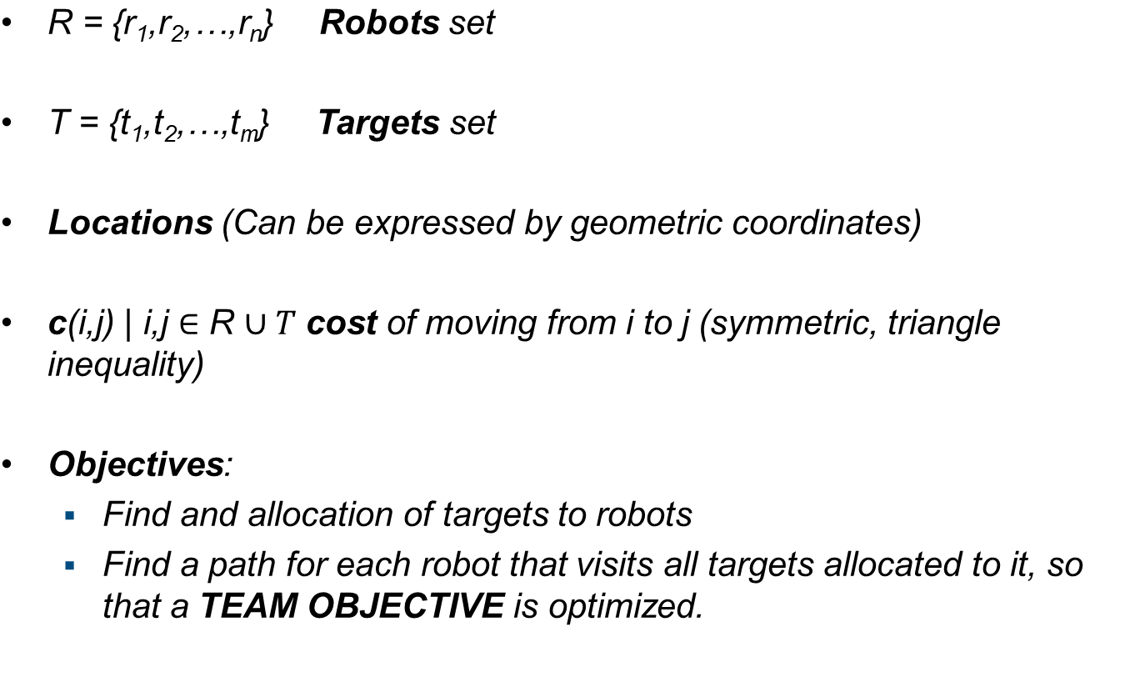
Multi-Robot Routing : Problem definition

Slide 6
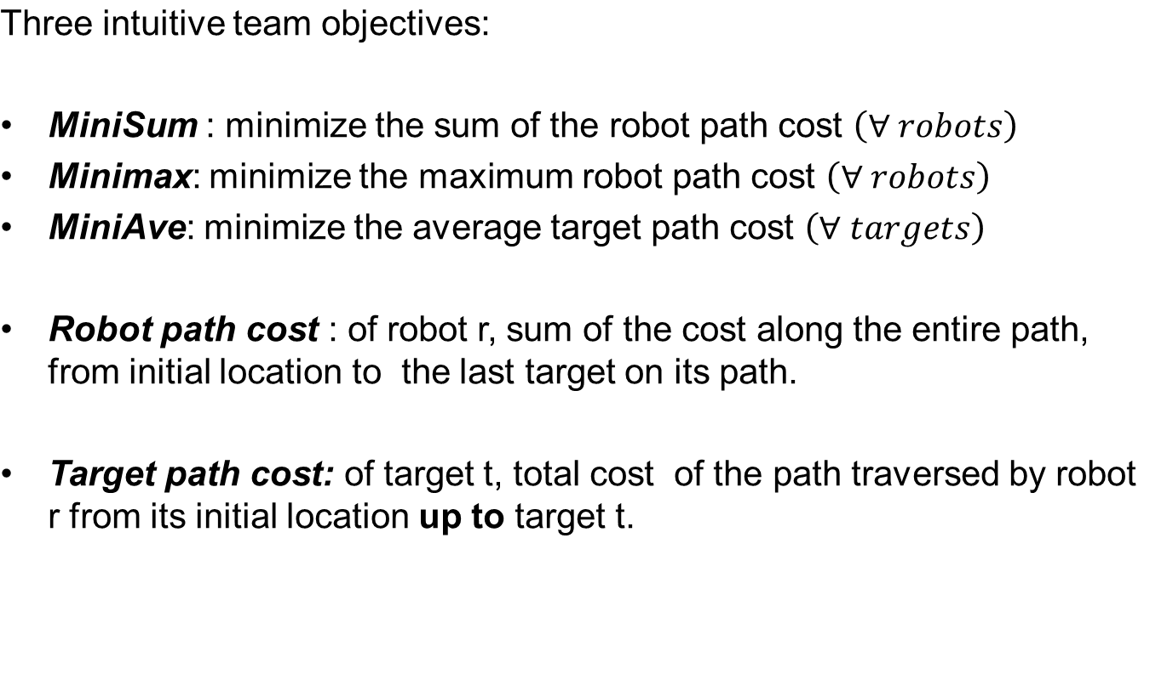
Team Objectives

Slide 7
Optimal Solution
The optimal performance for any of these three objectives is NP-Hard:
Theorem 1:
There is no polynomial time algorithm for solving multi-robot routing
optimally with MiniSum, MiniMax or MiniAve objectives, unless P = NP
Proof sketch:it is provable that a polynomial time algorithm for multi-robot routing with any of the three objectives implies a polynomial way to solve the well known Hamiltonian path (which is NP-Complete)
Efficient approximation algorithms to solve large scale instances of the problem

Slide 8
Auction Framework
Robots as bidders
Targets as goods
Initial situation:
  All target unallocated
During each round:
  All robots bid on unallocated targets (only one)
  The robot which places the overall lowest bid on any of the target wins, and that target is allocated to that robot.
A new round begins, untill all target have been allocated

Slide 9
Example of multi-round Auction
Robots n
Targets m
Robot knowledge
  Own Location
  Target locations
  Target allocation since now
  |R|
Robot Behaviour
  Compute the bid
  Broadcast the bid
  Receive the other robots bids
  Determine the winning one
  Allocate the target to the winner
Complexity: O(nm)

Slide 10
Example cont.
Decentralized implementation
No need of a central Auctioneer (No single point of failure)
Low communication complexity
How to compute the Path?

Slide 11
Key Factors for Performance
PATH COMPUTATION
  Each robot computes a path for visiting the allocated targets, then after the auction , moves along it
BID SELECTION
  Has to be computed at each round to select the best distribution of paths between the robots
  We have to select a good and efficient method for both

Slide 12
Paths vs Trees
PATH: Direct method, but NP-Hard
  (as prooved in theorem)
Tree: Indirect method (To be converted into a path)
Min spanning tree can be computed in polynomial time, then with Shortcutting technique compute a path from that.
For the three objectives:
  Minisum: Minimum Spanning Forest -> Prim’s algorithm (Polynomial)
  MiniMax: MSF but max cost tree to be minimized (NP-Hard)
  MiniAve: Minimum average-cost spanning forest. Connect each target to the closest root (Star configuration)
Shortcutting
Worst case:
twice the cost of the tree

Slide 13

Bidding Rules
Two classes: for Paths and for Trees
Some Notation:
Team objectives expressed as:
        g = performance of each robot
        f = performance of the team
        A = partition of set of targets (A_{i} targets allocated to robot i)
RPC(r_{i},A_{i}) = minimum robot path cost for robot i, when visiting all targets in A_{i}
CTPC(r_{i},A_{i}) = minimum cumulative target path cost of all targets in A_{i} if robot i visits all target in A_{i}

Slide 14



Bidding Rules
r_{i}
RPC(r_{i},A_{i}) : A_{i} : {t₁,t₂,t₃}
CTPC(r_{i},A_{i}) : A_{i} : {t₁,t₂,t₃}
t₃
t₁
t₂
r_{i}
t₃
t₁
t₂
Minisum:
MiniMax:
MiniAve:
f : Summation over all robots
f :maximum of the cost
f : average of CTPC,
over all robots

Slide 15

Bidding Rule:
Let: (S₁,S₂,…,S_{n}) current partial allocation
Let: t an unallocated target
BIDDING RULE:
Robot r bids on unallocated target t the difference in performance for the given team objective between the current allocation of targets to robots and the allocation that results from the current one if robot r
is additionally allocated target t.
Difference :
Where :
This diffrence will different for each of the tree objectives
(6 differences rule, Path vs Tree)

Slide 16


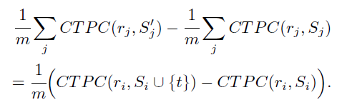
Bidding Rules
This generic rule perorm a sort of Hill climbing, aiming to find a good solution , not necessary optimal
MiniSum:
MiniMax:
MiniAve:
Allocate the target to the robot
Second term can be dropped
1/m can be dropped
Outcome remains unchanged

Slide 17


Bidding Rules for Paths
After the changes the resulting rules are:
BidSumPath:
BidMaxPath
BidAvePath:
Computing RPC and CTPC is NP-Hard, each robot can use approximation (heuristic).
For example insertion heuristic used in TSP

Slide 18
Bidding Rules for Trees
Similar analysis as for paths:
Some notations:
RTC(r_{i},S_{i}) : minimum robot tree cost over spanning tree rooted in {ri}
CTTC(r_{i},S_{i}) : minimum cumulative target tree cost
r_{i}
t₁
t₂
r_{i}
t₁
t₁
t₂
t₂

Slide 19
Bidding Rules for Trees
Without going through all the details:
BidSumTree:
BidMaxTree
BidAveTree:
Note: a tree for S_{i} remains almost unchanged after the insertion of a t target. (target t wasn’t allocated in previous round)

Slide 20

Bidding Rules for Trees
Further simplification
Rules can be further simplified:
BidSumTree:
BidMaxTree
BidAveTree:
Note: These rules for the trees can all be computed in POLYNOMIAL TIME
In these two rules the new target is allocated through the cheapest edge
The new target is connected directly at the root of the tree

Slide 21


Summary of Result
Performance of each bidding rule in comparison to optimal performance
-> Upper and Lower Bounds on performance ratio (for all rules)
I(n,m) = class of all instances of multi-robot routing, un upper bound for a rule R and objective X can be defined as:
R(I,X) = cost of the solution under obj X using rule R
O(I,X) = cost of the optimal solution
Lower Bound:

Slide 22
Intuition behind Bounds
An upper bound provides a guarantee on the performance of the corresponding rule for the corresponding objective
A lower bound usually represents pathological cases that demonstrate worst-case behavior, the performance ratio can’t be less than the lower bound.
Assumptions:
  For Tree rules, the conversion to path can be done optimally NP-Hard or via shortcutting polynomially
  For Path rules, not specified the way to calulate RPC and CTPC
    (Can be anything between Np-Hard optimally or using insertion heuristic, polynomially)
  Performance are guaranteed if using approximation their cost won’t be greater than the cost of the two used heuristics.

Slide 23
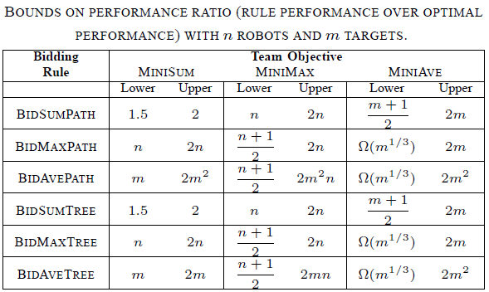
Bounds Table
This table summarize our results.
Theoretically the Path and the Tree rules offer almost identical guarantees.
These bounds have been prooved theoretically, but are still in experimental phase in practice.

Slide 24
In practice
The paths rules yield somewhat better solutions
  Constructing the path directly
The tree rules are computationally more efficient, because bid computation for trees is much faster than path one.
Also, the best guarantees are offered by MiniSum and Minimax rules, since in reality : n << m
Overall, these results show theoretically that this methods constitute
a viable solution for large scale multi-robot routing.

Slide 25


Simple example with MiniSum
Initial situation: all targets unallocated , n = 3, m = 7
1
2
1
2
3
4
5
3
6
7

Slide 26
Simple example with MiniSum
Each robot compute the bid for the unallocated target which will have the lowest bid for it:
1
2
1
2
3
4
5
3
6
7

Slide 27

Simple example with MiniSum
Broadcast of BidSumPath rule as:
1
2
1
2
3
4
5
3
6
7

Slide 28
Simple example with MiniSum
Decentralized computation of the winner, the lowest bid wins, in this case r1 will be allocated to t3
1
2
1
2
3
4
5
3
6
7

Slide 29
Simple example with MiniSum
New round begins, and robots compute the bids for the 2^ target, untill all targets are allocated
Note: we could consider that the actual position of r1 become the position of t3 to simplify the calculus of the final path
1
2
1
2
3
4
5
3
6
7

Slide 30
Simple example with MiniSum
Bid computation for r₁:
= 4
6
2
1
2
2
1
4
5
3
6
7

Slide 31
Simple example with MiniSum
R2 wins this round and t5 is allocated to it, new computation of the bid…
1
2
1
4
2
3
6
7

Slide 32
Simple example with MiniSum
Repeat untill all target are allocated: Final result
1
2
1
2
3
4
5
3
6
7

Slide 33
Conclusion
Auction- based methods can be used as an effective, decentralized methods for multi-robot coordination.
The paper has offered for the first time a generic framework for this kind of problems, offering theoretical guarantees on the performance.

