Slide 1
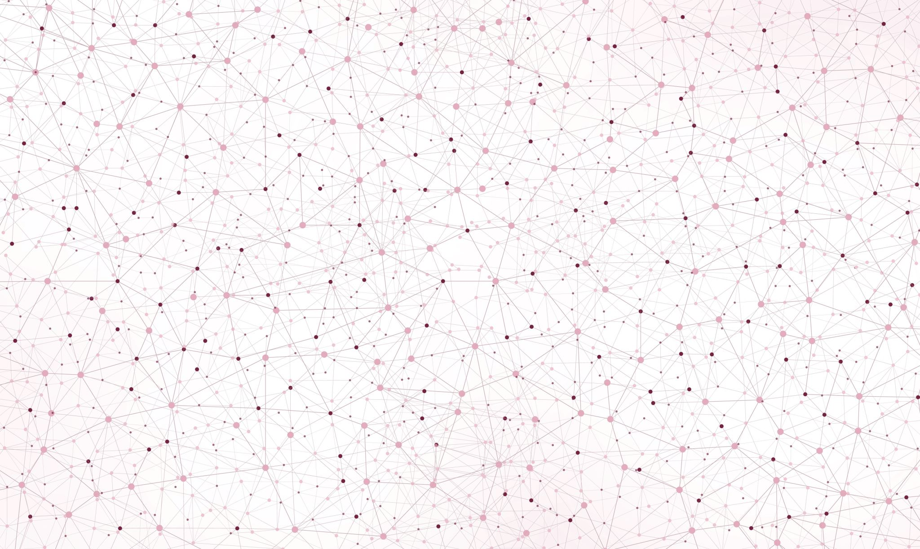
Reinforcement Learning, Flappy Bird
Guruprerana Shabadi and Luca Bonengel
CSE204 Project

Slide 2
GitHub repository: github.com/lucabonengel/FlappyBird

Slide 3
Outline of the presentation
The game, Flappy Bird
Algorithm 2: Q-learning algorithm
Description of the algorithm
Results
Algorithm 1: Neuroevolution algorithm
Description of the algorithm
Results
Comparison of the two algorithms
Interpretation of the differences in the results

Slide 4
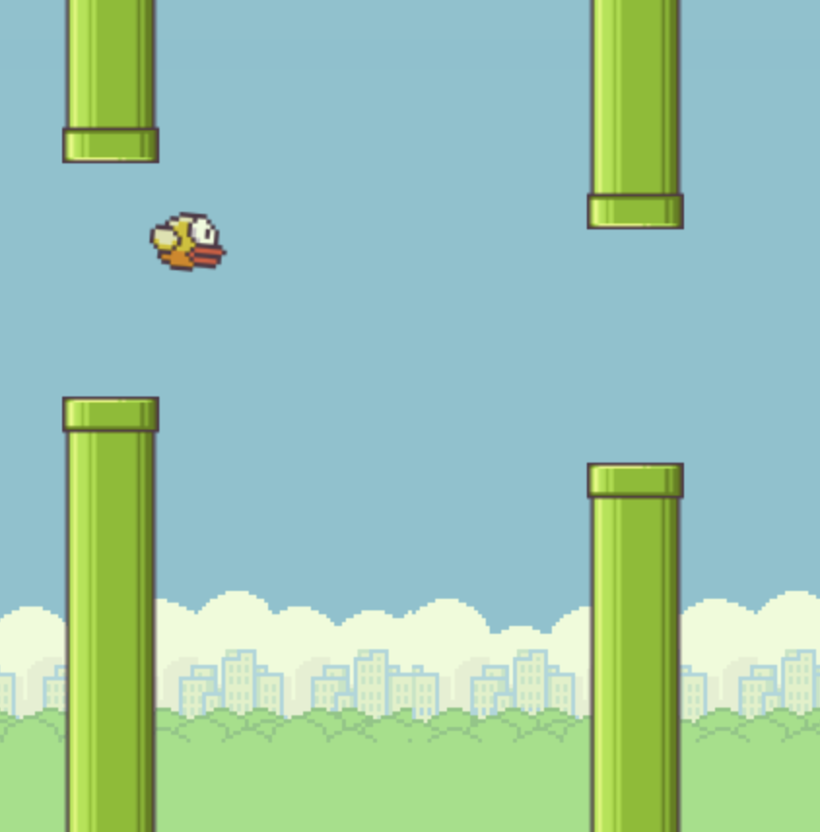
The game, Flappy Bird
An (in)famous game consisting in controlling a bird, attempting to fly between columns of green pipes without hitting them
Game project in CSE104

Slide 5
Algorithm 1: Q-learning algorithm

Slide 6
Algorithm 2: Neuroevolution algorithm
Neuroevolution is a machine learning technique that applies evolutionary algorithms to construct neural networks.
Population of neural networks evolves in order to find a network that solves the given task
1 neural network for 1 bird
First generation: weights initialised with random values

Slide 7
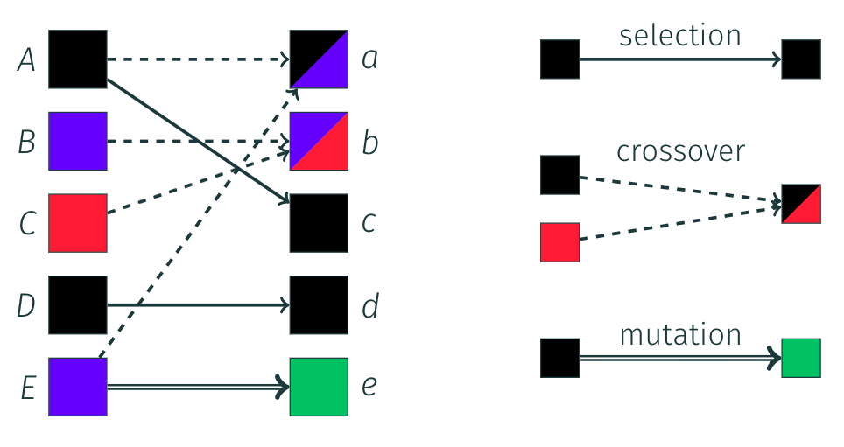
Generation of the next populations
Generation k
Generation k+1
Elitism (selection) consists in keeping the best neural networks as they are. These birds automatically survive to the next generation.
Crossovers are created by mixing the neural networks of a pair of well performing parents and adding some mutations (slightly changing some weights).
New random neural networks are also generated.
Methods for creating the neural networks of the next generations
Many other ways of creating neural networks for the next generation (e.g. slighty mutating a good performing one)

Slide 8
What proportions should we use?
E: elitism
R: random networks
B: breeding

Slide 9
Fixing parameters
We fix the following parameters for the following slides
20% elitism
20% of new random birds
60% of breeding and additional random mutations

Slide 10
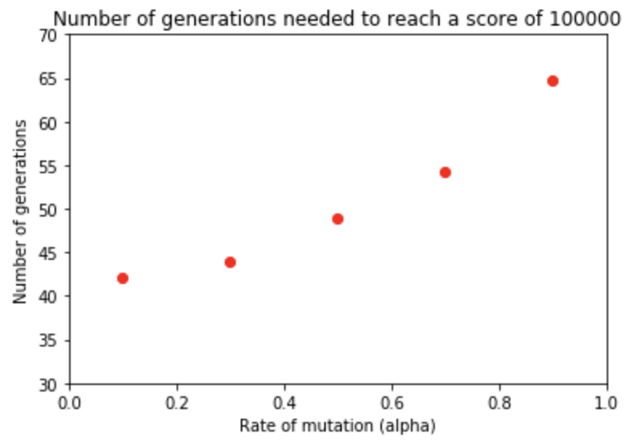
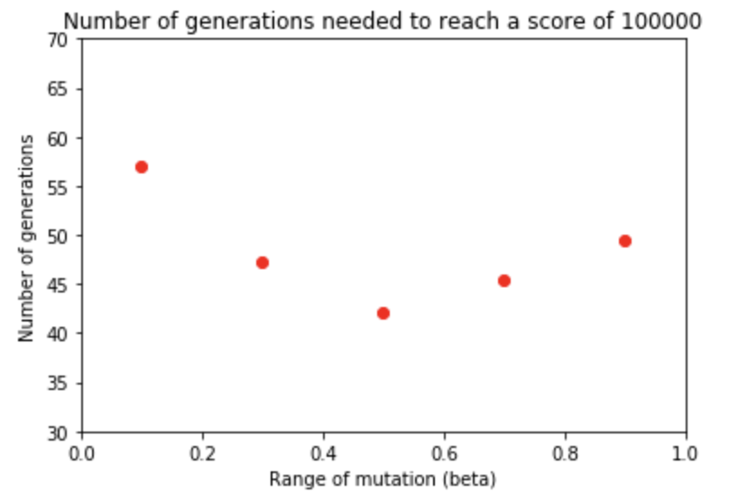
The importance of randomness

Slide 11
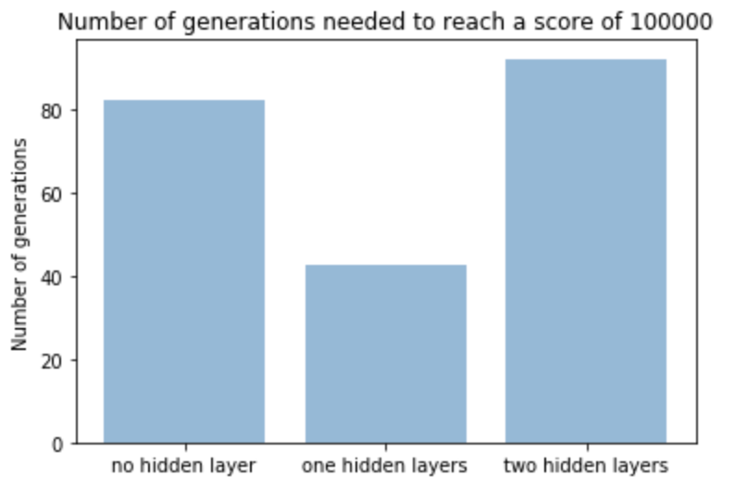
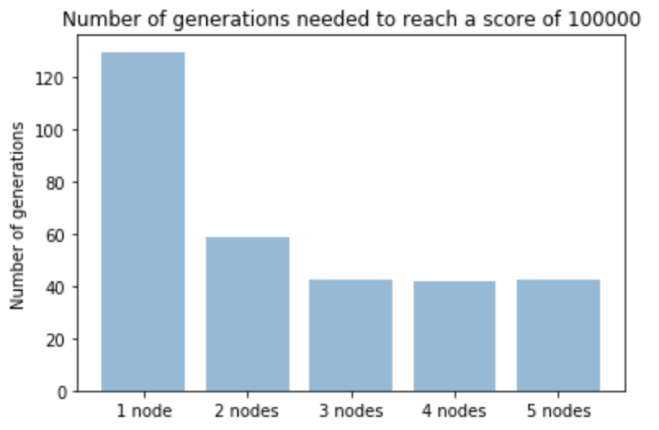
Neural network structure

