Slide 1
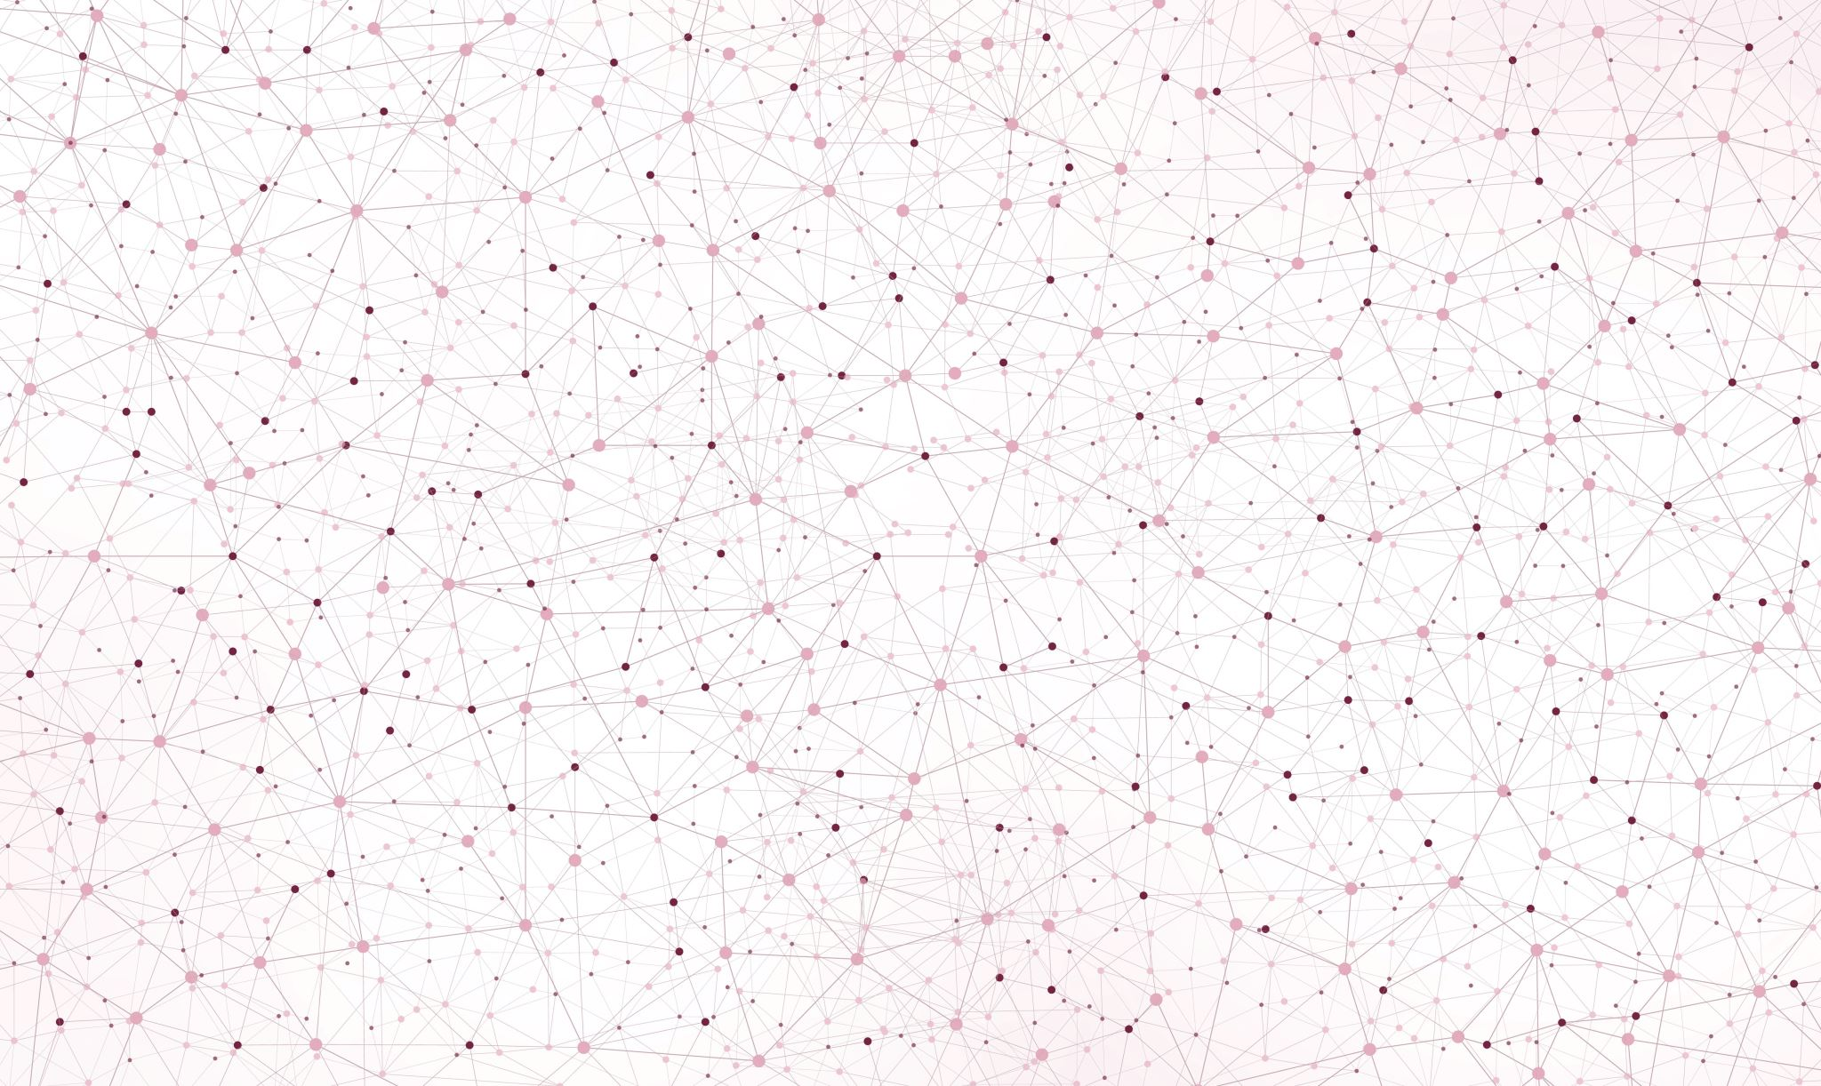
Reinforcement Learning, Flappy Bird
Guruprerana Shabadi & Luca Bonengel
CSE204 Project

Slide 2
GitHub repository: github.com/lucabonengel/FlappyProject

Slide 3
Outline of the presentation
The game, Flappy Bird
Algorithm 1: Q-learning algorithm
Description of the algorithm
Results
Algorithm 2: Neuroevolution algorithm
Description of the algorithm
Results
Comparison of the two algorithms

Slide 4
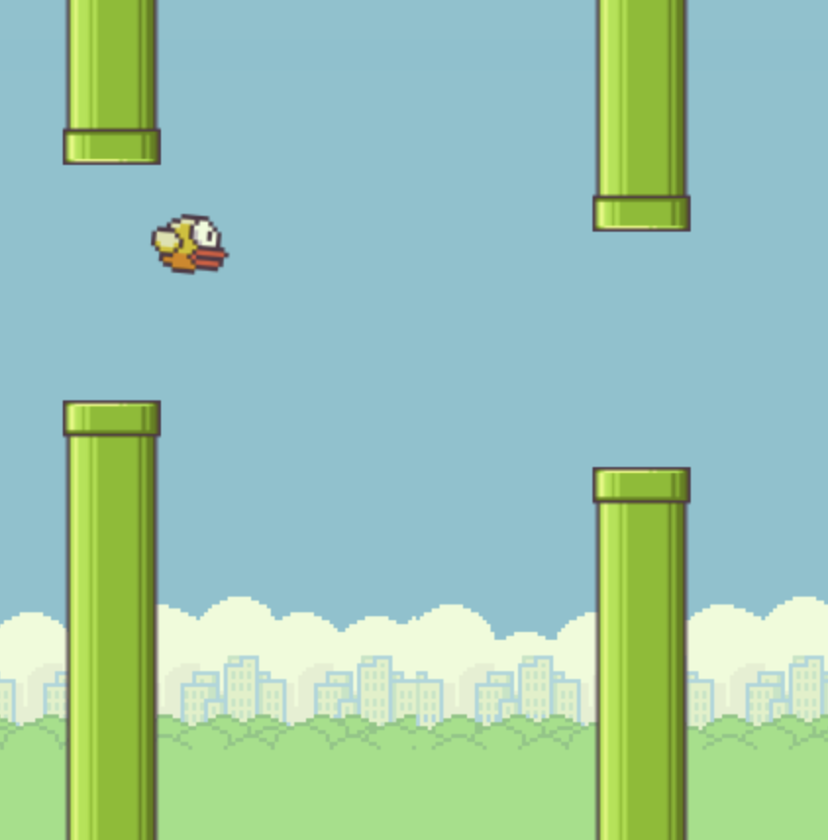
I. The game, Flappy Bird
An (in)famous game consisting in controlling a bird, attempting to fly between columns of green pipes without hitting them
Game project in CSE104

Slide 5
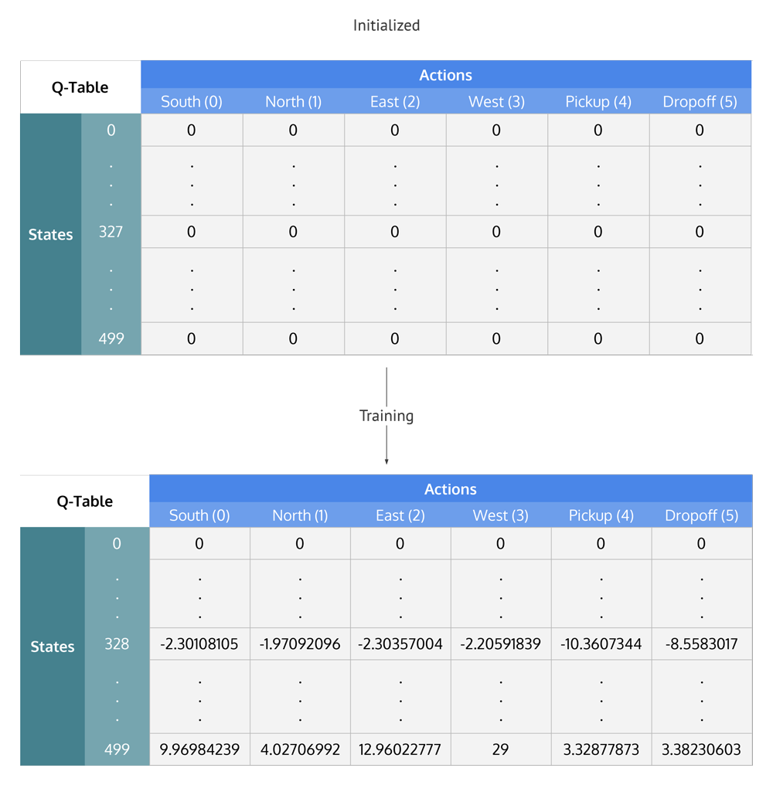
II. Algorithm 1: Q-learning algorithm
Simple model requiring no information about the environment
Gradually build up the Q-Matrix at each instance of the gameplay
Maximising cumulative rewards: each value in matrix represents expected reward given a state and action

Slide 6

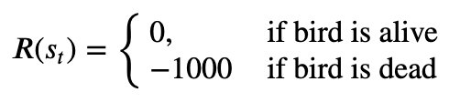
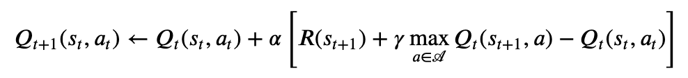
The update equation

Slide 7


The set of states
Optimal inputs:
y-coordinate of bird
y-coordinate of next obstacle
whether bird is alive
Big Q-matrix = long training
Small Q-matrix = fast training
BIG IDEA: Cut up grid into blocks

Slide 8
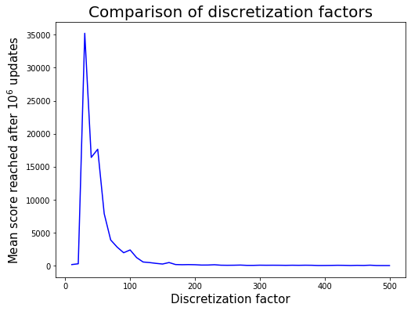
Why cut into 30 blocks?

Slide 9
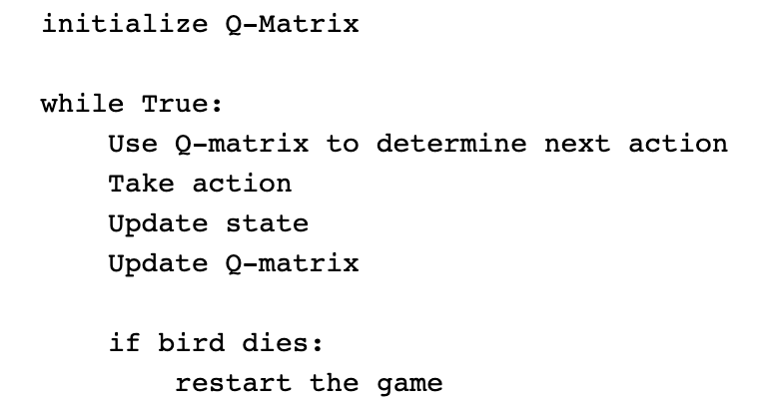
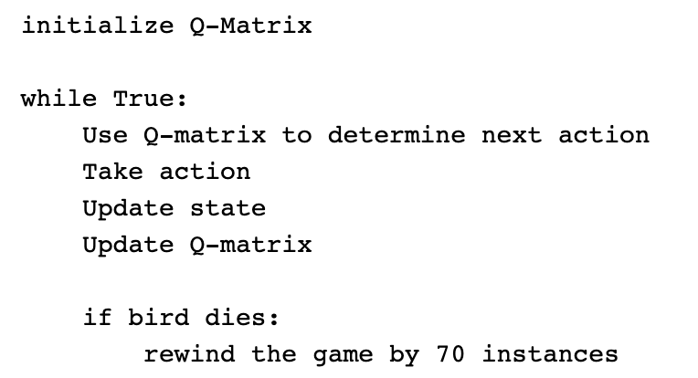
Still slow to learn: requires next big idea

Slide 10
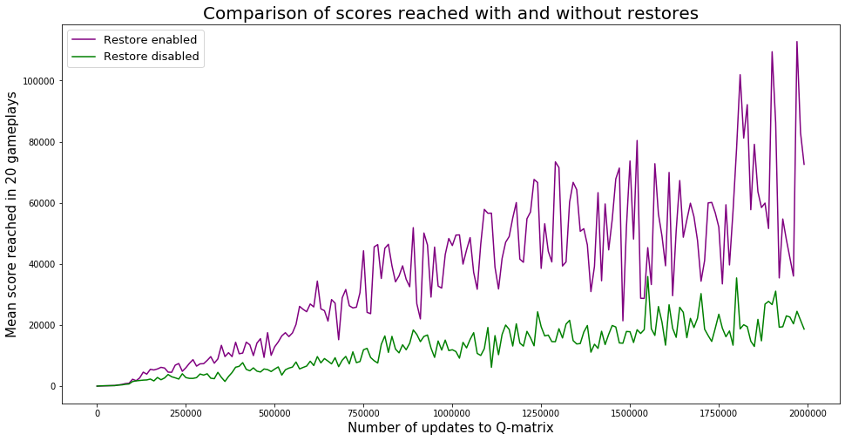

Slide 11
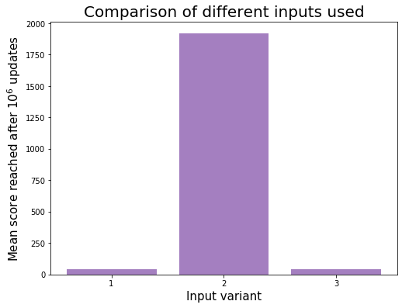
Inputs to use
Variant 1: y-coordinate of the bird, vertical distance to the next obstacle (pipe), and horizontal distance to the next obstacle
Variant 2: y-coordinate of the bird, and y-coordinate of the next obstacle
Variant 3: y-coordinate of the bird, horizontal distance to the next obstacle, and y-coordinate of the next obstacle

Slide 12
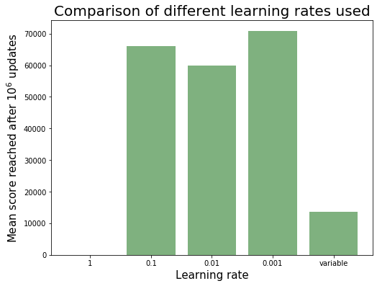
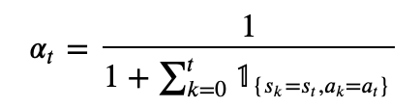
Comparison of learning rates
Constant works better.

Slide 13
Results
1 million updates to the Q-matrix = very high scores of above 100,000 easily.
10 million updates = a perfect bird which never dies.
Big training time: approx. 30 min on our computers

Slide 14
III. Algorithm 2: Neuroevolution algorithm
Neuroevolution is a machine learning technique that applies evolutionary algorithms to construct neural networks.
Population of neural networks evolves in order to find a network that solves the given task.
1 neural network for 1 bird.
First generation: weights initialised with random values in [-1, 1].

Slide 15
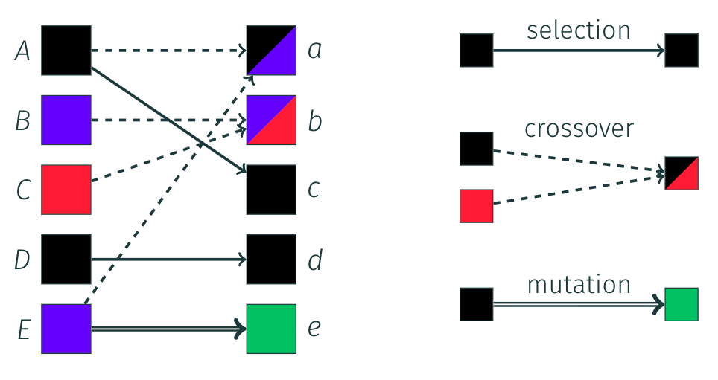
Generation of the next populations
Generation k
Generation k+1
Elitism (selection) consists in keeping the best neural networks as they are. These birds automatically survive to the next generation.
Crossovers are created by mixing the neural networks of a pair of well performing parents and adding some mutations (slightly changing some weights).
New random neural networks are also generated.
Methods for creating the neural networks of the next generations
Many other ways of creating neural networks for the next generation (e.g. slighty mutating a good performing one)

Slide 16
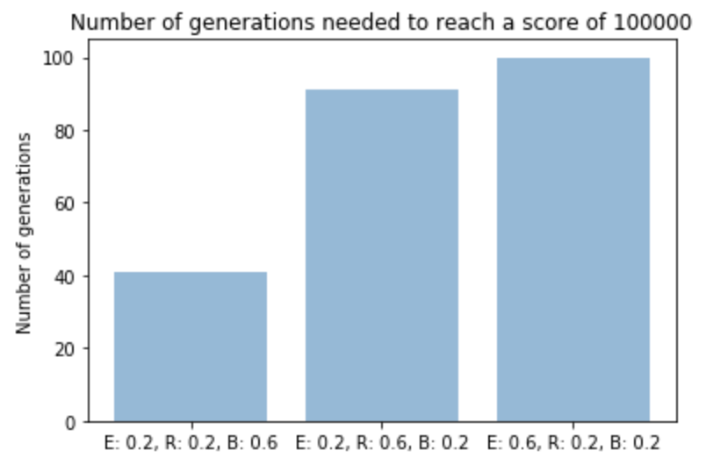
What proportions should we use?
E: elitism proportion
R: random networks proportion
B: breeding proportion

Slide 17
Fixing parameters
We fix the following parameters for the following slides:
20% elitism,
20% of new random birds,
60% of breeding and additional random mutations.

Slide 18
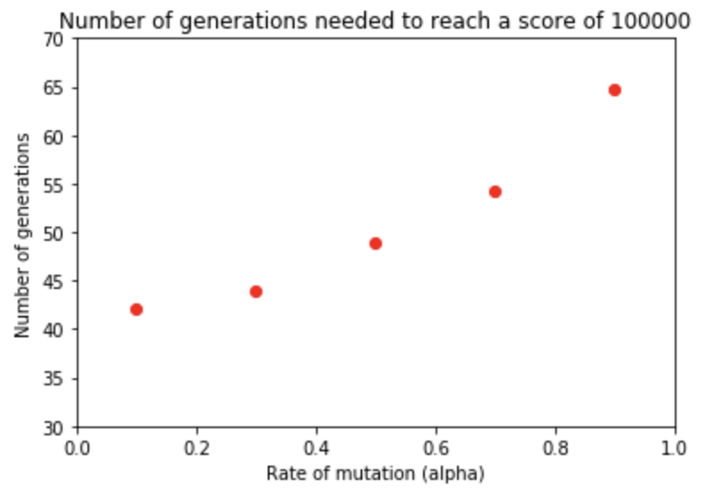
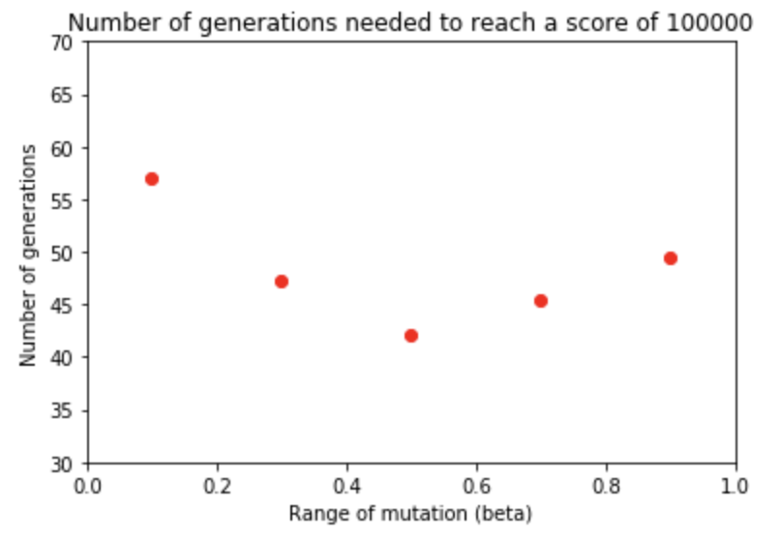
The importance of randomness

Slide 19
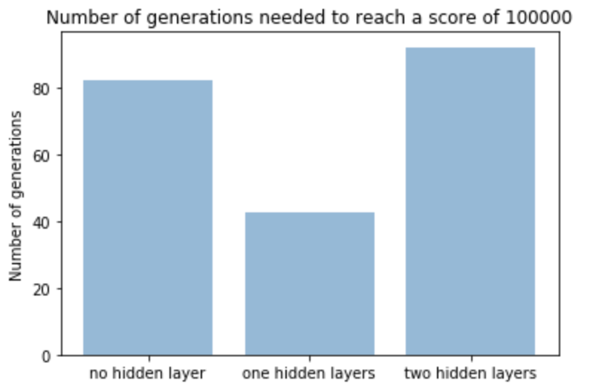
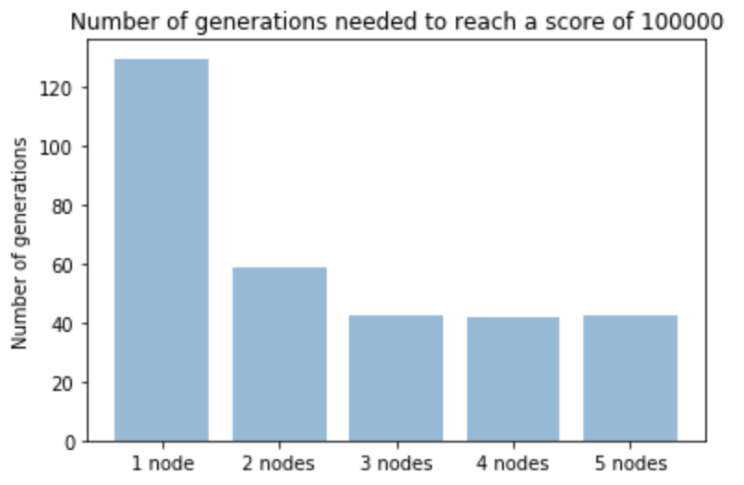
Neural network structure
(all hidden layers contain 3 nodes)
(1 hidden layer)

Slide 20
IV. Comparison of the two algorithms
Neuroevolution requires much lower storage and memory than Q-learning, which has to store big matrices.
Neuroevolution is much faster.

Slide 21
Some achievements
Implemented the game in JavaScript from scratch.
Implemented both algorithms without the aid of any external library.
Q-Learning was built with only the theory in mind and without looking at any other code sources.

Slide 22
References
Neuroevolution:
The concept of Neuroevolution: Scholarpedia.
Inspiration for the structure of the algorithm (some code come from this repository): [xviniette's repository]
Inspiration, similar project: [kishorliv's repository]
Q-Learning:
Convergence of Q-learning: [Watkins and Dayan in 1992]
Q-learning applied to flappy bird: [Moritz Ebeling-Rump, Manfred Kao, Zachary Hervieux-Moore]
Inspiration for discretization: [Cihan Ceyhan's repository]
Inspiration for restoring game states for training: [kyokin78's repository]

