Slide 1
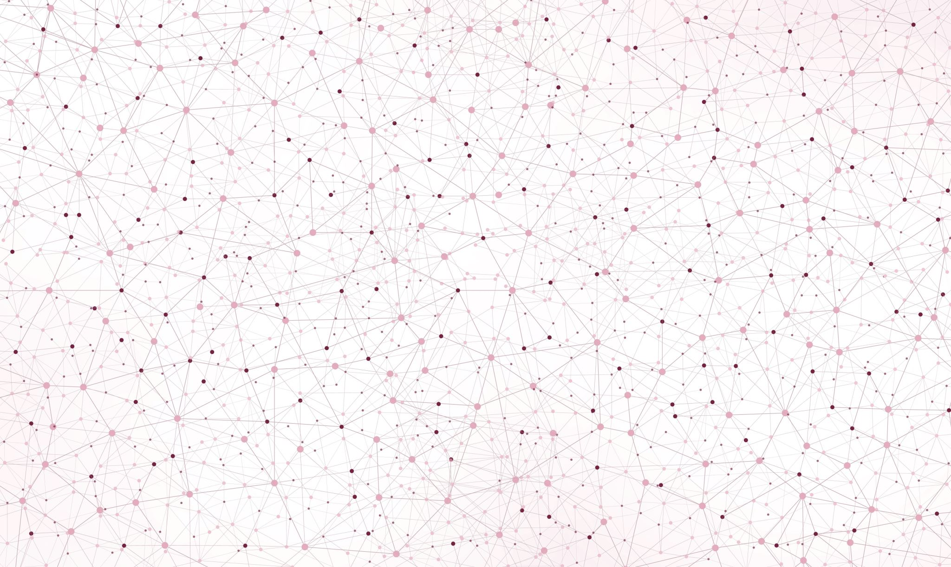
Reinforcement Learning, Flappy Bird
Guruprerana Shabadi and Luca Bonengel
CSE204 Project

Slide 2
Outline of the presentation
The game, Flappy Bird
Algorithm 1: Neuroevolution algorithm
Description of the algorithm
Results
Algorithm 2: Q-learning algorithm
Description of the algorithm
Results
Comparison of the two algorithms
Interpretation of the differences in the results

Slide 3
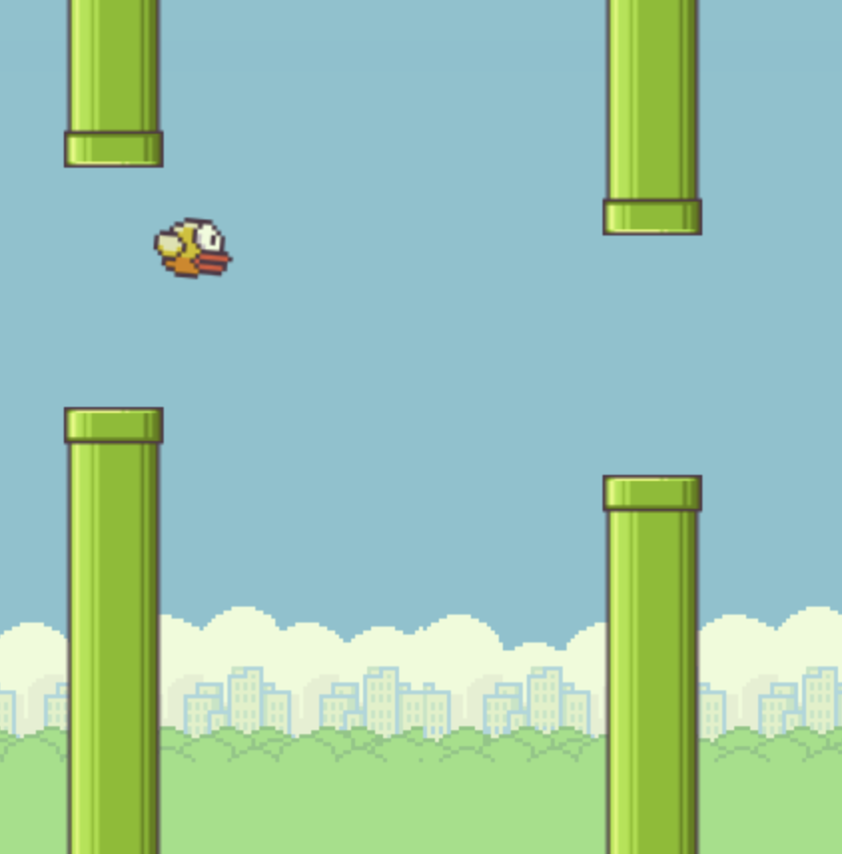
The game, Flappy Bird
An (in)famous game consisting in controlling a bird, attempting to fly between columns of green pipes without hitting them
Game project in CSE104

Slide 4
Algorithm 1: Neuroevolution algorithm
Neuroevolution is a machine learning technique that applies evolutionary algorithms to construct neural networks.
Population of neural networks evolves in order to find a network that solves the given task
1 neural network for 1 bird
First generation: weights initialised with random values

Slide 5
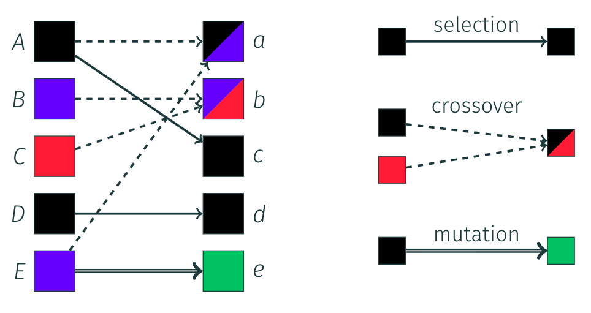
Generation of the next populations
Selections are the birds in the current generation that have the best scores. These birds automatically survive to the next generation.
Crossovers are created by mixing the neural networks of a pair of parents (and adding mutations).
Mutation children are created by introducing random changes (mutations) to the weights of a neural network of a single parent.
New random neural networks
Methods for creating the neural networks of the next generations

Slide 7
Algorithm 2: Q-learning algorithm

