Slide 1
S4T TRAINING
Stack4Things Plugins & Edge Services
Module B — IoTronic Plugins & Services · Ch.14
Lab VM: {{VM_IP}}
Assembling Smart CPS · Part II
Notes:
Welcome. In this module we will work through Stack4Things Plugins & Edge Services.
Module B — IoTronic Plugins & Services · Ch.14 Lab VM: {{VM_IP}}
The session alternates theory from the book with live exercises on the Stack4Things lab VM. Replace the placeholder IP with the address of the machine you are using.
Assembling Smart CPS · Part II.
When you're ready, advance to the first section.

Slide 2
Chapter 14 overview
Plugins · Fleet · Web services
Notes:
We now begin a new section: Chapter 14 overview. Plugins · Fleet · Web services. In the next slides, listen for whether we are in theory mode or hands-on mode, and open your terminal when the slides turn to lab work.

Slide 3
THEORY
Ch.14 abstract · Stack4Things Services
What Chapter 14 covers (abstract)
▸ Chapter 14 examines how Stack4Things injects customized business logic directly into remote IoT nodes at the network edge.
▸ Plugins are modular, extensible units orchestrated by the Lightning-Rod agent on each board.
▸ The chapter distinguishes synchronous on-demand execution from asynchronous continuous background operation.
▸ Fleet management treats heterogeneous devices as coordinated logical groups for bulk operations.
▸ Web services integration exposes board HTTP endpoints over the public Web without manual port forwarding.
▸ Together these capabilities turn passive edge nodes into programmable, remotely managed cyber-physical assets.
Assembling Smart CPS · Stack4Things Training
Theory
Notes:
In this slide we cover What Chapter 14 covers (abstract). This material is covered in Ch.14 abstract · Stack4Things Services.
First, Chapter 14 examines how Stack4Things injects customized business logic directly into remote IoT nodes at the network edge. Next, Plugins are modular, extensible units orchestrated by the Lightning-Rod agent on each board.
By contrast, The chapter distinguishes synchronous on-demand execution from asynchronous continuous background operation. We should also consider that Fleet management treats heterogeneous devices as coordinated logical groups for bulk operations.
Another key point is that Web services integration exposes board HTTP endpoints over the public Web without manual port forwarding. Furthermore, Together these capabilities turn passive edge nodes into programmable, remotely managed cyber-physical assets.
I'll pause here for questions, then we'll continue.

Slide 4
Prerequisites, objectives & deliverables
▸ Requires Module A complete — board must show Active in Horizon before any plugin demo.
▸ Create a synchronous HelloName plugin using the standard Python Worker class template.
▸ Inject the plugin on the Active board and invoke it via Plugin Call from Horizon.
▸ Verify the greeting in the Horizon result panel and in Lightning-Rod oslo_log output.
▸ Optional deliverable: Docker run alpine JSON result with container id and short_logs.
▸ Horizon login: admin / s4t · LR UI: http://{{VM_IP}}:1474 (me / arancino).
Assembling Smart CPS · Stack4Things Training
Notes:
On this slide, Prerequisites, objectives & deliverables.
First, Requires Module A complete — board must show Active in Horizon before any plugin demo. Next, Create a synchronous HelloName plugin using the standard Python Worker class template.
By contrast, Inject the plugin on the Active board and invoke it via Plugin Call from Horizon. We should also consider that Verify the greeting in the Horizon result panel and in Lightning-Rod oslo_log output.
Another key point is that regarding optional deliverable, docker run alpine JSON result with container id and short_logs. Furthermore, regarding horizon login, admin / s4t · LR UI: http://{{VM_IP}}:1474 (me / arancino).
If these objectives are clear, we can proceed.
Session timing — Module B — 60-minute timeline:

Slide 5
Plugin theory — motivation
Why edge logic matters in S4T
Notes:
We now begin a new section: Plugin theory — motivation. Why edge logic matters in S4T. In the next slides, listen for whether we are in theory mode or hands-on mode, and open your terminal when the slides turn to lab work.

Slide 6
THEORY
Ch.14 §14.1 · Plugins in Stack4Things
Why plugins? — extending the edge (Ch.14 §14.1)
▸ Traditional firmware updates require physical access or costly over-the-air reflashing of each device.
▸ Stack4Things plugins encapsulate sensing, actuation, local compute, or protocol forwarding as deployable Python modules.
▸ Operators upload plugin source to the IoTronic repository and inject it onto one board or an entire fleet remotely.
▸ Plugin logic executes inside Lightning-Rod on the board, close to sensors and actuators where latency is lowest.
▸ The model bridges low-level hardware control on the edge and high-level cloud orchestration through IoTronic APIs.
▸ Domain-specific behavior — environmental monitoring, container management, K3s join — becomes software-defined infrastructure.
Assembling Smart CPS · Stack4Things Training
Theory
Notes:
In this slide we cover Why plugins? — extending the edge (Ch.14 §14.1). This material is covered in Ch.14 §14.1 · Plugins in Stack4Things.
First, Traditional firmware updates require physical access or costly over-the-air reflashing of each device. Next, Stack4Things plugins encapsulate sensing, actuation, local compute, or protocol forwarding as deployable Python modules.
By contrast, Operators upload plugin source to the IoTronic repository and inject it onto one board or an entire fleet remotely. We should also consider that Plugin logic executes inside Lightning-Rod on the board, close to sensors and actuators where latency is lowest.
Another key point is that The model bridges low-level hardware control on the edge and high-level cloud orchestration through IoTronic APIs. Furthermore, Domain-specific behavior — environmental monitoring, container management, K3s join — becomes software-defined infrastructure.
I'll pause here for questions, then we'll continue.

Slide 7
THEORY
Ch.14 · plugin management model · Ch.4 I/Ocloud
Plugin-based architecture — separation of concerns
▸ IoTronic holds the plugin repository, metadata, injection state, and REST/Horizon management APIs in the cloud.
▸ Lightning-Rod loads the Worker class, passes runtime parameters, and supervises execution on the edge node.
▸ Each plugin is an independent unit: deploy, update, interrupt, or remove without restarting the full LR agent.
▸ Callable flag in Horizon marks synchronous plugins; non-callable plugins run as long-lived background workers.
▸ Results flow back through q_result queues to IoTronic, where Horizon and REST consumers read them.
▸ This mirrors the I/Ocloud idea from Chapter 4 — physical capability exposed as a remotely invocable function.
Assembling Smart CPS · Stack4Things Training
Theory
Notes:
In this slide we cover Plugin-based architecture — separation of concerns. This material is covered in Ch.14 · plugin management model · Ch.4 I/Ocloud.
First, IoTronic holds the plugin repository, metadata, injection state, and REST/Horizon management APIs in the cloud. Next, Lightning-Rod loads the Worker class, passes runtime parameters, and supervises execution on the edge node.
By contrast, regarding each plugin is an independent unit, deploy, update, interrupt, or remove without restarting the full LR agent. We should also consider that Callable flag in Horizon marks synchronous plugins; non-callable plugins run as long-lived background workers.
Another key point is that Results flow back through q_result queues to IoTronic, where Horizon and REST consumers read them. Furthermore, This mirrors the I/Ocloud idea from Chapter 4 — physical capability exposed as a remotely invocable function.
I'll pause here for questions, then we'll continue.

Slide 8
THEORY
Ch.14 · lst:plugin-skeleton · Plugin Manager
Lightning-Rod Plugin Manager runtime
▸ The Plugin Manager on each board loads the Python Worker subclass into an isolated execution context.
▸ Constructor signature is fixed: __init__(self, uuid, name, q_result, params=None) calling super on Plugin.Plugin.
▸ self.params carries the JSON dict from a Plugin Call in synchronous mode or startup configuration in async mode.
▸ self.q_result is a queue where run() puts return values that IoTronic forwards to the cloud caller or dashboard.
▸ Execution modes include callable (sync on demand), onboot (start when LR starts), and periodic (scheduled intervals).
▸ The run() method is the single entry point — all plugin business logic lives inside it or methods it calls.
▸ LR 0.4.17 requires the Python class to be named Worker regardless of the display name shown in Horizon.
Assembling Smart CPS · Stack4Things Training
Theory
Notes:
In this slide we cover Lightning-Rod Plugin Manager runtime. This material is covered in Ch.14 · lst:plugin-skeleton · Plugin Manager.
First, The Plugin Manager on each board loads the Python Worker subclass into an isolated execution context. Next, regarding constructor signature is fixed, __init__(self, uuid, name, q_result, params=None) calling super on Plugin.Plugin.
By contrast, Self.params carries the JSON dict from a Plugin Call in synchronous mode or startup configuration in async mode. We should also consider that Self.q_result is a queue where run() puts return values that IoTronic forwards to the cloud caller or dashboard.
Another key point is that Execution modes include callable (sync on demand), onboot (start when LR starts), and periodic (scheduled intervals). Furthermore, The run() method is the single entry point — all plugin business logic lives inside it or methods it calls.
In addition, LR 0.4.17 requires the Python class to be named Worker regardless of the display name shown in Horizon.
I'll pause here for questions, then we'll continue.

Slide 9
Asynchronous plugins
Continuous edge workloads · Ch.14 §14.1.1
Notes:
We now begin a new section: Asynchronous plugins. Continuous edge workloads · Ch.14 §14.1.1. In the next slides, listen for whether we are in theory mode or hands-on mode, and open your terminal when the slides turn to lab work.

Slide 10
THEORY
Ch.14 §14.1.1 · asynchronous plugins
Asynchronous plugins — purpose and pipeline (Ch.14 §14.1.1)
▸ Asynchronous plugins run continuously or at fixed intervals without an explicit cloud trigger for each iteration.
▸ They remain active in the background until an operator sends Stop or Interrupt from IoTronic or Horizon.
▸ The canonical pipeline is: Lightning-Rod → Sensor Plugin → Database → Visualization dashboard.
▸ Environmental monitoring, weather stations, and air-quality streams are the primary motivating use cases.
▸ Module C (Chapter 15) deploys the environmental_data async publisher writing CSV rows to InfluxDB every 30 seconds.
▸ Async plugins use while self._is_running loops with time.sleep intervals between acquisition cycles.
Assembling Smart CPS · Stack4Things Training
Theory
Notes:
In this slide we cover Asynchronous plugins — purpose and pipeline (Ch.14 §14.1.1). This material is covered in Ch.14 §14.1.1 · asynchronous plugins.
First, Asynchronous plugins run continuously or at fixed intervals without an explicit cloud trigger for each iteration. Next, They remain active in the background until an operator sends Stop or Interrupt from IoTronic or Horizon.
By contrast, regarding the canonical pipeline is, lightning-Rod, then Sensor Plugin, then Database, then Visualization dashboard. We should also consider that Environmental monitoring, weather stations, and air-quality streams are the primary motivating use cases.
Another key point is that Module C (Chapter 15) deploys the environmental_data async publisher writing CSV rows to InfluxDB every 30 seconds. Furthermore, Async plugins use while self._is_running loops with time.sleep intervals between acquisition cycles.
I'll pause here for questions, then we'll continue.

Slide 11
THEORY
Ch.14 · weather station async listing
Asynchronous plugins — weather station example
▸ The book's weather station plugin reads temperature, humidity, and barometric pressure from board sensors every 60 seconds.
▸ Each reading is timestamped, optionally enriched with device metadata, and written to a local or remote time-series store.
▸ Grafana or CKAN portals consume the stored series for operator dashboards and open-data publication.
▸ Because the plugin runs autonomously, network interruptions can be handled with local buffering and resume logic.
▸ Horizon shows async plugins with Callable = OFF; activation uses Start rather than Plugin Call.
▸ Interrupt stops the _is_running loop cleanly so the board can accept updated plugin code on the next inject.
▸ Listing reference: lst:plugin-async and ch14/plugins/asynchronous/weather_station_plugin.py.
Assembling Smart CPS · Stack4Things Training
Theory
Notes:
In this slide we cover Asynchronous plugins — weather station example. This material is covered in Ch.14 · weather station async listing.
First, The book's weather station plugin reads temperature, humidity, and barometric pressure from board sensors every 60 seconds. Next, Each reading is timestamped, optionally enriched with device metadata, and written to a local or remote time-series store.
By contrast, Grafana or CKAN portals consume the stored series for operator dashboards and open-data publication. We should also consider that Because the plugin runs autonomously, network interruptions can be handled with local buffering and resume logic.
Another key point is that Horizon shows async plugins with Callable = OFF; activation uses Start rather than Plugin Call. Furthermore, Interrupt stops the _is_running loop cleanly so the board can accept updated plugin code on the next inject.
In addition, regarding listing reference, lst:plugin-async and ch14/plugins/asynchronous/weather_station_plugin.py.
I'll pause here for questions, then we'll continue.

Slide 12
THEORY
Ch.14 §14.1.1 · async vs sync decision guide
Asynchronous plugins — when to choose async mode
▸ Choose async when data must be collected on a schedule independent of human or API-driven triggers.
▸ Choose async when the workload is long-running and would exceed reasonable synchronous call timeouts.
▸ Choose async when multiple samples must be aggregated before cloud upload to reduce bandwidth and cost.
▸ Do not use async for one-shot diagnostics, GPIO toggles, or Docker operations that need immediate JSON responses.
▸ Async plugins may still push interim results to q_result for live monitoring, but primary output is often direct DB writes.
▸ State persistence — e.g. last_index.state in Ch.15 — enables fault-tolerant resume after restart or crash.
Assembling Smart CPS · Stack4Things Training
Theory
Notes:
In this slide we cover Asynchronous plugins — when to choose async mode. This material is covered in Ch.14 §14.1.1 · async vs sync decision guide.
First, Choose async when data must be collected on a schedule independent of human or API-driven triggers. Next, Choose async when the workload is long-running and would exceed reasonable synchronous call timeouts.
By contrast, Choose async when multiple samples must be aggregated before cloud upload to reduce bandwidth and cost. We should also consider that Do not use async for one-shot diagnostics, GPIO toggles, or Docker operations that need immediate JSON responses.
Another key point is that Async plugins may still push interim results to q_result for live monitoring, but primary output is often direct DB writes. Furthermore, State persistence — e.g. last_index.state in Ch.15 — enables fault-tolerant resume after restart or crash.
I'll pause here for questions, then we'll continue.

Slide 13
Synchronous plugins
On-demand edge microservices · Ch.14 §14.1.2
Notes:
We now begin a new section: Synchronous plugins. On-demand edge microservices · Ch.14 §14.1.2. In the next slides, listen for whether we are in theory mode or hands-on mode, and open your terminal when the slides turn to lab work.

Slide 14
THEORY
Ch.14 §14.1.2 · synchronous plugins
Synchronous plugins — purpose and pipeline (Ch.14 §14.1.2)
▸ Synchronous plugins remain dormant on the board until explicitly invoked by a Plugin Call from IoTronic.
▸ Each invocation runs run() exactly once, places the result on q_result, and returns control to the Plugin Manager.
▸ The pipeline is: Cloud Request → IoTronic Plugin Call → Lightning-Rod executes Worker → result returned to caller.
▸ They behave like callable microservices embedded on the IoT board, addressable via Horizon UI or REST API.
▸ Use cases include instant sensor reads, GPIO or LED control, Docker container lifecycle, and K3s cluster join/status.
▸ Horizon Create Plugin form sets Callable = ON to register the plugin in synchronous mode.
Assembling Smart CPS · Stack4Things Training
Theory
Notes:
In this slide we cover Synchronous plugins — purpose and pipeline (Ch.14 §14.1.2). This material is covered in Ch.14 §14.1.2 · synchronous plugins.
First, Synchronous plugins remain dormant on the board until explicitly invoked by a Plugin Call from IoTronic. Next, Each invocation runs run() exactly once, places the result on q_result, and returns control to the Plugin Manager.
By contrast, regarding the pipeline is, cloud Request, then IoTronic Plugin Call, then Lightning-Rod executes Worker, then result returned to caller. We should also consider that They behave like callable microservices embedded on the IoT board, addressable via Horizon UI or REST API.
Another key point is that Use cases include instant sensor reads, GPIO or LED control, Docker container lifecycle, and K3s cluster join/status. Furthermore, Horizon Create Plugin form sets Callable = ON to register the plugin in synchronous mode.
I'll pause here for questions, then we'll continue.

Slide 15
THEORY
Ch.14 · lst:plugin-sync · hello_name_plugin
Synchronous plugins — HelloName as canonical example
▸ HelloName reads a name parameter from self.params and returns a personalized greeting string.
▸ If name is omitted, the plugin defaults to User — demonstrating defensive parameter handling on the edge.
▸ LOG.info writes the same message through oslo_log for centralized traceability in production deployments.
▸ The entire request–response cycle typically completes in sub-second time over the WAMP control channel.
▸ Listing lst:plugin-sync is the reference implementation used in today's hands-on lab block.
▸ Once HelloName works, the same inject-and-call pattern applies to LED control and Docker lifecycle plugins.
Assembling Smart CPS · Stack4Things Training
Theory
Notes:
In this slide we cover Synchronous plugins — HelloName as canonical example. This material is covered in Ch.14 · lst:plugin-sync · hello_name_plugin.
First, HelloName reads a name parameter from self.params and returns a personalized greeting string. Next, If name is omitted, the plugin defaults to User — demonstrating defensive parameter handling on the edge.
By contrast, LOG.info writes the same message through oslo_log for centralized traceability in production deployments. We should also consider that The entire request–response cycle typically completes in sub-second time over the WAMP control channel.
Another key point is that regarding listing lst, plugin-sync is the reference implementation used in today's hands-on lab block. Furthermore, Once HelloName works, the same inject-and-call pattern applies to LED control and Docker lifecycle plugins.
I'll pause here for questions, then we'll continue.

Slide 16
THEORY
Ch.14 §14.1.3 · orchestrator agent lifecycle listing
Orchestrator agent lifecycle plugin (Ch.14 §14.1.3)
▸ Separate from application Workers — manages board-side orchestrator agent state.
▸ Listing lst:plugin-orchestrator documents join/status/leave operations for edge agents.
▸ Used when LR must coordinate with external orchestration platforms beyond IoTronic alone.
▸ Distinct from K3s lifecycle plugin — different privilege and API surface.
▸ Not exercised in core lab — documented for completeness against book §14.1.3.
▸ Shows plugin model generality: any board-side Python logic can become a Worker.
Assembling Smart CPS · Stack4Things Training
Theory
Notes:
In this slide we cover Orchestrator agent lifecycle plugin (Ch.14 §14.1.3). This material is covered in Ch.14 §14.1.3 · orchestrator agent lifecycle listing.
First, Separate from application Workers — manages board-side orchestrator agent state. Next, regarding listing lst, plugin-orchestrator documents join/status/leave operations for edge agents.
By contrast, Used when LR must coordinate with external orchestration platforms beyond IoTronic alone. We should also consider that Distinct from K3s lifecycle plugin — different privilege and API surface.
Another key point is that Not exercised in core lab — documented for completeness against book §14.1.3. Furthermore, regarding shows plugin model generality, any board-side Python logic can become a Worker.
I'll pause here for questions, then we'll continue.

Slide 17
THEORY
Ch.14 §14.3 · GPIO weather server · demos/weather_web_server.py
GPIO and LED control plugin (Ch.14)
▸ Book web-services example reads /sys/class/gpio and toggles LED via POST /led.
▸ Hardware-facing WoT: REST endpoint maps to physical actuator on Raspberry Pi board.
▸ Contrasts with HelloName (pure software) and environmental (database publisher) plugins.
▸ Requires LR with GPIO access — Docker lab simulates HTTP; hardware pilots use real pins.
▸ Same inject + ServiceEnable path as weather_web_server.py for public WoT exposure.
▸ Connects Module B plugin model to Module F GPIO/LED endpoints in ch14 demos.
Assembling Smart CPS · Stack4Things Training
Theory
Notes:
In this slide we cover GPIO and LED control plugin (Ch.14). This material is covered in Ch.14 §14.3 · GPIO weather server · demos/weather_web_server.py.
First, Book web-services example reads /sys/class/gpio and toggles LED via POST /led. Next, regarding hardware-facing wot, REST endpoint maps to physical actuator on Raspberry Pi board.
By contrast, Contrasts with HelloName (pure software) and environmental (database publisher) plugins. We should also consider that Requires LR with GPIO access — Docker lab simulates HTTP; hardware pilots use real pins.
Another key point is that Same inject + ServiceEnable path as weather_web_server.py for public WoT exposure. Furthermore, Connects Module B plugin model to Module F GPIO/LED endpoints in ch14 demos.
I'll pause here for questions, then we'll continue.

Slide 18
THEORY
Ch.14 §14.1.2 · Plugin Call semantics
Synchronous plugins — parameter contracts and REST
▸ Plugin Call accepts a JSON object whose keys map directly to self.params inside Worker.run().
▸ Horizon provides a Call dialog; equivalent automation uses IoTronic REST endpoints on the Conductor API.
▸ Input parameter JSON schemas can be declared at plugin creation time to document expected Call payloads.
▸ Errors inside run() should be logged with LOG.error and returned as structured JSON on q_result when possible.
▸ Synchronous plugins do not use self._is_running loops unless the operation itself is intentionally long.
▸ Callable plugins can be injected on multiple boards and invoked independently with different params per board.
Assembling Smart CPS · Stack4Things Training
Theory
Notes:
In this slide we cover Synchronous plugins — parameter contracts and REST. This material is covered in Ch.14 §14.1.2 · Plugin Call semantics.
First, Plugin Call accepts a JSON object whose keys map directly to self.params inside Worker.run(). Next, Horizon provides a Call dialog; equivalent automation uses IoTronic REST endpoints on the Conductor API.
By contrast, Input parameter JSON schemas can be declared at plugin creation time to document expected Call payloads. We should also consider that Errors inside run() should be logged with LOG.error and returned as structured JSON on q_result when possible.
Another key point is that Synchronous plugins do not use self._is_running loops unless the operation itself is intentionally long. Furthermore, Callable plugins can be injected on multiple boards and invoked independently with different params per board.
I'll pause here for questions, then we'll continue.

Slide 19
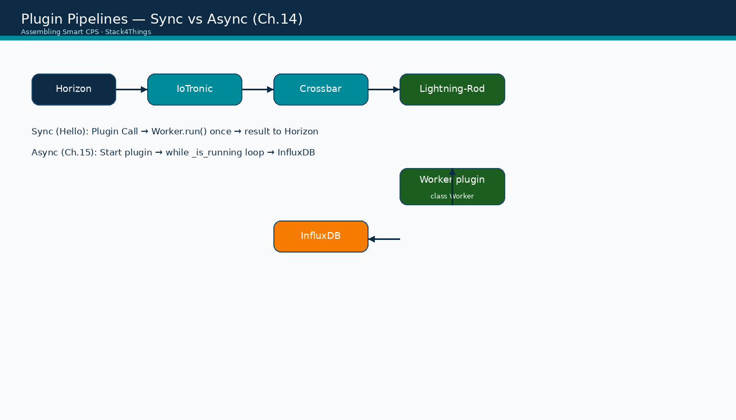
Plugin pipelines — sync vs async
Assembling Smart CPS · Stack4Things Training
Diagram
Theory diagram — pairs HelloName (sync) with Ch.15 environmental publisher (async)
Notes:
Please look at the diagram on screen: Plugin pipelines — sync vs async. Describe the main boxes and arrows. Relate each element to a Docker service or API you have already seen. In particular, note the following: Theory diagram — pairs HelloName (sync) with Ch.15 environmental publisher (async). Take a few seconds to orient before we continue.

Slide 20
Plugin lifecycle
Seven steps from development to removal
Notes:
We now begin a new section: Plugin lifecycle. Seven steps from development to removal. In the next slides, listen for whether we are in theory mode or hands-on mode, and open your terminal when the slides turn to lab work.

Slide 21
THEORY
Ch.14 · plugin lifecycle · steps 1–2
Plugin lifecycle — steps 1–2: develop and register
▸ Step 1 — Develop: write Python source following the S4T skeleton with Worker class, oslo_log, and run() method.
▸ Test logic locally where possible using a mock q_result queue before uploading to IoTronic.
▸ Step 2 — Create: upload the plugin to the IoTronic repository via Horizon Create Plugin or Conductor REST API.
▸ Provide display name, description, full source code, and Callable flag (ON = sync, OFF = async).
▸ Optional input-parameter JSON schema documents Plugin Call fields for synchronous plugins.
▸ The plugin receives a repository UUID; it is not yet running on any board until injection.
▸ Book listings: lst:plugin-skeleton (template), lst:plugin-sync, lst:plugin-docker, lst:plugin-k3s-lifecycle.
Assembling Smart CPS · Stack4Things Training
Theory
Notes:
In this slide we cover Plugin lifecycle — steps 1–2: develop and register. This material is covered in Ch.14 · plugin lifecycle · steps 1–2.
First, regarding step 1 — develop, write Python source following the S4T skeleton with Worker class, oslo_log, and run() method. Next, Test logic locally where possible using a mock q_result queue before uploading to IoTronic.
By contrast, regarding step 2 — create, upload the plugin to the IoTronic repository via Horizon Create Plugin or Conductor REST API. We should also consider that Provide display name, description, full source code, and Callable flag (ON = sync, OFF = async).
Another key point is that Optional input-parameter JSON schema documents Plugin Call fields for synchronous plugins. Furthermore, The plugin receives a repository UUID; it is not yet running on any board until injection.
In addition, regarding book listings, lst:plugin-skeleton (template), lst:plugin-sync, lst:plugin-docker, lst:plugin-k3s-lifecycle.
I'll pause here for questions, then we'll continue.

Slide 22
THEORY
Ch.14 · plugin lifecycle · steps 3–4
Plugin lifecycle — steps 3–4: inject and execute
▸ Step 3 — Inject: associate the repository plugin with a target board (or fleet) from Horizon Boards → Actions.
▸ Injection copies plugin metadata and source to the edge; Lightning-Rod acknowledges via WAMP messaging.
▸ Step 4 — Execute: for sync plugins, use Plugin Call with JSON params; for async, use Start from Horizon or API.
▸ Sync execution is single-shot; async execution enters the background loop until Stop or Interrupt.
▸ IoTronic tracks injection state per board so operators see which plugins are attached and running.
▸ Fleet-level inject deploys the same plugin to every member board in one coordinated operation (Ch.14 §14.2).
Assembling Smart CPS · Stack4Things Training
Theory
Notes:
In this slide we cover Plugin lifecycle — steps 3–4: inject and execute. This material is covered in Ch.14 · plugin lifecycle · steps 3–4.
First, regarding step 3 — inject, associate the repository plugin with a target board (or fleet) from Horizon Boards, then Actions. Next, Injection copies plugin metadata and source to the edge; Lightning-Rod acknowledges via WAMP messaging.
By contrast, regarding step 4 — execute, for sync plugins, use Plugin Call with JSON params; for async, use Start from Horizon or API. We should also consider that Sync execution is single-shot; async execution enters the background loop until Stop or Interrupt.
Another key point is that IoTronic tracks injection state per board so operators see which plugins are attached and running. Furthermore, Fleet-level inject deploys the same plugin to every member board in one coordinated operation (Ch.14 §14.2).
I'll pause here for questions, then we'll continue.

Slide 23
THEORY
Ch.14 · plugin lifecycle · steps 5–7
Plugin lifecycle — steps 5–7: update, interrupt, remove
▸ Step 5 — Update: push revised Python source to the repository and re-inject or hot-update on connected boards.
▸ Remote update avoids truck rolls — critical for large urban deployments like TOO(L)SMART in Chapter 15.
▸ Step 6 — Interrupt: for async plugins, signal _is_running = False to stop the loop without removing the injection.
▸ Interrupt is preferred over kill when the plugin maintains state files or open database connections.
▸ Step 7 — Remove: detach the plugin from the board; Lightning-Rod cleans up execution context and resources.
▸ Full lifecycle control — create, inject, execute, update, interrupt, delete — is available from Horizon and REST.
Assembling Smart CPS · Stack4Things Training
Theory
Notes:
In this slide we cover Plugin lifecycle — steps 5–7: update, interrupt, remove. This material is covered in Ch.14 · plugin lifecycle · steps 5–7.
First, regarding step 5 — update, push revised Python source to the repository and re-inject or hot-update on connected boards. Next, Remote update avoids truck rolls — critical for large urban deployments like TOO(L)SMART in Chapter 15.
By contrast, regarding step 6 — interrupt, for async plugins, signal _is_running = False to stop the loop without removing the injection. We should also consider that Interrupt is preferred over kill when the plugin maintains state files or open database connections.
Another key point is that regarding step 7 — remove, detach the plugin from the board; Lightning-Rod cleans up execution context and resources. Furthermore, Full lifecycle control — create, inject, execute, update, interrupt, delete — is available from Horizon and REST.
I'll pause here for questions, then we'll continue.

Slide 24
Structured logging
oslo_log and centralized observability
Notes:
We now begin a new section: Structured logging. oslo_log and centralized observability. In the next slides, listen for whether we are in theory mode or hands-on mode, and open your terminal when the slides turn to lab work.

Slide 25
THEORY
Ch.14–15 · oslo_log pattern · lst:plugin-sync
oslo_log in plugins — pattern and purpose (Ch.14–15)
▸ Every production plugin imports from oslo_log: from oslo_log import log as logging; LOG = logging.getLogger(__name__).
▸ LOG.info, LOG.debug, LOG.warning, and LOG.error provide structured, level-filtered messages from edge execution.
▸ Using the OpenStack logging stack ensures consistent formatting across IoTronic cloud services and Lightning-Rod.
▸ Plugin authors should log entry parameters, major state transitions, and errors — never silent failure on the edge.
▸ HelloName demonstrates the minimum viable pattern: LOG.info(message) alongside self.q_result.put(message).
▸ Docker and environmental plugins extend this with operation names, container ids, and InfluxDB write confirmations.
Assembling Smart CPS · Stack4Things Training
Theory
Notes:
In this slide we cover oslo_log in plugins — pattern and purpose (Ch.14–15). This material is covered in Ch.14–15 · oslo_log pattern · lst:plugin-sync.
First, regarding every production plugin imports from oslo_log, from oslo_log import log as logging; LOG = logging.getLogger(__name__). Next, LOG.info, LOG.debug, LOG.warning, and LOG.error provide structured, level-filtered messages from edge execution.
By contrast, Using the OpenStack logging stack ensures consistent formatting across IoTronic cloud services and Lightning-Rod. We should also consider that Plugin authors should log entry parameters, major state transitions, and errors — never silent failure on the edge.
Another key point is that HelloName demonstrates the minimum viable pattern: LOG.info(message) alongside self.q_result.put(message). Furthermore, Docker and environmental plugins extend this with operation names, container ids, and InfluxDB write confirmations.
I'll pause here for questions, then we'll continue.

Slide 26
THEORY
Ch.15 § logging infrastructure · Ch.14 Docker plugin traceability
Centralized logging — production vs lab (Ch.14–15)
▸ In production Stack4Things deployments, Lightning-Rod log streams forward to IoTronic centralized logging service.
▸ Operators query logs across all boards from the cloud without SSH access to individual edge nodes.
▸ Multi-tenant deployments isolate log streams per tenant/project following OpenStack Keystone boundaries.
▸ In the training lab, logs are visible via: docker compose logs lightning-rod | grep Hello (or environmental).
▸ Centralized logging is infrastructure observability — distinct from HTTP services exposed via WSTUN or Designate DNS.
▸ Chapter 15 environmental plugin uses the same oslo_log pattern for each CSV row sent to InfluxDB.
Assembling Smart CPS · Stack4Things Training
Theory
Notes:
In this slide we cover Centralized logging — production vs lab (Ch.14–15). This material is covered in Ch.15 § logging infrastructure · Ch.14 Docker plugin traceability.
First, In production Stack4Things deployments, Lightning-Rod log streams forward to IoTronic centralized logging service. Next, Operators query logs across all boards from the cloud without SSH access to individual edge nodes.
By contrast, Multi-tenant deployments isolate log streams per tenant/project following OpenStack Keystone boundaries. We should also consider that regarding in the training lab, logs are visible via, docker compose logs lightning-rod | grep Hello (or environmental).
Another key point is that Centralized logging is infrastructure observability — distinct from HTTP services exposed via WSTUN or Designate DNS. Furthermore, Chapter 15 environmental plugin uses the same oslo_log pattern for each CSV row sent to InfluxDB.
I'll pause here for questions, then we'll continue.

Slide 27
THEORY
Ch.14 §14.3 vs logging · Module F handoff
Logging vs web-exposed services — do not conflate
▸ Plugin logs answer: did the edge logic run, with what parameters, and did it succeed or throw?
▸ Web services answer: can an external HTTP client reach a board-local port through DNS or WSTUN tunnels?
▸ The weather_web_server.py demo (Ch.14 §14.3) exposes GET /sensors — that is a web service, not a log stream.
▸ Docker plugin returns JSON on q_result; LOG.info captures the same facts for audit trails.
▸ When debugging Plugin Call failures, check both Horizon result panel and LR container logs in parallel.
▸ Module F extends web services with WSTUN port forwarding; today's focus is plugin execution and logging.
Assembling Smart CPS · Stack4Things Training
Theory
Notes:
In this slide we cover Logging vs web-exposed services — do not conflate. This material is covered in Ch.14 §14.3 vs logging · Module F handoff.
First, regarding plugin logs answer, did the edge logic run, with what parameters, and did it succeed or throw? Next, regarding web services answer, can an external HTTP client reach a board-local port through DNS or WSTUN tunnels?
By contrast, The weather_web_server.py demo (Ch.14 §14.3) exposes GET /sensors — that is a web service, not a log stream. We should also consider that Docker plugin returns JSON on q_result; LOG.info captures the same facts for audit trails.
Another key point is that When debugging Plugin Call failures, check both Horizon result panel and LR container logs in parallel. Furthermore, Module F extends web services with WSTUN port forwarding; today's focus is plugin execution and logging.
I'll pause here for questions, then we'll continue.

Slide 28
Lab: HelloName sync plugin
Listing lst:plugin-sync · Callable = ON
Notes:
We now begin a new section: Lab: HelloName sync plugin. Listing lst:plugin-sync · Callable = ON. In the next slides, listen for whether we are in theory mode or hands-on mode, and open your terminal when the slides turn to lab work.
Instructor timing (title): Hands-on — HelloName sync plugin

Slide 29
DEMO
HelloName — learning outcomes
▸ Prove that the cloud can invoke customized edge logic on demand with sub-second turnaround over WAMP.
▸ Prove that Plugin Call JSON parameters reach Worker.run() as self.params and drive business logic.
▸ Prove that results return through q_result and appear in the Horizon Plugin Call result panel.
▸ Prove that oslo_log emits the same message inside the Lightning-Rod container for operator verification.
▸ Establish the inject-and-call workflow reused by Docker lifecycle, LED control, and fleet bulk deploy in later modules.
Assembling Smart CPS · Stack4Things Training
Demo
Notes:
In this demonstration, HelloName — learning outcomes.
First, Prove that the cloud can invoke customized edge logic on demand with sub-second turnaround over WAMP. Next, Prove that Plugin Call JSON parameters reach Worker.run() as self.params and drive business logic.
By contrast, Prove that results return through q_result and appear in the Horizon Plugin Call result panel. We should also consider that Prove that oslo_log emits the same message inside the Lightning-Rod container for operator verification.
Another key point is that Establish the inject-and-call workflow reused by Docker lifecycle, LED control, and fleet bulk deploy in later modules.
Check that your screen matches what we showed before moving on.

Slide 30
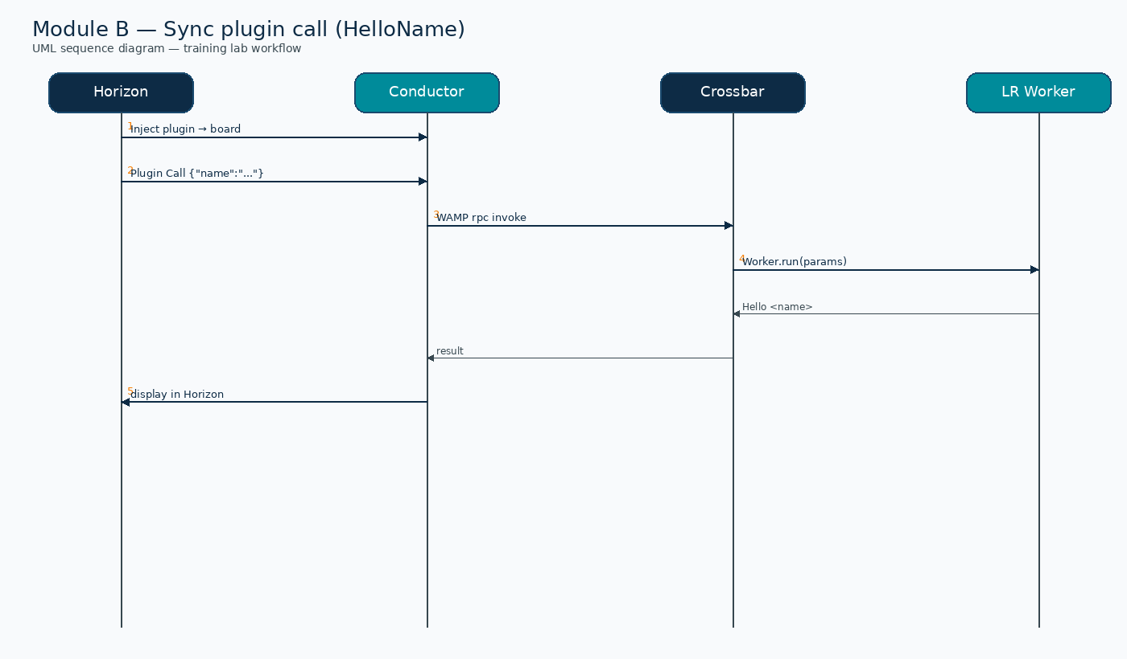
UML sequence — Sync Plugin Call (Module B)
Assembling Smart CPS · Stack4Things Training
Diagram
Inject → Plugin Call → Conductor → Crossbar → Worker.run() → result
Notes:
Please look at the sequence diagram on screen: UML sequence — Sync Plugin Call (Module B). Trace the diagram from left to right. Name each actor, the protocol used, and the message that crosses the cloud–edge boundary. In particular, note the following: Inject → Plugin Call → Conductor → Crossbar → Worker.run() → result. Take a few seconds to orient before we continue.

Slide 31
Plugin skeleton — FIXED section (do not change)
▸ from iotronic_lightningrod.modules.plugins import Plugin
▸ from oslo_log import log as logging
▸ LOG = logging.getLogger(__name__)
▸ class Worker(Plugin.Plugin): # name MUST be Worker in LR 0.4.17
▸ def __init__(self, uuid, name, q_result, params=None):
▸ super(Worker, self).__init__(uuid, name, q_result, params)
Assembling Smart CPS · Stack4Things Training
Notes:
On this slide, Plugin skeleton — FIXED section (do not change).
First, From iotronic_lightningrod.modules.plugins import Plugin. Next, From oslo_log import log as logging.
By contrast, LOG = logging.getLogger(__name__). We should also consider that regarding class worker(plugin.plugin), # name MUST be Worker in LR 0.4.17.
Another key point is that Def __init__(self, uuid, name, q_result, params=None):. Furthermore, Super(Worker, self).__init__(uuid, name, q_result, params).
If these objectives are clear, we can proceed.

Slide 32
Plugin skeleton — USER section (your logic in run)
▸ def run(self):
▸ person_name = self.params.get('name', 'User')
▸ message = f'Hello {person_name}'
▸ LOG.info(message)
▸ self.q_result.put(message)
▸ Only the run() body and helper methods belong in the USER section — keep FIXED imports and class name.
Assembling Smart CPS · Stack4Things Training
Notes:
On this slide, Plugin skeleton — USER section (your logic in run).
First, Def run(self):. Next, Person_name = self.params.get('name', 'User').
By contrast, Message = f'Hello {person_name}'. We should also consider that LOG.info(message).
Another key point is that Self.q_result.put(message). Furthermore, Only the run() body and helper methods belong in the USER section — keep FIXED imports and class name.
If these objectives are clear, we can proceed.

Slide 33
⚠ BOOK ↔ LAB
Worker class name + ch14 repository fix
▸ Lightning-Rod 0.4.17: the Python class MUST be named Worker — not HelloNamePlugin or any display alias.
▸ The dashboard plugin display name (HelloName) is independent of the Python class identifier.
▸ BUG: upstream ch14 hello_name_plugin.py uses HelloNamePlugin — injection will fail silently or error.
▸ Use the corrected file: training/ch14-fixed/plugins/synchronous/hello_name_plugin.py
▸ If Plugin Call returns empty, verify class name, injection status, and board Active state in that order.
Assembling Smart CPS · Stack4Things Training
Notes:
Before we continue, an important note about Worker class name + ch14 repository fix.
First, regarding lightning-rod 0.4.17, the Python class MUST be named Worker — not HelloNamePlugin or any display alias. Next, The dashboard plugin display name (HelloName) is independent of the Python class identifier.
By contrast, regarding bug, upstream ch14 hello_name_plugin.py uses HelloNamePlugin — injection will fail silently or error. We should also consider that regarding use the corrected file, training/ch14-fixed/plugins/synchronous/hello_name_plugin.py.
Another key point is that If Plugin Call returns empty, verify class name, injection status, and board Active state in that order.
Keep this difference in mind for the rest of the lab.

Slide 34
HelloNamePlugin — listing lst:plugin-sync
from iotronic_lightningrod.modules.plugins import Plugin
from oslo_log import log as logging
LOG = logging.getLogger(__name__)
class Worker(Plugin.Plugin):
def __init__(self, uuid, name, q_result, params=None):
super(Worker, self).__init__(uuid, name, q_result, params)
def run(self):
person_name = self.params.get('name', 'User')
message = f"Hello {person_name}"
LOG.info(message)
self.q_result.put(message)
Assembling Smart CPS · Stack4Things Training
Code
Notes:
On this slide we walk through the code for HelloNamePlugin — listing lst:plugin-sync.
Scroll slowly through the listing on screen while I explain each part.
This is the standard Stack4Things plugin skeleton. The Worker class extends the Plugin base type. The run method is what IoTronic invokes when you call the plugin from Horizon. Parameters arrive as a dictionary from the Plugin Call JSON. Results go back through the queue, and oslo_log records what happened on the board.
After reviewing the code, we'll apply it in the practical exercise.

Slide 35
Create Plugin form — field by field
▸ Horizon → IoT → Plugins → + Create Plugin.
▸ Plugin Name: HelloName — display label in repository and Call dialog.
▸ Description: optional — e.g. synchronous greeting demo for Module B.
▸ Source: paste full Python Worker code from the listing slide.
▸ Callable: ✓ ON — marks plugin as synchronous and enables Plugin Call button.
▸ Input parameters: optional JSON schema documenting the name field for callers.
Assembling Smart CPS · Stack4Things Training
Notes:
On this slide, Create Plugin form — field by field.
First, Horizon, then IoT, then Plugins, then + Create Plugin. Next, regarding plugin name, helloName — display label in repository and Call dialog.
By contrast, regarding description, optional — e.g. synchronous greeting demo for Module B. We should also consider that regarding source, paste full Python Worker code from the listing slide.
Another key point is that regarding callable, ✓ ON — marks plugin as synchronous and enables Plugin Call button. Furthermore, regarding input parameters, optional JSON schema documenting the name field for callers.
If these objectives are clear, we can proceed.

Slide 36
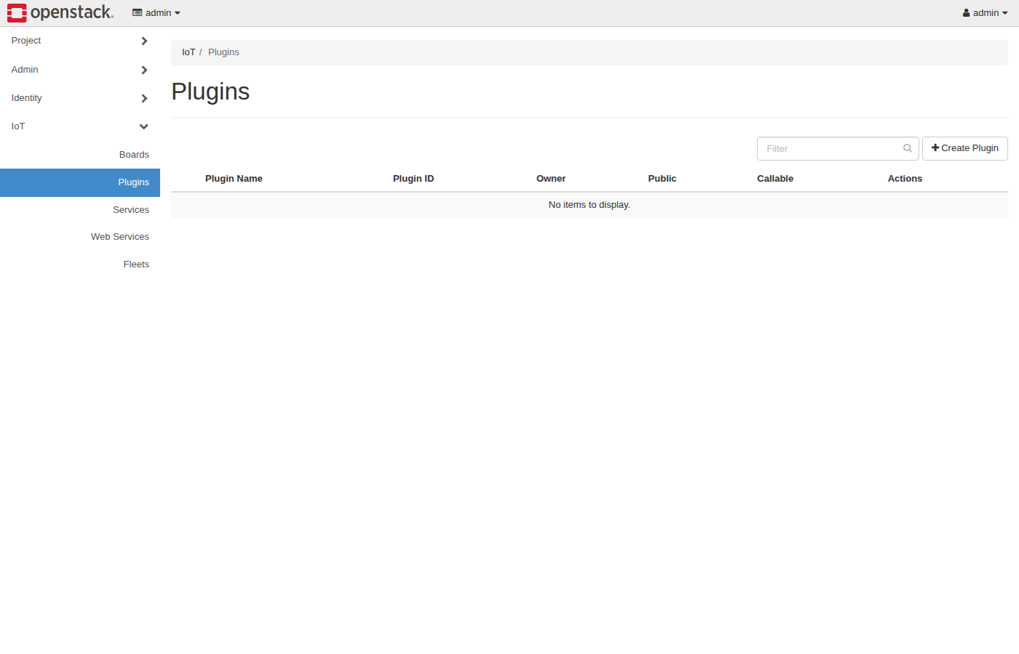
Horizon IoT — Plugins panel (live)
Assembling Smart CPS · Stack4Things Training
Screenshot
http://{{VM_IP}}/horizon/iot/plugins/
Notes:
Please look at the screenshot on screen: Horizon IoT — Plugins panel (live). Walk the class through what they see in the interface. Connect each panel and button to a component we already deployed in the stack. In particular, note the following: http://{{VM_IP}}/horizon/iot/plugins/. Take a few seconds to orient before we continue.

Slide 37
Create HelloName plugin
▸ Open http://{{VM_IP}}/horizon — login admin / s4t.
▸ Navigate IoT → Plugins → + Create Plugin.
▸ Paste from: training/ch14-fixed/plugins/synchronous/hello_name_plugin.py (NOT upstream ch14).
▸ Repo: github.com/AssemblingSmartCPS/ch14 · set Callable = ON · class must be Worker.
▸ Verify: ./validate/validate-demo-ch14.sh
Assembling Smart CPS · Stack4Things Training
Notes:
Now we move to the hands-on part: Create HelloName plugin. Open your lab VM and follow along.
First, regarding open http, //{{VM_IP}}/horizon — login admin / s4t. Next, Navigate IoT, then Plugins, then + Create Plugin.
By contrast, regarding paste from, training/ch14-fixed/plugins/synchronous/hello_name_plugin.py (NOT upstream ch14). We should also consider that regarding repo, github.com/AssemblingSmartCPS/ch14 · set Callable = ON · class must be Worker.
Another key point is that regarding verify, ./validate/validate-demo-ch14.sh.
Raise your hand if you're stuck — we'll wait until most of you are done.
Instructor timing (title): Step 1 — Create HelloName plugin (10 min)

Slide 38
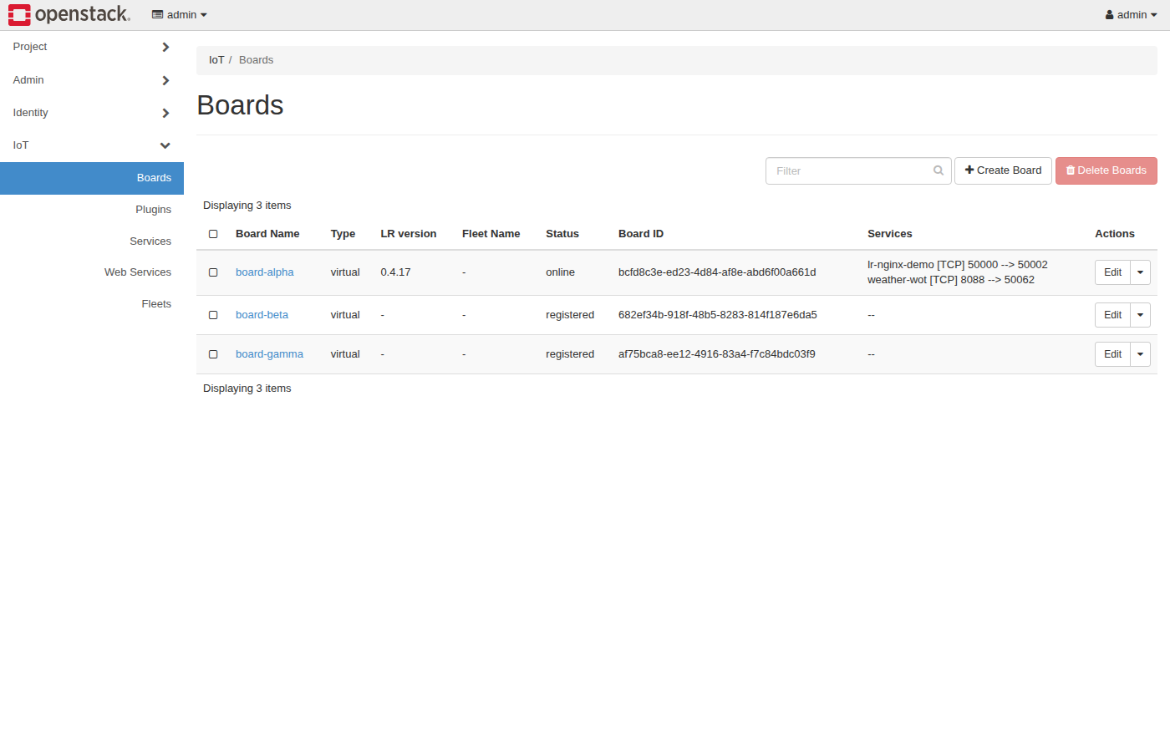
Horizon IoT — Boards panel (inject target)
Assembling Smart CPS · Stack4Things Training
Screenshot
http://{{VM_IP}}/horizon/iot/ — select Active board → Actions → Inject Plugin
Notes:
Please look at the screenshot on screen: Horizon IoT — Boards panel (inject target). Walk the class through what they see in the interface. Connect each panel and button to a component we already deployed in the stack. In particular, note the following: http://{{VM_IP}}/horizon/iot/ — select Active board → Actions → Inject Plugin. Take a few seconds to orient before we continue.

Slide 39
Inject plugin on board
▸ Horizon → IoT → Boards → select your Active board from Module A.
▸ Actions → Inject Plugin → choose HelloName from repository.
▸ Confirm injection — plugin is now attached to the board edge agent.
▸ Board must remain Active; re-check LR Status at http://{{VM_IP}}:1474 if inject fails.
Assembling Smart CPS · Stack4Things Training
Notes:
Now we move to the hands-on part: Inject plugin on board. Open your lab VM and follow along.
First, Horizon, then IoT, then Boards, then select your Active board from Module A. Next, Actions, then Inject Plugin, then choose HelloName from repository.
By contrast, Confirm injection — plugin is now attached to the board edge agent. We should also consider that Board must remain Active; re-check LR Status at http://{{VM_IP}}:1474 if inject fails.
Raise your hand if you're stuck — we'll wait until most of you are done.
Instructor timing (title): Step 2 — Inject plugin on board (5 min)

Slide 40
Plugin Call JSON
{"name": "YourName"}
Assembling Smart CPS · Stack4Things Training
Code
Notes:
On this slide we walk through the code for Plugin Call JSON.
Scroll slowly through the listing on screen while I explain each part.
Point out the imports, the class definition, and the run method. Students will adapt this template in the lab rather than writing from scratch.
After reviewing the code, we'll apply it in the practical exercise.
Instructor timing (title): Step 3 — Plugin Call JSON

Slide 41
Plugin Call and verify
▸ Horizon → Plugins → HelloName → Call (or board Actions → Call Plugin).
▸ Paste JSON: {"name": "Messina"} — replace with your own name to personalize.
▸ Check Horizon result panel — expect: Hello Messina (or Hello YourName).
▸ Verify LR logs: docker compose logs lightning-rod 2>&1 | grep Hello
Assembling Smart CPS · Stack4Things Training
Notes:
Now we move to the hands-on part: Plugin Call and verify. Open your lab VM and follow along.
First, Horizon, then Plugins, then HelloName, then Call (or board Actions, then Call Plugin). Next, regarding paste json, {"name": "Messina"} — replace with your own name to personalize.
By contrast, regarding check horizon result panel — expect, hello Messina (or Hello YourName). We should also consider that regarding verify lr logs, docker compose logs lightning-rod 2>&1 | grep Hello.
Raise your hand if you're stuck — we'll wait until most of you are done.
Instructor timing (title): Step 3 — Plugin Call and verify (10 min)

Slide 42
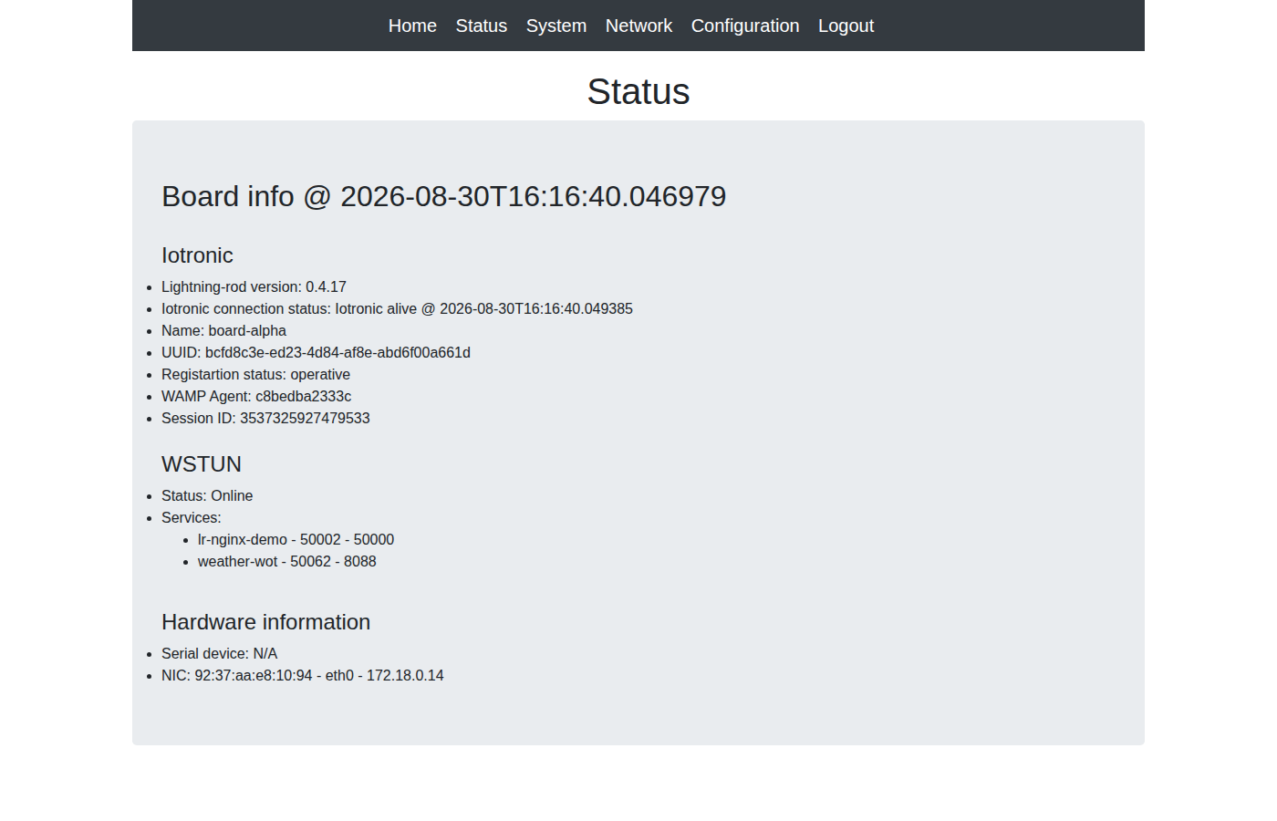
Lightning-Rod — Status (plugin runtime)
Assembling Smart CPS · Stack4Things Training
Screenshot
http://{{VM_IP}}:1474 — Connected board + plugin activity in LR logs
Notes:
Please look at the screenshot on screen: Lightning-Rod — Status (plugin runtime). Walk the class through what they see in the interface. Connect each panel and button to a component we already deployed in the stack. In particular, note the following: http://{{VM_IP}}:1474 — Connected board + plugin activity in LR logs. Take a few seconds to orient before we continue.

Slide 43
THEORY
Ch.14 §14.1.2 · sync operational flow
Sync pipeline — operational flow step by step
▸ Step A: operator triggers Plugin Call in Horizon with JSON payload.
▸ Step B: IoTronic Conductor validates the request and sends a WAMP command to Lightning-Rod.
▸ Step C: LR Plugin Manager loads the injected Worker class and binds self.params from the Call JSON.
▸ Step D: Worker.run() executes once, writes LOG.info, and puts the greeting string on q_result.
▸ Step E: IoTronic receives the result and displays it in Horizon; REST API exposes the same payload.
▸ Any failure in steps B–D surfaces as empty result, LR error log, or WAMP disconnect on Status page.
Assembling Smart CPS · Stack4Things Training
Theory
Notes:
In this slide we cover Sync pipeline — operational flow step by step. This material is covered in Ch.14 §14.1.2 · sync operational flow.
First, regarding step a, operator triggers Plugin Call in Horizon with JSON payload. Next, regarding step b, IoTronic Conductor validates the request and sends a WAMP command to Lightning-Rod.
By contrast, regarding step c, LR Plugin Manager loads the injected Worker class and binds self.params from the Call JSON. We should also consider that regarding step d, worker.run() executes once, writes LOG.info, and puts the greeting string on q_result.
Another key point is that regarding step e, IoTronic receives the result and displays it in Horizon; REST API exposes the same payload. Furthermore, Any failure in steps B–D surfaces as empty result, LR error log, or WAMP disconnect on Status page.
I'll pause here for questions, then we'll continue.

Slide 44
Expected HelloName output and troubleshooting
▸ Horizon Plugin Call result panel: Hello Messina (or your chosen name).
▸ LR container log line: INFO Hello Messina — confirms oslo_log path works.
▸ Empty result → check Worker class name is exactly Worker, not HelloNamePlugin.
▸ No log line → plugin not injected or board not Active; re-run Module A onboarding.
▸ WAMP error → confirm LR Configuration uses wss://crossbar:8181 inside Docker network.
Assembling Smart CPS · Stack4Things Training
Notes:
On this slide, Expected HelloName output and troubleshooting.
First, regarding horizon plugin call result panel, hello Messina (or your chosen name). Next, regarding lr container log line, INFO Hello Messina — confirms oslo_log path works.
By contrast, Empty result, then check Worker class name is exactly Worker, not HelloNamePlugin. We should also consider that No log line, then plugin not injected or board not Active; re-run Module A onboarding.
Another key point is that regarding wamp error → confirm lr configuration uses wss, //crossbar:8181 inside Docker network.
If these objectives are clear, we can proceed.

Slide 45
Optional — Docker plugin at edge
Ch.14 §14.1.4 · container lifecycle
Notes:
We now begin a new section: Optional — Docker plugin at edge. Ch.14 §14.1.4 · container lifecycle. In the next slides, listen for whether we are in theory mode or hands-on mode, and open your terminal when the slides turn to lab work.

Slide 46
THEORY
Ch.14 §14.1.4 · Docker plugin listing
Docker management plugin — design (Ch.14 §14.1.4)
▸ The Docker lifecycle plugin uses docker.from_env() — the official Python SDK talking to the host Docker daemon.
▸ Plugin Call JSON drives operations: run, stop, remove, and inspect on named containers.
▸ run pulls the image if missing, optionally removes an existing same-name container, starts detached, and returns status.
▸ This enables deploying containerized microservices on edge boards without SSH to each device.
▸ Fleet-wide inject can launch the same monitoring sidecar on every board in a coordinated batch.
▸ Listing reference: lst:plugin-docker · ch14/plugins/synchronous/docker_lifecycle_plugin.py.
Assembling Smart CPS · Stack4Things Training
Theory
Notes:
In this slide we cover Docker management plugin — design (Ch.14 §14.1.4). This material is covered in Ch.14 §14.1.4 · Docker plugin listing.
First, The Docker lifecycle plugin uses docker.from_env() — the official Python SDK talking to the host Docker daemon. Next, regarding plugin call json drives operations, run, stop, remove, and inspect on named containers.
By contrast, Run pulls the image if missing, optionally removes an existing same-name container, starts detached, and returns status. We should also consider that This enables deploying containerized microservices on edge boards without SSH to each device.
Another key point is that Fleet-wide inject can launch the same monitoring sidecar on every board in a coordinated batch. Furthermore, regarding listing reference, lst:plugin-docker · ch14/plugins/synchronous/docker_lifecycle_plugin.py.
I'll pause here for questions, then we'll continue.

Slide 47
THEORY
Ch.14 · Docker plugin · lab overlay docker-compose.lab.yml
Docker plugin — lab prerequisites and security
▸ Lightning-Rod must reach /var/run/docker.sock on the host — enabled by training lab overlay mount.
▸ Verify: docker exec lightning-rod ls /var/run/docker.sock — file must exist inside LR container.
▸ Install SDK if missing: docker exec lightning-rod pip install docker
▸ Granting Docker socket access is powerful — production deployments must sandbox and audit plugin code.
▸ Returned JSON includes status, container id, name, and short_logs tail for immediate verification.
▸ stop and remove operations use container_name from params — same field as run for consistency.
Assembling Smart CPS · Stack4Things Training
Theory
Notes:
In this slide we cover Docker plugin — lab prerequisites and security. This material is covered in Ch.14 · Docker plugin · lab overlay docker-compose.lab.yml.
First, Lightning-Rod must reach /var/run/docker.sock on the host — enabled by training lab overlay mount. Next, regarding verify, docker exec lightning-rod ls /var/run/docker.sock — file must exist inside LR container.
By contrast, regarding install sdk if missing, docker exec lightning-rod pip install docker. We should also consider that Granting Docker socket access is powerful — production deployments must sandbox and audit plugin code.
Another key point is that Returned JSON includes status, container id, name, and short_logs tail for immediate verification. Furthermore, Stop and remove operations use container_name from params — same field as run for consistency.
I'll pause here for questions, then we'll continue.

Slide 48
DEMO
Docker plugin — learning outcomes
▸ Prove that synchronous plugins can orchestrate host Docker daemon operations from a Plugin Call JSON payload.
▸ Prove that alpine container starts on the board host and returns id, status, and log tail without SSH.
▸ Prove that edge containerization complements plugin model — microservices beside Python Worker logic.
▸ Optional only — skip if time is short; HelloName deliverable is sufficient for Module B completion.
Assembling Smart CPS · Stack4Things Training
Demo
Notes:
In this demonstration, Docker plugin — learning outcomes.
First, Prove that synchronous plugins can orchestrate host Docker daemon operations from a Plugin Call JSON payload. Next, Prove that alpine container starts on the board host and returns id, status, and log tail without SSH.
By contrast, Prove that edge containerization complements plugin model — microservices beside Python Worker logic. We should also consider that Optional only — skip if time is short; HelloName deliverable is sufficient for Module B completion.
Check that your screen matches what we showed before moving on.

Slide 49
Docker PluginCall — run alpine container
{
"operation": "run",
"image": "alpine",
"container_name": "test_alpine",
"command": "echo Hello from plugin!",
"auto_remove": false
}
Assembling Smart CPS · Stack4Things Training
Code
Notes:
On this slide we walk through the code for Docker PluginCall — run alpine container.
Scroll slowly through the listing on screen while I explain each part.
This JSON is what you paste into the Plugin Call panel. Each field is part of the contract between Horizon and the Docker lifecycle plugin: the operation to perform, the image to run, the container name, and the command to execute inside the container.
After reviewing the code, we'll apply it in the practical exercise.

Slide 50
Docker plugin demo — optional steps
▸ 1. docker exec lightning-rod ls /var/run/docker.sock — confirm socket mount.
▸ 2. docker exec lightning-rod pip install docker (if ImportError on first call).
▸ 3. Create and inject Docker lifecycle plugin from ch14 listing; Callable = ON.
▸ 4. Plugin Call with JSON above → verify status running, container id, short_logs echo line.
Assembling Smart CPS · Stack4Things Training
Notes:
Now we move to the hands-on part: Docker plugin demo — optional steps. Open your lab VM and follow along.
docker exec lightning-rod ls /var/run/docker.sock — confirm socket mount. docker exec lightning-rod pip install docker (if ImportError on first call).
Create and inject Docker lifecycle plugin from ch14 listing; Callable = ON. Plugin Call with JSON above, then verify status running, container id, short_logs echo line.
Raise your hand if you're stuck — we'll wait until most of you are done.
Instructor timing (title): Docker plugin demo — optional steps (15 min)

Slide 51
Fleet, K3s & web services preview
Theory for Modules D, F, and H
Notes:
We now begin a new section: Fleet, K3s & web services preview. Theory for Modules D, F, and H. In the next slides, listen for whether we are in theory mode or hands-on mode, and open your terminal when the slides turn to lab work.

Slide 52
THEORY
Ch.14 §14.2 · fig:fleetpanel · FLEET_MANAGEMENT.md
Fleet abstraction — coordinated edge groups (Ch.14 §14.2)
▸ A fleet is a tenant-aware logical collection of boards — not merely a UI label or tag.
▸ Devices grouped by operational intent act in unison: same plugin, same config, same data collection schedule.
▸ Horizon Fleets panel lists fleets; each fleet has a Plugins tab for bulk inject and lifecycle operations.
▸ Coordinated ops reduce administrative overhead when managing dozens or hundreds of urban sensor stations.
▸ Fleet health metrics include device availability percentage, error rates, and data quality across members.
▸ Full hands-on with three boards and fleet Hello inject: Module D (ModuleD_MultiBoard deck).
Assembling Smart CPS · Stack4Things Training
Theory
Notes:
In this slide we cover Fleet abstraction — coordinated edge groups (Ch.14 §14.2). This material is covered in Ch.14 §14.2 · fig:fleetpanel · FLEET_MANAGEMENT.md.
First, A fleet is a tenant-aware logical collection of boards — not merely a UI label or tag. Next, Devices grouped by operational intent act in unison: same plugin, same config, same data collection schedule.
By contrast, Horizon Fleets panel lists fleets; each fleet has a Plugins tab for bulk inject and lifecycle operations. We should also consider that Coordinated ops reduce administrative overhead when managing dozens or hundreds of urban sensor stations.
Another key point is that Fleet health metrics include device availability percentage, error rates, and data quality across members. Furthermore, Full hands-on with three boards and fleet Hello inject: Module D (ModuleD_MultiBoard deck).
I'll pause here for questions, then we'll continue.

Slide 53
THEORY
Ch.14 §14.2 · fleet-level plugin deployment
Fleet operations — bulk deploy pattern
▸ Create fleet in Horizon with name and description tied to your OpenStack tenant/project.
▸ Associate Active boards as fleet members — heterogeneous device types can share one fleet.
▸ Inject Plugin on fleet deploys the repository plugin to every member in one action.
▸ Sync plugins still require per-board or API-driven Plugin Call unless a orchestration layer batches calls.
▸ Async plugins are started fleet-wide — environmental monitoring on all stations simultaneously.
▸ Book example: weather-monitoring-fleet with shared alert thresholds for temperature and humidity.
Assembling Smart CPS · Stack4Things Training
Theory
Notes:
In this slide we cover Fleet operations — bulk deploy pattern. This material is covered in Ch.14 §14.2 · fleet-level plugin deployment.
First, Create fleet in Horizon with name and description tied to your OpenStack tenant/project. Next, Associate Active boards as fleet members — heterogeneous device types can share one fleet.
By contrast, Inject Plugin on fleet deploys the repository plugin to every member in one action. We should also consider that Sync plugins still require per-board or API-driven Plugin Call unless a orchestration layer batches calls.
Another key point is that Async plugins are started fleet-wide — environmental monitoring on all stations simultaneously. Furthermore, regarding book example, weather-monitoring-fleet with shared alert thresholds for temperature and humidity.
I'll pause here for questions, then we'll continue.

Slide 54
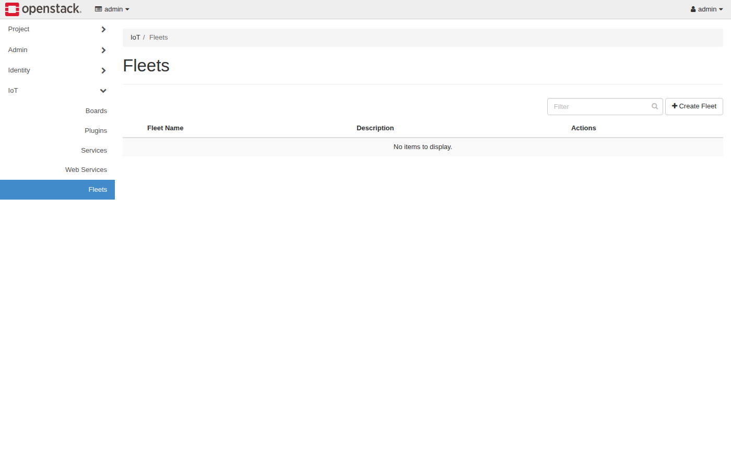
Horizon IoT — Fleets panel
Assembling Smart CPS · Stack4Things Training
Screenshot
http://{{VM_IP}}/horizon/iot/fleets/
Notes:
Please look at the screenshot on screen: Horizon IoT — Fleets panel. Walk the class through what they see in the interface. Connect each panel and button to a component we already deployed in the stack. In particular, note the following: http://{{VM_IP}}/horizon/iot/fleets/. Take a few seconds to orient before we continue.

Slide 55
THEORY
Ch.14 §14.1.5 · lst:plugin-k3s-lifecycle
K3s lifecycle plugin — theory only (Ch.14 §14.1.5)
▸ The K3s plugin is synchronous: operations join, status, and leave against a Kubernetes edge cluster.
▸ join installs a K3s agent on the board pointing at server endpoint URL and cluster join token.
▸ status reports whether the node is registered and ready in the cluster control plane.
▸ leave removes the agent cleanly — enabling dynamic scale-out and scale-in of IoT nodes as K8s workers.
▸ Requires root privileges, working K3s server, and network reachability — not part of the 3-hour core lab.
▸ Hands-on deferred to Module H (Blueprint + K3s) · listing lst:plugin-k3s-lifecycle.
Assembling Smart CPS · Stack4Things Training
Theory
Notes:
In this slide we cover K3s lifecycle plugin — theory only (Ch.14 §14.1.5). This material is covered in Ch.14 §14.1.5 · lst:plugin-k3s-lifecycle.
First, regarding the k3s plugin is synchronous, operations join, status, and leave against a Kubernetes edge cluster. Next, Join installs a K3s agent on the board pointing at server endpoint URL and cluster join token.
By contrast, Status reports whether the node is registered and ready in the cluster control plane. We should also consider that Leave removes the agent cleanly — enabling dynamic scale-out and scale-in of IoT nodes as K8s workers.
Another key point is that Requires root privileges, working K3s server, and network reachability — not part of the 3-hour core lab. Furthermore, Hands-on deferred to Module H (Blueprint + K3s) · listing lst:plugin-k3s-lifecycle.
I'll pause here for questions, then we'll continue.

Slide 56
THEORY
Ch.14 §14.1.5 · Module H preview
K3s at the edge — why it matters for smart CPS
▸ Kubernetes at the edge standardizes packaging, scheduling, and health checks for containerized edge apps.
▸ S4T plugins bridge IoTronic fleet orchestration with K3s node lifecycle without manual SSH provisioning.
▸ Blueprint (Chapter 11) and Crossplane provider patterns extend this to declarative GitOps in advanced modules.
▸ Join token and server URL arrive as Plugin Call JSON params — same contract as HelloName and Docker plugins.
▸ Production smart-city stacks combine LR plugins for sensors with K3s for heavier analytics containers.
▸ Do not attempt K3s join in today's lab VM — theory only to connect Ch.14 listings to Module H roadmap.
Assembling Smart CPS · Stack4Things Training
Theory
Notes:
In this slide we cover K3s at the edge — why it matters for smart CPS. This material is covered in Ch.14 §14.1.5 · Module H preview.
First, Kubernetes at the edge standardizes packaging, scheduling, and health checks for containerized edge apps. Next, S4T plugins bridge IoTronic fleet orchestration with K3s node lifecycle without manual SSH provisioning.
By contrast, Blueprint (Chapter 11) and Crossplane provider patterns extend this to declarative GitOps in advanced modules. We should also consider that Join token and server URL arrive as Plugin Call JSON params — same contract as HelloName and Docker plugins.
Another key point is that Production smart-city stacks combine LR plugins for sensors with K3s for heavier analytics containers. Furthermore, Do not attempt K3s join in today's lab VM — theory only to connect Ch.14 listings to Module H roadmap.
I'll pause here for questions, then we'll continue.

Slide 57
THEORY
Ch.14 §14.3 · WEB_SERVICES_INTEGRATION.md
Web services preview — exposing board HTTP (Ch.14 §14.3)
▸ Stack4Things Web Services expose IoT HTTP endpoints on the public Web without manual router port forwarding.
▸ Designate DNS-as-a-Service assigns a subdomain per board — e.g. weather.board-1.example.com.
▸ NGINX reverse proxy and WebSocket tunnels route HTTPS requests to the board local service port.
▸ Book demo: weather_web_server.py serves GET /sensors, GET /led/status, POST /led/toggle on port 8080.
▸ Connects to Web of Things theory in Chapter 6 — physical sensors as REST resources on the global Web.
▸ Full WSTUN lab demo without Designate DNS: Module F (ModuleF_WebServices_WoT deck).
Assembling Smart CPS · Stack4Things Training
Theory
Notes:
In this slide we cover Web services preview — exposing board HTTP (Ch.14 §14.3). This material is covered in Ch.14 §14.3 · WEB_SERVICES_INTEGRATION.md.
First, Stack4Things Web Services expose IoT HTTP endpoints on the public Web without manual router port forwarding. Next, Designate DNS-as-a-Service assigns a subdomain per board — e.g. weather.board-1.example.com.
By contrast, NGINX reverse proxy and WebSocket tunnels route HTTPS requests to the board local service port. We should also consider that regarding book demo, weather_web_server.py serves GET /sensors, GET /led/status, POST /led/toggle on port 8080.
Another key point is that Connects to Web of Things theory in Chapter 6 — physical sensors as REST resources on the global Web. Furthermore, regarding full wstun lab demo without designate dns, module F (ModuleF_WebServices_WoT deck).
I'll pause here for questions, then we'll continue.

Slide 58
THEORY
Ch.14 · demos/weather_web_server.py · Ch.6 WoT
Web services — weather station WoT endpoints
▸ GET /sensors returns JSON with timestamp, temperature, humidity, and pressure readings.
▸ GET /led/status reports actuator state; POST /led/toggle flips GPIO-driven LED for remote actuation.
▸ Horizon Web Services Manager registers service name and local port per board for tunnel establishment.
▸ WSTUN lab alternative maps cloud public_port (50001–50100) to board local port without DNS registration.
▸ Web-exposed services are long-lived HTTP servers — distinct from one-shot synchronous plugin calls.
▸ Service catalog + ServiceEnable workflow documented in Module F with nginx demo on LR port 50000.
Assembling Smart CPS · Stack4Things Training
Theory
Notes:
In this slide we cover Web services — weather station WoT endpoints. This material is covered in Ch.14 · demos/weather_web_server.py · Ch.6 WoT.
First, GET /sensors returns JSON with timestamp, temperature, humidity, and pressure readings. Next, GET /led/status reports actuator state; POST /led/toggle flips GPIO-driven LED for remote actuation.
By contrast, Horizon Web Services Manager registers service name and local port per board for tunnel establishment. We should also consider that WSTUN lab alternative maps cloud public_port (50001–50100) to board local port without DNS registration.
Another key point is that Web-exposed services are long-lived HTTP servers — distinct from one-shot synchronous plugin calls. Furthermore, Service catalog + ServiceEnable workflow documented in Module F with nginx demo on LR port 50000.
I'll pause here for questions, then we'll continue.

Slide 59
Horizon IoT — Boards with services (preview)
Assembling Smart CPS · Stack4Things Training
Screenshot
http://{{VM_IP}}/horizon/iot/ — web services attach to Active boards · Module F hands-on
Notes:
Please look at the screenshot on screen: Horizon IoT — Boards with services (preview). Walk the class through what they see in the interface. Connect each panel and button to a component we already deployed in the stack. In particular, note the following: http://{{VM_IP}}/horizon/iot/ — web services attach to Active boards · Module F hands-on. Take a few seconds to orient before we continue.

Slide 60
Module B checklist and handoff to Module C
▸ □ HelloName Plugin Call returns Hello <name> in Horizon and LR logs.
▸ □ (Optional) Docker run alpine succeeded with container id in JSON result.
▸ Deliverable: Plugin Call screenshot or docker compose logs lightning-rod | grep Hello snippet.
▸ Next: Module C — async environmental publisher + InfluxDB time-series (Ch.15).
▸ Run validation: cd training && ./validate-lab.sh before starting Module C.
Assembling Smart CPS · Stack4Things Training
Notes:
On this slide, Module B checklist and handoff to Module C.
First, □ HelloName Plugin Call returns Hello <name> in Horizon and LR logs. Next, □ (Optional) Docker run alpine succeeded with container id in JSON result.
By contrast, regarding deliverable, plugin Call screenshot or docker compose logs lightning-rod | grep Hello snippet. We should also consider that regarding next, module C — async environmental publisher + InfluxDB time-series (Ch.15).
Another key point is that regarding run validation, cd training && ./validate-lab.sh before starting Module C.
If these objectives are clear, we can proceed.

