Slide 1
S4T TRAINING
IoT-hosted Computation & Smart-City Services
Module C — IoT-hosted Computation · Ch.15
Lab VM: {{VM_IP}}
Assembling Smart CPS · Part II
Notes:
Welcome. In this module we will work through IoT-hosted Computation & Smart-City Services.
Module C — IoT-hosted Computation · Ch.15 Lab VM: {{VM_IP}}
The session alternates theory from the book with live exercises on the Stack4Things lab VM. Replace the placeholder IP with the address of the machine you are using.
Assembling Smart CPS · Part II.
When you're ready, advance to the first section.

Slide 2
Chapter 15 overview
From middleware to urban observability
Notes:
We now begin a new section: Chapter 15 overview. From middleware to urban observability. In the next slides, listen for whether we are in theory mode or hands-on mode, and open your terminal when the slides turn to lab work.

Slide 3
THEORY
Ch.15 abstract · IoT-hosted computation
Chapter 15 scope — abstract and positioning
▸ Chapter 15 moves from platform deployment (Ch.13) and edge plugins (Ch.14) to an observable urban service.
▸ Environmental monitoring demonstrates an end-to-end workflow: edge acquisition → time-series storage → dashboards.
▸ The chapter frames IoT nodes as software-defined infrastructure — programmable and remotely managed assets.
▸ Chapter 15 emphasizes design principles, three-layer architecture, and real smart-city replication.
▸ The TOO(L)SMART national project provides two deployment models validated across five Italian pilot cities.
▸ Today's lab reproduces the core data path with CSV replay instead of physical sensors on Raspberry Pi hardware.
Assembling Smart CPS · Stack4Things Training
Theory
Notes:
In this slide we cover Chapter 15 scope — abstract and positioning. This material is covered in Ch.15 abstract · IoT-hosted computation.
First, Chapter 15 moves from platform deployment (Ch.13) and edge plugins (Ch.14) to an observable urban service. Next, Environmental monitoring demonstrates an end-to-end workflow: edge acquisition, then time-series storage, then dashboards.
By contrast, The chapter frames IoT nodes as software-defined infrastructure — programmable and remotely managed assets. We should also consider that Chapter 15 emphasizes design principles, three-layer architecture, and real smart-city replication.
Another key point is that The TOO(L)SMART national project provides two deployment models validated across five Italian pilot cities. Furthermore, Today's lab reproduces the core data path with CSV replay instead of physical sensors on Raspberry Pi hardware.
I'll pause here for questions, then we'll continue.

Slide 4
Learning objectives and deliverables
▸ Understand the three-layer architecture: orchestration, execution, and application/storage.
▸ Deploy the async environmental_data plugin writing CSV rows to InfluxDB every 30 seconds.
▸ Query time-series data with Influx CLI — deliverable: rows visible in environmental_data.
▸ Relate the lab demo to TOO(L)SMART smart-city deployment models in Turin and plug-and-play cities.
▸ Horizon login: admin / s4t · InfluxDB ping: http://{{VM_IP}}:8086/ping · LR UI: me / arancino at :1474.
Assembling Smart CPS · Stack4Things Training
Notes:
On this slide, Learning objectives and deliverables.
First, regarding understand the three-layer architecture, orchestration, execution, and application/storage. Next, Deploy the async environmental_data plugin writing CSV rows to InfluxDB every 30 seconds.
By contrast, Query time-series data with Influx CLI — deliverable: rows visible in environmental_data. We should also consider that Relate the lab demo to TOO(L)SMART smart-city deployment models in Turin and plug-and-play cities.
Another key point is that regarding horizon login, admin / s4t · InfluxDB ping: http://{{VM_IP}}:8086/ping · LR UI: me / arancino at :1474.
If these objectives are clear, we can proceed.
Session timing — Module C — 60-minute timeline:

Slide 5
Design principles
Firmware vs plugins · modular edge architecture
Notes:
We now begin a new section: Design principles. Firmware vs plugins · modular edge architecture. In the next slides, listen for whether we are in theory mode or hands-on mode, and open your terminal when the slides turn to lab work.

Slide 6
THEORY
Ch.15 introduction · firmware vs plugin
Firmware vs plugin paradigm — why plugins win (Ch.15 intro)
▸ Traditional firmware embeds logic in flash — updates require physical access, truck rolls, or risky OTA reflashing.
▸ Firmware changes are slow, expensive, and tightly coupled to specific hardware board revisions and pin maps.
▸ Stack4Things plugins deploy at runtime — IoTronic orchestrates upload, inject, start, update, and removal remotely.
▸ Edge logic can iterate daily during a smart-city pilot without touching device flash or rebooting the OS.
▸ The plugin model aligns with I/Ocloud virtualization from Chapter 4 — sensors become callable software functions.
▸ Chapter 15 environmental publisher is the canonical async plugin proving continuous urban data acquisition.
Assembling Smart CPS · Stack4Things Training
Theory
Notes:
In this slide we cover Firmware vs plugin paradigm — why plugins win (Ch.15 intro). This material is covered in Ch.15 introduction · firmware vs plugin.
First, Traditional firmware embeds logic in flash — updates require physical access, truck rolls, or risky OTA reflashing. Next, Firmware changes are slow, expensive, and tightly coupled to specific hardware board revisions and pin maps.
By contrast, Stack4Things plugins deploy at runtime — IoTronic orchestrates upload, inject, start, update, and removal remotely. We should also consider that Edge logic can iterate daily during a smart-city pilot without touching device flash or rebooting the OS.
Another key point is that The plugin model aligns with I/Ocloud virtualization from Chapter 4 — sensors become callable software functions. Furthermore, Chapter 15 environmental publisher is the canonical async plugin proving continuous urban data acquisition.
I'll pause here for questions, then we'll continue.

Slide 7
THEORY
Ch.15 · software-defined edge nodes
Firmware vs plugin — operational comparison
▸ Firmware rollback requires backup partitions or JTAG recovery — plugins rollback by re-injecting prior repository version.
▸ Firmware testing cycles span hardware QA labs; plugin testing uses the same Horizon inject flow as production.
▸ Multiple plugins coexist on one board — environmental, Docker, HelloName — without reflashing monolithic firmware.
▸ Plugin interrupt and remove cleanly stop background loops and release Python resources on Lightning-Rod.
▸ Production Raspberry Pi stations run the same Worker class as today's LR container — only the data source changes.
▸ Physical sensors replace CSV rows; InfluxDB host, measurement name, and 30-second interval stay identical.
Assembling Smart CPS · Stack4Things Training
Theory
Notes:
In this slide we cover Firmware vs plugin — operational comparison. This material is covered in Ch.15 · software-defined edge nodes.
First, Firmware rollback requires backup partitions or JTAG recovery — plugins rollback by re-injecting prior repository version. Next, Firmware testing cycles span hardware QA labs; plugin testing uses the same Horizon inject flow as production.
By contrast, Multiple plugins coexist on one board — environmental, Docker, HelloName — without reflashing monolithic firmware. We should also consider that Plugin interrupt and remove cleanly stop background loops and release Python resources on Lightning-Rod.
Another key point is that Production Raspberry Pi stations run the same Worker class as today's LR container — only the data source changes. Furthermore, Physical sensors replace CSV rows; InfluxDB host, measurement name, and 30-second interval stay identical.
I'll pause here for questions, then we'll continue.

Slide 8
THEORY
Ch.15 § design principles
Design principles — modular plugin architecture (Ch.15)
▸ Modular plugin-based architecture enforces clear separation of concerns across cloud, edge, and storage tiers.
▸ Orchestration (IoTronic) owns lifecycle, multi-tenancy, REST APIs, and Horizon dashboard operations.
▸ Execution (Lightning-Rod) owns Worker loading, WAMP messaging, oslo_log emission, and local I/O access.
▸ Application logic lives inside the plugin — CSV parsing, timestamp assignment, InfluxDB write_points calls.
▸ External time-series storage (InfluxDB) keeps the edge lightweight — no heavy database on constrained boards.
▸ Security sandboxing limits plugin access to declared resources; extensibility adds new Workers without platform forks.
Assembling Smart CPS · Stack4Things Training
Theory
Notes:
In this slide we cover Design principles — modular plugin architecture (Ch.15). This material is covered in Ch.15 § design principles.
First, Modular plugin-based architecture enforces clear separation of concerns across cloud, edge, and storage tiers. Next, Orchestration (IoTronic) owns lifecycle, multi-tenancy, REST APIs, and Horizon dashboard operations.
By contrast, Execution (Lightning-Rod) owns Worker loading, WAMP messaging, oslo_log emission, and local I/O access. We should also consider that Application logic lives inside the plugin — CSV parsing, timestamp assignment, InfluxDB write_points calls.
Another key point is that External time-series storage (InfluxDB) keeps the edge lightweight — no heavy database on constrained boards. Furthermore, Security sandboxing limits plugin access to declared resources; extensibility adds new Workers without platform forks.
I'll pause here for questions, then we'll continue.

Slide 9
THEORY
Ch.15 § design principles · fault tolerance
Design principles — state, fault tolerance, observability
▸ State management uses last_index.state on disk so the plugin resumes CSV replay after restart or crash.
▸ Fault tolerance: failed InfluxDB writes log errors via oslo_log but the loop continues to next row when possible.
▸ Structured logging spans execution layer → centralized IoTronic logs in production deployments.
▸ Lightweight edge plus external DB mirrors smart-city reality — Pi acquisition, cloud-scale storage and Grafana.
▸ Open standards throughout: JSON data points, WAMP control, Docker Compose lab stack, CKAN open-data portals.
▸ These principles directly enabled TOO(L)SMART replication from Turin reference to four plug-and-play cities.
Assembling Smart CPS · Stack4Things Training
Theory
Notes:
In this slide we cover Design principles — state, fault tolerance, observability. This material is covered in Ch.15 § design principles · fault tolerance.
First, State management uses last_index.state on disk so the plugin resumes CSV replay after restart or crash. Next, regarding fault tolerance, failed InfluxDB writes log errors via oslo_log but the loop continues to next row when possible.
By contrast, Structured logging spans execution layer, then centralized IoTronic logs in production deployments. We should also consider that Lightweight edge plus external DB mirrors smart-city reality — Pi acquisition, cloud-scale storage and Grafana.
Another key point is that regarding open standards throughout, JSON data points, WAMP control, Docker Compose lab stack, CKAN open-data portals. Furthermore, These principles directly enabled TOO(L)SMART replication from Turin reference to four plug-and-play cities.
I'll pause here for questions, then we'll continue.

Slide 10
THEORY
Ch.15 § design principles · security sandboxing
Security and sandboxing (Ch.15)
▸ Running arbitrary plugin code requires sandboxing, access control, and signature verification.
▸ Tenant isolation in IoTronic prevents one operator from injecting plugins on another's boards.
▸ LR executes Python Workers with OS-level boundaries — production adds resource limits and auditing.
▸ Digital signatures on uploaded plugins ensure integrity before fleet-wide rollout.
▸ Security-by-design aligns with GDPR and smart-city procurement requirements in TOO(L)SMART.
▸ Lab scope: trusted training environment — production deployments enforce stricter policies.
Assembling Smart CPS · Stack4Things Training
Theory
Notes:
In this slide we cover Security and sandboxing (Ch.15). This material is covered in Ch.15 § design principles · security sandboxing.
First, Running arbitrary plugin code requires sandboxing, access control, and signature verification. Next, Tenant isolation in IoTronic prevents one operator from injecting plugins on another's boards.
By contrast, LR executes Python Workers with OS-level boundaries — production adds resource limits and auditing. We should also consider that Digital signatures on uploaded plugins ensure integrity before fleet-wide rollout.
Another key point is that Security-by-design aligns with GDPR and smart-city procurement requirements in TOO(L)SMART. Furthermore, regarding lab scope, trusted training environment — production deployments enforce stricter policies.
I'll pause here for questions, then we'll continue.

Slide 11
THEORY
Ch.15 abstract · PluginExec tool
PluginExec — local plugin testing (Ch.15)
▸ PluginExec is a command-line tool that simulates plugin execution on the board before cloud inject.
▸ Developers debug Worker.run() locally with mock params and q_result — faster iteration cycle.
▸ Reduces failed inject cycles during smart-city pilot deployments with hundreds of boards.
▸ Same Worker class used in PluginExec and IoTronic inject — behaviour matches production.
▸ Workflow: write → PluginExec test → upload repository → inject → Start on Active board.
▸ Book abstract positions PluginExec as accelerator for plugin-based urban services.
Assembling Smart CPS · Stack4Things Training
Theory
Notes:
In this slide we cover PluginExec — local plugin testing (Ch.15). This material is covered in Ch.15 abstract · PluginExec tool.
First, PluginExec is a command-line tool that simulates plugin execution on the board before cloud inject. Next, Developers debug Worker.run() locally with mock params and q_result — faster iteration cycle.
By contrast, Reduces failed inject cycles during smart-city pilot deployments with hundreds of boards. We should also consider that Same Worker class used in PluginExec and IoTronic inject — behaviour matches production.
Another key point is that regarding workflow, write, then PluginExec test, then upload repository, then inject, then Start on Active board. Furthermore, Book abstract positions PluginExec as accelerator for plugin-based urban services.
I'll pause here for questions, then we'll continue.

Slide 12
THEORY
Ch.15 · tab:meteorological · tab:airquality · plugin_demo listing
Book vs lab environmental JSON schema (Ch.15)
▸ Book measurement environmental_data includes full air-quality set: CO, CO2, O3, NO2, VOC.
▸ Lab CSV subset focuses on Temperature, Humidity, PM2.5, PM10 — sufficient for InfluxDB demo.
▸ Tags: host, source · timestamp: ISO format assigned per row in plugin_demo run loop.
▸ Same InfluxDB line protocol and database name secco — only field cardinality differs.
▸ Production Raspberry Pi stations use identical schema with live sensor drivers instead of CSV.
▸ Tables tab:meteorological and tab:airquality in book define full pilot-city parameter lists.
Assembling Smart CPS · Stack4Things Training
Theory
Notes:
In this slide we cover Book vs lab environmental JSON schema (Ch.15). This material is covered in Ch.15 · tab:meteorological · tab:airquality · plugin_demo listing.
First, Book measurement environmental_data includes full air-quality set: CO, CO2, O3, NO2, VOC. Next, Lab CSV subset focuses on Temperature, Humidity, PM2.5, PM10 — sufficient for InfluxDB demo.
By contrast, regarding tags, host, source · timestamp: ISO format assigned per row in plugin_demo run loop. We should also consider that Same InfluxDB line protocol and database name secco — only field cardinality differs.
Another key point is that Production Raspberry Pi stations use identical schema with live sensor drivers instead of CSV. Furthermore, regarding tables tab, meteorological and tab:airquality in book define full pilot-city parameter lists.
I'll pause here for questions, then we'll continue.

Slide 13
THEORY
Ch.15 § Environmental monitoring · LoRaWAN architecture
LoRaWAN edge-collector-cloud path (Ch.15)
▸ TOO(L)SMART stations often use LoRaWAN: many end nodes → few gateway collectors → cloud.
▸ Gateway placement at urban zone edges mitigates path loss — uniform coverage in dense cities.
▸ S4T LR on collector node runs environmental async plugin — same architecture as today's lab.
▸ LoRaWAN handles low-power wide-area links; InfluxDB and Grafana remain in application tier.
▸ Lab CSV replay simulates collector-acquired rows — swap CSV for LoRa decoder output in production.
▸ Book cites empirical LoRaWAN deployment studies for Turin and other pilot municipalities.
Assembling Smart CPS · Stack4Things Training
Theory
Notes:
In this slide we cover LoRaWAN edge-collector-cloud path (Ch.15). This material is covered in Ch.15 § Environmental monitoring · LoRaWAN architecture.
First, regarding too(l)smart stations often use lorawan, many end nodes, then few gateway collectors, then cloud. Next, Gateway placement at urban zone edges mitigates path loss — uniform coverage in dense cities.
By contrast, S4T LR on collector node runs environmental async plugin — same architecture as today's lab. We should also consider that LoRaWAN handles low-power wide-area links; InfluxDB and Grafana remain in application tier.
Another key point is that Lab CSV replay simulates collector-acquired rows — swap CSV for LoRa decoder output in production. Furthermore, Book cites empirical LoRaWAN deployment studies for Turin and other pilot municipalities.
I'll pause here for questions, then we'll continue.

Slide 14
Three-layer architecture
Orchestration · execution · application
Notes:
We now begin a new section: Three-layer architecture. Orchestration · execution · application. In the next slides, listen for whether we are in theory mode or hands-on mode, and open your terminal when the slides turn to lab work.

Slide 15
THEORY
Ch.15 · fig:chap15 architecture · orchestration layer
Orchestration layer — IoTronic cloud control plane
▸ IoTronic Conductor exposes REST API on port 8812 and Horizon IoT panels for operators and tenants.
▸ It maintains the plugin repository, board registry, injection mappings, and fleet group definitions.
▸ Start, Stop, Interrupt, and Plugin Call commands traverse RabbitMQ and Crossbar WAMP to reach Lightning-Rod.
▸ Multi-tenant isolation follows OpenStack Keystone — each city project sees only its boards and plugins.
▸ Centralized logging aggregation receives LR log streams for cross-fleet troubleshooting without SSH.
▸ Chapter 13 deployed this layer in Module A; Chapter 15 adds async plugin activation on top of it.
Assembling Smart CPS · Stack4Things Training
Theory
Notes:
In this slide we cover Orchestration layer — IoTronic cloud control plane. This material is covered in Ch.15 · fig:chap15 architecture · orchestration layer.
First, IoTronic Conductor exposes REST API on port 8812 and Horizon IoT panels for operators and tenants. Next, It maintains the plugin repository, board registry, injection mappings, and fleet group definitions.
By contrast, Start, Stop, Interrupt, and Plugin Call commands traverse RabbitMQ and Crossbar WAMP to reach Lightning-Rod. We should also consider that Multi-tenant isolation follows OpenStack Keystone — each city project sees only its boards and plugins.
Another key point is that Centralized logging aggregation receives LR log streams for cross-fleet troubleshooting without SSH. Furthermore, Chapter 13 deployed this layer in Module A; Chapter 15 adds async plugin activation on top of it.
I'll pause here for questions, then we'll continue.

Slide 16
THEORY
Ch.15 · execution layer · Lightning-Rod
Execution layer — Lightning-Rod edge agent
▸ Lightning-Rod connects the board to IoTronic via WAMP over wss://crossbar:8181 inside the Docker s4t network.
▸ Plugin Manager loads the Worker class, sets self._is_running for async loops, and routes self.params.
▸ oslo_log LOG.info and LOG.error emit structured messages consumed locally and forwarded centrally in production.
▸ LR container in the lab simulates a physical board — same agent binary used on Raspberry Pi edge nodes.
▸ pip-installed dependencies (influxdb, pandas, requests) must exist inside LR before environmental plugin starts.
▸ Network hostname influxdb resolves on s4t bridge — localhost inside LR does not reach the InfluxDB container.
Assembling Smart CPS · Stack4Things Training
Theory
Notes:
In this slide we cover Execution layer — Lightning-Rod edge agent. This material is covered in Ch.15 · execution layer · Lightning-Rod.
First, Lightning-Rod connects the board to IoTronic via WAMP over wss://crossbar:8181 inside the Docker s4t network. Next, Plugin Manager loads the Worker class, sets self._is_running for async loops, and routes self.params.
By contrast, Oslo_log LOG.info and LOG.error emit structured messages consumed locally and forwarded centrally in production. We should also consider that LR container in the lab simulates a physical board — same agent binary used on Raspberry Pi edge nodes.
Another key point is that Pip-installed dependencies (influxdb, pandas, requests) must exist inside LR before environmental plugin starts. Furthermore, Network hostname influxdb resolves on s4t bridge — localhost inside LR does not reach the InfluxDB container.
I'll pause here for questions, then we'll continue.

Slide 17
THEORY
Ch.15 · application layer · InfluxDB · Grafana · CKAN
Application layer — plugin, storage, visualization
▸ The environmental Worker reads CSV rows, assigns UTC timestamps, and writes InfluxDB points every 30 seconds.
▸ InfluxDB 1.8 stores measurement environmental_data in database secco with admin credentials in the lab overlay.
▸ Grafana dashboards (grafana.json in ch15 repo) visualize air-quality and meteorological fields for operators.
▸ CKAN data portals publish open datasets to citizens — the TOO(L)SMART public-facing tier above raw time-series.
▸ Node-RED flows in full Turin deployment orchestrate alerts and integrations beyond simple storage.
▸ Lab validates the plugin → InfluxDB path; Grafana and CKAN are previewed as production application tier.
Assembling Smart CPS · Stack4Things Training
Theory
Notes:
In this slide we cover Application layer — plugin, storage, visualization. This material is covered in Ch.15 · application layer · InfluxDB · Grafana · CKAN.
First, The environmental Worker reads CSV rows, assigns UTC timestamps, and writes InfluxDB points every 30 seconds. Next, InfluxDB 1.8 stores measurement environmental_data in database secco with admin credentials in the lab overlay.
By contrast, Grafana dashboards (grafana.json in ch15 repo) visualize air-quality and meteorological fields for operators. We should also consider that CKAN data portals publish open datasets to citizens — the TOO(L)SMART public-facing tier above raw time-series.
Another key point is that Node-RED flows in full Turin deployment orchestrate alerts and integrations beyond simple storage. Furthermore, Lab validates the plugin, then InfluxDB path; Grafana and CKAN are previewed as production application tier.
I'll pause here for questions, then we'll continue.

Slide 18
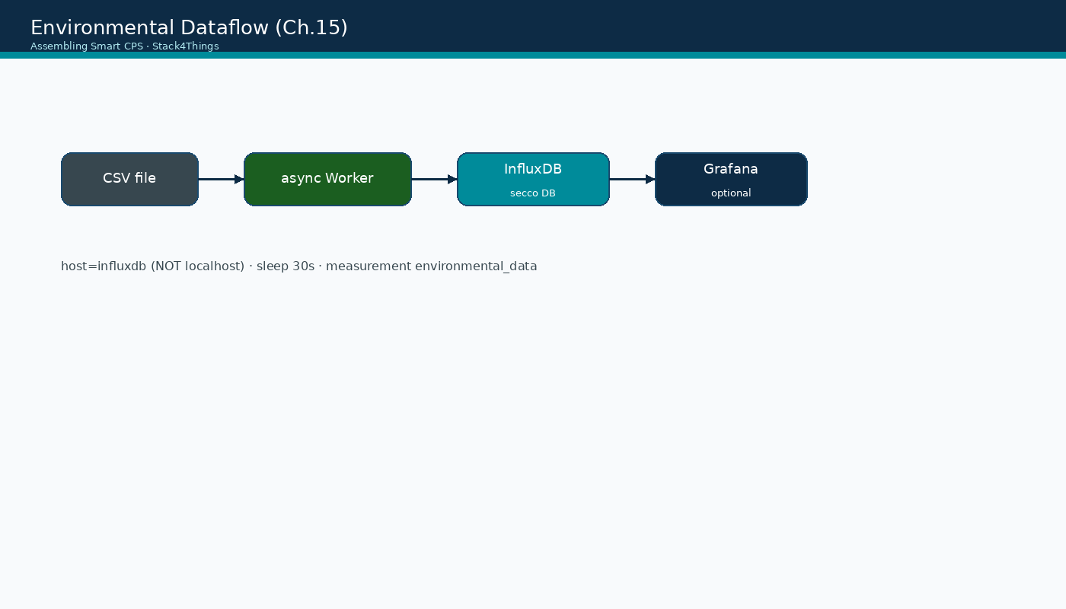
Environmental dataflow (diagram)
Assembling Smart CPS · Stack4Things Training
Diagram
CSV → async Worker → InfluxDB (host=influxdb) → optional Grafana · Ch.15 pipeline
Notes:
Please look at the diagram on screen: Environmental dataflow (diagram). Describe the main boxes and arrows. Relate each element to a Docker service or API you have already seen. In particular, note the following: CSV → async Worker → InfluxDB (host=influxdb) → optional Grafana · Ch.15 pipeline. Take a few seconds to orient before we continue.

Slide 19
Environmental data publisher
Async plugin · Ch.15 listing
Notes:
We now begin a new section: Environmental data publisher. Async plugin · Ch.15 listing. In the next slides, listen for whether we are in theory mode or hands-on mode, and open your terminal when the slides turn to lab work.

Slide 20
THEORY
Ch.15 · environmental data publisher listing
Environmental publisher — purpose and data source
▸ The environmental data publisher simulates a continuous real-time sensor stream by replaying CSV rows.
▸ Each row receives a fresh UTC timestamp at publish time — decoupling historical data from wall-clock acquisition.
▸ In production, Raspberry Pi boards with I2C, SPI, or GPIO sensors replace CSV iloc iteration with live reads.
▸ The plugin is asynchronous: Callable = OFF, activated with Start, runs until Stop or dataset exhaustion.
▸ Repository: github.com/AssemblingSmartCPS/ch15 · lab file: training/ch15-lab/plugin_demo_lab.py.
▸ Measurement name written to InfluxDB: environmental_data — the validation target for today's deliverable.
Assembling Smart CPS · Stack4Things Training
Theory
Notes:
In this slide we cover Environmental publisher — purpose and data source. This material is covered in Ch.15 · environmental data publisher listing.
First, The environmental data publisher simulates a continuous real-time sensor stream by replaying CSV rows. Next, Each row receives a fresh UTC timestamp at publish time — decoupling historical data from wall-clock acquisition.
By contrast, In production, Raspberry Pi boards with I2C, SPI, or GPIO sensors replace CSV iloc iteration with live reads. We should also consider that regarding the plugin is asynchronous, callable = OFF, activated with Start, runs until Stop or dataset exhaustion.
Another key point is that regarding repository, github.com/AssemblingSmartCPS/ch15 · lab file: training/ch15-lab/plugin_demo_lab.py. Furthermore, regarding measurement name written to influxdb, environmental_data — the validation target for today's deliverable.
I'll pause here for questions, then we'll continue.

Slide 21
THEORY
Ch.15 · plugin __init__ · CSV download from Google Drive
Environmental publisher — initialization and CSV handling
▸ On __init__, the Worker ensures /opt/data exists and downloads structured_time_series_v2.csv if missing.
▸ pandas reads the CSV, parses the time column, and fills NaN with zero for safe float conversion.
▸ InfluxDBClient connects with host, port 8086, username admin, password admin, database secco.
▸ create_database ensures secco exists before the run loop begins publishing points.
▸ load_last_index reads last_index.state to resume from the last successfully written row after restart.
▸ Dependencies: influxdb, pandas, requests — install inside LR container before plugin Start.
Assembling Smart CPS · Stack4Things Training
Theory
Notes:
In this slide we cover Environmental publisher — initialization and CSV handling. This material is covered in Ch.15 · plugin __init__ · CSV download from Google Drive.
First, On __init__, the Worker ensures /opt/data exists and downloads structured_time_series_v2.csv if missing. Next, Pandas reads the CSV, parses the time column, and fills NaN with zero for safe float conversion.
By contrast, InfluxDBClient connects with host, port 8086, username admin, password admin, database secco. We should also consider that Create_database ensures secco exists before the run loop begins publishing points.
Another key point is that Load_last_index reads last_index.state to resume from the last successfully written row after restart. Furthermore, regarding dependencies, influxdb, pandas, requests — install inside LR container before plugin Start.
I'll pause here for questions, then we'll continue.

Slide 22
THEORY
Ch.15 · generate_data_point · listing
Environmental publisher — generate_data_point structure
▸ Each InfluxDB point has measurement environmental_data, tags host and source, UTC time, and numeric fields.
▸ Tags identify the station name and source file — enabling multi-station queries in Grafana and CKAN.
▸ Fields include meteorological and air-quality metrics parsed via safe_float from CSV columns.
▸ safe_float strips quotes and returns 0.0 on parse failure — preventing one bad cell from crashing the loop.
▸ write_points sends a single-element list; success logs Row N sent via oslo_log for traceability.
▸ After each write, last_index increments and persists to last_index.state for fault-tolerant resume.
Assembling Smart CPS · Stack4Things Training
Theory
Notes:
In this slide we cover Environmental publisher — generate_data_point structure. This material is covered in Ch.15 · generate_data_point · listing.
First, Each InfluxDB point has measurement environmental_data, tags host and source, UTC time, and numeric fields. Next, Tags identify the station name and source file — enabling multi-station queries in Grafana and CKAN.
By contrast, Fields include meteorological and air-quality metrics parsed via safe_float from CSV columns. We should also consider that Safe_float strips quotes and returns 0.0 on parse failure — preventing one bad cell from crashing the loop.
Another key point is that Write_points sends a single-element list; success logs Row N sent via oslo_log for traceability. Furthermore, After each write, last_index increments and persists to last_index.state for fault-tolerant resume.
I'll pause here for questions, then we'll continue.

Slide 23
InfluxDB and networking
Lab overlay · LR container connectivity
Notes:
We now begin a new section: InfluxDB and networking. Lab overlay · LR container connectivity. In the next slides, listen for whether we are in theory mode or hands-on mode, and open your terminal when the slides turn to lab work.

Slide 24
THEORY
Ch.15 · InfluxDB Docker deployment · lab overlay
InfluxDB in the lab stack — deployment and access
▸ Training overlay docker-compose.lab.yml adds influxdb:1.8 on Docker network s4t alongside S4T services.
▸ Host port 8086 maps to InfluxDB HTTP API — curl http://{{VM_IP}}:8086/ping returns 204 when healthy.
▸ Default credentials: admin / admin — enabled via INFLUXDB_HTTP_AUTH_ENABLED in compose environment.
▸ Database secco stores environmental time-series; _internal is InfluxDB system metadata.
▸ Interactive shell: docker exec -it influxdb influx -username admin -password admin
▸ Book also documents standalone docker run influxdb:1.8 for non-compose deployments.
Assembling Smart CPS · Stack4Things Training
Theory
Notes:
In this slide we cover InfluxDB in the lab stack — deployment and access. This material is covered in Ch.15 · InfluxDB Docker deployment · lab overlay.
First, Training overlay docker-compose.lab.yml adds influxdb:1.8 on Docker network s4t alongside S4T services. Next, Host port 8086 maps to InfluxDB HTTP API — curl http://{{VM_IP}}:8086/ping returns 204 when healthy.
By contrast, regarding default credentials, admin / admin — enabled via INFLUXDB_HTTP_AUTH_ENABLED in compose environment. We should also consider that Database secco stores environmental time-series; _internal is InfluxDB system metadata.
Another key point is that regarding interactive shell, docker exec -it influxdb influx -username admin -password admin. Furthermore, Book also documents standalone docker run influxdb:1.8 for non-compose deployments.
I'll pause here for questions, then we'll continue.

Slide 25
THEORY
Ch.15 · container networking · critical lab fix
LR → InfluxDB networking — why localhost fails
▸ Default ch15 plugin_demo uses host localhost:8086 — this FAILS inside the Lightning-Rod container.
▸ localhost inside LR refers to the LR container itself, where no InfluxDB process listens on 8086.
▸ Fix: self.host = 'influxdb' — Docker embedded DNS on network s4t resolves the InfluxDB service name.
▸ Lab file training/ch15-lab/plugin_demo_lab.py already applies this fix — use it, not raw repo plugin_demo.
▸ Do NOT use host gateway IP (172.17.0.1) — fragile across Docker restarts and compose network changes.
▸ Same hostname pattern as wss://crossbar:8181 from Module A — always use s4t service names inside containers.
Assembling Smart CPS · Stack4Things Training
Theory
Notes:
In this slide we cover LR → InfluxDB networking — why localhost fails. This material is covered in Ch.15 · container networking · critical lab fix.
First, regarding default ch15 plugin_demo uses host localhost, 8086 — this FAILS inside the Lightning-Rod container. Next, Localhost inside LR refers to the LR container itself, where no InfluxDB process listens on 8086.
By contrast, regarding fix, self.host = 'influxdb' — Docker embedded DNS on network s4t resolves the InfluxDB service name. We should also consider that Lab file training/ch15-lab/plugin_demo_lab.py already applies this fix — use it, not raw repo plugin_demo.
Another key point is that Do NOT use host gateway IP (172.17.0.1) — fragile across Docker restarts and compose network changes. Furthermore, regarding same hostname pattern as wss, //crossbar:8181 from Module A — always use s4t service names inside containers.
I'll pause here for questions, then we'll continue.

Slide 26
THEORY
Ch.15 · InfluxDB time-series concepts
InfluxDB data model — measurements, tags, fields, time
▸ InfluxDB 1.x line protocol: measurement, tag set, field set, and timestamp define each point.
▸ Tags (host, source) are indexed strings — use for GROUP BY station in queries and Grafana templates.
▸ Fields (Temperature, PM25, Humidity, …) hold numeric values — the actual sensor readings.
▸ Timestamps are UTC ISO format assigned at publish time in the lab CSV replay scenario.
▸ Retention policies and continuous queries can downsample raw 30-second data for long-term storage.
▸ SHOW MEASUREMENTS and SELECT * FROM environmental_data LIMIT 5 validate successful plugin writes.
Assembling Smart CPS · Stack4Things Training
Theory
Notes:
In this slide we cover InfluxDB data model — measurements, tags, fields, time. This material is covered in Ch.15 · InfluxDB time-series concepts.
First, regarding influxdb 1.x line protocol, measurement, tag set, field set, and timestamp define each point. Next, Tags (host, source) are indexed strings — use for GROUP BY station in queries and Grafana templates.
By contrast, Fields (Temperature, PM25, Humidity, …) hold numeric values — the actual sensor readings. We should also consider that Timestamps are UTC ISO format assigned at publish time in the lab CSV replay scenario.
Another key point is that Retention policies and continuous queries can downsample raw 30-second data for long-term storage. Furthermore, SHOW MEASUREMENTS and SELECT * FROM environmental_data LIMIT 5 validate successful plugin writes.
I'll pause here for questions, then we'll continue.

Slide 27
JSON schema and execution loop
Data model · async run() method
Notes:
We now begin a new section: JSON schema and execution loop. Data model · async run() method. In the next slides, listen for whether we are in theory mode or hands-on mode, and open your terminal when the slides turn to lab work.

Slide 28
THEORY
Ch.15 Table · meteorological JSON fields
JSON data model — meteorological fields (Ch.15)
▸ Temperature records ambient air temperature in degrees Celsius from the CSV replay or live sensor.
▸ Humidity captures relative humidity percentage — critical for comfort and mold-risk urban indicators.
▸ Wind_speed and Wind_direction describe horizontal flow magnitude and compass bearing.
▸ Pressure reports barometric pressure — useful for weather trend analysis across station networks.
▸ Precipitation accumulates rainfall depth — key hydrological input for smart-city flood early warning.
▸ Gust, Light, and UVI extend the meteorological profile for comprehensive station dashboards.
Assembling Smart CPS · Stack4Things Training
Theory
Notes:
In this slide we cover JSON data model — meteorological fields (Ch.15). This material is covered in Ch.15 Table · meteorological JSON fields.
First, Temperature records ambient air temperature in degrees Celsius from the CSV replay or live sensor. Next, Humidity captures relative humidity percentage — critical for comfort and mold-risk urban indicators.
By contrast, Wind_speed and Wind_direction describe horizontal flow magnitude and compass bearing. We should also consider that Pressure reports barometric pressure — useful for weather trend analysis across station networks.
Another key point is that Precipitation accumulates rainfall depth — key hydrological input for smart-city flood early warning. Furthermore, Gust, Light, and UVI extend the meteorological profile for comprehensive station dashboards.
I'll pause here for questions, then we'll continue.

Slide 29
THEORY
Ch.15 Table · air quality JSON · lines 633–664
JSON data model — air quality and particulate fields
▸ PM25, PM10, and PM100 measure particulate matter at 2.5, 10, and 100 micrometer thresholds.
▸ Part03 through Part100 provide size-binned particle count distributions for detailed air-quality studies.
▸ These fields map directly to EU air-quality index reporting used in TOO(L)SMART open-data portals.
▸ CO, CO2, O3, NO2, and VOC appear in the book schema for full stations — lab CSV includes PM and meteo subset.
▸ lat, lon, and alt tags geolocate each reading for map overlays in Grafana and CKAN.
▸ Consistent field naming across cities enabled TOO(L)SMART Model 2 plug-and-play VM replication.
Assembling Smart CPS · Stack4Things Training
Theory
Notes:
In this slide we cover JSON data model — air quality and particulate fields. This material is covered in Ch.15 Table · air quality JSON · lines 633–664.
First, PM25, PM10, and PM100 measure particulate matter at 2.5, 10, and 100 micrometer thresholds. Next, Part03 through Part100 provide size-binned particle count distributions for detailed air-quality studies.
By contrast, These fields map directly to EU air-quality index reporting used in TOO(L)SMART open-data portals. We should also consider that CO, CO2, O3, NO2, and VOC appear in the book schema for full stations — lab CSV includes PM and meteo subset.
Another key point is that Lat, lon, and alt tags geolocate each reading for map overlays in Grafana and CKAN. Furthermore, Consistent field naming across cities enabled TOO(L)SMART Model 2 plug-and-play VM replication.
I'll pause here for questions, then we'll continue.

Slide 30
THEORY
Ch.15 · JSON structure listing · open-data contract
JSON data model — tags, timestamps, and open-data alignment
▸ Tag host identifies the station name from CSV name column — e.g. distinct Turin district stations.
▸ Tag source_file traces provenance to the original CSV segment for audit and debugging.
▸ UTC timestamps on each point align Grafana time axes across time zones in multi-city deployments.
▸ JSON structure in the book listing is the contract CKAN harvesters and Grafana datasources expect.
▸ Lab plugin assigns datetime.utcnow().isoformat() per row — simulating live acquisition cadence.
▸ Production stations use sensor read time or NTP-synchronized board clock for the time field.
Assembling Smart CPS · Stack4Things Training
Theory
Notes:
In this slide we cover JSON data model — tags, timestamps, and open-data alignment. This material is covered in Ch.15 · JSON structure listing · open-data contract.
First, Tag host identifies the station name from CSV name column — e.g. distinct Turin district stations. Next, Tag source_file traces provenance to the original CSV segment for audit and debugging.
By contrast, UTC timestamps on each point align Grafana time axes across time zones in multi-city deployments. We should also consider that JSON structure in the book listing is the contract CKAN harvesters and Grafana datasources expect.
Another key point is that Lab plugin assigns datetime.utcnow().isoformat() per row — simulating live acquisition cadence. Furthermore, Production stations use sensor read time or NTP-synchronized board clock for the time field.
I'll pause here for questions, then we'll continue.

Slide 31
THEORY
Ch.15 · async run() listing
Execution loop — run() method step by step (Ch.15)
▸ run() logs plugin start, InfluxDB target host:port, database name, and resume index.
▸ while self._is_running and self.last_index < len(self.df): fetches the current CSV row by iloc.
▸ generate_data_point(row) builds the InfluxDB dict with measurement, tags, time, and fields.
▸ client.write_points([data_point]) sends the point; success logs Row N sent, failure logs exception.
▸ last_index increments; save_last_index persists progress to /opt/data/last_index.state.
▸ time.sleep(30) waits 30 seconds between publications — matching book cadence and lab timing.
▸ Loop exits when dataset complete or plugin stopped; logs Dataset complete or plugin stopped.
Assembling Smart CPS · Stack4Things Training
Theory
Notes:
In this slide we cover Execution loop — run() method step by step (Ch.15). This material is covered in Ch.15 · async run() listing.
First, regarding run() logs plugin start, influxdb target host, port, database name, and resume index. Next, While self._is_running and self.last_index < len(self.df): fetches the current CSV row by iloc.
By contrast, Generate_data_point(row) builds the InfluxDB dict with measurement, tags, time, and fields. We should also consider that Client.write_points([data_point]) sends the point; success logs Row N sent, failure logs exception.
Another key point is that Last_index increments; save_last_index persists progress to /opt/data/last_index.state. Furthermore, Time.sleep(30) waits 30 seconds between publications — matching book cadence and lab timing.
In addition, Loop exits when dataset complete or plugin stopped; logs Dataset complete or plugin stopped.
I'll pause here for questions, then we'll continue.

Slide 32
THEORY
Ch.15 · plugin activation · Ch.14 lifecycle
Execution loop — timing, Start vs Plugin Call, lifecycle
▸ Async plugins never use Plugin Call for each row — Start launches the entire loop until Stop or Interrupt.
▸ Thirty-second interval means ~2 rows per minute — plan query validation accordingly after 5+ minutes running.
▸ Interrupt sets _is_running False — preferred graceful stop before plugin code update or board maintenance.
▸ Remove injection only after Stop — avoids orphaned write loops holding InfluxDB client connections.
▸ Same seven-step lifecycle from Ch.14 applies: create, inject, start, monitor, update, interrupt, remove.
Assembling Smart CPS · Stack4Things Training
Theory
Notes:
In this slide we cover Execution loop — timing, Start vs Plugin Call, lifecycle. This material is covered in Ch.15 · plugin activation · Ch.14 lifecycle.
First, Async plugins never use Plugin Call for each row — Start launches the entire loop until Stop or Interrupt. Next, Thirty-second interval means ~2 rows per minute — plan query validation accordingly after 5+ minutes running.
By contrast, Interrupt sets _is_running False — preferred graceful stop before plugin code update or board maintenance. We should also consider that Remove injection only after Stop — avoids orphaned write loops holding InfluxDB client connections.
Another key point is that regarding same seven-step lifecycle from ch.14 applies, create, inject, start, monitor, update, interrupt, remove.
I'll pause here for questions, then we'll continue.
Instructor cues:
• Start the plugin by minute 18 of the hands-on block to accumulate rows before Module C wrap-up at minute 52.

Slide 33
Lab: InfluxDB and async plugin
Lab overlay · plugin_demo_lab.py
Notes:
We now begin a new section: Lab: InfluxDB and async plugin. Lab overlay · plugin_demo_lab.py. In the next slides, listen for whether we are in theory mode or hands-on mode, and open your terminal when the slides turn to lab work.
Instructor timing (title): Hands-on — InfluxDB and async plugin

Slide 34
DEMO
Environmental publisher — learning outcomes
▸ Prove async plugins run autonomously without a Plugin Call per data point — validating Module B async theory.
▸ Prove edge LR container publishes time-series to InfluxDB reachable on Docker network s4t at hostname influxdb.
▸ Prove the data model matches TOO(L)SMART air-quality and meteorological schema with environmental_data measurement.
▸ Prove state file resume and oslo_log traceability for production-style fault-tolerant urban monitoring.
▸ Deliverable: at least one SELECT * FROM environmental_data row with Temperature and PM25 fields populated.
Assembling Smart CPS · Stack4Things Training
Demo
Notes:
In this demonstration, Environmental publisher — learning outcomes.
First, Prove async plugins run autonomously without a Plugin Call per data point — validating Module B async theory. Next, Prove edge LR container publishes time-series to InfluxDB reachable on Docker network s4t at hostname influxdb.
By contrast, Prove the data model matches TOO(L)SMART air-quality and meteorological schema with environmental_data measurement. We should also consider that Prove state file resume and oslo_log traceability for production-style fault-tolerant urban monitoring.
Another key point is that regarding deliverable, at least one SELECT * FROM environmental_data row with Temperature and PM25 fields populated.
Check that your screen matches what we showed before moving on.

Slide 35
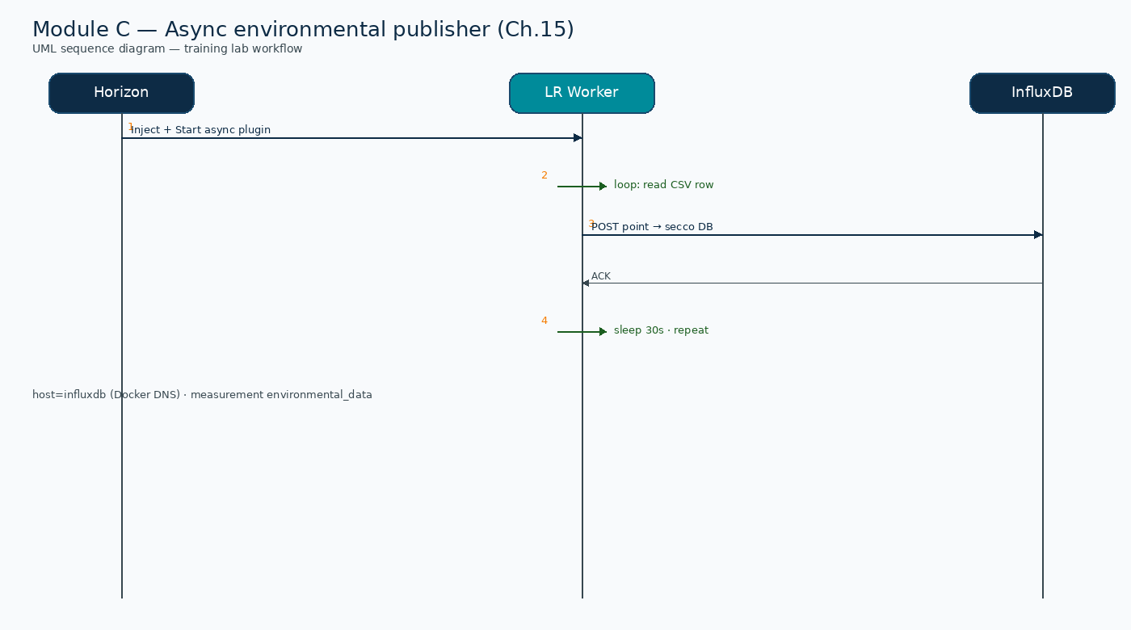
UML sequence — Async environmental publisher (Module C)
Assembling Smart CPS · Stack4Things Training
Diagram
Start plugin → loop CSV → InfluxDB secco.environmental_data every 30s
Notes:
Please look at the sequence diagram on screen: UML sequence — Async environmental publisher (Module C). Trace the diagram from left to right. Name each actor, the protocol used, and the message that crosses the cloud–edge boundary. In particular, note the following: Start plugin → loop CSV → InfluxDB secco.environmental_data every 30s. Take a few seconds to orient before we continue.

Slide 36
Verify InfluxDB
▸ Confirm container influxdb running: docker compose ps | grep influxdb (lab overlay).
▸ curl http://{{VM_IP}}:8086/ping — expect HTTP 204 No Content.
▸ docker exec influxdb influx -username admin -password admin \
▸ -execute 'CREATE DATABASE IF NOT EXISTS secco'
▸ SHOW DATABASES should list secco alongside _internal.
Assembling Smart CPS · Stack4Things Training
Notes:
Now we move to the hands-on part: Verify InfluxDB. Open your lab VM and follow along.
First, regarding confirm container influxdb running, docker compose ps | grep influxdb (lab overlay). Next, regarding curl http, //{{VM_IP}}:8086/ping — expect HTTP 204 No Content.
By contrast, Docker exec influxdb influx -username admin -password admin \. We should also consider that -execute 'CREATE DATABASE IF NOT EXISTS secco'.
Another key point is that SHOW DATABASES should list secco alongside _internal.
Raise your hand if you're stuck — we'll wait until most of you are done.
Instructor timing (title): Step 1 — Verify InfluxDB (5 min)

Slide 37
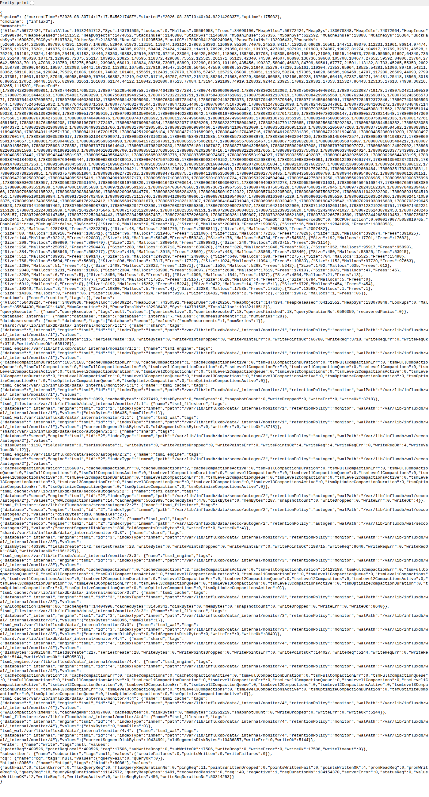
InfluxDB — debug / metrics page
Assembling Smart CPS · Stack4Things Training
Screenshot
http://{{VM_IP}}:8086/debug/vars
Notes:
Please look at the screenshot on screen: InfluxDB — debug / metrics page. Walk the class through what they see in the interface. Connect each panel and button to a component we already deployed in the stack. In particular, note the following: http://{{VM_IP}}:8086/debug/vars. Take a few seconds to orient before we continue.

Slide 38
⚠ BOOK ↔ LAB
LR → InfluxDB networking fix (critical)
▸ Default ch15 plugin uses localhost:8086 — FAILS inside LR container with connection refused.
▸ Fix: self.host = 'influxdb' (Docker DNS on network s4t) — already applied in plugin_demo_lab.py.
▸ Use lab file: training/ch15-lab/plugin_demo_lab.py — not raw training/repos/ch15/plugin_demo.
▸ Do NOT use host IP gateway — fragile across restarts; use s4t service names consistently.
Assembling Smart CPS · Stack4Things Training
Notes:
Before we continue, an important note about LR → InfluxDB networking fix (critical).
First, regarding default ch15 plugin uses localhost, 8086 — FAILS inside LR container with connection refused. Next, regarding fix, self.host = 'influxdb' (Docker DNS on network s4t) — already applied in plugin_demo_lab.py.
By contrast, regarding use lab file, training/ch15-lab/plugin_demo_lab.py — not raw training/repos/ch15/plugin_demo. We should also consider that Do NOT use host IP gateway — fragile across restarts; use s4t service names consistently.
Keep this difference in mind for the rest of the lab.

Slide 39
Install dependencies in LR
▸ docker exec -it lightning-rod pip install influxdb pandas requests
▸ docker exec -it lightning-rod mkdir -p /opt/data
▸ CSV downloads automatically on first plugin start from Google Drive URL in plugin code.
▸ Verify LR on s4t network: docker inspect lightning-rod | grep -A5 Networks
Assembling Smart CPS · Stack4Things Training
Notes:
Now we move to the hands-on part: Install dependencies in LR. Open your lab VM and follow along.
First, Docker exec -it lightning-rod pip install influxdb pandas requests. Next, Docker exec -it lightning-rod mkdir -p /opt/data.
By contrast, CSV downloads automatically on first plugin start from Google Drive URL in plugin code. We should also consider that regarding verify lr on s4t network, docker inspect lightning-rod | grep -A5 Networks.
Raise your hand if you're stuck — we'll wait until most of you are done.
Instructor timing (title): Step 2 — Install dependencies in LR (5 min)

Slide 40
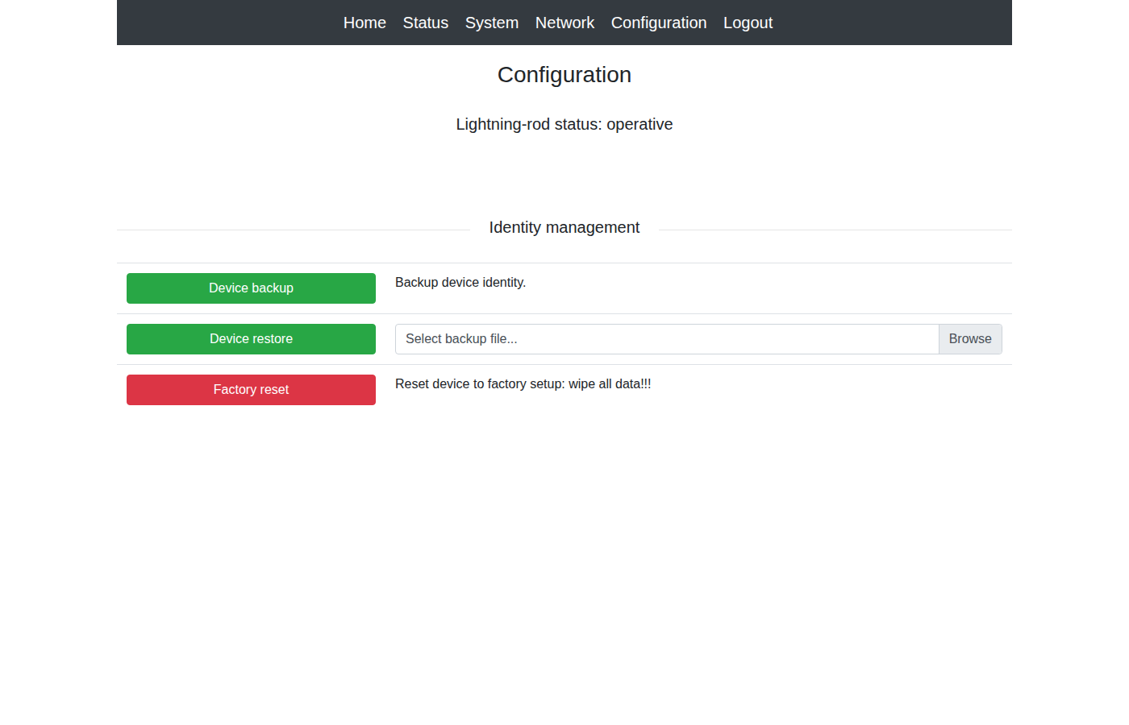
Lightning-Rod — Configuration
Assembling Smart CPS · Stack4Things Training
Screenshot
http://{{VM_IP}}:1474 — async plugin executes inside LR on network s4t
Notes:
Please look at the screenshot on screen: Lightning-Rod — Configuration. Walk the class through what they see in the interface. Connect each panel and button to a component we already deployed in the stack. In particular, note the following: http://{{VM_IP}}:1474 — async plugin executes inside LR on network s4t. Take a few seconds to orient before we continue.

Slide 41
Create and start async plugin
▸ Horizon → Plugins → Create — paste training/ch15-lab/plugin_demo_lab.py source.
▸ Callable = OFF (async) → Submit to repository.
▸ Inject on Active board from Module A → use Start (NOT Plugin Call).
▸ Watch logs: docker compose logs -f lightning-rod — expect Row N sent every 30 seconds.
Assembling Smart CPS · Stack4Things Training
Notes:
Now we move to the hands-on part: Create and start async plugin. Open your lab VM and follow along.
First, Horizon, then Plugins, then Create — paste training/ch15-lab/plugin_demo_lab.py source. Next, Callable = OFF (async), then Submit to repository.
By contrast, Inject on Active board from Module A, then use Start (NOT Plugin Call). We should also consider that regarding watch logs, docker compose logs -f lightning-rod — expect Row N sent every 30 seconds.
Raise your hand if you're stuck — we'll wait until most of you are done.
Instructor timing (title): Step 3 — Create and start async plugin (15 min)

Slide 42
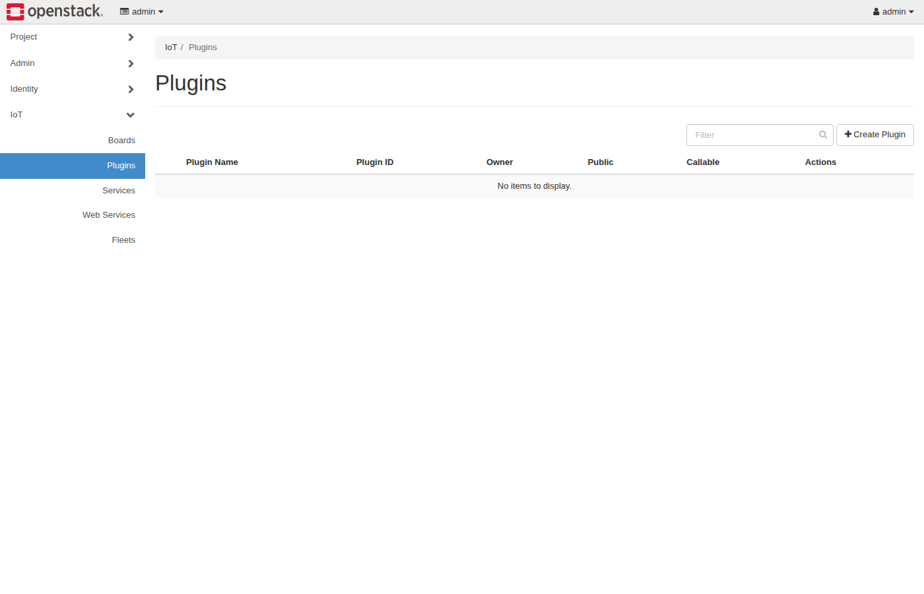
Horizon IoT — Plugins (async Start)
Assembling Smart CPS · Stack4Things Training
Screenshot
http://{{VM_IP}}/horizon/iot/plugins/ — Callable=OFF → Inject → Start
Notes:
Please look at the screenshot on screen: Horizon IoT — Plugins (async Start). Walk the class through what they see in the interface. Connect each panel and button to a component we already deployed in the stack. In particular, note the following: http://{{VM_IP}}/horizon/iot/plugins/ — Callable=OFF → Inject → Start. Take a few seconds to orient before we continue.

Slide 43
Query InfluxDB and validate
▸ docker exec influxdb influx -username admin -password admin -database secco \
▸ -execute 'SELECT * FROM environmental_data ORDER BY time DESC LIMIT 5'
▸ Expected: rows with temperature, humidity fields — verified 4+ points in lab.
$ ./validate/validate-demo-ch15.sh
Assembling Smart CPS · Stack4Things Training
Notes:
Now we move to the hands-on part: Query InfluxDB and validate. Open your lab VM and follow along.
First, Docker exec influxdb influx -username admin -password admin -database secco \. Next, -execute 'SELECT * FROM environmental_data ORDER BY time DESC LIMIT 5'.
By contrast, regarding expected, rows with temperature, humidity fields — verified 4+ points in lab. Please run the following command on your VM: ./validate/validate-demo-ch15.sh. Wait until you see a sensible result before continuing.
Raise your hand if you're stuck — we'll wait until most of you are done.
Instructor timing (title): Step 4 — Query InfluxDB and validate (10 min)

Slide 44
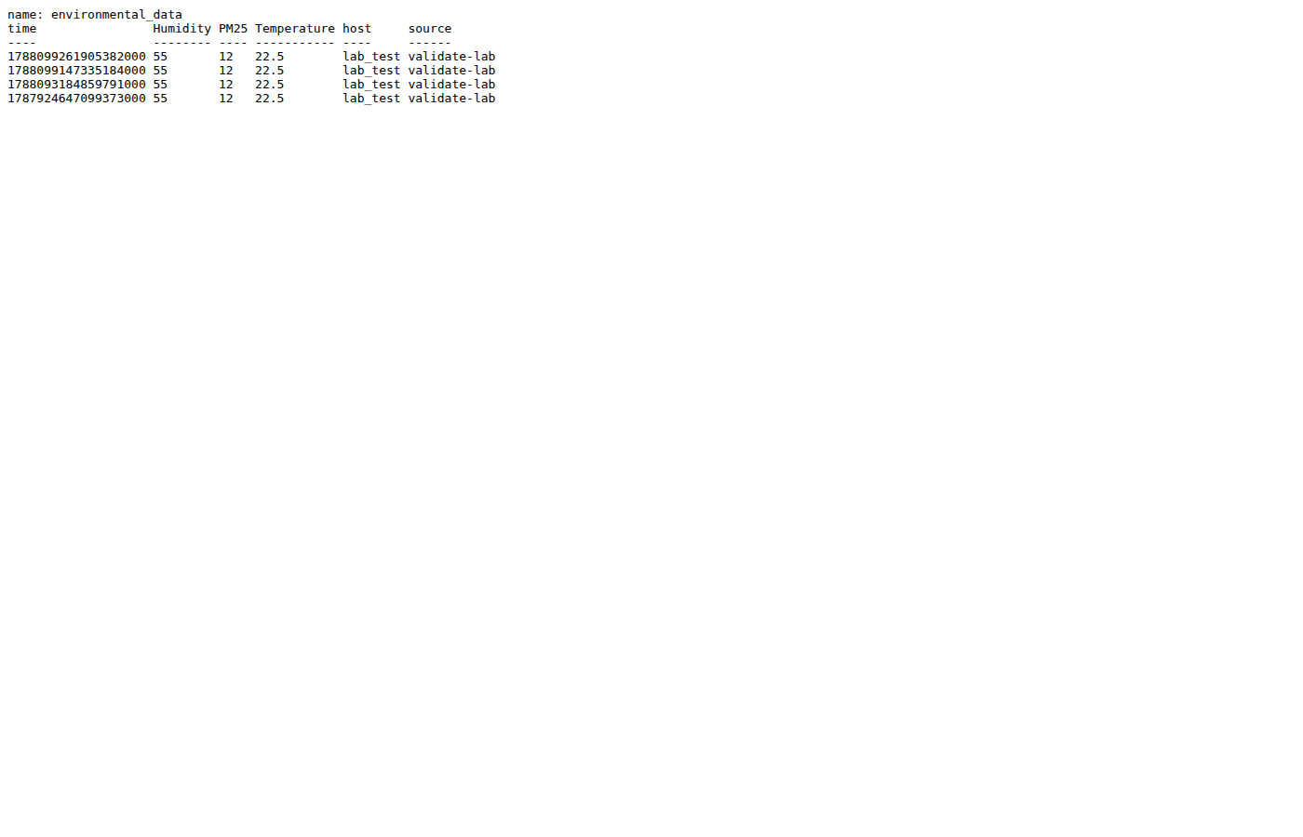
InfluxDB — environmental_data query result
Assembling Smart CPS · Stack4Things Training
Screenshot
Verified query output from Module C demo
Notes:
Please look at the screenshot on screen: InfluxDB — environmental_data query result. Walk the class through what they see in the interface. Connect each panel and button to a component we already deployed in the stack. In particular, note the following: Verified query output from Module C demo. Take a few seconds to orient before we continue.

Slide 45
Lab: troubleshooting — environmental plugin
▸ No rows after 2 min → check plugin Started (not just injected) and LR logs for connection errors.
▸ Connection refused to InfluxDB → confirm self.host = 'influxdb' not localhost in plugin source.
▸ CSV download failed → verify VM has outbound HTTPS to Google Drive; check /opt/data inside LR.
▸ ImportError influxdb → re-run pip install inside lightning-rod container before Start.
▸ Empty measurement → wrong database; confirm USE secco and SHOW MEASUREMENTS output.
Assembling Smart CPS · Stack4Things Training
Notes:
On this slide, Lab: troubleshooting — environmental plugin.
First, No rows after 2 min, then check plugin Started (not just injected) and LR logs for connection errors. Next, Connection refused to InfluxDB, then confirm self.host = 'influxdb' not localhost in plugin source.
By contrast, CSV download failed, then verify VM has outbound HTTPS to Google Drive; check /opt/data inside LR. We should also consider that ImportError influxdb, then re-run pip install inside lightning-rod container before Start.
Another key point is that Empty measurement, then wrong database; confirm USE secco and SHOW MEASUREMENTS output.
If these objectives are clear, we can proceed.
Instructor timing (title): Hands-on troubleshooting — environmental plugin

Slide 46
TOO(L)SMART smart-city case
Ch.15 §15.5 · national replication
Notes:
We now begin a new section: TOO(L)SMART smart-city case. Ch.15 §15.5 · national replication. In the next slides, listen for whether we are in theory mode or hands-on mode, and open your terminal when the slides turn to lab work.

Slide 47
THEORY
Ch.15 §15.5 · TOO(L)SMART
TOO(L)SMART — national smart station network overview
▸ TOO(L)SMART builds a replicable national network of environmental smart stations across Italian cities.
▸ Pilot cities: Turin, Padua, Lecce, Siracusa, and Messina — each with distinct deployment maturity.
▸ Goal: democratize air-quality and meteorological monitoring with open data and standardized edge software.
▸ Stack4Things and IoTronic orchestrate edge nodes; cloud stores time-series and serves CKAN open-data APIs.
▸ Grafana dashboards and Node-RED flows provide operator visualization and alert automation.
▸ Today's lab CSV plugin implements the same Worker pattern deployed on physical Pi stations in the field.
Assembling Smart CPS · Stack4Things Training
Theory
Notes:
In this slide we cover TOO(L)SMART — national smart station network overview. This material is covered in Ch.15 §15.5 · TOO(L)SMART.
First, TOO(L)SMART builds a replicable national network of environmental smart stations across Italian cities. Next, regarding pilot cities, turin, Padua, Lecce, Siracusa, and Messina — each with distinct deployment maturity.
By contrast, regarding goal, democratize air-quality and meteorological monitoring with open data and standardized edge software. We should also consider that Stack4Things and IoTronic orchestrate edge nodes; cloud stores time-series and serves CKAN open-data APIs.
Another key point is that Grafana dashboards and Node-RED flows provide operator visualization and alert automation. Furthermore, Today's lab CSV plugin implements the same Worker pattern deployed on physical Pi stations in the field.
I'll pause here for questions, then we'll continue.

Slide 48
THEORY
Ch.15 · Deployment Model 1 · Turin
Deployment Model 1 — Turin full integration
▸ Turin deployed seven monitoring stations as the reference architecture for the entire national program.
▸ Full stack: S4T, IoTronic, Lightning-Rod, InfluxDB, Grafana, CKAN, Node-RED, and WebSocket tunnels.
▸ Custom integration tied each station to municipal IT, university research networks, and public portals.
▸ Approximately eight months from design to deployment plus one year of operational validation.
▸ Lessons from Turin informed standardized VM bundles used in Model 2 cities.
▸ Turin remains the template for cities willing to invest in deep OpenStack and S4T integration.
Assembling Smart CPS · Stack4Things Training
Theory
Notes:
In this slide we cover Deployment Model 1 — Turin full integration. This material is covered in Ch.15 · Deployment Model 1 · Turin.
First, Turin deployed seven monitoring stations as the reference architecture for the entire national program. Next, regarding full stack, S4T, IoTronic, Lightning-Rod, InfluxDB, Grafana, CKAN, Node-RED, and WebSocket tunnels.
By contrast, Custom integration tied each station to municipal IT, university research networks, and public portals. We should also consider that Approximately eight months from design to deployment plus one year of operational validation.
Another key point is that Lessons from Turin informed standardized VM bundles used in Model 2 cities. Furthermore, Turin remains the template for cities willing to invest in deep OpenStack and S4T integration.
I'll pause here for questions, then we'll continue.

Slide 49
THEORY
Ch.15 · Model 1 · Turin operational validation
Deployment Model 1 — Turin operational outcomes
▸ Continuous environmental_data streams feed municipal air-quality compliance reporting.
▸ Open CKAN datasets enable citizen science apps and academic research on urban pollution.
▸ Centralized IoTronic logging lets operators diagnose station faults without visiting rooftop enclosures.
▸ Plugin remote update deployed new CSV field mappings without hardware changes during pilot extensions.
▸ WebSocket tunnels exposed station maintenance APIs securely through municipal firewalls.
▸ Model 1 proves the three-layer architecture at production scale — not only lab Docker Compose.
Assembling Smart CPS · Stack4Things Training
Theory
Notes:
In this slide we cover Deployment Model 1 — Turin operational outcomes. This material is covered in Ch.15 · Model 1 · Turin operational validation.
First, Continuous environmental_data streams feed municipal air-quality compliance reporting. Next, Open CKAN datasets enable citizen science apps and academic research on urban pollution.
By contrast, Centralized IoTronic logging lets operators diagnose station faults without visiting rooftop enclosures. We should also consider that Plugin remote update deployed new CSV field mappings without hardware changes during pilot extensions.
Another key point is that WebSocket tunnels exposed station maintenance APIs securely through municipal firewalls. Furthermore, Model 1 proves the three-layer architecture at production scale — not only lab Docker Compose.
I'll pause here for questions, then we'll continue.

Slide 50
THEORY
Ch.15 · Deployment Model 2 · VM bundle
Deployment Model 2 — plug-and-play VM bundles
▸ Padua, Lecce, Siracusa, and Messina received pre-configured VM images for rapid city onboarding.
▸ Each bundle ships Controller Node plus Data Portal — minimal custom integration per municipality.
▸ Modularity and virtualization accelerated city-to-city replication from months toward weeks.
▸ Open standards throughout: CKAN for data, WAMP for control, JSON for payloads, Docker for packaging.
▸ Cities with limited OpenStack expertise still join the network without Turin-scale custom engineering.
▸ Environmental Worker and InfluxDB measurement schema are identical across Model 1 and Model 2.
Assembling Smart CPS · Stack4Things Training
Theory
Notes:
In this slide we cover Deployment Model 2 — plug-and-play VM bundles. This material is covered in Ch.15 · Deployment Model 2 · VM bundle.
First, Padua, Lecce, Siracusa, and Messina received pre-configured VM images for rapid city onboarding. Next, Each bundle ships Controller Node plus Data Portal — minimal custom integration per municipality.
By contrast, Modularity and virtualization accelerated city-to-city replication from months toward weeks. We should also consider that regarding open standards throughout, CKAN for data, WAMP for control, JSON for payloads, Docker for packaging.
Another key point is that Cities with limited OpenStack expertise still join the network without Turin-scale custom engineering. Furthermore, Environmental Worker and InfluxDB measurement schema are identical across Model 1 and Model 2.
I'll pause here for questions, then we'll continue.

Slide 51
THEORY
Ch.15 · Model 2 · replication economics
Deployment Model 2 — when cities choose plug-and-play
▸ Smaller municipalities lack dedicated cloud engineers — VM bundles reduce operational skill requirements.
▸ Pre-tested images include Grafana dashboards and CKAN harvesters matching TOO(L)SMART field naming.
▸ Controller Node VM runs IoTronic-facing services; edge Pi boards still run Lightning-Rod and plugins.
▸ Data Portal VM hosts InfluxDB, Grafana, and public APIs — separating acquisition from publication tier.
▸ Upgrade path: cities can migrate from Model 2 bundle toward Model 1 full integration as maturity grows.
▸ Lab Docker Compose is a minimal Model 2 slice — one VM, one LR board, one InfluxDB, one async plugin.
Assembling Smart CPS · Stack4Things Training
Theory
Notes:
In this slide we cover Deployment Model 2 — when cities choose plug-and-play. This material is covered in Ch.15 · Model 2 · replication economics.
First, Smaller municipalities lack dedicated cloud engineers — VM bundles reduce operational skill requirements. Next, Pre-tested images include Grafana dashboards and CKAN harvesters matching TOO(L)SMART field naming.
By contrast, Controller Node VM runs IoTronic-facing services; edge Pi boards still run Lightning-Rod and plugins. We should also consider that Data Portal VM hosts InfluxDB, Grafana, and public APIs — separating acquisition from publication tier.
Another key point is that regarding upgrade path, cities can migrate from Model 2 bundle toward Model 1 full integration as maturity grows. Furthermore, Lab Docker Compose is a minimal Model 2 slice — one VM, one LR board, one InfluxDB, one async plugin.
I'll pause here for questions, then we'll continue.

Slide 52
THEORY
Ch.15 conclusion · TOO(L)SMART lessons
Lessons learned — TOO(L)SMART and Chapter 15
▸ Plugin model enables remote logic updates without physical access — essential for rooftop station maintenance.
▸ Time-series storage plus Grafana dashboards give operators observability missing from raw CSV exports.
▸ Cloud-native OpenStack with IoTronic scales multi-city orchestration under Keystone multi-tenancy.
▸ Lab CSV demo maps one-to-one to Raspberry Pi sensor acquisition — swap data source, keep architecture.
▸ Open-data publication via CKAN closes the loop from edge sensing to citizen-facing urban intelligence.
▸ Software-defined infrastructure turns each station into a remotely programmable cyber-physical asset.
Assembling Smart CPS · Stack4Things Training
Theory
Notes:
In this slide we cover Lessons learned — TOO(L)SMART and Chapter 15. This material is covered in Ch.15 conclusion · TOO(L)SMART lessons.
First, Plugin model enables remote logic updates without physical access — essential for rooftop station maintenance. Next, Time-series storage plus Grafana dashboards give operators observability missing from raw CSV exports.
By contrast, Cloud-native OpenStack with IoTronic scales multi-city orchestration under Keystone multi-tenancy. We should also consider that Lab CSV demo maps one-to-one to Raspberry Pi sensor acquisition — swap data source, keep architecture.
Another key point is that Open-data publication via CKAN closes the loop from edge sensing to citizen-facing urban intelligence. Furthermore, Software-defined infrastructure turns each station into a remotely programmable cyber-physical asset.
I'll pause here for questions, then we'll continue.

Slide 53
3-hour core course wrap-up
▸ Module A (Ch.13): deploy I/Ocloud S4T stack, onboard board to Active state.
▸ Module B (Ch.14): sync HelloName plugin, async theory, optional Docker at edge.
▸ Module C (Ch.15): environmental async publisher → InfluxDB time-series validation.
▸ Extended path (6–9h): Modules D–I — multiboard fleet, VN, web services, FL, Blueprint, FaaS.
▸ See 00_Course_Map_EN.pptx · validate: cd training && ./validate-lab.sh
Assembling Smart CPS · Stack4Things Training
Notes:
On this slide, 3-hour core course wrap-up.
First, regarding module a (ch.13), deploy I/Ocloud S4T stack, onboard board to Active state. Next, regarding module b (ch.14), sync HelloName plugin, async theory, optional Docker at edge.
By contrast, regarding module c (ch.15), environmental async publisher, then InfluxDB time-series validation. We should also consider that regarding extended path (6–9h), modules D–I — multiboard fleet, VN, web services, FL, Blueprint, FaaS.
Another key point is that regarding see 00_course_map_en.pptx · validate, cd training && ./validate-lab.sh.
If these objectives are clear, we can proceed.

Slide 54
Final deliverables checklist
▸ □ Board Active screenshot (Module A).
▸ □ HelloName Plugin Call output in Horizon or LR log (Module B).
▸ □ InfluxDB SELECT * FROM environmental_data LIMIT 5 output (Module C).
▸ Material: training/GUIDA_SETUP_CORSISTI.md · training/HANDS_ON_COMMANDS.md
Assembling Smart CPS · Stack4Things Training
Notes:
On this slide, Final deliverables checklist.
First, □ Board Active screenshot (Module A). Next, □ HelloName Plugin Call output in Horizon or LR log (Module B).
By contrast, □ InfluxDB SELECT * FROM environmental_data LIMIT 5 output (Module C). We should also consider that regarding material, training/GUIDA_SETUP_CORSISTI.md · training/HANDS_ON_COMMANDS.md.
If these objectives are clear, we can proceed.

