Slide 1
S4T TRAINING
Module D — Multi-board & Fleet Operations
Extension · Ch.13–14 · VM {{VM_IP}}
Extension · Ch.14 — Multi-board & Fleet · prerequisite for Module G
Notes:
Welcome. In this module we will work through Module D — Multi-board & Fleet Operations.
Extension · Ch.13–14 · VM {{VM_IP}}
The session alternates theory from the book with live exercises on the Stack4Things lab VM. Replace the placeholder IP with the address of the machine you are using.
Extension · Ch.14 — Multi-board & Fleet · prerequisite for Module G.
When you're ready, advance to the first section.

Slide 2
Why multiple boards?
Fleet theory before scaling the lab
Notes:
We now begin a new section: Why multiple boards?. Fleet theory before scaling the lab. In the next slides, listen for whether we are in theory mode or hands-on mode, and open your terminal when the slides turn to lab work.

Slide 3
THEORY
Ch.13 multi-board note · Ch.14 fleet abstract
Scaling from one board to a fleet (Ch.13–14)
▸ Real S4T deployments manage hundreds of heterogeneous boards across sites
▸ Each board = one Lightning-Rod instance with unique IoTronic registration code
▸ Lab simulates 3 boards via lightning-rod, lightning-rod-2, lightning-rod-3 containers
▸ Same cloud IoTronic Conductor manages all boards under one Keystone tenant
▸ Multi-board topology mirrors TOO(L)SMART multi-station urban deployments (Ch.15)
▸ Book repo ch13 documents docker-compose scaling pattern used in this module
Assembling Smart CPS · Stack4Things Training
Theory
Notes:
In this slide we cover Scaling from one board to a fleet (Ch.13–14). This material is covered in Ch.13 multi-board note · Ch.14 fleet abstract.
First, Real S4T deployments manage hundreds of heterogeneous boards across sites. Next, Each board = one Lightning-Rod instance with unique IoTronic registration code.
By contrast, Lab simulates 3 boards via lightning-rod, lightning-rod-2, lightning-rod-3 containers. We should also consider that Same cloud IoTronic Conductor manages all boards under one Keystone tenant.
Another key point is that Multi-board topology mirrors TOO(L)SMART multi-station urban deployments (Ch.15). Furthermore, Book repo ch13 documents docker-compose scaling pattern used in this module.
I'll pause here for questions, then we'll continue.

Slide 4
THEORY
Ch.13 § Lightning-Rod configuration · fig:chap13:lr-conf
Lightning-Rod instance isolation (Ch.13)
▸ Each LR container binds a distinct host port (:1474, :1475, :1476) for its Web UI
▸ WAMP connection shares crossbar:8181 — IoTronic distinguishes boards by registration
▸ Board metadata (name, UUID, status) stored in IoTronic MariaDB — not in LR container
▸ Plugin inject targets a specific board UUID or an entire fleet collection
▸ Credentials per LR dashboard: me / arancino — same pattern on all three instances
▸ Active state requires successful WAMP handshake + heartbeat to Conductor
Assembling Smart CPS · Stack4Things Training
Theory
Notes:
In this slide we cover Lightning-Rod instance isolation (Ch.13). This material is covered in Ch.13 § Lightning-Rod configuration · fig:chap13:lr-conf.
First, regarding each lr container binds a distinct host port (, 1474, :1475, :1476) for its Web UI. Next, regarding wamp connection shares crossbar, 8181 — IoTronic distinguishes boards by registration.
By contrast, Board metadata (name, UUID, status) stored in IoTronic MariaDB — not in LR container. We should also consider that Plugin inject targets a specific board UUID or an entire fleet collection.
Another key point is that regarding credentials per lr dashboard, me / arancino — same pattern on all three instances. Furthermore, Active state requires successful WAMP handshake + heartbeat to Conductor.
I'll pause here for questions, then we'll continue.

Slide 5
THEORY
Ch.13 § board onboarding · listing create_board
Board registration workflow recap (Ch.13)
▸ Horizon IoT → Create Board → copy one-time registration code
▸ LR Configuration page: paste code, set WAMP URL wss://crossbar:8181, save
▸ Board transitions: Created → Registering → Active (or Error if misconfigured)
▸ Three boards in this module: board-alpha, board-beta, board-gamma
▸ Each board gets independent plugin namespace — inject does not cross boards unless fleet
▸ REST API mirror: GET /v1/boards/ lists all registered boards with status field
Assembling Smart CPS · Stack4Things Training
Theory
Notes:
In this slide we cover Board registration workflow recap (Ch.13). This material is covered in Ch.13 § board onboarding · listing create_board.
First, Horizon IoT, then Create Board, then copy one-time registration code. Next, regarding lr configuration page, paste code, set WAMP URL wss://crossbar:8181, save.
By contrast, regarding board transitions, created, then Registering, then Active (or Error if misconfigured). We should also consider that regarding three boards in this module, board-alpha, board-beta, board-gamma.
Another key point is that Each board gets independent plugin namespace — inject does not cross boards unless fleet. Furthermore, regarding rest api mirror, GET /v1/boards/ lists all registered boards with status field.
I'll pause here for questions, then we'll continue.

Slide 6
THEORY
Ch.14 §14.2 · Stack4Things fleet management
Fleet abstraction in depth (Ch.14 §14.2)
▸ Fleet ≠ trivial label — semantically meaningful collection of IoT devices
▸ Tenant-aware grouping under OpenStack Keystone multi-tenancy model
▸ Members act in unison: one fleet-level inject reaches ALL boards in the fleet
▸ Absence or failure of one member can affect fleet-level application behaviour
▸ Fleet metadata editable: name, description, member add/remove without re-registering boards
▸ Book figures: fig:fleetpanel, fig:fleetpanelCreation, fig:fleetinjPop
Assembling Smart CPS · Stack4Things Training
Theory
Notes:
In this slide we cover Fleet abstraction in depth (Ch.14 §14.2). This material is covered in Ch.14 §14.2 · Stack4Things fleet management.
First, Fleet ≠ trivial label — semantically meaningful collection of IoT devices. Next, Tenant-aware grouping under OpenStack Keystone multi-tenancy model.
By contrast, regarding members act in unison, one fleet-level inject reaches ALL boards in the fleet. We should also consider that Absence or failure of one member can affect fleet-level application behaviour.
Another key point is that regarding fleet metadata editable, name, description, member add/remove without re-registering boards. Furthermore, regarding book figures, fig:fleetpanel, fig:fleetpanelCreation, fig:fleetinjPop.
I'll pause here for questions, then we'll continue.

Slide 7
THEORY
Ch.14 bulk plugin deployment · fig:fleetinjPop
Fleet vs individual board operations (Ch.14)
▸ Individual inject: fine-grained control, debugging one misbehaving board
▸ Fleet inject: operational efficiency at scale — one UI action, N boards updated
▸ Same Worker Python code runs on each LR independently after fleet inject
▸ Plugin Call (sync) still per-board unless custom fleet orchestration API used
▸ Fleet delete removes grouping only — boards remain registered and Active
▸ Production pattern: dev/test on single board → promote inject to fleet for rollout
Assembling Smart CPS · Stack4Things Training
Theory
Notes:
In this slide we cover Fleet vs individual board operations (Ch.14). This material is covered in Ch.14 bulk plugin deployment · fig:fleetinjPop.
First, regarding individual inject, fine-grained control, debugging one misbehaving board. Next, regarding fleet inject, operational efficiency at scale — one UI action, N boards updated.
By contrast, Same Worker Python code runs on each LR independently after fleet inject. We should also consider that Plugin Call (sync) still per-board unless custom fleet orchestration API used.
Another key point is that Fleet delete removes grouping only — boards remain registered and Active. Furthermore, regarding production pattern, dev/test on single board, then promote inject to fleet for rollout.
I'll pause here for questions, then we'll continue.

Slide 8
THEORY
Ch.14 § Stack4Things fleets · Horizon IoT dashboard
Horizon fleet UI workflow (Ch.14)
▸ Fleets panel: http://{{VM_IP}}/horizon/iot/fleets/ — create, filter, edit, delete
▸ Create Fleet: name + description → add member boards from Active board list
▸ Fleet detail → Plugins tab: inject / update / remove on ALL fleet members at once
▸ Boards panel remains for device-level troubleshooting and individual actions
▸ Horizon login: admin / s4t — same tenant sees all boards and fleets
▸ Screenshots in deck captured from live lab — regenerate via capture_dashboards.py
Assembling Smart CPS · Stack4Things Training
Theory
Notes:
In this slide we cover Horizon fleet UI workflow (Ch.14). This material is covered in Ch.14 § Stack4Things fleets · Horizon IoT dashboard.
First, regarding fleets panel, http://{{VM_IP}}/horizon/iot/fleets/ — create, filter, edit, delete. Next, regarding create fleet, name + description, then add member boards from Active board list.
By contrast, regarding fleet detail → plugins tab, inject / update / remove on ALL fleet members at once. We should also consider that Boards panel remains for device-level troubleshooting and individual actions.
Another key point is that regarding horizon login, admin / s4t — same tenant sees all boards and fleets. Furthermore, Screenshots in deck captured from live lab — regenerate via capture_dashboards.py.
I'll pause here for questions, then we'll continue.

Slide 9
THEORY
Ch.14 §14.1 plugin lifecycle · fleet inject listing
Plugin inject on fleet — execution model (Ch.14)
▸ IoTronic sends inject command to each fleet member's Lightning-Rod concurrently
▸ Each LR Plugin Manager loads Worker class independently — no shared process
▸ Sync plugin (HelloName): after fleet inject, Plugin Call is still one board at a time
▸ Async plugin: Start on fleet would launch background loop on every member simultaneously
▸ Fleet inject failure on one member: check that board's LR logs before retrying fleet action
▸ Module G (FL) uses per-board async inject — fleet inject not used for Flower clients
Assembling Smart CPS · Stack4Things Training
Theory
Notes:
In this slide we cover Plugin inject on fleet — execution model (Ch.14). This material is covered in Ch.14 §14.1 plugin lifecycle · fleet inject listing.
First, IoTronic sends inject command to each fleet member's Lightning-Rod concurrently. Next, Each LR Plugin Manager loads Worker class independently — no shared process.
By contrast, regarding sync plugin (helloname), after fleet inject, Plugin Call is still one board at a time. We should also consider that regarding async plugin, start on fleet would launch background loop on every member simultaneously.
Another key point is that regarding fleet inject failure on one member, check that board's LR logs before retrying fleet action. Furthermore, Module G (FL) uses per-board async inject — fleet inject not used for Flower clients.
I'll pause here for questions, then we'll continue.

Slide 10
THEORY
Ch.14 §14.2 · supported fleet operations · fig:fleetinjPop
Fleet operations beyond inject (Ch.14 §14.2)
▸ Fleet-level async Start launches background plugins on all members simultaneously.
▸ Fleet update pushes revised plugin source to every attached board in one operation.
▸ Fleet remove detaches plugin from all members — boards remain Active in Horizon.
▸ Fleet health: absence or failure of one member can break fleet-level application logic.
▸ REST API mirrors Horizon: fleet CRUD and bulk plugin operations via Conductor.
▸ Lab focuses on sync HelloName fleet inject — async fleet Start is production pattern for Ch.15.
Assembling Smart CPS · Stack4Things Training
Theory
Notes:
In this slide we cover Fleet operations beyond inject (Ch.14 §14.2). This material is covered in Ch.14 §14.2 · supported fleet operations · fig:fleetinjPop.
First, Fleet-level async Start launches background plugins on all members simultaneously. Next, Fleet update pushes revised plugin source to every attached board in one operation.
By contrast, Fleet remove detaches plugin from all members — boards remain Active in Horizon. We should also consider that regarding fleet health, absence or failure of one member can break fleet-level application logic.
Another key point is that regarding rest api mirrors horizon, fleet CRUD and bulk plugin operations via Conductor. Furthermore, Lab focuses on sync HelloName fleet inject — async fleet Start is production pattern for Ch.15.
I'll pause here for questions, then we'll continue.

Slide 11
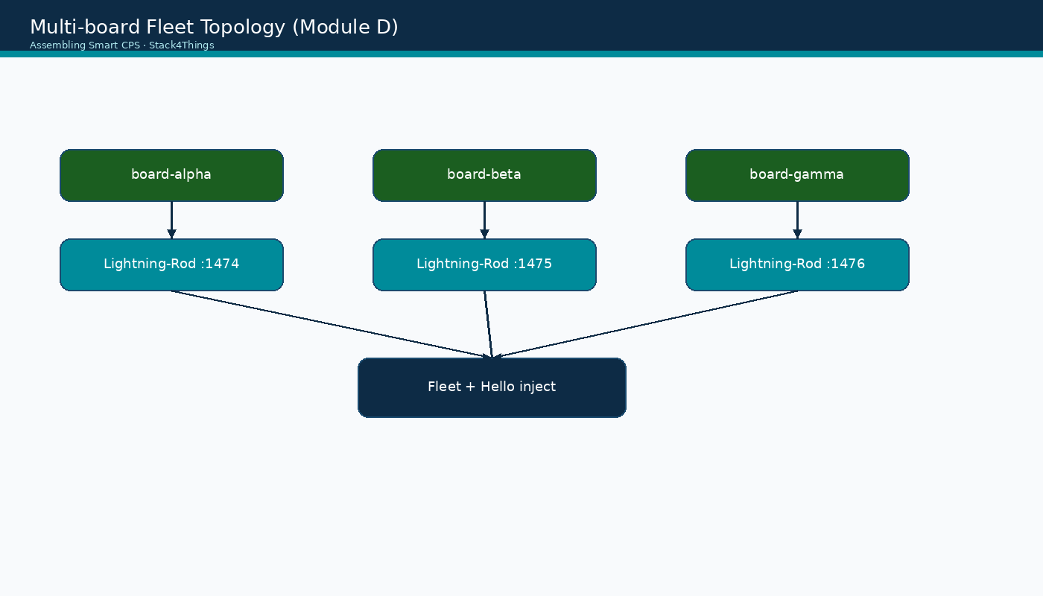
Multi-board fleet topology
Assembling Smart CPS · Stack4Things Training
Diagram
Three LR instances → one IoTronic Conductor → fleet-level plugin inject
Notes:
Please look at the diagram on screen: Multi-board fleet topology. Describe the main boxes and arrows. Relate each element to a Docker service or API you have already seen. In particular, note the following: Three LR instances → one IoTronic Conductor → fleet-level plugin inject. Take a few seconds to orient before we continue.

Slide 12
Module D — learning objectives
▸ Start lightning-rod-2 and lightning-rod-3 on host ports 1475 and 1476
▸ Register board-alpha, board-beta, board-gamma — all Active in Horizon
▸ Create a fleet containing all three boards
▸ Fleet inject HelloName sync plugin; verify Plugin Call on each board
▸ Pass validate-lab-multiboard.sh — prerequisite for Module G Federated Learning
Assembling Smart CPS · Stack4Things Training
Notes:
On this slide, Module D — learning objectives.
First, Start lightning-rod-2 and lightning-rod-3 on host ports 1475 and 1476. Next, Register board-alpha, board-beta, board-gamma — all Active in Horizon.
By contrast, Create a fleet containing all three boards. We should also consider that Fleet inject HelloName sync plugin; verify Plugin Call on each board.
Another key point is that Pass validate-lab-multiboard.sh — prerequisite for Module G Federated Learning.
If these objectives are clear, we can proceed.

Slide 13
DEMO
What this module proves — demo goals
▸ Same IoTronic Conductor orchestrates multiple edge agents concurrently
▸ Fleet inject deploys identical plugin logic to all members in one Horizon action
▸ Each board maintains independent LR runtime — fleet is logical grouping only
▸ Prerequisite satisfied for Module G: 3 Active clients on separate boards for FL
▸ Mirrors production rollout: test plugin on one board → fleet inject for deployment
▸ Students can articulate difference between board inject and fleet inject
Assembling Smart CPS · Stack4Things Training
Demo
Notes:
In this demonstration, What this module proves — demo goals.
First, Same IoTronic Conductor orchestrates multiple edge agents concurrently. Next, Fleet inject deploys identical plugin logic to all members in one Horizon action.
By contrast, Each board maintains independent LR runtime — fleet is logical grouping only. We should also consider that regarding prerequisite satisfied for module g, 3 Active clients on separate boards for FL.
Another key point is that regarding mirrors production rollout, test plugin on one board, then fleet inject for deployment. Furthermore, Students can articulate difference between board inject and fleet inject.
Check that your screen matches what we showed before moving on.
Session timing — Module D — 45-minute timeline:

Slide 14
Lab: start extra Lightning-Rod instances
Docker Compose lab overlay
Notes:
We now begin a new section: Lab: start extra Lightning-Rod instances. Docker Compose lab overlay. In the next slides, listen for whether we are in theory mode or hands-on mode, and open your terminal when the slides turn to lab work.
Instructor timing (title): Hands-on — start extra Lightning-Rod instances

Slide 15
Start LR-2 and LR-3 containers
$ cd training/repos/ch13
$ docker compose -f docker-compose.yml \
▸ -f ../../patches/docker-compose.lab.yml up -d lightning-rod-2 lightning-rod-3
$ training/experiments/multiboard/check-endpoints.sh
▸ Expected: HTTP 200 on {{VM_IP}}:1475 and {{VM_IP}}:1476
Assembling Smart CPS · Stack4Things Training
Notes:
Now we move to the hands-on part: Start LR-2 and LR-3 containers. Open your lab VM and follow along.
Please run the following command on your VM: cd training/repos/ch13. Wait until you see a sensible result before continuing. Please run the following command on your VM: docker compose -f docker-compose.yml \. Wait until you see a sensible result before continuing.
By contrast, -f ../../patches/docker-compose.lab.yml up -d lightning-rod-2 lightning-rod-3. Please run the following command on your VM: training/experiments/multiboard/check-endpoints.sh. Wait until you see a sensible result before continuing.
Another key point is that regarding expected, HTTP 200 on {{VM_IP}}:1475 and {{VM_IP}}:1476.
Raise your hand if you're stuck — we'll wait until most of you are done.
Instructor timing (title): Step 1 — Start LR-2 and LR-3 containers

Slide 16
THEORY
training/patches/docker-compose.lab.yml · ch13 repo
Lab compose port mapping (Ch.13 patch)
▸ docker-compose.lab.yml adds lightning-rod-2 → host :1475, lightning-rod-3 → :1476
▸ Default lightning-rod (instance 1) remains on :1474 from Module A
▸ All three share iotronic-network — WAMP crossbar reachable as wss://crossbar:8181
▸ check-endpoints.sh verifies UI reachability before board registration begins
▸ Container names: lightning-rod, lightning-rod-2, lightning-rod-3 — distinct hostnames
▸ If port conflict: ensure no other service bound to 1475/1476 on lab VM
Assembling Smart CPS · Stack4Things Training
Theory
Notes:
In this slide we cover Lab compose port mapping (Ch.13 patch). This material is covered in training/patches/docker-compose.lab.yml · ch13 repo.
First, Docker-compose.lab.yml adds lightning-rod-2, then host :1475, lightning-rod-3, then :1476. Next, regarding default lightning-rod (instance 1) remains on, 1474 from Module A.
By contrast, All three share iotronic-network — WAMP crossbar reachable as wss://crossbar:8181. We should also consider that Check-endpoints.sh verifies UI reachability before board registration begins.
Another key point is that regarding container names, lightning-rod, lightning-rod-2, lightning-rod-3 — distinct hostnames. Furthermore, regarding if port conflict, ensure no other service bound to 1475/1476 on lab VM.
I'll pause here for questions, then we'll continue.

Slide 17
Lab: register three boards in Horizon
Create Board × 3
Notes:
We now begin a new section: Lab: register three boards in Horizon. Create Board × 3. In the next slides, listen for whether we are in theory mode or hands-on mode, and open your terminal when the slides turn to lab work.
Instructor timing (title): Hands-on — register three boards in Horizon

Slide 18
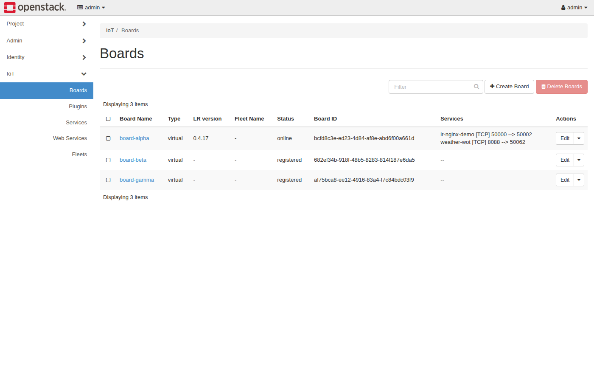
Horizon IoT — Boards dashboard (create 3 boards)
Assembling Smart CPS · Stack4Things Training
Screenshot
http://{{VM_IP}}/horizon/iot/ → Create Board × 3 · login admin / s4t
Notes:
Please look at the screenshot on screen: Horizon IoT — Boards dashboard (create 3 boards). Walk the class through what they see in the interface. Connect each panel and button to a component we already deployed in the stack. In particular, note the following: http://{{VM_IP}}/horizon/iot/ → Create Board × 3 · login admin / s4t. Take a few seconds to orient before we continue.

Slide 19
Create three boards in Horizon
▸ Open http://{{VM_IP}}/horizon/iot/ — login admin / s4t
▸ Create Board: board-alpha → copy registration code to notepad
▸ Create Board: board-beta → copy registration code
▸ Create Board: board-gamma → copy registration code
▸ Do NOT reuse codes — each board gets a unique one-time registration token
Assembling Smart CPS · Stack4Things Training
Notes:
Now we move to the hands-on part: Create three boards in Horizon. Open your lab VM and follow along.
First, regarding open http, //{{VM_IP}}/horizon/iot/ — login admin / s4t. Next, regarding create board, board-alpha, then copy registration code to notepad.
By contrast, regarding create board, board-beta, then copy registration code. We should also consider that regarding create board, board-gamma, then copy registration code.
Another key point is that Do NOT reuse codes — each board gets a unique one-time registration token.
Raise your hand if you're stuck — we'll wait until most of you are done.
Instructor timing (title): Step 2 — Create three boards in Horizon

Slide 20
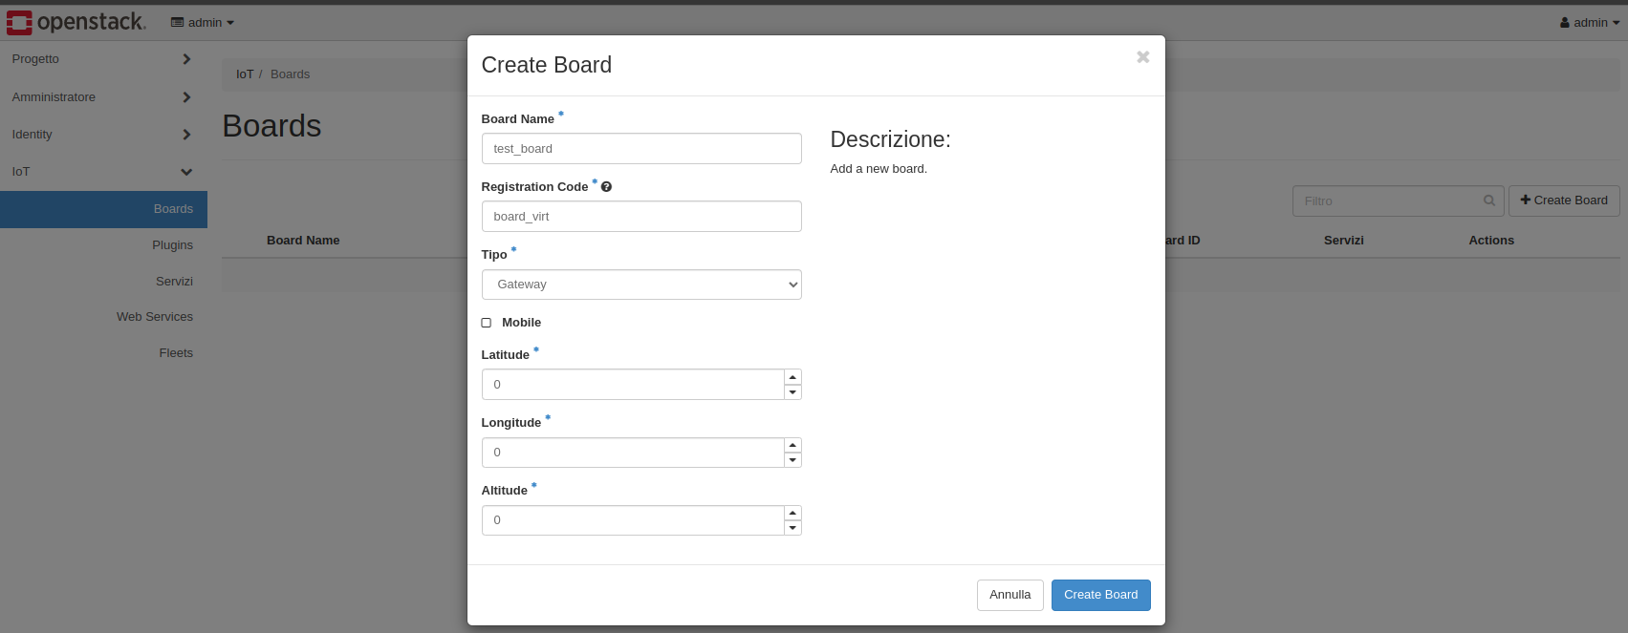
Book figure — Create Board form (Ch.13)
Reference UI fields: name, description, registration code display
Assembling Smart CPS · Stack4Things Training
Screenshot
Notes:
Please look at the screenshot on screen: Book figure — Create Board form (Ch.13). Walk the class through what they see in the interface. Connect each panel and button to a component we already deployed in the stack. In particular, note the following: Reference UI fields: name, description, registration code display. Take a few seconds to orient before we continue.

Slide 21
Lab: configure each Lightning-Rod
Registration code + WAMP URL
Notes:
We now begin a new section: Lab: configure each Lightning-Rod. Registration code + WAMP URL. In the next slides, listen for whether we are in theory mode or hands-on mode, and open your terminal when the slides turn to lab work.
Instructor timing (title): Hands-on — configure each Lightning-Rod

Slide 22
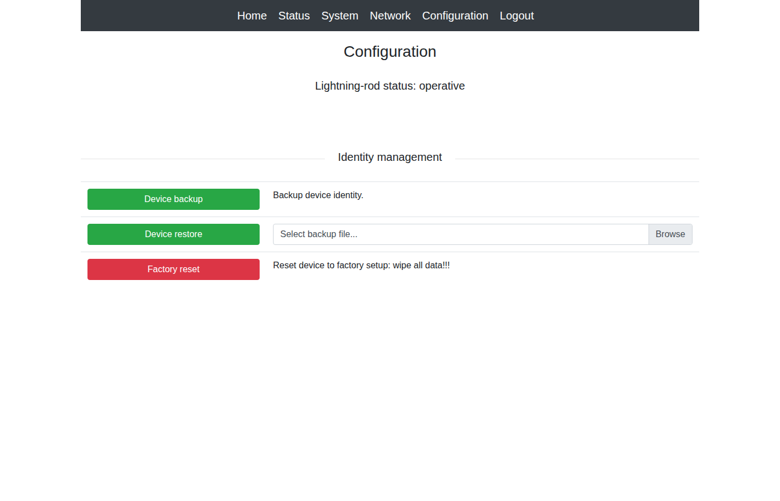
LR instance 1 — Configuration (board-alpha)
Assembling Smart CPS · Stack4Things Training
Screenshot
http://{{VM_IP}}:1474/config — board-alpha · me / arancino
Notes:
Please look at the screenshot on screen: LR instance 1 — Configuration (board-alpha). Walk the class through what they see in the interface. Connect each panel and button to a component we already deployed in the stack. In particular, note the following: http://{{VM_IP}}:1474/config — board-alpha · me / arancino. Take a few seconds to orient before we continue.

Slide 23
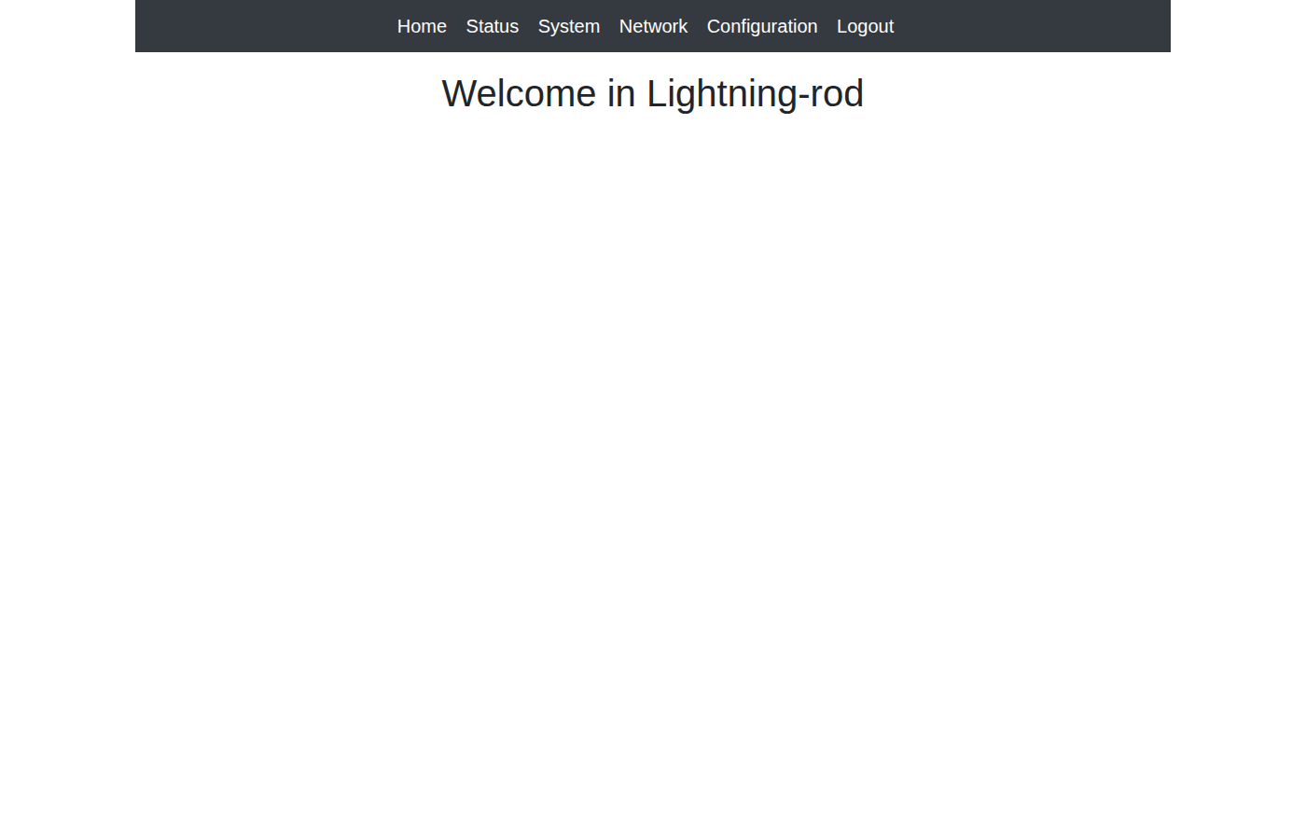
LR instance 2 — home dashboard
Assembling Smart CPS · Stack4Things Training
Screenshot
http://{{VM_IP}}:1475 — board-beta will register here
Notes:
Please look at the screenshot on screen: LR instance 2 — home dashboard. Walk the class through what they see in the interface. Connect each panel and button to a component we already deployed in the stack. In particular, note the following: http://{{VM_IP}}:1475 — board-beta will register here. Take a few seconds to orient before we continue.

Slide 24
Configure Lightning-Rod instance 1 (alpha)
▸ Open http://{{VM_IP}}:1474/config — login me / arancino
▸ Paste board-alpha registration code
▸ WAMP URL: wss://crossbar:8181 · Save
▸ Verify board-alpha shows Active in Horizon before proceeding
Assembling Smart CPS · Stack4Things Training
Notes:
Now we move to the hands-on part: Configure Lightning-Rod instance 1 (alpha). Open your lab VM and follow along.
First, regarding open http, //{{VM_IP}}:1474/config — login me / arancino. Next, Paste board-alpha registration code.
By contrast, regarding wamp url, wss://crossbar:8181 · Save. We should also consider that Verify board-alpha shows Active in Horizon before proceeding.
Raise your hand if you're stuck — we'll wait until most of you are done.
Instructor timing (title): Step 3 — Configure Lightning-Rod instance 1 (alpha)

Slide 25
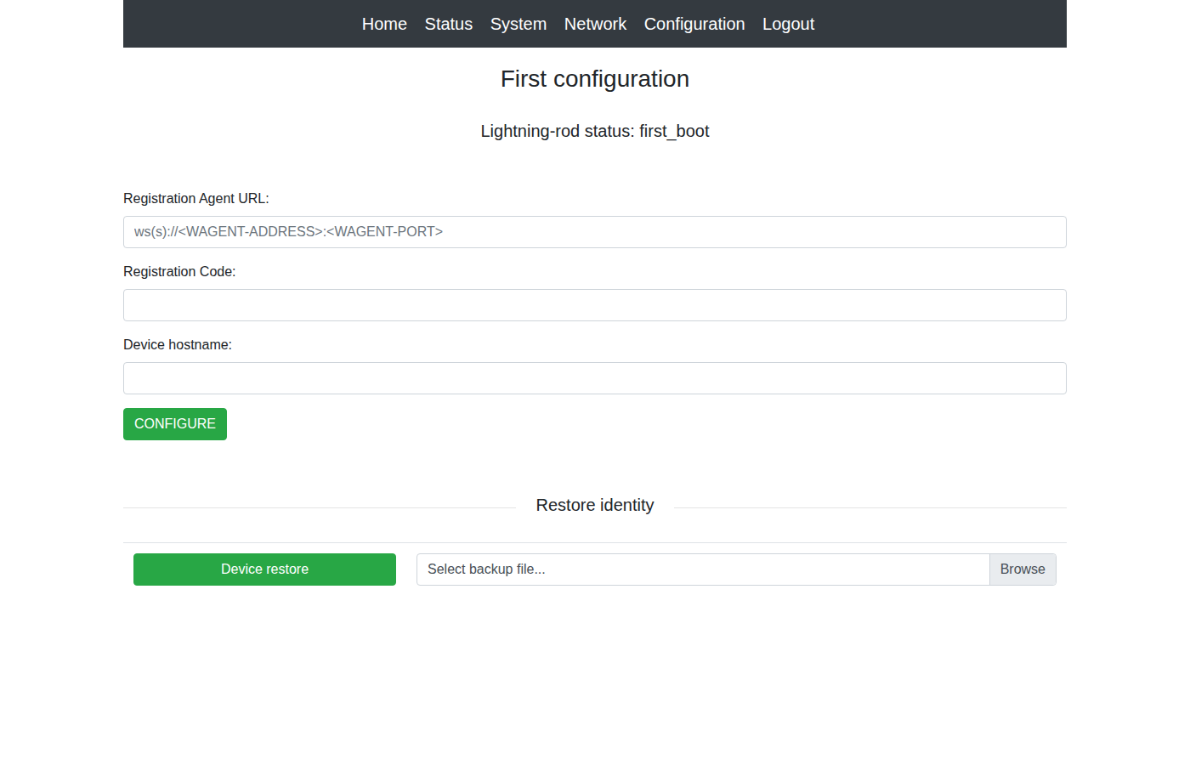
LR instance 2 — Configuration (board-beta)
Assembling Smart CPS · Stack4Things Training
Screenshot
http://{{VM_IP}}:1475/config — board-beta registration
Notes:
Please look at the screenshot on screen: LR instance 2 — Configuration (board-beta). Walk the class through what they see in the interface. Connect each panel and button to a component we already deployed in the stack. In particular, note the following: http://{{VM_IP}}:1475/config — board-beta registration. Take a few seconds to orient before we continue.

Slide 26
Configure Lightning-Rod instance 2 (beta)
▸ Open http://{{VM_IP}}:1475/config — login me / arancino
▸ Paste board-beta registration code · WAMP: wss://crossbar:8181 · Save
▸ Wait for Active status in Horizon
Assembling Smart CPS · Stack4Things Training
Notes:
Now we move to the hands-on part: Configure Lightning-Rod instance 2 (beta). Open your lab VM and follow along.
First, regarding open http, //{{VM_IP}}:1475/config — login me / arancino. Next, regarding paste board-beta registration code · wamp, wss://crossbar:8181 · Save.
By contrast, Wait for Active status in Horizon.
Raise your hand if you're stuck — we'll wait until most of you are done.
Instructor timing (title): Step 4 — Configure Lightning-Rod instance 2 (beta)

Slide 27
LR instance 3 — home dashboard
Assembling Smart CPS · Stack4Things Training
Screenshot
http://{{VM_IP}}:1476 — board-gamma will register here
Notes:
Please look at the screenshot on screen: LR instance 3 — home dashboard. Walk the class through what they see in the interface. Connect each panel and button to a component we already deployed in the stack. In particular, note the following: http://{{VM_IP}}:1476 — board-gamma will register here. Take a few seconds to orient before we continue.

Slide 28
LR instance 3 — Configuration (board-gamma)
Assembling Smart CPS · Stack4Things Training
Screenshot
http://{{VM_IP}}:1476/config — board-gamma registration
Notes:
Please look at the screenshot on screen: LR instance 3 — Configuration (board-gamma). Walk the class through what they see in the interface. Connect each panel and button to a component we already deployed in the stack. In particular, note the following: http://{{VM_IP}}:1476/config — board-gamma registration. Take a few seconds to orient before we continue.

Slide 29
Configure Lightning-Rod instance 3 (gamma)
▸ Open http://{{VM_IP}}:1476/config — login me / arancino
▸ Paste board-gamma registration code · WAMP: wss://crossbar:8181 · Save
▸ All three boards MUST show Active in Horizon before fleet inject
Assembling Smart CPS · Stack4Things Training
Notes:
Now we move to the hands-on part: Configure Lightning-Rod instance 3 (gamma). Open your lab VM and follow along.
First, regarding open http, //{{VM_IP}}:1476/config — login me / arancino. Next, regarding paste board-gamma registration code · wamp, wss://crossbar:8181 · Save.
By contrast, All three boards MUST show Active in Horizon before fleet inject.
Raise your hand if you're stuck — we'll wait until most of you are done.
Instructor timing (title): Step 5 — Configure Lightning-Rod instance 3 (gamma)

Slide 30
THEORY
Ch.13 troubleshooting · IoTronic REST API
Troubleshooting multi-board registration
▸ Board stuck in Registering: check LR logs — docker logs lightning-rod-2
▸ Wrong code on wrong LR: board shows Error — remove and re-create board in Horizon
▸ WAMP connection refused: verify crossbar container healthy in docker compose ps
▸ Duplicate registration: each code valid for one LR instance only
▸ API check: curl -s http://{{VM_IP}}:8812/v1/boards/ | python3 -m json.tool
▸ All three status fields must read Active before continuing to fleet creation
Assembling Smart CPS · Stack4Things Training
Theory
Notes:
In this slide we cover Troubleshooting multi-board registration. This material is covered in Ch.13 troubleshooting · IoTronic REST API.
First, regarding board stuck in registering, check LR logs — docker logs lightning-rod-2. Next, regarding wrong code on wrong lr, board shows Error — remove and re-create board in Horizon.
By contrast, regarding wamp connection refused, verify crossbar container healthy in docker compose ps. We should also consider that regarding duplicate registration, each code valid for one LR instance only.
Another key point is that regarding api check, curl -s http://{{VM_IP}}:8812/v1/boards/ | python3 -m json.tool. Furthermore, All three status fields must read Active before continuing to fleet creation.
I'll pause here for questions, then we'll continue.

Slide 31
Lab: create fleet and inject HelloName
Fleet-level plugin deploy
Notes:
We now begin a new section: Lab: create fleet and inject HelloName. Fleet-level plugin deploy. In the next slides, listen for whether we are in theory mode or hands-on mode, and open your terminal when the slides turn to lab work.
Instructor timing (title): Hands-on — create fleet and inject HelloName

Slide 32
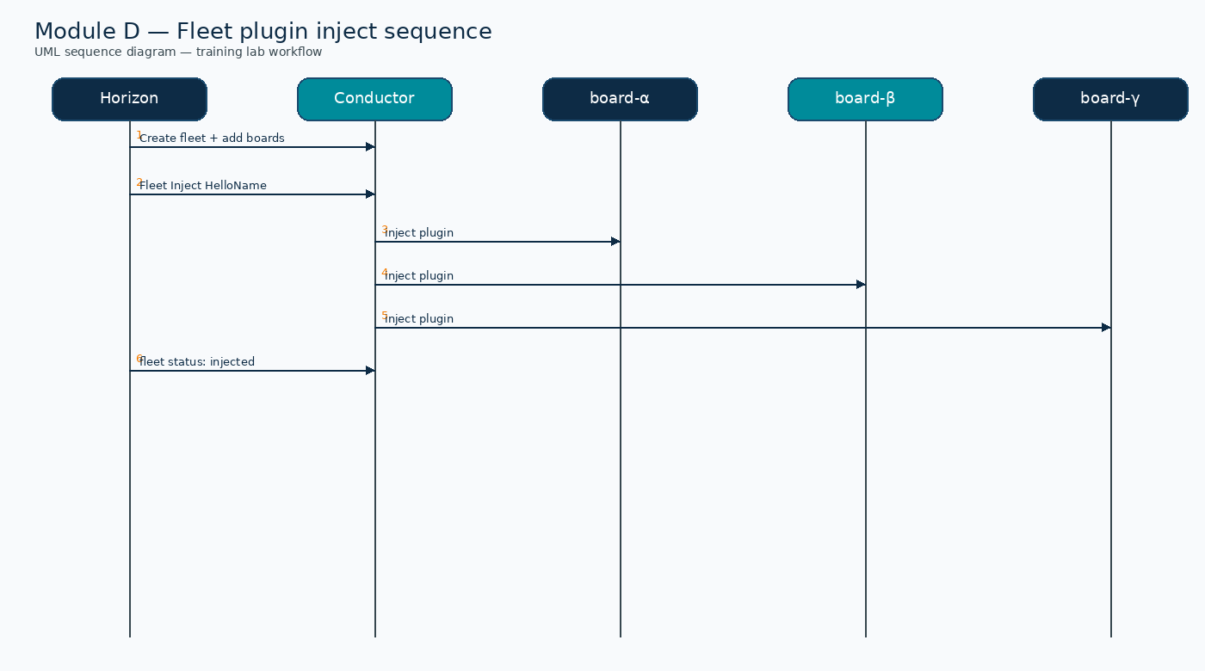
UML sequence — Fleet plugin inject (Module D)
Assembling Smart CPS · Stack4Things Training
Diagram
Create fleet → inject HelloName on board-alpha, beta, gamma
Notes:
Please look at the sequence diagram on screen: UML sequence — Fleet plugin inject (Module D). Trace the diagram from left to right. Name each actor, the protocol used, and the message that crosses the cloud–edge boundary. In particular, note the following: Create fleet → inject HelloName on board-alpha, beta, gamma. Take a few seconds to orient before we continue.

Slide 33
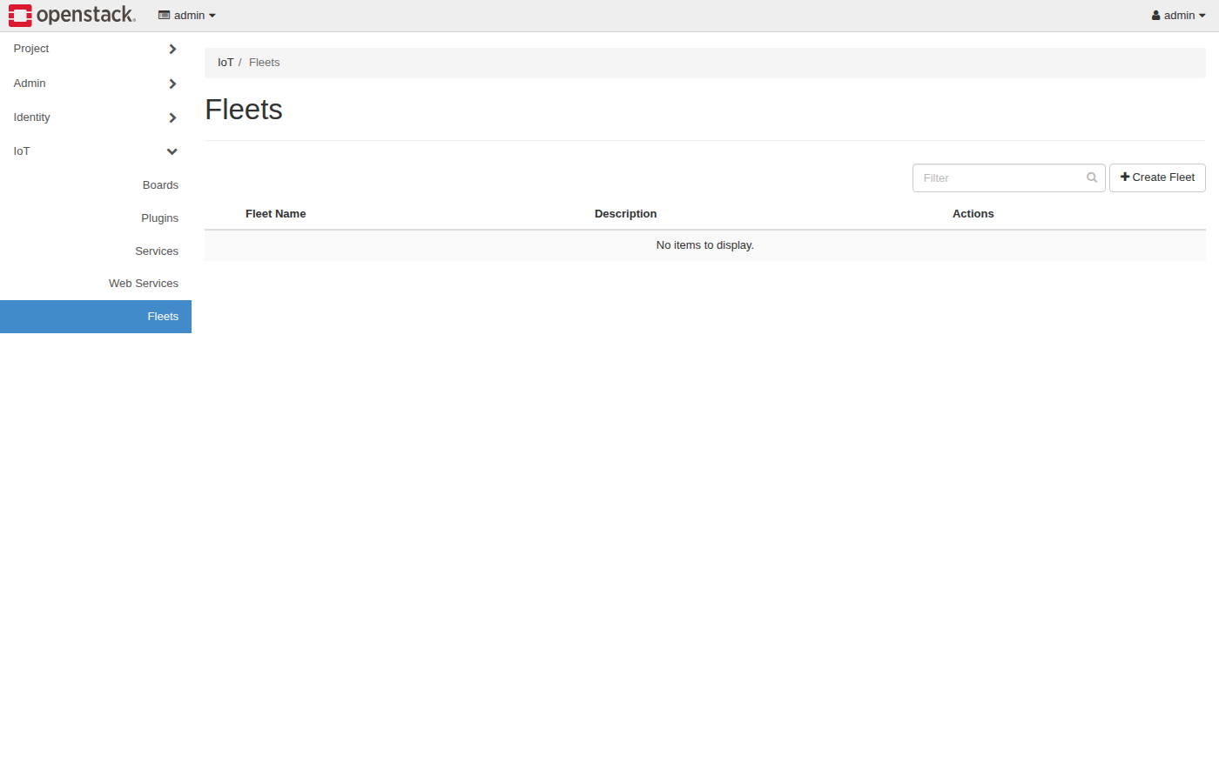
Horizon IoT — Fleets panel
Assembling Smart CPS · Stack4Things Training
Screenshot
http://{{VM_IP}}/horizon/iot/fleets/ — Create Fleet
Notes:
Please look at the screenshot on screen: Horizon IoT — Fleets panel. Walk the class through what they see in the interface. Connect each panel and button to a component we already deployed in the stack. In particular, note the following: http://{{VM_IP}}/horizon/iot/fleets/ — Create Fleet. Take a few seconds to orient before we continue.

Slide 34
Create fleet and add all Active boards
▸ http://{{VM_IP}}/horizon/iot/fleets/ → Create Fleet
▸ Name: lab-fleet-3 · add board-alpha, board-beta, board-gamma
▸ Save — verify all three members listed in fleet detail view
Assembling Smart CPS · Stack4Things Training
Notes:
Now we move to the hands-on part: Create fleet and add all Active boards. Open your lab VM and follow along.
First, regarding http, //{{VM_IP}}/horizon/iot/fleets/, then Create Fleet. Next, regarding name, lab-fleet-3 · add board-alpha, board-beta, board-gamma.
By contrast, Save — verify all three members listed in fleet detail view.
Raise your hand if you're stuck — we'll wait until most of you are done.
Instructor timing (title): Step 6 — Create fleet and add all Active boards

Slide 35
Fleet inject HelloName plugin
▸ Fleet → Plugins tab → Inject → select HelloName (from Module B)
▸ Confirm inject succeeds on all three members
▸ Per board: Plugins → HelloName → Plugin Call → {"name": "fleet-demo"}
▸ Verify JSON result returned on each of :1474, :1475, :1476 boards
Assembling Smart CPS · Stack4Things Training
Notes:
Now we move to the hands-on part: Fleet inject HelloName plugin. Open your lab VM and follow along.
First, Fleet, then Plugins tab, then Inject, then select HelloName (from Module B). Next, Confirm inject succeeds on all three members.
By contrast, regarding per board, plugins, then HelloName, then Plugin Call, then {"name": "fleet-demo"}. We should also consider that regarding verify json result returned on each of, 1474, :1475, :1476 boards.
Raise your hand if you're stuck — we'll wait until most of you are done.
Instructor timing (title): Step 7 — Fleet inject HelloName plugin

Slide 36
THEORY
Ch.14 §14.2 · bulk plugin deployment
Fleet inject vs individual inject — when to use each
▸ Development/debug: individual board inject — isolate failures quickly
▸ Production rollout: fleet inject — consistent version across all edge nodes
▸ Heterogeneous fleets: filter members by tag/metadata before inject (production feature)
▸ HelloName sync demo: fleet inject saves time; Plugin Call proves per-board execution
▸ Module G FL: per-board async inject with different CSV — not fleet inject pattern
▸ Book Ch.14 fleet panel screenshots match Horizon workflow shown in hands-on steps
Assembling Smart CPS · Stack4Things Training
Theory
Notes:
In this slide we cover Fleet inject vs individual inject — when to use each. This material is covered in Ch.14 §14.2 · bulk plugin deployment.
First, regarding development/debug, individual board inject — isolate failures quickly. Next, regarding production rollout, fleet inject — consistent version across all edge nodes.
By contrast, regarding heterogeneous fleets, filter members by tag/metadata before inject (production feature). We should also consider that regarding helloname sync demo, fleet inject saves time; Plugin Call proves per-board execution.
Another key point is that regarding module g fl, per-board async inject with different CSV — not fleet inject pattern. Furthermore, Book Ch.14 fleet panel screenshots match Horizon workflow shown in hands-on steps.
I'll pause here for questions, then we'll continue.

Slide 37
Validate & wrap-up
Confirm lab state for Module G
Notes:
We now begin a new section: Validate & wrap-up. Confirm lab state for Module G. In the next slides, listen for whether we are in theory mode or hands-on mode, and open your terminal when the slides turn to lab work.

Slide 38
Validate multi-board lab state
$ cd training && ./validate-lab-multiboard.sh
$ curl -s http://{{VM_IP}}:8812/v1/boards/ | python3 -m json.tool
▸ Expected: 3 boards, all status Active, fleet lab-fleet-3 exists
Assembling Smart CPS · Stack4Things Training
Notes:
Now we move to the hands-on part: Validate multi-board lab state. Open your lab VM and follow along.
Please run the following command on your VM: cd training && ./validate-lab-multiboard.sh. Wait until you see a sensible result before continuing. Please run the following command on your VM: curl -s http://{{VM_IP}}:8812/v1/boards/ | python3 -m json.tool. Wait until you see a sensible result before continuing.
By contrast, regarding expected, 3 boards, all status Active, fleet lab-fleet-3 exists.
Raise your hand if you're stuck — we'll wait until most of you are done.
Instructor timing (title): Step 8 — Validate multi-board lab state

Slide 39
Module D checklist
▸ □ Three boards Active in Horizon (board-alpha, board-beta, board-gamma)
▸ □ Three LR UIs reachable: {{VM_IP}}:1474, :1475, :1476
▸ □ Fleet created with HelloName injected on all members
▸ □ validate-lab-multiboard.sh passes
▸ Prerequisite satisfied → proceed to Module G (Federated Learning) or Module F (WSTUN)
Assembling Smart CPS · Stack4Things Training
Notes:
On this slide, Module D checklist.
First, □ Three boards Active in Horizon (board-alpha, board-beta, board-gamma). Next, regarding □ three lr uis reachable, {{VM_IP}}:1474, :1475, :1476.
By contrast, □ Fleet created with HelloName injected on all members. We should also consider that □ validate-lab-multiboard.sh passes.
Another key point is that Prerequisite satisfied, then proceed to Module G (Federated Learning) or Module F (WSTUN).
If these objectives are clear, we can proceed.

