Slide 1
S4T TRAINING
Module E — Virtual Networking
Ch.5 · Extension · VM {{VM_IP}} · OPTIONAL tier
Extension · Ch.5 — Virtual Networking · optional if Neutron incomplete
Notes:
Welcome. In this module we will work through Module E — Virtual Networking.
Ch.5 · Extension · VM {{VM_IP}} · OPTIONAL tier
The session alternates theory from the book with live exercises on the Stack4Things lab VM. Replace the placeholder IP with the address of the machine you are using.
Extension · Ch.5 — Virtual Networking · optional if Neutron incomplete.
When you're ready, advance to the first section.

Slide 2
Network virtualization theory
Ch.5 — Neutron + IoTronic ports before the lab
Notes:
We now begin a new section: Network virtualization theory. Ch.5 — Neutron + IoTronic ports before the lab. In the next slides, listen for whether we are in theory mode or hands-on mode, and open your terminal when the slides turn to lab work.

Slide 3
THEORY
Ch.5 · Network virtualization in IoT · chapter abstract
Problem: connecting cloud and edge (Ch.5)
▸ IoT boards sit behind NAT, firewalls, and heterogeneous LAN topologies
▸ Cloud applications in VMs need logical connectivity to edge devices and sensors
▸ Network virtualization: overlay networks independent of physical wiring
▸ Stack4Things extends OpenStack Neutron toward edge IoT nodes via IoTronic
▸ Goal: treat remote boards as first-class network citizens in the cloud overlay
▸ Complements WSTUN (Module F) which solves HTTP service exposure, not L2/L3 overlay
Assembling Smart CPS · Stack4Things Training
Theory
Notes:
In this slide we cover Problem: connecting cloud and edge (Ch.5). This material is covered in Ch.5 · Network virtualization in IoT · chapter abstract.
First, IoT boards sit behind NAT, firewalls, and heterogeneous LAN topologies. Next, Cloud applications in VMs need logical connectivity to edge devices and sensors.
By contrast, regarding network virtualization, overlay networks independent of physical wiring. We should also consider that Stack4Things extends OpenStack Neutron toward edge IoT nodes via IoTronic.
Another key point is that regarding goal, treat remote boards as first-class network citizens in the cloud overlay. Furthermore, Complements WSTUN (Module F) which solves HTTP service exposure, not L2/L3 overlay.
I'll pause here for questions, then we'll continue.

Slide 4
THEORY
Ch.5 § OpenStack networking · Neutron architecture
OpenStack Neutron recap for IoT context (Ch.5)
▸ Neutron manages virtual networks, subnets, routers, security groups in OpenStack
▸ Standard cloud VMs attach to Neutron networks via virtual interfaces (VIFs)
▸ IoTronic ports API extends this model: boards receive VIFs on overlay networks
▸ WAgent (Worker Agent) on cloud side coordinates tunnel/port setup with edge LR agent
▸ Production: full Neutron L2/L3 with ML2 plugin; Docker lab: API workflow demo only
▸ Book tables list IoTronic networking REST endpoints with request/response schemas
Assembling Smart CPS · Stack4Things Training
Theory
Notes:
In this slide we cover OpenStack Neutron recap for IoT context (Ch.5). This material is covered in Ch.5 § OpenStack networking · Neutron architecture.
First, Neutron manages virtual networks, subnets, routers, security groups in OpenStack. Next, Standard cloud VMs attach to Neutron networks via virtual interfaces (VIFs).
By contrast, regarding iotronic ports api extends this model, boards receive VIFs on overlay networks. We should also consider that WAgent (Worker Agent) on cloud side coordinates tunnel/port setup with edge LR agent.
Another key point is that regarding production, full Neutron L2/L3 with ML2 plugin; Docker lab: API workflow demo only. Furthermore, Book tables list IoTronic networking REST endpoints with request/response schemas.
I'll pause here for questions, then we'll continue.

Slide 5
THEORY
Ch.5 · IoTronic networking API · attach port listing
Virtual ports & VIF abstraction (Ch.5)
▸ POST /v1/boards/{uuid}/ports/ attaches virtual network interface to registered board
▸ Response JSON includes VIF_name, ip address, MAC_add — logical identity on overlay
▸ Board-side: virtual interface appears in Linux network stack (tun/tap device)
▸ Applications on board bind to assigned overlay IP without physical NIC changes
▸ Cloud-side: other VMs on same Neutron network reach board via overlay routing
▸ Enables peer-to-peer cloud↔edge communication for latency-sensitive workloads
Assembling Smart CPS · Stack4Things Training
Theory
Notes:
In this slide we cover Virtual ports & VIF abstraction (Ch.5). This material is covered in Ch.5 · IoTronic networking API · attach port listing.
First, POST /v1/boards/{uuid}/ports/ attaches virtual network interface to registered board. Next, Response JSON includes VIF_name, ip address, MAC_add — logical identity on overlay.
By contrast, regarding board-side, virtual interface appears in Linux network stack (tun/tap device). We should also consider that Applications on board bind to assigned overlay IP without physical NIC changes.
Another key point is that regarding cloud-side, other VMs on same Neutron network reach board via overlay routing. Furthermore, Enables peer-to-peer cloud↔edge communication for latency-sensitive workloads.
I'll pause here for questions, then we'll continue.

Slide 6
THEORY
Ch.5 · WAgent · Ch.13 docker-compose service list
WAgent orchestration role (Ch.5 + Ch.13)
▸ WAgent container (iotronic-wagent) runs alongside Conductor in cloud stack
▸ Receives port attach requests from IoTronic → configures tunnel/VIF on cloud side
▸ Coordinates with Lightning-Rod agent on board for edge-side interface creation
▸ Logs in docker logs iotronic-wagent show attach attempt and backend response
▸ If Neutron backend unavailable: API accepts request but L3 may not fully provision
▸ Lab value: understand book workflow before production OpenStack deployment
Assembling Smart CPS · Stack4Things Training
Theory
Notes:
In this slide we cover WAgent orchestration role (Ch.5 + Ch.13). This material is covered in Ch.5 · WAgent · Ch.13 docker-compose service list.
First, WAgent container (iotronic-wagent) runs alongside Conductor in cloud stack. Next, Receives port attach requests from IoTronic, then configures tunnel/VIF on cloud side.
By contrast, Coordinates with Lightning-Rod agent on board for edge-side interface creation. We should also consider that Logs in docker logs iotronic-wagent show attach attempt and backend response.
Another key point is that regarding if neutron backend unavailable, API accepts request but L3 may not fully provision. Furthermore, regarding lab value, understand book workflow before production OpenStack deployment.
I'll pause here for questions, then we'll continue.

Slide 7
THEORY
Ch.4 I/Ocloud + Ch.5 VN · fig:chap05:vn-workflow
I/Ocloud networking context (Ch.4–5 bridge)
▸ Virtual Nodes in cloud can participate in same overlay as physical boards
▸ Designate provides DNS naming; Neutron provides topology; IoTronic binds boards
▸ Full production: multi-site SLICES experiments span Neutron networks (Ch.10–11)
▸ VN enables cloud microservices to push/pull data directly to edge sensors
▸ Different from Module F WSTUN: VN is network-layer; WSTUN is application-layer tunnel
▸ Both coexist in complete S4T deployments for different connectivity patterns
Assembling Smart CPS · Stack4Things Training
Theory
Notes:
In this slide we cover I/Ocloud networking context (Ch.4–5 bridge). This material is covered in Ch.4 I/Ocloud + Ch.5 VN · fig:chap05:vn-workflow.
First, Virtual Nodes in cloud can participate in same overlay as physical boards. Next, Designate provides DNS naming; Neutron provides topology; IoTronic binds boards.
By contrast, regarding full production, multi-site SLICES experiments span Neutron networks (Ch.10–11). We should also consider that VN enables cloud microservices to push/pull data directly to edge sensors.
Another key point is that regarding different from module f wstun, VN is network-layer; WSTUN is application-layer tunnel. Furthermore, Both coexist in complete S4T deployments for different connectivity patterns.
I'll pause here for questions, then we'll continue.

Slide 8
THEORY
Ch.5 · API tables · training/experiments/virtual-networking/
Attach-port REST workflow step-by-step (Ch.5)
▸ Step 1: obtain Keystone token (or use Horizon session for API exploration)
▸ Step 2: GET /v1/boards/ — select Active board UUID
▸ Step 3: GET /v1/networks/ or Horizon — obtain target Neutron network UUID
▸ Step 4: POST /v1/boards/{BOARD_UUID}/ports/ with {"network": "NETWORK_UUID"}
▸ Step 5: parse response — note VIF_name, ip, MAC for verification on board
▸ Step 6: test connectivity from cloud VM to board overlay IP (production)
Assembling Smart CPS · Stack4Things Training
Theory
Notes:
In this slide we cover Attach-port REST workflow step-by-step (Ch.5). This material is covered in Ch.5 · API tables · training/experiments/virtual-networking/.
First, regarding step 1, obtain Keystone token (or use Horizon session for API exploration). Next, regarding step 2, GET /v1/boards/ — select Active board UUID.
By contrast, regarding step 3, GET /v1/networks/ or Horizon — obtain target Neutron network UUID. We should also consider that regarding step 4, POST /v1/boards/{BOARD_UUID}/ports/ with {"network": "NETWORK_UUID"}.
Another key point is that regarding step 5, parse response — note VIF_name, ip, MAC for verification on board. Furthermore, regarding step 6, test connectivity from cloud VM to board overlay IP (production).
I'll pause here for questions, then we'll continue.

Slide 9
THEORY
Ch.5 § Network virtualization in IoT · MENO · VITRO
MENO and Virtual Sensor Networks (Ch.5)
▸ Managed Ecosystem of Networked Objects (MENO): limited cooperating devices without public IPs.
▸ VITRO Virtual Sensor Networking (VSN): dynamic collaboration across admin domains.
▸ Applications see only the logical overlay — physical LAN boundaries become transparent.
▸ Motivates S4T NV beyond lab attach-port: smart factories, buildings, and city districts.
▸ Contrasts with exposing every sensor on a public server — most IoT apps need local cooperation.
▸ Book figure: fig:chap05:MENO — end-to-end logical network over heterogeneous physical links.
Assembling Smart CPS · Stack4Things Training
Theory
Notes:
In this slide we cover MENO and Virtual Sensor Networks (Ch.5). This material is covered in Ch.5 § Network virtualization in IoT · MENO · VITRO.
First, regarding managed ecosystem of networked objects (meno), limited cooperating devices without public IPs. Next, regarding vitro virtual sensor networking (vsn), dynamic collaboration across admin domains.
By contrast, Applications see only the logical overlay — physical LAN boundaries become transparent. We should also consider that regarding motivates s4t nv beyond lab attach-port, smart factories, buildings, and city districts.
Another key point is that Contrasts with exposing every sensor on a public server — most IoT apps need local cooperation. Furthermore, regarding book figure, fig:chap05:MENO — end-to-end logical network over heterogeneous physical links.
I'll pause here for questions, then we'll continue.

Slide 10
THEORY
Ch.5 § use cases · fig:chap05:use-cases · fig:chap05:use-case-personal
S4T NV use cases from the book (Ch.5)
▸ Partitioning: split devices on one LAN into separate VNs — e.g. departments in a smart building.
▸ Cross-network: connect geo-distributed boards without VPN configuration on edge routers.
▸ Cloud extension: add OpenStack VMs to the same VN as edge sensors for storage and analytics.
▸ Personal devices: smartphones/tablets join VN — static overlay IP survives WiFi↔4G handoff.
▸ Hybrid VNs combine all patterns — countless topologies for application-specific requirements.
▸ AllJoyn requires same broadcast domain; S4T NV crosses NAT and subnet boundaries.
Assembling Smart CPS · Stack4Things Training
Theory
Notes:
In this slide we cover S4T NV use cases from the book (Ch.5). This material is covered in Ch.5 § use cases · fig:chap05:use-cases · fig:chap05:use-case-personal.
First, regarding partitioning, split devices on one LAN into separate VNs — e.g. departments in a smart building. Next, regarding cross-network, connect geo-distributed boards without VPN configuration on edge routers.
By contrast, regarding cloud extension, add OpenStack VMs to the same VN as edge sensors for storage and analytics. We should also consider that regarding personal devices, smartphones/tablets join VN — static overlay IP survives WiFi↔4G handoff.
Another key point is that Hybrid VNs combine all patterns — countless topologies for application-specific requirements. Furthermore, AllJoyn requires same broadcast domain; S4T NV crosses NAT and subnet boundaries.
I'll pause here for questions, then we'll continue.

Slide 11
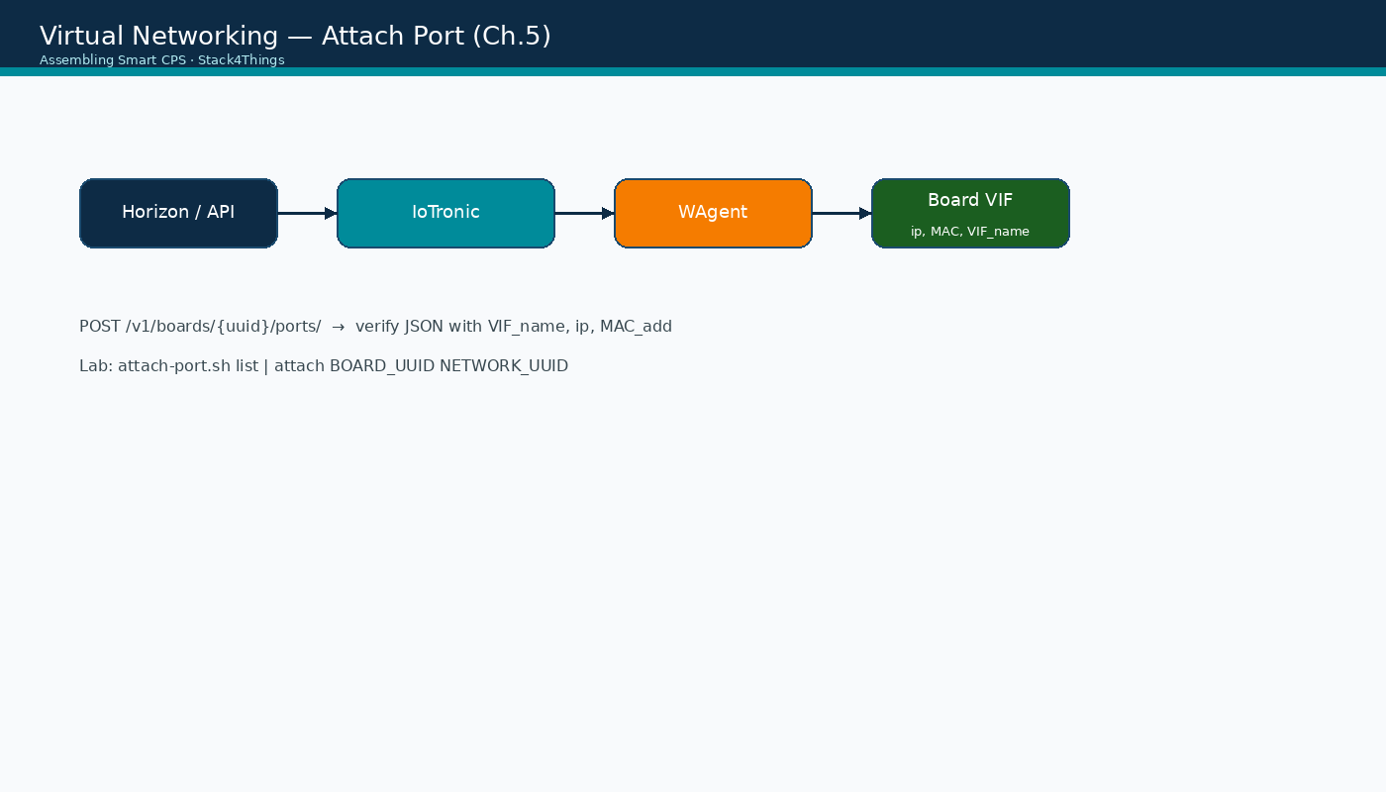
Attach port workflow
Assembling Smart CPS · Stack4Things Training
Diagram
Horizon/API → IoTronic → WAgent → board virtual interface
Notes:
Please look at the diagram on screen: Attach port workflow. Describe the main boxes and arrows. Relate each element to a Docker service or API you have already seen. In particular, note the following: Horizon/API → IoTronic → WAgent → board virtual interface. Take a few seconds to orient before we continue.

Slide 12
Module E — learning objectives
▸ Understand Ch.5 virtual networking theory and IoTronic ports API
▸ Execute attach-port.sh helper script against live lab Conductor
▸ Inspect WAgent logs for orchestration evidence
▸ Articulate VN vs WSTUN difference (network overlay vs HTTP tunnel)
▸ Pass validate-lab-vn.sh where Neutron backend permits
Assembling Smart CPS · Stack4Things Training
Notes:
On this slide, Module E — learning objectives.
First, Understand Ch.5 virtual networking theory and IoTronic ports API. Next, Execute attach-port.sh helper script against live lab Conductor.
By contrast, Inspect WAgent logs for orchestration evidence. We should also consider that Articulate VN vs WSTUN difference (network overlay vs HTTP tunnel).
Another key point is that Pass validate-lab-vn.sh where Neutron backend permits.
If these objectives are clear, we can proceed.

Slide 13
DEMO
What this module demonstrates — demo goals
▸ Operator can request virtual port attachment via REST API on live Conductor
▸ WAgent logs show orchestration attempt even if Neutron L3 backend is limited in Docker
▸ Students understand production attach-port workflow before field deployment
▸ Board appears as network participant — not just HTTP endpoint behind NAT
▸ Foundation for SLICES multi-site experiments (Ch.10–11) using Neutron overlays
▸ Optional module — skip gracefully if short on time without blocking other modules
Assembling Smart CPS · Stack4Things Training
Demo
Notes:
In this demonstration, What this module demonstrates — demo goals.
First, Operator can request virtual port attachment via REST API on live Conductor. Next, WAgent logs show orchestration attempt even if Neutron L3 backend is limited in Docker.
By contrast, Students understand production attach-port workflow before field deployment. We should also consider that Board appears as network participant — not just HTTP endpoint behind NAT.
Another key point is that Foundation for SLICES multi-site experiments (Ch.10–11) using Neutron overlays. Furthermore, Optional module — skip gracefully if short on time without blocking other modules.
Check that your screen matches what we showed before moving on.
Session timing — Module E — 45-minute timeline (OPTIONAL):

Slide 14
Lab: explore boards and ports
attach-port.sh helper scripts
Notes:
We now begin a new section: Lab: explore boards and ports. attach-port.sh helper scripts. In the next slides, listen for whether we are in theory mode or hands-on mode, and open your terminal when the slides turn to lab work.
Instructor timing (title): Hands-on — explore boards and ports

Slide 15
List boards and existing ports
$ cd training
$ ./experiments/virtual-networking/attach-port.sh boards
$ ./experiments/virtual-networking/attach-port.sh list
▸ Note Active board UUID(s) and any existing port attachments
Assembling Smart CPS · Stack4Things Training
Notes:
Now we move to the hands-on part: List boards and existing ports. Open your lab VM and follow along.
Please run the following command on your VM: cd training. Wait until you see a sensible result before continuing. Please run the following command on your VM: ./experiments/virtual-networking/attach-port.sh boards. Wait until you see a sensible result before continuing.
Please run the following command on your VM: ./experiments/virtual-networking/attach-port.sh list. Wait until you see a sensible result before continuing. We should also consider that Note Active board UUID(s) and any existing port attachments.
Raise your hand if you're stuck — we'll wait until most of you are done.
Instructor timing (title): Step 1 — List boards and existing ports

Slide 16
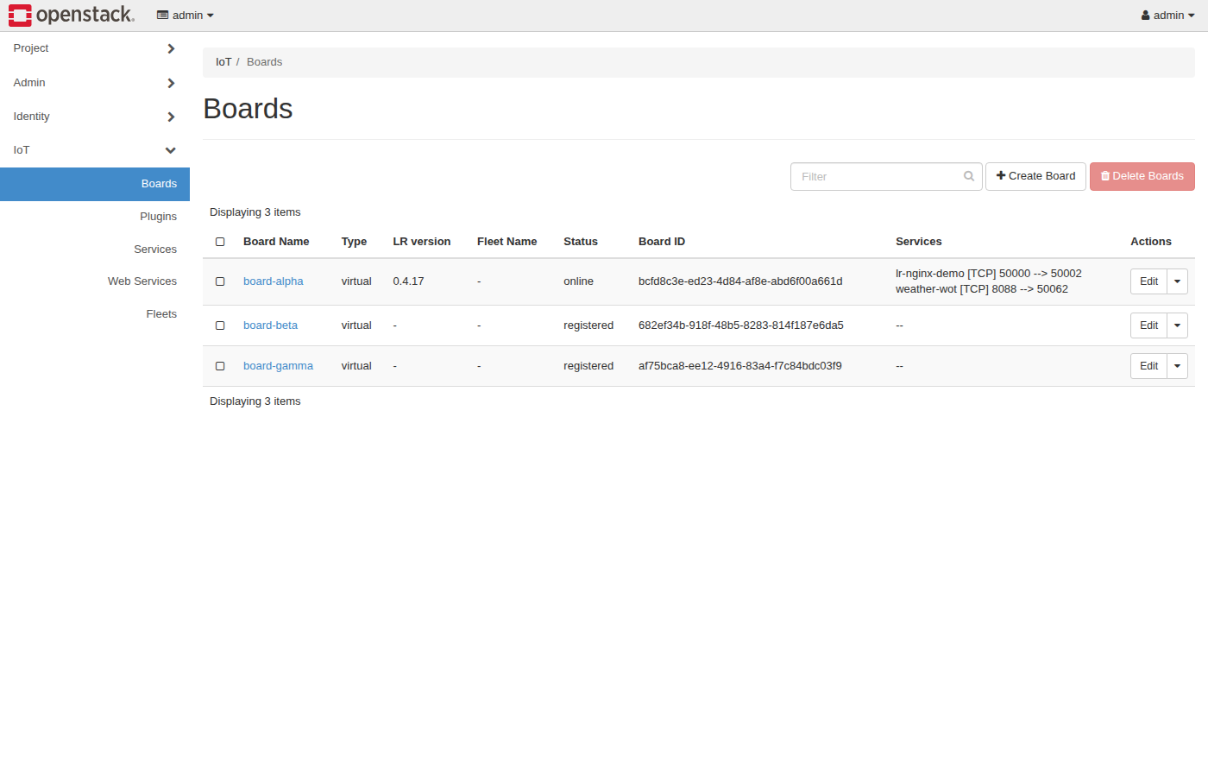
Horizon IoT — Boards (attach port context)
Assembling Smart CPS · Stack4Things Training
Screenshot
http://{{VM_IP}}/horizon/iot/ · login admin / s4t · select Active board
Notes:
Please look at the screenshot on screen: Horizon IoT — Boards (attach port context). Walk the class through what they see in the interface. Connect each panel and button to a component we already deployed in the stack. In particular, note the following: http://{{VM_IP}}/horizon/iot/ · login admin / s4t · select Active board. Take a few seconds to orient before we continue.

Slide 17
THEORY
training/experiments/virtual-networking/attach-port.sh
attach-port.sh script internals
▸ Script wraps IoTronic REST API with lab-friendly output formatting
▸ boards subcommand: GET /v1/boards/ — filters Active boards
▸ list subcommand: GET /v1/boards/{uuid}/ports/ — shows existing VIF attachments
▸ Uses Conductor at http://{{VM_IP}}:8812 — same endpoint as Module A API checks
▸ Token acquisition: script reads from env or prompts — see script header for details
▸ Safe to re-run list after attach to confirm new port appears in response JSON
Assembling Smart CPS · Stack4Things Training
Theory
Notes:
In this slide we cover attach-port.sh script internals. This material is covered in training/experiments/virtual-networking/attach-port.sh.
First, Script wraps IoTronic REST API with lab-friendly output formatting. Next, regarding boards subcommand, GET /v1/boards/ — filters Active boards.
By contrast, regarding list subcommand, GET /v1/boards/{uuid}/ports/ — shows existing VIF attachments. We should also consider that regarding uses conductor at http, //{{VM_IP}}:8812 — same endpoint as Module A API checks.
Another key point is that regarding token acquisition, script reads from env or prompts — see script header for details. Furthermore, Safe to re-run list after attach to confirm new port appears in response JSON.
I'll pause here for questions, then we'll continue.

Slide 18
Lab: attach port via API
POST when network UUID known
Notes:
We now begin a new section: Lab: attach port via API. POST when network UUID known. In the next slides, listen for whether we are in theory mode or hands-on mode, and open your terminal when the slides turn to lab work.
Instructor timing (title): Hands-on — attach port via API

Slide 19
Attach port API call
curl -X POST http://{{VM_IP}}:8812/v1/boards/{BOARD_UUID}/ports/ \
-H "X-Auth-Token: $TOKEN" -H "Content-Type: application/json" \
-d '{"network": "{NETWORK_UUID}"}'
Assembling Smart CPS · Stack4Things Training
Code
Notes:
On this slide we walk through the code for Attach port API call.
Scroll slowly through the listing on screen while I explain each part.
Point out the imports, the class definition, and the run method. Students will adapt this template in the lab rather than writing from scratch.
After reviewing the code, we'll apply it in the practical exercise.
Instructor timing (title): Step 2 — Attach port API call

Slide 20
THEORY
Ch.5 · ports API response schema
Expected API response fields (Ch.5)
▸ VIF_name: logical interface identifier assigned by IoTronic/Neutron
▸ ip address: overlay IP reachable within the Neutron network context
▸ MAC_add: hardware address for L2 operations on the overlay segment
▸ Empty or error response: Neutron backend may not be fully wired in Docker lab
▸ Partial success still demonstrates API contract students will use in production
▸ Compare response schema with Ch.5 API tables in the book listing
Assembling Smart CPS · Stack4Things Training
Theory
Notes:
In this slide we cover Expected API response fields (Ch.5). This material is covered in Ch.5 · ports API response schema.
First, regarding vif_name, logical interface identifier assigned by IoTronic/Neutron. Next, regarding ip address, overlay IP reachable within the Neutron network context.
By contrast, regarding mac_add, hardware address for L2 operations on the overlay segment. We should also consider that regarding empty or error response, neutron backend may not be fully wired in Docker lab.
Another key point is that Partial success still demonstrates API contract students will use in production. Furthermore, Compare response schema with Ch.5 API tables in the book listing.
I'll pause here for questions, then we'll continue.

Slide 21
THEORY
Ch.5 · edge virtual interface · TUN/TAP
TUN/TAP and edge-side networking (Ch.5)
▸ Virtual interfaces on board appear as tun/tap devices in Linux network stack
▸ ip link show on board container reveals new interface after successful attach
▸ Applications bind to assigned overlay IP — no change to physical NIC configuration
▸ Edge routing tables may need update for multi-homed board scenarios (advanced)
▸ WSTUN (Module F) solves different problem: HTTP service exposure via NAT traversal
▸ VN + WSTUN complement each other in full S4T production deployments
Assembling Smart CPS · Stack4Things Training
Theory
Notes:
In this slide we cover TUN/TAP and edge-side networking (Ch.5). This material is covered in Ch.5 · edge virtual interface · TUN/TAP.
First, Virtual interfaces on board appear as tun/tap devices in Linux network stack. Next, Ip link show on board container reveals new interface after successful attach.
By contrast, Applications bind to assigned overlay IP — no change to physical NIC configuration. We should also consider that Edge routing tables may need update for multi-homed board scenarios (advanced).
Another key point is that regarding wstun (module f) solves different problem, HTTP service exposure via NAT traversal. Furthermore, VN + WSTUN complement each other in full S4T production deployments.
I'll pause here for questions, then we'll continue.

Slide 22
Verify WAgent logs
$ docker logs iotronic-wagent 2>&1 | tail -30
▸ Look for port attach / VIF configuration messages
Assembling Smart CPS · Stack4Things Training
Notes:
Now we move to the hands-on part: Verify WAgent logs. Open your lab VM and follow along.
Please run the following command on your VM: docker logs iotronic-wagent 2>&1 | tail -30. Wait until you see a sensible result before continuing. Next, Look for port attach / VIF configuration messages.
Raise your hand if you're stuck — we'll wait until most of you are done.
Instructor timing (title): Step 3 — Verify WAgent logs
Instructor cues:
• If no Neutron network UUID available: document API attempt for instructor review

Slide 23
THEORY
Ch.5 · Ch.14 §14.3 · Module F cross-reference
VN vs WSTUN — comparison table (Ch.5 vs Ch.14)
▸ VN (this module): L2/L3 overlay — board gets IP on Neutron network
▸ WSTUN (Module F): L7 reverse tunnel — board HTTP service exposed on public port
▸ VN use case: cloud VM pings board overlay IP; microservice-to-sensor direct TCP
▸ WSTUN use case: curl http://{{VM_IP}}:50002/ reaches nginx on board port 50000
▸ Production: both enabled simultaneously for different application patterns
▸ Lab Docker stack: WSTUN fully functional; VN demonstrates API + WAgent workflow
Assembling Smart CPS · Stack4Things Training
Theory
Notes:
In this slide we cover VN vs WSTUN — comparison table (Ch.5 vs Ch.14). This material is covered in Ch.5 · Ch.14 §14.3 · Module F cross-reference.
First, regarding vn (this module), L2/L3 overlay — board gets IP on Neutron network. Next, regarding wstun (module f), L7 reverse tunnel — board HTTP service exposed on public port.
By contrast, regarding vn use case, cloud VM pings board overlay IP; microservice-to-sensor direct TCP. We should also consider that regarding wstun use case, curl http://{{VM_IP}}:50002/ reaches nginx on board port 50000.
Another key point is that regarding production, both enabled simultaneously for different application patterns. Furthermore, regarding lab docker stack, WSTUN fully functional; VN demonstrates API + WAgent workflow.
I'll pause here for questions, then we'll continue.

Slide 24
Validate & further reading
Production Neutron requirements
Notes:
We now begin a new section: Validate & further reading. Production Neutron requirements. In the next slides, listen for whether we are in theory mode or hands-on mode, and open your terminal when the slides turn to lab work.

Slide 25
Validate VN module
$ cd training && ./validate-lab-vn.sh
▸ Script checks API reachability and WAgent container health
Assembling Smart CPS · Stack4Things Training
Notes:
Now we move to the hands-on part: Validate VN module. Open your lab VM and follow along.
Please run the following command on your VM: cd training && ./validate-lab-vn.sh. Wait until you see a sensible result before continuing. Next, Script checks API reachability and WAgent container health.
Raise your hand if you're stuck — we'll wait until most of you are done.
Instructor timing (title): Step 4 — Validate VN module

Slide 26
THEORY
Ch.5 · production checklist · ch05 repo
Production deployment requirements (Ch.5)
▸ Full OpenStack Neutron with ML2 plugin and network agent on compute nodes
▸ IoTronic Conductor + WAgent deployed as OpenStack services (not Docker lab compose)
▸ Board Lightning-Rod agent version compatible with IoTronic ports API version
▸ Network UUIDs managed via Horizon Network panel or neutron CLI
▸ SLICES RI testbeds (Ch.10) provide production-grade Neutron for experimenters
▸ Reference repo: github.com/AssemblingSmartCPS/ch05 — Neutron port specs
Assembling Smart CPS · Stack4Things Training
Theory
Notes:
In this slide we cover Production deployment requirements (Ch.5). This material is covered in Ch.5 · production checklist · ch05 repo.
First, Full OpenStack Neutron with ML2 plugin and network agent on compute nodes. Next, IoTronic Conductor + WAgent deployed as OpenStack services (not Docker lab compose).
By contrast, Board Lightning-Rod agent version compatible with IoTronic ports API version. We should also consider that Network UUIDs managed via Horizon Network panel or neutron CLI.
Another key point is that SLICES RI testbeds (Ch.10) provide production-grade Neutron for experimenters. Furthermore, regarding reference repo, github.com/AssemblingSmartCPS/ch05 — Neutron port specs.
I'll pause here for questions, then we'll continue.

Slide 27
Module E checklist & reference
▸ □ attach-port.sh boards lists Active board from Module A
▸ □ Port attach API call attempted (or documented why Neutron UUID unavailable)
▸ □ WAgent logs inspected for orchestration messages
▸ □ Student can explain VN vs WSTUN difference
▸ Reference: Book Ch.5 tables · github.com/AssemblingSmartCPS/ch05
Assembling Smart CPS · Stack4Things Training
Notes:
On this slide, Module E checklist & reference.
First, □ attach-port.sh boards lists Active board from Module A. Next, □ Port attach API call attempted (or documented why Neutron UUID unavailable).
By contrast, □ WAgent logs inspected for orchestration messages. We should also consider that □ Student can explain VN vs WSTUN difference.
Another key point is that regarding reference, book Ch.5 tables · github.com/AssemblingSmartCPS/ch05.
If these objectives are clear, we can proceed.

