Slide 1
S4T TRAINING
Module F — Web Services, WSTUN & WoT
Ch.6 + Ch.14 · Extension · VM {{VM_IP}}
Extension · Ch.6 + Ch.14 — Web Services, WSTUN & WoT · book :8080 vs lab :50000
Notes:
Welcome. In this module we will work through Module F — Web Services, WSTUN & WoT.
Ch.6 + Ch.14 · Extension · VM {{VM_IP}}
The session alternates theory from the book with live exercises on the Stack4Things lab VM. Replace the placeholder IP with the address of the machine you are using.
Extension · Ch.6 + Ch.14 — Web Services, WSTUN & WoT · book :8080 vs lab :50000.
When you're ready, advance to the first section.

Slide 2
Web of Things theory
Ch.6 — layered model before the WSTUN demo
Notes:
We now begin a new section: Web of Things theory. Ch.6 — layered model before the WSTUN demo. In the next slides, listen for whether we are in theory mode or hands-on mode, and open your terminal when the slides turn to lab work.

Slide 3
THEORY
Ch.6 §6.1 · fragmented IoT · need for common abstraction
Fragmented IoT and the need for abstraction (Ch.6)
▸ IoT devices use incompatible protocols — Zigbee, MQTT, CoAP, proprietary HTTP APIs.
▸ Each vendor ships its own stack — integration requires custom middleware and data mapping.
▸ Parallel to the pre-WWW Internet: incompatible islands before HTTP unified access.
▸ WoT reuses HTTP, URIs, JSON, REST — decades of proven Web infrastructure and tooling.
▸ Common abstraction decouples application logic from board-specific SDKs and pin maps.
▸ S4T I/Ocloud + WoT gateway pattern is the book's answer to fragmentation at scale.
Assembling Smart CPS · Stack4Things Training
Theory
Notes:
In this slide we cover Fragmented IoT and the need for abstraction (Ch.6). This material is covered in Ch.6 §6.1 · fragmented IoT · need for common abstraction.
First, IoT devices use incompatible protocols — Zigbee, MQTT, CoAP, proprietary HTTP APIs. Next, Each vendor ships its own stack — integration requires custom middleware and data mapping.
By contrast, regarding parallel to the pre-www internet, incompatible islands before HTTP unified access. We should also consider that WoT reuses HTTP, URIs, JSON, REST — decades of proven Web infrastructure and tooling.
Another key point is that Common abstraction decouples application logic from board-specific SDKs and pin maps. Furthermore, S4T I/Ocloud + WoT gateway pattern is the book's answer to fragmentation at scale.
I'll pause here for questions, then we'll continue.

Slide 4
THEORY
Ch.6 · Weaving the Web of Things · chapter abstract
Web of Things paradigm (Ch.6)
▸ Extend Web standards (HTTP, URIs, JSON, HTML) to physical objects and sensors
▸ Web Things expose RESTful APIs: readable properties, invokable actions, events
▸ Three integration patterns: direct API on device, smart gateway, I/Ocloud virtual nodes
▸ Goal: interoperable IoT at Web scale — not proprietary silo protocols (MQTT-only, etc.)
▸ WoT aligns with I/Ocloud vision (Ch.4): programmable CPS as Web-accessible infrastructure
▸ Module I (Ch.7 Deviceless) builds on WoT exposure patterns introduced here
Assembling Smart CPS · Stack4Things Training
Theory
Notes:
In this slide we cover Web of Things paradigm (Ch.6). This material is covered in Ch.6 · Weaving the Web of Things · chapter abstract.
First, Extend Web standards (HTTP, URIs, JSON, HTML) to physical objects and sensors. Next, regarding web things expose restful apis, readable properties, invokable actions, events.
By contrast, regarding three integration patterns, direct API on device, smart gateway, I/Ocloud virtual nodes. We should also consider that regarding goal, interoperable IoT at Web scale — not proprietary silo protocols (MQTT-only, etc.).
Another key point is that regarding wot aligns with i/ocloud vision (ch.4), programmable CPS as Web-accessible infrastructure. Furthermore, Module I (Ch.7 Deviceless) builds on WoT exposure patterns introduced here.
I'll pause here for questions, then we'll continue.

Slide 5
THEORY
Ch.6 · fig:chap06:WoT-layers · Access
WoT layered model — Access layer (Ch.6)
▸ Device becomes HTTP resource: GET /temperature, POST /led, GET /humidity
▸ Content negotiation: JSON for machines, HTML for human-readable sensor dashboards
▸ Gateway pattern: heterogeneous sensors → LR adapts protocols → uniform REST on HTTP/S
▸ Book live demo: wot.rasp-univ.iot.* — Flask endpoints on Raspberry Pi gateway
▸ Security: HTTPS termination at cloud reverse proxy; board may use HTTP internally
▸ Book figure: fig:chap06:WoT-layers — Access is the foundation layer
Assembling Smart CPS · Stack4Things Training
Theory
Notes:
In this slide we cover WoT layered model — Access layer (Ch.6). This material is covered in Ch.6 · fig:chap06:WoT-layers · Access.
First, regarding device becomes http resource, GET /temperature, POST /led, GET /humidity. Next, regarding content negotiation, JSON for machines, HTML for human-readable sensor dashboards.
By contrast, regarding gateway pattern, heterogeneous sensors, then LR adapts protocols, then uniform REST on HTTP/S. We should also consider that regarding book live demo, wot.rasp-univ.iot.* — Flask endpoints on Raspberry Pi gateway.
Another key point is that regarding security, HTTPS termination at cloud reverse proxy; board may use HTTP internally. Furthermore, regarding book figure, fig:chap06:WoT-layers — Access is the foundation layer.
I'll pause here for questions, then we'll continue.

Slide 6
THEORY
Ch.6 · Find · Share · Compose layers
WoT layered model — Find, Share, Compose (Ch.6)
▸ Find: machine-readable Thing Descriptions + discovery mechanisms (CoRE Link Format, etc.)
▸ Share: cross-domain access with social/trust models — who may read/actuate which Thing
▸ Compose: mashups combining distributed Web Things (sensor page + live video + map)
▸ S4T stack: Designate DNS + IoTronic service catalog enable Find at Web scale
▸ Horizon Web Services Manager exposes human-friendly URLs for board services
▸ DeXMS mediators (Ch.6 §6.4) deploy protocol bridges (MQTT, CoAP) on remote gateways
Assembling Smart CPS · Stack4Things Training
Theory
Notes:
In this slide we cover WoT layered model — Find, Share, Compose (Ch.6). This material is covered in Ch.6 · Find · Share · Compose layers.
First, regarding find, machine-readable Thing Descriptions + discovery mechanisms (CoRE Link Format, etc.). Next, regarding share, cross-domain access with social/trust models — who may read/actuate which Thing.
By contrast, regarding compose, mashups combining distributed Web Things (sensor page + live video + map). We should also consider that regarding s4t stack, designate DNS + IoTronic service catalog enable Find at Web scale.
Another key point is that Horizon Web Services Manager exposes human-friendly URLs for board services. Furthermore, DeXMS mediators (Ch.6 §6.4) deploy protocol bridges (MQTT, CoAP) on remote gateways.
I'll pause here for questions, then we'll continue.

Slide 7
THEORY
Ch.6 §6.4 · Stack4Things gateway WoT system · fig:chap06:s4t-wot
Gateway-based WoT in S4T (Ch.6 §6.4)
▸ Heterogeneous boards connect via Lightning-Rod — protocol adaptation at the edge
▸ Cloud stack: Designate (DNS) + IoTronic + NGINX reverse proxy + WebSocket tunnels
▸ Book architecture: cloud NGINX routes https://wot.board.example.com → board HTTP service
▸ LR runs local HTTP server (Flask, nginx) — cloud exposes it on public URL or port
▸ WoT Thing Description documents available endpoints for automated discovery
▸ Training lab uses WSTUN port mapping instead of full Designate DNS registration
Assembling Smart CPS · Stack4Things Training
Theory
Notes:
In this slide we cover Gateway-based WoT in S4T (Ch.6 §6.4). This material is covered in Ch.6 §6.4 · Stack4Things gateway WoT system · fig:chap06:s4t-wot.
First, Heterogeneous boards connect via Lightning-Rod — protocol adaptation at the edge. Next, regarding cloud stack, designate (DNS) + IoTronic + NGINX reverse proxy + WebSocket tunnels.
By contrast, regarding book architecture, cloud NGINX routes https://wot.board.example.com, then board HTTP service. We should also consider that LR runs local HTTP server (Flask, nginx) — cloud exposes it on public URL or port.
Another key point is that WoT Thing Description documents available endpoints for automated discovery. Furthermore, Training lab uses WSTUN port mapping instead of full Designate DNS registration.
I'll pause here for questions, then we'll continue.

Slide 8
THEORY
Ch.6 § DNS in OpenStack · Designate · ACME · sec:expose-service
Designate DNS and ACME certificates (Ch.6)
▸ Designate is OpenStack's DNS-as-a-service — manages zones and records for board subdomains.
▸ Production WoT URL: web-server.node-A.example.com decomposed into service.node.fqdn parts.
▸ ACME (Certbot/Let's Encrypt) issues DV TLS certificates once DNS records propagate.
▸ Cloud NGINX terminates HTTPS and forwards to WSTUN backend for the matching board tunnel.
▸ Nine-step book workflow: catalog service → Enable → DNS → cert → NGINX → public HTTPS URL.
▸ Lab WSTUN skips DNS/ACME — same ServiceEnable API, different public endpoint format.
Assembling Smart CPS · Stack4Things Training
Theory
Notes:
In this slide we cover Designate DNS and ACME certificates (Ch.6). This material is covered in Ch.6 § DNS in OpenStack · Designate · ACME · sec:expose-service.
First, Designate is OpenStack's DNS-as-a-service — manages zones and records for board subdomains. Next, regarding production wot url, web-server.node-A.example.com decomposed into service.node.fqdn parts.
By contrast, ACME (Certbot/Let's Encrypt) issues DV TLS certificates once DNS records propagate. We should also consider that Cloud NGINX terminates HTTPS and forwards to WSTUN backend for the matching board tunnel.
Another key point is that regarding nine-step book workflow, catalog service, then Enable, then DNS, then cert, then NGINX, then public HTTPS URL. Furthermore, Lab WSTUN skips DNS/ACME — same ServiceEnable API, different public endpoint format.
I'll pause here for questions, then we'll continue.

Slide 9
THEORY
Ch.6 §6.4 DeXMS · CoAP/MQTT mediation · fig:chap06:mediation
DeXMS — gateway mediators for heterogeneous protocols (Ch.6)
▸ DeXMS deploys protocol-bridge mediators on remote gateways via IoTronic RPC.
▸ DeXIDL GUI generates mediator JARs — packaged into LR Docker images for K8s/K3s rollout.
▸ CoAP observe streams and MQTT pub/sub topics become HTTP endpoints for WoT consumers.
▸ ESB-style integration without forcing every sensor to speak HTTP natively.
▸ Book sequence diagrams: CoAP→HTTP and MQTT→HTTP mediation paths (fig:chap06:coap/mqtt).
▸ Connects Module F HTTP demos to constrained-device protocols in smart-city deployments.
Assembling Smart CPS · Stack4Things Training
Theory
Notes:
In this slide we cover DeXMS — gateway mediators for heterogeneous protocols (Ch.6). This material is covered in Ch.6 §6.4 DeXMS · CoAP/MQTT mediation · fig:chap06:mediation.
First, DeXMS deploys protocol-bridge mediators on remote gateways via IoTronic RPC. Next, DeXIDL GUI generates mediator JARs — packaged into LR Docker images for K8s/K3s rollout.
By contrast, CoAP observe streams and MQTT pub/sub topics become HTTP endpoints for WoT consumers. We should also consider that ESB-style integration without forcing every sensor to speak HTTP natively.
Another key point is that regarding book sequence diagrams, coAP, then HTTP and MQTT, then HTTP mediation paths (fig:chap06:coap/mqtt). Furthermore, Connects Module F HTTP demos to constrained-device protocols in smart-city deployments.
I'll pause here for questions, then we'll continue.

Slide 10
THEORY
Ch.6 · three WoT integration patterns
Direct vs gateway vs virtual-node WoT patterns (Ch.6)
▸ Direct: sensor board runs HTTP server — reachable if public IP (rare in IoT)
▸ Gateway: LR aggregates multiple sensors → single REST API surface (most common S4T)
▸ Virtual node: cloud-side software representation with same REST contract as physical board
▸ S4T supports all three; Ch.14 web services focus on gateway pattern with DNS/WSTUN
▸ Book weather station: gateway pattern — Flask on board, exposed via cloud proxy
▸ Lab nginx demo: gateway pattern — nginx in LR container, exposed via WSTUN tunnel
Assembling Smart CPS · Stack4Things Training
Theory
Notes:
In this slide we cover Direct vs gateway vs virtual-node WoT patterns (Ch.6). This material is covered in Ch.6 · three WoT integration patterns.
First, regarding direct, sensor board runs HTTP server — reachable if public IP (rare in IoT). Next, regarding gateway, LR aggregates multiple sensors, then single REST API surface (most common S4T).
By contrast, regarding virtual node, cloud-side software representation with same REST contract as physical board. We should also consider that S4T supports all three; Ch.14 web services focus on gateway pattern with DNS/WSTUN.
Another key point is that regarding book weather station, gateway pattern — Flask on board, exposed via cloud proxy. Furthermore, regarding lab nginx demo, gateway pattern — nginx in LR container, exposed via WSTUN tunnel.
I'll pause here for questions, then we'll continue.

Slide 11
S4T Web Services (Ch.14 §14.3)
Designate + WSTUN + service catalog
Notes:
We now begin a new section: S4T Web Services (Ch.14 §14.3). Designate + WSTUN + service catalog. In the next slides, listen for whether we are in theory mode or hands-on mode, and open your terminal when the slides turn to lab work.

Slide 12
THEORY
Ch.14 §14.3 · Web services integration · abstract
Stack4Things Web Services overview (Ch.14 §14.3)
▸ Expose IoT resources over the Web without manual port forwarding on edge routers
▸ Designate DNS-as-a-Service assigns subdomain per board (wot.board-1.example.com)
▸ NGINX reverse proxy + WebSocket tunnel routes HTTPS to edge HTTP service
▸ IoTronic Service Catalog: define reusable service templates (name + port + protocol)
▸ ServiceEnable action on board activates tunnel — cloud assigns public endpoint
▸ Book repo: ch14/demos/weather_web_server.py — canonical WoT weather station on :8080
Assembling Smart CPS · Stack4Things Training
Theory
Notes:
In this slide we cover Stack4Things Web Services overview (Ch.14 §14.3). This material is covered in Ch.14 §14.3 · Web services integration · abstract.
First, Expose IoT resources over the Web without manual port forwarding on edge routers. Next, Designate DNS-as-a-Service assigns subdomain per board (wot.board-1.example.com).
By contrast, NGINX reverse proxy + WebSocket tunnel routes HTTPS to edge HTTP service. We should also consider that regarding iotronic service catalog, define reusable service templates (name + port + protocol).
Another key point is that ServiceEnable action on board activates tunnel — cloud assigns public endpoint. Furthermore, regarding book repo, ch14/demos/weather_web_server.py — canonical WoT weather station on :8080.
I'll pause here for questions, then we'll continue.

Slide 13
THEORY
Ch.14 · Web Services Manager · fig:chap14:wot-manager
Web Services Manager workflow (Ch.14)
▸ Horizon Web Services panel → enable WSM per board → configure subdomain
▸ Service catalog entry: name (e.g. wot) + local port (8080 in book weather demo)
▸ Public URL: https://wot.board-1.example.com (Designate A record + NGINX location block)
▸ Exposes sensor GET endpoints + actuator POST (temperature, humidity, LED toggle)
▸ Book figures: fig:chap14:wot-manager, fig:chap14:wot-example
▸ Full path requires Designate + NGINX + valid DNS zone — optional in Docker lab
Assembling Smart CPS · Stack4Things Training
Theory
Notes:
In this slide we cover Web Services Manager workflow (Ch.14). This material is covered in Ch.14 · Web Services Manager · fig:chap14:wot-manager.
First, Horizon Web Services panel, then enable WSM per board, then configure subdomain. Next, regarding service catalog entry, name (e.g. wot) + local port (8080 in book weather demo).
By contrast, regarding public url, https://wot.board-1.example.com (Designate A record + NGINX location block). We should also consider that Exposes sensor GET endpoints + actuator POST (temperature, humidity, LED toggle).
Another key point is that regarding book figures, fig:chap14:wot-manager, fig:chap14:wot-example. Furthermore, Full path requires Designate + NGINX + valid DNS zone — optional in Docker lab.
I'll pause here for questions, then we'll continue.

Slide 14
THEORY
Ch.14 demos/weather_web_server.py · listing weather endpoints
Book weather server — weather_web_server.py (Ch.14)
▸ Flask app on board port 8080 — GET /temperature, /humidity, POST /led
▸ Simulated or real sensor reads — returns JSON for programmatic access
▸ Represents canonical WoT gateway service in book hands-on walkthrough
▸ Service catalog entry: name=wot, port=8080, protocol=TCP
▸ After ServiceEnable: public URL or WSTUN port maps to board :8080
▸ Students should understand this as the production-intent service (vs lab nginx shortcut)
Assembling Smart CPS · Stack4Things Training
Theory
Notes:
In this slide we cover Book weather server — weather_web_server.py (Ch.14). This material is covered in Ch.14 demos/weather_web_server.py · listing weather endpoints.
First, Flask app on board port 8080 — GET /temperature, /humidity, POST /led. Next, Simulated or real sensor reads — returns JSON for programmatic access.
By contrast, Represents canonical WoT gateway service in book hands-on walkthrough. We should also consider that regarding service catalog entry, name=wot, port=8080, protocol=TCP.
Another key point is that regarding after serviceenable, public URL or WSTUN port maps to board :8080. Furthermore, Students should understand this as the production-intent service (vs lab nginx shortcut).
I'll pause here for questions, then we'll continue.

Slide 15
THEORY
Ch.13 WSTUN · Ch.16 MACM WSTUNServer · docker-compose
WSTUN — lab alternative to full Designate (Ch.13–14)
▸ WSTUN Server (iotronic-wstun) manages reverse WebSocket tunnels to NAT-bound boards
▸ Service catalog: define service name + local TCP port on board (lab: 50000)
▸ ServiceEnable on board → cloud assigns public_port from range 50001–50100
▸ Lab access: http://{{VM_IP}}:<public_port>/ — no DNS registration required
▸ Same IoTronic API workflow as production — only the public endpoint format differs
▸ Book Ch.16 MACM documents WSTUNServer component architecture
Assembling Smart CPS · Stack4Things Training
Theory
Notes:
In this slide we cover WSTUN — lab alternative to full Designate (Ch.13–14). This material is covered in Ch.13 WSTUN · Ch.16 MACM WSTUNServer · docker-compose.
First, WSTUN Server (iotronic-wstun) manages reverse WebSocket tunnels to NAT-bound boards. Next, regarding service catalog, define service name + local TCP port on board (lab: 50000).
By contrast, ServiceEnable on board, then cloud assigns public_port from range 50001–50100. We should also consider that regarding lab access, http://{{VM_IP}}:<public_port>/ — no DNS registration required.
Another key point is that Same IoTronic API workflow as production — only the public endpoint format differs. Furthermore, Book Ch.16 MACM documents WSTUNServer component architecture.
I'll pause here for questions, then we'll continue.

Slide 16
THEORY
Ch.14 demos/weather_web_server.py · run-weather-demo.sh
Book :8080 vs lab ports — verified divergence
▸ Book (Ch.14): weather_web_server.py on port 8080 — GET /sensors, POST /led/toggle
▸ LR compose image reserves :8080 internally — lab runs weather on port 8088 instead
▸ Lab infra smoke test: lr-nginx-demo on port 50000 → WSTUN public_port (e.g. 50002)
▸ Book WoT demo verified: weather-wot service on lab port 8088 → WSTUN :50062 → HTTP 200 /sensors
▸ Both demos use identical IoTronic workflow: catalog → ServiceEnable → curl public endpoint
▸ Repo: github.com/AssemblingSmartCPS/ch14 · demos/weather_web_server.py
Assembling Smart CPS · Stack4Things Training
Theory
Notes:
In this slide we cover Book :8080 vs lab ports — verified divergence. This material is covered in Ch.14 demos/weather_web_server.py · run-weather-demo.sh.
First, regarding book (ch.14), weather_web_server.py on port 8080 — GET /sensors, POST /led/toggle. Next, regarding lr compose image reserves, 8080 internally — lab runs weather on port 8088 instead.
By contrast, regarding lab infra smoke test, lr-nginx-demo on port 50000, then WSTUN public_port (e.g. 50002). We should also consider that regarding book wot demo verified, weather-wot service on lab port 8088, then WSTUN :50062, then HTTP 200 /sensors.
Another key point is that regarding both demos use identical iotronic workflow, catalog, then ServiceEnable, then curl public endpoint. Furthermore, regarding repo, github.com/AssemblingSmartCPS/ch14 · demos/weather_web_server.py.
I'll pause here for questions, then we'll continue.

Slide 17
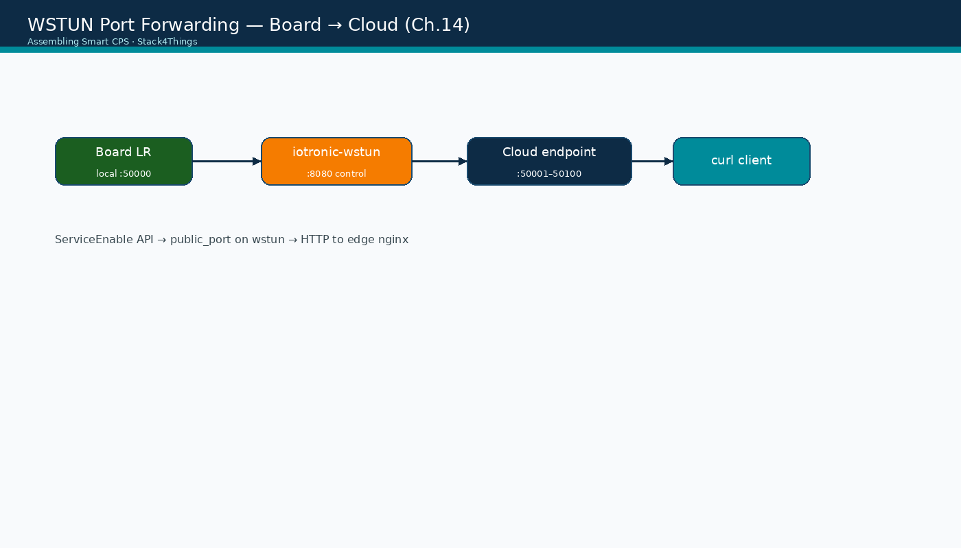
WSTUN port forwarding architecture
Assembling Smart CPS · Stack4Things Training
Diagram
Edge service → WSTUN tunnel → cloud public_port (50001–50100 range)
Notes:
Please look at the diagram on screen: WSTUN port forwarding architecture. Describe the main boxes and arrows. Relate each element to a Docker service or API you have already seen. In particular, note the following: Edge service → WSTUN tunnel → cloud public_port (50001–50100 range). Take a few seconds to orient before we continue.

Slide 18
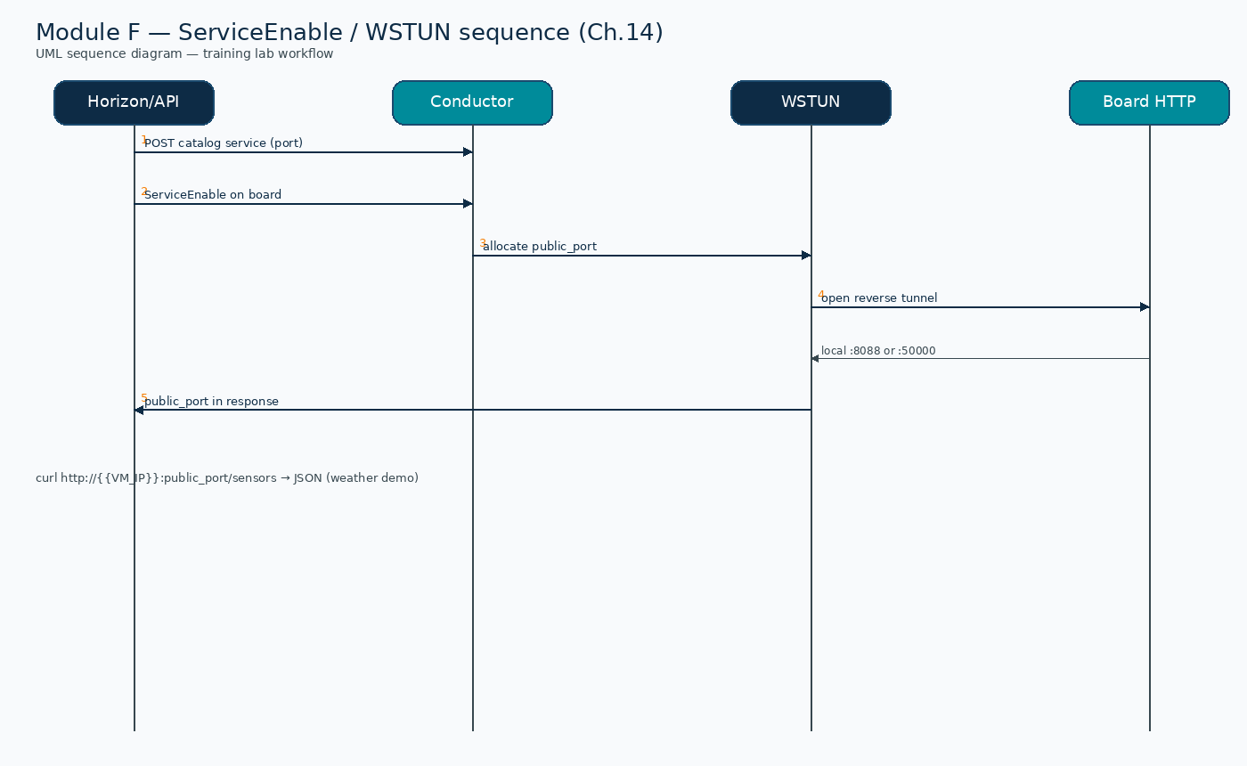
UML sequence — ServiceEnable / WSTUN (Module F)
Assembling Smart CPS · Stack4Things Training
Diagram
Catalog → ServiceEnable → WSTUN tunnel → curl public_port/sensors
Notes:
Please look at the sequence diagram on screen: UML sequence — ServiceEnable / WSTUN (Module F). Trace the diagram from left to right. Name each actor, the protocol used, and the message that crosses the cloud–edge boundary. In particular, note the following: Catalog → ServiceEnable → WSTUN tunnel → curl public_port/sensors. Take a few seconds to orient before we continue.

Slide 19
Module F — learning objectives
▸ Explain Ch.6 WoT layered model and Ch.14 web services architecture
▸ Run book weather demo via run-weather-demo.sh (port 8088 lab / 8080 book)
▸ Run nginx infra smoke test via setup-wstun-demo.py (port 50000)
▸ Execute ServiceEnable on Active board — obtain public_port mapping
▸ curl /sensors JSON from weather tunnel and HTTP 200 from nginx tunnel
Assembling Smart CPS · Stack4Things Training
Notes:
On this slide, Module F — learning objectives.
First, Explain Ch.6 WoT layered model and Ch.14 web services architecture. Next, Run book weather demo via run-weather-demo.sh (port 8088 lab / 8080 book).
By contrast, Run nginx infra smoke test via setup-wstun-demo.py (port 50000). We should also consider that Execute ServiceEnable on Active board — obtain public_port mapping.
Another key point is that Curl /sensors JSON from weather tunnel and HTTP 200 from nginx tunnel.
If these objectives are clear, we can proceed.

Slide 20
DEMO
Demo A — Book weather server (ch14) — verified
▸ Script: experiments/webservices/run-weather-demo.sh
▸ Starts weather_web_server.py inside LR on lab port 8088 (book uses 8080 on hardware)
▸ Creates catalog entry weather-wot · ServiceEnable → public_port (verified :50062)
▸ Success: curl http://{{VM_IP}}:<public_port>/sensors → JSON temperature/humidity
▸ Screenshot: assets/chapter14/weather-server-dashboard.png
▸ State file: experiments/webservices/weather-state.json
Assembling Smart CPS · Stack4Things Training
Demo
Notes:
In this demonstration, Demo A — Book weather server (ch14) — verified.
First, regarding script, experiments/webservices/run-weather-demo.sh. Next, Starts weather_web_server.py inside LR on lab port 8088 (book uses 8080 on hardware).
By contrast, Creates catalog entry weather-wot · ServiceEnable, then public_port (verified :50062). We should also consider that regarding success, curl http://{{VM_IP}}:<public_port>/sensors, then JSON temperature/humidity.
Another key point is that regarding screenshot, assets/chapter14/weather-server-dashboard.png. Furthermore, regarding state file, experiments/webservices/weather-state.json.
Check that your screen matches what we showed before moving on.
Session timing — Module F — 40-minute timeline:

Slide 21
DEMO
Demo B — nginx infra smoke test — verified
▸ Script: experiments/webservices/setup-wstun-demo.py
▸ Catalog lr-nginx-demo port 50000 → public_port (verified :50002) → HTTP 200
▸ Validates WSTUN tunnel plumbing without deploying Flask weather server
▸ Use when time is short — weather demo proves full WoT API path
▸ Both services can coexist on same board with different local ports
Assembling Smart CPS · Stack4Things Training
Demo
Notes:
In this demonstration, Demo B — nginx infra smoke test — verified.
First, regarding script, experiments/webservices/setup-wstun-demo.py. Next, Catalog lr-nginx-demo port 50000, then public_port (verified :50002), then HTTP 200.
By contrast, Validates WSTUN tunnel plumbing without deploying Flask weather server. We should also consider that Use when time is short — weather demo proves full WoT API path.
Another key point is that Both services can coexist on same board with different local ports.
Check that your screen matches what we showed before moving on.

Slide 22
Lab stack — WSTUN component ports
▸ WSTUN control plane: iotronic-wstun container in docker compose stack
▸ Tunnel public range: host ports 50001–50100 mapped in lab overlay patch
▸ Requires board Active (Module A) + service catalog entry with valid port ≠ 0
▸ Conductor API: http://{{VM_IP}}:8812 · Horizon: http://{{VM_IP}}/horizon/iot/
▸ Horizon login: admin / s4t
Assembling Smart CPS · Stack4Things Training
Notes:
On this slide, Lab stack — WSTUN component ports.
First, regarding wstun control plane, iotronic-wstun container in docker compose stack. Next, regarding tunnel public range, host ports 50001–50100 mapped in lab overlay patch.
By contrast, Requires board Active (Module A) + service catalog entry with valid port ≠ 0. We should also consider that regarding conductor api, http://{{VM_IP}}:8812 · Horizon: http://{{VM_IP}}/horizon/iot/.
Another key point is that regarding horizon login, admin / s4t.
If these objectives are clear, we can proceed.

Slide 23
⚠ BOOK ↔ LAB
Horizon Create Service — Porta default is 0!
▸ Form /horizon/iot/services/create/ defaults Porta = 0 — INVALID for any service
▸ You MUST set Porta = 50000 for lab nginx demo (LOCAL_PORT constant in this deck)
▸ Book weather demo uses port 8080 — same form, different port value
▸ Port 0 causes ServiceEnable failure or silent misconfiguration — always verify in list
▸ Prefer API if UI unclear: POST /v1/services with explicit port field in JSON body
▸ setup-wstun-demo.py script automates catalog creation with correct port
Assembling Smart CPS · Stack4Things Training
Notes:
Before we continue, an important note about Horizon Create Service — Porta default is 0!.
First, Form /horizon/iot/services/create/ defaults Porta = 0 — INVALID for any service. Next, You MUST set Porta = 50000 for lab nginx demo (LOCAL_PORT constant in this deck).
By contrast, Book weather demo uses port 8080 — same form, different port value. We should also consider that Port 0 causes ServiceEnable failure or silent misconfiguration — always verify in list.
Another key point is that regarding prefer api if ui unclear, POST /v1/services with explicit port field in JSON body. Furthermore, Setup-wstun-demo.py script automates catalog creation with correct port.
Keep this difference in mind for the rest of the lab.

Slide 24
Lab: Demo A: book weather server
run-weather-demo.sh
Notes:
We now begin a new section: Lab: Demo A: book weather server. run-weather-demo.sh. In the next slides, listen for whether we are in theory mode or hands-on mode, and open your terminal when the slides turn to lab work.
Instructor timing (title): Hands-on — Demo A: book weather server

Slide 25
Run verified weather demo script
$ cd training
$ ./experiments/webservices/run-weather-demo.sh
▸ # Starts ch14/demos/weather_web_server.py inside LR on port 8088
▸ # Creates catalog weather-wot · ServiceEnable · writes weather-state.json
▸ Expected: OK http://{{VM_IP}}:<public_port>/sensors → HTTP 200
Assembling Smart CPS · Stack4Things Training
Notes:
Now we move to the hands-on part: Run verified weather demo script. Open your lab VM and follow along.
Please run the following command on your VM: cd training. Wait until you see a sensible result before continuing. Please run the following command on your VM: ./experiments/webservices/run-weather-demo.sh. Wait until you see a sensible result before continuing.
By contrast, # Starts ch14/demos/weather_web_server.py inside LR on port 8088. We should also consider that # Creates catalog weather-wot · ServiceEnable · writes weather-state.json.
Another key point is that regarding expected, OK http://{{VM_IP}}:<public_port>/sensors, then HTTP 200.
Raise your hand if you're stuck — we'll wait until most of you are done.
Instructor timing (title): Step 1 — Run verified weather demo script

Slide 26
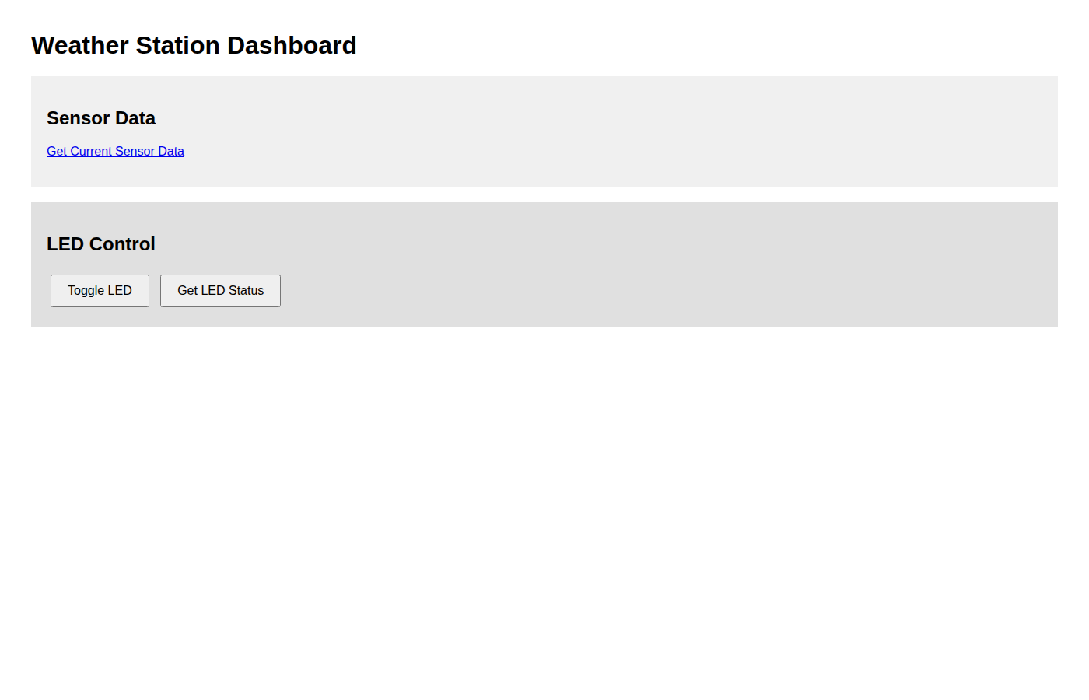
Weather server dashboard via WSTUN tunnel
Assembling Smart CPS · Stack4Things Training
Screenshot
http://{{VM_IP}}:<public_port>/ — JSON /sensors from ch14 demo
Notes:
Please look at the screenshot on screen: Weather server dashboard via WSTUN tunnel. Walk the class through what they see in the interface. Connect each panel and button to a component we already deployed in the stack. In particular, note the following: http://{{VM_IP}}:<public_port>/ — JSON /sensors from ch14 demo. Take a few seconds to orient before we continue.

Slide 27
Verify WoT sensor API
$ CLOUD=$(python3 -c "import json; print(json.load(open('experiments/webservices/weather-state.json'))['cloud_port'])")
$ curl -s http://{{VM_IP}}:$CLOUD/sensors | python3 -m json.tool
▸ Expected fields: temperature, humidity, pressure, device=weather-station
$ curl -X POST http://{{VM_IP}}:$CLOUD/led/toggle
Assembling Smart CPS · Stack4Things Training
Notes:
Now we move to the hands-on part: Verify WoT sensor API. Open your lab VM and follow along.
Please run the following command on your VM: CLOUD=$(python3 -c "import json; print(json.load(open('experiments/webservices/weather-state.json'))['cloud_port'])"). Wait until you see a sensible result before continuing. Please run the following command on your VM: curl -s http://{{VM_IP}}:$CLOUD/sensors | python3 -m json.tool. Wait until you see a sensible result before continuing.
By contrast, regarding expected fields, temperature, humidity, pressure, device=weather-station. Please run the following command on your VM: curl -X POST http://{{VM_IP}}:$CLOUD/led/toggle. Wait until you see a sensible result before continuing.
Raise your hand if you're stuck — we'll wait until most of you are done.
Instructor timing (title): Step 2 — Verify WoT sensor API

Slide 28
Lab: Demo B: nginx infra smoke test
setup-wstun-demo.py
Notes:
We now begin a new section: Lab: Demo B: nginx infra smoke test. setup-wstun-demo.py. In the next slides, listen for whether we are in theory mode or hands-on mode, and open your terminal when the slides turn to lab work.
Instructor timing (title): Hands-on — Demo B: nginx infra smoke test

Slide 29
Run nginx WSTUN smoke test
$ .venv/bin/python experiments/webservices/setup-wstun-demo.py
▸ Creates lr-nginx-demo port 50000 · captures Horizon screenshots
$ curl -v http://{{VM_IP}}:50002/
▸ Expected: HTTP 200 nginx welcome page
Assembling Smart CPS · Stack4Things Training
Notes:
Now we move to the hands-on part: Run nginx WSTUN smoke test. Open your lab VM and follow along.
Please run the following command on your VM: .venv/bin/python experiments/webservices/setup-wstun-demo.py. Wait until you see a sensible result before continuing. Next, Creates lr-nginx-demo port 50000 · captures Horizon screenshots.
Please run the following command on your VM: curl -v http://{{VM_IP}}:50002/. Wait until you see a sensible result before continuing. We should also consider that regarding expected, HTTP 200 nginx welcome page.
Raise your hand if you're stuck — we'll wait until most of you are done.
Instructor timing (title): Step 3 — Run nginx WSTUN smoke test

Slide 30
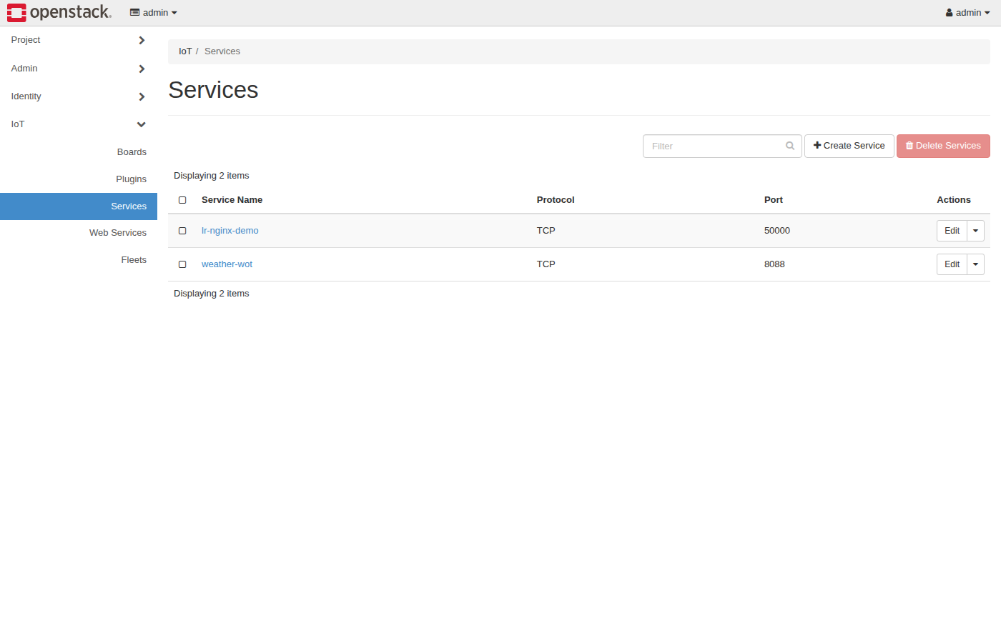
Horizon — Servizi list (port verified)
Assembling Smart CPS · Stack4Things Training
Screenshot
http://{{VM_IP}}/horizon/iot/services/ — lr-nginx-demo port 50000
Notes:
Please look at the screenshot on screen: Horizon — Servizi list (port verified). Walk the class through what they see in the interface. Connect each panel and button to a component we already deployed in the stack. In particular, note the following: http://{{VM_IP}}/horizon/iot/services/ — lr-nginx-demo port 50000. Take a few seconds to orient before we continue.

Slide 31
THEORY
Ch.14 · IoTronic services API · listing create_service
Service catalog REST schema (Ch.14)
▸ POST /v1/services — body: name (string), port (integer), protocol (TCP|UDP)
▸ GET /v1/services/ — list all catalog entries with UUID and port fields
▸ Catalog is tenant-global — same service definition reused across multiple boards
▸ ServiceEnable on board creates board-specific tunnel instance with public_port
▸ DELETE /v1/services/{uuid} — remove catalog entry (boards must disable first)
▸ Port must match actual listening port inside LR container (50000 nginx / 8080 Flask)
Assembling Smart CPS · Stack4Things Training
Theory
Notes:
In this slide we cover Service catalog REST schema (Ch.14). This material is covered in Ch.14 · IoTronic services API · listing create_service.
First, regarding post /v1/services — body, name (string), port (integer), protocol (TCP|UDP). Next, GET /v1/services/ — list all catalog entries with UUID and port fields.
By contrast, Catalog is tenant-global — same service definition reused across multiple boards. We should also consider that ServiceEnable on board creates board-specific tunnel instance with public_port.
Another key point is that DELETE /v1/services/{uuid} — remove catalog entry (boards must disable first). Furthermore, Port must match actual listening port inside LR container (50000 nginx / 8080 Flask).
I'll pause here for questions, then we'll continue.

Slide 32
ServiceEnable on board (API)
curl -X POST http://{{VM_IP}}:8812/v1/boards/<BOARD_UUID>/services/lr-nginx-demo/action \
-H "X-Auth-Token: $TOKEN" -H "Content-Type: application/json" \
-d '{"action":"ServiceEnable"}'
Assembling Smart CPS · Stack4Things Training
Code
Notes:
On this slide we walk through the code for ServiceEnable on board (API).
Scroll slowly through the listing on screen while I explain each part.
Point out the imports, the class definition, and the run method. Students will adapt this template in the lab rather than writing from scratch.
After reviewing the code, we'll apply it in the practical exercise.
Instructor timing (title): Step 2 — ServiceEnable on board (API)

Slide 33
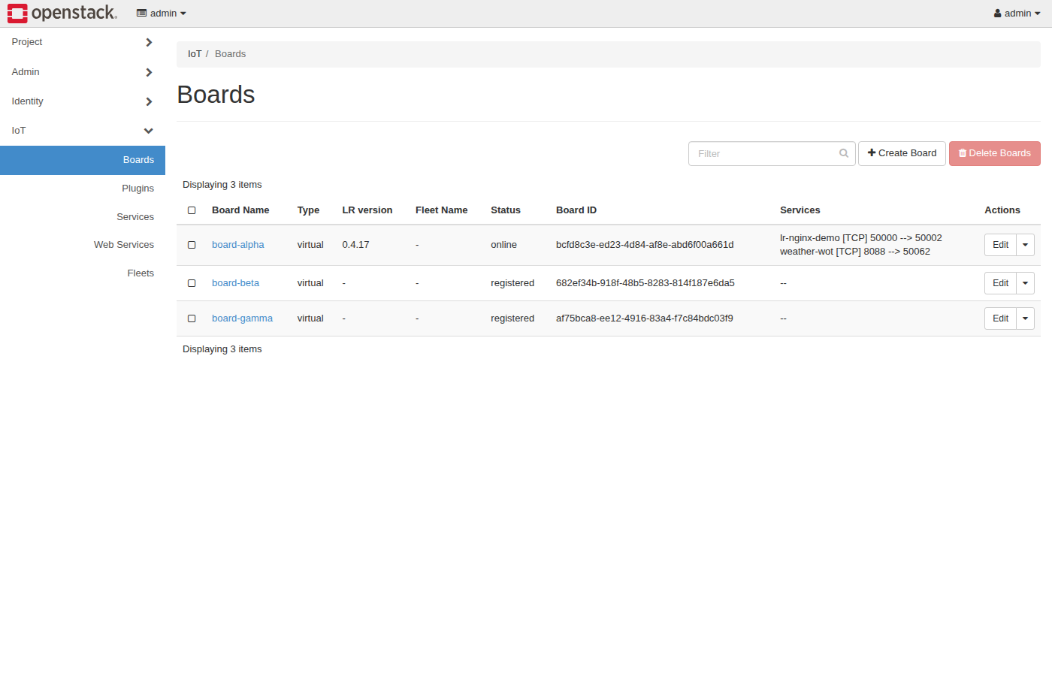
Horizon — Boards with exposed service
Assembling Smart CPS · Stack4Things Training
Screenshot
Servizi column: lr-nginx-demo [TCP] 50000 → 50002
Notes:
Please look at the screenshot on screen: Horizon — Boards with exposed service. Walk the class through what they see in the interface. Connect each panel and button to a component we already deployed in the stack. In particular, note the following: Servizi column: lr-nginx-demo [TCP] 50000 → 50002. Take a few seconds to orient before we continue.

Slide 34
THEORY
Ch.14 · ServiceEnable · WSTUN port allocation
ServiceEnable response and port mapping (Ch.14)
▸ Response public_port: host-accessible port on lab VM (50001–50100 range)
▸ Board column in Horizon shows: service_name [protocol] local_port → public_port
▸ Traffic flow: client → {{VM_IP}}:public_port → WSTUN → LR:local_port
▸ LR nginx (lab) or Flask (book) must be listening BEFORE ServiceEnable
▸ ServiceDisable action tears down tunnel — public_port returned to pool
▸ Multiple services on same board: separate catalog entries with different local ports
Assembling Smart CPS · Stack4Things Training
Theory
Notes:
In this slide we cover ServiceEnable response and port mapping (Ch.14). This material is covered in Ch.14 · ServiceEnable · WSTUN port allocation.
First, regarding response public_port, host-accessible port on lab VM (50001–50100 range). Next, regarding board column in horizon shows, service_name [protocol] local_port, then public_port.
By contrast, regarding traffic flow, client, then {{VM_IP}}:public_port, then WSTUN, then LR:local_port. We should also consider that LR nginx (lab) or Flask (book) must be listening BEFORE ServiceEnable.
Another key point is that ServiceDisable action tears down tunnel — public_port returned to pool. Furthermore, regarding multiple services on same board, separate catalog entries with different local ports.
I'll pause here for questions, then we'll continue.

Slide 35
Verify cloud endpoint with curl
$ curl -v http://{{VM_IP}}:50002/
▸ # nginx demo public_port — check wstun-state.json if different
▸ Expected: HTTP 200 + nginx welcome page from board LR container
$ ./validate/validate-demo-ch14.sh && ./validate-lab-wstun.sh
Assembling Smart CPS · Stack4Things Training
Notes:
Now we move to the hands-on part: Verify cloud endpoint with curl. Open your lab VM and follow along.
Please run the following command on your VM: curl -v http://{{VM_IP}}:50002/. Wait until you see a sensible result before continuing. Next, # nginx demo public_port — check wstun-state.json if different.
By contrast, regarding expected, HTTP 200 + nginx welcome page from board LR container. Please run the following command on your VM: ./validate/validate-demo-ch14.sh && ./validate-lab-wstun.sh. Wait until you see a sensible result before continuing.
Raise your hand if you're stuck — we'll wait until most of you are done.
Instructor timing (title): Step 4 — Verify cloud endpoint with curl

Slide 36
WSTUN troubleshooting logs
$ docker logs iotronic-wstun 2>&1 | tail -20
$ docker logs lightning-rod 2>&1 | grep -i 'Cloud service'
▸ Look for: TCP server listening on assigned public port
▸ Common fix: recreate catalog entry if port was 0
Assembling Smart CPS · Stack4Things Training
Notes:
Now we move to the hands-on part: WSTUN troubleshooting logs. Open your lab VM and follow along.
Please run the following command on your VM: docker logs iotronic-wstun 2>&1 | tail -20. Wait until you see a sensible result before continuing. Please run the following command on your VM: docker logs lightning-rod 2>&1 | grep -i 'Cloud service'. Wait until you see a sensible result before continuing.
By contrast, regarding look for, TCP server listening on assigned public port. We should also consider that regarding common fix, recreate catalog entry if port was 0.
Raise your hand if you're stuck — we'll wait until most of you are done.
Instructor timing (title): Step 5 — WSTUN troubleshooting logs

Slide 37
THEORY
Ch.14 demos/weather_web_server.py · weather-state.json
Book weather server — verified lab procedure (Ch.14)
▸ Script run-weather-demo.sh copies ch14/demos/weather_web_server.py into LR container
▸ Lab port 8088 used because LR compose image reserves :8080 for WSTUN client stack
▸ Catalog entry weather-wot port 8088 · ServiceEnable → curl /sensors JSON via public_port
▸ Verified: HTTP 200 on /sensors with temperature, humidity, pressure fields
▸ Book hardware boards use port 8080 as documented in ch14/demos/README.md
▸ Repo: github.com/AssemblingSmartCPS/ch14
Assembling Smart CPS · Stack4Things Training
Theory
Notes:
In this slide we cover Book weather server — verified lab procedure (Ch.14). This material is covered in Ch.14 demos/weather_web_server.py · weather-state.json.
First, Script run-weather-demo.sh copies ch14/demos/weather_web_server.py into LR container. Next, Lab port 8088 used because LR compose image reserves :8080 for WSTUN client stack.
By contrast, Catalog entry weather-wot port 8088 · ServiceEnable, then curl /sensors JSON via public_port. We should also consider that regarding verified, HTTP 200 on /sensors with temperature, humidity, pressure fields.
Another key point is that Book hardware boards use port 8080 as documented in ch14/demos/README.md. Furthermore, regarding repo, github.com/AssemblingSmartCPS/ch14.
I'll pause here for questions, then we'll continue.

Slide 38
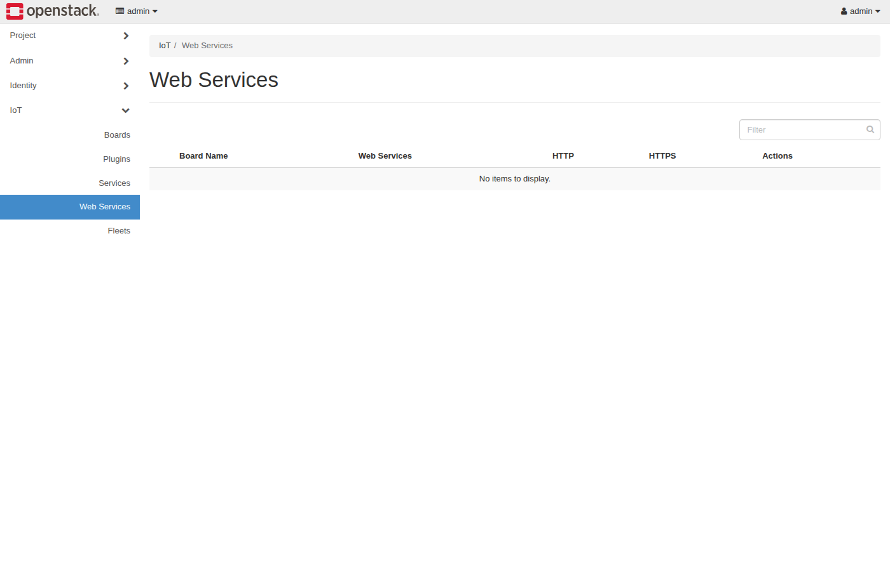
Horizon — Web Services panel (Designate path)
Assembling Smart CPS · Stack4Things Training
Screenshot
http://{{VM_IP}}/horizon/iot/webservices/ — full WoT URL setup (optional tour)
Notes:
Please look at the screenshot on screen: Horizon — Web Services panel (Designate path). Walk the class through what they see in the interface. Connect each panel and button to a component we already deployed in the stack. In particular, note the following: http://{{VM_IP}}/horizon/iot/webservices/ — full WoT URL setup (optional tour). Take a few seconds to orient before we continue.

Slide 39
THEORY
Ch.14 · local domain simulation · Designate integration
Production WoT path — Designate + /etc/hosts (Ch.14)
▸ Install/configure OpenStack Designate with public domain zone (example.com)
▸ Testing without real DNS: map example.com → {{VM_IP}} in /etc/hosts on client machine
▸ Enable WSM → service wot :8080 → https://wot.board-1.example.com/temperature
▸ NGINX terminates TLS — forwards to WSTUN tunnel — same machinery as port mapping
▸ Human-readable URLs enable WoT Find/Share layers (Ch.6) at scale
▸ Designate optional in Docker lab — WSTUN port path sufficient for training objectives
Assembling Smart CPS · Stack4Things Training
Theory
Notes:
In this slide we cover Production WoT path — Designate + /etc/hosts (Ch.14). This material is covered in Ch.14 · local domain simulation · Designate integration.
First, Install/configure OpenStack Designate with public domain zone (example.com). Next, regarding testing without real dns, map example.com, then {{VM_IP}} in /etc/hosts on client machine.
By contrast, regarding enable wsm → service wot, 8080, then https://wot.board-1.example.com/temperature. We should also consider that NGINX terminates TLS — forwards to WSTUN tunnel — same machinery as port mapping.
Another key point is that Human-readable URLs enable WoT Find/Share layers (Ch.6) at scale. Furthermore, Designate optional in Docker lab — WSTUN port path sufficient for training objectives.
I'll pause here for questions, then we'll continue.

Slide 40
THEORY
Ch.6 · Ch.14 security notes
WoT security considerations (Ch.6 + Ch.14)
▸ HTTPS at cloud edge — never expose raw board HTTP to public Internet in production
▸ Keystone authentication for IoTronic API — ServiceEnable requires valid token
▸ Board services should validate input on POST actuators (LED, GPIO) — prevent abuse
▸ Rate limiting at NGINX for public WSTUN endpoints under DDoS exposure
▸ Lab: HTTP acceptable on {{VM_IP}}:public_port for classroom — not production pattern
▸ Cross-reference Module E VN for network-layer security groups on overlay
Assembling Smart CPS · Stack4Things Training
Theory
Notes:
In this slide we cover WoT security considerations (Ch.6 + Ch.14). This material is covered in Ch.6 · Ch.14 security notes.
First, HTTPS at cloud edge — never expose raw board HTTP to public Internet in production. Next, Keystone authentication for IoTronic API — ServiceEnable requires valid token.
By contrast, Board services should validate input on POST actuators (LED, GPIO) — prevent abuse. We should also consider that Rate limiting at NGINX for public WSTUN endpoints under DDoS exposure.
Another key point is that regarding lab, HTTP acceptable on {{VM_IP}}:public_port for classroom — not production pattern. Furthermore, Cross-reference Module E VN for network-layer security groups on overlay.
I'll pause here for questions, then we'll continue.

Slide 41
THEORY
Ch.6 RESTful Things · Ch.14 weather_web_server.py endpoints
REST design for WoT resources (Ch.6 + Ch.14)
▸ GET /temperature — read sensor property; idempotent, cacheable, safe method
▸ POST /led — actuate actuator with JSON body {"state": "on"} — non-idempotent action
▸ Content-Type: application/json for machine clients; text/html optional for dashboards
▸ HTTP status codes: 200 OK read, 201 Created action, 503 if sensor temporarily unavailable
▸ Book weather server returns JSON: {"temperature": 22.5, "unit": "C"} — WoT property pattern
▸ Lab nginx returns HTML welcome page — infra validation only; weather server is true WoT API
Assembling Smart CPS · Stack4Things Training
Theory
Notes:
In this slide we cover REST design for WoT resources (Ch.6 + Ch.14). This material is covered in Ch.6 RESTful Things · Ch.14 weather_web_server.py endpoints.
First, GET /temperature — read sensor property; idempotent, cacheable, safe method. Next, POST /led — actuate actuator with JSON body {"state": "on"} — non-idempotent action.
By contrast, regarding content-type, application/json for machine clients; text/html optional for dashboards. We should also consider that regarding http status codes, 200 OK read, 201 Created action, 503 if sensor temporarily unavailable.
Another key point is that regarding book weather server returns json, {"temperature": 22.5, "unit": "C"} — WoT property pattern. Furthermore, Lab nginx returns HTML welcome page — infra validation only; weather server is true WoT API.
I'll pause here for questions, then we'll continue.

Slide 42
THEORY
Ch.6 §6.4 gateway architecture · Ch.14 NGINX integration
NGINX reverse proxy role in S4T WoT (Ch.6 §6.4 + Ch.14)
▸ Cloud NGINX terminates TLS and routes Host header to correct board tunnel backend
▸ Location block per subdomain: wot.board-1.example.com → upstream WSTUN backend port
▸ Board-side nginx (lab :50000) or Flask (:8080) is origin server — NGINX is edge proxy
▸ WebSocket upgrade headers preserved for WSTUN tunnel establishment and maintenance
▸ Same NGINX instance serves Horizon UI and IoT service proxy — different server_name blocks
▸ Production: NGINX + Designate + WSTUN three-component path to Deviceless URL (Module I)
Assembling Smart CPS · Stack4Things Training
Theory
Notes:
In this slide we cover NGINX reverse proxy role in S4T WoT (Ch.6 §6.4 + Ch.14). This material is covered in Ch.6 §6.4 gateway architecture · Ch.14 NGINX integration.
First, Cloud NGINX terminates TLS and routes Host header to correct board tunnel backend. Next, regarding location block per subdomain, wot.board-1.example.com, then upstream WSTUN backend port.
By contrast, regarding board-side nginx (lab, 50000) or Flask (:8080) is origin server — NGINX is edge proxy. We should also consider that WebSocket upgrade headers preserved for WSTUN tunnel establishment and maintenance.
Another key point is that Same NGINX instance serves Horizon UI and IoT service proxy — different server_name blocks. Furthermore, regarding production, NGINX + Designate + WSTUN three-component path to Deviceless URL (Module I).
I'll pause here for questions, then we'll continue.

Slide 43
THEORY
Ch.6 · Find layer · Thing Description W3C WoT spec cross-reference
Thing Descriptions and discovery (Ch.6 Find layer)
▸ WoT Thing Description (TD): JSON-LD document listing properties, actions, events, schemas
▸ Well-known URI: /.well-known/wot-thing-description — automated discovery by mashup apps
▸ CoRE Link Format alternative for constrained devices — Link header in HTTP responses
▸ S4T Designate DNS enables stable TD URL: https://wot.board.example.com/td
▸ Find layer completes Access: clients discover API contract before invoking endpoints
▸ Lab WSTUN path skips Find (no DNS) — students should know production adds TD + DNS
Assembling Smart CPS · Stack4Things Training
Theory
Notes:
In this slide we cover Thing Descriptions and discovery (Ch.6 Find layer). This material is covered in Ch.6 · Find layer · Thing Description W3C WoT spec cross-reference.
First, regarding wot thing description (td), JSON-LD document listing properties, actions, events, schemas. Next, regarding well-known uri, /.well-known/wot-thing-description — automated discovery by mashup apps.
By contrast, CoRE Link Format alternative for constrained devices — Link header in HTTP responses. We should also consider that regarding s4t designate dns enables stable td url, https://wot.board.example.com/td.
Another key point is that regarding find layer completes access, clients discover API contract before invoking endpoints. Furthermore, Lab WSTUN path skips Find (no DNS) — students should know production adds TD + DNS.
I'll pause here for questions, then we'll continue.

Slide 44
THEORY
Ch.14 · service lifecycle · ServiceDisable listing
Service lifecycle — Enable, Disable, Update (Ch.14)
▸ ServiceEnable: creates WSTUN tunnel, assigns public_port, starts forwarding traffic
▸ ServiceDisable: tears down tunnel, releases public_port back to pool 50001–50100
▸ Board must be Active before ServiceEnable — same prerequisite as plugin inject (Module A)
▸ Changing catalog port requires Disable → update catalog → re-Enable on affected boards
▸ Multiple services per board: separate catalog entries (lr-nginx-demo :50000, wot :8080)
▸ Horizon boards column shows all active service mappings per board for operational audit
Assembling Smart CPS · Stack4Things Training
Theory
Notes:
In this slide we cover Service lifecycle — Enable, Disable, Update (Ch.14). This material is covered in Ch.14 · service lifecycle · ServiceDisable listing.
First, regarding serviceenable, creates WSTUN tunnel, assigns public_port, starts forwarding traffic. Next, regarding servicedisable, tears down tunnel, releases public_port back to pool 50001–50100.
By contrast, Board must be Active before ServiceEnable — same prerequisite as plugin inject (Module A). We should also consider that Changing catalog port requires Disable, then update catalog, then re-Enable on affected boards.
Another key point is that regarding multiple services per board, separate catalog entries (lr-nginx-demo :50000, wot :8080). Furthermore, Horizon boards column shows all active service mappings per board for operational audit.
I'll pause here for questions, then we'll continue.

Slide 45
THEORY
Ch.14 §14.3 · WSTUN vs Designate comparison table
WSTUN vs Designate — decision guide (Ch.14)
▸ Use WSTUN port mapping: lab, demos, quick tests — http://{{VM_IP}}:public_port/path
▸ Use Designate DNS: production, human URLs, WoT Find/Share layers, Module I Deviceless
▸ Same ServiceEnable API — difference is only how clients construct the public URL
▸ Designate requires DNS zone + NGINX server_name config — more setup, better UX
▸ Book weather demo intended for Designate path — WSTUN port path is lab training shortcut
▸ Both paths traverse same WebSocket tunnel — WSTUNServer is shared infrastructure
Assembling Smart CPS · Stack4Things Training
Theory
Notes:
In this slide we cover WSTUN vs Designate — decision guide (Ch.14). This material is covered in Ch.14 §14.3 · WSTUN vs Designate comparison table.
First, regarding use wstun port mapping, lab, demos, quick tests — http://{{VM_IP}}:public_port/path. Next, regarding use designate dns, production, human URLs, WoT Find/Share layers, Module I Deviceless.
By contrast, Same ServiceEnable API — difference is only how clients construct the public URL. We should also consider that Designate requires DNS zone + NGINX server_name config — more setup, better UX.
Another key point is that Book weather demo intended for Designate path — WSTUN port path is lab training shortcut. Furthermore, Both paths traverse same WebSocket tunnel — WSTUNServer is shared infrastructure.
I'll pause here for questions, then we'll continue.

Slide 46
ServiceDisable cleanup (optional)
▸ API: POST .../services/lr-nginx-demo/action with {"action":"ServiceDisable"}
▸ Verify Horizon boards column clears service mapping
▸ Re-Enable to confirm public_port may change — not guaranteed same port after recycle
Assembling Smart CPS · Stack4Things Training
Notes:
Now we move to the hands-on part: ServiceDisable cleanup (optional). Open your lab VM and follow along.
First, regarding api, POST .../services/lr-nginx-demo/action with {"action":"ServiceDisable"}. Next, Verify Horizon boards column clears service mapping.
By contrast, Re-Enable to confirm public_port may change — not guaranteed same port after recycle.
Raise your hand if you're stuck — we'll wait until most of you are done.
Instructor timing (title): Step 5 — ServiceDisable cleanup (optional)

Slide 47
Validate WSTUN module
$ cd training && ./validate-lab-wstun.sh
▸ Script verifies catalog port, ServiceEnable state, and curl HTTP 200
Assembling Smart CPS · Stack4Things Training
Notes:
Now we move to the hands-on part: Validate WSTUN module. Open your lab VM and follow along.
Please run the following command on your VM: cd training && ./validate-lab-wstun.sh. Wait until you see a sensible result before continuing. Next, Script verifies catalog port, ServiceEnable state, and curl HTTP 200.
Raise your hand if you're stuck — we'll wait until most of you are done.
Instructor timing (title): Step 6 — Validate WSTUN module

Slide 48
Module F checklist
▸ □ weather-wot service verified: curl /sensors → JSON HTTP 200 (run-weather-demo.sh)
▸ □ lr-nginx-demo port 50000 → public_port curl HTTP 200 (setup-wstun-demo.py)
▸ □ Board Servizi column shows both tunnel mappings
▸ □ Student can explain book port 8080 vs lab port 8088 (LR image constraint)
▸ □ Student can describe Designate path vs WSTUN port path
▸ □ ./validate/validate-all.sh Module F checks pass
Assembling Smart CPS · Stack4Things Training
Notes:
On this slide, Module F checklist.
First, regarding □ weather-wot service verified, curl /sensors, then JSON HTTP 200 (run-weather-demo.sh). Next, □ lr-nginx-demo port 50000, then public_port curl HTTP 200 (setup-wstun-demo.py).
By contrast, □ Board Servizi column shows both tunnel mappings. We should also consider that □ Student can explain book port 8080 vs lab port 8088 (LR image constraint).
Another key point is that □ Student can describe Designate path vs WSTUN port path. Furthermore, □ ./validate/validate-all.sh Module F checks pass.
If these objectives are clear, we can proceed.

