Slide 1
S4T TRAINING
Module G — Federated Learning on the Edge
Ch.19 · Advanced · VM {{VM_IP}}
Advanced · Ch.19 — Federated Learning · requires Module D (3 Active boards)
Notes:
Welcome. In this module we will work through Module G — Federated Learning on the Edge.
Ch.19 · Advanced · VM {{VM_IP}}
The session alternates theory from the book with live exercises on the Stack4Things lab VM. Replace the placeholder IP with the address of the machine you are using.
Advanced · Ch.19 — Federated Learning · requires Module D (3 Active boards).
When you're ready, advance to the first section.

Slide 2
Federated Learning theory
Ch.19 — motivation, architecture, taxonomy
Notes:
We now begin a new section: Federated Learning theory. Ch.19 — motivation, architecture, taxonomy. In the next slides, listen for whether we are in theory mode or hands-on mode, and open your terminal when the slides turn to lab work.

Slide 3
THEORY
Ch.19 · FL motivation · regulatory compliance section
Why Federated Learning? (Ch.19)
▸ Centralized ML: collect all raw data to cloud — privacy, GDPR, bandwidth, latency risks
▸ FL: train collaboratively — raw data never leaves edge devices or local storage
▸ Only model weight updates (gradients/parameters) sent to aggregation server each round
▸ Critical for healthcare, finance, smart cities, IoT fleets with sensitive local data
▸ Regulatory frameworks (GDPR, DPDP, HIPAA) restrict data centralization — FL enables compliance
▸ Book motivation section cites real-world cases: hospitals, banks, cross-device IoT
Assembling Smart CPS · Stack4Things Training
Theory
Notes:
In this slide we cover Why Federated Learning? (Ch.19). This material is covered in Ch.19 · FL motivation · regulatory compliance section.
First, regarding centralized ml, collect all raw data to cloud — privacy, GDPR, bandwidth, latency risks. Next, regarding fl, train collaboratively — raw data never leaves edge devices or local storage.
By contrast, Only model weight updates (gradients/parameters) sent to aggregation server each round. We should also consider that Critical for healthcare, finance, smart cities, IoT fleets with sensitive local data.
Another key point is that Regulatory frameworks (GDPR, DPDP, HIPAA) restrict data centralization — FL enables compliance. Furthermore, regarding book motivation section cites real-world cases, hospitals, banks, cross-device IoT.
I'll pause here for questions, then we'll continue.

Slide 4
THEORY
Ch.19 · centralized vs federated comparison
Centralized vs federated — operational contrast (Ch.19)
▸ Centralized: ETL pipeline uploads datasets → single GPU cluster trains monolithic model
▸ Federated: N clients train locally → server aggregates → global model improves iteratively
▸ Centralized bottleneck: network upload of full dataset from each edge site
▸ Federated bottleneck: straggler clients, non-IID data distribution, communication rounds
▸ S4T value proposition: IoTronic deploys FL client plugin to fleet — operational layer for FL
▸ Lab demo: 3 production lines, 3 CSV files, 1 Flower server — horizontal FL for failure prediction
Assembling Smart CPS · Stack4Things Training
Theory
Notes:
In this slide we cover Centralized vs federated — operational contrast (Ch.19). This material is covered in Ch.19 · centralized vs federated comparison.
First, in the centralized approach, an ETL pipeline uploads datasets, then a single GPU cluster trains a monolithic model. Next, in the federated approach, N clients train locally, then the server aggregates, then the global model improves iteratively.
By contrast, a major bottleneck of centralized training is network upload of full dataset from each edge site. We should also consider that federated learning has bottlenecks: straggler clients, non-IID data distribution, communication rounds.
Another key point is that for Stack4Things, the value proposition is that IoTronic deploys FL client plugin to fleet — the operational layer for federated learning. Furthermore, our lab demonstration uses 3 production lines, 3 CSV files, 1 Flower server — horizontal FL for failure prediction.
I'll pause here for questions, then we'll continue.

Slide 5
THEORY
Ch.19 · fig:chap19:federated_learning_architecture · listing server.py
FL architecture components (Ch.19)
▸ Server (Flower in lab): orchestrates rounds, aggregates updates (FedAvg algorithm)
▸ Clients: local training on board-resident telemetry — machine_1/2/3.csv (predictive maintenance)
▸ Stack4Things: async plugin injected on each board via IoTronic — Worker connects to server
▸ Direct TCP to Flower server on VM host — lightweight for lab; MQTT optional in field
▸ Book figure: fig:chap19:federated_learning_architecture — 3 clients + 1 server
▸ Each client runs local epochs before sending weight update — not every mini-batch
Assembling Smart CPS · Stack4Things Training
Theory
Notes:
In this slide we cover FL architecture components (Ch.19). This material is covered in Ch.19 · fig:chap19:federated_learning_architecture · listing server.py.
First, regarding server (flower in lab), orchestrates rounds, aggregates updates (FedAvg algorithm). Next, regarding clients, local training on board-resident telemetry — machine_1/2/3.csv (predictive maintenance).
By contrast, regarding stack4things, async plugin injected on each board via IoTronic — Worker connects to server. We should also consider that Direct TCP to Flower server on VM host — lightweight for lab; MQTT optional in field.
Another key point is that regarding book figure, fig:chap19:federated_learning_architecture — 3 clients + 1 server. Furthermore, Each client runs local epochs before sending weight update — not every mini-batch.
I'll pause here for questions, then we'll continue.

Slide 6
THEORY
Ch.19 · FedAvg · Flower framework references
FedAvg aggregation algorithm (Ch.19)
▸ Federated Averaging: server computes weighted average of client model parameters
▸ Weight proportional to local dataset size — larger datasets influence global model more
▸ Round k: server broadcasts global model → clients train locally → clients send updates
▸ Server aggregates → broadcasts updated global model → repeat for FL_ROUNDS iterations
▸ Convergence depends on data IID-ness — lab CSVs designed with compatible schema
▸ Flower framework abstracts transport — same FedAvg logic in lab and production
Assembling Smart CPS · Stack4Things Training
Theory
Notes:
In this slide we cover FedAvg aggregation algorithm (Ch.19). This material is covered in Ch.19 · FedAvg · Flower framework references.
First, regarding federated averaging, server computes weighted average of client model parameters. Next, Weight proportional to local dataset size — larger datasets influence global model more.
By contrast, regarding round k, server broadcasts global model, then clients train locally, then clients send updates. We should also consider that Server aggregates, then broadcasts updated global model, then repeat for FL_ROUNDS iterations.
Another key point is that Convergence depends on data IID-ness — lab CSVs designed with compatible schema. Furthermore, Flower framework abstracts transport — same FedAvg logic in lab and production.
I'll pause here for questions, then we'll continue.

Slide 7
THEORY
Ch.19 · FL types · horizontal vs vertical
FL taxonomy — four categories (Ch.19)
▸ Horizontal FL: same features, different samples — hospitals, IoT boards (lab demo type)
▸ Vertical FL: different features, same samples — bank + credit card company collaboration
▸ Cross-silo: organizations with stable connectivity and rich local datasets
▸ Cross-device: many mobile/IoT clients, intermittent connectivity, small local data
▸ Lab demo: horizontal cross-silo — 3 boards, same CSV schema, different row samples
▸ Book taxonomy table helps students classify real-world FL deployment scenarios
Assembling Smart CPS · Stack4Things Training
Theory
Notes:
In this slide we cover FL taxonomy — four categories (Ch.19). This material is covered in Ch.19 · FL types · horizontal vs vertical.
First, regarding horizontal fl, same features, different samples — hospitals, IoT boards (lab demo type). Next, regarding vertical fl, different features, same samples — bank + credit card company collaboration.
By contrast, regarding cross-silo, organizations with stable connectivity and rich local datasets. We should also consider that regarding cross-device, many mobile/IoT clients, intermittent connectivity, small local data.
Another key point is that our lab demonstration uses horizontal cross-silo — 3 boards, same CSV schema, different row samples. Furthermore, Book taxonomy table helps students classify real-world FL deployment scenarios.
I'll pause here for questions, then we'll continue.

Slide 8
THEORY
Ch.19 · non-IID · predictive maintenance lab extension
Non-IID data challenges (Ch.19)
▸ Real edge data often non-IID: each production line has different failure signatures
▸ Lab: CNC spindle vs conveyor vs pump — distinct vibration/temperature/current patterns
▸ target=1 = failure imminent; federated model learns global predictor without centralizing CSVs
▸ Non-IID slows convergence — may require more FL_ROUNDS or specialized aggregation
▸ Production mitigations: FedProx, SCAFFOLD — beyond lab scope
▸ Module D fleet (3 boards) mirrors cross-silo industrial FL scenario
Assembling Smart CPS · Stack4Things Training
Theory
Notes:
In this slide we cover Non-IID data challenges (Ch.19). This material is covered in Ch.19 · non-IID · predictive maintenance lab extension.
First, regarding real edge data often non-iid, each production line has different failure signatures. Next, regarding lab, CNC spindle vs conveyor vs pump — distinct vibration/temperature/current patterns.
By contrast, Target=1 = failure imminent; federated model learns global predictor without centralizing CSVs. We should also consider that Non-IID slows convergence — may require more FL_ROUNDS or specialized aggregation.
Another key point is that regarding production mitigations, fedProx, SCAFFOLD — beyond lab scope. Furthermore, Module D fleet (3 boards) mirrors cross-silo industrial FL scenario.
I'll pause here for questions, then we'll continue.

Slide 9
THEORY
Ch.19 · server on cloud VM · 3 board clients · Horizon Federated Learn
S4T + FL integration — plugin model (Ch.19)
▸ Each board monitors a different machine: vibration, temperature, motor current (local CSV)
▸ Target: binary failure_imminent — raw telemetry never leaves the edge board
▸ Plugin lifecycle: install datasets → shared fl-client in FL panel → inject → Start
▸ board-alpha = CNC spindle, board-beta = conveyor motor, board-gamma = pump line
▸ Non-IID by design: each line has different failure signatures (Ch.19 horizontal FL)
▸ Repo: ch19/server.py + fl_client_plugin.py + machine_*.csv (generate_pm_datasets.py)
Assembling Smart CPS · Stack4Things Training
Theory
Notes:
In this slide we cover S4T + FL integration — plugin model (Ch.19). This material is covered in Ch.19 · server on cloud VM · 3 board clients · Horizon Federated Learning panel.
First, regarding each board monitors a different machine, vibration, temperature, motor current (local CSV). Next, regarding target, binary failure_imminent — raw telemetry never leaves the edge board.
By contrast, regarding plugin lifecycle, install datasets, then shared fl-client in FL panel, then inject, then Start. We should also consider that Board-alpha = CNC spindle, board-beta = conveyor motor, board-gamma = pump line.
Another key point is that regarding non-iid by design, each line has different failure signatures (Ch.19 horizontal FL). Furthermore, regarding repo, ch19/server.py + fl_client_plugin.py + machine_*.csv (generate_pm_datasets.py).
I'll pause here for questions, then we'll continue.

Slide 10
THEORY
Ch.19 · regulatory compliance · privacy-preserving FL footnote
Privacy and regulatory framing (Ch.19)
▸ GDPR Article 25: data protection by design — FL keeps raw data at edge by default
▸ DPDP (India), HIPAA (US healthcare): restrict cross-border raw data transfer
▸ FL enables smarter systems while data stays on edge nodes under local jurisdiction
▸ S4T provides deployment vehicle (IoTronic inject) — FL provides training methodology
▸ Production extensions: differential privacy noise on updates, secure aggregation (crypto)
▸ Lab scope: demonstrate FL workflow — not production-grade privacy guarantees
Assembling Smart CPS · Stack4Things Training
Theory
Notes:
In this slide we cover Privacy and regulatory framing (Ch.19). This material is covered in Ch.19 · regulatory compliance · privacy-preserving FL footnote.
First, regarding gdpr article 25, data protection by design — FL keeps raw data at edge by default. Next, regarding dpdp (india), hipaa (us healthcare), restrict cross-border raw data transfer.
By contrast, FL enables smarter systems while data stays on edge nodes under local jurisdiction. We should also consider that S4T provides deployment vehicle (IoTronic inject) — FL provides training methodology.
Another key point is that regarding production extensions, differential privacy noise on updates, secure aggregation (crypto). Furthermore, regarding lab scope, demonstrate FL workflow — not production-grade privacy guarantees.
I'll pause here for questions, then we'll continue.

Slide 11
THEORY
Ch.19 § Challenges and open issues · FedProx · secure aggregation foot
FL challenges and open issues (Ch.19)
▸ System heterogeneity: boards differ in CPU, RAM, bandwidth — stragglers delay aggregation rounds.
▸ Client availability: intermittent connectivity reduces effective participants per round.
▸ Model heterogeneity: incompatible architectures complicate weight merging and convergence.
▸ Statistical heterogeneity (Non-IID): skewed local data degrades global model accuracy.
▸ Model update security: poisoning and backdoor attacks via malicious local training data.
▸ Mitigations include FedProx, secure aggregation, differential privacy — research beyond lab scope.
Assembling Smart CPS · Stack4Things Training
Theory
Notes:
In this slide we cover FL challenges and open issues (Ch.19). This material is covered in Ch.19 § Challenges and open issues · FedProx · secure aggregation footnote.
First, regarding system heterogeneity, boards differ in CPU, RAM, bandwidth — stragglers delay aggregation rounds. Next, regarding client availability, intermittent connectivity reduces effective participants per round.
By contrast, regarding model heterogeneity, incompatible architectures complicate weight merging and convergence. We should also consider that regarding statistical heterogeneity (non-iid), skewed local data degrades global model accuracy.
Another key point is that regarding model update security, poisoning and backdoor attacks via malicious local training data. Furthermore, Mitigations include FedProx, secure aggregation, differential privacy — research beyond lab scope.
I'll pause here for questions, then we'll continue.

Slide 12
THEORY
Ch.19 § Core requirements · tools and frameworks
FL platform landscape (Ch.19)
▸ Open source: TensorFlow Federated, Flower (lab choice), PySyft, LEAF benchmarks, FedML.
▸ Enterprise: NVIDIA FLARE, IBM FL — production orchestration and compliance tooling.
▸ Flower chosen in ch19 repo for lightweight Python server + edge client plugin integration.
▸ Platform choice depends on scale, privacy requirements, and edge hardware constraints.
▸ S4T contribution: same IoTronic inject lifecycle deploys FL client Workers on real boards.
▸ Google/Apple on-device FL cited in book as industry validation of federated approach.
Assembling Smart CPS · Stack4Things Training
Theory
Notes:
In this slide we cover FL platform landscape (Ch.19). This material is covered in Ch.19 § Core requirements · tools and frameworks.
First, regarding open source, tensorFlow Federated, Flower (lab choice), PySyft, LEAF benchmarks, FedML. Next, regarding enterprise, NVIDIA FLARE, IBM FL — production orchestration and compliance tooling.
By contrast, Flower chosen in ch19 repo for lightweight Python server + edge client plugin integration. We should also consider that Platform choice depends on scale, privacy requirements, and edge hardware constraints.
Another key point is that regarding s4t contribution, same IoTronic inject lifecycle deploys FL client Workers on real boards. Furthermore, Google/Apple on-device FL cited in book as industry validation of federated approach.
I'll pause here for questions, then we'll continue.

Slide 13
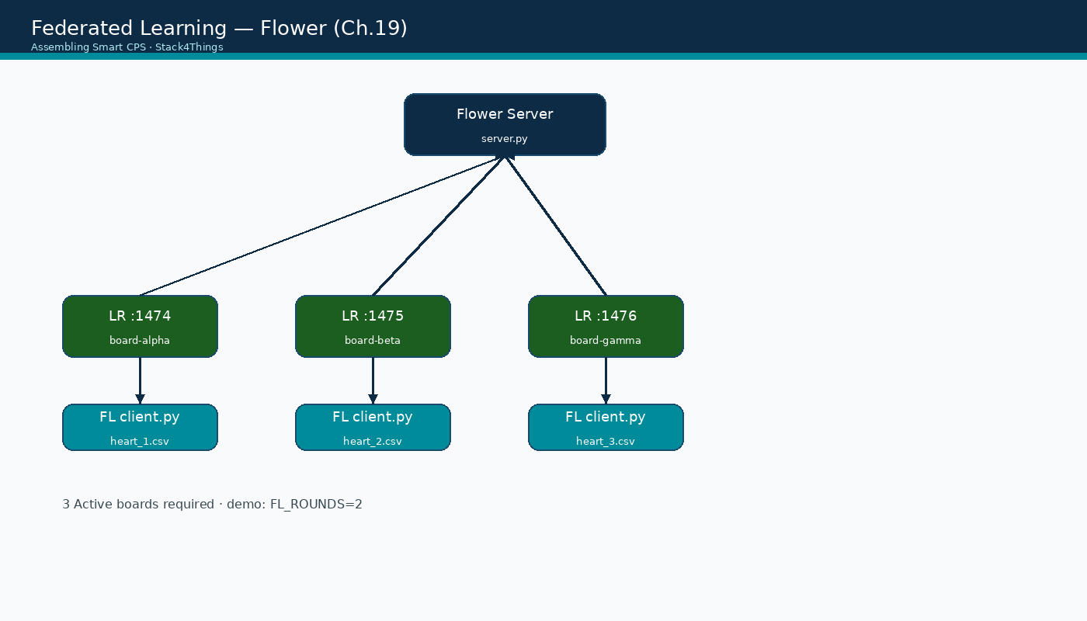
FL architecture — 3 edge clients
Assembling Smart CPS · Stack4Things Training
Diagram
Flower server on VM host + 3 LR clients on :1474/:1475/:1476 (Module D)
Notes:
Please look at the diagram on screen: FL architecture — 3 edge clients. Describe the main boxes and arrows. Relate each element to a Docker service or API you have already seen. In particular, note the following: Flower server on VM host + 3 LR clients on :1474/:1475/:1476 (Module D). Take a few seconds to orient before we continue.

Slide 14
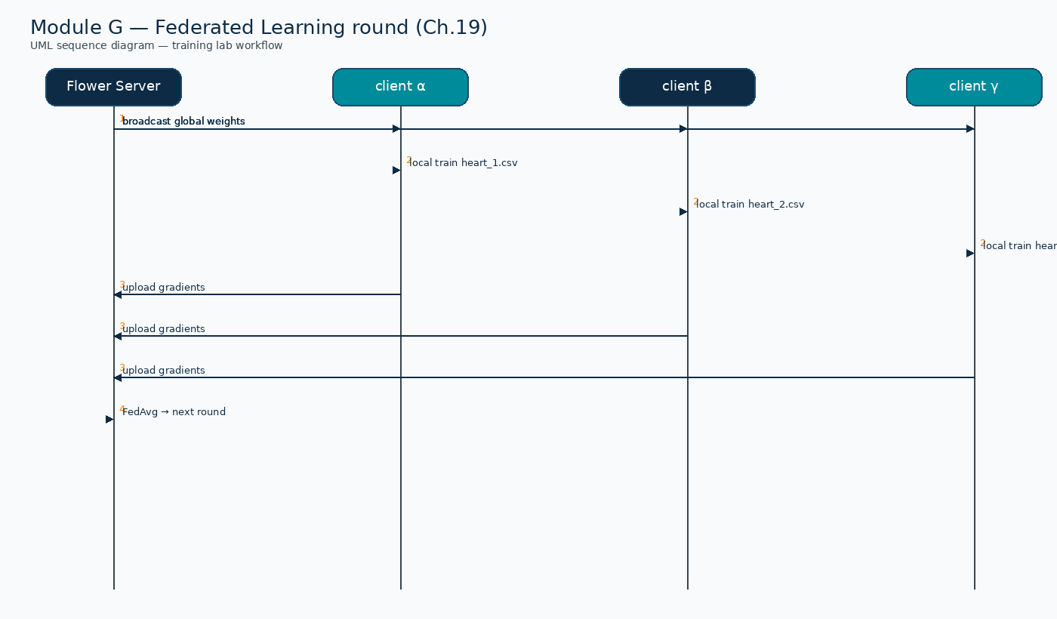
UML sequence — Federated Learning round (Module G)
Assembling Smart CPS · Stack4Things Training
Diagram
Broadcast weights → local train → upload gradients → FedAvg
Notes:
Please look at the sequence diagram on screen: UML sequence — Federated Learning round (Module G). Trace the diagram from left to right. Name each actor, the protocol used, and the message that crosses the cloud–edge boundary. In particular, note the following: Broadcast weights → local train → upload gradients → FedAvg. Take a few seconds to orient before we continue.

Slide 15
Module G — learning objectives
▸ Explain FL motivation, FedAvg, and horizontal cross-silo taxonomy (Ch.19)
▸ Deploy Flower server; federated failure-prediction model across 3 edge production lines
▸ Inject FL async client on 3 Active boards with distinct machine_*.csv datasets
▸ Pass validate-lab-fl.sh — bridge Ch.19 AI methodology with Ch.13–14 S4T stack
Assembling Smart CPS · Stack4Things Training
Notes:
On this slide, Module G — learning objectives.
First, Explain FL motivation, FedAvg, and horizontal cross-silo taxonomy (Ch.19). Next, Deploy Flower server; federated failure-prediction model across 3 edge production lines.
By contrast, Inject FL async client on 3 Active boards with distinct machine_*.csv datasets. We should also consider that Pass validate-lab-fl.sh — bridge Ch.19 AI methodology with Ch.13–14 S4T stack.
If these objectives are clear, we can proceed.
Instructor cues:
• Observe ≥2 aggregation rounds complete (FL_ROUNDS=2 classroom pacing)

Slide 16
DEMO
What the FL demo proves — demo goals
▸ Edge boards participate in distributed ML without sharing raw CSV data across boards
▸ IoTronic deploys identical FL client plugin code to heterogeneous Active boards
▸ Aggregation improves global model accuracy over successive rounds (FL_ROUNDS=2 in class)
▸ Bridges Ch.19 AI methodology with Ch.13–14 S4T operational stack (inject + Start)
▸ Students can classify lab setup as horizontal cross-silo FL from Ch.19 taxonomy
▸ Flower server log shows round completion — tangible evidence of federated aggregation
Assembling Smart CPS · Stack4Things Training
Demo
Notes:
In this demonstration, What the FL demo proves — demo goals.
First, Edge boards participate in distributed ML without sharing raw CSV data across boards. Next, IoTronic deploys identical FL client plugin code to heterogeneous Active boards.
By contrast, Aggregation improves global model accuracy over successive rounds (FL_ROUNDS=2 in class). We should also consider that Bridges Ch.19 AI methodology with Ch.13–14 S4T operational stack (inject + Start).
Another key point is that Students can classify lab setup as horizontal cross-silo FL from Ch.19 taxonomy. Furthermore, Flower server log shows round completion — tangible evidence of federated aggregation.
Check that your screen matches what we showed before moving on.
Session timing — Module G — 60-minute timeline:

Slide 17
Prerequisites & resource constraints
▸ Module D complete — 3 Active boards on {{VM_IP}}:1474/:1475/:1476
▸ Repo: ch19/server.py + fl_client_plugin.py + machine_*.csv (predictive maintenance lab)
▸ Run install-fl-on-boards.sh once — deps + machine_*.csv into LR containers
▸ Do NOT run simultaneously with Module H K3s — RAM gate: free -h ≥ 2 GB during FL
▸ Horizon admin / s4t · LR dashboards me / arancino on all three instances
Assembling Smart CPS · Stack4Things Training
Notes:
On this slide, Prerequisites & resource constraints.
First, Module D complete — 3 Active boards on {{VM_IP}}:1474/:1475/:1476. Next, regarding repo, ch19/server.py + fl_client_plugin.py + machine_*.csv (predictive maintenance lab).
By contrast, Run install-fl-on-boards.sh once — deps + machine_*.csv into LR containers. We should also consider that Do NOT run simultaneously with Module H K3s — RAM gate: free -h ≥ 2 GB during FL.
Another key point is that Horizon admin / s4t · LR dashboards me / arancino on all three instances.
If these objectives are clear, we can proceed.
Instructor cues:
• Classroom pacing: FL_ROUNDS=2 — keeps session within 60 minutes

Slide 18
Lab: Flower server setup
Install dependencies + start aggregation
Notes:
We now begin a new section: Lab: Flower server setup. Install dependencies + start aggregation. In the next slides, listen for whether we are in theory mode or hands-on mode, and open your terminal when the slides turn to lab work.
Instructor timing (title): Hands-on — Flower server setup

Slide 19
Install FL deps on VM and boards
$ cd training && pip install flwr torch pandas scikit-learn # or use .venv
$ ./experiments/federated-learning/install-fl-on-boards.sh
▸ Copies machine_1/2/3.csv + fl_client_plugin.py into each LR container (/opt/fl/)
Assembling Smart CPS · Stack4Things Training
Notes:
Now we move to the hands-on part: Install FL deps on VM and boards. Open your lab VM and follow along.
Please run the following command on your VM: cd training && pip install flwr torch pandas scikit-learn # or use .venv. Wait until you see a sensible result before continuing. Please run the following command on your VM: ./experiments/federated-learning/install-fl-on-boards.sh. Wait until you see a sensible result before continuing.
By contrast, Copies machine_1/2/3.csv + fl_client_plugin.py into each LR container (/opt/fl/).
Raise your hand if you're stuck — we'll wait until most of you are done.
Instructor timing (title): Step 1 — Install FL deps on VM and boards

Slide 20
THEORY
Ch.19 · server.py on cloud VM · FL_PORT=8087 · Horizon panel + fl-cont
Flower server configuration (Ch.19)
▸ server.py on VM host: FedAvg strategy — same role as book listing (Cap. 19)
▸ FL_ROUNDS env var controls aggregation iterations — set to 2 for classroom demo
▸ Server binds 0.0.0.0:8087 (default) — avoids WSTUN conflict on :8080
▸ LR containers reach VM host via Docker bridge gateway (e.g. 172.18.0.1:8087)
▸ Minimum clients: 3 (matches 3 boards from Module D) — server waits for all before round
Assembling Smart CPS · Stack4Things Training
Theory
Notes:
In this slide we cover Flower server configuration (Ch.19). This material is covered in Ch.19 · server.py on cloud VM · FL_PORT=8087 · Horizon panel + fl-control :8091.
First, regarding server.py on vm host, fedAvg strategy — same role as book listing (Cap. 19). Next, FL_ROUNDS env var controls aggregation iterations — set to 2 for classroom demo.
By contrast, regarding server binds 0.0.0.0, 8087 (default) — avoids WSTUN conflict on :8080. We should also consider that LR containers reach VM host via Docker bridge gateway (e.g. 172.18.0.1:8087).
Another key point is that regarding minimum clients, 3 (matches 3 boards from Module D) — server waits for all before round.
I'll pause here for questions, then we'll continue.
Instructor cues:
• Server log prints per-round aggregated metrics — instructor projects for class visibility

Slide 21
Enable FL panel and start Flower server
$ cd training && ./experiments/federated-learning/setup-fl-horizon.sh # once
▸ Horizon → IoT → Federated Learning → Lab parameters → Save
▸ Click Start Flower server (or Restart after param changes) — live topology iframe
▸ Optional demo-ready: ./experiments/federated-learning/setup-fl-demo-plugins.sh
Assembling Smart CPS · Stack4Things Training
Notes:
Now we move to the hands-on part: Enable FL panel and start Flower server. Open your lab VM and follow along.
Please run the following command on your VM: cd training && ./experiments/federated-learning/setup-fl-horizon.sh # once. Wait until you see a sensible result before continuing. Next, Horizon, then IoT, then Federated Learning, then Lab parameters, then Save.
By contrast, Click Start Flower server (or Restart after param changes) — live topology iframe. We should also consider that regarding optional demo-ready, ./experiments/federated-learning/setup-fl-demo-plugins.sh.
Raise your hand if you're stuck — we'll wait until most of you are done.
Instructor timing (title): Step 2 — Enable FL panel and start Flower server

Slide 22
Lab: deploy FL client plugins
Single shared fl-client plugin
Notes:
We now begin a new section: Lab: deploy FL client plugins. Single shared fl-client plugin. In the next slides, listen for whether we are in theory mode or hands-on mode, and open your terminal when the slides turn to lab work.
Instructor timing (title): Hands-on — deploy FL client plugins

Slide 23
Create and inject FL client plugin
▸ Horizon → Federated Learning → Create / update FL client plugin (name: fl-client)
▸ One shared async plugin — per-board JSON: csv_file + board_name only
▸ Inject fl-client: board-alpha (machine_1/CNC), board-beta (machine_2/conveyor), board-gamma (machine_3/pump)
▸ Lab parameters supply server_address and dashboard_url — Apply to all boards
Assembling Smart CPS · Stack4Things Training
Notes:
Now we move to the hands-on part: Create and inject FL client plugin. Open your lab VM and follow along.
First, Horizon, then Federated Learning, then Create / update FL client plugin (name: fl-client). Next, regarding one shared async plugin — per-board json, csv_file + board_name only.
By contrast, regarding inject fl-client, board-alpha (machine_1/CNC), board-beta (machine_2/conveyor), board-gamma (machine_3/pump). We should also consider that Lab parameters supply server_address and dashboard_url — Apply to all boards.
Raise your hand if you're stuck — we'll wait until most of you are done.
Instructor timing (title): Step 3 — Create and inject FL client plugin

Slide 24
Horizon — Federated Learning panel (Module G)
▸ Screenshot not available
▸ Predictive maintenance lab · machine_1/2/3.csv per board · admin / s4t
Assembling Smart CPS · Stack4Things Training
Notes:
Please look at the screenshot on screen: Horizon — Federated Learning panel (Module G). Walk the class through what they see in the interface. Connect each panel and button to a component we already deployed in the stack. In particular, note the following: Predictive maintenance lab · machine_1/2/3.csv per board · admin / s4t. Take a few seconds to orient before we continue.

Slide 25
Lab parameters — rounds, server and dashboard URLs
▸ Screenshot not available
▸ FL rounds + Docker gateway for Flower :8087 and dashboard :8090
Assembling Smart CPS · Stack4Things Training
Notes:
Please look at the screenshot on screen: Lab parameters — rounds, server and dashboard URLs. Walk the class through what they see in the interface. Connect each panel and button to a component we already deployed in the stack. In particular, note the following: FL rounds + Docker gateway for Flower :8087 and dashboard :8090. Take a few seconds to orient before we continue.

Slide 26
Edge FL clients — failure prediction per production line
▸ Screenshot not available
▸ board-alpha CNC · board-beta conveyor · board-gamma pump · machine_*.csv JSON
Assembling Smart CPS · Stack4Things Training
Notes:
Please look at the screenshot on screen: Edge FL clients — failure prediction per production line. Walk the class through what they see in the interface. Connect each panel and button to a component we already deployed in the stack. In particular, note the following: board-alpha CNC · board-beta conveyor · board-gamma pump · machine_*.csv JSON. Take a few seconds to orient before we continue.

Slide 27
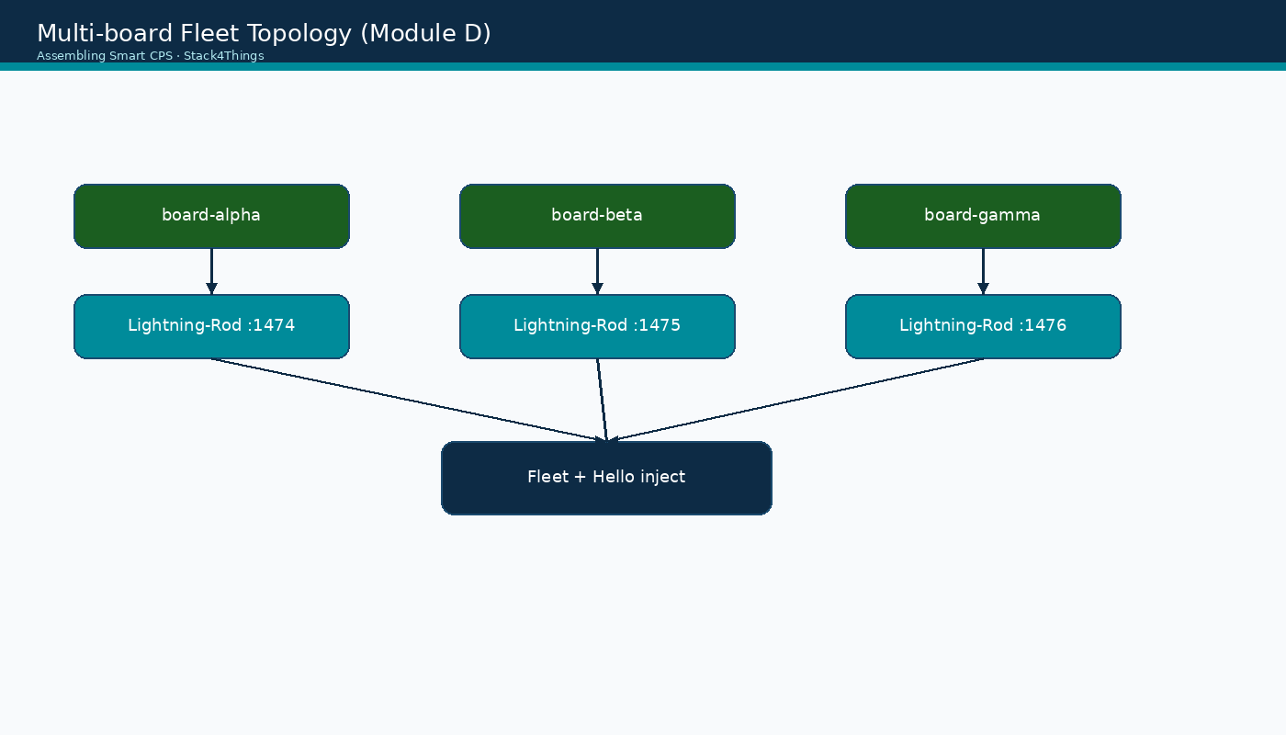
Multi-board topology for FL clients
Assembling Smart CPS · Stack4Things Training
Diagram
3 LR clients :1474/:1475/:1476 → Flower server on VM host :8087 (not on a board)
Notes:
Please look at the diagram on screen: Multi-board topology for FL clients. Describe the main boxes and arrows. Relate each element to a Docker service or API you have already seen. In particular, note the following: 3 LR clients :1474/:1475/:1476 → Flower server on VM host :8087 (not on a board). Take a few seconds to orient before we continue.

Slide 28
Live topology — federated failure-prediction dashboard
▸ Screenshot not available
▸ Vibration/temperature/current models aggregate without sharing raw CSVs
Assembling Smart CPS · Stack4Things Training
Notes:
Please look at the screenshot on screen: Live topology — federated failure-prediction dashboard. Walk the class through what they see in the interface. Connect each panel and button to a component we already deployed in the stack. In particular, note the following: Vibration/temperature/current models aggregate without sharing raw CSVs. Take a few seconds to orient before we continue.

Slide 29
Start FL clients on all three boards
▸ With Flower server running: Federated Learning panel → Start all clients
▸ Or Start fl-client individually per board from the panel
▸ Watch live topology: clients connect → rounds advance → loss/accuracy update
▸ LR logs: docker logs lightning-rod-2 — local training progress messages
Assembling Smart CPS · Stack4Things Training
Notes:
Now we move to the hands-on part: Start FL clients on all three boards. Open your lab VM and follow along.
First, regarding with flower server running, federated Learning panel, then Start all clients. Next, Or Start fl-client individually per board from the panel.
By contrast, regarding watch live topology, clients connect, then rounds advance, then loss/accuracy update. We should also consider that regarding lr logs, docker logs lightning-rod-2 — local training progress messages.
Raise your hand if you're stuck — we'll wait until most of you are done.
Instructor timing (title): Step 4 — Start FL clients on all three boards

Slide 30
THEORY
Ch.19 · fl_client_plugin.py Worker + HeartClient · async plugin patter
Client plugin execution flow (Ch.19)
▸ Start action launches async Worker — connects to Flower server via gRPC/TCP
▸ Worker loads local CSV — initializes model with global weights from server
▸ Local training: N local epochs on board CPU — sends weight delta to server
▸ Server aggregates all 3 client updates — broadcasts new global weights
▸ Round 2: clients receive updated global model — repeat local training
▸ Stop: Interrupt plugin on each board after rounds complete — clean shutdown
Assembling Smart CPS · Stack4Things Training
Theory
Notes:
In this slide we cover Client plugin execution flow (Ch.19). This material is covered in Ch.19 · fl_client_plugin.py Worker + HeartClient · async plugin pattern.
First, Start action launches async Worker — connects to Flower server via gRPC/TCP. Next, Worker loads local CSV — initializes model with global weights from server.
By contrast, regarding local training, N local epochs on board CPU — sends weight delta to server. We should also consider that Server aggregates all 3 client updates — broadcasts new global weights.
Another key point is that regarding round 2, clients receive updated global model — repeat local training. Furthermore, regarding stop, interrupt plugin on each board after rounds complete — clean shutdown.
I'll pause here for questions, then we'll continue.

Slide 31
THEORY
fix-iotronic-wampagents.sh · validate-lab-fl.sh · install-fl-on-boards
Troubleshooting FL connectivity (Ch.19 lab)
▸ Clients cannot connect: verify server on VM :8087 and gateway IP from install-fl-on-boards.sh
▸ Horizon 'Unable to retrieve boards list': run scripts/fix-iotronic-wampagents.sh
▸ Server stuck waiting: ensure all 3 Start actions fired — minimum client count not met
▸ OOM on board: reduce local epochs in plugin params — edge boards have limited RAM
▸ Plugin error on Start: re-run install-fl-on-boards.sh (flwr/torch in LR container)
▸ validate-lab-fl.sh — artifacts, Horizon mounts, panel URL, live proxy + optional E2E
Assembling Smart CPS · Stack4Things Training
Theory
Notes:
In this slide we cover Troubleshooting FL connectivity (Ch.19 lab). This material is covered in fix-iotronic-wampagents.sh · validate-lab-fl.sh · install-fl-on-boards.sh.
First, regarding clients cannot connect, verify server on VM :8087 and gateway IP from install-fl-on-boards.sh. Next, regarding horizon 'unable to retrieve boards list', run scripts/fix-iotronic-wampagents.sh.
By contrast, regarding server stuck waiting, ensure all 3 Start actions fired — minimum client count not met. We should also consider that regarding oom on board, reduce local epochs in plugin params — edge boards have limited RAM.
Another key point is that regarding plugin error on start, re-run install-fl-on-boards.sh (flwr/torch in LR container). Furthermore, Validate-lab-fl.sh — artifacts, Horizon mounts, panel URL, live proxy + optional E2E.
I'll pause here for questions, then we'll continue.

Slide 32
THEORY
Ch.19 + Ch.11 Type 4 · SLICES RI FL experiment pattern
FL in the Cloud Continuum research context (Ch.19 + Ch.11)
▸ Ch.11 Type 4 experiments: AI/ML workflows including federated learning at edge
▸ SLICES RI multi-site FL: clients on different European sites, server on cloud slice
▸ S4T IoTronic inject scales FL client deployment — same pattern as Module D fleet ops
▸ Crossplane Workflow CRD could declare FL experiment: server + N client plugins + datasets
▸ Edge-board FL preserves data sovereignty requirements of SLICES partner institutions
▸ Lab on {{VM_IP}} is minimal horizontal FL — production scales to cross-silo federation
Assembling Smart CPS · Stack4Things Training
Theory
Notes:
In this slide we cover FL in the Cloud Continuum research context (Ch.19 + Ch.11). This material is covered in Ch.19 + Ch.11 Type 4 · SLICES RI FL experiment pattern.
First, regarding ch.11 type 4 experiments, AI/ML workflows including federated learning at edge. Next, regarding slices ri multi-site fl, clients on different European sites, server on cloud slice.
By contrast, S4T IoTronic inject scales FL client deployment — same pattern as Module D fleet ops. We should also consider that Crossplane Workflow CRD could declare FL experiment: server + N client plugins + datasets.
Another key point is that Edge-board FL preserves data sovereignty requirements of SLICES partner institutions. Furthermore, Lab on {{VM_IP}} is minimal horizontal FL — production scales to cross-silo federation.
I'll pause here for questions, then we'll continue.

Slide 33
Validate & wrap-up
Confirm aggregation + Module H exclusion
Notes:
We now begin a new section: Validate & wrap-up. Confirm aggregation + Module H exclusion. In the next slides, listen for whether we are in theory mode or hands-on mode, and open your terminal when the slides turn to lab work.

Slide 34
Validate FL lab
$ cd training && ./validate-lab-fl.sh
▸ Live topology shows rounds completing; loss numeric (not em-dash)
▸ Interrupt FL plugins on all boards after successful validation
Assembling Smart CPS · Stack4Things Training
Notes:
Now we move to the hands-on part: Validate FL lab. Open your lab VM and follow along.
Please run the following command on your VM: cd training && ./validate-lab-fl.sh. Wait until you see a sensible result before continuing. Next, Live topology shows rounds completing; loss numeric (not em-dash).
By contrast, Interrupt FL plugins on all boards after successful validation.
Raise your hand if you're stuck — we'll wait until most of you are done.
Instructor timing (title): Step 5 — Validate FL lab

Slide 35
Module G checklist & resource note
▸ □ Horizon FL panel: Start server + Start all clients — rounds complete in live topology
▸ □ Three production lines connected via fl-client with correct machine_*.csv per board
▸ □ validate-lab-fl.sh passes (Horizon mounts + :8091 control API)
▸ □ free -h ≥ 2 GB during FL — do NOT run K3s Blueprint (Module H) concurrently
▸ □ Students articulate horizontal cross-silo FL classification from Ch.19 taxonomy
Assembling Smart CPS · Stack4Things Training
Notes:
On this slide, Module G checklist & resource note.
First, regarding □ horizon fl panel, start server + Start all clients — rounds complete in live topology. Next, □ Three production lines connected via fl-client with correct machine_*.csv per board.
By contrast, regarding □ validate-lab-fl.sh passes (horizon mounts +, 8091 control API). We should also consider that □ free -h ≥ 2 GB during FL — do NOT run K3s Blueprint (Module H) concurrently.
Another key point is that □ Students articulate horizontal cross-silo FL classification from Ch.19 taxonomy.
If these objectives are clear, we can proceed.

