Slide 1
S4T TRAINING
Module I — FaaS & the Deviceless Paradigm
Ch.7 · Advanced · VM {{VM_IP}}
Advanced · Ch.7 — FaaS & Deviceless · contrasts Modules B, C, F
Notes:
Welcome. In this module we will work through Module I — FaaS & the Deviceless Paradigm.
Ch.7 · Advanced · VM {{VM_IP}}
The session alternates theory from the book with live exercises on the Stack4Things lab VM. Replace the placeholder IP with the address of the machine you are using.
Advanced · Ch.7 — FaaS & Deviceless · contrasts Modules B, C, F.
When you're ready, advance to the first section.

Slide 2
Deviceless & serverless theory
Ch.7 — before side-by-side plugin demos
Notes:
We now begin a new section: Deviceless & serverless theory. Ch.7 — before side-by-side plugin demos. In the next slides, listen for whether we are in theory mode or hands-on mode, and open your terminal when the slides turn to lab work.

Slide 3
THEORY
Ch.7 · The Deviceless paradigm · chapter abstract
Deviceless paradigm (Ch.7)
▸ Physical devices abstracted as composable virtual Web resources with stable DNS names
▸ Developers interact with Things via HTTP URIs — not device-specific SDKs or serial protocols
▸ Geographic distribution transparent: wot.sensor-barcelona.example.com just works
▸ Deviceless = operational realization of WoT vision (Ch.6) at Cloud Continuum scale
▸ S4T Module F WSTUN/Designate exposure is the lab step toward Deviceless naming
▸ Book abstract positions Deviceless as key enabler for programmable CPS infrastructure
Assembling Smart CPS · Stack4Things Training
Theory
Notes:
In this slide we cover Deviceless paradigm (Ch.7). This material is covered in Ch.7 · The Deviceless paradigm · chapter abstract.
First, Physical devices abstracted as composable virtual Web resources with stable DNS names. Next, Developers interact with Things via HTTP URIs — not device-specific SDKs or serial protocols.
By contrast, regarding geographic distribution transparent, wot.sensor-barcelona.example.com just works. We should also consider that Deviceless = operational realization of WoT vision (Ch.6) at Cloud Continuum scale.
Another key point is that S4T Module F WSTUN/Designate exposure is the lab step toward Deviceless naming. Furthermore, Book abstract positions Deviceless as key enabler for programmable CPS infrastructure.
I'll pause here for questions, then we'll continue.

Slide 4
THEORY
Ch.7 · device abstraction · WoT cross-reference Ch.6
From devices to Web resources (Ch.7)
▸ Traditional IoT: developer learns board SDK, GPIO libraries, firmware toolchain
▸ Deviceless: developer consumes OpenAPI/REST contract — implementation opaque
▸ DNS stability: service moves from board A to board B — URL unchanged for consumers
▸ Compose (Ch.6 layer): mashup apps combine Deviceless resources without owning hardware
▸ Stack4Things IoTronic + Designate + NGINX implement Deviceless naming infrastructure
▸ Module I connects abstract Ch.7 taxonomy to concrete Ch.14 plugin modes in lab
Assembling Smart CPS · Stack4Things Training
Theory
Notes:
In this slide we cover From devices to Web resources (Ch.7). This material is covered in Ch.7 · device abstraction · WoT cross-reference Ch.6.
First, regarding traditional iot, developer learns board SDK, GPIO libraries, firmware toolchain. Next, regarding deviceless, developer consumes OpenAPI/REST contract — implementation opaque.
By contrast, regarding dns stability, service moves from board A to board B — URL unchanged for consumers. We should also consider that regarding compose (ch.6 layer), mashup apps combine Deviceless resources without owning hardware.
Another key point is that Stack4Things IoTronic + Designate + NGINX implement Deviceless naming infrastructure. Furthermore, Module I connects abstract Ch.7 taxonomy to concrete Ch.14 plugin modes in lab.
I'll pause here for questions, then we'll continue.

Slide 5
THEORY
Ch.7 · serverless on OpenStack · Qinling · OpenWhisk-Light
PaaS vs FaaS vs Deviceless (Ch.7)
▸ PaaS: long-running platform service — always-on process or container on cloud/edge
▸ FaaS: event-driven function — invoke, execute, return result, scale to zero between calls
▸ Deviceless: device capability exposed as callable Web resource with DNS name — not a function runtime per se
▸ OpenStack Qinling: serverless functions on OpenStack cloud infrastructure (Zun containers)
▸ OpenWhisk-Light referenced in book as lightweight FaaS research platform
▸ All three coexist in Cloud Continuum — choice depends on workload lifetime and trigger pattern
Assembling Smart CPS · Stack4Things Training
Theory
Notes:
In this slide we cover PaaS vs FaaS vs Deviceless (Ch.7). This material is covered in Ch.7 · serverless on OpenStack · Qinling · OpenWhisk-Light.
First, regarding paas, long-running platform service — always-on process or container on cloud/edge. Next, regarding faas, event-driven function — invoke, execute, return result, scale to zero between calls.
By contrast, regarding deviceless, device capability exposed as callable Web resource with DNS name — not a function runtime per se. We should also consider that regarding openstack qinling, serverless functions on OpenStack cloud infrastructure (Zun containers).
Another key point is that OpenWhisk-Light referenced in book as lightweight FaaS research platform. Furthermore, All three coexist in Cloud Continuum — choice depends on workload lifetime and trigger pattern.
I'll pause here for questions, then we'll continue.

Slide 6
THEORY
Ch.7 · FaaS properties · edge serverless discussion
FaaS characteristics in detail (Ch.7)
▸ Event-triggered: HTTP request, message queue event, scheduled cron — not continuous loop
▸ Stateless execution: function instance holds no persistent state between invocations
▸ Scale to zero: no cost/resources when idle — cold start latency trade-off
▸ Managed runtime: platform handles packaging, scaling, logging — developer supplies handler code
▸ Billing model: per-invocation + execution duration — vs PaaS always-on provisioning
▸ Edge FaaS (Ch.7 + Ch.11): functions deployed near data sources in K3s/Knative substrate
Assembling Smart CPS · Stack4Things Training
Theory
Notes:
In this slide we cover FaaS characteristics in detail (Ch.7). This material is covered in Ch.7 · FaaS properties · edge serverless discussion.
First, regarding event-triggered, HTTP request, message queue event, scheduled cron — not continuous loop. Next, regarding stateless execution, function instance holds no persistent state between invocations.
By contrast, regarding scale to zero, no cost/resources when idle — cold start latency trade-off. We should also consider that regarding managed runtime, platform handles packaging, scaling, logging — developer supplies handler code.
Another key point is that regarding billing model, per-invocation + execution duration — vs PaaS always-on provisioning. Furthermore, regarding edge faas (ch.7 + ch.11), functions deployed near data sources in K3s/Knative substrate.
I'll pause here for questions, then we'll continue.

Slide 7
THEORY
Ch.7 · PaaS at the edge · Module C cross-reference
PaaS characteristics in detail (Ch.7)
▸ Long-running service: process starts once, serves many requests over hours/days/months
▸ Stateful acceptable: in-memory caches, connection pools, persistent background threads
▸ Always-on cost: container/VM provisioned continuously — even during idle periods
▸ Edge PaaS example: environmental_data async plugin (Module C) — 30 s publish loop
▸ Docker plugin (Module B optional): deploys containerized service on edge on demand
▸ PaaS appropriate when continuous monitoring/actuation required — not one-shot queries
Assembling Smart CPS · Stack4Things Training
Theory
Notes:
In this slide we cover PaaS characteristics in detail (Ch.7). This material is covered in Ch.7 · PaaS at the edge · Module C cross-reference.
First, regarding long-running service, process starts once, serves many requests over hours/days/months. Next, regarding stateful acceptable, in-memory caches, connection pools, persistent background threads.
By contrast, regarding always-on cost, container/VM provisioned continuously — even during idle periods. We should also consider that regarding edge paas example, environmental_data async plugin (Module C) — 30 s publish loop.
Another key point is that regarding docker plugin (module b optional), deploys containerized service on edge on demand. Furthermore, PaaS appropriate when continuous monitoring/actuation required — not one-shot queries.
I'll pause here for questions, then we'll continue.

Slide 8
THEORY
Ch.7 applied to Part II labs · Ch.14 plugin modes
Mapping book concepts to S4T lab demos (Ch.7 applied)
▸ HelloName Plugin Call (Module B) ≈ FaaS-like: one shot invocation, immediate JSON result
▸ environmental_data async plugin (Module C) ≈ PaaS-like: continuous microservice loop
▸ Docker plugin run (Module B optional) ≈ deploying containerized PaaS on edge on demand
▸ WoT HTTP exposure via WSTUN (Module F) ≈ Deviceless: board service as Web resource
▸ Sync vs async plugin modes (Ch.14) directly encode FaaS-like vs PaaS-like behaviour
▸ Module I makes taxonomy explicit — students re-label demos they already executed
Assembling Smart CPS · Stack4Things Training
Theory
Notes:
In this slide we cover Mapping book concepts to S4T lab demos (Ch.7 applied). This material is covered in Ch.7 applied to Part II labs · Ch.14 plugin modes.
First, regarding helloname plugin call (module b) ≈ faas-like, one shot invocation, immediate JSON result. Next, Environmental_data async plugin (Module C) ≈ PaaS-like: continuous microservice loop.
By contrast, Docker plugin run (Module B optional) ≈ deploying containerized PaaS on edge on demand. We should also consider that WoT HTTP exposure via WSTUN (Module F) ≈ Deviceless: board service as Web resource.
Another key point is that Sync vs async plugin modes (Ch.14) directly encode FaaS-like vs PaaS-like behaviour. Furthermore, Module I makes taxonomy explicit — students re-label demos they already executed.
I'll pause here for questions, then we'll continue.

Slide 9
THEORY
Ch.7 + Ch.11 Type 1 serverless experiments
Serverless at the continuum edge (Ch.7 + Ch.11)
▸ Function-as-a-Service models extend toward edge nodes in Cloud Continuum architecture
▸ K8s + Knative or Qinling can host ephemeral functions near IoT data sources
▸ S4T callable sync plugins are stepping stone — no Qinling in current Docker lab compose
▸ Blueprint Module H K3s substrate enables future FaaS integration via Crossplane CRDs
▸ Ch.11 Type 1 experiments include serverless architectural paradigm category
▸ Research direction: IoTronic inject deploys function handler instead of long-running Worker
Assembling Smart CPS · Stack4Things Training
Theory
Notes:
In this slide we cover Serverless at the continuum edge (Ch.7 + Ch.11). This material is covered in Ch.7 + Ch.11 Type 1 serverless experiments.
First, Function-as-a-Service models extend toward edge nodes in Cloud Continuum architecture. Next, K8s + Knative or Qinling can host ephemeral functions near IoT data sources.
By contrast, S4T callable sync plugins are stepping stone — no Qinling in current Docker lab compose. We should also consider that Blueprint Module H K3s substrate enables future FaaS integration via Crossplane CRDs.
Another key point is that Ch.11 Type 1 experiments include serverless architectural paradigm category. Furthermore, regarding research direction, IoTronic inject deploys function handler instead of long-running Worker.
I'll pause here for questions, then we'll continue.

Slide 10
THEORY
Ch.7 · Qinling references · OpenStack serverless roadmap
Qinling and OpenStack serverless (Ch.7)
▸ Qinling: OpenStack project for function lifecycle management on Zun containers
▸ Functions packaged as containers — triggered by HTTP or message bus events
▸ Integrates with Keystone auth, Designate DNS — full OpenStack ecosystem fit
▸ Not deployed in current training Docker compose — documented as research/production direction
▸ Would enable true scale-to-zero functions managed like other OpenStack services
▸ Deviceless DNS + Qinling functions = full Ch.7 vision operational on S4T stack
Assembling Smart CPS · Stack4Things Training
Theory
Notes:
In this slide we cover Qinling and OpenStack serverless (Ch.7). This material is covered in Ch.7 · Qinling references · OpenStack serverless roadmap.
First, regarding qinling, openStack project for function lifecycle management on Zun containers. Next, Functions packaged as containers — triggered by HTTP or message bus events.
By contrast, Integrates with Keystone auth, Designate DNS — full OpenStack ecosystem fit. We should also consider that Not deployed in current training Docker compose — documented as research/production direction.
Another key point is that Would enable true scale-to-zero functions managed like other OpenStack services. Furthermore, Deviceless DNS + Qinling functions = full Ch.7 vision operational on S4T stack.
I'll pause here for questions, then we'll continue.

Slide 11
THEORY
Ch.7 § Zun · fig:chap07:zun-system
Zun — OpenStack container service (Ch.7)
▸ Zun-api: REST/WSGI entry point from Horizon or CLI for container lifecycle.
▸ Zun-compute: agent on compute nodes — hides Docker runtime operations from users.
▸ Zun-wsproxy: interactive shell and log streaming into running containers.
▸ Zun-scheduler: filters (RAM, CPU, labels) select host for new container placement.
▸ Zun networking driver: assigns reachability — Neutron in cloud, IoTronic WSTUN at edge.
▸ Capsule ≈ Kubernetes Pod: runtime + sidecar + pause containers sharing network namespace.
Assembling Smart CPS · Stack4Things Training
Theory
Notes:
In this slide we cover Zun — OpenStack container service (Ch.7). This material is covered in Ch.7 § Zun · fig:chap07:zun-system.
First, regarding zun-api, REST/WSGI entry point from Horizon or CLI for container lifecycle. Next, regarding zun-compute, agent on compute nodes — hides Docker runtime operations from users.
By contrast, regarding zun-wsproxy, interactive shell and log streaming into running containers. We should also consider that regarding zun-scheduler, filters (RAM, CPU, labels) select host for new container placement.
Another key point is that regarding zun networking driver, assigns reachability — Neutron in cloud, IoTronic WSTUN at edge. Furthermore, regarding capsule ≈ kubernetes pod, runtime + sidecar + pause containers sharing network namespace.
I'll pause here for questions, then we'll continue.

Slide 12
THEORY
Ch.7 § Implementation aspects · fig:chap07:devless-cloud-arch
Deviceless edge reachability — Zun + WSTUN (Ch.7)
▸ IoT nodes act as Zun compute hosts — containers run on boards, not only in datacenter.
▸ Standard Neutron overlay cannot reach NAT-bound edge capsules — custom driver required.
▸ New Zun networking driver maps each public cloud port to a remote container via WSTUN.
▸ HostnameFilter scheduler policy targets a specific board by name/id for function placement.
▸ Qinling runtime creation on edge: Qinling → Zun capsule → IoTronic tunnel → reachable URL.
▸ Same WSTUN infrastructure as Module F — Deviceless adds serverless function semantics on top.
Assembling Smart CPS · Stack4Things Training
Theory
Notes:
In this slide we cover Deviceless edge reachability — Zun + WSTUN (Ch.7). This material is covered in Ch.7 § Implementation aspects · fig:chap07:devless-cloud-arch.
First, IoT nodes act as Zun compute hosts — containers run on boards, not only in datacenter. Next, Standard Neutron overlay cannot reach NAT-bound edge capsules — custom driver required.
By contrast, New Zun networking driver maps each public cloud port to a remote container via WSTUN. We should also consider that HostnameFilter scheduler policy targets a specific board by name/id for function placement.
Another key point is that regarding qinling runtime creation on edge, qinling, then Zun capsule, then IoTronic tunnel, then reachable URL. Furthermore, Same WSTUN infrastructure as Module F — Deviceless adds serverless function semantics on top.
I'll pause here for questions, then we'll continue.

Slide 13
THEORY
Ch.7 § Flow-based development · Node-RED · sec:use-cases
Node-RED and flow-based Deviceless (Ch.7)
▸ Node-RED provides visual flow programming — wires connect HTTP, MQTT, and function nodes.
▸ Deviceless extends flows across cloud and edge without installing Node-RED on every board.
▸ Qinling function nodes invoke edge runtimes — distributed logic with Web-native triggers.
▸ Contrasts with OpenWhisk-Light: limited to local-only triggers on a single node.
▸ Book use cases show remote wires linking cloud dashboards to edge sensor preprocessing.
▸ Module I conceptual bridge — lab uses sync/async plugins instead of Qinling functions today.
Assembling Smart CPS · Stack4Things Training
Theory
Notes:
In this slide we cover Node-RED and flow-based Deviceless (Ch.7). This material is covered in Ch.7 § Flow-based development · Node-RED · sec:use-cases.
First, Node-RED provides visual flow programming — wires connect HTTP, MQTT, and function nodes. Next, Deviceless extends flows across cloud and edge without installing Node-RED on every board.
By contrast, Qinling function nodes invoke edge runtimes — distributed logic with Web-native triggers. We should also consider that regarding contrasts with openwhisk-light, limited to local-only triggers on a single node.
Another key point is that Book use cases show remote wires linking cloud dashboards to edge sensor preprocessing. Furthermore, Module I conceptual bridge — lab uses sync/async plugins instead of Qinling functions today.
I'll pause here for questions, then we'll continue.

Slide 14
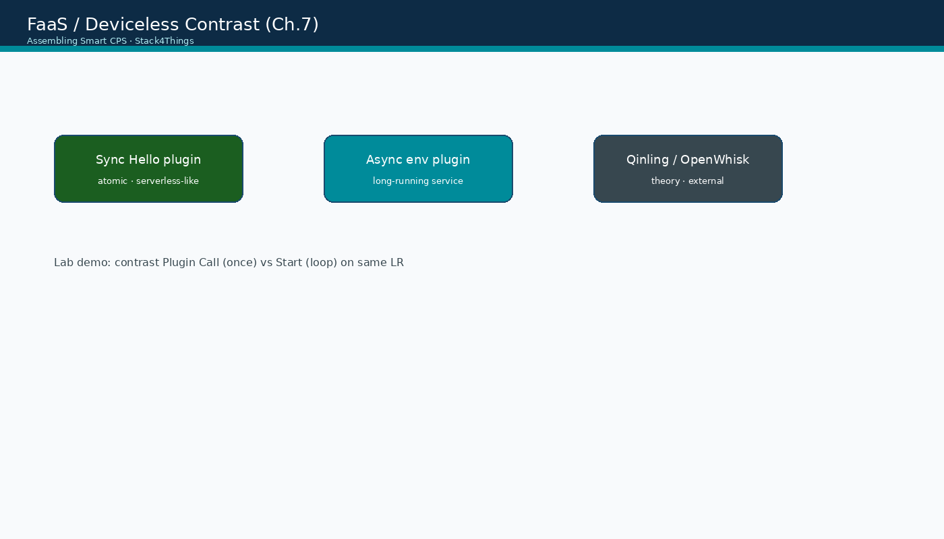
Serverless-like vs long-running contrast
Assembling Smart CPS · Stack4Things Training
Diagram
HelloName sync Plugin Call (FaaS-like) vs environmental async (PaaS-like)
Notes:
Please look at the diagram on screen: Serverless-like vs long-running contrast. Describe the main boxes and arrows. Relate each element to a Docker service or API you have already seen. In particular, note the following: HelloName sync Plugin Call (FaaS-like) vs environmental async (PaaS-like). Take a few seconds to orient before we continue.

Slide 15
Module I — learning objectives
▸ Define Deviceless, FaaS, and PaaS from Ch.7 with S4T lab examples
▸ Execute side-by-side Demo 1 (HelloName Plugin Call) and Demo 2 (environmental Start)
▸ Articulate which book category each existing module demo represents
▸ Connect Module F WoT exposure to Deviceless Web resource naming
▸ Identify Qinling/K3s as future FaaS integration path (Ch.7 + Ch.11)
Assembling Smart CPS · Stack4Things Training
Notes:
On this slide, Module I — learning objectives.
First, Define Deviceless, FaaS, and PaaS from Ch.7 with S4T lab examples. Next, Execute side-by-side Demo 1 (HelloName Plugin Call) and Demo 2 (environmental Start).
By contrast, Articulate which book category each existing module demo represents. We should also consider that Connect Module F WoT exposure to Deviceless Web resource naming.
Another key point is that Identify Qinling/K3s as future FaaS integration path (Ch.7 + Ch.11).
If these objectives are clear, we can proceed.

Slide 16
DEMO
Side-by-side demo goals (Ch.7 applied to lab)
▸ Demo 1: HelloName Plugin Call — atomic invocation, zero persistent background state
▸ Demo 2: environmental_data Start — long-running loop, continuous InfluxDB time-series output
▸ Students label each demo: FaaS-like, PaaS-like, or Deviceless (Module F exposure layer)
▸ No new containers or plugins — reuses Modules B and C artefacts on {{VM_IP}} lab
▸ Discussion prompts: Which billing model fits each pattern? Which has cold start? Which is stateful?
▸ Connects abstract Ch.7 taxonomy to concrete Ch.14 plugin sync/async modes already learned
Assembling Smart CPS · Stack4Things Training
Demo
Notes:
In this demonstration, Side-by-side demo goals (Ch.7 applied to lab).
First, regarding demo 1, helloName Plugin Call — atomic invocation, zero persistent background state. Next, regarding demo 2, environmental_data Start — long-running loop, continuous InfluxDB time-series output.
By contrast, regarding students label each demo, faaS-like, PaaS-like, or Deviceless (Module F exposure layer). We should also consider that No new containers or plugins — reuses Modules B and C artefacts on {{VM_IP}} lab.
Another key point is that regarding discussion prompts, which billing model fits each pattern? Which has cold start? Which is stateful? Furthermore, Connects abstract Ch.7 taxonomy to concrete Ch.14 plugin sync/async modes already learned.
Check that your screen matches what we showed before moving on.
Session timing — Module I — 35-minute timeline:

Slide 17
Lab: Demo 1 — FaaS-like Plugin Call
HelloName synchronous invocation
Notes:
We now begin a new section: Lab: Demo 1 — FaaS-like Plugin Call. HelloName synchronous invocation. In the next slides, listen for whether we are in theory mode or hands-on mode, and open your terminal when the slides turn to lab work.
Instructor timing (title): Hands-on Demo 1 — FaaS-like Plugin Call

Slide 18
Demo 1 — atomic Plugin Call (serverless-like)
▸ Open http://{{VM_IP}}/horizon/iot/ — login admin / s4t
▸ Plugins → HelloName (from Module B) → Plugin Call
▸ {"name": "FaaS-demo"}
▸ Single invocation → immediate JSON result — no background process persists
▸ Contrast: no Start/Stop lifecycle — function-equivalent behaviour
Assembling Smart CPS · Stack4Things Training
Notes:
Now we move to the hands-on part: Demo 1 — atomic Plugin Call (serverless-like). Open your lab VM and follow along.
First, regarding open http, //{{VM_IP}}/horizon/iot/ — login admin / s4t. Next, Plugins, then HelloName (from Module B), then Plugin Call.
By contrast, regarding {"name", "FaaS-demo"}. We should also consider that Single invocation, then immediate JSON result — no background process persists.
Another key point is that regarding contrast, no Start/Stop lifecycle — function-equivalent behaviour.
Raise your hand if you're stuck — we'll wait until most of you are done.

Slide 19
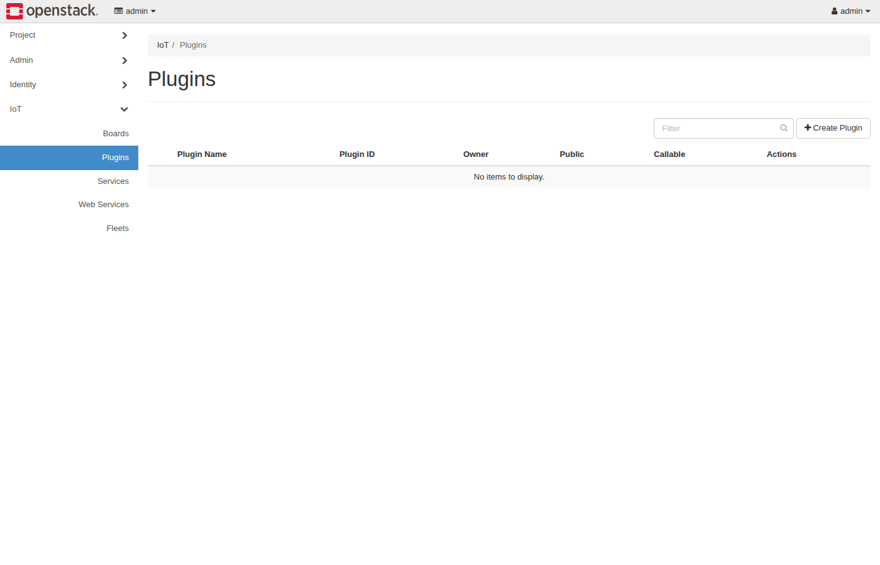
Horizon IoT — Plugins (sync Plugin Call)
Assembling Smart CPS · Stack4Things Training
Screenshot
Callable=ON → one-shot invocation · HelloName sync plugin
Notes:
Please look at the screenshot on screen: Horizon IoT — Plugins (sync Plugin Call). Walk the class through what they see in the interface. Connect each panel and button to a component we already deployed in the stack. In particular, note the following: Callable=ON → one-shot invocation · HelloName sync plugin. Take a few seconds to orient before we continue.

Slide 20
THEORY
Ch.14 §14.1.2 sync pipeline · Ch.7 FaaS mapping
Why HelloName is FaaS-like (Ch.7 + Ch.14)
▸ Dormant until Plugin Call trigger — no CPU consumed while idle on board
▸ Single input JSON → single output JSON — request/response function signature
▸ No persistent state between calls — each Plugin Call is independent invocation
▸ Execution duration: milliseconds — matches FaaS short-lived handler pattern
▸ Missing FaaS features in lab: auto-scale, cold start metrics, per-invocation billing
▸ Closest lab analog to Ch.7 FaaS without deploying Qinling infrastructure
Assembling Smart CPS · Stack4Things Training
Theory
Notes:
In this slide we cover Why HelloName is FaaS-like (Ch.7 + Ch.14). This material is covered in Ch.14 §14.1.2 sync pipeline · Ch.7 FaaS mapping.
First, Dormant until Plugin Call trigger — no CPU consumed while idle on board. Next, Single input JSON, then single output JSON — request/response function signature.
By contrast, No persistent state between calls — each Plugin Call is independent invocation. We should also consider that regarding execution duration, milliseconds — matches FaaS short-lived handler pattern.
Another key point is that regarding missing faas features in lab, auto-scale, cold start metrics, per-invocation billing. Furthermore, Closest lab analog to Ch.7 FaaS without deploying Qinling infrastructure.
I'll pause here for questions, then we'll continue.

Slide 21
Lab: Demo 2 — PaaS-like async service
environmental_data continuous publisher
Notes:
We now begin a new section: Lab: Demo 2 — PaaS-like async service. environmental_data continuous publisher. In the next slides, listen for whether we are in theory mode or hands-on mode, and open your terminal when the slides turn to lab work.
Instructor timing (title): Hands-on Demo 2 — PaaS-like async service

Slide 22
Demo 2 — long-running async plugin (PaaS-like)
▸ Start environmental_data plugin from Module C (or restart if stopped)
▸ Observe continuous InfluxDB writes every 30 s at http://{{VM_IP}}:8086
▸ Contrast: no Plugin Call per iteration — persistent _is_running background loop
▸ Stop/Interrupt required to halt — unlike one-shot HelloName Plugin Call
Assembling Smart CPS · Stack4Things Training
Notes:
Now we move to the hands-on part: Demo 2 — long-running async plugin (PaaS-like). Open your lab VM and follow along.
First, Start environmental_data plugin from Module C (or restart if stopped). Next, Observe continuous InfluxDB writes every 30 s at http://{{VM_IP}}:8086.
By contrast, regarding contrast, no Plugin Call per iteration — persistent _is_running background loop. We should also consider that Stop/Interrupt required to halt — unlike one-shot HelloName Plugin Call.
Raise your hand if you're stuck — we'll wait until most of you are done.

Slide 23
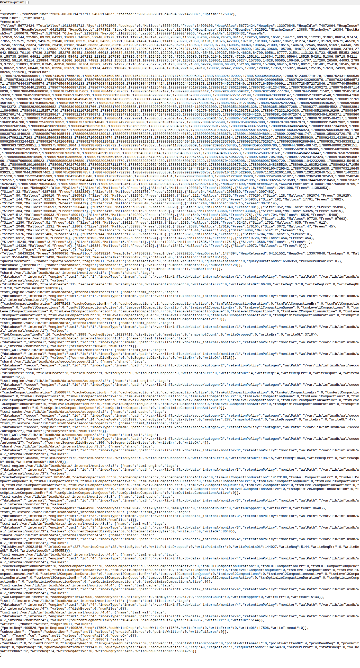
InfluxDB — continuous async output
Assembling Smart CPS · Stack4Things Training
Screenshot
Time-series grows while plugin runs — PaaS-style always-on edge service
Notes:
Please look at the screenshot on screen: InfluxDB — continuous async output. Walk the class through what they see in the interface. Connect each panel and button to a component we already deployed in the stack. In particular, note the following: Time-series grows while plugin runs — PaaS-style always-on edge service. Take a few seconds to orient before we continue.

Slide 24
THEORY
Ch.15 async environmental plugin · Ch.7 PaaS mapping
Why environmental_data is PaaS-like (Ch.7 + Ch.15)
▸ Long-running background thread — active for minutes/hours during class session
▸ Stateful loop: maintains sensor read schedule and InfluxDB connection context
▸ Always-on resource consumption on board while plugin Started — no scale to zero
▸ Continuous output stream — not event-triggered single response pattern
▸ Matches edge microservice/PaaS deployment model from Ch.15 environmental publisher
▸ Production: would run 24/7 on edge gateway — FaaS inappropriate for this pattern
Assembling Smart CPS · Stack4Things Training
Theory
Notes:
In this slide we cover Why environmental_data is PaaS-like (Ch.7 + Ch.15). This material is covered in Ch.15 async environmental plugin · Ch.7 PaaS mapping.
First, Long-running background thread — active for minutes/hours during class session. Next, regarding stateful loop, maintains sensor read schedule and InfluxDB connection context.
By contrast, Always-on resource consumption on board while plugin Started — no scale to zero. We should also consider that Continuous output stream — not event-triggered single response pattern.
Another key point is that Matches edge microservice/PaaS deployment model from Ch.15 environmental publisher. Furthermore, regarding production, would run 24/7 on edge gateway — FaaS inappropriate for this pattern.
I'll pause here for questions, then we'll continue.

Slide 25
THEORY
Ch.7 Deviceless · Ch.6 WoT · Module F cross-reference
Deviceless layer — Module F connection (Ch.7 + Ch.6)
▸ Module F WSTUN exposes board HTTP service at {{VM_IP}}:public_port — Web resource URI
▸ Production Designate path: stable DNS name independent of board physical location
▸ Deviceless consumer: curl https://wot.board.example.com/temperature — no LR SDK needed
▸ FaaS handler behind Deviceless URL: function invoked via HTTP POST to named endpoint
▸ Three-layer stack: Deviceless (naming) + FaaS/PaaS (execution model) + WoT (API contract)
▸ Module I completes taxonomy: HelloName=FaaS-like, environmental=PaaS-like, WSTUN=Deviceless enabler
Assembling Smart CPS · Stack4Things Training
Theory
Notes:
In this slide we cover Deviceless layer — Module F connection (Ch.7 + Ch.6). This material is covered in Ch.7 Deviceless · Ch.6 WoT · Module F cross-reference.
First, Module F WSTUN exposes board HTTP service at {{VM_IP}}:public_port — Web resource URI. Next, regarding production designate path, stable DNS name independent of board physical location.
By contrast, regarding deviceless consumer, curl https://wot.board.example.com/temperature — no LR SDK needed. We should also consider that regarding faas handler behind deviceless url, function invoked via HTTP POST to named endpoint.
Another key point is that regarding three-layer stack, deviceless (naming) + FaaS/PaaS (execution model) + WoT (API contract). Furthermore, regarding module i completes taxonomy, helloName=FaaS-like, environmental=PaaS-like, WSTUN=Deviceless enabler.
I'll pause here for questions, then we'll continue.

Slide 26
Wrap-up & future directions
Qinling + K3s + Course Map link
Notes:
We now begin a new section: Wrap-up & future directions. Qinling + K3s + Course Map link. In the next slides, listen for whether we are in theory mode or hands-on mode, and open your terminal when the slides turn to lab work.

Slide 27
THEORY
Ch.7 · future directions · Ch.11 K3s substrate
Future work — full Ch.7 vision on S4T (Ch.7 + Ch.11)
▸ Qinling on OpenStack S4T: true scale-to-zero functions with Keystone auth
▸ Knative on Module H K3s: Kubernetes-native FaaS with auto-scaling pods
▸ Crossplane CRD: declare function + Deviceless DNS + board target in single YAML
▸ IoTronic inject: deploy function handler container instead of persistent Worker class
▸ Research papers cited in Ch.7 on edge serverless latency and cold-start optimization
▸ Current training lab: conceptual bridge complete — infrastructure evolution is next step
Assembling Smart CPS · Stack4Things Training
Theory
Notes:
In this slide we cover Future work — full Ch.7 vision on S4T (Ch.7 + Ch.11). This material is covered in Ch.7 · future directions · Ch.11 K3s substrate.
First, regarding qinling on openstack s4t, true scale-to-zero functions with Keystone auth. Next, regarding knative on module h k3s, kubernetes-native FaaS with auto-scaling pods.
By contrast, regarding crossplane crd, declare function + Deviceless DNS + board target in single YAML. We should also consider that regarding iotronic inject, deploy function handler container instead of persistent Worker class.
Another key point is that Research papers cited in Ch.7 on edge serverless latency and cold-start optimization. Furthermore, regarding current training lab, conceptual bridge complete — infrastructure evolution is next step.
I'll pause here for questions, then we'll continue.

Slide 28
Module I wrap-up checklist
▸ □ Demo 1 executed: HelloName Plugin Call labelled FaaS-like by students
▸ □ Demo 2 executed: environmental_data Start labelled PaaS-like by students
▸ □ Student explains Deviceless connection to Module F WoT/WSTUN exposure
▸ □ Student identifies Qinling/K3s as production FaaS path (Ch.7 + Ch.11)
▸ Return to Course Map — full 9h path complete: A→I modules covered
Assembling Smart CPS · Stack4Things Training
Notes:
On this slide, Module I wrap-up checklist.
First, regarding □ demo 1 executed, helloName Plugin Call labelled FaaS-like by students. Next, regarding □ demo 2 executed, environmental_data Start labelled PaaS-like by students.
By contrast, □ Student explains Deviceless connection to Module F WoT/WSTUN exposure. We should also consider that □ Student identifies Qinling/K3s as production FaaS path (Ch.7 + Ch.11).
Another key point is that regarding return to course map — full 9h path complete, A, then I modules covered.
If these objectives are clear, we can proceed.

