Slide 1
DATASET CS JOBS SALARY
LUCA DI BELLO - DATA SCIENCE - 2022/2023

Slide 2
3 DIFFERENT DATASETS
IT SECURITY JOBS SALARY (1429 ROWS, 23.10.2022)
https://github.com/foorilla/infosec-jobs-com-salaries
AI JOBS SALARY (1103 ROWS, 23.10.2022)
https://github.com/foorilla/ai-jobs-net-salaries
DEVOPS JOBS SALARY (720 ROWS, 23.10.2022)
https://github.com/foorilla/devops-jobs-net-salaries

Slide 3
Dataset structure
11 columns
Work year
Experience level (EL, MI, SE, EX)
Employment type (PT, FT, CT, FL)
Job title
Salary
Salary currency
Salary in USD
Employee residence
Remote ratio (0, 50, 100)
Company location
Company size (S, M, L)
Notes:
Experience level:
EL: Entry-Level / Junior
MI: Mid-Level / Intermediate
SE: Senior-Level / Expert
EX: Executive-level / Director
Employment type:
PT: Part-Time
FT: Full-Time
CT: Contract
FL: Freelance
Remote ratio:
0: No remote work (less than 20%)
50: Partially remote
100: Fully remote (more than 80%)
Company size:
S: less than 50 employees
M: 50 to 250 employees
L: more than 250 employees

Slide 4

Possibile analysis
Notes:
Salario medio per tipo di lavoro
Salario per stato di residenza
Confronto dello stipendio dello stesso lavoro tra aziende di diversa grandezza
Confronto dello stipendio con experience level differente

Slide 5
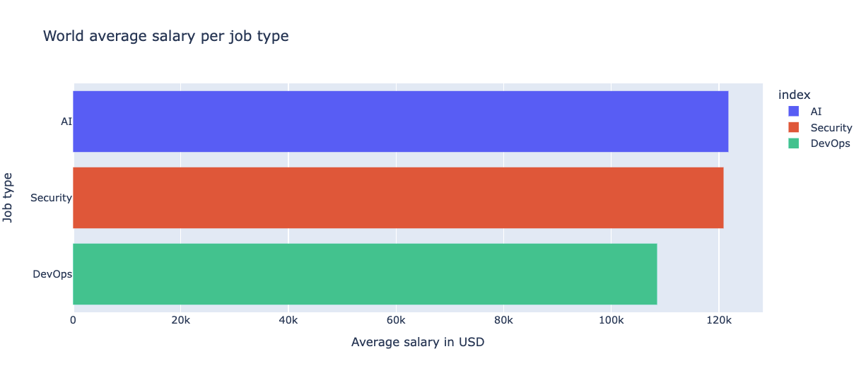
Notes:
Salario medio per tipo di lavoro
Salario per stato di residenza
Confronto dello stipendio dello stesso lavoro tra aziende di diversa grandezza
Confronto dello stipendio con experience level differente

