Slide 1

Movers
Theory of Computation – Spring 2024
Università della Svizzera Italiana
Luca Di Bello, Agnese Zamboni, Georgy Batyrev, Dimitrios Pagonis

Slide 2


Problem description
N floors
M movers
...

Slide 3
Problem description
Can we move all forniture to the ground floor in less then time t_{max}?
# 2
N floors
# 1
M movers
# 0
...

Slide 4








Problem description: objective
N floors
M movers
Chair
Wardrobe
Safe
# 2
TV
Boxes
Table
# 1
# 0
Joe
Bill
Mia

Slide 5
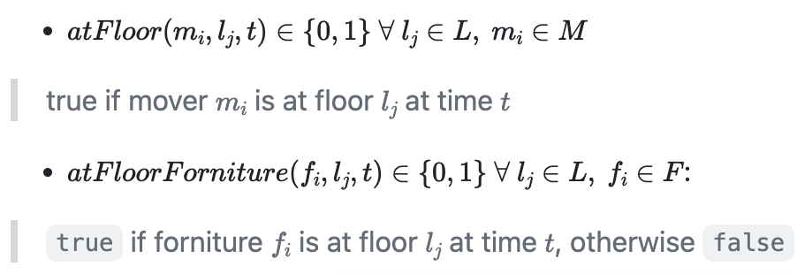
State variables
M = { , , }
F = { , , }

Slide 6
State variables
# 2
t
= 1
#2
t
= 1
# 1
#1
t = 2
# 0

Slide 7
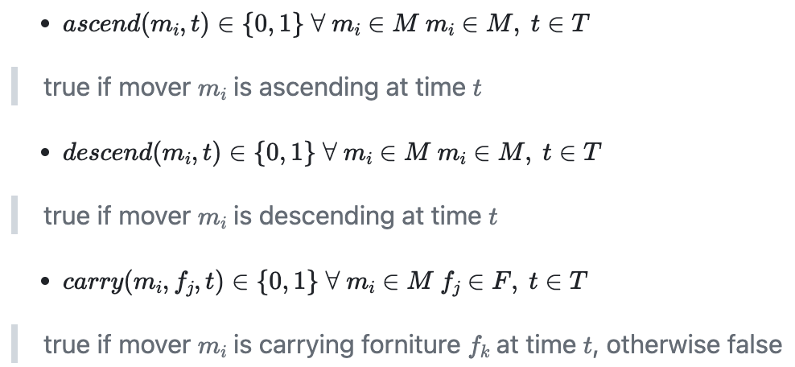
Movers actions
M = { , , }
F = { , , }

Slide 8
Movers: simulation
# 2
Safe
# 1
ascend(…)
# 0
t = 0
Joe

Slide 9
Movers: simulation
# 2
ascend(…)
Safe
# 1
Joe
# 0
t = 1

Slide 10
Movers: simulation
# 2
Joe
descend(…)
Safe
# 1
# 0
t = 2

Slide 11
Movers: simulation
# 2
Safe
carry(…)
# 1
Joe
# 0
t = 3

Slide 12
Movers: simulation
# 2
carry(…)
# 1
Joe
# 0
t = 3

Slide 13

Movers: simulation
# 2
t_{max = 4}
# 1
# 0
t = 4
Joe

Slide 14
How we have solved this problem
Mathematical model
Report
Movers
SAT Problem
Frontend
Solver
APIs
Backend

Slide 15
Mathematical model
5
variables
18
constraints
SAT
solver
Define the rules of
the game!

Slide 16
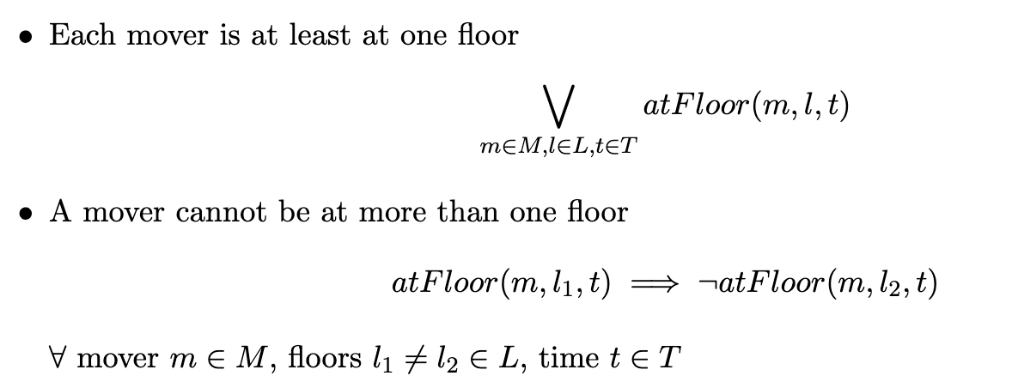
Mathematical model: some constraints
# 1
# 2
...

Slide 17
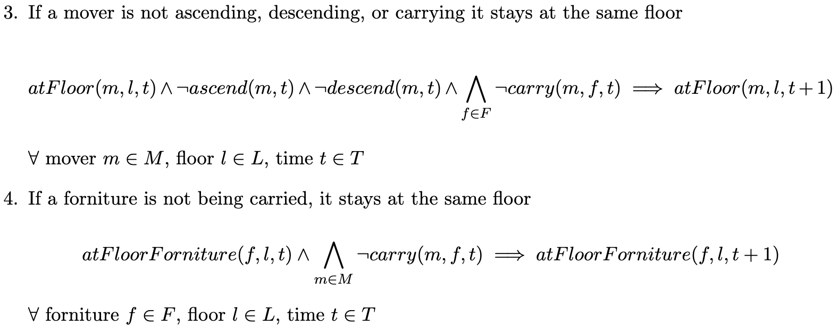
Mathematical model: some constraints
# 3
# 4
...

Slide 18
How we have solved this problem
Mathematical model
Report
Movers
SAT Problem
Frontend
Solver
APIs
Backend

Slide 19

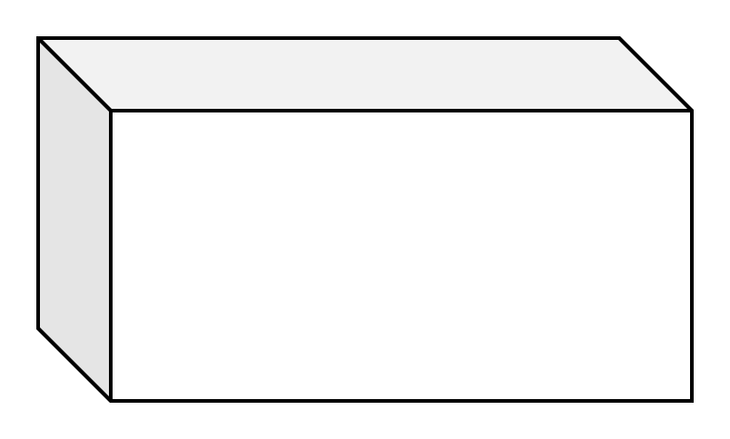



System Design
Internet
HTTP POST
HTTP GET
Backend
/solve
1) Data validation
API call with JSON
User builds instance
2) Build problem
3) Solve it
Frontend
4) Parse Results

Slide 20
System Design
Internet
HTTP POST
Backend
/solve
1) Data validation
Receive solution
100101001010...
2) Build problem
3) Solve it
Frontend
4) Parse Results
Show result + steps!

Slide 21

Demo: try the solver on your devices!
https://movers.lucadibello.ch

