Slide 1

Improving OCR Output Quality of Historical German Texts with LLMs
Pipeline Validation and Post-Correction Benchmarks
Federico Villa
Supervisor: Prof. Luca Ducceschi
Co-Supervisor: Prof. Marco Carlo Passarotti

Slide 2
Digitizing South Tyrolean Heritage
The Archive: Landesbibliothek Teßmann (Bolzano)
Focus: 19th-century German literature, poetry and journals.
Current State: Massive digitization efforts, but accessibility is limited by raw text quality.

Slide 3
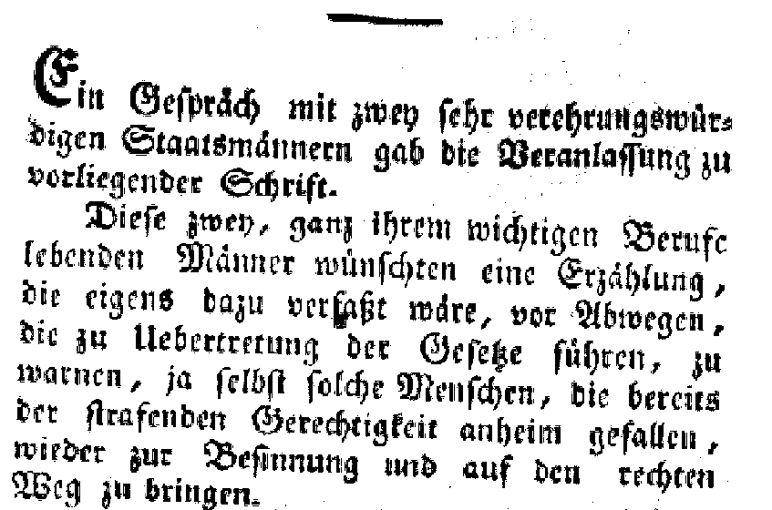
The Problem:
Fraktur & Historical Noise
Typeface:
Fraktur (‘Blackletter’) was standard in 19th-century Germany.
Visual Complexity:
Broken strokes, dense ink, similar glyphs.
Physical Degradation: Foxing, ink bleed-through, warped pages.

Slide 4
Why Standard OCR Fails
Visual Ambiguity: e.g. ‘Long-s’ (“f” vs. “ſ”) problem.
Ligatures: Complex combined characters (ch=ch, ck=ck, tz=tz) often misread.
Original Pipeline Results: The commercial solution yielded ~18,7% WER.
Impact: 1 in 6 words incorrectly transcribed, making any linguistic analysis impossible.

Slide 5
Research Objectives
Establish a High-Quality Baseline:
Replace the commercial OCR with a specialized open-source pipeline.
Evaluate LLM Post-Correction:
Can Generative AI fix residual errors without fine-tuning?
Cost-Benefit Analysis:
Identify the ‘Efficiency Frontier’ for large-scale digitization.

Slide 6
Methodology: A Two-Stage Pipeline
Stage 1:
Specialized OCR
Tools:
OCR-D framework + Calamari Engine
Model: ‘deep3-fraktur19’
Stage 2:
LLM Post-Correction
Approach:
Zero-Shot Prompting
Models:
Comparison of 16 models

Slide 7
Stage 1 Results: The OCR Baseline
Original Commercial OCR:
New OCR-D Pipeline:
CER: 8.24%
WER: 18.75%
CER: 2.89%
WER: 4.57%
OCR improvement: ~75% in word errors before LLMs.

Slide 8
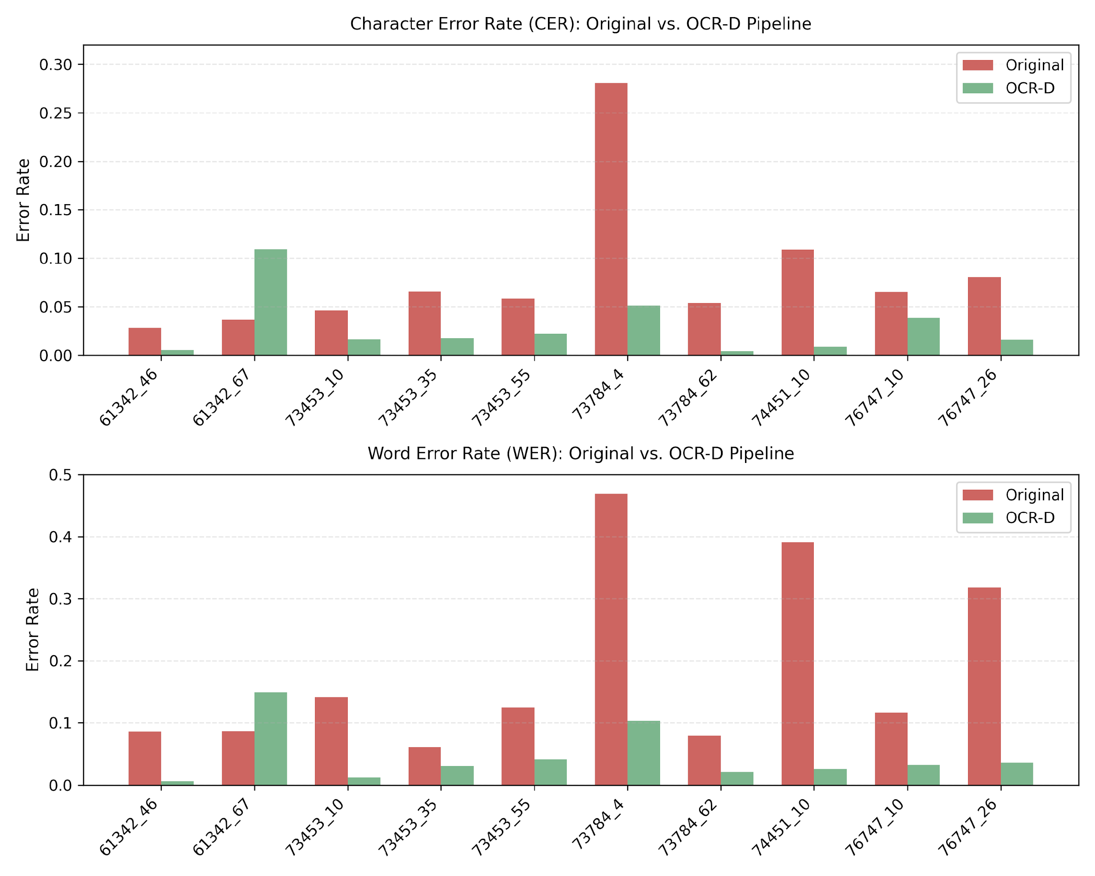
Stage 1 Results: The OCR Baseline

Slide 9
The Remaining Challenge:
Residual Errors
Visual Errors: ‘Hauf’ instead of ‘Haus’ (f/long-s confusion).
Segmentation Issues: Broken words at line ends.
Context Failures: Valid words in wrong contexts (e.g. ‘die’ vs ‘das’).
Goal: Use LLMs to fix these semantic and visual anomalies.

Slide 10

LLM Post-Correction Setup
Proprietary:
GPT-5, Gemini 2.0/2.5, DeepSeek V3/R1
Method:
Zero-Shot Prompting (Expert Editor Persona)
16 Models
Open Weights:
Llama 3.1, Qwen 2.5/3, Gemma 3

Slide 11
System Prompt Design
You are an expert of 18th century german correcting OCRed texts, written in Fraktur.
I will provide you a part of an OCRed text.
It could have some errors.
Only if necessary, you have to correct it but preserving the text as much as possible.
Consider that some characters or words without any sense could be introduced by scanning errors:
System Role
Task Instructions
Noise Handling

Slide 12
Post-Correction Results:
The Bifurcation
The Enhancers (Positive RER):
Reduced errors by 60-75%.
Respected archaic constraints.
The Regressors (Negative RER):
Increased errors (sometimes by >100%).
Hallucinated or aggressively modernized text.

Slide 13
The Enhancer (Top Performers)
DeepSeek V3:
75.1% WER Reduction (Best Overall)
GPT-5:
70.7% WER Reduction
Gemini 2.0 Flash:
68.4% WER Reduction
Key Success: Able to de-scramble noisy border text where OCR failed completely.

Slide 14
The Regressors
Llama 3.1 (8B):
Catastrophic failure (-119% RER)
Qwen 2.5 (14B & 72B):
Significant regression (up to 41.5%)
Over-alignment: Trained to be ‘helpful assistants’, they aggressively fixed valid 19th-century spelling.
Hallucinations: Invented new sentences when confused by layout noise.

Slide 15
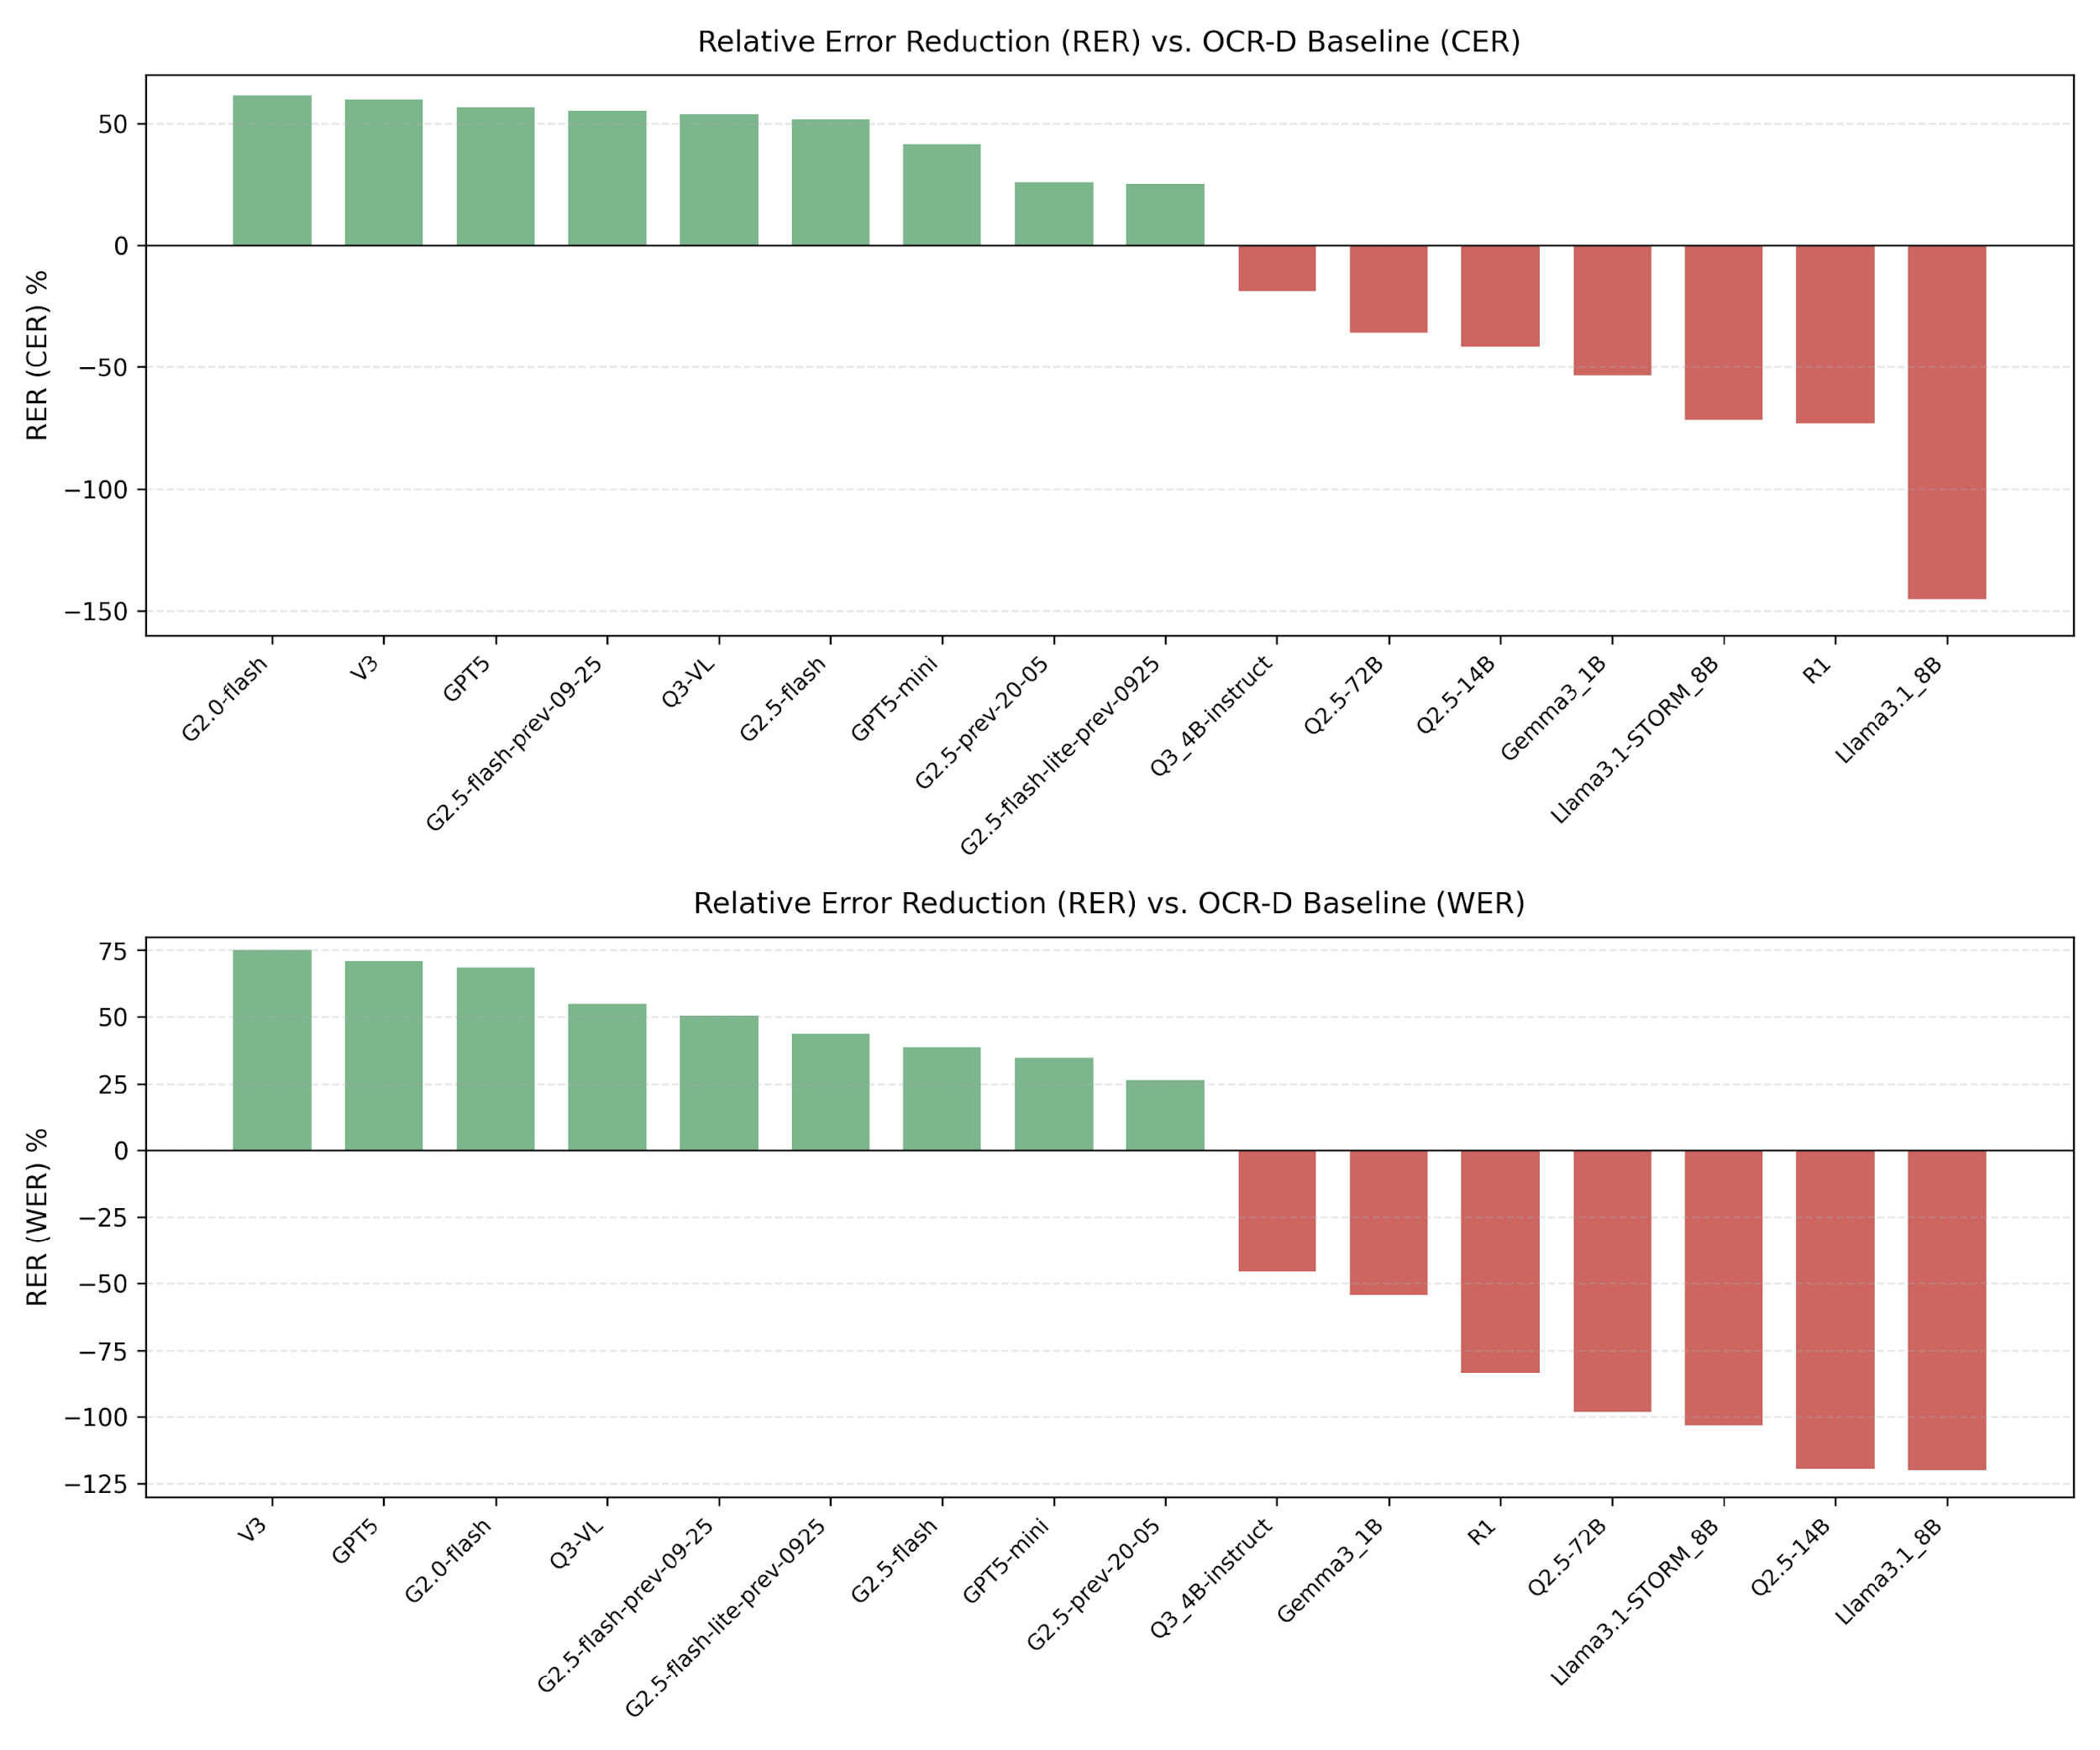
Relative Error Reduction Overview

Slide 16
Analysis I: The Scaling Fallacy
Assumption: Bigger is better.
Reality:
Qwen 2.5 (72B) was worse than Qwen 3 (4B).
Gemini 2.0 Flash (~20B) rivaled GPT-5 (Trillions).
Conclusion: Specific training data matters more than parameter count.

Slide 17
Analysis II: Vision & Drift
Vision-Language Potential:
Qwen3-VL (+54% RER).
Hypothesis: Visual grounding helps understand glyph confusion.
Generational Drift:
Gemini 2.0 Flash (+68%) beat Gemini 2.5 Flash (+38%).
Latest ≠ Best for niche tasks.

Slide 18
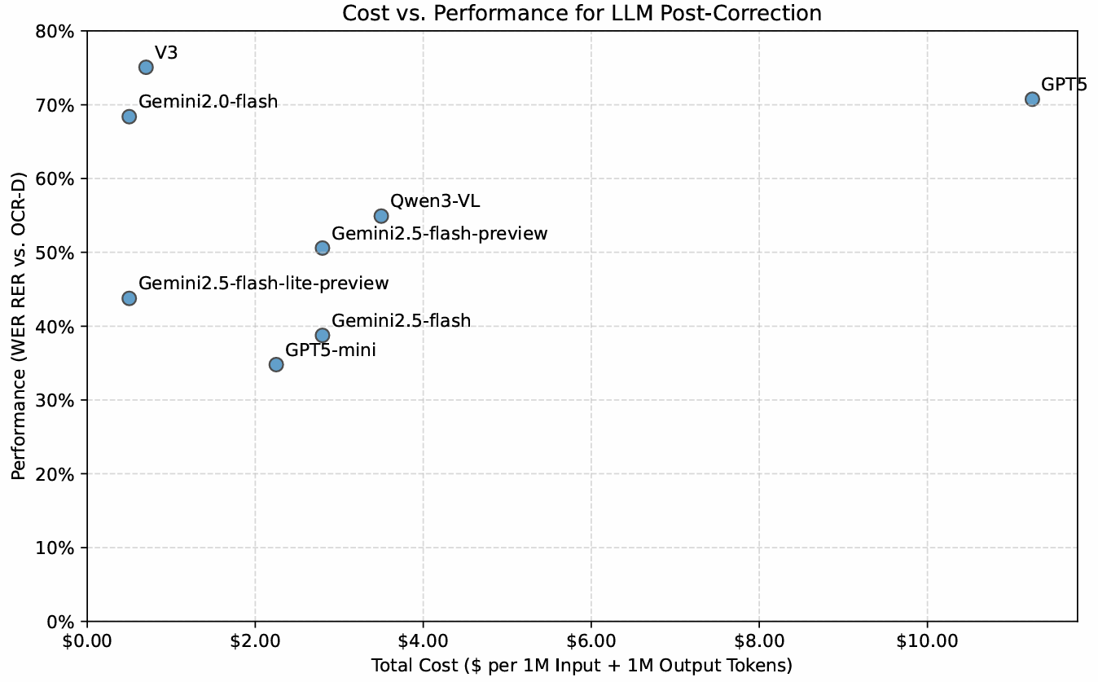
Cost vs Performance

Slide 19
The Efficiency Frontier
The Sweet Spot
(High Performance, Low Cost):
Model | $/1M token
DeepSeek V3 | 0.70
Gemini 2.0 Flash | 0.5
Diminishing Returns
(High Cost):
Model | $/1M token
GPT-5 | 11.25
Qwen3-VL | 3.5

Slide 20
Conclusion & Further Research
1. OCR pipeline works: 75% improvement over legacy.
2. LLMs works (if chosen carefully): up to 75% further improvement.
Further works:
Improving Upstream Layout Analysis
Leveraging Document-Level Context

Slide 21
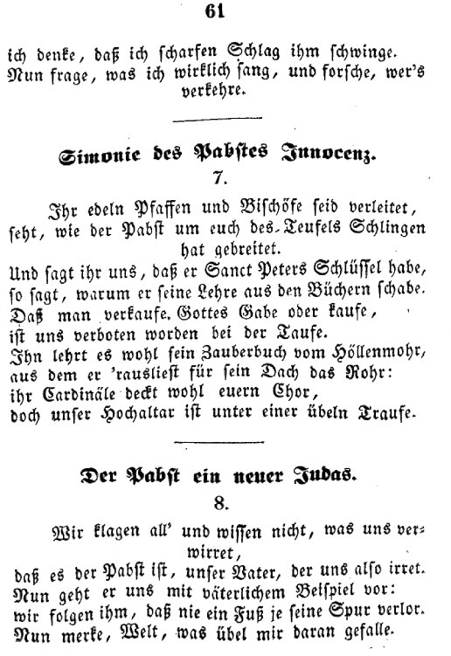
Document-Level Context

Slide 22
Thank you for your attention.
Improving OCR Output Quality of Historical German Texts with LLMs
Federico Villa

