Slide 1
Iot Project 2024
Password Injector

Slide 2
EEPROM
EEPROM
Tommaso Repele

Slide 3
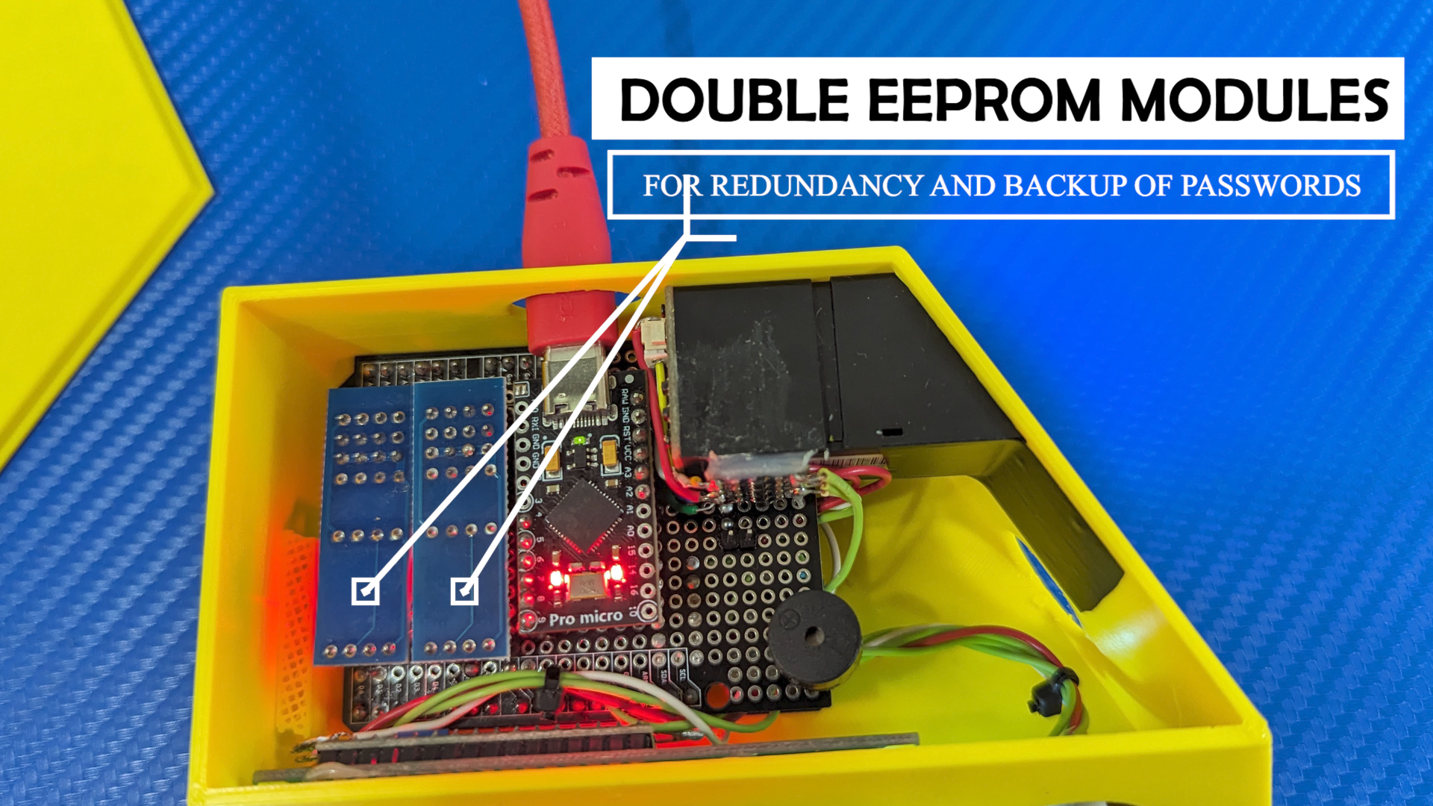
Memory management

Slide 4
What’s an EEPROM
Non-volatile memory
Like an array
In our case divided into 140-character blocks
2 EEPROM modules for backup and redundancy
struct Credential
{
char title[40];
char username[50];
char password[50];
};
//234 passwords

Slide 5
copyAintoB
void copyAintoB(int eepromAddressA, int eepromAddressB){
for(int i = 0; i < EEPROM_SIZE_BYTES; i++){
writeToEEPROM(i, readFromEEPROM(i, eepromAddressA), eepromAddressB);
}
}
Copies data from an EEPROM module to the other
Uses writeToEEPROM() and readFromEEPROM()
All functions are included in the library

Slide 6
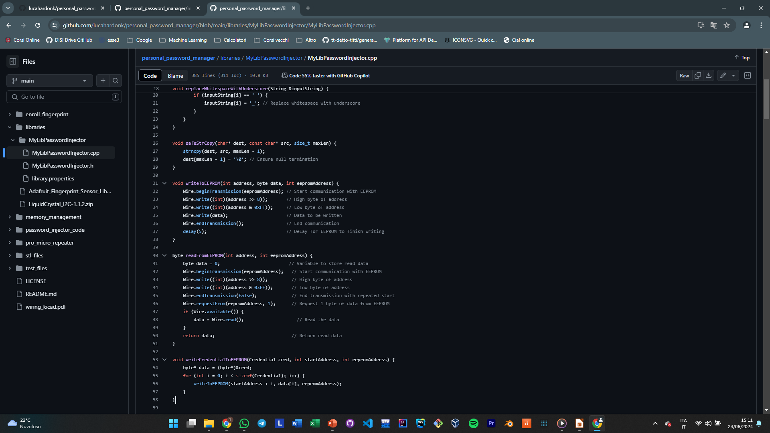
Write and Read byte

Slide 7
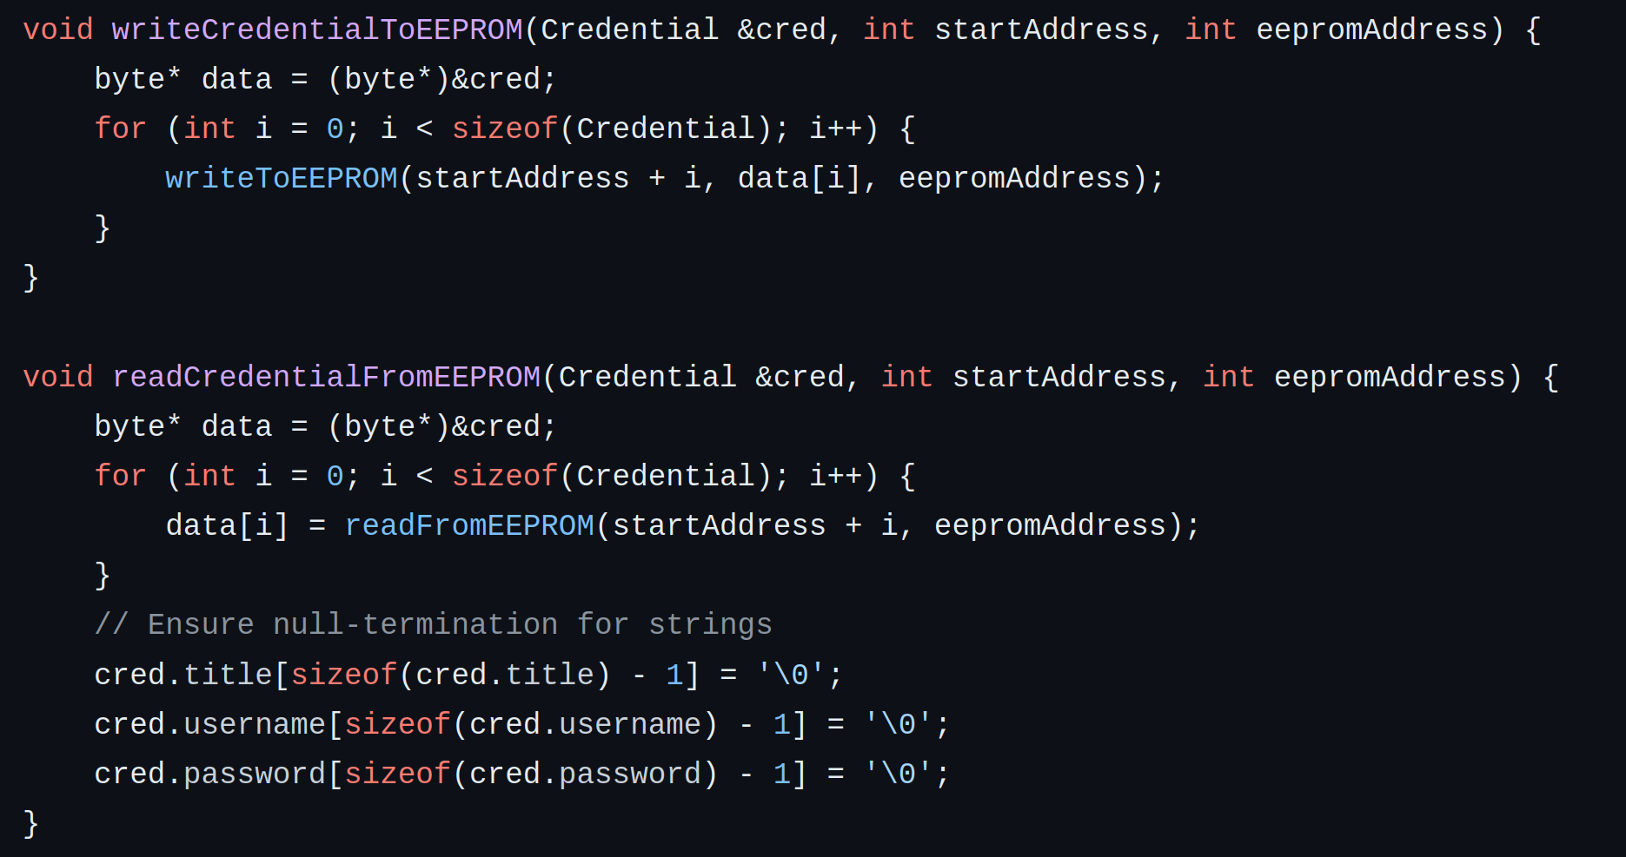
Write and Read Credential

Slide 8
External devices
Cecilia Cavosi

Slide 9
Buzzer
void setupBuzzer(int pin, int freq) {
// Set the pin as output
DDRD |= (1 << pin);
// Calculate the compare match value for the desired frequency
uint32_t compareMatch = F_CPU / (2 * freq * 1024UL) - 1;
// Configure Timer1 for CTC mode (Clear Timer on Compare Match)
TCCR1A = 0; // Clear Timer1 settings
TCCR1B = (1 << WGM12); // CTC mode
TCCR1B |= (1 << CS10) | (1 << CS12); // Set prescaler to 1024
// Set the compare match value
OCR1A = compareMatch;
// Enable Timer1 compare match A interrupt
TIMSK1 |= (1 << OCIE1A);
// Enable global interrupts
sei();
}
ISR(TIMER1_COMPA_vect) {
if (buzzerOn) {
PORTD ^= (1 << BUZZER_PIN); // Toggle the state of the buzzer pin
}
}

Slide 10
Joystick
int analogReadChannel(uint8_t channel) {
ADMUX = (1 << REFS0) | (channel & 0x0F); // Select AVCC reference and desired analog input channel
ADCSRA |= (1 << ADSC); // Start the conversion
while (ADCSRA & (1 << ADSC)); // Wait for conversion to complete
return ADC; // Read the ADC value (combines ADCL and ADCH)
}

Slide 11

LCD (Liquid Crystal Display)
LiquidCrystal_I2C lcd(0x27, 16, 2);
lcd.init();
lcd.clear();
lcd.setCursor(0, 0);
lcd.print("erasing all memory");
byte arrowIcon[8] = {
B00000,
B00100,
B00010,
B11111,
B00010,
B00100,
B00000,
};

Slide 12
Board Communication
Luca Hardonk

Slide 13
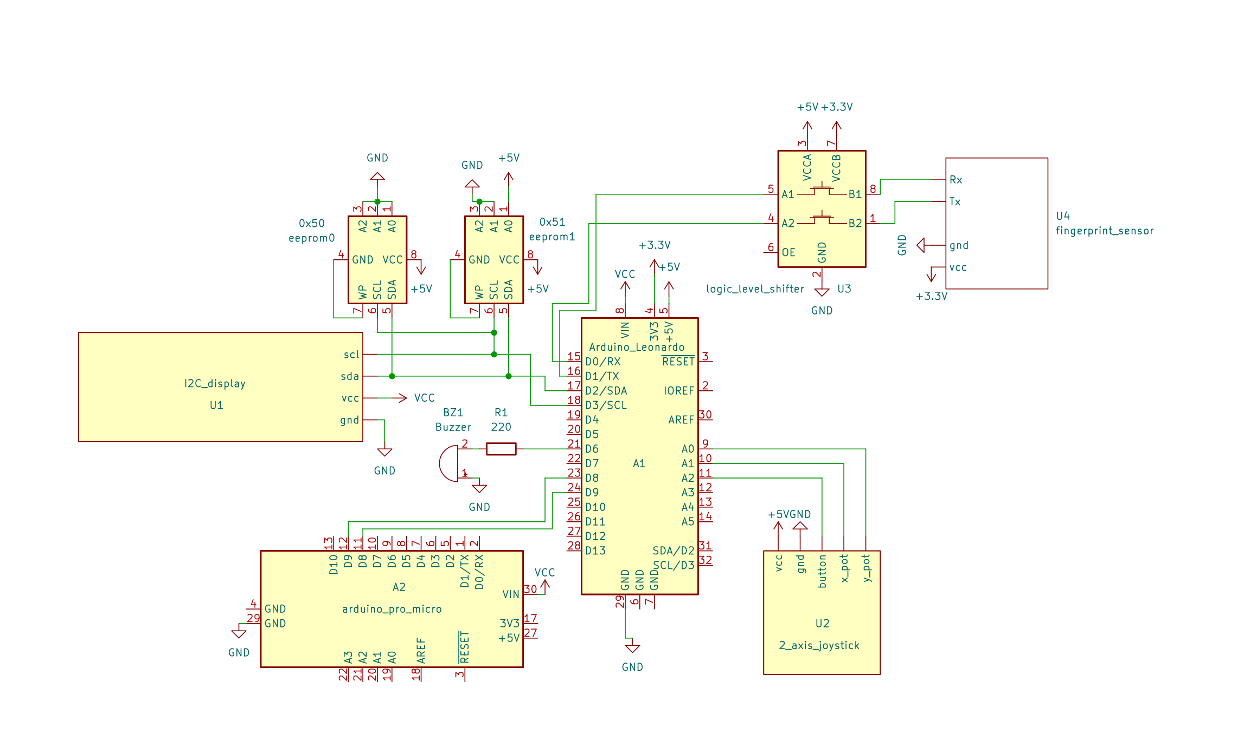
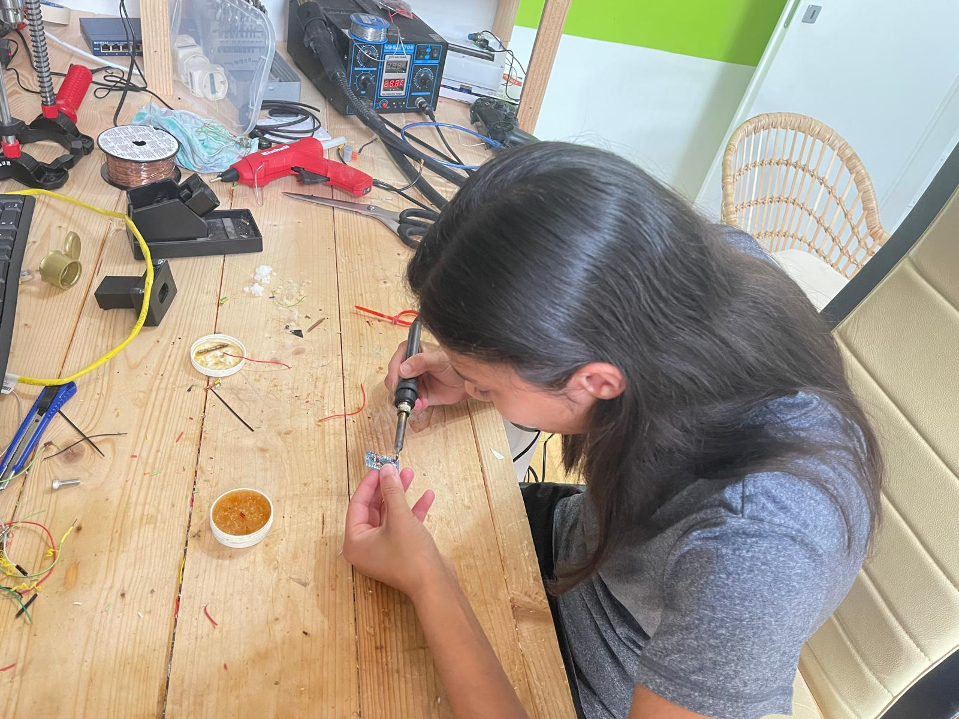
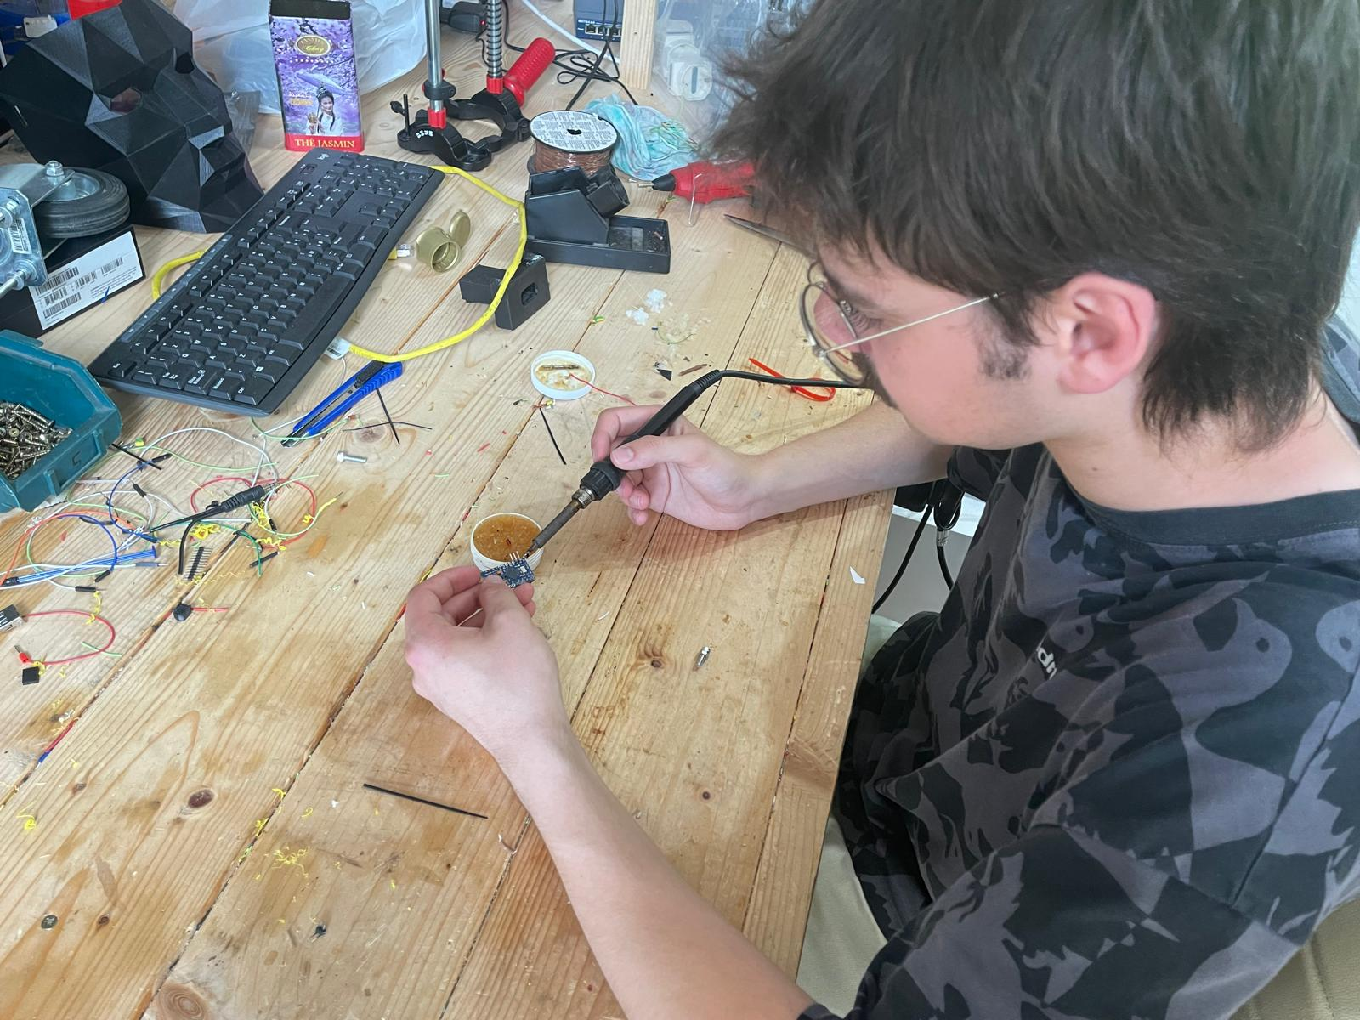
Wiring

Slide 14

General Coding
Implemented the library with all necessary data structures and internal variables to easily reproduce the project
https://github.com/lucahardonk/personal_password_manager/tree/main/libraries/MyLibPasswordInjector
Git Repository management

Slide 15
Keyboard emulation
Increased security separating the main board with sensitive information from the outside world.
having a board capable of emulating a HID ensures Os compatibilities.
#include <SoftwareSerial.h>
#include <Keyboard.h>
// Define the software serial pins
#define RX_PIN 8
#define TX_PIN 9
SoftwareSerial mySerial(RX_PIN, TX_PIN); // RX, TX
void setup() {
// Start the USB serial communication for debugging
//Serial.begin(9600); // for debug only
// Start the software serial communication
mySerial.begin(9600);
//allocate 64 bytes aviable as buffer
// Start the Keyboard library
Keyboard.begin();
}
void loop() {
// Check if data is available → reports how full the buffer is
if (mySerial.available()) {
// Read the incoming data until a newline character is encountered
String data = mySerial.readStringUntil('\n');
// Print the received data to the Serial Monitor for debugging
//Serial.print(data);
// Send the received data as keyboard input
Keyboard.print(data); // presses individual keys to form the string
Keyboard.print('\n'); // Ensure the end character is newline
}
delay(5); // pooling delay
}

Slide 16
Fingerprint sensor
Troubleshooted with a logic level shifter
Standard code readapted from the Adafruit_Fingerprint_Sensor_Library
int getFingerprintIDez() {
uint8_t p = finger.getImage();
if (p != FINGERPRINT_OK) return -1;
p = finger.image2Tz();
if (p != FINGERPRINT_OK) return -1;
p = finger.fingerFastSearch();
if (p != FINGERPRINT_OK) return -1;
// found a match!
Serial.print("Found ID #"); Serial.print(finger.fingerID);
Serial.print(" with confidence of "); Serial.println(finger.confidence);
return finger.fingerID;
}

Slide 17
Thank you!

