Slide 1
BID AGAINST
Rocket
SPACEX

Slide 2
Executive Summary
Summary of methodologies:
Data collection and wrangling
SQL
Visualization
Predictive Analysis
Summary of Results:
Whether the first stage will land can be predicted with a relatively high accuracy

Slide 3
CONTENTS
Introduction
Methodology – Data Collection and Wrangling
Methodology – EDA and Interactive Visual Analytics
Methodology – Predictive Analysis
Results – EDA with Visualization
Results – EDA with SQL
Results – Interactive map with Folium
Results – Predictive Analysis
Conclusion

Slide 4
Introduction
Falcon 9 first stage will land successfully and costs less than other providers.
Questions:
What is the price of each launch?
If SpaceX will reuse the first stage?

Slide 5
Methodology – Data Collection and Wrangling
Request Data from API -> Turn data from .json to dataframe -> Clean data -> save to csv files
Get Data by web scraping -> Turn data from html to dataframe -> Clean data -> save to csv files

Slide 6
Methodology – EDA and Interactive Visual Analytics
Explore the sites and orbits of launches, giving a label of success
Visualize the relationship between flight number, payload and launch site
Visualize the relationship between flight number, payload and orbit type
Visualize the launch success yearly trend
Use Folium to mark launch sites and calculate the distances

Slide 7
Methodology – Predictive Analysis
Handle data for preparation
Build modes: logistic regression, SVM, decision tree, K-nearest neighbor
Use score to compare the better model

Slide 8
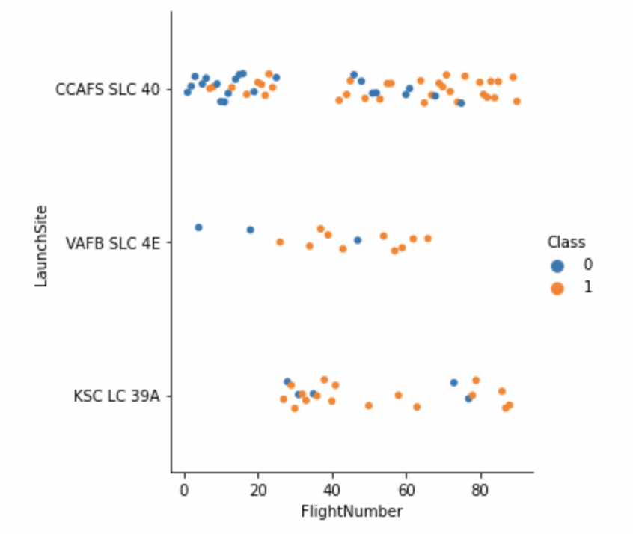
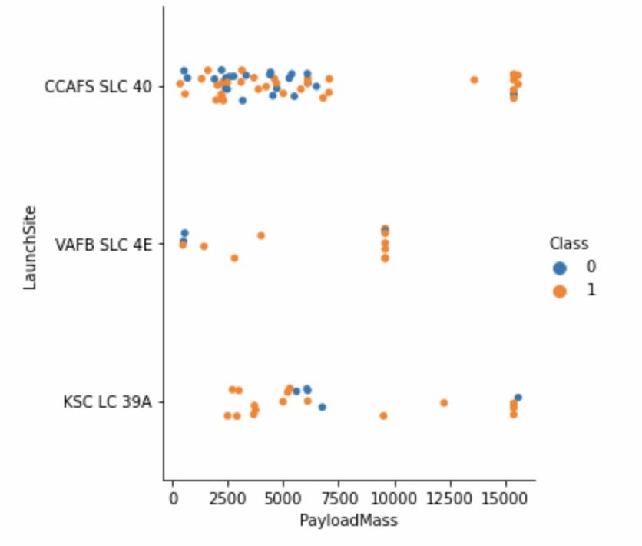
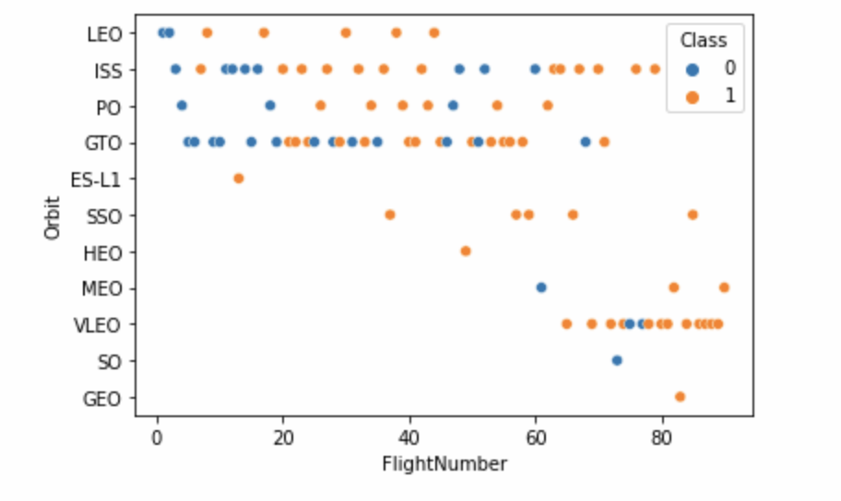
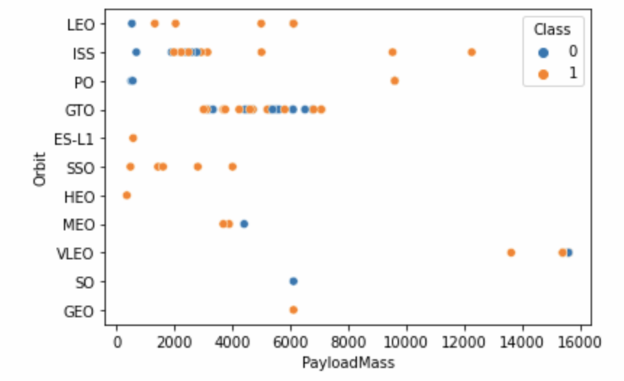
Results – EDA with Visualization

Slide 9
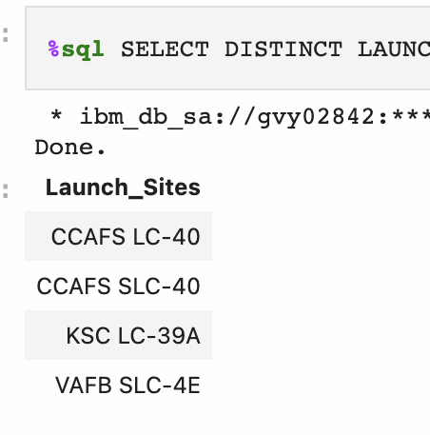
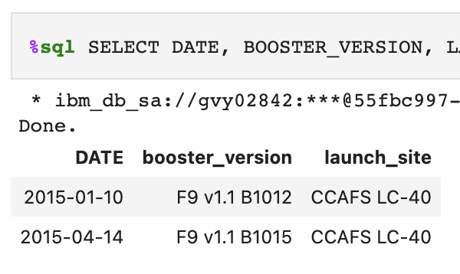
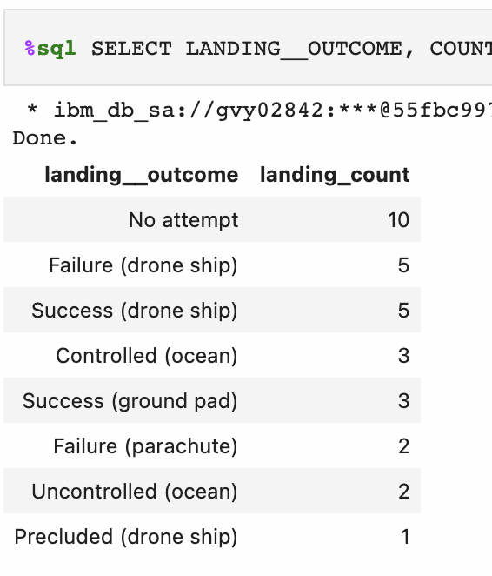
Results – EDA with SQL

Slide 10
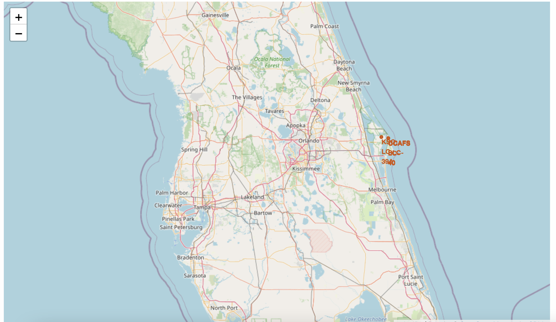
Results – Interactive map with Folium

Slide 11
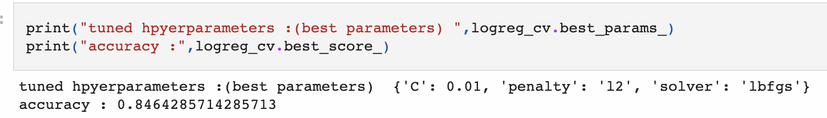
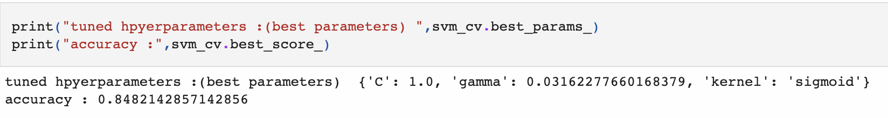
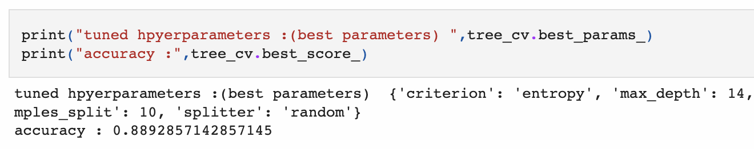
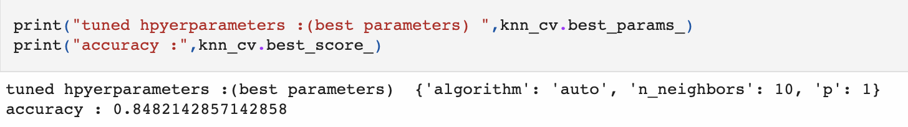
Results – Predictive Analysis

Slide 12
Conclusion
All models used have a high accuracy to predict the landing outcome, among with Decision Tree performs the best.

Slide 13
Thank you for watching.

