Slide 1







UNIVERSITY SOFTWARE PROJECT
EcoMeal
Reducing Food Waste Through a Digital Surplus-Food Marketplace
Team: [Team member names]
Course: [University · Course · Year]
github.com/lucajianu/EcoMeal
Notes:
Good morning everyone. We are presenting EcoMeal, our university software project: a web application that fights food waste. Every evening, restaurants, bakeries and grocery stores are left with food that is still perfectly safe to eat but can no longer be sold tomorrow. EcoMeal lets these businesses publish discounted surplus packages with a pickup window, and lets customers discover them. Today we will briefly cover the technologies, then walk through the application itself with live screenshots — including how an administrator's experience differs from a regular user's.

Slide 2









WHY ECOMEAL EXISTS
The Problem & Our Solution
Unsold food
end-of-day surplus, still safe to eat
Businesses publish discounted surplus packages
Customers discover offers and pick them up in time
Disposal
edible food becomes waste
Save food
Save money
Support local businesses
Loss
for the business and the planet
A marketplace where end-of-day surplus becomes an opportunity — for businesses, customers and the environment.
Notes:
The problem: food businesses cannot predict demand exactly, so safe, edible food is discarded every evening — the business loses the money it invested, and good food becomes waste. EcoMeal's answer is a marketplace connecting the two sides: businesses publish discounted packages from their surplus with a pickup interval before closing, and customers nearby discover and collect them. Everyone wins: less waste, cheaper food, recovered revenue.

Slide 3




SHORT TECH OVERVIEW
Technologies
Blazor — Interactive Server
ASP.NET Core Web API
UI written in C# with reusable Razor components; two-way data binding, EditForm validation, dependency injection. No JavaScript SPA.
independent backend with controller-based REST endpoints, async actions, DTOs as the API contract, Swagger/OpenAPI for testing.
EF Core + SQL Server
ASP.NET Core Identity
code-first entities and migrations; relationships configured in the DbContext; fully asynchronous queries and updates.
registration and login with access tokens; Admin and User roles seeded at startup; role-based authorization on the API.
One language, one stack: C# end to end — the Blazor client talks to the Web API over HTTP + JSON with a Bearer access token.
Notes:
A quick look at the stack before the demo. The frontend is Blazor with Interactive Server rendering — the interface logic runs in C# on the server, built from reusable Razor components with built-in form validation. The backend is a separate ASP.NET Core Web API exposing REST endpoints and exchanging DTOs as JSON. Persistence is Entity Framework Core over SQL Server, code-first with migrations. And authentication is ASP.NET Core Identity: registration, token-based login, and two roles — Admin and User — enforced on the API. Everything is C#, which kept the team fast in a single ecosystem.

Slide 4





SEPARATION OF CONCERNS
System Architecture
User Browser
Role of each layer
Blazor Interactive Server UI — Razor components
Razor components display data and collect input
Frontend services isolate all HTTP communication
Controllers expose the REST endpoints
Identity authenticates and authorizes
DTOs define the API contract
EF Core runs queries and updates
SQL Server stores the application data
Frontend services — BusinessService · PackageService · AuthService
HTTP + JSON · Bearer token
ASP.NET Core Web API — REST controllers + Identity
DTOs — the API contract between client and server
Entity Framework Core — EcoMealDbContext
SQL Server database
Notes:
The system is two independent applications. The browser talks to the Blazor client; Razor components delegate all HTTP communication to service classes — BusinessService, PackageService and AuthService — which call the Web API with JSON and a Bearer access token attached automatically. On the server, controllers validate input, Identity handles who you are and what you may do, DTOs keep the contract stable, and EF Core maps entities to SQL Server. Each layer has exactly one job.

Slide 5
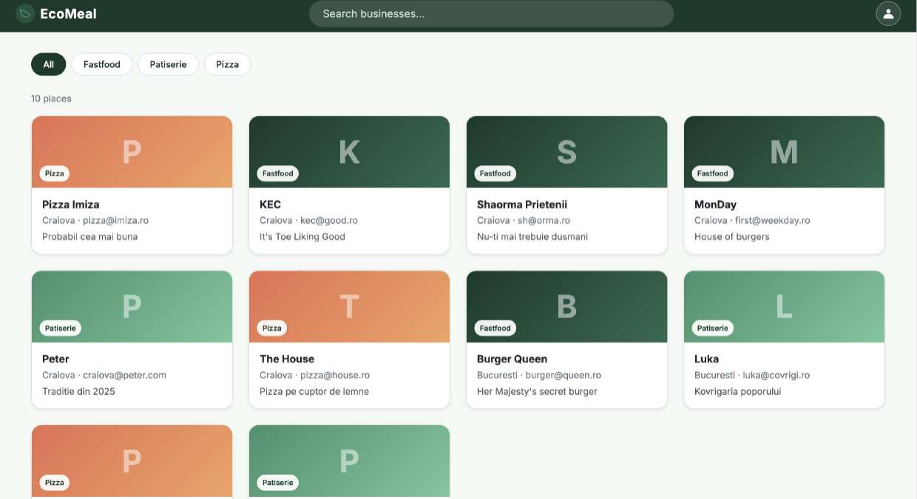
FEATURE TOUR · EVERYONE
Home — Discover Local Businesses
1
1
Search bar — always in the top bar, Bolt-Food style; filters as you type
2
3
2
Type chips — one click filters by business type (Fastfood, Patiserie, Pizza…)
3
Business cards — loaded from GET /api/business; colour-coded by type, click for details
Open to everyone — no account needed to browse.
Notes:
This is the home page as any visitor sees it — no account required to browse. The dark-green top bar carries the brand, the search box and the account icon. Businesses arrive from the API as JSON and render as colour-coded cards, one Razor component per card. The chips underneath filter by business type with a single click, and everything reacts instantly because the filtering happens in C# on the already-loaded list.

Slide 6
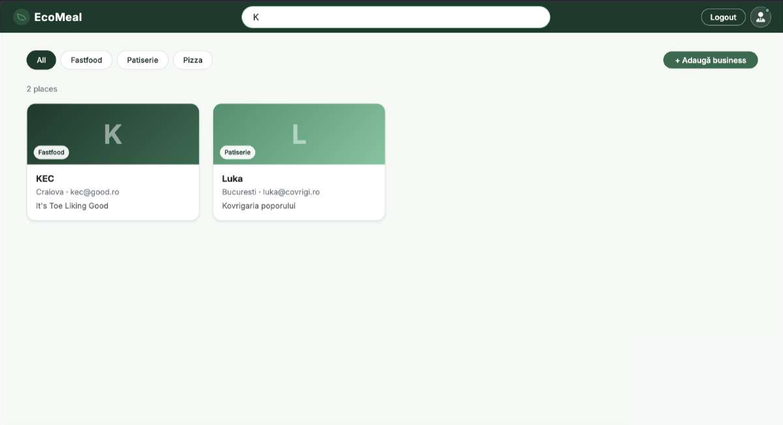
FEATURE TOUR · EVERYONE
Live Search
1
1
Type “K” — the navbar input writes into a shared SearchState service
2
3
2
Instant count — the list reacts through an event — here 10 places shrink to 2
3
Matches — case-insensitive name search combined with the type filter
Notes:
Search lives in the navigation bar itself. The input writes into a small shared state service; the business list subscribes to its change event and re-filters on every keystroke. Typing the letter K instantly narrows ten places down to the two whose names match — case-insensitively — and the search combines freely with the type chips. Typing from any other page automatically brings you back to the list.

Slide 7
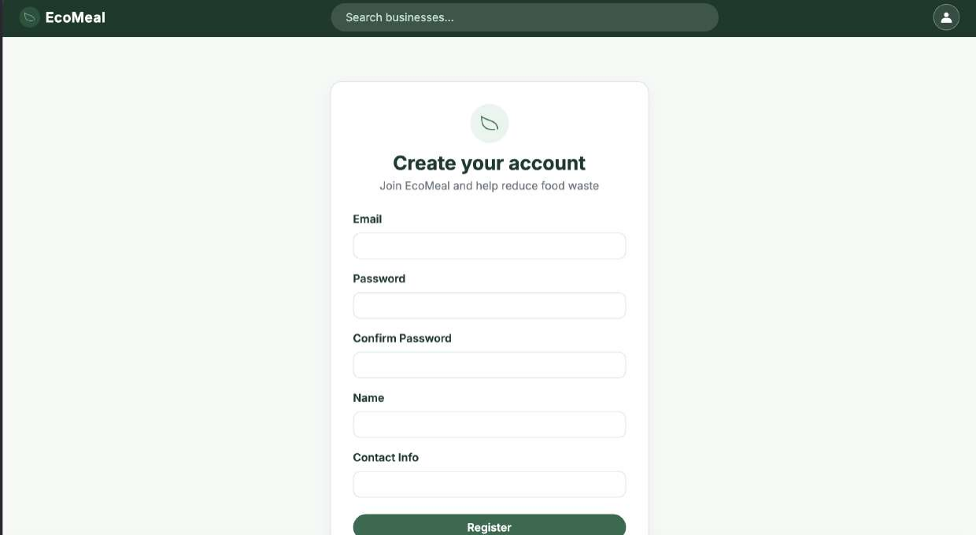
FEATURE TOUR · ACCOUNTS
Register
1
1
One clean card — email, password + confirmation, name and contact info
What happens on submit
1. Data annotations validate the form client-side
2. POST /api/auth/register sends the JSON
3. Identity checks password rules, hashes it, creates the user
4. The “User” role is assigned automatically
5. You are redirected to the login page
Notes:
Creating an account takes one card: email, password with confirmation, name and contact. Data annotations validate the fields before anything leaves the browser; on submit, the form posts JSON to our register endpoint, where ASP.NET Core Identity enforces the password policy, stores only a hash — never the password itself — creates the user, and assigns the default User role. Any server-side errors, like a duplicate email, come back and are shown above the form.

Slide 8
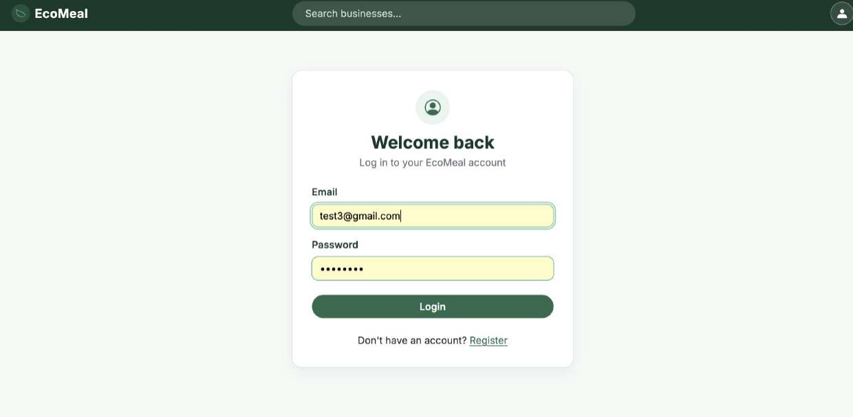
FEATURE TOUR · ACCOUNTS
Login
1
1
Welcome back — email + password; a link leads to Register if you have no account
Behind the button
1. POST /login (built-in Identity endpoint)
2. Identity verifies and returns an access token
3. Token stored in encrypted browser storage
4. Every API call now carries “Bearer <token>”
5. The UI updates instantly — no page reload
Notes:
Login goes through Identity's built-in endpoint, which returns an access token. We keep that token in ProtectedLocalStorage — encrypted browser storage — and a delegating handler attaches it as a Bearer header to every subsequent API request, so no other code ever thinks about authentication. A custom AuthenticationStateProvider notifies the interface, so the navbar switches to the logged-in state immediately, without a reload.

Slide 9
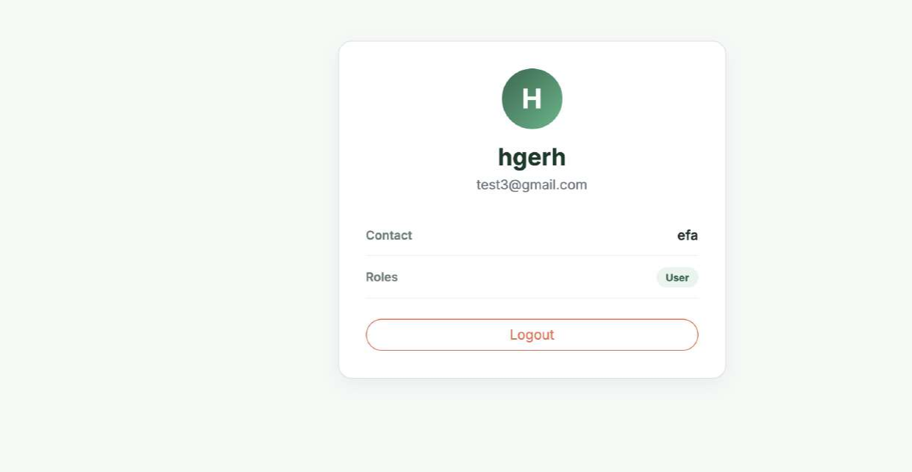
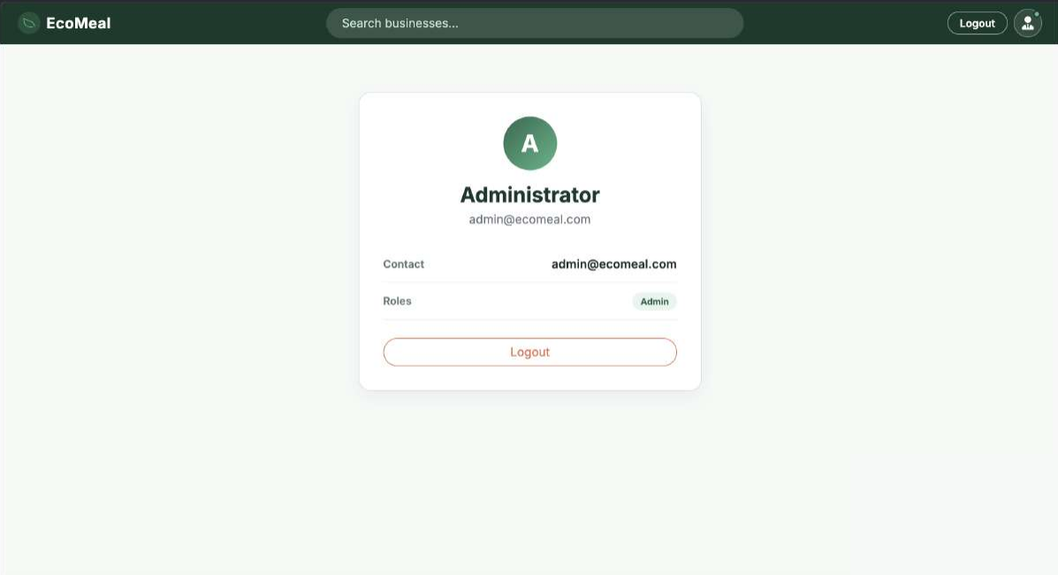
FEATURE TOUR · ACCOUNTS
My Account & Roles
USER
ADMIN
1
2
The user icon in the navbar opens this page (or Login when signed out). Data comes from the protected GET /api/auth/me endpoint — name, email, contact and roles (1, 2). Logout clears the stored token.
Notes:
Clicking the user icon in the navbar brings you here — or to the login page if you are signed out. The page calls a protected endpoint, /api/auth/me, which only answers when a valid token is attached, and returns the profile plus roles. On the left, a regular registered user with the User badge; on the right, the administrator account with the Admin badge. The Logout button deletes the token from browser storage and returns the interface to its anonymous state.

Slide 10
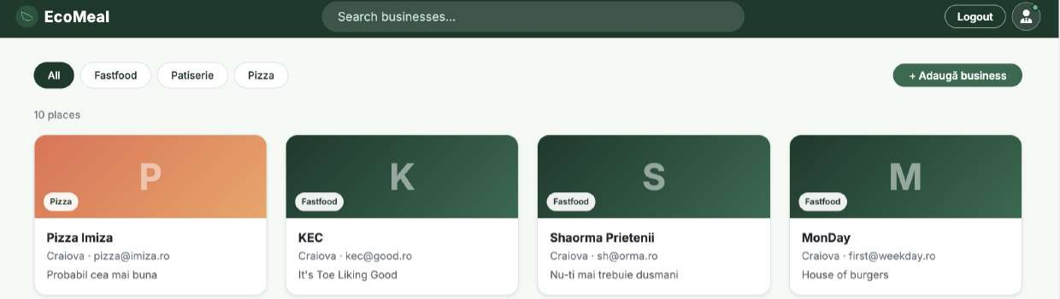
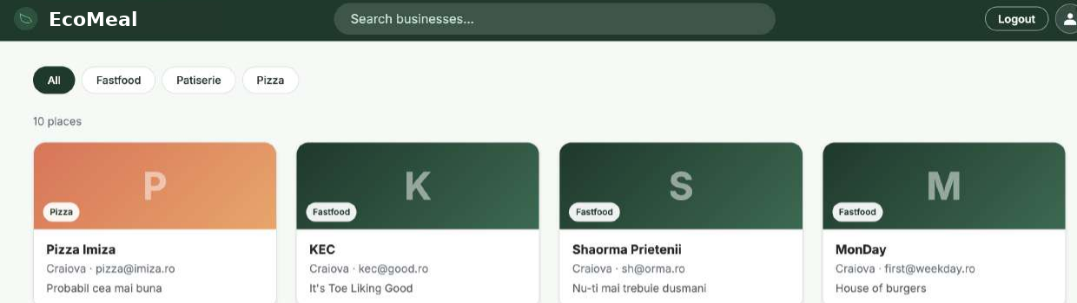
FEATURE TOUR · AUTHORIZATION
Admin vs. Regular User
1
ADMIN
2
1 tie icon marks the admin
2 “+ Adaugă business” — admins only
3
USER
3 plain icon — no admin controls anywhere
Same page, two roles — AuthorizeView hides admin controls; the API enforces it with [Authorize(Roles = "Admin")].
Notes:
Here is the same home page seen by two different accounts. On top, the administrator: the account icon becomes a user-with-a-tie, and an extra button appears for adding a business. Below, a regular logged-in user: plain icon, no management buttons anywhere. This is done with AuthorizeView components that render content only for a given role — but the interface is just the polite layer. The real enforcement is on the API, where create, edit and delete endpoints require the Admin role and answer 401 or 403 otherwise.

Slide 11
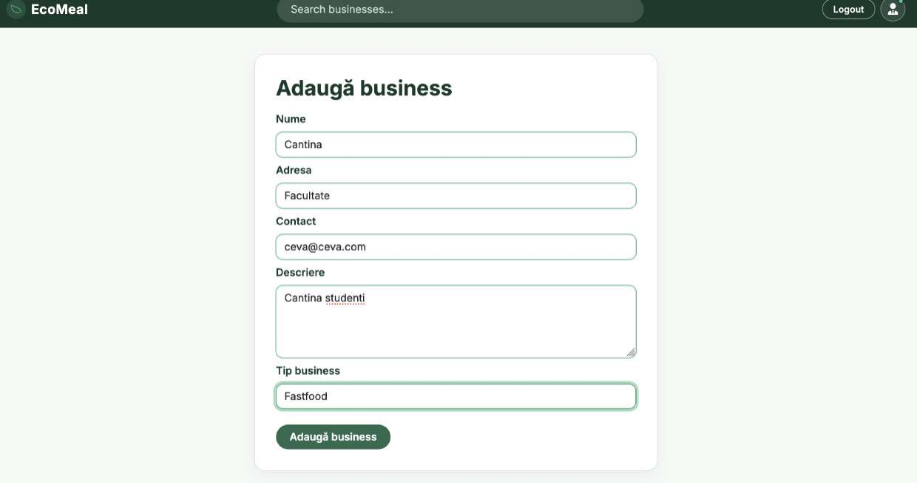
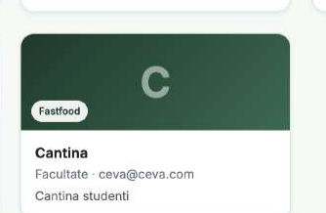

FEATURE TOUR · ADMIN
Adding a Business
1
Business types from the API — the dropdown is filled by GET /api/businesstypes
2
Submit — POST /api/business — admin-only; the referenced type ID is validated server-side
1
2
“Cantina” instantly appears in the list
Notes:
As admin, adding a business is one validated form: name, address, contact, description, and a type selected from a dropdown that is itself loaded from the API. The same Razor component doubles as the edit form. On submit, the JSON goes to POST /api/business — an admin-only endpoint that additionally verifies the business type ID exists before saving through EF Core, returning 400 for an unknown type. Right after saving, the new business — here our “Cantina” — shows up in the list.

Slide 12
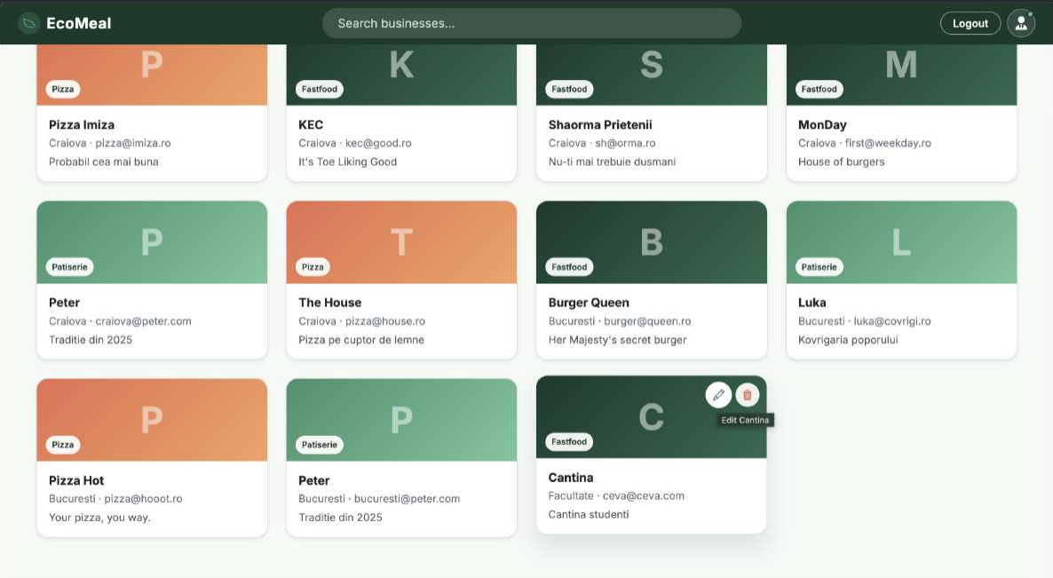
FEATURE TOUR · ADMIN
Editing & Deleting a Business
1
Hover actions — pencil = edit, bin = delete; they appear only on hover, only for admins
2
Tooltips — each button announces its target — “Edit Cantina”
1
2
Edit reuses the same form pre-filled (PUT, 204 No Content).
Delete removes the business (DELETE, 204) — its packages go with it.
Notes:
Management stays out of the way until you need it: hovering a card as admin reveals two round buttons — a pencil to edit and a bin to delete, with tooltips naming the exact business. Edit opens the same form pre-filled with current data and saves through a PUT returning 204 No Content; delete calls the DELETE endpoint. Regular users never see these buttons, and even a crafted request without an admin token is rejected by the API.

Slide 13
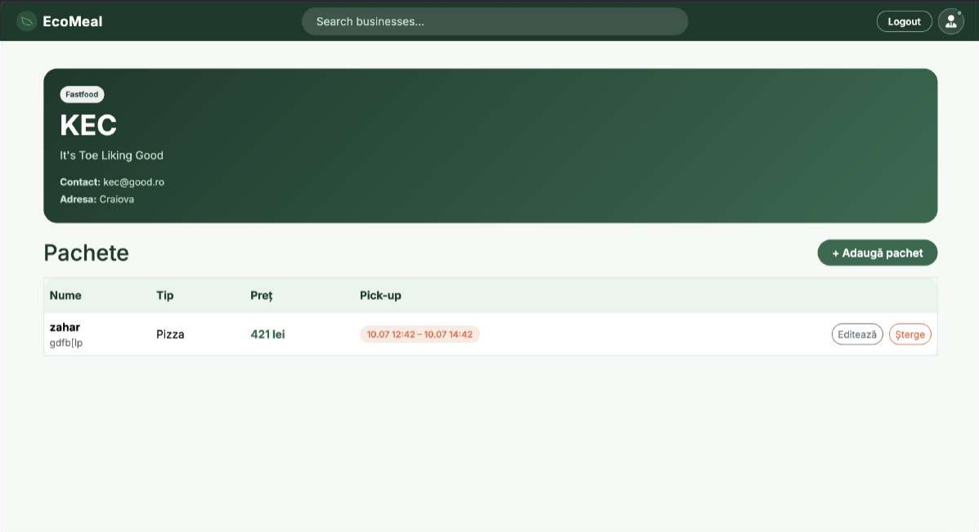
FEATURE TOUR · PACKAGES
Business Details & Packages
1
Profile hero — type badge, description, contact and address — one GET /api/business/{id} with packages included
1
2
Pickup window — each package shows price and its pickup interval
3
2
3
Admin actions — add, edit or delete packages — hidden for regular users
Notes:
Clicking a card opens the business page. A single API call returns the business together with its packages — entity relations projected into one DTO. The dark-green hero shows the profile; below it, the package table lists each offer with its type, price and, highlighted in orange, the pickup window in which the customer must collect it. Because we are logged in as admin here, the add, edit and delete controls are visible; a regular user sees a clean read-only table.

Slide 14
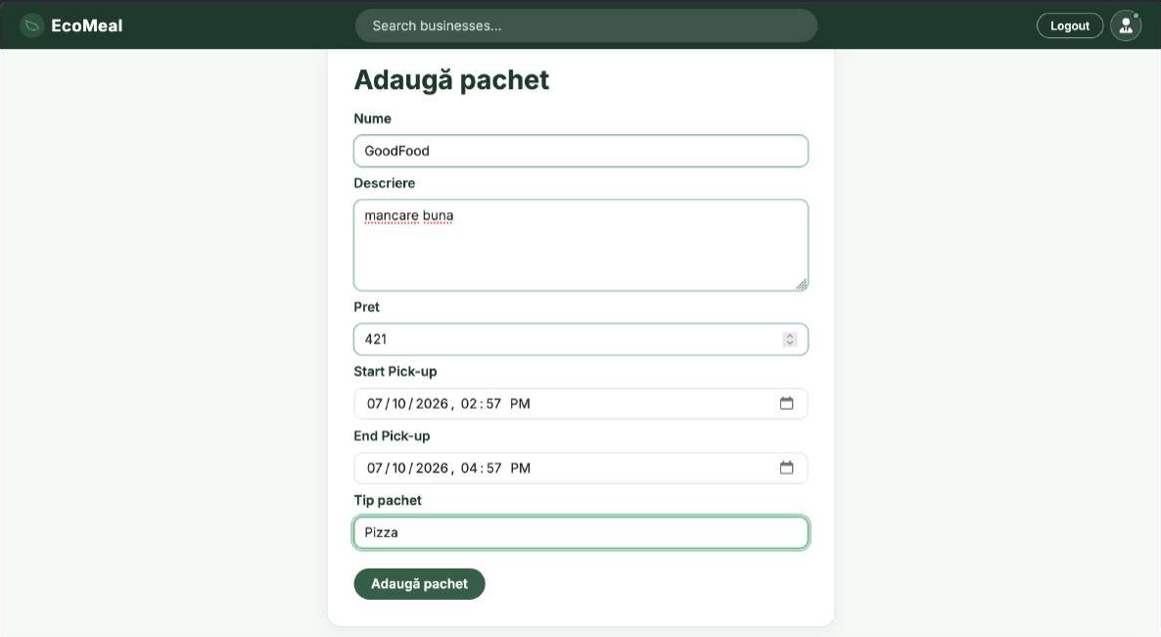
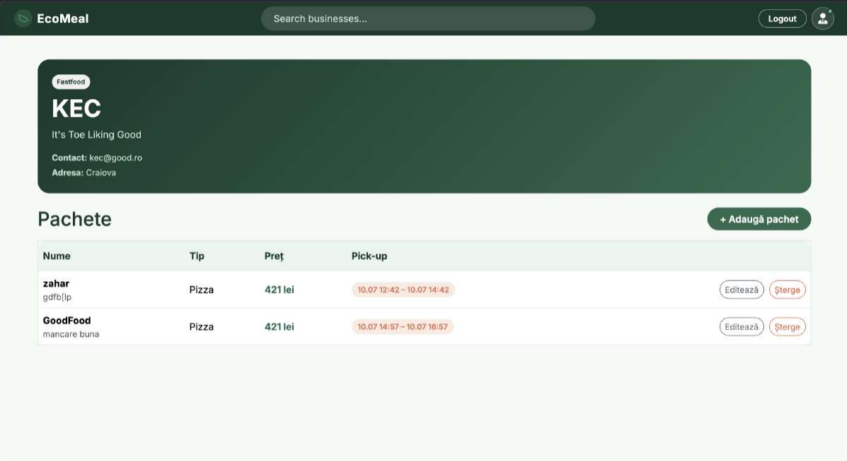
FEATURE TOUR · ADMIN
Adding a Package
1
Price — the discounted price in lei
2
Pickup start & end — the time window for collection
1
3
Type — from GET /api/packagetypes
2
3
4
4 — “GoodFood” joins the table
Notes:
Publishing a surplus package: name, description, the discounted price, and — the heart of EcoMeal — the pickup window with a start and end time, plus a package type loaded from the API. Validation guards the required fields; submit posts to the admin-only packages endpoint, EF Core saves the entity with 201 Created, and the interface navigates back to the business page, where GoodFood now appears in the table with its orange pickup badge.

Slide 15
ENTITY FRAMEWORK CORE + SQL SERVER
Database Design
Business
Package
BusinessType
1
*
PK Id
Name, Address
Contact, Description
FK BusinessTypeId
1
*
PK Id
Name, Price
NoPackage (qty)
StartPickup, EndPickup
FK BusinessId
FK PackageTypeId
PK Id
Name
1
*
1
User (Identity)
Order
PackageType
1
*
PK Id
FK UserId
FK PackageId
Status, PlacedAt
*
PK Id
Name
PK Id
Email, PasswordHash
Name, Contact
Order — modelled, not yet in the UI: status lifecycle (pending · accepted · rejected · finished · cancelled) prepares the reservation workflow.
Notes:
Under the hood: a BusinessType classifies many Businesses, a Business publishes many Packages, a PackageType classifies many Packages. The User entity extends IdentityUser, carrying the hashed password and account data alongside our Name and Contact fields — accounts are fully live. The Order entity, outlined dark, is the one part that is modelled but has no UI yet: it links a user to a package with a placement time and a five-state status lifecycle, ready for the future reservation workflow.

Slide 16






UNDER ACTIVE DEVELOPMENT
Current Limitations & Future Development
Accounts — next steps
Ordering
Payments
business-owner accounts · profile management · email confirmation · password reset
complete reservation workflow · quantity & real-time availability
online / in-app payment for reserved packages
Discovery & engagement
Robustness
Operations & impact
maps & geolocation · notifications · ratings & reviews · image upload
stronger server-side validation · global error handling · automated tests
deployment & production configuration · analytics: meals saved, waste prevented
Register, login and Admin roles are already done — everything on this slide is still ahead of us.
Notes:
To be clear about scope: everything on this slide is planned, not implemented. With registration, login and roles in place, the next milestone is the ordering workflow — the Order table and its status lifecycle already exist in the model, and quantity tracking can build on the package quantity field. Beyond that: payments, maps and geolocation, notifications, ratings, image upload, plus the engineering work — stronger validation, error handling, automated tests, deployment — and finally impact analytics: meals saved, waste prevented.

Slide 17

Conclusion
EcoMeal addresses a real food-waste problem with a practical mechanism
It creates value for businesses, customers and the environment at once
Current version: business & package management + secure register / login with roles
Blazor, ASP.NET Core, Identity, EF Core and SQL Server form a strong base
“EcoMeal transforms end-of-day surplus into an opportunity rather than waste.”
Thank you!
Questions?
github.com/lucajianu/EcoMeal
Notes:
To conclude: EcoMeal takes a problem every food business knows — good food left over at closing time — and turns it into an opportunity. What you saw today is a working full-stack application: browsing, searching and filtering for everyone; registration and token-based login; a personal account page; and complete business and package management reserved for administrators, enforced both in the interface and on the API. The architecture and data model are ready for what comes next: reservations and the full order lifecycle. EcoMeal transforms end-of-day surplus into an opportunity rather than waste. Thank you — we are happy to take questions.

