Slide 1
Capstone Project for the Machine Learning Fundamentals
Luca Lamoni
07/01/2019

Slide 2
Table of Contents
Exploration of the Dataset
Question(s) to Answer
Augmenting the Dataset
Classification Approaches
Regression Approaches
Conclusions/Next steps

Slide 3
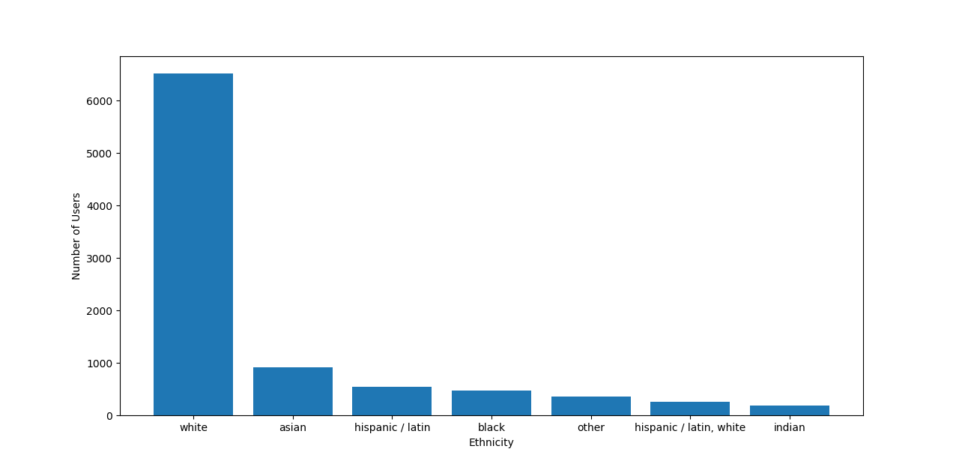
Exploration of the Dataset 1
Here I sub-sampled the initial dataset to have only 7 ethnicity categories
All these categories had more than 100 users
I discarded all the others ethnicities in order to simplify the analysis

Slide 4
Augmenting the Dataset
Ethnicity | Ethnicity_code
white | 0
asian | 1
hispanic / latin | 2
black | 3
other | 4
hispanic / latin, white | 5
indian | 6
Ethnicity_code is a column that has been added to the sub-set used for the analysis

Slide 5
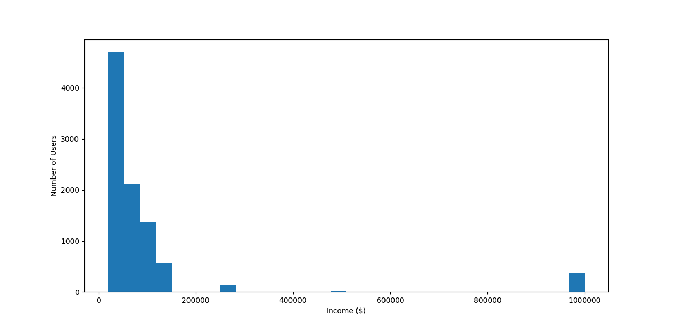
Exploration of the Dataset 2
Based on the previous sub-sample I looked at the distribution of income among the users of OKCupid
I also excluded from the sub-set users that indicated their income as “-1” as I interpreted it as a way to avoid providing personal details and therefore not useful for the aims of my analysis

Slide 6
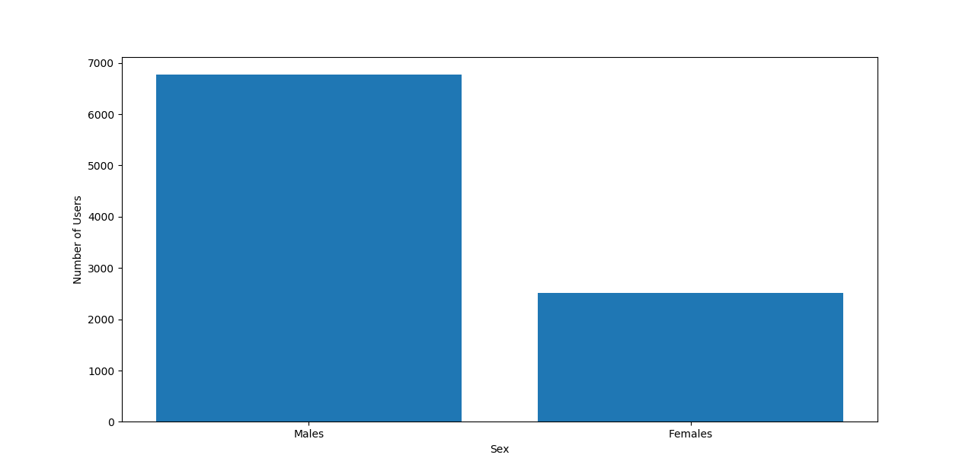
Exploration of the Dataset 3
Here I looked at the difference between the number of males and females who use the dating app
Males are more than the double of females
A further column was added to the dataset “sex_code” in which 0 corresponds to males and 1 to females

Slide 7
Question to Answer
During the last months, the problem of pay gaps between men and women and ethnic minorities has finally surfaced as one of the challenges of our times
I explored this issue with the OKCupid dataset in order to evaluate if sex of app users could be predicted based on their ethnicity and their income

Slide 8
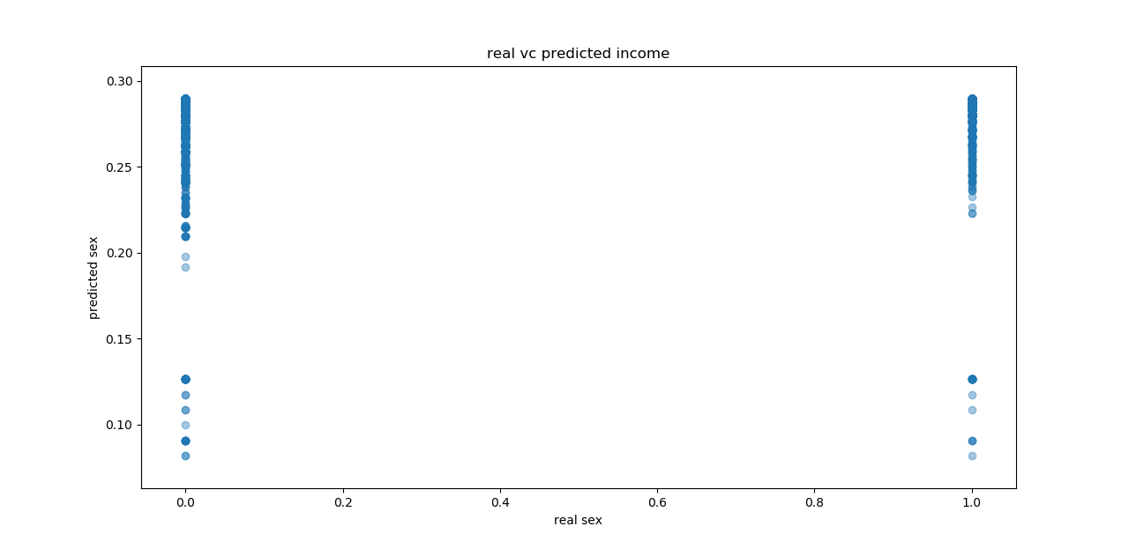
Regression Approaches
I tested two regression approaches:
A Multiple Linear Regression
K-Nearest Neighbors Regression
Regression is probably not the most suited technique in order to predict a categorical variable as the sex of users
The models scores for both approaches calculated on the validation set were quite low:
-0.0006 (Multiple Linear Regression)
-0.1629 (K-Nearest Neighbors Regression)

Slide 9
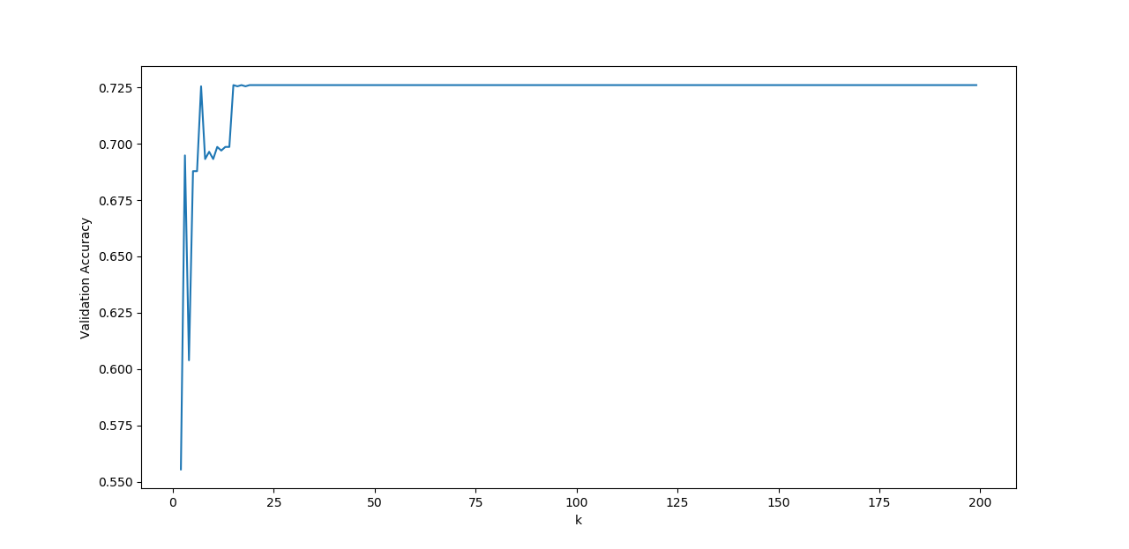
Classification Approaches
The implementation of these approaches lead to greater accuracy compared to Linear Regression (Figure on the left, based on K-Nearest Neighbor Classifier Validation accuracy with different number of neighbors)
K-Nearest Neighbor Classifier reached a high accuracy (0.725) and a level of precision (0.250) which indicate that the model produced a moderate number of relevant predictions
I tested also two classification approaches:
K-Nearest Neighbor Classifier
Support Vector Machines
K-Nearest Neighbor Classifier with 8 Neighbors
Accuracy: 0.724
Recall: 0.003
Precision: 0.250
F1 Score: 0.007

Slide 10
Conclusions/Next steps
Although th models presented here did not performed outstandingly, based on their results it could be inferred that income and ethnicity could be potentially useful variables in order to predict the sex of an app user
In order to better understand the effects of income inequality based on ethnicity and sex discrimination further analysis is needed with a finer tuning of classification models and the introduction of other potentially useful variables such as age and education

